Slide 1
THE PVA’S ROLE IN THE PROPERTY TAX ASSESSMENT APPEAL PROCESS

Slide 2
Reassessment of Real Property
Each year the property valuation administrator is responsible for ensuring all real property is assessed at its estimated fair cash value. For any property that is reassessed, a notice of the reassessment must be sent to the property owner. Revenue Form 62A352 is provided for the PVAs to use for this purpose and is shown on the next slide.
The notice will not only inform the property owner of the proposed new assessment, but it will also provide instructions on how the appeal process works and the timeframe for filing an appeal.

Slide 3
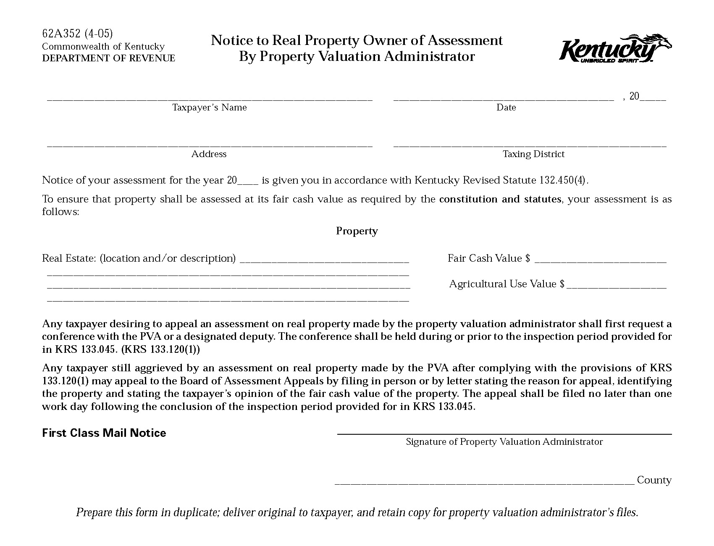

Slide 4
Tax Roll Inspection Period
In accordance with the statutory property tax calendar, the real property tax roll inspection period is scheduled to begin the first Monday in May and run for 13 days. Typically, the inspection period will go Monday through Saturday the first two full weeks of May and conclude on the third Monday in May.
For 2019, the tax roll inspection period is scheduled for May 6 – 20.
The tax roll inspection period can be rescheduled for a later time period if necessary.
The inspection period does not have to begin on a Monday.
The inspection period cannot end on a Saturday, Sunday or legal holiday.
The tax roll inspection period must be advertised in the local newspaper.

Slide 5
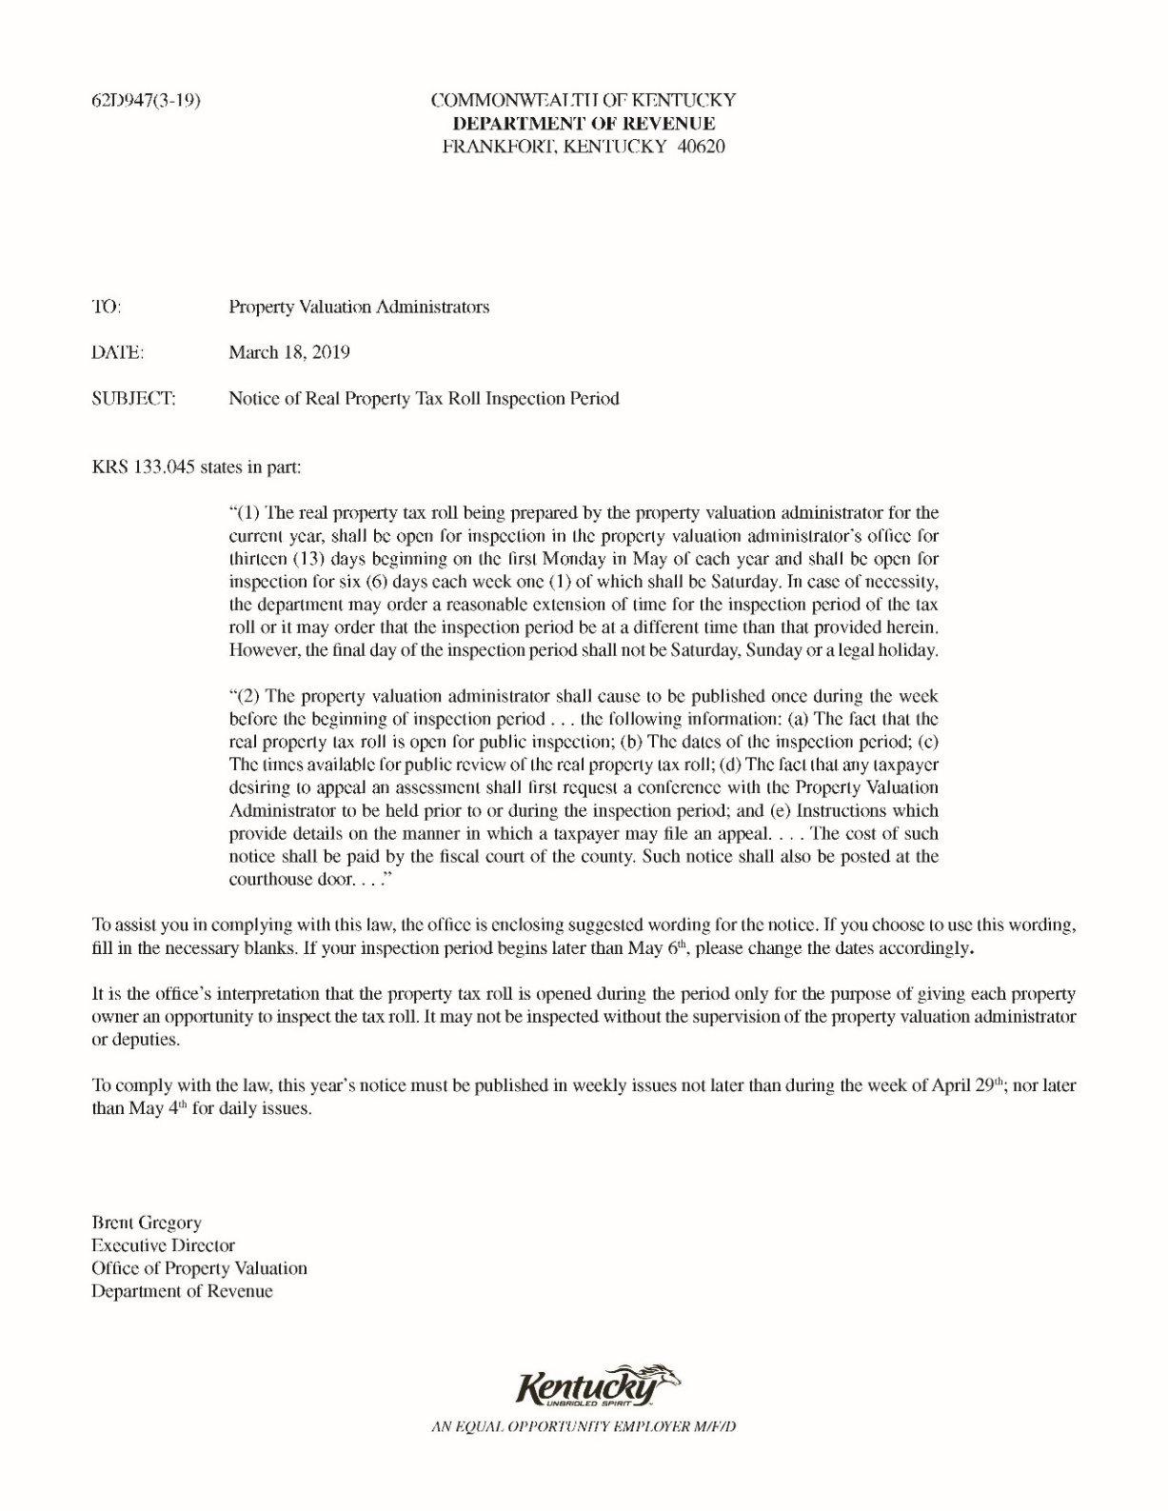
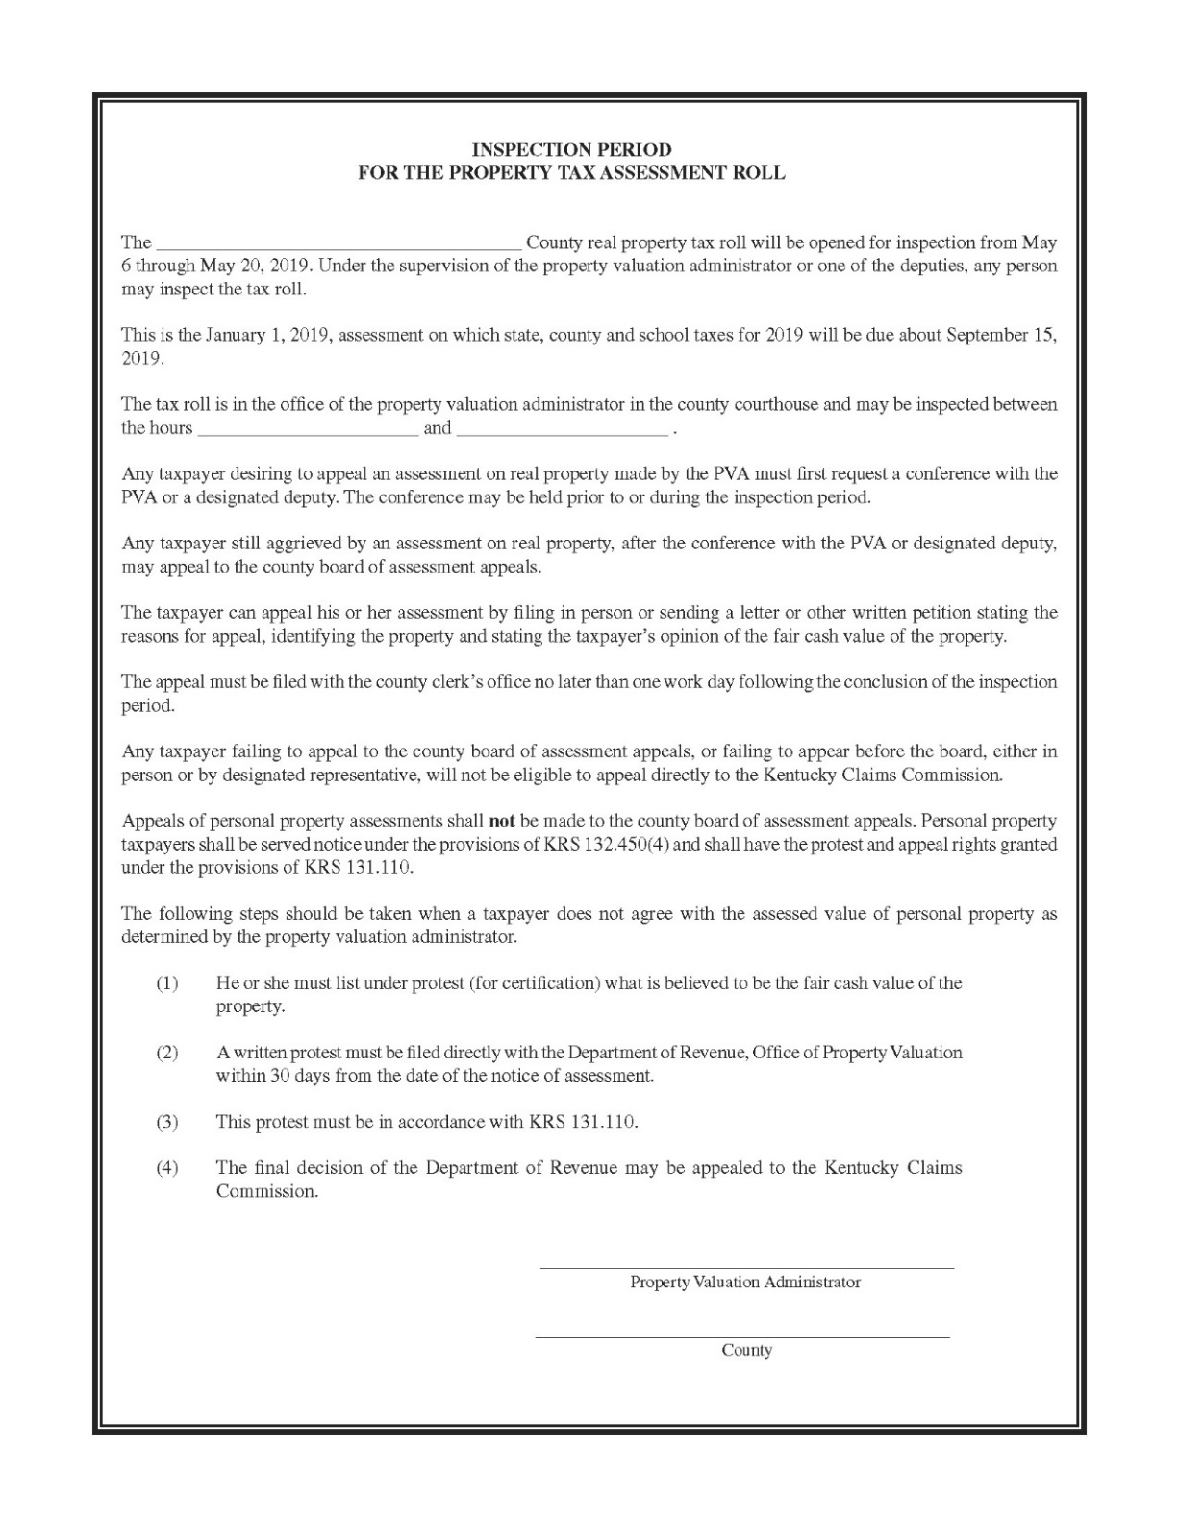

Slide 6
Conferences with Property Owners
Any time prior to or during the tax roll inspection period, a property owner may schedule a time to meet with the PVA to discuss his or her property’s assessed value.
At the conference, the PVA will provide documentation to support the property’s assessment. The taxpayer should bring evidence of why he or she believes the assessment is too high.
If the PVA and property owner can reach an agreement on the assessed value, then the agreed upon assessment is documented on the conference record form and the property owner’s tax bill will be based upon that assessed value.
If no agreement is reached, then that is also documented on the conference record form. The taxpayer is then eligible to file an appeal in the county clerk’s office.
Occasionally the agreed upon assessment amount at the conference does not get reflected on the updated tax roll or the tax bill received in the fall by the property owner. For this reason, the documentation received from the property owner during the conference needs to be retained by the PVA just in case an exoneration needs to be completed.

Slide 8
Conferences with Taxpayer Representatives
Some taxpayers – especially large commercial property owners – will have a compensated representative hold a conference on their behalf with the PVA.
In accordance with KRS 133.120, these representatives must be one of the following:
An attorney;
A certified public accountant;
A certified real estate broker;
A Kentucky licensed real estate broker;
An employee of the property owner;
A licensed or certified Kentucky real estate appraiser;
An appraiser who possesses a temporary practice permit or reciprocal license or certification in Kentucky to perform appraisals and whose license or certification requires him or her to conform to the Uniform Standards of Professional Appraisal Practice; or
Any other individual possessing a professional appraisal designation recognized by the Department.

Slide 9
Conferences with Taxpayer Representatives (cont’d)
The Office of Property Valuation has developed a list of designations that, if held by a taxpayer representative, will qualify the representative to appear before the PVA. This list includes the following:
American Association of Certified Appraisers
Certified Form -Appraiser -CF -A
Certified Appraiser - Farm and Land - CA - FL
Certified Appraiser -Residential -CA - R
Certified Appraiser - Senior -CA -S
Certified Appraiser - Consultant - CA – C
American Society of Appraisers
Accredited Member -AM
Accredited Senior Appraiser - ASA
Accredited Agricultural Consultant - AAC
Accredited Farm Manager-AFM
Accredited Rural Appraiser - ARA
Accredited Real Property Review Appraiser - RPRA
Professional Member
Appraisal Institute
MAI -Commercial Appraisal
SRPA - Residential Appraiser
SREA - Residential Appraiser
SRA - Residential Appraiser
RM - Residential Appraiser
International Association of Assessing Officers
Certified Assessment Evaluator - CAE
Residential Evaluation Specialist -RES
Cadastral Mapping Specialist - CMS
Personal Property Specialist - PPS
Assessment Administration Specialist -AAS
International Right of Way Association
Senior Right of Way Agent –SRWA
National Association of Independent Fee Appraisers
Member- lFA
Member/Agriculture –IFAA
Senior Member – IFAS
Appraiser Counselor – MSA
National Association of Master Appraisers
Master Residential Appraiser- MRA
Master Farm and Land Appraiser - MFLA
Master Senior Appraiser – MSA
Appraisal Institute of Canada
Canadian Residential Appraiser - CRA
Accredited Appraiser Canadian Institute – AACI
The Institute of Property Taxation
Certified Member of the Institute – CMI
Kentucky Real Estate Appraisal Board
Appraiser Trainee License
Licensed Real Property Appraiser
Certified Residential Appraiser
Certified General Appraiser
Kentucky Department of Revenue
Senior Kentucky Assessor
Certified Kentucky Assessor

Slide 10
Conferences with Taxpayer Representatives (cont’d)
Many taxpayer representatives will contact the Office of Property Valuation directly to receive a letter that states they are authorized to appear on behalf of their clients at conferences and appeal hearings. When this occurs, the representative’s credentials are reviewed and, if they are judged to meet the requirements of the statute, a letter is issued to the representative which states he or she is qualified to appear on behalf of clients in Kentucky. The representative is required to produce this letter upon request of the PVA or appeals board.
Taxpayer representative needs to have a letter of authorization from the property owner before they are eligible to have a conference.

Slide 11
Filing of Appeals
All appeals are filed in the county clerk’s office. The clerk is required to provide a copy of each appeal to the PVA. Revenue Form 62F031 is provided for the county clerk’s use to document each appeal that is filed.
The county clerk will then schedule the appeal hearings before the local board of assessment appeals.

Slide 12
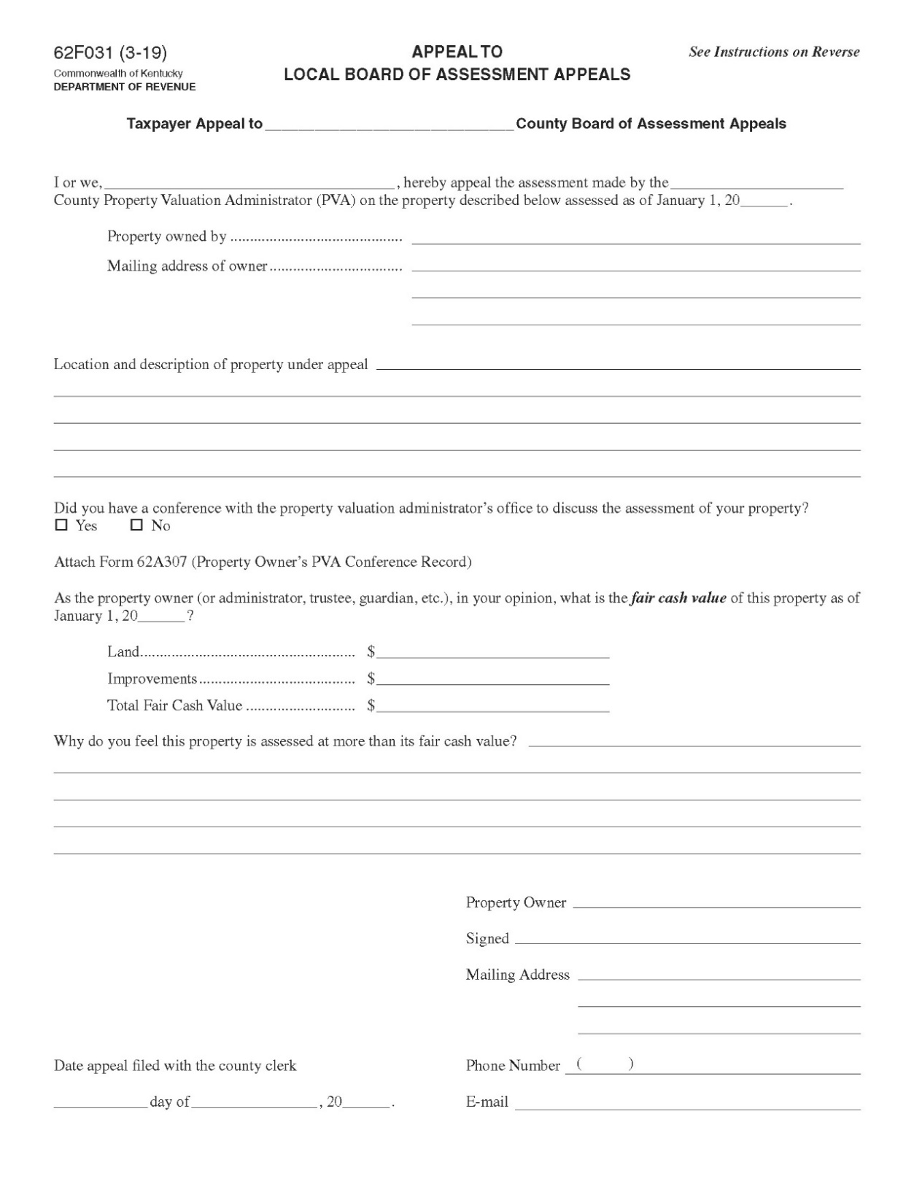
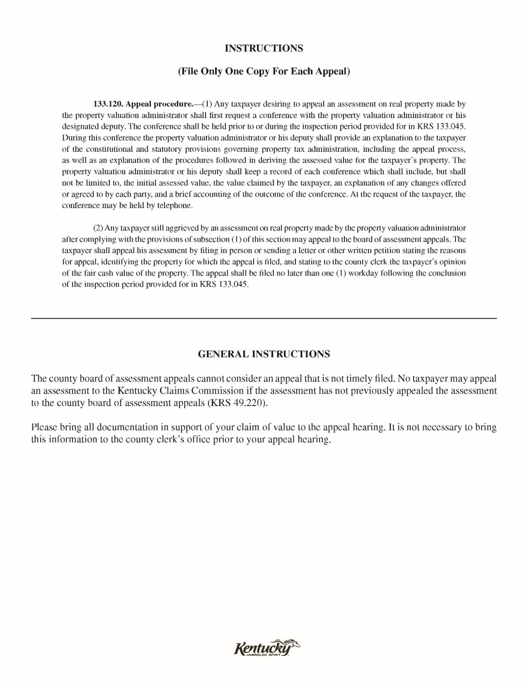

Slide 13
Request for Information
Upon being notified of an appeal being filed, the PVA then requests the property owner to provide documentation to support his or her claim of value stated in the appeal filing. This evidence does not have to be made available until the actual appeal hearing. Revenue Form 62A302 can be used to make this information request.

Slide 14
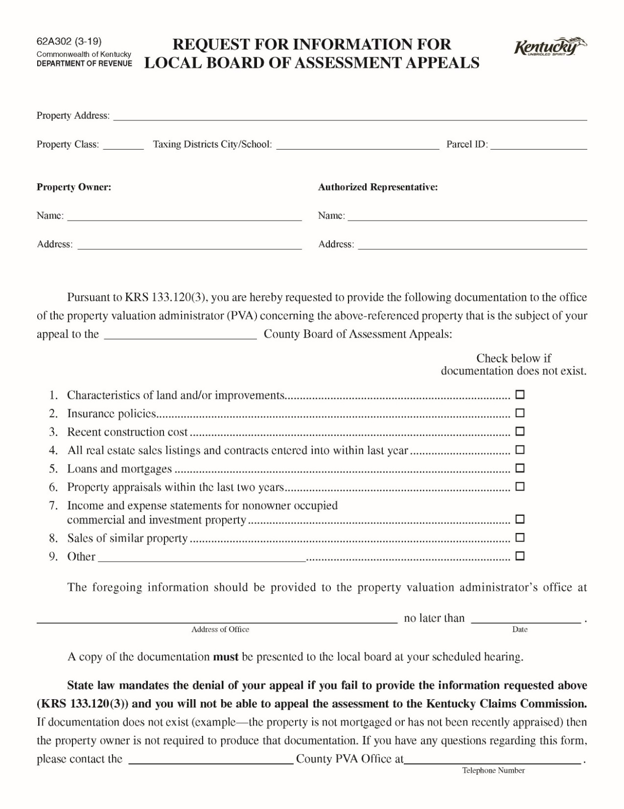

Slide 15
Composition of the Local Board of Assessment Appeals
The county board of assessment appeals is composed of 3 reputable real property owners who have resided in the county for at least 5 years.
If qualified people cannot be found within the county, then qualified property owners residing in adjacent counties can be appointed to the local board.
One board member is appointed by the fiscal court, another member is appointed by the county judge/executive and the third member is appointed by the mayor of the city with the largest assessment using the county tax roll.
The terms of the board members should already be set up so that they are staggered and one member will leave each year.

Slide 16
Composition of the Local Board of Assessment Appeals
The term of a newly appointed member shall be for 3 years.
A board member who has served a full term shall not be eligible for reappointment for 3 years.
The board members should have extensive knowledge of real estate values in the county, preferably through real estate appraisal, sales, management, financing or construction.
If the PVA believes a board member is not qualified to serve, the Office of Property Valuation needs to be contacted. The board member will then be requested to produce evidence of his or her qualifications and a determination will be made.

Slide 17
Hearings Before the Local Board
The first day of the local board of assessment appeals is initially devoted to the orientation and training program conducted by the PVA. The Office of Property Valuation furnishes the training materials for the PVA’s use.
The board will then review the assessments of the property owned by the PVA and each of the deputies. Adjustments can be made to these assessments by the board.
Upon completion of these tasks, the local board can begin hearing appeals if any have been filed.

Slide 18
Hearings Before the Local Board
At the appeal hearing, the taxpayer shall provide factual evidence to support his or her appeal. If the taxpayer fails to provide reasonable information pertaining to the value of the property that has been requested by the PVA, the Department of Revenue or any member of the local board, the taxpayer’s appeal shall be denied.
After the taxpayer has finished, the PVA will then provide evidence to support the assessment that was made for the property.
The local board shall only hear and consider evidence that has been submitted to it in the presence of both the PVA and taxpayer or their authorized representatives.
The local board will make a decision and it is the county clerk’s job to notify the taxpayer and PVA of that determination.

Slide 19
Appeals of the Local Board’s Decision
Either the taxpayer or the PVA can appeal a decision by the local board of assessment appeals. These appeals go to the Kentucky Claims Commission (KCC) and must be made within 30 days of the date the local board of assessment appeals made its decision.
If a PVA wants to continue the appeal process to the KCC, the county attorney must represent the PVA – unless the county attorney has a conflict of interest. The county attorney shall handle the legal filings required of the KCC. The Office of Property Valuation can also be consulted if there are any questions about filing an appeal with the KCC.

