Slide 1
Product and Services Overview
Commonwealth of Kentucky
June 2016
Notes:
Change items that are in red font.

Slide 2
New Employee
Complete the PVA Computer Access form and e-mail it to Stacey so she can complete additional form for COT and submit everything.
If you need to set them up on an existing computer let her know that too so a ticket can be sent to COT Desktop Field Services to have a technician get them setup.

Slide 3
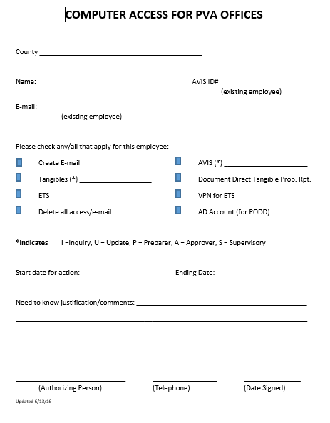

Slide 4
Ordering Computers
Requirements
Windows 7/64 bit Professional or Enterprise
8 Gigs RAM
Minimum of 500 Gig Hard Drive
i5 Processor

Slide 5
What to remember when ordering computers…
You can order through COT or buy direct
COT can setup you machines for $45/hr
If you opt to purchase from COT’s rated service, setup cost is included.
If you purchase direct you may need to purchase software such as Office Suite (ie. Word, Outlook, ect,) and Antivirus (ie. McAfee)

Slide 6
Rates – Option 1
You purchase the device outright costing approximately $833.93, no software or monitor included with this option.
You can purchase virus protection software through COT for $9.95/yr but not the Microsoft Office Suite (Word, Excel, Outlook, and PowerPoint).
Any support for these devices will incur an hourly charge of $45.00/hr.

Slide 7
Rates – Option 2 (Required to be on the State Network)
You decide to use COT CC20 rated services for the computers, you pay approximately $200 to $400 up front, then you pay $67.00 per month for each computer.
With this option, you receive the virus protection software, Microsoft Office Suite and support at no additional cost.
Support for these devices will not incur additional costs.
If you need a monitor you will be changed DT50 rates which include Monitor - Tier I (20" prof. series flat panel) at $3/mo or DT60 Monitor - Tier II (24" prof. series flat panel)
**Tablets are on a new price range and will vary based on the purchasing option.

Slide 8
Rates – Option 3 (Required to be on the State Network)
You decide to use COT CC30 rated services for the computers, you pay $77 per month for each computer and you agree to keep the computer for a minimum of 4 years.
With this option, you receive the virus protection software, Microsoft Office Suite and support at no additional cost.
Support for these devices will not incur additional costs.
If you need a monitor you will be charged DT50 rates which include Monitor - Tier I (20" prof. series flat panel) at $3/mo or DT60 Monitor - Tier II (24" prof. series flat panel)
**Tablets are on a new price range and will vary based on the purchasing option.

Slide 9
Desktop Device Support (Included with Options 2 and 3)
The desktop Device Support service covers the following:
Approximate 48 month replacement cycle
24x7 access to the Commonwealth Service Desk
Support staff is available on-site Monday-Friday, 7:00am to 6:00pm (EST)
Asset Management, Change Management and Configuration Management services
Setup, installation, configuration, preventative maintenance, upgrades and patching
Standard desktop imaging at the time of installation
Operating System Support
Microsoft Office Professional suite support
Antivirus Suite Support
Desktop Firewall Capabilities
Virus and Spyware protection
Notes:
Use if break pages are needed.

Slide 10
I ordered computers on my own NOW WHAT?
Call/Contact Stacey to let her know you have ordered computers and that a ticket needs to be created to have COT Desktop Field Services set them up, unless you employ a local business.
Once the ticket is logged COT will have a technician contact you to set up a date and time for the install.
Once computers are setup you will need someone from Revenue to install ARC, TRIM and or ARM.
*Note that a device used to connect back to the State Network MUST have anti virus software. McAfee is available for $9.95 a year per machine through COT.

Slide 11
AntiVirus
Everyone MUST have AntiVirus software on their computer. Preferred is McAfee which can be purchased through COT.
Super AntiSpyware is a free malware software that can be installed in addition to AntiVirus software.

Slide 12
Going Local? What you need to know…
Are you already paying for internet through a local provider?
Does your local provider offer a router?
Do you have Zscope?
Do you have VPN access for ETS?
You might need to make provisions to have your tax roll programs re-installed on your computer.
You may also have to call your printer/copier company and have them re-install your software.

Slide 13
AD Self Service/Accounts
Everyone must sign up for AD Self Service
AD Self Service allows you to reset your password and unlock your account.
AD accounts are needed for access to PODD, ETS, KAVIS and ky.gov e-mail accounts.

Slide 14
Passwords
On 4/29/2016 COT implemented a policy that all password will expire in 90 days instead of 30.
This will affect all PVA offices no matter if you are on the state network or local.

Slide 15
When do I contact the CSD?
When you have a problem with…
AD/State E-mail/VPN issues
Email accounts that end in @ky.gov
Entrust encryption
Mainframe Account
Hardware/Software issues
May incur Out of Scope charges at $45/hr*

Slide 16
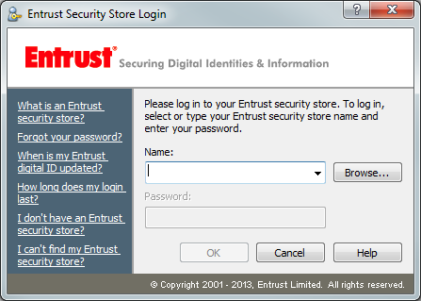
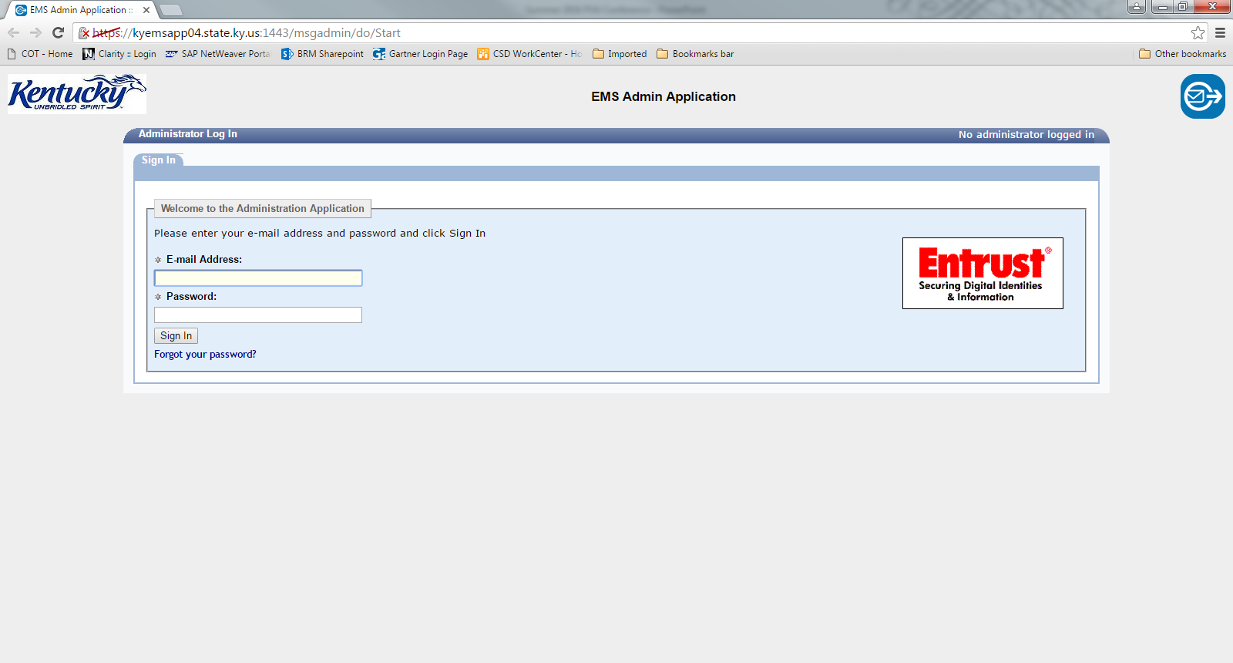
Secure Email for Sensitive information
If you have a state email address this is what you will see.
For those of you who have an outside email address this is what you will see.

Slide 17
Commonwealth Service Desk
Business Hours:
Monday - Friday from 6:30 AM - 6:00 PM (EST)
Saturday from 7:30 AM - 1:00 PM (EST)
To open a support ticket with the Commonwealth Service Desk:
Call 502-564-7576 or 800-372-7434 for 24*7*365 phone support
*Limited phone support is provided after business hours by COT’s Main Console
E-mail CommonwealthServiceDesk@ky.gov
*E-mails submitted after normal business hours will be addressed the following business day

Slide 18
Commonwealth Service Desk cont.
When you contact the Commonwealth Service Desk, be sure to provide:
Full name
USERID (KYFD01\PV# or first.last)
Agency name
Phone number
Physical location
Detailed description of the problem or inquiry
*Give as much information as possible.
For inquiries on an existing ticket, call or email the Commonwealth Service Desk and provide your ticket number.

Slide 19
PVA Applications and Contacts
ARC – Mike Tackett (502-564-7220) or Mike Wolff (502-564-2688)
Arm – James Marcum (502-564-7221)
TRIM – James Marcum (502-564-7221)
PVD – Contact GUTS

Slide 20
Erica Russell
Business Relationship Manager
Finance Administration Cabinet
501 High Street, 8th Floor
Frankfort, KY 40601
Office: 502-782-2492
Cell: 502-229-7988
Email: Erica.Russell@ky.gov
Notes:
Use if break pages are needed.

Slide 21
Does anyone have any
Questions or Comments?

