Slide 1
SALE OF DELINQUENT PROPERTY TAX BILLS IN KENTUCKY
County Clerk Training – April 2021
Department of Revenue
Office of Property Valuation
http://revenue.ky.gov/clerknetwork

Slide 2
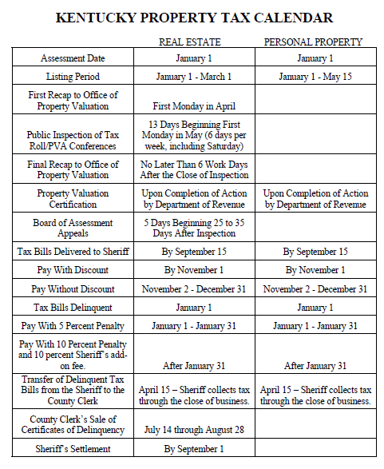
Property Tax Calendar

Slide 3
County Clerk Responsibilities
Accept delinquent tax bills from the sheriff as of the close of business on April 15th
Must submit or arrange to submit to DOR a list of all certificates of delinquency received from the Sheriff
Update office records and distribute payments to the various taxing districts and local officials
Work with the Department of Revenue to set a tax sale date

Slide 4
County Clerk Responsibilities
Will need to advertise the certificates of delinquency on a county sponsored website.
The certificates of delinquency will also need to be advertised in the local newspaper.
Communicate with county attorney regarding bills under installment payment plans and other “Protected Certificates of Delinquency.”
Review lists submitted by third parties and process payments for prior year preferences the morning of the tax sale.
Conduct the tax sale in accordance with established procedures.

Slide 7
county clerk responsibilities
Must submit or arrange to submit to DOR a list of all certificates of delinquency received from the Sheriff
  This list must be submitted by May 15 each year
  This list shall include the property owner name, property address and parcel number or lot number if available
  Tax bill number should be included

Slide 8
County Clerk Responsibilities
By June 1 of each year the DOR will publish each county’s list on its website:
  www.revenue.ky.gov/property+tax/
DOR and County Clerk shall be held harmless regarding the content or any omission relating to the information provided

Slide 9
County Clerk Responsibilities
Establishment of a Tax Sale Date
Beginning 90 days after the delinquent tax bills are transferred from the sheriff’s office to the county clerk’s office, there is an initial 45 day time period during which the tax sale must be held
In counties on a normal collection schedule, the delinquent tax bills will be transferred to the county clerk’s office at the close of business on April 15th. This means that the tax sale will need to be scheduled between July 14th and August 28th
County clerks who have delinquent oil and gas or unmined mineral tax bill have up to an additional 60 days to schedule their tax sale since these are typically on a delayed schedule. The additional time means the tax sale can be scheduled as late as October 27

Slide 10
County Clerk Responsibilities
Establishment of a Tax Sale Date
Notify the Department of Revenue of the sale date
  Contact Maurette Harris
The Department will publish a schedule of all tax sales on its website and on the County Clerk’s website –
www.revenue.ky.gov/CLERKNetwork

Slide 11
County Clerk Responsibilities
All certificates of delinquency must be advertised in the local newspaper and on a county sponsored website
Although the county clerk is responsible for the content of the advertisement, the county will pay the cost of the advertisement

Slide 12
County Clerk Responsibilities
There are actually 2 advertisements that are required to run in the local newspaper
  The first, which runs the week before the advertisement that contains a listing of the certificates of delinquency – must be ½ page and contain the following:

Slide 13
County Clerk Responsibilities
    That the actual list of certificates of delinquency will be published the following week
    That the list of delinquent tax bills is available for public inspection during normal business hours
    The business hours and address of the county clerk’s office
    That the list will be posted on the internet and the website address where the list may be accessed
    The date and time of the tax sale
    Payment information for taxpayers who want to pay their certificate of delinquency prior to the sale
    Registration and payment requirements for individuals and entities who want to participate in the tax sale

Slide 14
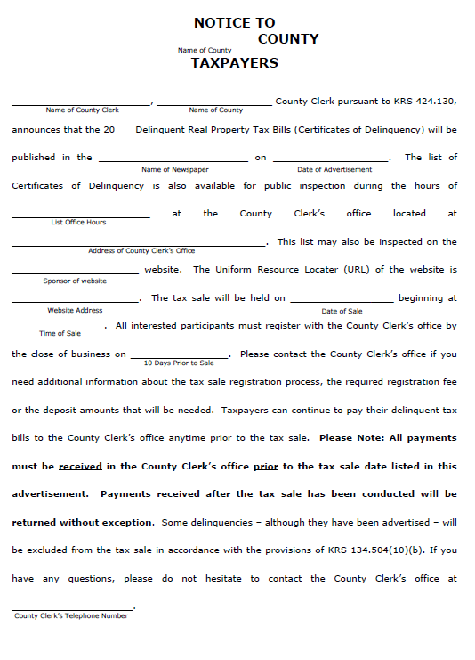

Slide 15
County Clerk Responsibilities
The second newspaper publication shall include all of the information listed in the initial advertisement and the actual list of the certificates of delinquency to be sold
This advertisement needs to appear in the local newspaper at least 30 days but not more than 45 days before the scheduled sale date

Slide 16
County Clerk Responsibilities
The listing of the certificates of delinquency shall be posted to the county sponsored website at least 30 days prior to the sale date
Updates for payments need to be made to the website on at least a weekly basis

Slide 17
Recovering Advertising Costs
County Clerk Responsibilities
The cost incurred for the advertising of the certificates of delinquency can be added to each certificate on a pro-rata basis
KRS 134.128(5)( c) allows a factor to be applied to the base cost of advertising to allow for the certificates of delinquency that will remain unpaid
For the 2020 certificates of delinquency, it is estimated that 55% of the certificates of delinquency will not be paid
Adjustments will be made in future years based on actual experience

Slide 18
Recovering Advertising Costs
County Clerk Responsibilities
The formula to use to determine the amount to add to each certificate of delinquency for the advertising costs is as follows:
  Total Ad Costs divided by number of Certificates
  That amount is multiplied by 1.55
  The result can then be rounded up to the next dollar.

Slide 19
Recovering Advertising Costs
County Clerk Responsibilities
The following example will illustrate how to compute the advertising cost to add to each certificate.
  Advertising cost paid - $5,500
  Number of certificates – 475
  $5,500 / 475 = $11.58
  $11.58 x 1.55 = $17.95
  $17.95 can be rounded up to $18.00

Slide 20
State Registration
A third party purchaser must first register with the Department of Revenue if they want to acquire:
  more than 3 certificates in any county
  more than 5 certificates statewide
  or spend more than $10,000
If approved, can purchase 60 days after application has been received
A Certificate of Registration
    Purchasing Date

Slide 21
State Registration

Slide 22
county Registration
At least 10 calendar days before the date of the tax sale, each individual or entity seeking to participate in the sale shall register with the county clerk
The information to be provided is as follows:
  Purchaser’s name
  Street address
  Mailing address – if different from the street address
  Telephone number
  If the purchaser is an entity, the name of a contact person shall also be provided

Slide 23
county Registration
A potential purchaser shall also submit an affidavit affirming that the purchaser is not related to any other individual or entity that will be participating in the sale
The following should be considered related entities:
  Members of the same family; and
  Entities
    With common ownership or management
    Having been formed by one or more of the same entities
    Having one or more of the same investors
    Having one or more of the same directors, members, partners or officers
    Having more than one client registered for that county’s sale
Regulations for related entities 103 KAR 5:180

Slide 24
county Registration
The county clerk will charge each third party purchaser a registration fee. The fee(s) shall be:
  $5.00 for each certificate of delinquency on purchaser’s priority list
  $10.00 for each certificate of delinquency on purchaser’s list of current certificates.
  Total registration fee shall not exceed $250

Slide 25
county Registration
Third party purchasers holding a certificate of delinquency from a prior year shall submit to the county clerk a separate list of current year certificates they wish to purchase that relate to the property for which they hold the prior year certificate of delinquency
This list shall be submitted at least 10 days before the sale date

Slide 26
county Registration
This list shall be clearly identified as a prior year certificate of delinquency list and shall include the following information:
  The current year’s tax bill number;
  The amount due for each current year’s tax bill;
  The prior year claim’s tax bill number;
  The prior year claim’s tax year;
  The book and page numbers where the prior year claim is filed, if applicable; and
  The account or parcel identification number, if applicable

Slide 27
county Registration
The county clerk can request the third party purchaser to provide a copy of the prior year certificate of delinquency
A deposit of 100% of the total amount due on the certificates of delinquency included on the priority list is required
Payment of the deposit shall be made in accordance with KRS 134.126(1)(b)

Slide 28
Purchase Process for Third Party Purchasers With Prior Year Certificates
county Registration
During the time period between the submission of the lists and the tax sale date, the county clerk shall review the lists to identify which third party purchaser holds the most recent prior year tax claim.
The current year certificates that are verified to have a valid prior year claim will then be sold to the appropriate third party purchaser on the tax sale date.

Slide 29
county Registration
Purchase Process for Third Party Purchasers With Prior Year Certificates
If a purchaser holding a certificate of delinquency from the most recent tax year declines to purchase the current year’s certificate of delinquency, the purchaser holding a prior certificate of delinquency from the next most recent year shall be allowed to purchase the certificate of delinquency, if it is included on their list of priority certificates of delinquency. If no purchaser has included the certificate of delinquency on a priority list, the certificate of delinquency will then be placed in the pool of certificates to be sold at the tax sale.

Slide 30
county Registration
Third party purchasers shall submit a list of certificates of delinquency that they are interested in purchasing at the tax sale at least 10 calendar days prior to the sale date. The list shall be prepared in an order as determined by the county clerk and shall include:
  The tax bill number;
  The taxpayer name;
  The amount due on the certificate of delinquency; and
  A total amount of all certificates of delinquency

Slide 31
county Registration
A deposit of 25% of the total amount due on the certificates of delinquency on this list is required
Payment of the deposit shall be made in accordance with KRS 134.126 (1)(b)

Slide 32
county Registration
KRS 134.126 (1)(b) states that the county clerk may accept payment by any commercially acceptable means. However, the county clerk may limit the acceptable method of payment to those that ensure the payment cannot be reversed or nullified due to insufficient funds
The county clerk cannot require the deposit to be made in cash
The deposit is calculated based upon the value of the certificates of delinquency listed on the third party purchaser’s lists
All deposits are due at least 10 calendar days prior to the tax sale date
If the county clerk determines that a third party purchaser’s deposit is inadequate, the clerk shall allow the third party purchaser until the day of the tax sale to make an additional payment so that the deposit is correct
The county clerk will be required to refund any unused portion of a deposit made by a third party purchaser no later than 10 business days after completion of the tax sale

Slide 33
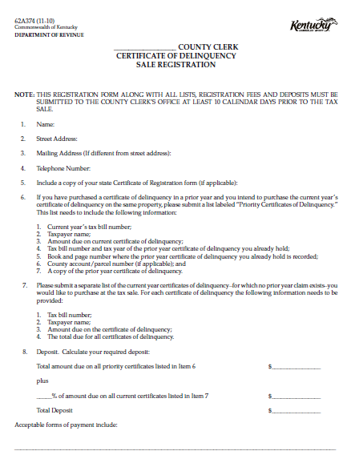
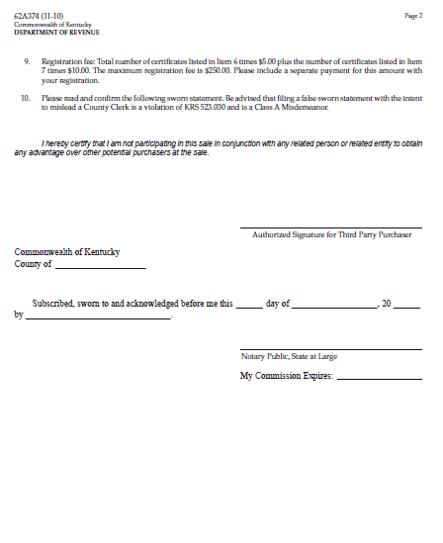

Slide 34
Tax Sale Procedures
The sale shall be conducted in a manner similar to a professional sports draft with each purchaser having an opportunity to purchase certificates in turn through several rounds
The order of selection shall be determined by a random drawing with the purchaser drawing the lowest number going first

Slide 35
Tax Sale Procedures
Purchase rounds shall continue until all certificates have been sold or all purchasers have withdrawn from the sale
When a purchaser withdraws from the sale, no other purchaser may take the place of the withdrawing purchaser
Purchasers shall only be allowed to purchase those certificates included on their previously submitted list
  Unless certificates remain after all purchasers have withdrawn. Those certificates can be sold to any purchaser

Slide 36
Tax Sale Procedures
The county clerk may impose a time limit on purchasers during each round
The county clerk may allow a purchaser to select another certificate if the certificate selected has already been chosen earlier. However, any alternate selection must be done within the time limit imposed

Slide 37
Tax Sale Procedures
The county clerk shall determine how many certificates may be purchased in each round based on the following guidelines:
  In counties with 500 or fewer certificates, they may be sold in lots of up to 5;
  In counties with 501 – 1,000 certificates, they may be sold in lots of up to 10;
  In counties with 1,001 – 2,500 certificates, they may be sold in lots of up to 25;
  In counties with 2,501 – 7,500 certificates, they may be sold in lots of up to 50.
  In counties with more than 7,500 certificates, they may be sold in lots of up to 50 for the first 4 rounds. For all subsequent rounds, they may be sold in lots not to exceed 2% of the total number of certificates in the sale pool.

Slide 38
Tax Sale Procedures
A purchaser may opt out of the purchase process at any time prior to the completion of the sale
  If a purchaser does not complete 3 consecutive full turns they are to be considered withdrawn
Payment shall be made at the time of the sale and shall be submitted in the form required by the county clerk
The county clerk shall have the final say on any questions regarding the sale process
Refunds of unused deposits shall be issued by the County Clerk within 10 business days after the tax sale date

Slide 39
County Clerks and the Local Board of Assessment Appeals

Slide 40
Summary of Appeals Process
PVA mails assessment notices.
Inspection Period held beginning first Monday in May. (May 3, 2021) unless extension approved.
PVA holds conference with property owners.
Any appeals are filed with the county clerk.
Appeals are heard by the local board of assessment appeals, 25-35 days after the end of the Inspection Period.

Slide 41
Clerk’s Duties
The county clerk, or a representative of the office, serves as the clerk of the board of assessment appeals and any temporary panels. This is authorized by KRS 133.125(1).

Slide 42
Clerk’s Duties
The clerk has three (3) working days after the expiration of the inspection period to provide a copy to the property valuation administrator of each appeal petition and a summary of the appeals filed with the county board of assessment appeals. The summary shall be in a format, or on a form, provided or approved by the Department of Revenue. –KRS 133.125(1)
The form “Summary of Appeals Filed With the County Board of Assessment Appeals” (Form 62A303-B) should be used.

Slide 43
Clerk’s Duties
Decisions of the local board of assessment appeals should be mailed within three (3) working days to the property owner by certified mail. The correct form to use is Notice to Property Owners of Final Decision of Board of Assessment Appeals, Form 62A354.
Any state or county agency charged with the administration of any taxing or licensing measure which is under the jurisdiction of the board shall mail by certified mail notice of its ruling, order, or determination within three (3) working days from the date of the decision.
–KRS 49.220
The clerk shall certify to the judge/executive the number of days the board was in session for payment due the board members and the clerk shall be paid in the same manner as a member of the board. (Certification, Form 62A303-A)

Slide 44
Clerk’s Duties
Minutes of the Board of Assessment Appeals, Form 62A303
An accurate record of the proceedings and orders of the board and of each of its authorized panels shall be kept and shall show the name of the owner of the property, the description, the type of property, the amount of the assessment the property valuation administrator placed on the property, and the amount of change made in the assessment by the board. (KRS 133.125(2))
Certification, Form 62A303-A
A copy certified by the chairman of the board and attested by the county clerk shall be filed by the clerk with the property valuation administrator and with the Department of Revenue within five (5) days after the adjournment of the board. (KRS 133.125(2))

Slide 45
Clerk’s Duties
Order of Allowance, Form 62A1092
The county clerk shall certify to the county judge/executive the number of days during which the board was in session, and the court shall enter this fact of record along with the amount due the board members for their services. On a presentation of a copy of the order, the Finance and Administration Cabinet shall draw a warrant on the State Treasurer in favor of the board members and clerk for the amount due for their services.
        -KRS 133.125(3)

Slide 46
Compensation for the Clerk
The county clerk and any authorized deputies serving as clerk of the board or a panel thereof shall be allowed the same compensation per day for their services as is allowed to members of the board of their county, and they shall be paid in the same manner as members of the board are paid. The county clerk and his authorized deputies shall be allowed compensation for completing and filing the record of the board in the same manner as allowed for their services while acting as clerk of the board or clerk of a panel of the board.
-KRS 133.125(4)

Slide 47
Contact information
For more information go to the
Kentucky Department of Revenue website: http://www.revenue.ky.gov
or Contact:
Tom Crawford at 502-564-7179
Melissa Klink at 502-564-7191
Maurette Harris at 502-564-7230

