Slide 1
Monthly Ad Valorem Report & ACH payment
November 20, 2019
Kentucky Department of Revenue • 501 High Street, St 32 • Frankfort, KY 40601

Slide 2
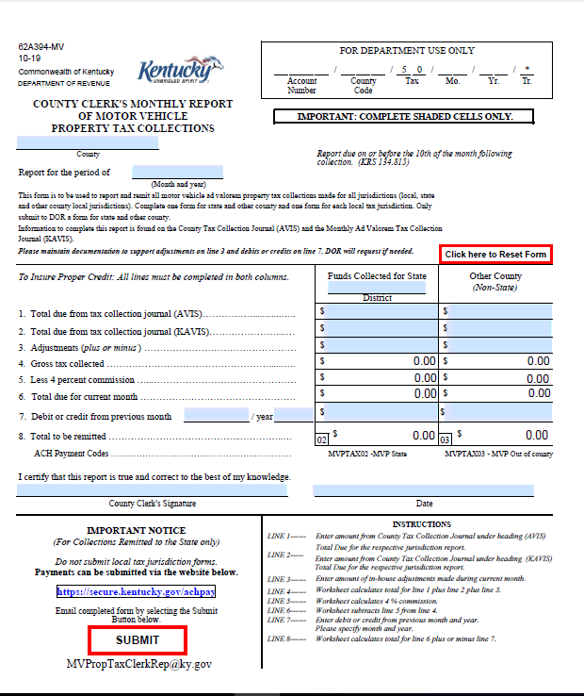
Updated Form- 62A394-MV
PDF Version

Slide 3
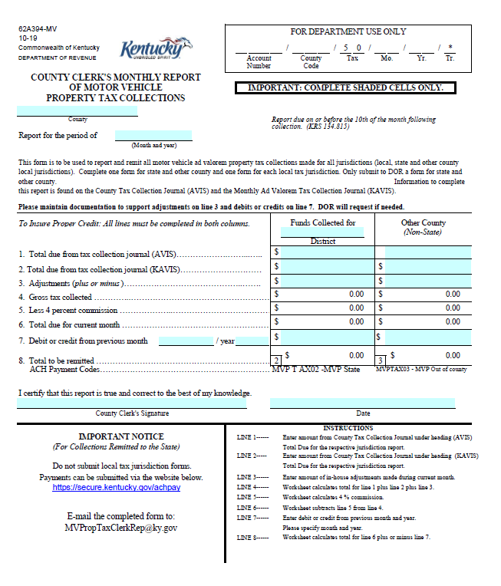
Updated Form- 62A394-MV
Excel Version
NOTE: The excel version doesn’t include a ‘Submit’ button. You MUST email the form to MVPropTaxClerkRep@ky.gov

Slide 4
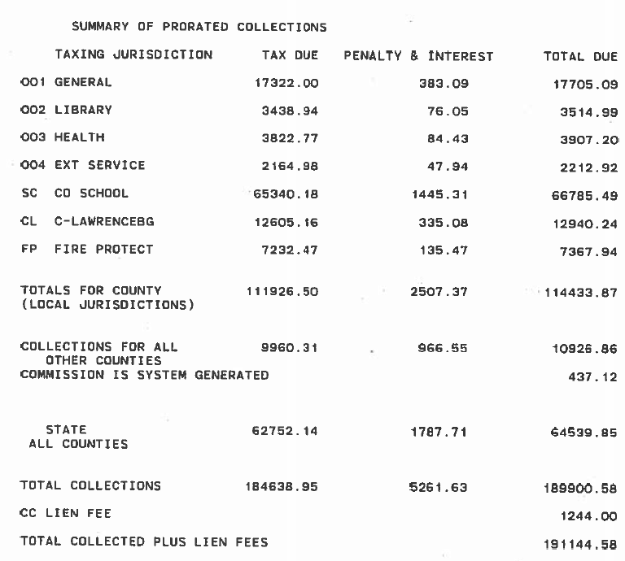
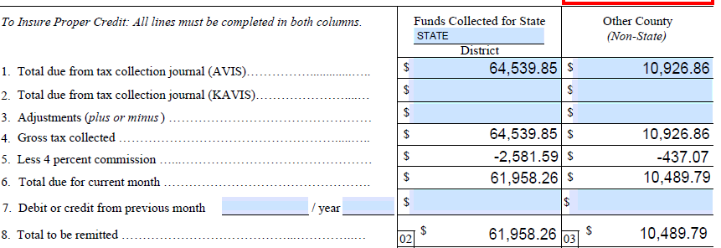
Inputting AVIs & KAVIS information on the 62A394-MV

Slide 5
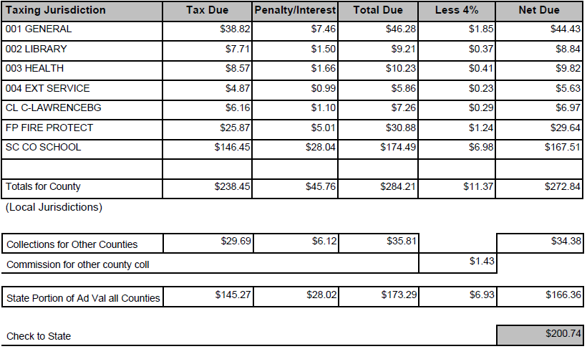
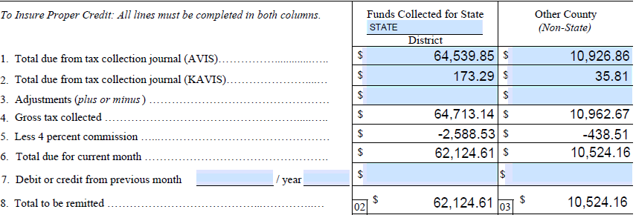
Inputting AVIs & KAVIS information on the 62A394-MV

Slide 6
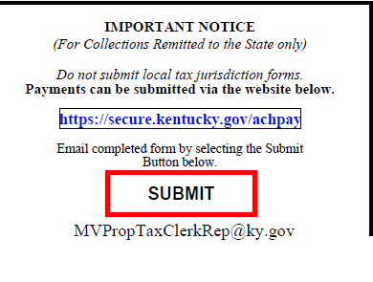
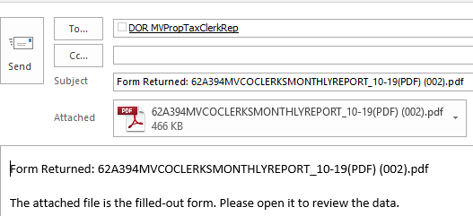
How to Submit the Completed Form to DOR
Click the submit button
Click Send
Automatically attach file to default email
NOTE: The excel version doesn’t include a ‘Submit’ button. You MUST email the form to MVPropTaxClerkRep@ky.gov

Slide 7
How to Submit ACH Payment
Login to account
Click the link at the bottom of the form

Slide 8
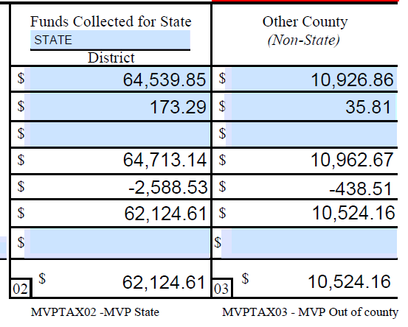
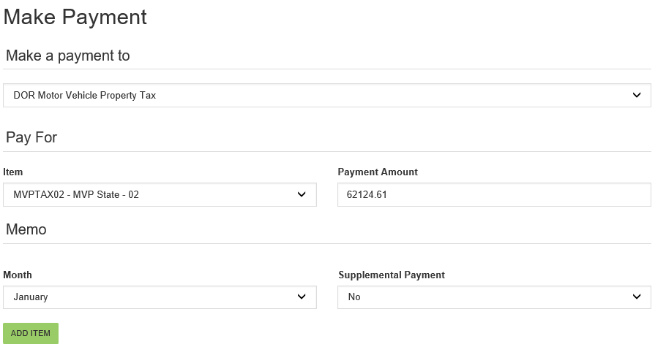
How to Submit ACH payment-STATE
Select-DOR Motor Vehicle Property Tax
Select- MVPTAX02 for State portion
Enter payment amount from the form
Select Month
Click ‘Add Item’

Slide 9
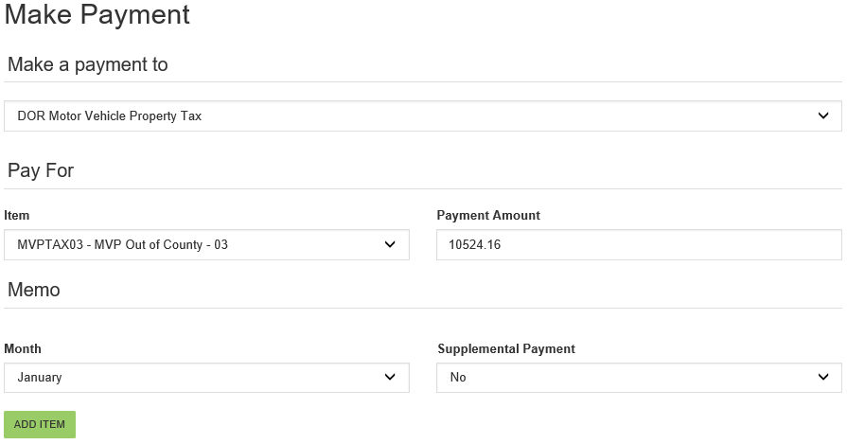
How to Submit ACH payment-Other County
Select-DOR Motor Vehicle Property Tax
Select- MVPTAX03 for Out of County portion
Enter payment amount from the form
Select Month
Click ‘Add Item’

Slide 10
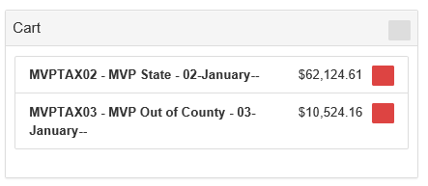
Finalizing ACH Payment
Both State and Out of County payments will appear in your cart.
Select the bank account you wish to use
Click the ‘Pay’ button to submit payment

Slide 11
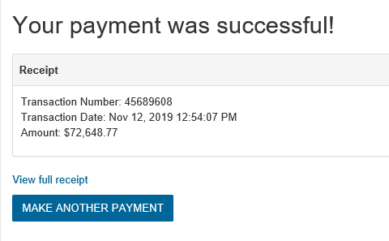
Payment Confirmation
Click here for payment details & to print confirmation

Slide 12
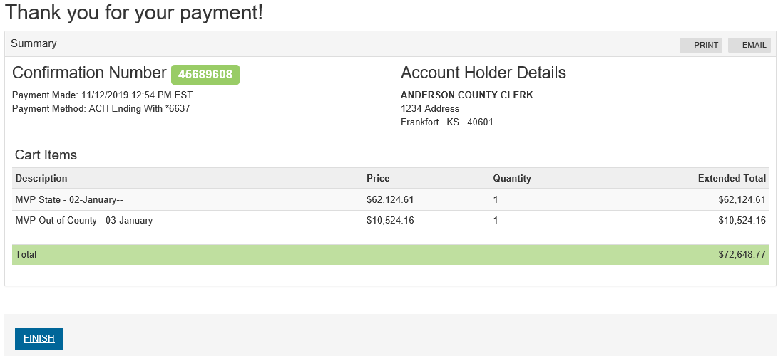
Payment Confirmation

Slide 13
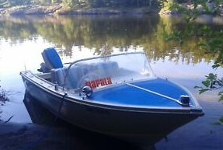
VEHICLE TRANSACTIONS
Sales prior to assessment date titling occurs after assessment date

Slide 14
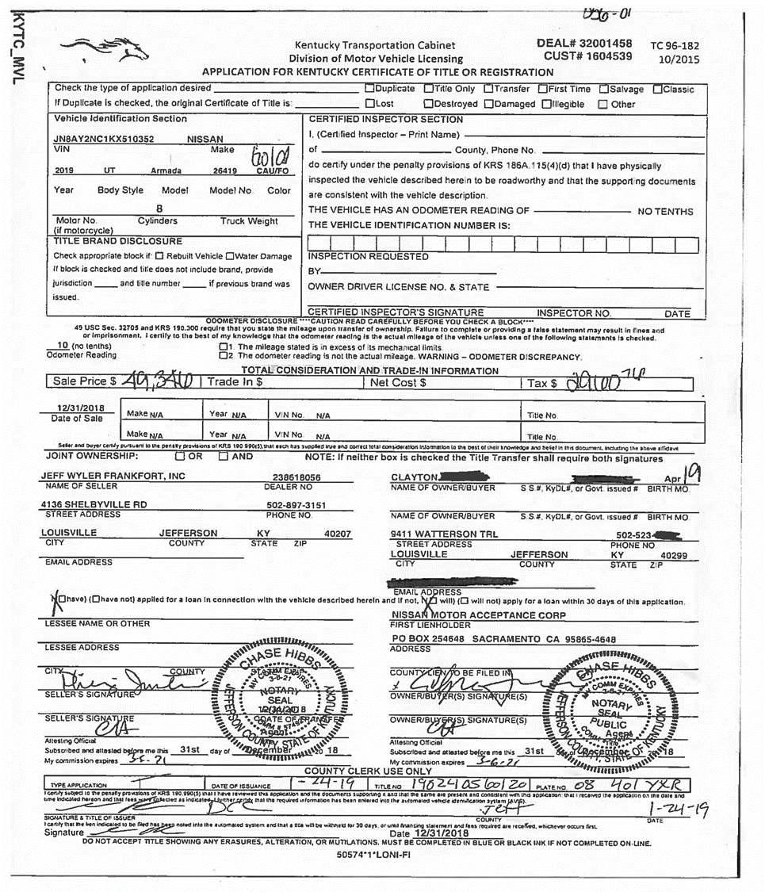
Sale Date prior to January 1
Attest to date prior to January 1

Slide 15
Sales Prior to Assessment Date -Titling Occurs After Assessment Date
These transactions can occur throughout the year but primarily in January - February
These transactions without manual intervention will not be assessed and taxes collected for the current year.
These transactions will not occur on the current year motor vehicle and boat projection reports unless segments are created prior to April 30th.
Some counties work with the County Clerk to get them to provide copies of these VTR’s or they provide title numbers so the PVA offices can find in PODD and create the segments for the current year via F3 screen and update any segments related to trade-ins.

Slide 16
JUSTIFICATION AND BENEFITS TO ALL STAKEHOLDERS
County Clerks and PVAs working together to get these transactions when the taxpayer (customer) makes application for title benefits everyone.
Confuses taxpayers when they get a bill for a motor vehicle from the State.
State issued bills for motor vehicles are not included in projection reports.
The correct vehicle can be assessed and any trade-ins can be removed, if applicable.
Enhanced collection when locally done. Delinquent state motor vehicle bills do not stop taxpayer from renewing future vehicles as local delinquent bills do.

Slide 17
JUSTIFICATION AND BENEFITS TO ALL STAKEHOLDERS
County Clerk will receive Commission for collection.
Will be included on projection reports in segments added prior to April 30th.
Benefit to PVA since projection is part of County budget allocation.
Benefit to local taxing jurisdictions for budgeting and tax rate setting process.
Benefit to local taxing jurisdictions to include valuation since Apportioned Vehicle money is spread based on the projection report.

Slide 18
FIRST QUARTER TRANSACTIONS
Transactions with birth months in January and February and some March.
DOR can create a special segment with an alternative date for collection the first year which will revert to birth month the following year.
PVA can fax to DOR and we can handle these.

Slide 19
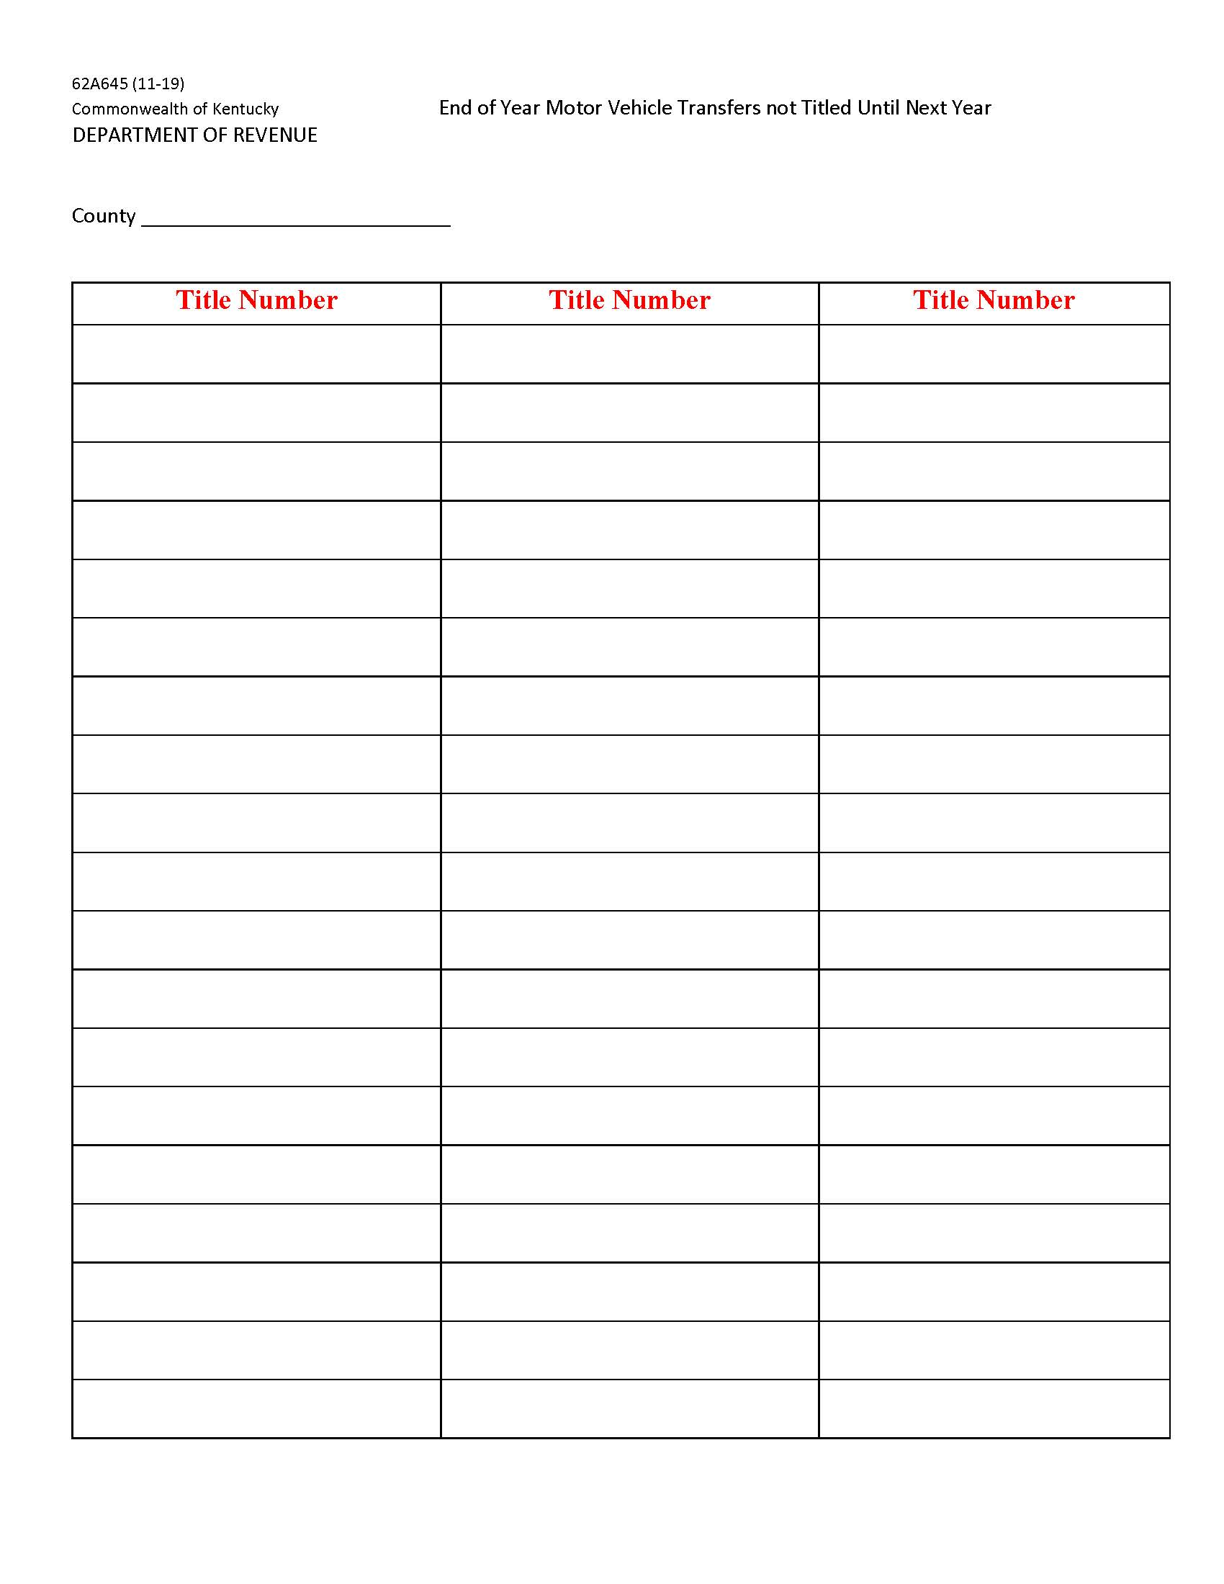
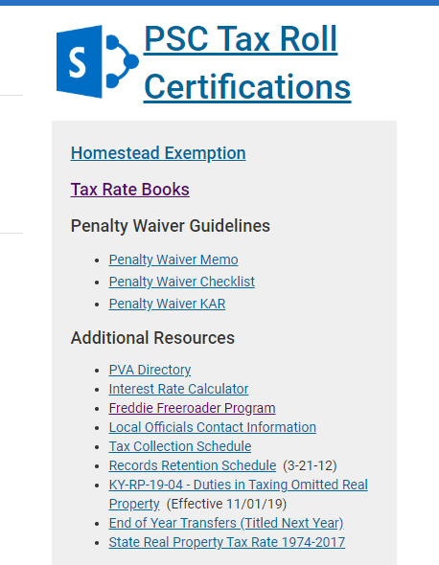
62A645 End of Year Motor Vehicle Transfers not Titled until next year.
Can copy title from mainframe system directly into PDF fillable form.
Share with PVA who can look up title in PODD and create current year segments.
Can take out trade-ins if applicable.
https://revenue.ky.gov/Pages/index.aspx

Slide 21
Questions
Lindsey Brown- Section Supervisor 502-564-7384
Jehna Cornish- Branch Manager 502-782-2507

