Slide 1
The Kentucky Department of Revenue presented the following information at the KY Tax Conference hosted by the Kentucky Chamber of Commerce on November 12, 2019. This presentation covered a general overview and introduction to the Department of Revenue.
The information in this presentation was prepared from information the Department of Revenue possessed and believed to be accurate and relevant on the date of the meeting. This information does not constitute a final ruling, order, or determination of the Department of Revenue and cannot be appealed.

Slide 2
KY Tax Conference
Getting to Know the KY Department of Revenue
Presentation Date: November 12, 2019
Kentucky Department of Revenue • 501 High Street • Frankfort, KY 40601 • (502) 564-4581

Slide 3
Why would anyone want to know the KDOR?
The Kentucky Department of Revenue (KDOR) implements all tax laws passed by the Kentucky General Assembly.
KDOR collects all General Fund and most Road Fund taxes.
KDOR performs compliance and audits of taxpayers.
KDOR touches virtually every citizens and business in the Commonwealth.

Slide 4
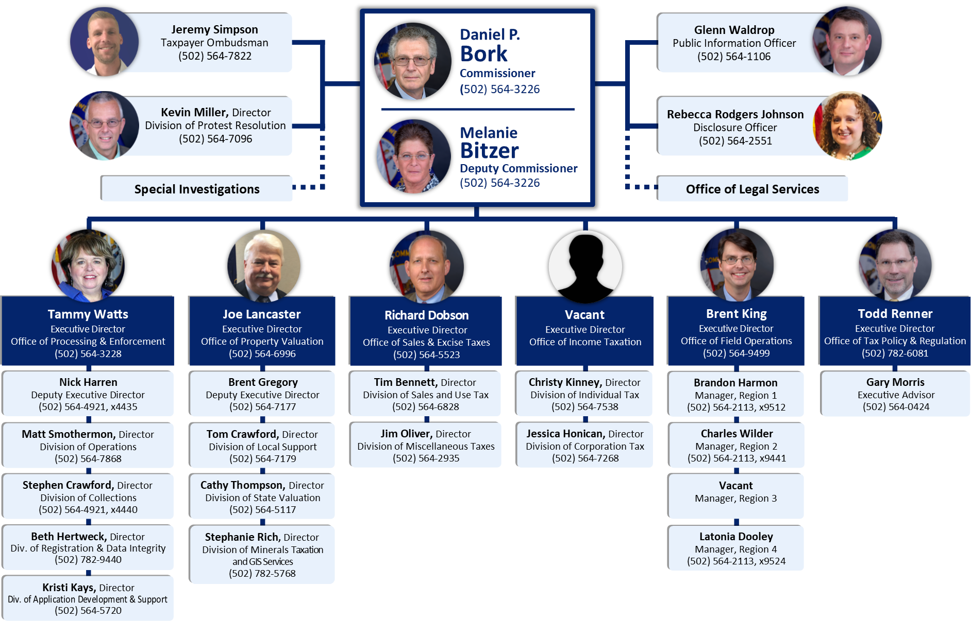

Slide 5
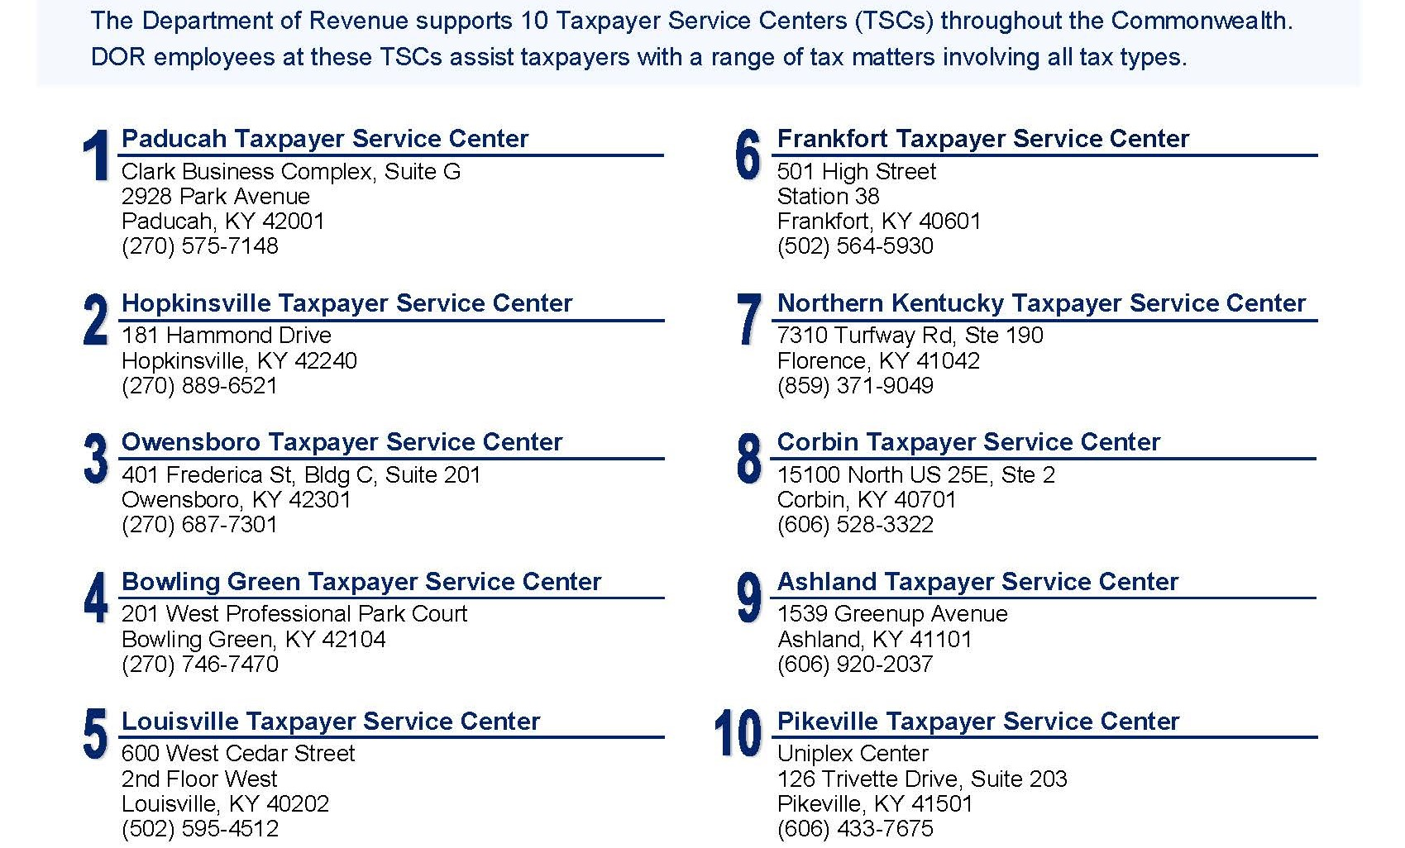
Taxpayer Service Centers

Slide 6
Outside Organizations
Federation of Tax Administrators (FTA)
Southeast Association of Tax Administrators (SEATA)
Streamlined Sales Tax Governing Board (SSUTA)
Multistate Tax Commission (MTC)

Slide 7
Statutes and Regulations
“Revenue and Taxation” statutes appear in Title XI of the Kentucky Revised Statutes (KRS)
Title XI includes KRS Chapters 131 through 145
General Assembly updates tax statutes annually
Regulations appear in Title 103 of the Kentucky Administrative Regulations (KAR)
KDOR updates KAR through the General Assembly
HB 4 from 2019 significantly increased regulation promulgation timing

Slide 8
New Regulation Process
New Regulation Rules
Regulations must be amended or re-certified every 7 years
General Assembly can review any regulation in committee at any time
LRC will publish a list of regulation deficiencies every December
Governor can retain regulation as written, require agency amendment, or defer to legislature
Legislature can work with agency to amend or void regulation
New Regulation Process
Still filed by 15th of each month
Public comment period extended by one month
Secondary review committee now has 90- not 30-days to review

Slide 9
Regulation Changes
Great collaboration with Chamber, KyCPA, and other industry groups.
KAR updates through October 2019 below.
Effort will continue through year end.
 | Administrative | Income | Miscellaneous* | Sales* | Property | Total
Beginning | 8 | 59 | 35 | 62 | 14 | 178
New | - | 1 | - | 3 | 2 | 6
Repealed | - | (22) | (7) | (2) | (5) | (36)
Ending | 8 | 38 | 28 | 63 | 11 | 148
 | Administrative | Income | Miscellaneous* | Sales* | Property | Total
New | - | 1 | - | 3 | 2 | 6
Amended | 5 | 33 | 11 | 45 | 5 | 99
No Change | 3 | 4 | 17 | 15 | 4 | 43
Total | 8 | 38 | 28 | 63 | 11 | 148

Slide 10
Revenue Procedure KY-RP-19-03
Authorized by KRS 131.130(8)
Background information on RPs, TAMs, PLRs, and GILs
Distinguishes regulations from guidance
Guidance does not have the force and effect of law
Defines and provides reasons for issuance or denial
Outlines the process and content requirements for guidance requests
Provides procedures for issuing guidance
2019 revision provides for publication of PLRs and minor updates
Guidance does not constitute a final ruling, order, or determination of KDOR. Therefore, KDOR guidance cannot be appealed to the Kentucky Claims Commission, Tax Appeals, not may a taxpayer file a protest based on issuance of KDOR guidance.

Slide 11
Revenue Guidance Project
Revenue Procedure (RP)
Provides procedural guidance to assist in the administration of laws and regulations by providing direction that may be followed in order to comply with the law.
Technical Advice Memorandum (TAM)
Guidance that applies principles of tax law to a set of facts or general category of taxpayer.
Format: Issue – Facts and Discussion – Law – Conclusion
Private Letter Ruling (PLR)
Issued upon taxpayer request and are based on specific factual situations provided by the taxpayer.
Are publicly available in redacted form after October 1, 2019
General Information Letter (GIL)
Anonymous PLRs hat are no binding on KDOR

Slide 12
Recent Tax Law Changes
HB 487 from 2018
Move from income to consumption tax
Lowered income tax rates and expanded sales tax base
HB 354 from 2019
Responded to unpopular changes in HB 487
Repealed bank franchise tax
HB 458 from 2019
Provided clarity for unitary groups definitions and NOL sharing

Slide 13
Major KDOR Initiatives
Integrated Tax System (ITS)
Moves KDOR from 150+ applications to 1 system
Will allow taxpayer account access online
“One Department One Team”
Culture shift away from “silo” mentality
More consistent responses from all KDOR areas
Tax Guidance
KRS 131.130(8) allows KDOR to issue non-binding guidance setting forth its interpretation of statutes and regulations

Slide 14
Getting to Know the KY Department of Revenue
Daniel P. Bork, Commissioner
 Dan.Bork@ky.gov
 (502) 564-3226
The information in this presentation is for educational and informational purposes only and does not constitute legal advice. Information is presented as an overall review that is subject to law changes and may not apply to all states. For accurate information on issues related to the Kentucky Department of Revenue, please reference KRS Title XI and KAR Chapter 103.
Information in this presentation is believed to be accurate as of the date of publication. In the event that any information in this presentation is later determined to be in error, this presentation cannot be used by taxpayers in supporting a specific position or issue before the Department of Revenue, as it does not have the statutory or regulatory authority.
Kentucky Department of Revenue
501 High Street • Frankfort, KY 40601
(502) 564-4581

