Slide 1
Tax Collection Topics
2024
Kentucky Sheriff’s Association Conference
September 11, 2024

Slide 2
Sheriff’s Official Receipt
After the tax bills have been prepared, a receipt which details the total amount of taxes due to each district must be prepared. (Revenue Form 62A385 Sheriff’s Official Receipt)
This is normally done through the computer software that is used to print the tax bills.
It is important to verify the accuracy of the receipt since the Sheriff will be charged with collecting the amounts shown on the receipt.
This receipt MUST be signed by the Sheriff and County Clerk, then entered into the fiscal court order book.
The receipt should be signed before tax bills are collected.
KRS 133.220(3)

Slide 3
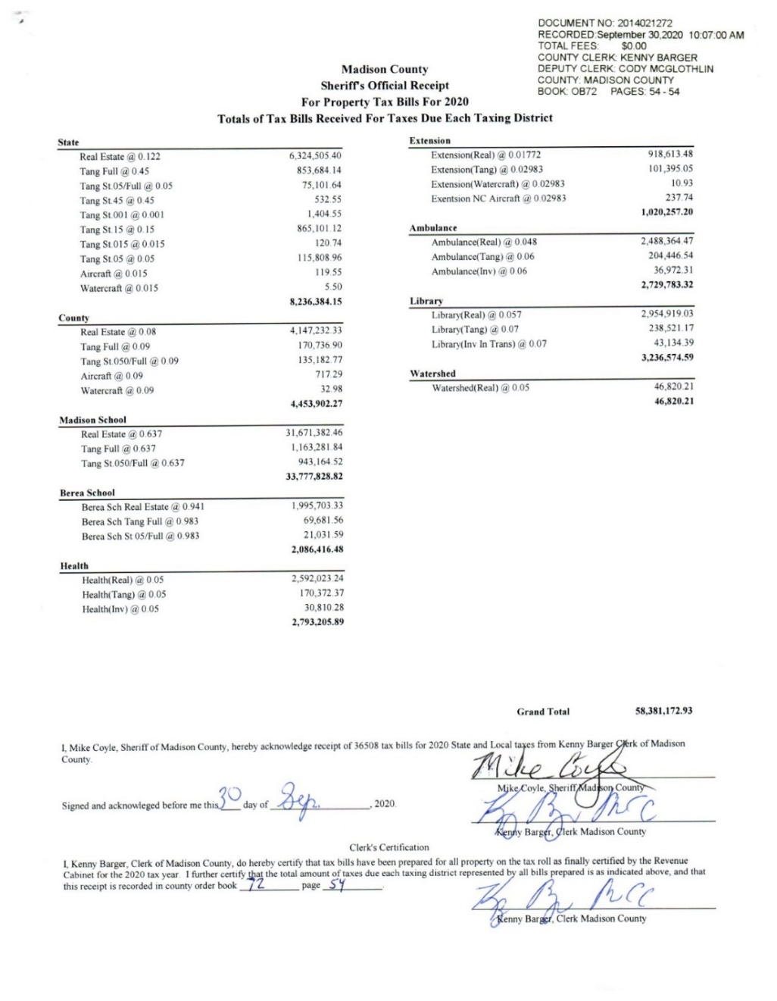
Sheriff’s Official Receipt

Slide 4
Additional, Supplemental & Omitted Tax Bills
Additional Bills – Bills that are prepared when a taxpayer does not receive a tax bill for a property. Regardless of what phase the tax collection is in, the additional bill must have a 30 day time period for each collection period.
Supplemental Bills – Bills that result from the property assessment appeals process. While an appeal is pending, KRS 133.120(9) entitles a taxpayer to pay property tax on his or her claim of value. When a final decision has been reached for the assessed value, if it is higher than the taxpayer’s claim of value, a supplemental tax bill must be prepared. Interest maybe applied to the bill based on the date of the final decision.
Omitted Bills – Bills that are prepared when the PVA has determined that a parcel has been left off of the property tax roll. Omitted property taxes can be levied against a taxpayer for up to five years and have penalty and interest added.
An Official Receipt MUST be prepared with ALL Additional, Supplemental & Omitted tax bills and MUST be signed by the Sheriff & Clerk.

Slide 5
Additional/Supplemental Bill Form

Slide 6
Additional/Supplemental Official Receipt

Slide 7
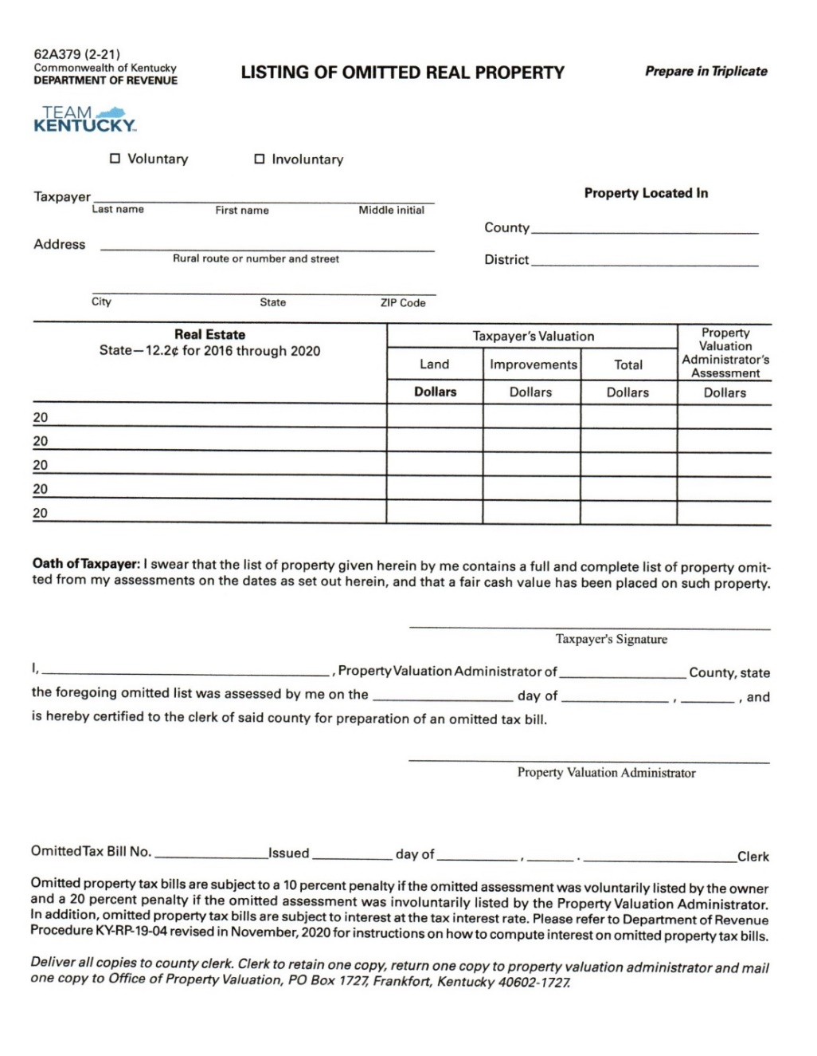
Omitted Bill Form

Slide 8
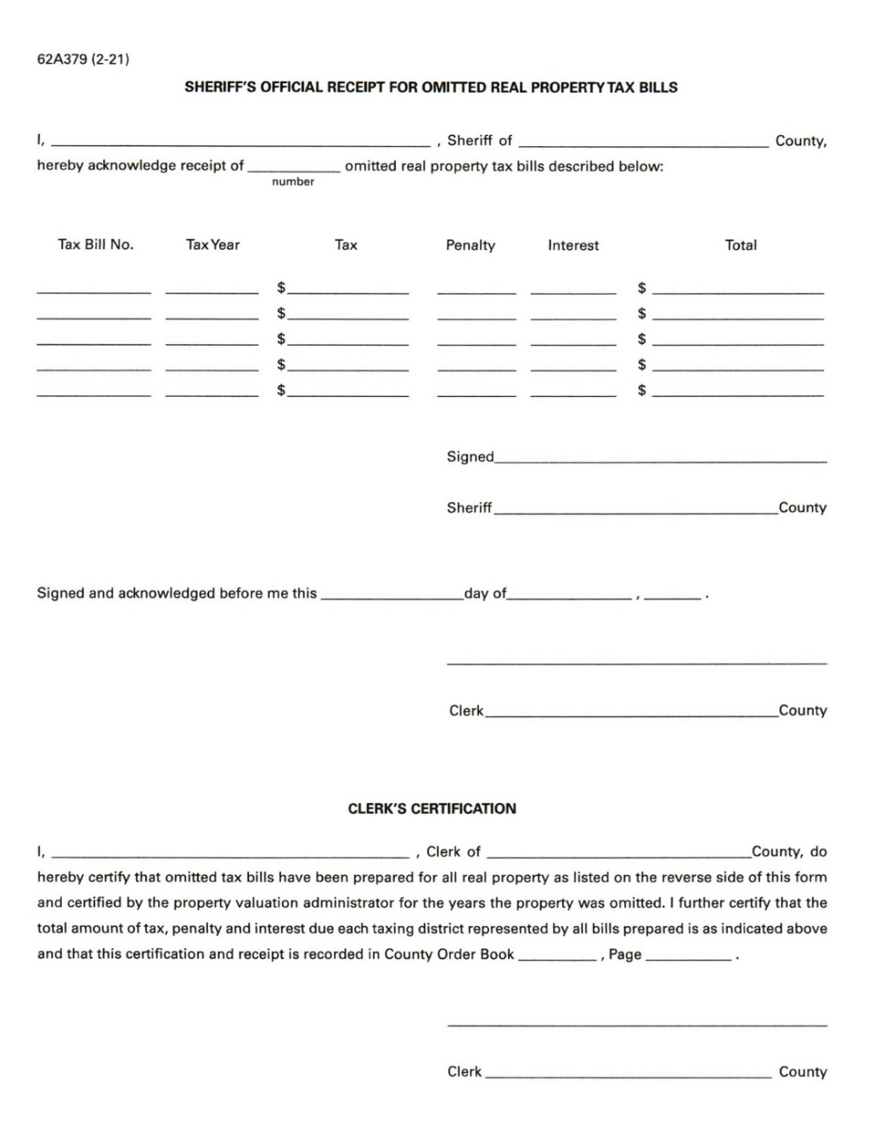
Omitted Bill Official Receipt

Slide 9
Exonerations
Exonerations are used when an adjustment needs to be made to a tax bill after it has been prepared and mailed.
All exonerations are generated in the PVA Office or by the Department of Revenue.
No bill can be adjusted unless an exoneration is issued by the PVA or by the Department of Revenue.
Exonerations can either decrease or increase the assessment of the bill. The majority of exonerations are decreases.

Slide 10
Exonerations
Attach a copy of the bill before the exoneration is entered and another copy of the bill after the exoneration is entered. (recommended)
Verify that the exoneration forms are filled out completely and correctly.
Verify the correct Homestead Exemption amount is used for the corresponding year.
Verify that the math on the exoneration form is correct.

Slide 11
Exonerations Form

Slide 12
Refunds
Refund exonerations are used when a decrease in assessment needs to be made to a tax bill after it has already been paid.
All refund exonerations are generated in the PVA Office or by the Department of Revenue.
The taxpayer has two years from the date of payment to request a refund.
(KRS 134.590)
The amount that is refunded needs to reflect any discounts or penalties applicable to the time frame in which the tax bill was paid.

Slide 13
Refunds
Verify that the refund forms are filled out completely and correctly.
Verify the correct Homestead Exemption amount is used for the corresponding year.
Verify that the math on the refund form is correct.
A copy of the paid tax bill should be attached to the refund form.
Refunds are reduced from the districts monthly collection report.

Slide 14
Refunds
When processing a refund, do NOT unpay or exonerate the paid tax bill.
This will cause credit for the refund to be given multiple times.
Just put it on the refund list/spreadsheet.
If you utilize your tax collection program’s refund option, just enter it in there.
Include the tax year and bill number on the refund check memo line, especially on those that are going to the mortgage company.
Checks that are written for an overpayment should not be included on the refund list. Just write overpayment, not refund on the memo line.

Slide 15
Refund Form

Slide 16
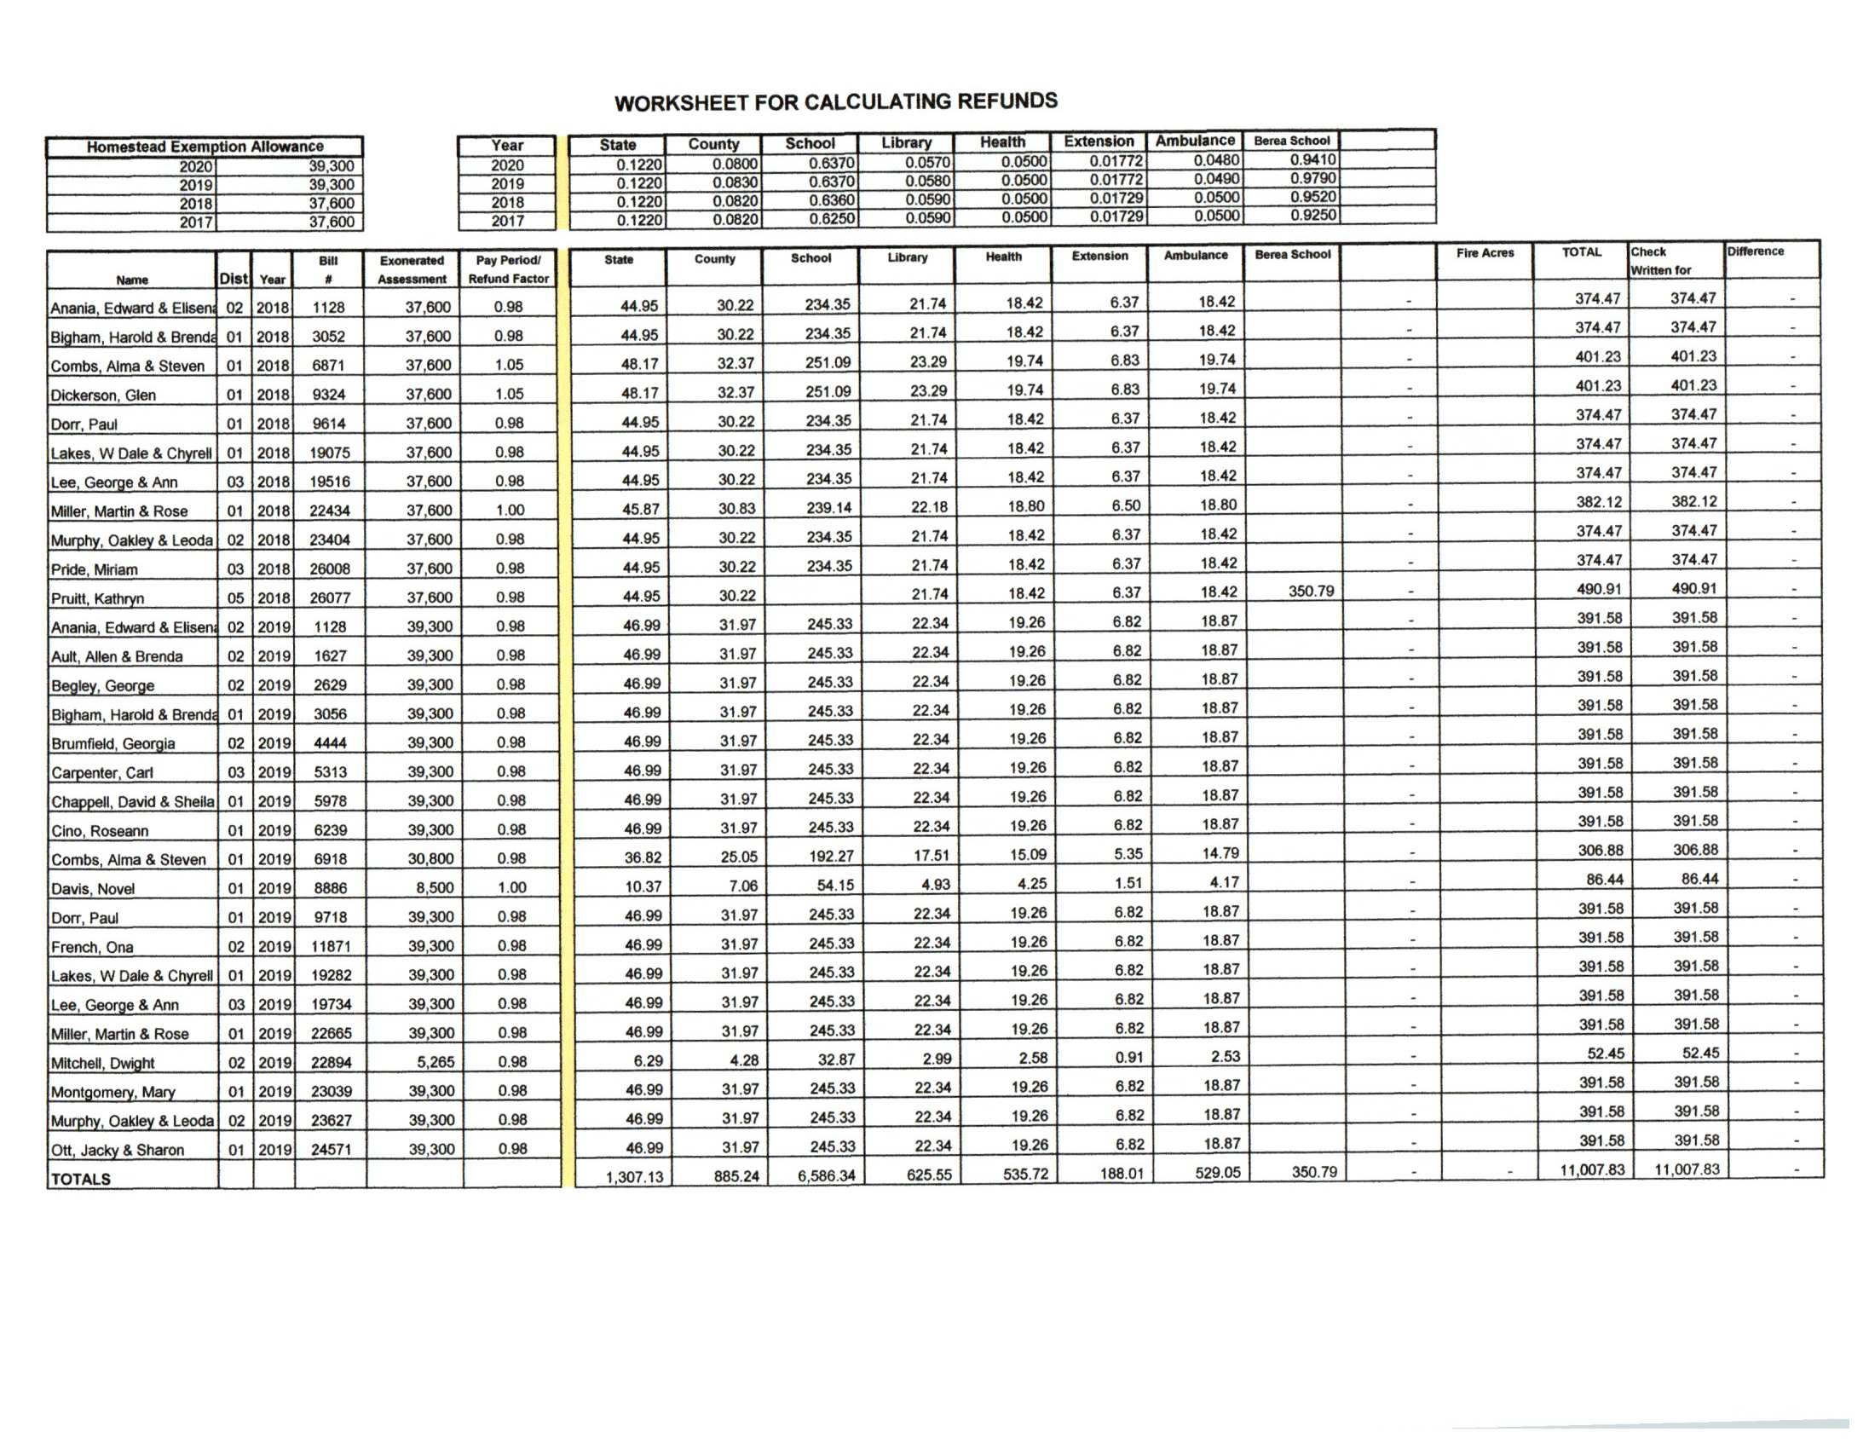
Refund Recap Spreadsheet

Slide 17
Tangible Refunds
When you receive a tangible refund that is from an audit, contact your State Field Representative.
They will look over the refund to ensure that all adjustments are being accounted for and that it is processed correctly.
These can be large amounts that include some categories that decrease in value and some categories that increase in value.

Slide 18
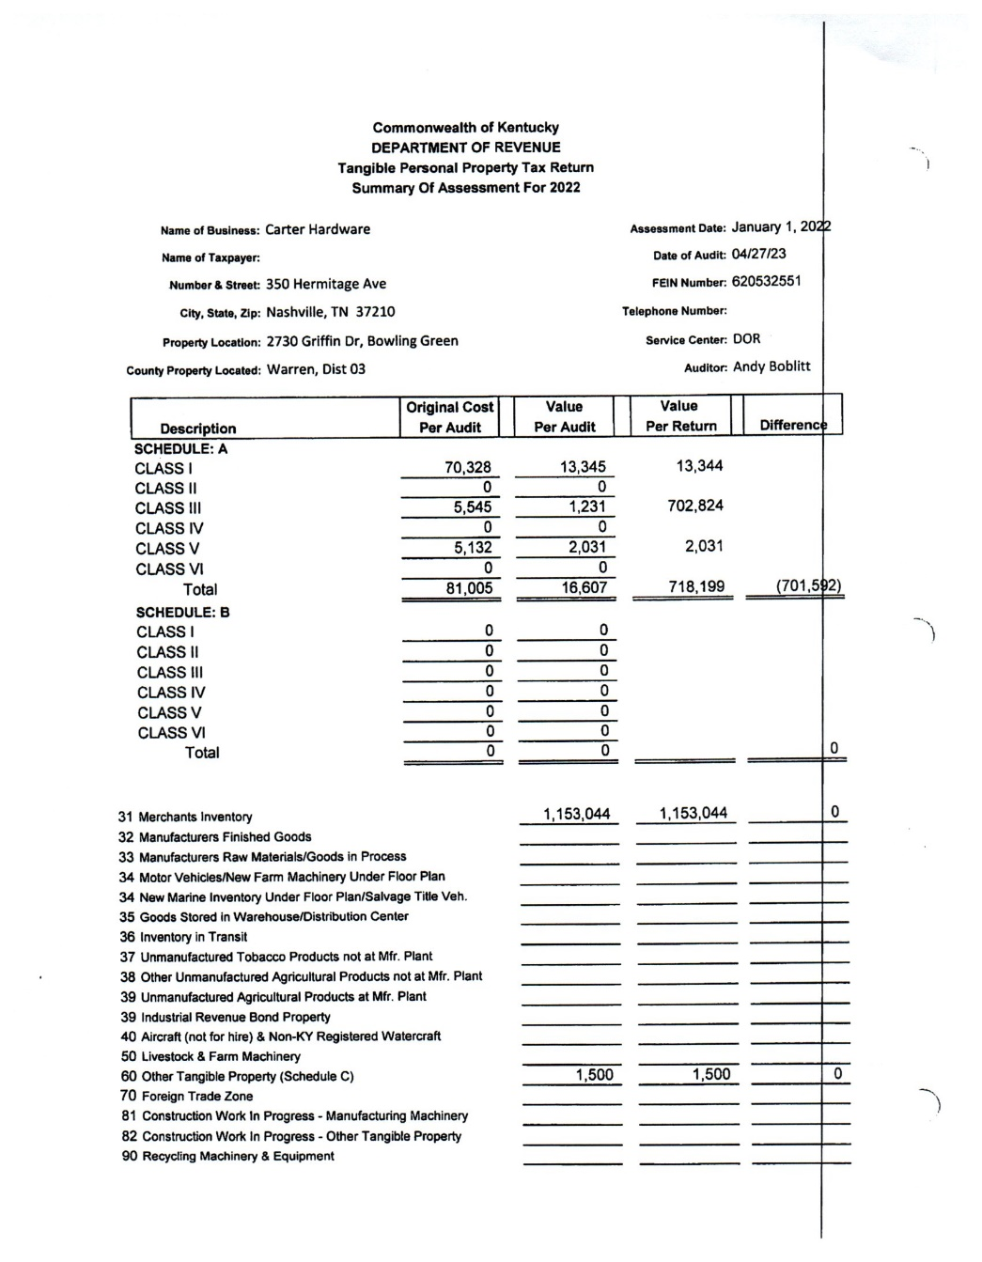
Tangible Refunds

Slide 19
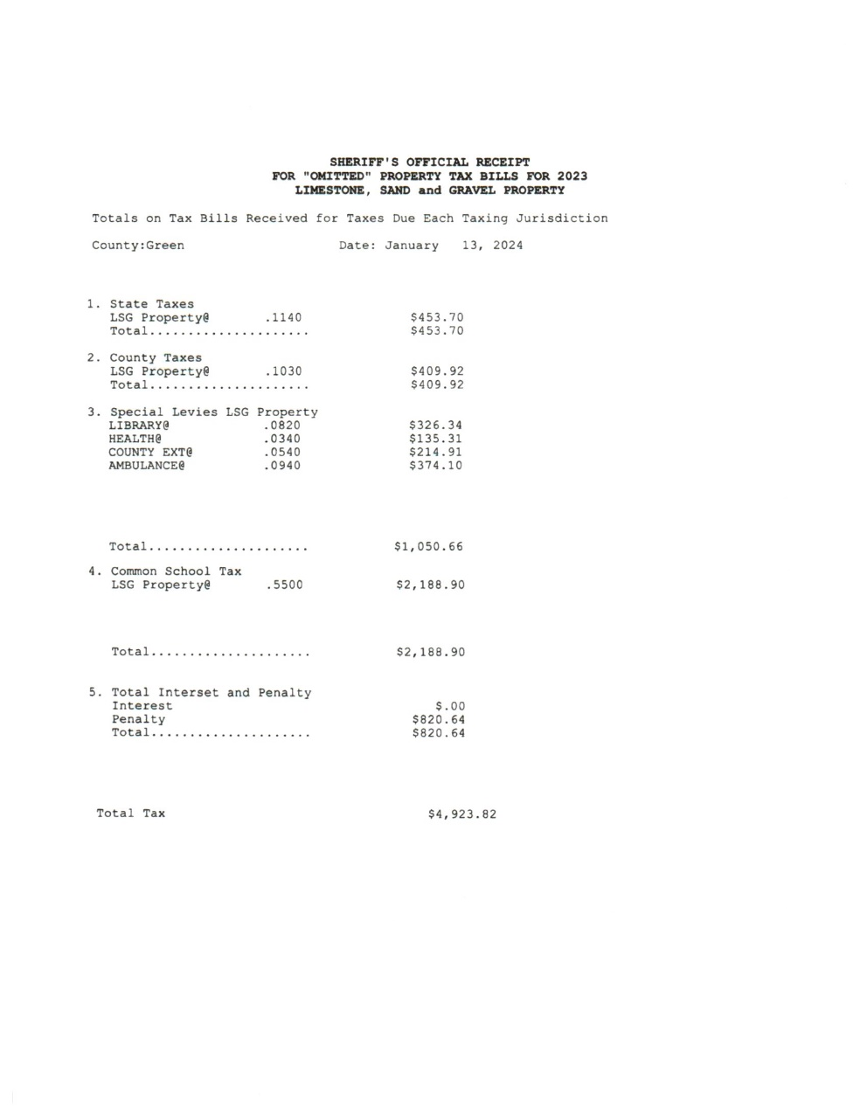
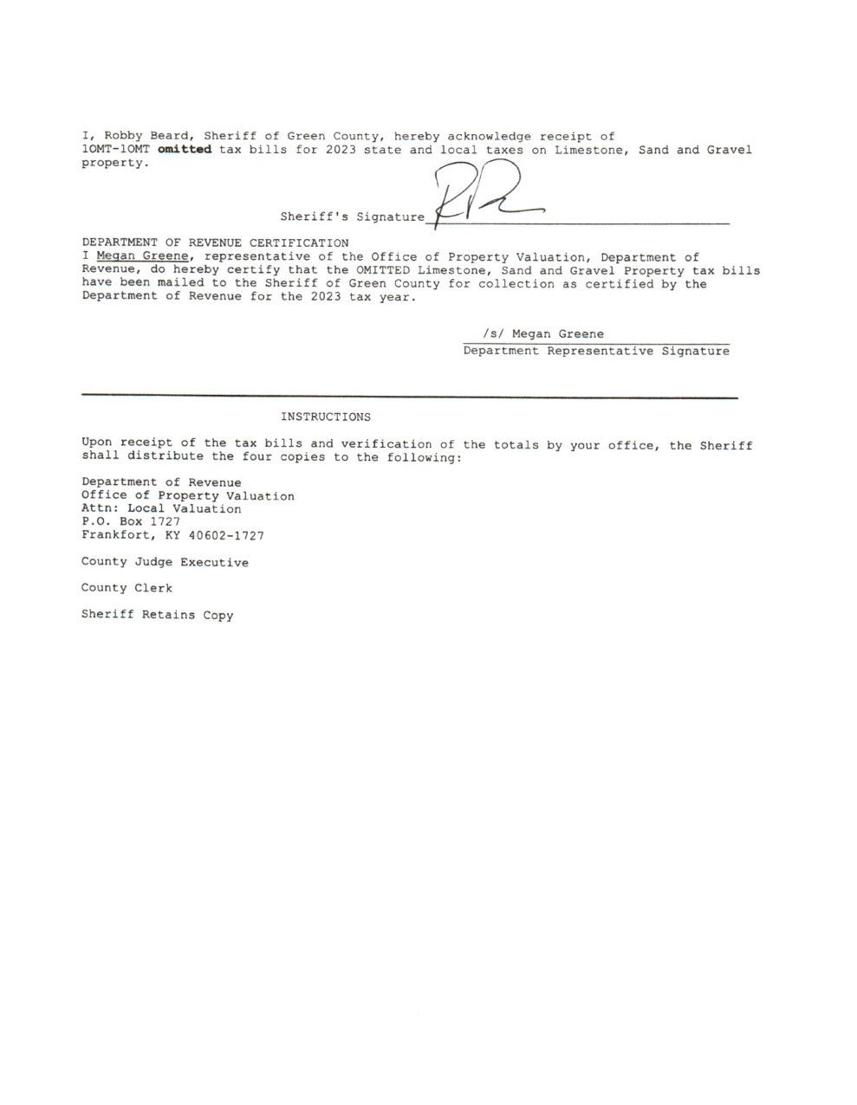
Omitted Mineral Bills

Slide 20
Omitted Mineral Bills
State - $453.70 x 20% = $90.74
20% for Each Taxing District
State = $90.74
County = $81.98
Library = $65.27
Health = $27.06
Extension = $42.98
Ambulance = $74.82
School = $437.78
Total = $820.64

Slide 21
State Settlement
The yearly State Settlement may be started after the delinquent tax bills have been transferred to the County Clerk’s office (April 16th) and the April monthly disbursement has been made.
The yearly State Settlement and the yearly Local Settlement are independent of each other.
Your State Department of Revenue Field Representative should contact you and set up a date to start the settlement.
When a date is scheduled for us to start the State Settlement, please make every attempt to be there and to be available.
If plans change, please contact us to reschedule.
If copies of reports or other information needs to be made, please have those made prior to the schedule start date.

Slide 22
Information for the State Settlement
Copy of the Official Receipt (Signed by Sheriff & Clerk and Recorded)
Copy of the Oil/LSG/Clay/Gas Official Receipts (with signature page)
Decrease Exoneration Report (Both Real & Tangible)
Increase Exoneration Report (Both Real & Tangible)
Copy of all exonerations. (We just need to verify them not a copy to keep.)
Delinquent Bill Report (Both Real & Tangible)
Delinquent Bill Report for Prior Year Additional Bills (Both Real & Tangible)
Copy of Receipt(s) transferring delinquent bills to the Clerk.
Refund Report (Both Current & Prior Year Refunds)
Copy of the Refund Form from the PVA for all refunds (Both Current & Prior Year Refunds) (We just need to verify them not a copy to keep.)
Additional Bill List (Both Current & Prior Year Bills)
Copy of Additional Bill Authorization Form from PVA
Copy of Official Receipt for all Additional Bills (Signed by Sheriff & Clerk)
Copy of newspaper article advertising the Due Date of Taxes
Copy of Local Settlement
Copy of Fiscal Court Order Approving Local Settlement

Slide 23
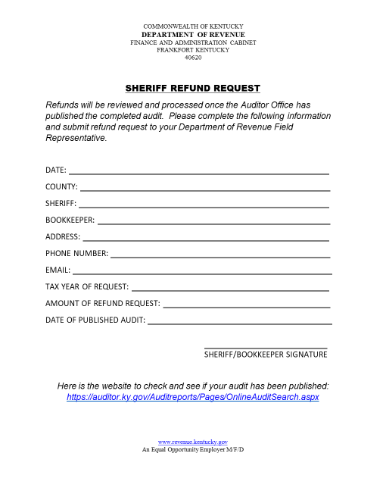
Sheriff Refund Request Form
New

Slide 24
Sheriff Refund Request
The Sheriff or Bookkeeper will complete the Refund Request Form once their audit has been completed and the Auditor’s office has published the audit showing a refund is due to the Sheriff.
The Refund Request Form will be sent to the appropriate Office of Property Valuation Field Representative.
The Field Representative will verify the Auditor’s website to confirm that the audit has been published and the refund amount that was determined is due.
The Field Representative will then compare the refund amount on Refund Request Form to the amount on the State Settlement.
If the amounts match, then the refund request will be submitted.
If the amounts are different, then the Field Representative will determine the discrepancy before the request can be submitted.

Slide 25
Resources
Frankfort Contact
Ellen Long
P.O. Box 1727
Frankfort, KY 40602
Ellen.Long2@ky.gov
www.revenue.ky.gov/sheriffnetwork

Slide 26
Tax Collection Topics
Ben Williams
Property Assessment Coordinator IV
KY Department of Revenue
606-425-6634
ben.williams@ky.gov
Martha Tapley
Revenue Branch Manager
KY Department of Revenue
606-307-6058
martha.tapley@ky.gov
The information in this presentation is for educational and informational purposes only and does not constitute legal advice. Information is presented as an overall review that is subject to law changes and may not apply to all states. For accurate information on issues related to State Real Property Tax Rate, please reference KRS 132.020.
Information in this presentation is believed to be accurate as of the date of publication. However, any statement in error that may occur during presentations made by the Department of Revenue as part of its tax education program shall not expressly or impliedly supersede the Department of Revenue’s official interpretation of the law or its policies utilized in administering state revenue and tax laws.
Kentucky Department of Revenue • 501 High Street • Frankfort, KY 40601 • (502) 564-8338

