Slide 1
2024 Kentucky Income Tax Changes
University of Kentucky Income Tax Seminar
Kentucky Department of Revenue • 501 High Street • Frankfort, KY 40601 • (502) 564-3226

Slide 2
Introductions
Jordan Moseley
Policy/Research Consultant
Division of Corporation Income Tax
Jessica Martin
Policy/Research Consultant
Division of Individual Income Tax
Brad Asher, CPA
Tax Consultant
Kentucky Department of Revenue • 501 High Street • Frankfort, KY 40601 • (502) 564-3226

Slide 3
Corporate Income Tax/LLET
2024 Updates
Kentucky Department of Revenue • 501 High Street • Frankfort, KY 40601 • (502) 564-8139

Slide 4
Overview of the 2024 Legislative Session
HB 8
Updated IRC conformity date
Extension of Corporate Income Tax Exemption for Disaster Response Businesses
Deferred tax deduction for Unitary Filings
Broadband Tax Credit created

Slide 5
Updated IRC Conformity Date
For tax years beginning on or after January 1, 2024:
The IRC conformity date is December 31, 2023.
Previous conformity date was December 31, 2022.
As a result, the Internal Revenue Code in effect on December 31, 2023, is applicable for Kentucky Income Tax purposes, unless Kentucky has specific statutes that state otherwise.
Statute Reference: KRS 141.010(21)

Slide 6
Disaster Response Businesses
The exemption initially passed during the 2021 Legislative Session and was set to expire January 1, 2025. HB 8 extended the corporation income tax exemption for disaster response businesses to tax years beginning on or after January 1, 2021, but before January 1, 2027.
For purposes of this exemption, disaster response business is defined by KRS 141.010(10). Disaster response businesses eligible for the exemption:
Have no presence in Kentucky and conduct no business in Kentucky except for disaster or emergency-related work during a response period;
Services are requested by a registered business or state or local government to perform disaster or emergency-related work during a response period; and
Have no registrations, tax filings, or nexus in Kentucky other than disaster or emergency-related work during the calendar year immediately preceding the declared state disaster or emergency.
For taxable years beginning on or after January 1, 2021, but before January 1, 2027, the tax imposed by this section shall not apply to a disaster response employee or to a disaster response business. The remainder of the income received by such nonresident shall be deemed nontaxable by this state.

Slide 7
Deferred Tax Deduction
HB 8 delays the deferred tax deduction until tax years beginning on or after January 1, 2026.
The deduction is allowed for companies filing a combined report that saw an increase in a net deferred tax liability, a decrease in a net deferred tax asset, or aggregate change from a net deferred tax asset to a net deferred tax liability as a result of the imposition of the combined reporting requirement.
Any combined group intending to claim the deferred tax deduction must have filed a statement with the Department of Revenue on or before July 1, 2019.

Slide 8
Broadband Expansion Tax Credit
The broadband expansion tax credit is available for tax years beginning on or after January 1, 2025, but before January 1, 2029.
The total amount of the credit awarded is capped at $5 million for each taxable year.
Companies must complete and file an application with the Department by December 31 of the calendar year in which the investment was made.
The Department will review and approve the allowable credit amount by February 1.

Slide 9
Broadband Expansion Tax Credit
This is a nonrefundable and nontransferable tax credit.
The credit is limited to 50% of the amount of sales tax paid for purchases of eligible equipment and services, reduced by any seller reimbursement allowed under KRS 139.570.
It requires that equipment and services are used to expand broadband.
The credit can be used against:
Limited Liability Entity Tax
Corporation Tax
Individual Income Tax
Statute Reference: KRS 141.391

Slide 10
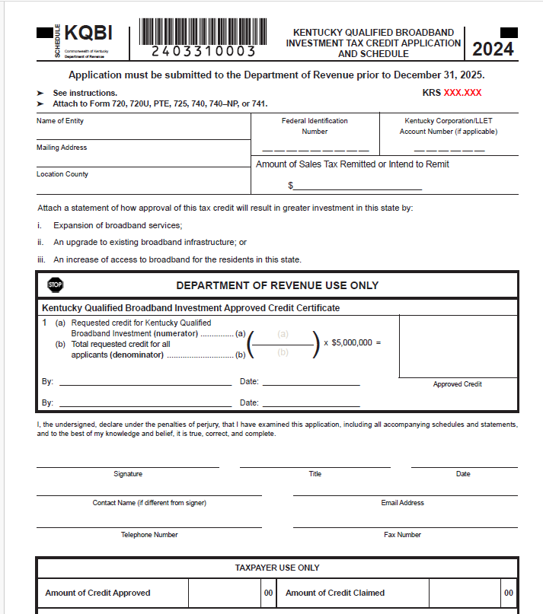
Broadband Expansion Tax Credit KRS 141.391

Slide 11
From the 2023 Legislative Session
Distilled Spirits Tax Credit
For tax years beginning on or after January 1, 2024, eligible taxpayers may elect to:
Waive any accumulated credits and claim a nonrefundable and nontransferable tax credit of 100% of the property taxes timely paid on up to 25,000 barrels of distilled spirits in a bonded warehouse; or
Waive all future tax credits and claim a refundable credit against sales and use tax and employee withholding taxes resulting from capital projects that meet specific investment and employment requirements.

Slide 12
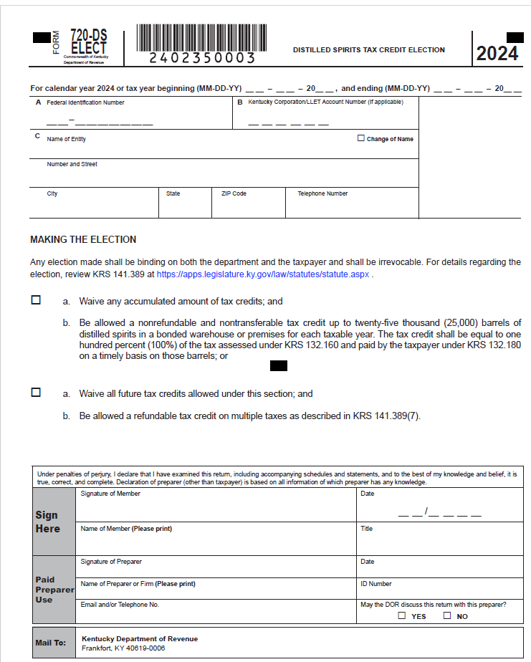
Form 720-DS-ELECT
HB 5 (2023) Distilled Spirits Tax Credit
720-DS-ELECT
Statute reference: KRS 141.389

Slide 13
PTET Estimated Payments Required for 2024
For tax years beginning on or after January 1, 2024, an electing entity is required to make estimated payments.
Form PTET-P has been created to allow an electing entity to calculate the penalty due on the underpayment of estimated taxes for PTET.
Statute Reference: KRS 141.209

Slide 14
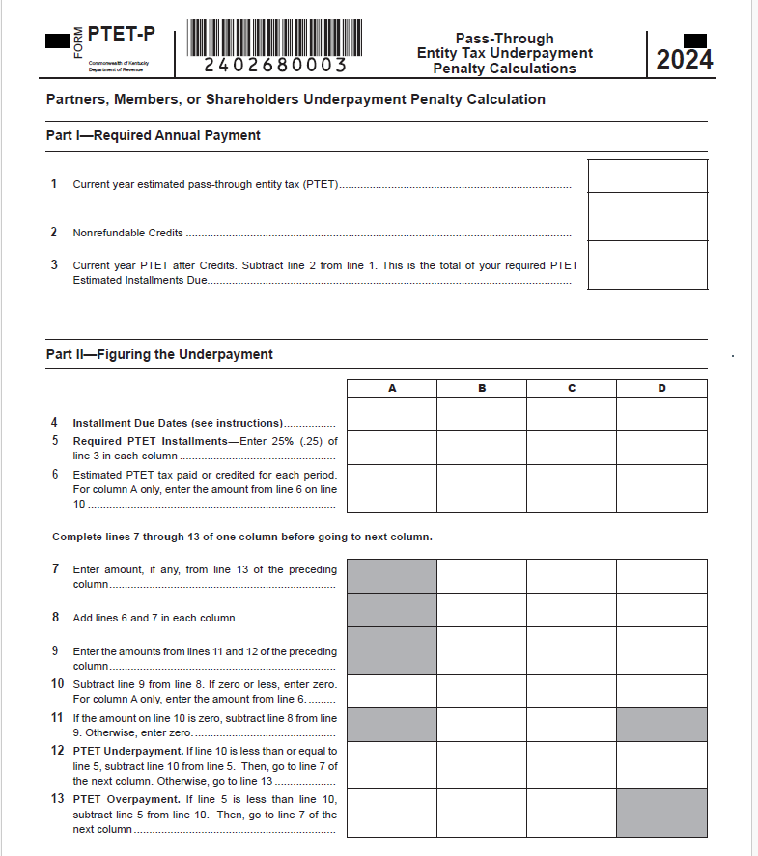
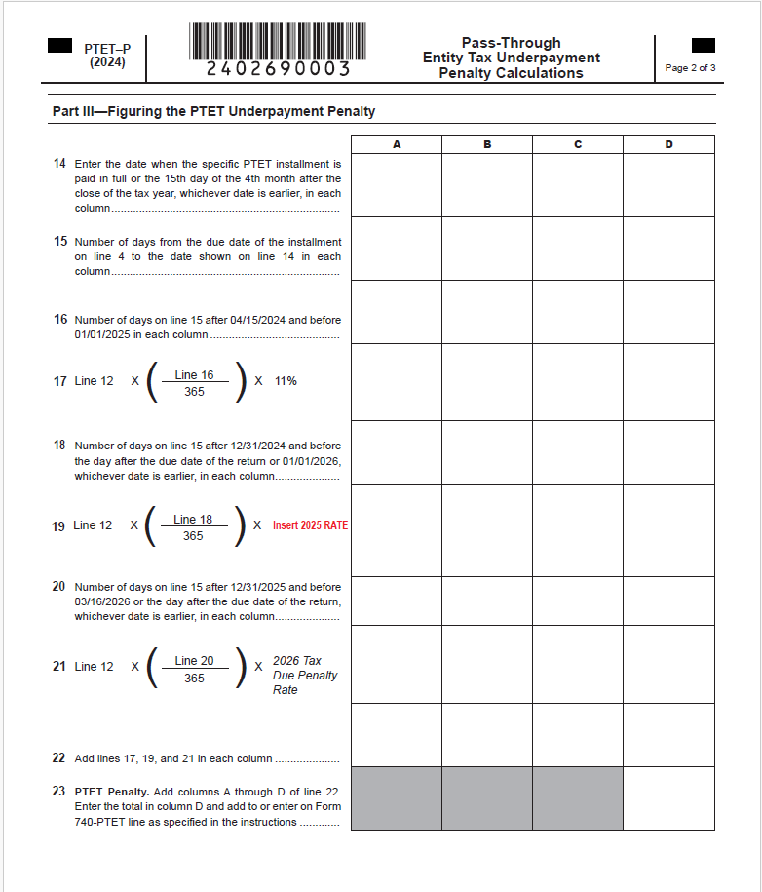
Form PTET-P Pass-Through Entity Underpayment Penalty

Slide 15
Individual Income Tax
2024 Updates
Kentucky Department of Revenue • 501 High Street • Frankfort, KY 40601 • (502) 564-4581

Slide 16
Overview of the 2024 Legislative Session
HB 8
Updated IRC conformity date to December 31, 2023, for tax years beginning on or after January 1, 2024
KRS 141.020 extended the provision for taxable years beginning on or after January 1, 2021, but before January 1, 2027, for a disaster response employee and disaster response business as defined in KRS 141.010.
Broadband Tax Credit created under KRS 141.391

Slide 17
Individual Income Tax: Form Changes
All forms have been updated with year changes and any legislative threshold changes.
2024 Standard Deduction: $3,160
Individual Income Tax Rate for tax year 2024 is 4%
Schedule ITC – added Worksheet INV for the inventory tax credit and updated Family Size Tax Credit Table
Form 741 –attach Schedule ITC when necessary

Slide 18
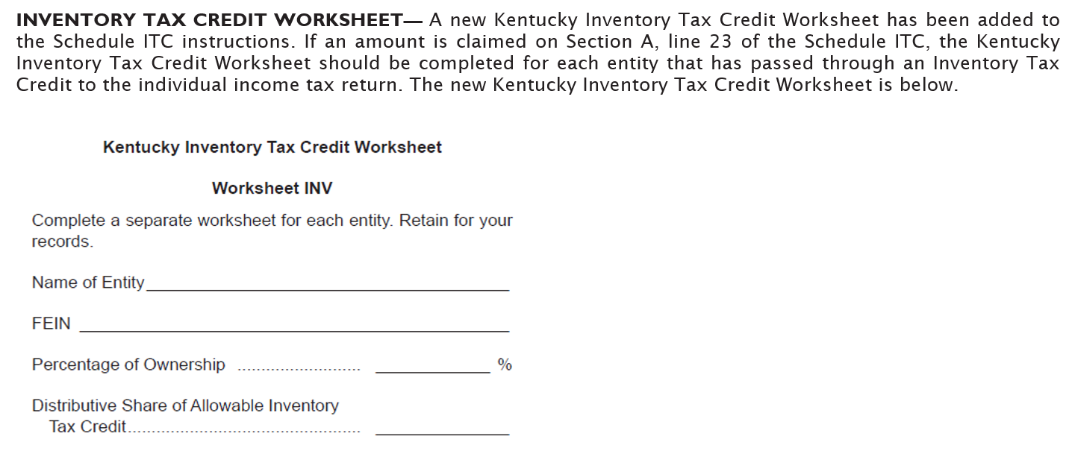
Schedule ITC: Worksheet INV

Slide 19
Form 741 – Schedule ITC
Nonrefundable credits claimed on the Fiduciary return should be included on Schedule ITC and attached to Form 741.
Language on Form 741 and Schedule ITC has been updated to clarify the need to enclose Schedule ITC when necessary.

Slide 20
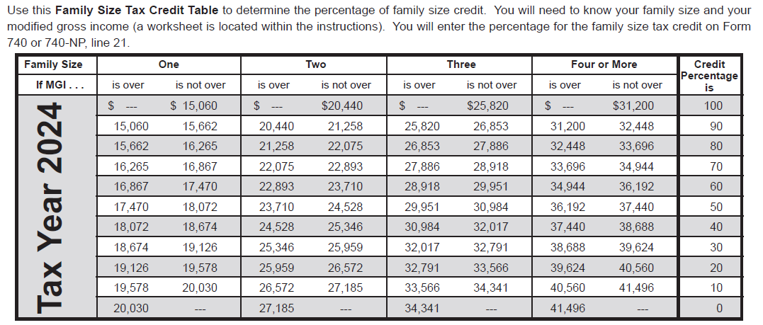
Individual Income Tax: Family Size Tax Credit

Slide 21
Looking Ahead – Reduction of Individual Income Tax Rate
HB 8 (2022) amended by HB 659 (2022)
Additional changes have been made to the rate reduction conditions.
The Budget Reserve Trust Fund will be reviewed each year and compared with the General Fund.
Individual Income Tax Rate can be reduced by 0.5% each tax year if fiscal requirements are met.
All future individual income tax rate reductions must be approved by the General Assembly.
The Individual Income Tax Rate for tax year 2025 is 4%.
The Standard Deduction for tax year 2025 is $3,270.

Slide 22
Employer Payroll Withholding
All filing types are now mandated by e-file requirements.
For tax year 2025, the tax rate will remain at 4%.
Note: If a taxpayer receives more than one W-2 annually, they may need to withhold an additional $130 for each additional W-2 received. The standard deduction is factored into the calculation for Kentucky withholding, and withholding for each W-2 will account for the standard deduction. The employee, however, will only receive this deduction once their return is filed.

Slide 23
Withholding on Gambling Winnings
Regulation 103 KAR 18:070 establishes the withholding rate on gambling winnings at the maximum income tax rate: 4% for tax year 2025.
Payments of gambling winnings subject to federal tax withholding must also deduct and withhold Kentucky income tax.
Tax withheld from gambling winnings must be reported and paid on the payer’s withholding account on Form K-1 or K-3.
Gambling winnings subject to withholding are those of more than $5,000 from the following sources:
Any sweepstakes, wagering pool, or lottery; or
Any other wager, if the proceeds are at least 300 times the amount of the bet.

Slide 24
Other Information and Reminders
Kentucky Department of Revenue • 501 High Street • Frankfort, KY 40601 • (502) 564-4581

Slide 25
Electronic Payments
Actual withdrawal of electronic payments may be later than the requested date. Please allow up to two weeks for processing.
Please do not submit duplicate payments.

Slide 26
Electronic Payments
We have noticed an increase in misapplied payments. Please caution taxpayers to choose the correct tax type when making an electronic payment.
Tax Type:
“Individual Income Tax – (Tax Account number is the Social Security Number)”
This would be used to make a payment when the return is filed to pay the balance of tax due.
“Individual Income Tax – Estimated Payment (Tax Account number is the Social Security Number)”
This would be used to make an estimated tax payment for the following tax year. The year will automatically default to the year for which we are accepting estimated tax payments.

Slide 27
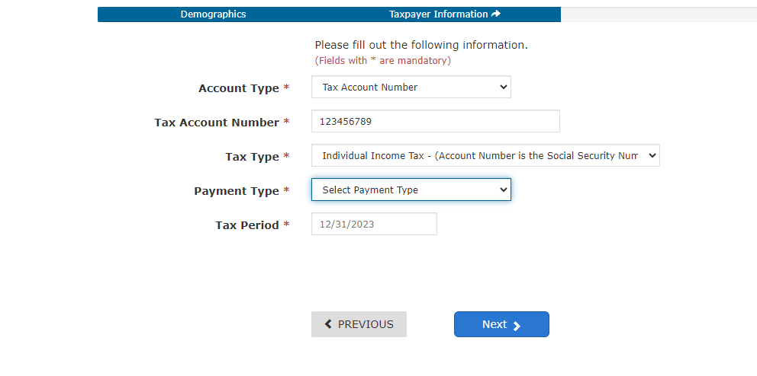
Payments for Tax Due on a Return

Slide 28
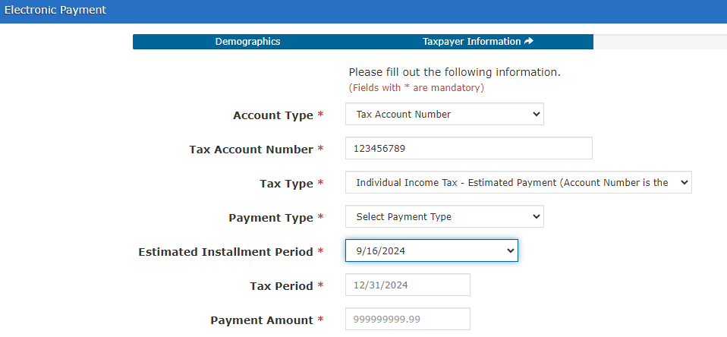
Estimated Tax Payments

Slide 29
Electronic Filing
Electronic filing is available through third-party vendors that support Kentucky.
Visit the Department of Revenue website at Revenue.ky.gov for updates of approved Tax Software Vendors under the Tax Professionals Tab and click on Software Developers.
YTD 2024:
94% of tax year 2023 individual income tax returns were e-filed
58% of tax year 2023 corporate and pass-through entity tax returns were e-filed

Slide 30
Tax Interest Rate
2025 Tax Interest Rate: 8%
Rate charged on unpaid taxes is 10%
(Base rate of % plus 2%)
Rate paid when interest is due on a refund is 6%
(Base rate of % minus 2%)
Statute Reference: KRS 131.183

Slide 31
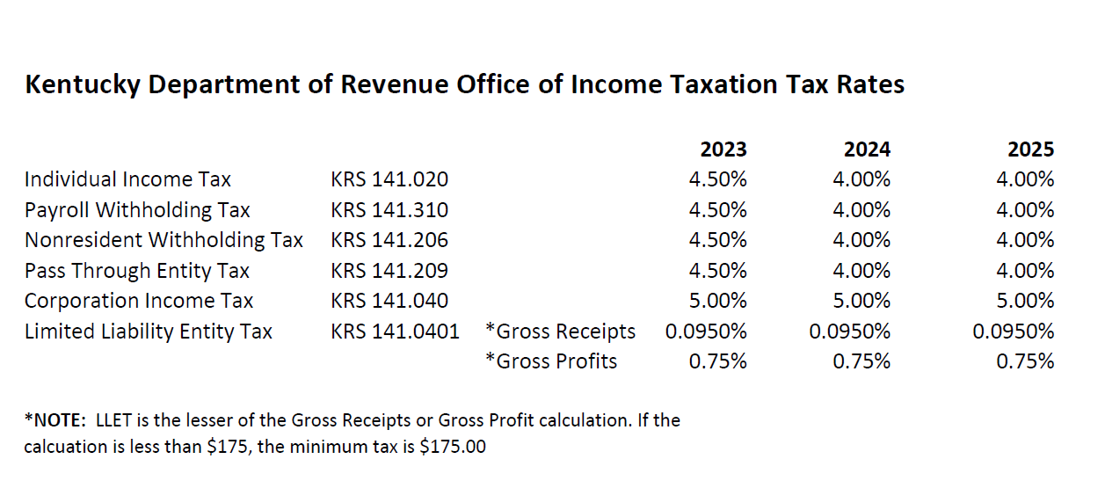
Tax Rates

Slide 32
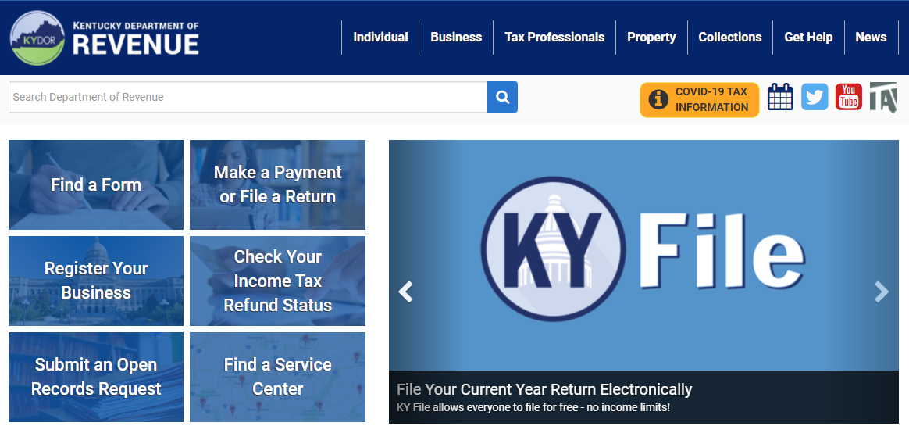
Stay in Touch
Department of Revenue Website
https://revenue.ky.gov
Kentucky Business One Stop Portal
https://onestop.ky.gov

Slide 33
Press Releases and Important Updates
The Kentucky Department of Revenue (DOR) provides important updates to tax information on Revenue.ky.gov.
Check the DOR website regularly for timely information on disaster relief provisions.
DOR will implement a new Integrated Tax System in March 2025.
Stay Connected: sign up for Revenue news and updates directly to your inbox.

Slide 34
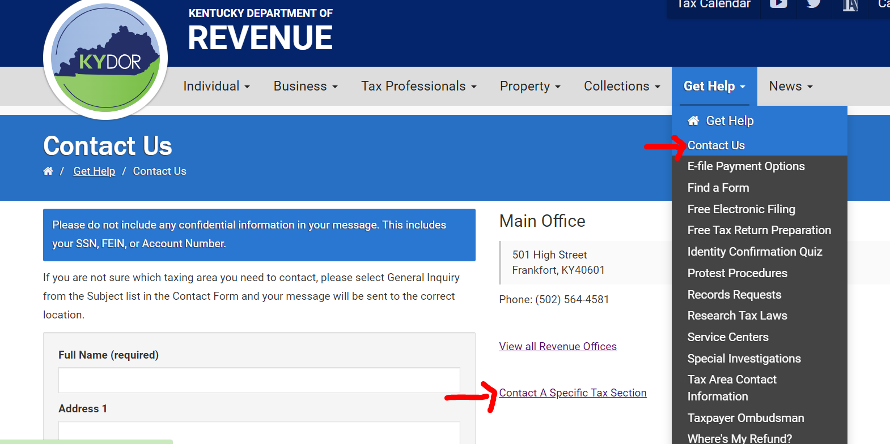
Reach out to DOR via Web Response

Slide 35
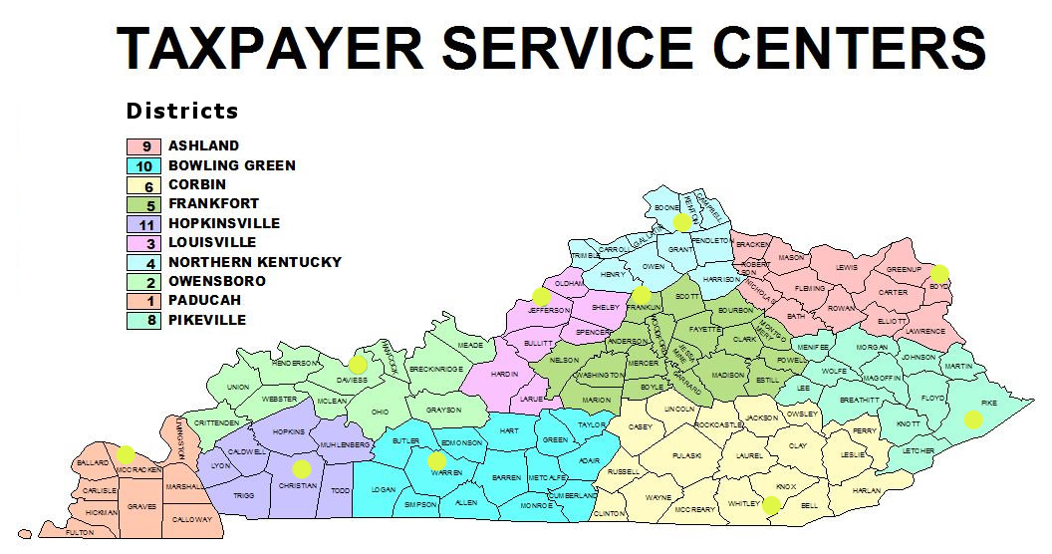
Taxpayer Service Center Map

Slide 36
Taxpayer Service Centers
Ashland Taxpayer Service Center
1539 Greenup Avenue, Suite 501 41101-7695
(606) 920-2037
Bowling Green Taxpayer Service Center
201 West Professional Park Court, 42104-3278
(270) 746-7470
Corbin Taxpayer Service Center
15100 North US25E, Suite 2, 40701-6188
(606) 528-3322
Frankfort Taxpayer Service Center
501 High Street, 40601-2103
(502) 564-4581 (Taxpayer Assistance)
Hopkinsville Taxpayer Service Center
181 Hammond Drive, 42240-7926
(270) 889-6521
Louisville Taxpayer Service Center
600 West Cedar Street, 2nd Floor West, 40202-2310
(502) 595-4512
Northern Kentucky Taxpayer Service Center
Turfway Ridge Office Park
7310 Turfway Road, Suite 190, Florence, 41042-4871
(859) 371-9049
Owensboro Taxpayer Service Center
401 Frederica Street, Building C, Suite 201, 42301-6295
(270) 687-7301
Paducah Taxpayer Service Center
Clark Business Complex, Suite G
2928 Park Avenue, 42001-4024
(270) 575-7148
Pikeville Taxpayer Service Center
Uniplex Center, 126 Trivette Drive, Suite 203, 41501-1275
(606) 433-7675

Slide 37
Revenue Contact Phone Numbers
Collections | (502) 564-4921
Corporation Tax | (502) 564-8139
DOR One Stop Help Line | (502) 564-5053
E-Filing Assistance (Business Forms) | (502) 564-7926
E-Filing Assistance (Individual Forms) | (502) 564-7862
Field Operations | (502) 564-2113
Forms and Envelopes | (502) 564-3658
Individual Income Tax | (502) 564-4581
Inheritance Tax | (502) 564-4810
Local Government & County Fees | (502) 564-8785
Miscellaneous Tax | (502) 564-2935
Motor Fuels | (502) 564-3853
Motor Vehicle Usage | (502) 564-4455
Ombudsman | (502) 564-7822
Property Tax | (502) 564-8338
Protest Resolution | (502) 564-6734
Registration | (502) 564-3306
Sales & Use Tax | (502) 564-5170
Special Investigations | (502) 564-4470
State Operator | (502) 564-3130
Withholding (also use for WRAPS) | (502) 564-7287

Slide 38
2024 Kentucky Income Tax Changes
Jordan Moseley | Jessica Martin
Policy/Research Consultant Division of Corporation Tax | Policy/Research Consultant Division of Individual Income Tax
 Jordan.Moseley@ky.gov |  JessicaE.Martin@ky.gov
 (502) 564-7281 |  (502) 564-7311
Brad Asher, CPA
Tax Consultant
 Brad.Asher@ky.gov
Kentucky Department of Revenue • 501 High Street • Frankfort, KY 40601 • (502) 564-4581

Slide 39
Disclaimer
The Department has developed this presentation to enhance taxpayer understanding of and compliance with the new tax legislation enacted by the Kentucky General Assembly during the 2024 regular legislative session. The information in this presentation is for educational and informational purposes only and does not constitute legal advice. Information is presented as an overall review that is subject to law changes. To review the amendments to Kentucky tax laws enacted during the 2024 regular session in more detail, please refer to House Bill 8 and the relevant statutory provisions of the Kentucky Revised Statutes. You may refer to KRS 141.209 and KRS 141.389 for relevant information from the 2023 regular session.
Information in this presentation is believed to be accurate as of the date of publication. However, any statement in error that may occur during presentations made by the Department of Revenue as part of its tax education program shall not expressly or implied supersede the Department of Revenue’s official interpretation of the law or its policies utilized in administering state revenue and tax laws.

