Slide 1


Kentucky Sketch Conversion Project
August 1, 2024 – by Mike Tackett, Director
Kentucky Department of Revenue • 501 High Street • Frankfort, KY 40601 • (502) 564-8338

Slide 2


Presentation Overview
DGI’s 3-inch Ortho & Oblique Aerial Project - Kentucky from Above
Converting Sketches into GIS
Geo-Reference / Rotate Sketches
Adding the Address to GIS Sketches
Add comments on sketches such as, aerial issues, wrong addresses, industrial/apartment complexes, missing structures, etc.
GIS Sketch conversion findings in Maricopa County, Arizona

Slide 3
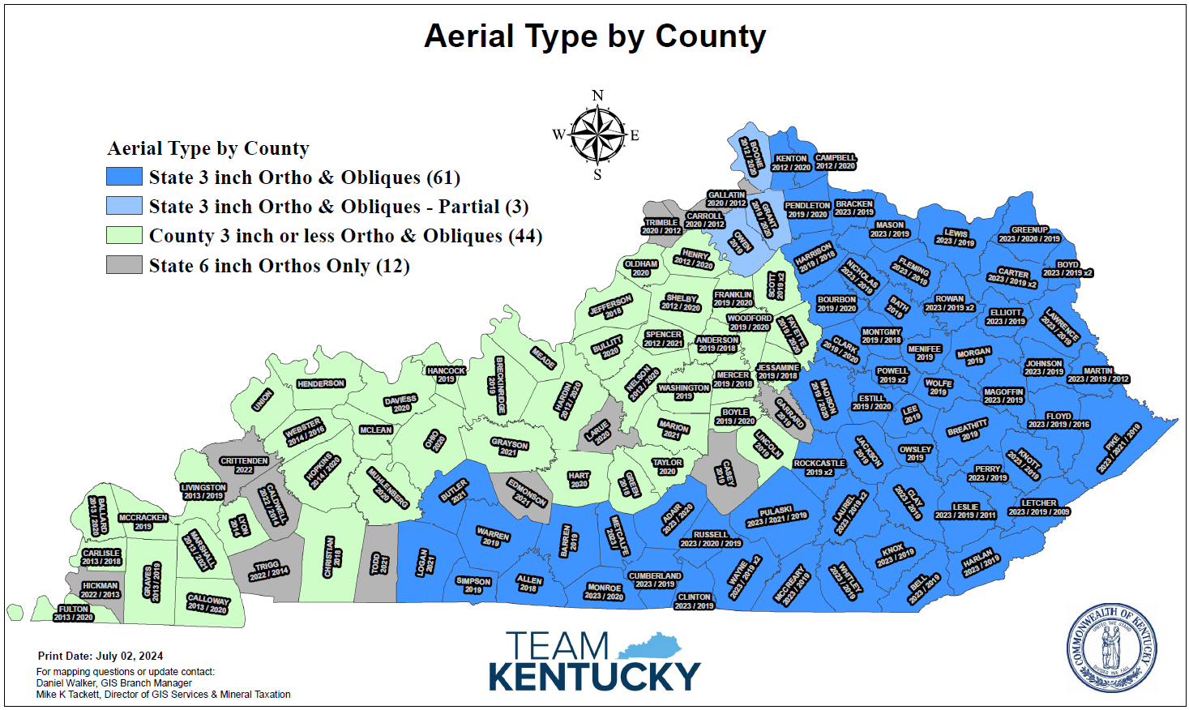
Aerial Types by County
The Commonwealth has received the first year of three-inch ortho and oblique
aerials. Thirty-eight counties have been fully captured and four have been partially captured.
The plan in 2024 is to capture the remaining counties. Weather will be the determining factor on the completion date.
Obliques are useful finding new structures and measuring additions on existing structures. Twenty-One Counties have obliques to work with for the first time. Some eastern counties have already reported finding new property using the oblique viewer provided by the state.

Slide 4
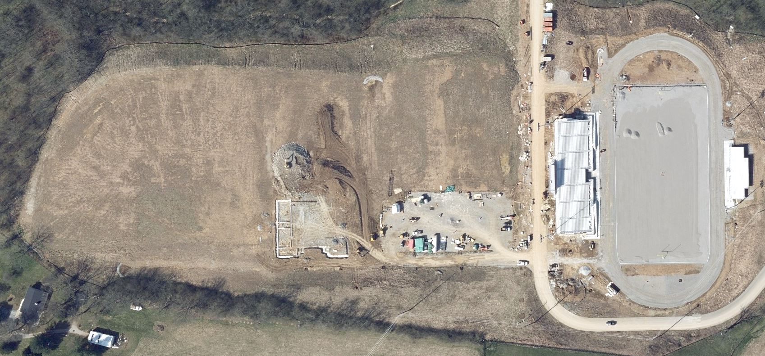
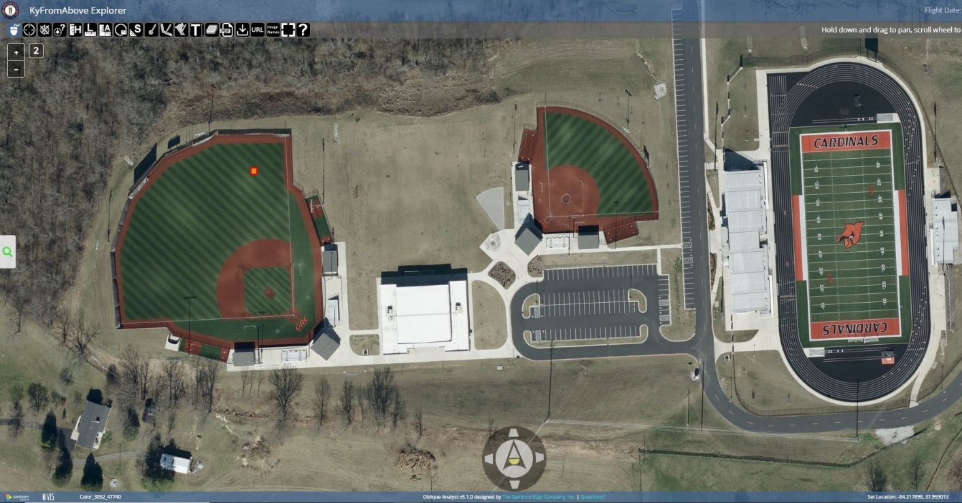
Aerial Types by County
Find new property with better ortho and oblique aerials
Get oblique views from behind locked gates.
Get multiple oblique views to see through trees to find missing structures.
Aerials of new subdivisions
2019 State 3 inch Ortho
2023 State 3 inch Ortho
Oblique aerial imagery enables assessors to view properties and structures remotely, detect changes, and calculate values more quickly than with traditional site visits. Instead of travel cost for sending assessors into the field, aerial imagery brings the world to the assessors. This allows for accurate property assessments right from their office desk.

Slide 5
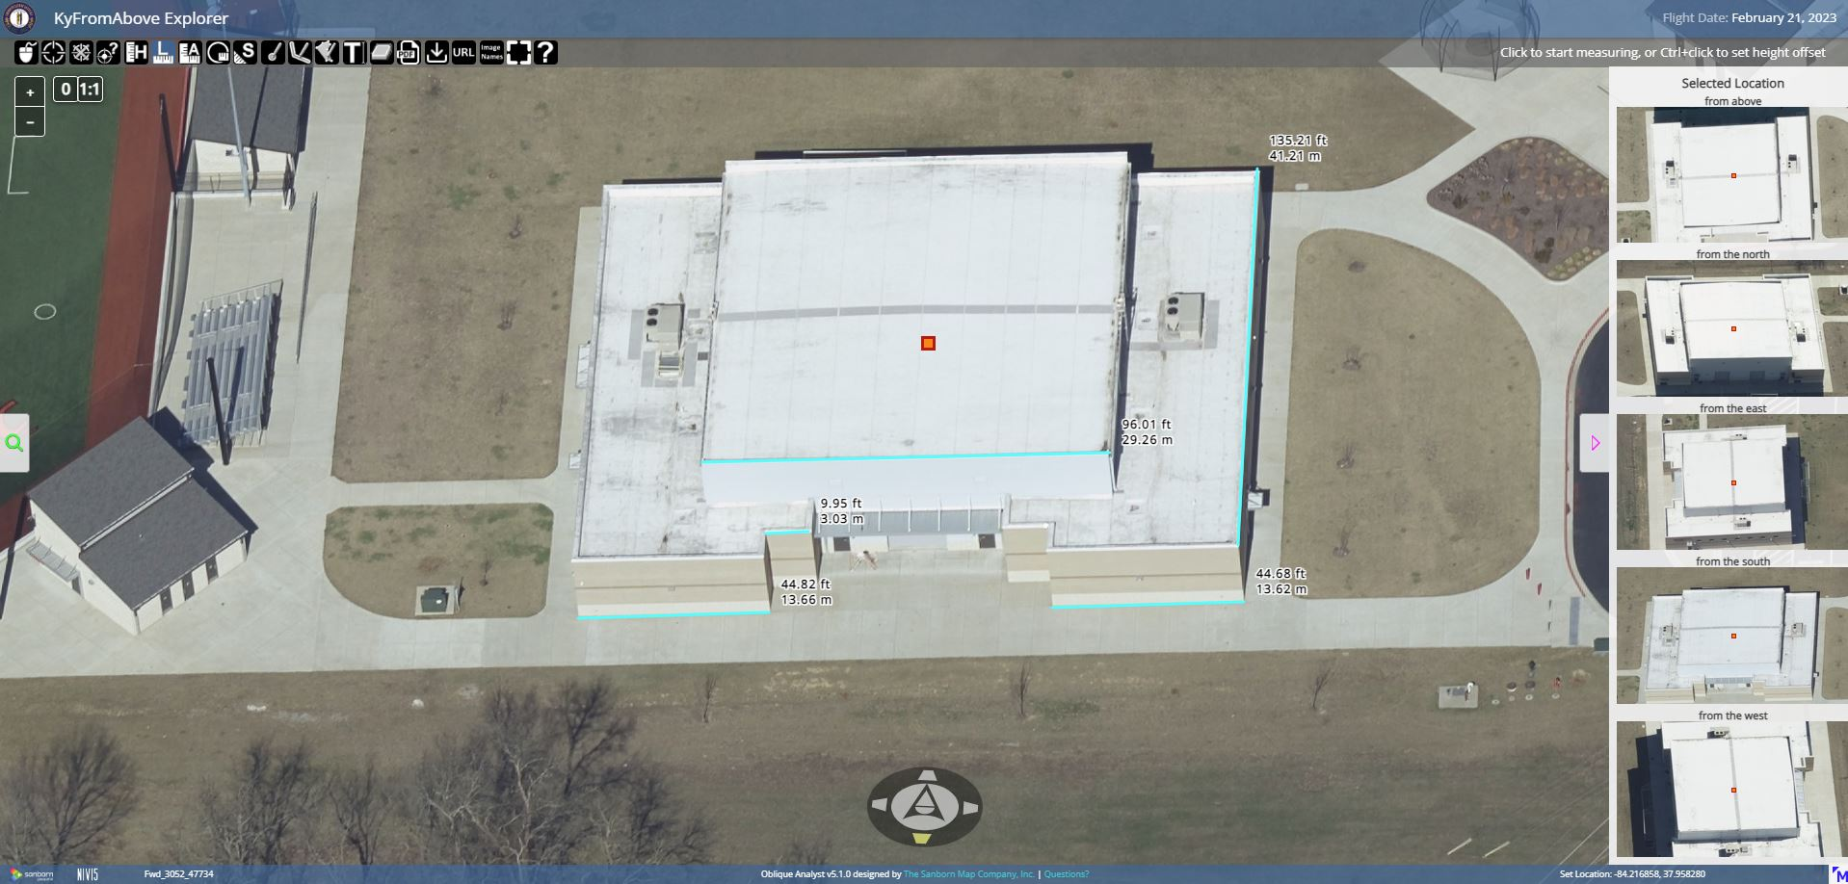
Aerial Types by County
PVAs can use the website toolbar to measure length, area, or height on any structure and use the site locations on right to rotate the structure to measure each side in the viewer.

Slide 6
How to Start fixing Sketches in ArcGIS
Vender converts Apex, Rapid Sketch, GeoSketch sketches into SHP or GDB
Load converted Sketch file from vendor (esri) in ArcGIS
Load Parcels, 911 Address Points and EagleView Aerials in ArcGIS. (Aerial should be the latest available)
A second set of Aerials may be needed, preferably from KY from Above
  If not, an older EagleView, Geomni, or Sandborn Aerial
  This is only for buildings with aerial photography errors
  Stay with EagleView Aerial for most or all Georeferencing
Build a new Custom Toolbar and name it Sketch Toolbar
  Add the following tools: Edit Tool, Rotate, Identify, Zoom In, Save Edits, Mirror, Clear Selection & Pan
Rotate / Geo-Reference sketch drawings over aerials at a no more than 1 inch = 17 ft. scale

Slide 7
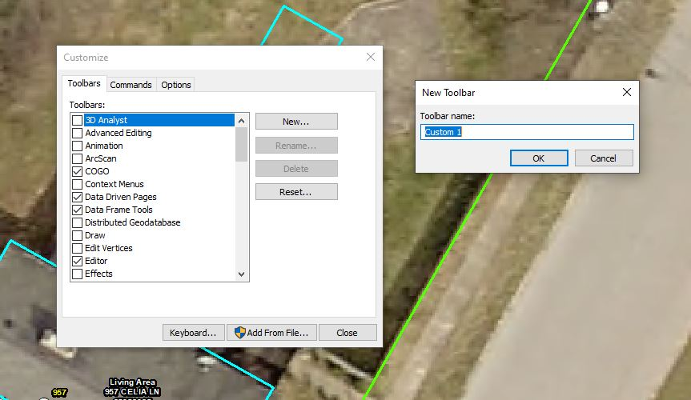
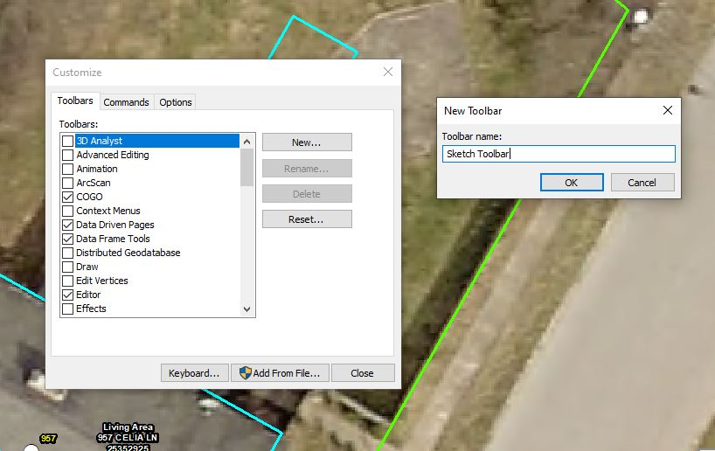
How to Start Fixing Sketches in ArcGIS
How to Create the Sketch Toolbar
1) Double click in the “ArcGIS GUI” (top of screen in grey), this will bring up the “Customize” box.
2) Next, click the “New” button, then name the toolbar ”Sketch Toolbar”
& click “OK” button.

Slide 8
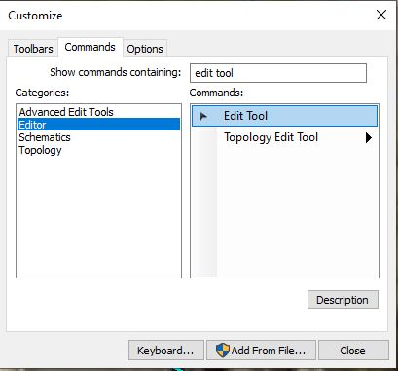

How to Start Fixing Sketches in ArcGIS
Click the “Commands” tab after creating a blank toolbar
In the “Show commands containing” field, type in the name of the tool
Example: Edit Tool
Left mouse click on the “Edit” tool, hold, and drag the edit tool icon to the new toolbar. Continue with the “Rotate, Identify, Zoom In, Save Edits, Mirror, Clear Selection, and Pan” Tools.

Slide 9
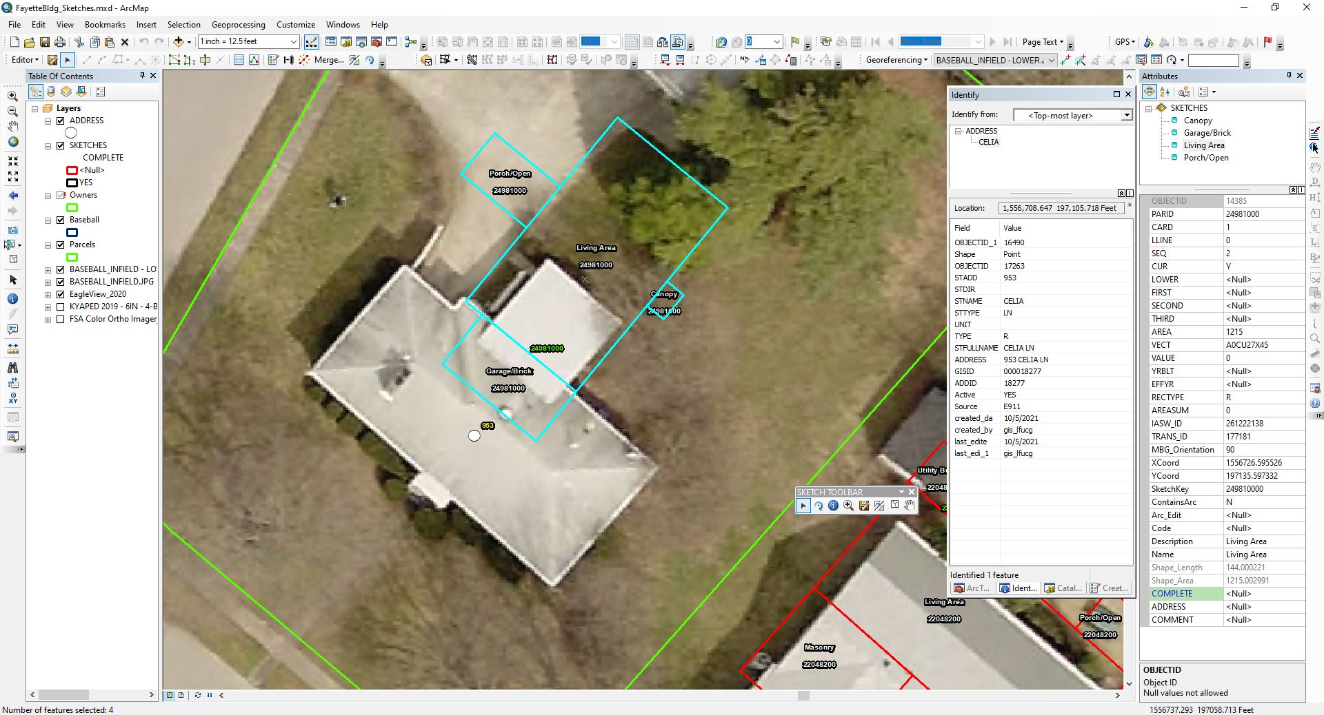
SELECT ALL STRUCTURE POLYGONS WITH THE EDIT TOOL, LEFT MOUSE CLICK AND DRAG BOX AROUND ALL ASSOCIATED POLYGONS
2
1

Slide 10
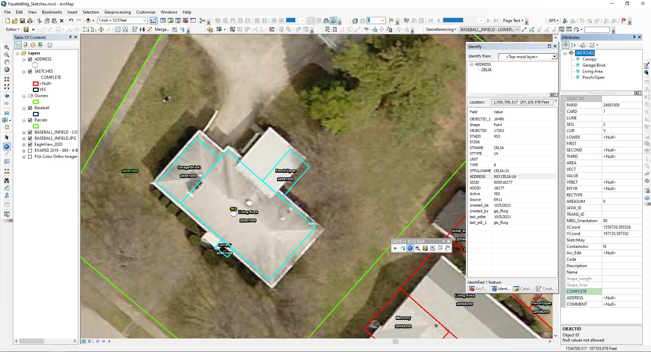
ROTATE ALL POLYGONS ASSOCIATED WITH STRUCTURE TO MATCH THE AERIALS
2
1

Slide 11
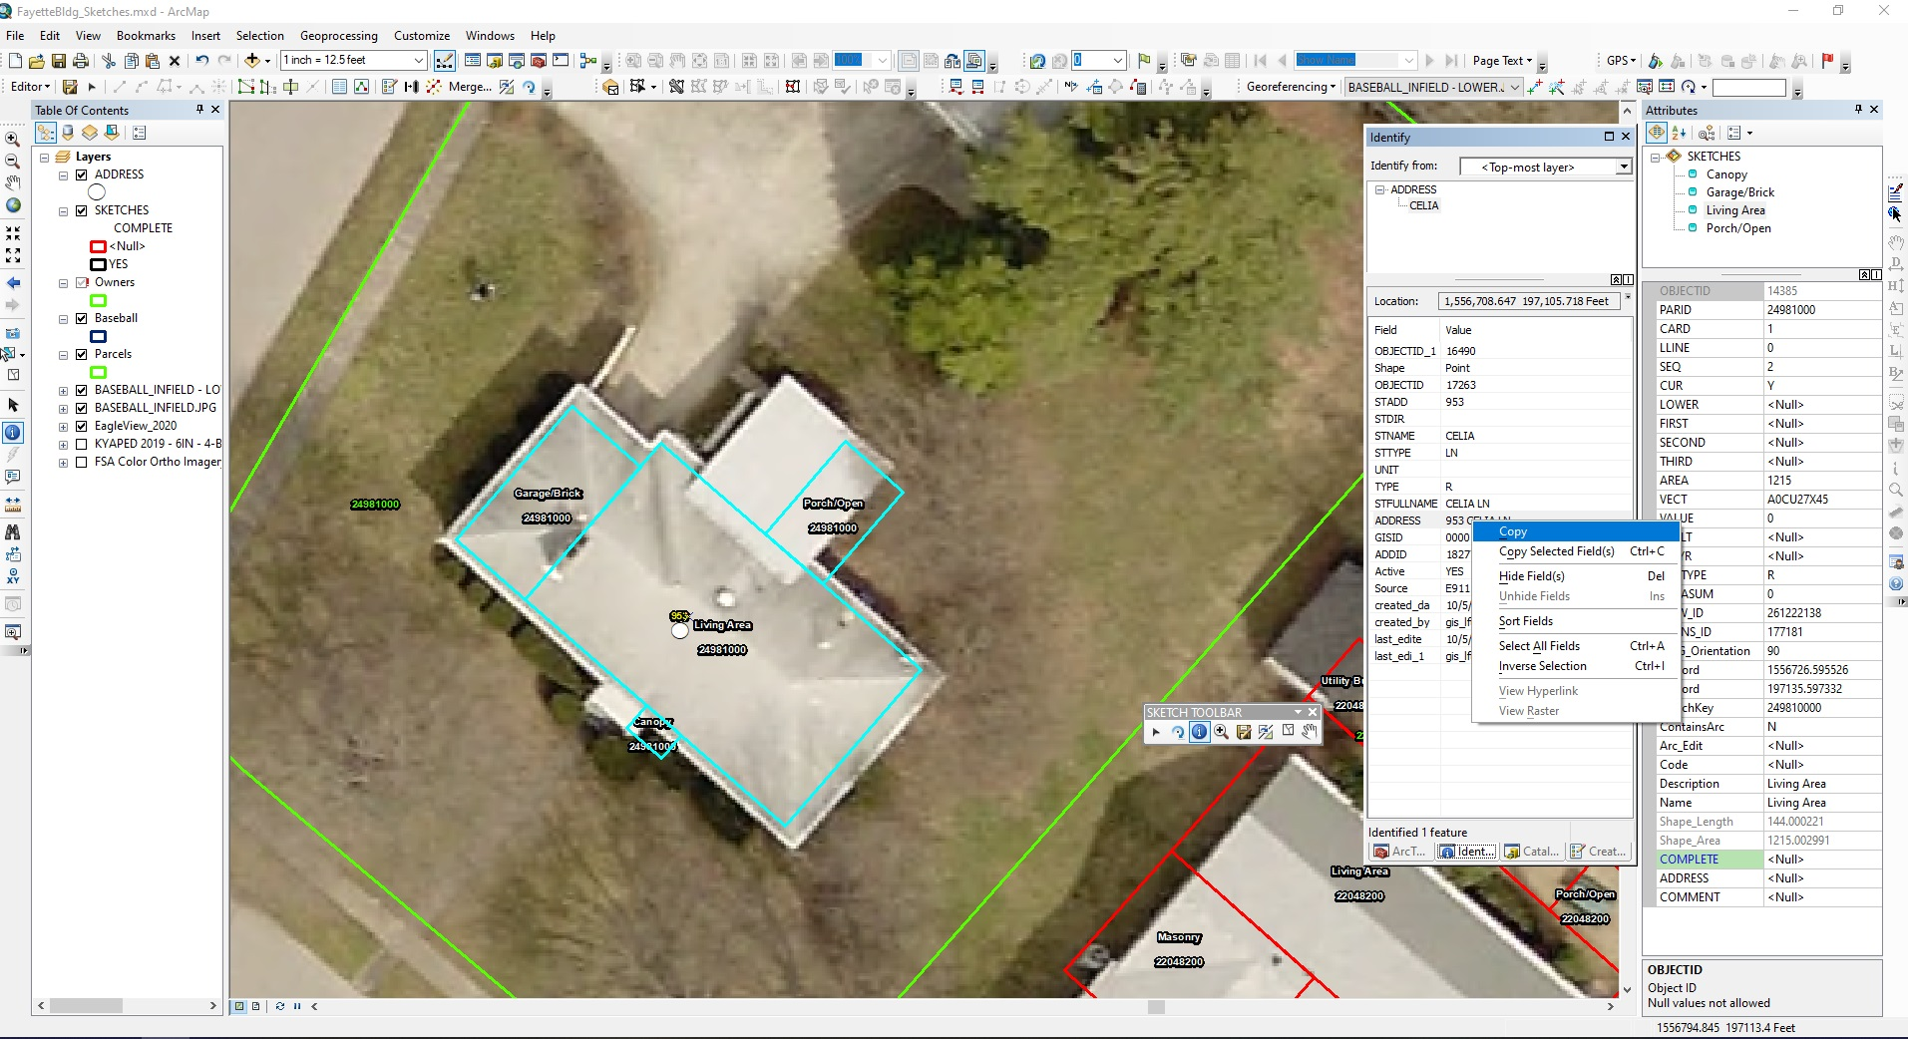
IDENTIFY THE ADDRESS POINT AND COPY THE ADDRESS AND PASTE IN THE ADDRESS FIELD OF THE STRUCTURE SKETCH
3
1
4
2
YES for Complete
Paste Address

Slide 12
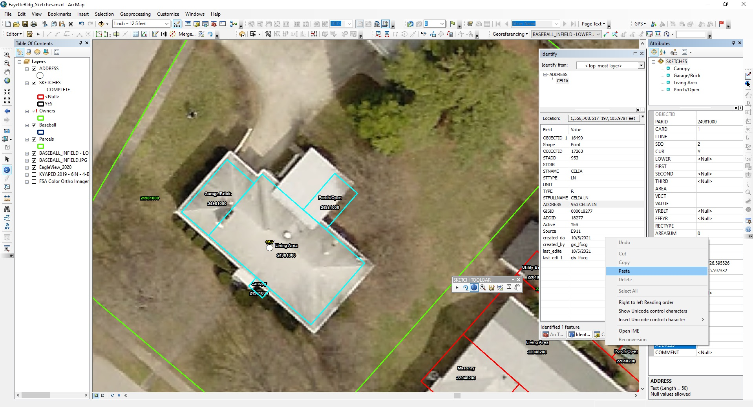
HOW TO PASTE INTO COMMENT FIELD
-RIGHT CLICK & PASTE IN ATTRIBUTE FIELD
-LEFT CLICK & CLICK CTRL BUTTON & V TO PASTE
HOW TO PASTE INTO COMMENT FIELD
-RIGHT CLICK & PASTE IN ATTRIBUTE FIELD
-LEFT CLICK IN FIELD, HOLD CTRL & V BUTTONS TO PASTE
2
1

Slide 13
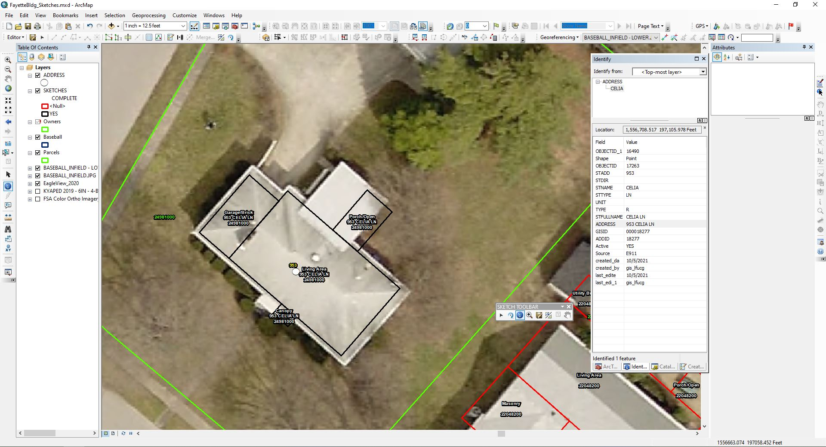
WHEN COMPLETE, THE SKETCH OUTLINE WILL TURN BLACK FROM RED AND THE ADDRESS WILL BE DISPLAYED ON STRUCTURE POLYGONS

Slide 14
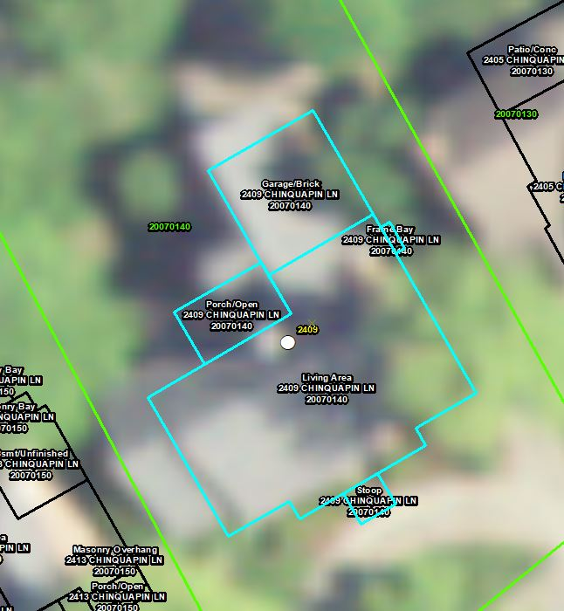
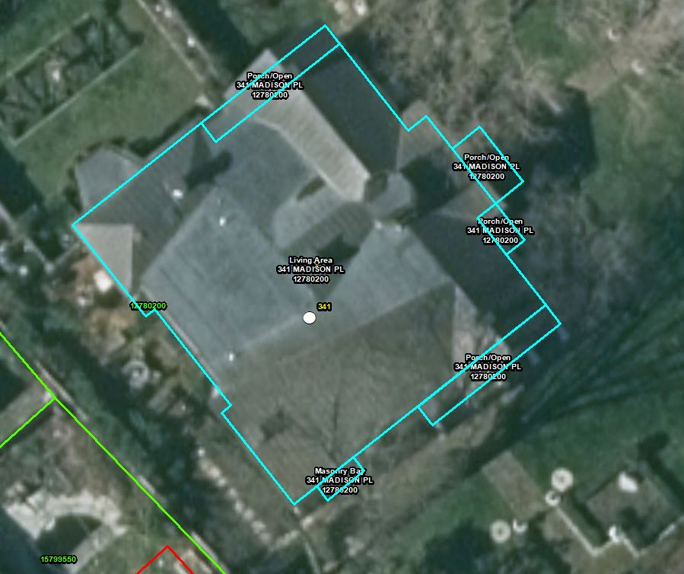
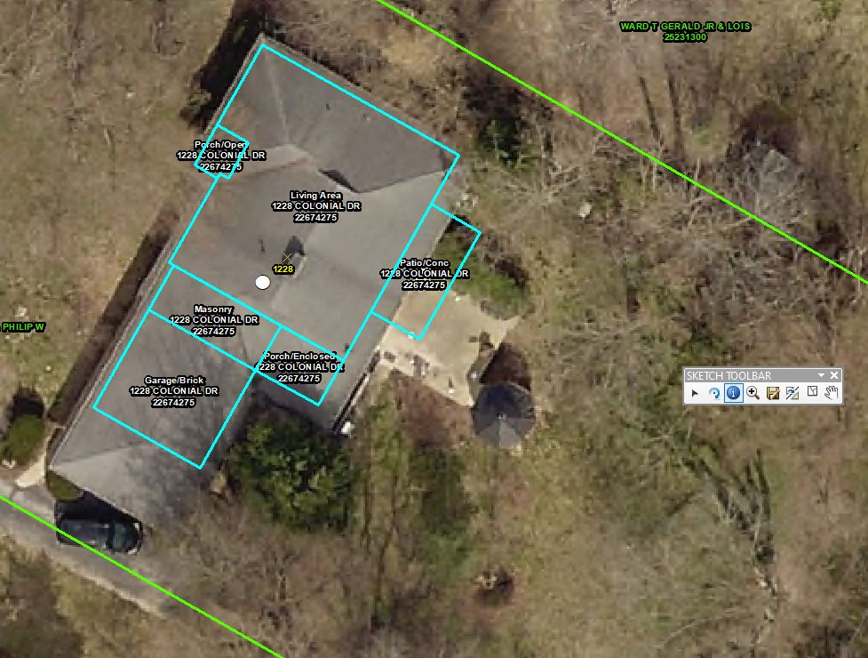
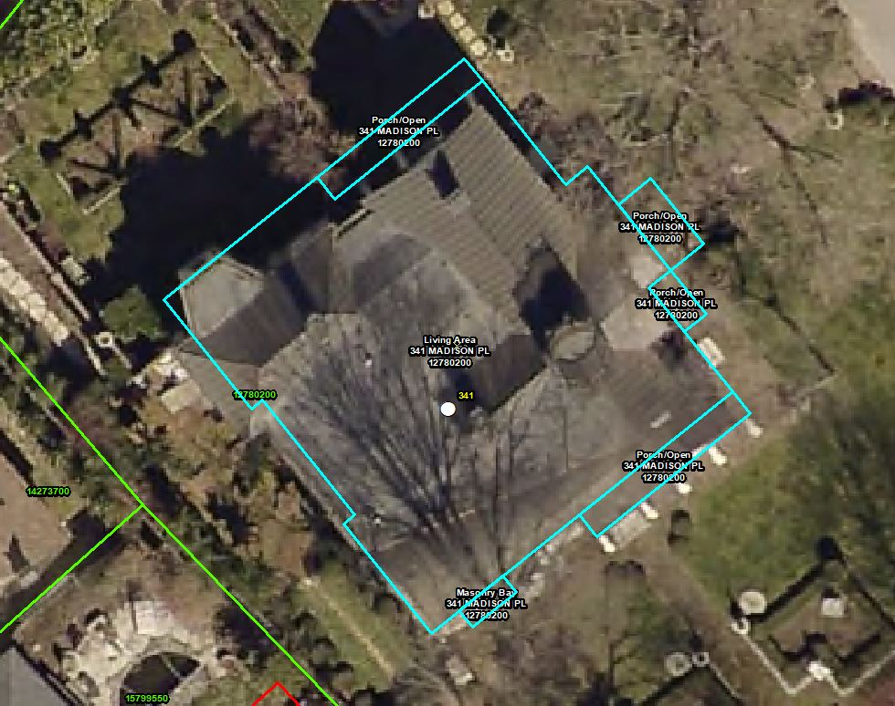
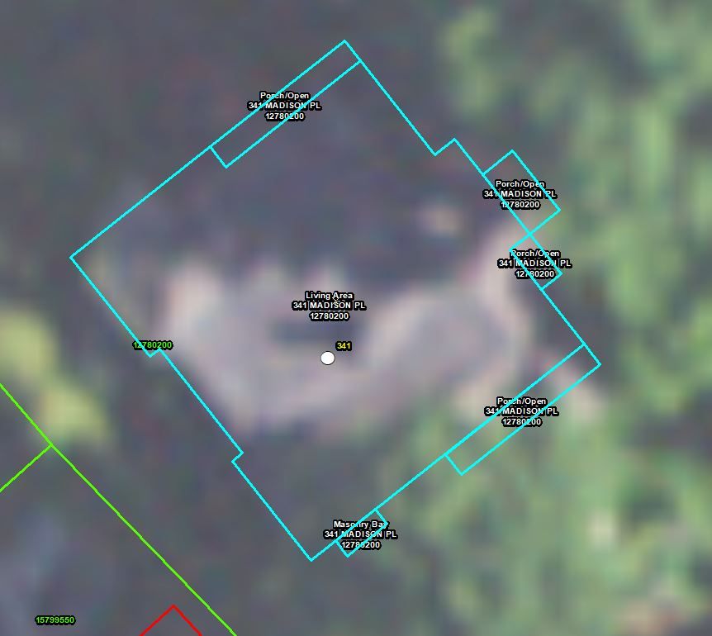
HOW AERIAL RESOLUTION CAN MAKE A DIFFERENCE

Slide 15
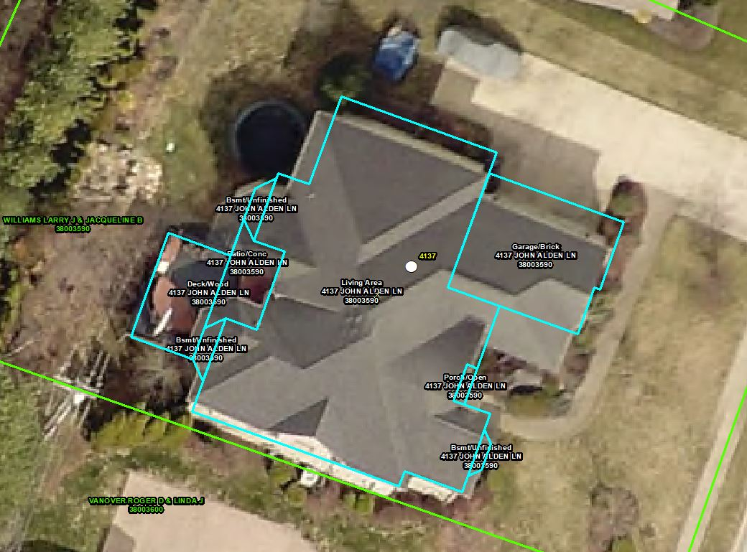
SOME ERRORS ARE IN THE AERIALS, WATCH DAREN’S PRESENATION TO HELP KY FROM ABOVE FIND ERRORS IN 21 NEW COUNTIES

Slide 16
USE THE LATEST AERIAL TO GEOREFERENCE (FIT) SKETCHES IN GIS
1
2
3
1 - 2 FT PIXELS
2 - 6 INCH PIXELS *
3 - 3 INCH PIXELS

Slide 17
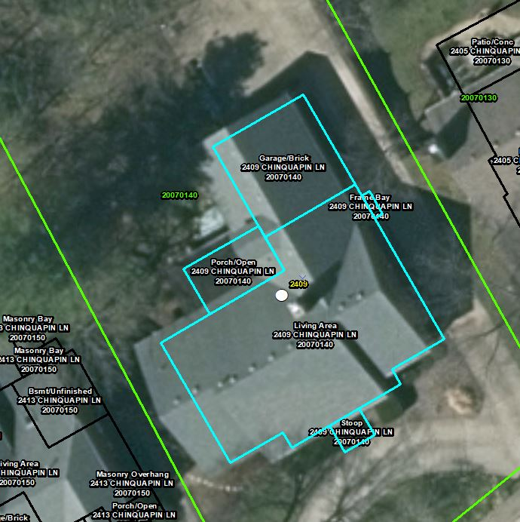
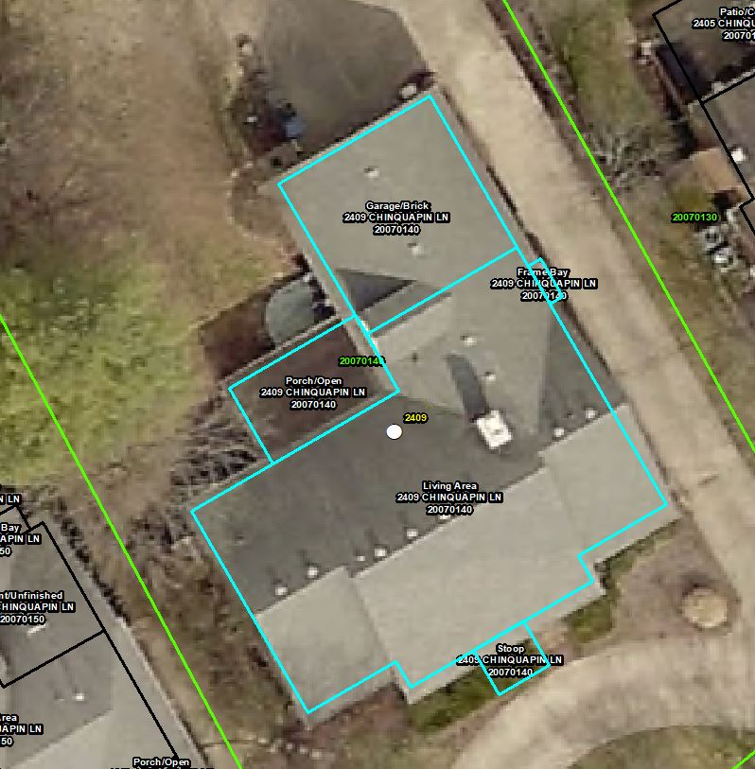
USE THE LATEST AERIAL TO FIT (GEOREFERENCE) SKETCHES IN GIS
1
2
3
1 - 2 FT PIXELS
2 - 6 INCH PIXELS
3 - 3 INCH PIXELS

Slide 18
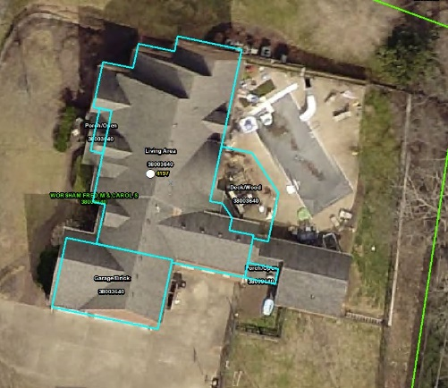
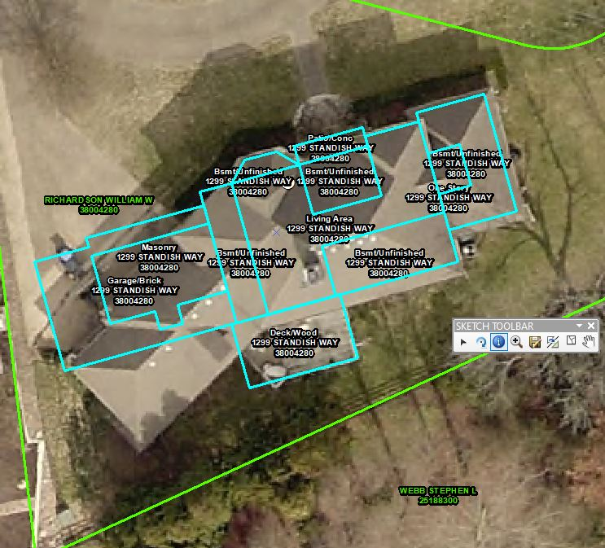
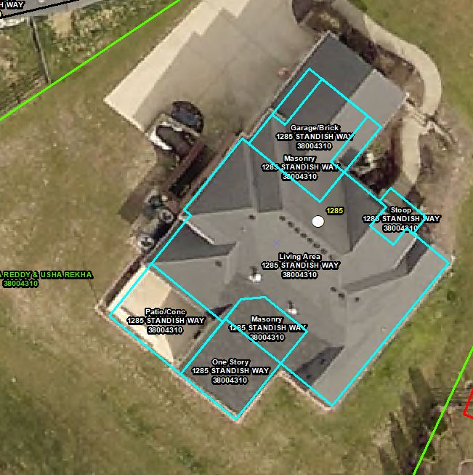

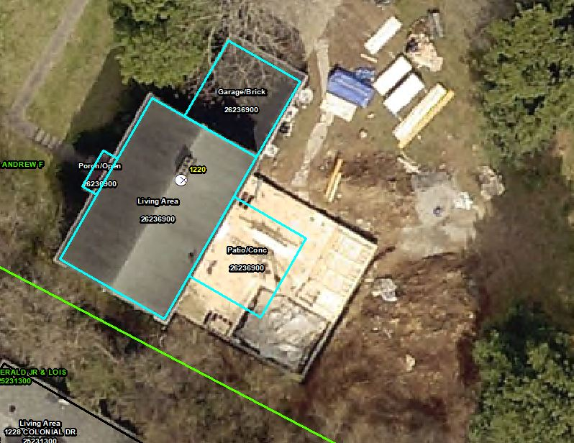
HOW CONVERTING SKETCHES TO GIS HELPS FIX ERRORS

Slide 19
MISMEASURED STRUCTURES CAN BE DISCOVERED & CORRECTED

Slide 20
BAD ANGLE ON SKETCH

Slide 21
NEW PORCH ADDITION

Slide 22
GARAGE EXPANDED & NEW PATIO

Slide 23
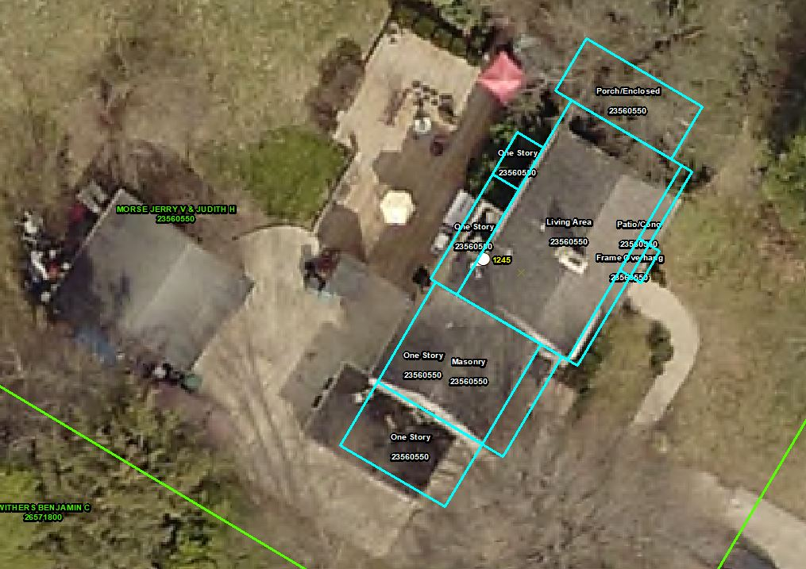
NEW OR MISSED DETACHED GARAGE& NEW DECK

Slide 24
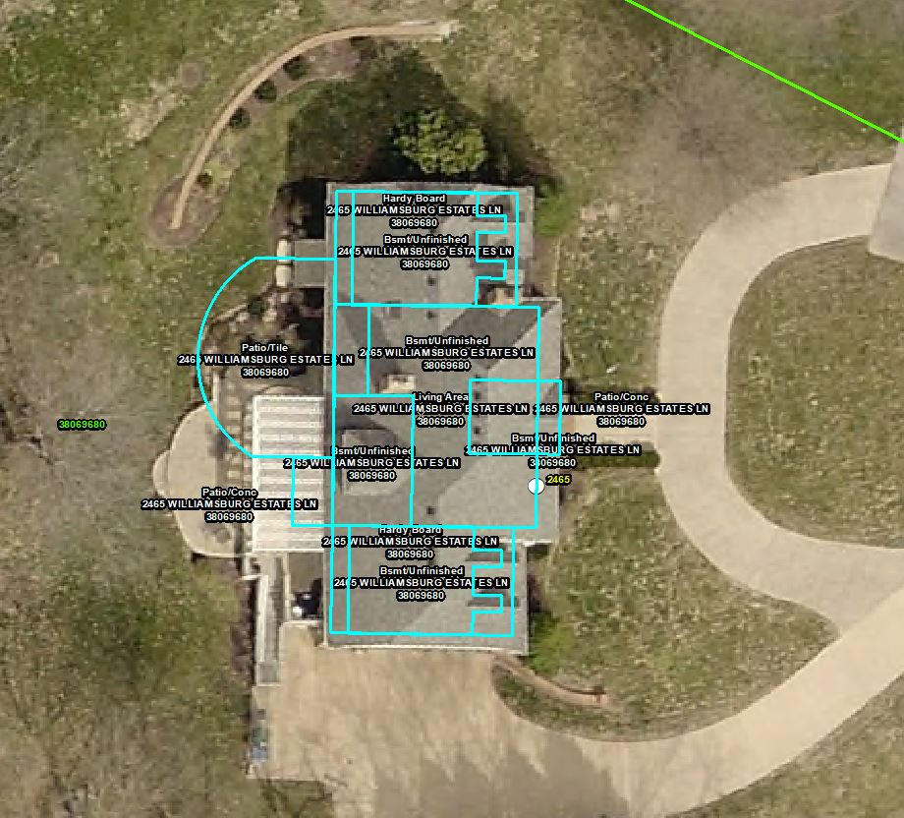
MINOR ERRORS CAN BE FIXED
EXAMPLE:
BACKPORCH
&
COVERED BACK PORCH

Slide 25

NEW POOL HOUSE ADDITION, POOL, & PATIO

Slide 26
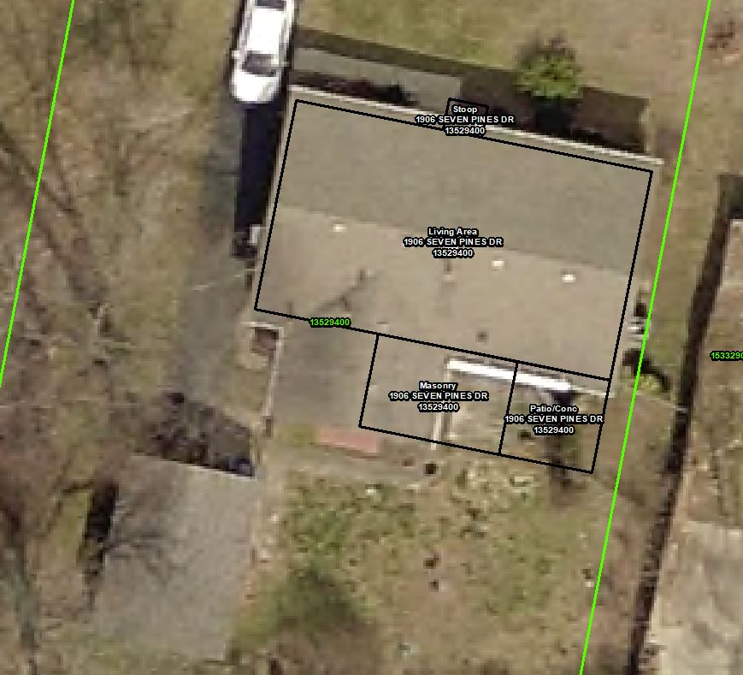
USE THE MIRROR TOOL TO FIX SKETCH IN GIS

Slide 27
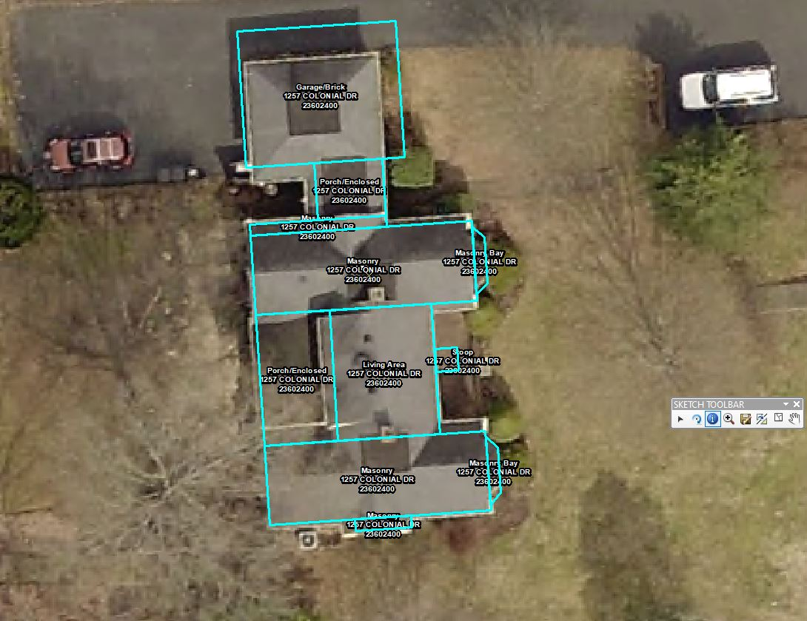
FINDING MISS MEASURED AREAS

Slide 28
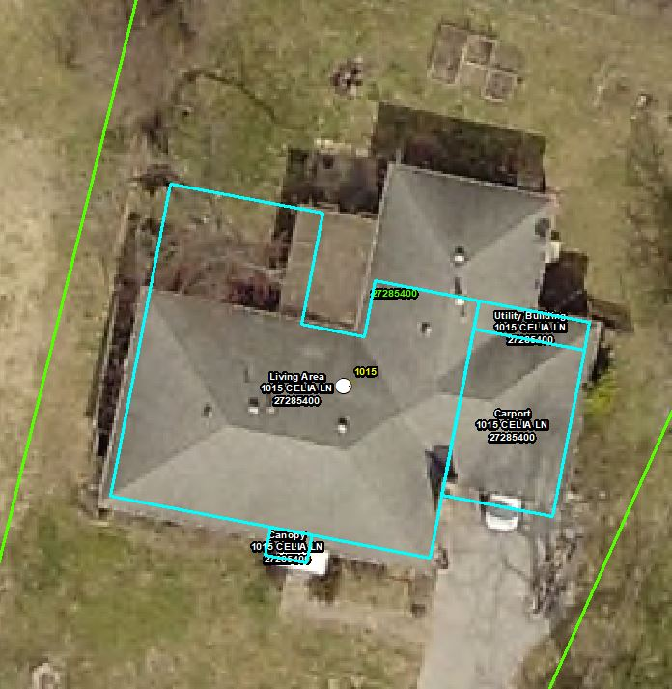
MANUALLY FIX ERRORS USING THE NEW POLYGON AND RIGHT-ANGLE TOOL
WING OF HOUSE ON WRONG SIDE

Slide 29
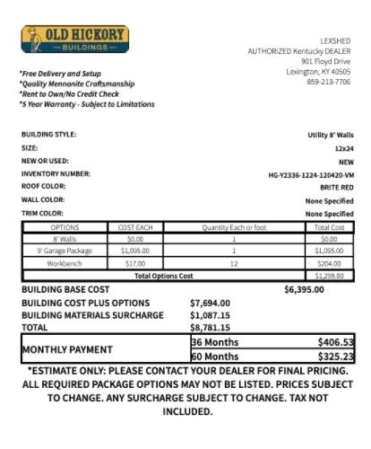
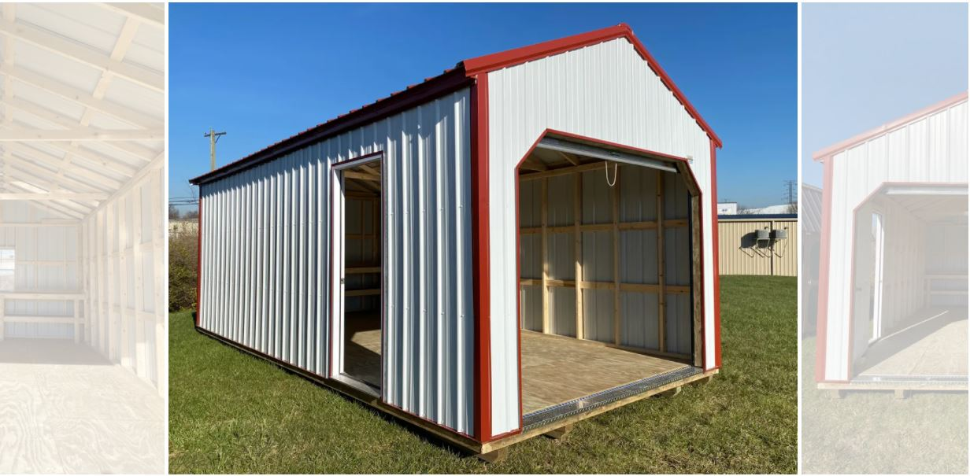
SKETCHING SHEDS, BARNS, DETACHED GARAGES, ETC.

Slide 30
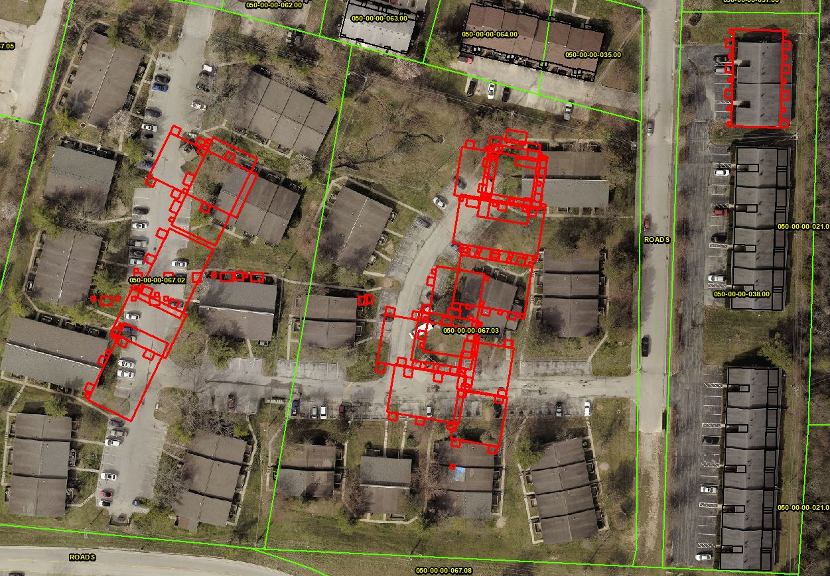
PARCELS WITH MULTIPLE BUILDINGS NEED BUILDING NUMBERS
EXAMPLE:
-APARTMENT COMPLEX
-INDUSTRIAL COMPLEX
-MOBILE HOME PARK
ETC.

Slide 31
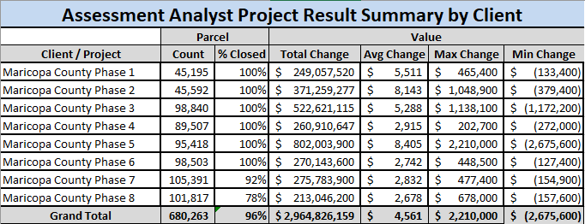
FINDINGS IN MARICOPA COUNTY, ARIZONA
680,263 properties equal a net value change of $2,964,826,159
NEARLY $3 BILLION

Slide 32
FINDINGS IN MARICOPA COUNTY, ARIZONA
Client/ Project | Parcel Count | Values
 |  | Total Change | Avg Change | Max Change | Min Change
Maricopa County Phase 1 | 45,195 | $249,057,520 | $5,511 | $465,400 | $(133,400)
Maricopa County Phase 2 | 45,592 | $371,259,277 | $8,143 | $1,048,900 | $(379,400)
Maricopa County Phase 3 | 98,840 | $522,621,115 | $5,288 | $1,138,100 | $(1,172,200)
Maricopa County Phase 4 | 54,224 | $152,530,400 | $2,813 | $ 202,700 | $(149,400)
Fulton County Phase 1 | 19,273 | $33,818,900 | $1,755 | $1,202,900 | -
Maui County Phase 1 | 4,717 | $29,038,298 | $6,156 | $360,721 | $(266,189)
Maui County Phase 2 | 1,268 | $20,771,015 | $16,381 | $1,683,558 | $(2,766,808)
Kauai County Phase 1 | 2,915 | $32,631,141 | $11,194 | $242,139 | $ (355,044)
Bernalillo County Phase 1
Grand Total | 272,024 | $1,411,727,666 | $5,190 | $1,683,558 | $ (2,766,808)
Over $1,411,727,666 in new assessed value created using Assessment Analysis

Slide 33


Kentucky Sketch Conversion Project
Mike Tackett
 Mike.Tackett@ky.gov
 (502) 564-7220
David Gordon
 David.Gordon@ky.gov
 (502) 564-7179
The information in this presentation is for educational and informational purposes only and does not constitute legal advice. Information is presented as an overall review that is subject to law changes and may not apply to all states. For accurate information on issues related to State Real Property Tax Rate, please reference KRS 132.020.
Information in this presentation is believed to be accurate as of the date of publication. In the event that any information in this presentation is later determined to be in error, this presentation cannot be used by taxpayers in supporting a specific position or issue before the Department of Revenue, as it does not have the statutory or regulatory authority.
Kentucky Department of Revenue • 501 High Street • Frankfort, KY 40601 • (502) 564-8338

