Slide 1


2025 Fall Conference
Education Program Workshop
Kentucky Department of Revenue • 501 High Street • Frankfort, KY 40601 • (502) 564-8338

Slide 2


*the statute was
Education Information
For Information regarding the Education Program:
Tracey Bonzo,
Revenue Branch Manager
Local Officials Compliance Branch
Department of Revenue
TraceyL.Bonzo@ky.gov
502-564-7177

Slide 3
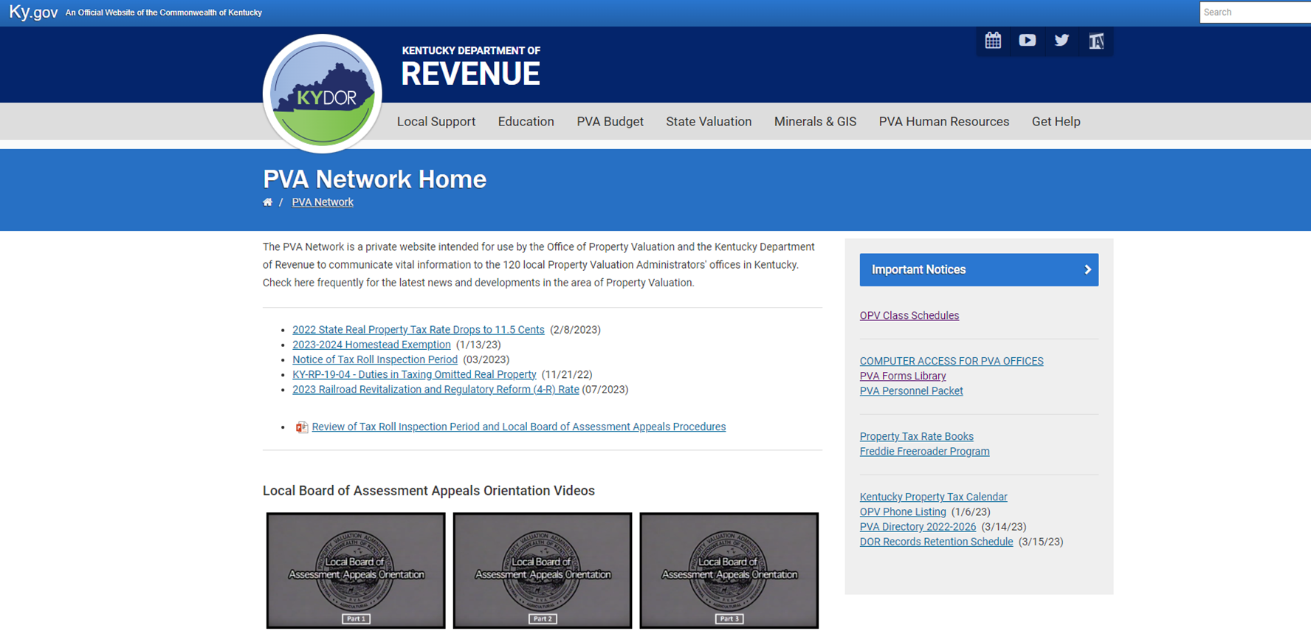
*the statute was
http://revenue.ky.gov/PVANetwork/

Slide 4
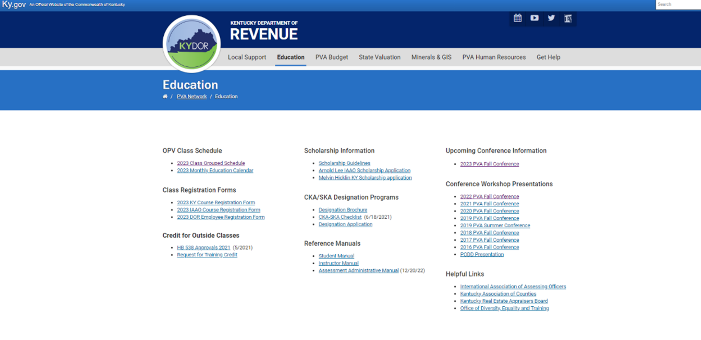
*the statute was
Education Tab

Slide 5
Statutory Education Requirements
1. KRS 132.597 - Expense Allowance Program
30 hours (15 with SKA) per calendar year
Hours in excess of 30 cannot be carried over to subsequent calendar years

Slide 6
Statutory Education Requirements
House Bill 538 – Training Incentive Program
40 hours per calendar year
Lump Sum payment adjusted annually
Check is issued the month following completion of hours
Hours in excess of 40 can be carried over to subsequent years
A maximum of 40 hours can be carried over to subsequent years

Slide 7
Statutory Education Requirements
*Hours for both requirements can be earned concurrently*

Slide 8
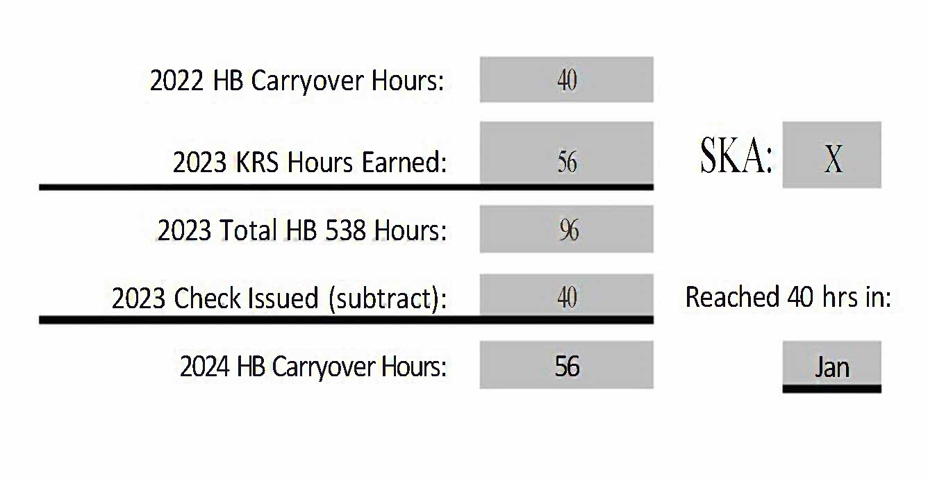
Understanding Your Hours Worksheet

Slide 9
Understanding Your Hours Worksheet

Slide 10
Understanding Your Hours Worksheet

Slide 11
Understanding Your Hours Worksheet

Slide 12
Understanding Your Hours Worksheet

Slide 13
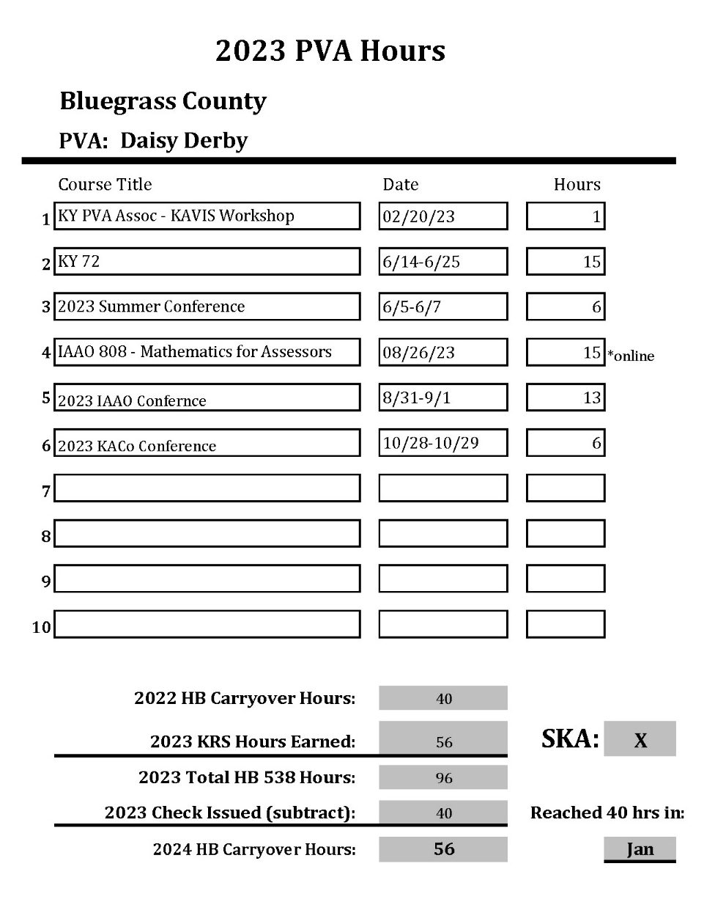
Understanding Your Hours Worksheet
Daisy Derby had 40 hours to carry over from 2022.
This fulfills her HB 538 requirement for 2023. She
would have received her check at the end of February
2023.
Daisy Derby earned 56 hours during 2023. This
fulfills her (15 hours) 2023 expense allowance hours,
since she has her SKA.
Daisey Derby will be able to carry over 40 of her
remaining 56 hours to 2024.
Her remaining 16 hours will roll off.

Slide 14
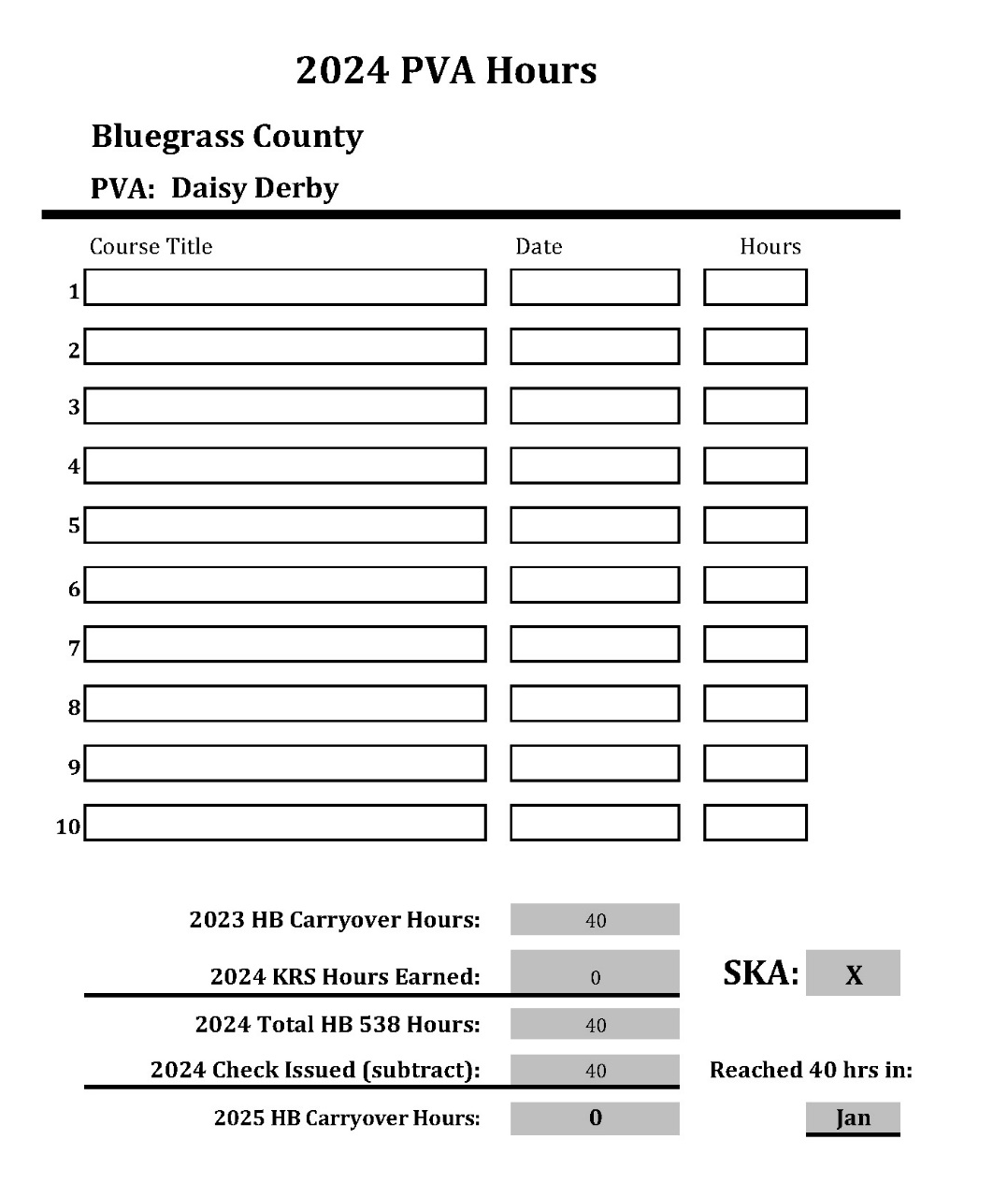
Understanding Your Hours Worksheet
Daisy Derby has already fulfilled her HB 538 requirement for 2024.
She will receive her HB 538 incentive check
at the end of February 2024.
She will need 15 hours to fulfill her Expense
Allowance hours. (SKA)
*If the PVA has not earned their (SKA)
designation, 30 hours are needed*

Slide 15
How Can You Fulfill Your Statutory Education Requirement
Approved Courses
KY Courses
Workshops/Conferences held by DOR
PVA Association Summer Conference
IAAO Courses
KY Office of Diversity, Equality, and Training (ODE&T)
KY Association of Counties (KACo) and Department of Local Government (DLG)
KY Real Estate Appraisal Board (KREAB) and KY Real Estate Commission (KREC)
Online classes offered by and/or approved by IAAO, ODE&T, DLG, KREAB & KREC only
up to 10 hours per calendar year for all PVAs
up to 25 hours per calendar year with a SKA designation

Slide 16
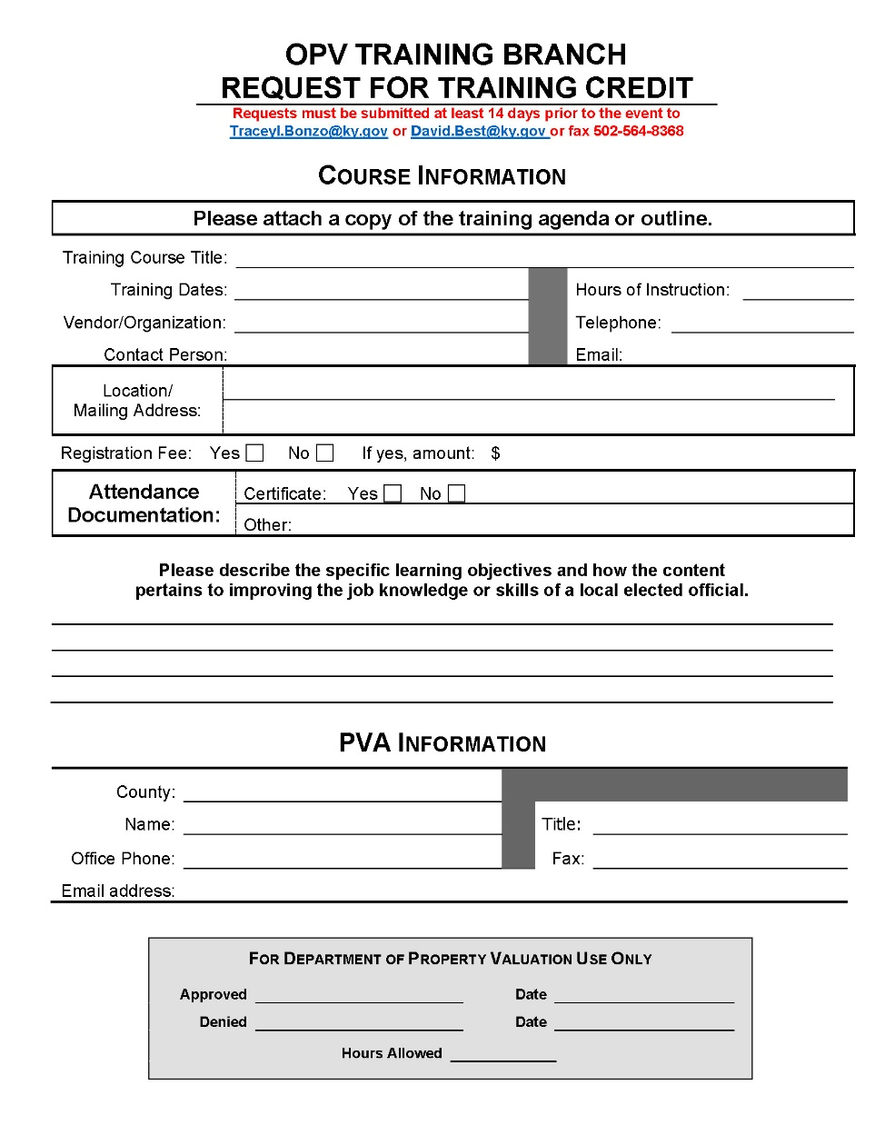
How Can You Fulfill Your Statutory Education Requirement
Outside Training Opportunities
Please submit Request for Training Credit Form
Two Weeks in Advance for Approval

Slide 17
Outside Course Approval Requirements
Relevance to performed duties
Ability of sponsor to verify attendance
Reputation of organization/entity sponsoring the training
Extent of actual training
Availability to all PVAs
Note: If approval is granted for one PVA, it acts as blanket approval for all.

Slide 18
Kentucky Courses
Most KY courses are 15 hours (GIS 68 is 18 hours)
Begin Monday at 1:00
8:30 – 4:15 Tuesday
8:30 – 4:15 Wednesday
8:30 – 11:30 – Test
$50 cost for 15-hour class
3 hours for test
Passing grade is 70% or better
Must attend at least 12 hours of class to take exam

Slide 19
IAAO Courses
Cost
Beginning 2025
$650 for IAAO Members
$750 for Non-Members
Most IAAO Courses are 30 hours
15-hour workshops
7.5-hour workshops
8:00 – 4:30 Mon – Thurs
Test on Friday 8:30 (3 ½ hours)

Slide 20

Kentucky Professional Designation Program
Designations Offered:
Certified Kentucky Assessor (CKA)
Senior Kentucky Assessor (SKA)

Slide 21

Kentucky Professional Designation Program

Slide 22
Kentucky Professional Designation Program
Certified Kentucky Assessor (CKA)
Choose one of the 4 tracks
Real Property Assessment Track
Personal Property Assessment Track
Administrative Track
Mapping Track
3 Years of Experience in Kentucky Property Tax
Assessment Administration

Slide 23
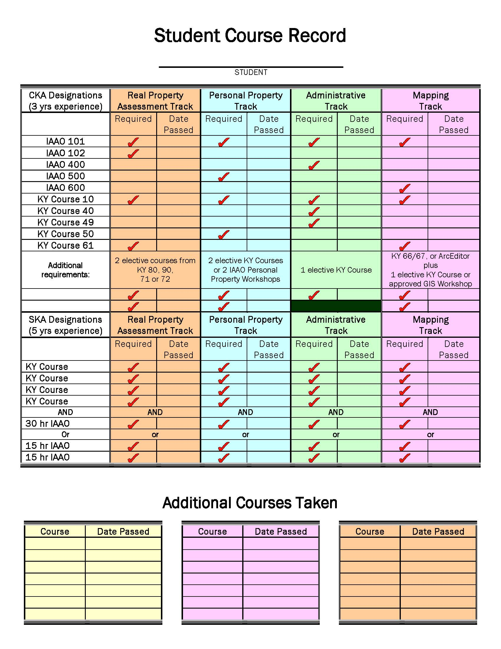
Kentucky Professional Designation Program

Slide 24
Kentucky Professional Designation Program
Senior Kentucky Assessor (SKA)
Must have CKA
4 additional KY courses
1 additional IAAO 30-hour course or 2 IAAO 15-hour courses
Additional 2 years of experience in Kentucky Property Tax Assessment Administration (total of 5 years)

Slide 25
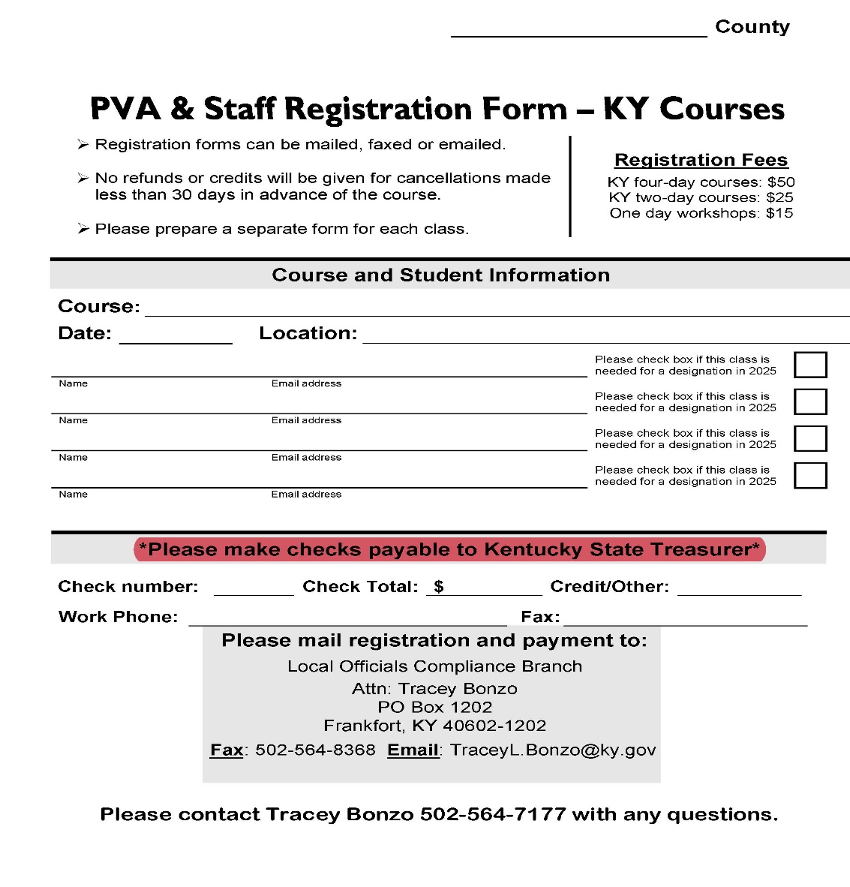
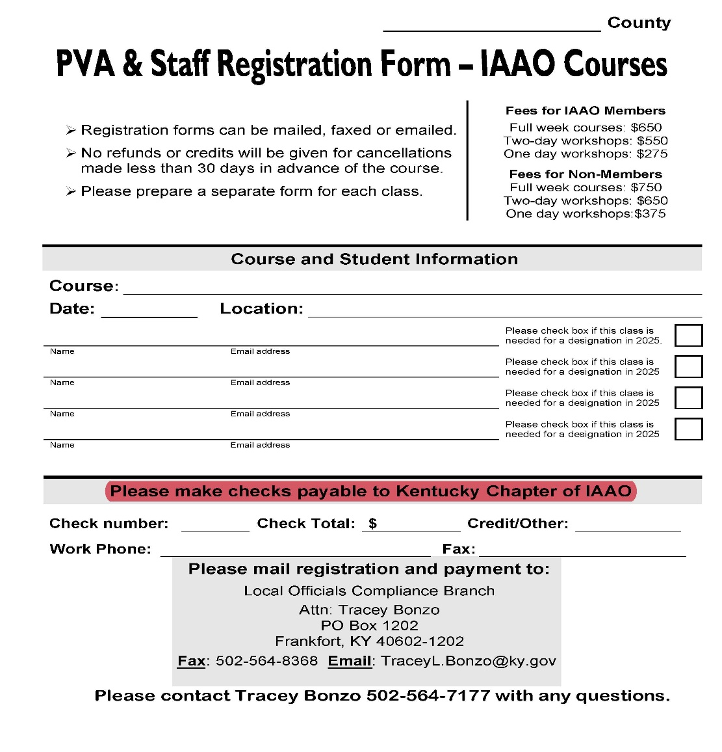
Registration Forms

Slide 26
Payments, Cancellations, and Refunds
*When paying for a Kentucky Course, please make checks payable to
Kentucky State Treasurer.
*When paying for an IAAO Course, please make checks payable to the Kentucky Chapter of IAAO.
Cancellations:
Must be received no less than 30 days prior to the course in order to receive credit/refund.
Refunds:
KY courses - receive class credit (Cancellation Policy applies)
IAAO course – can receive refund for cancellation (Cancellation Policy applies)
Send refund request to Kim Holt

Slide 27
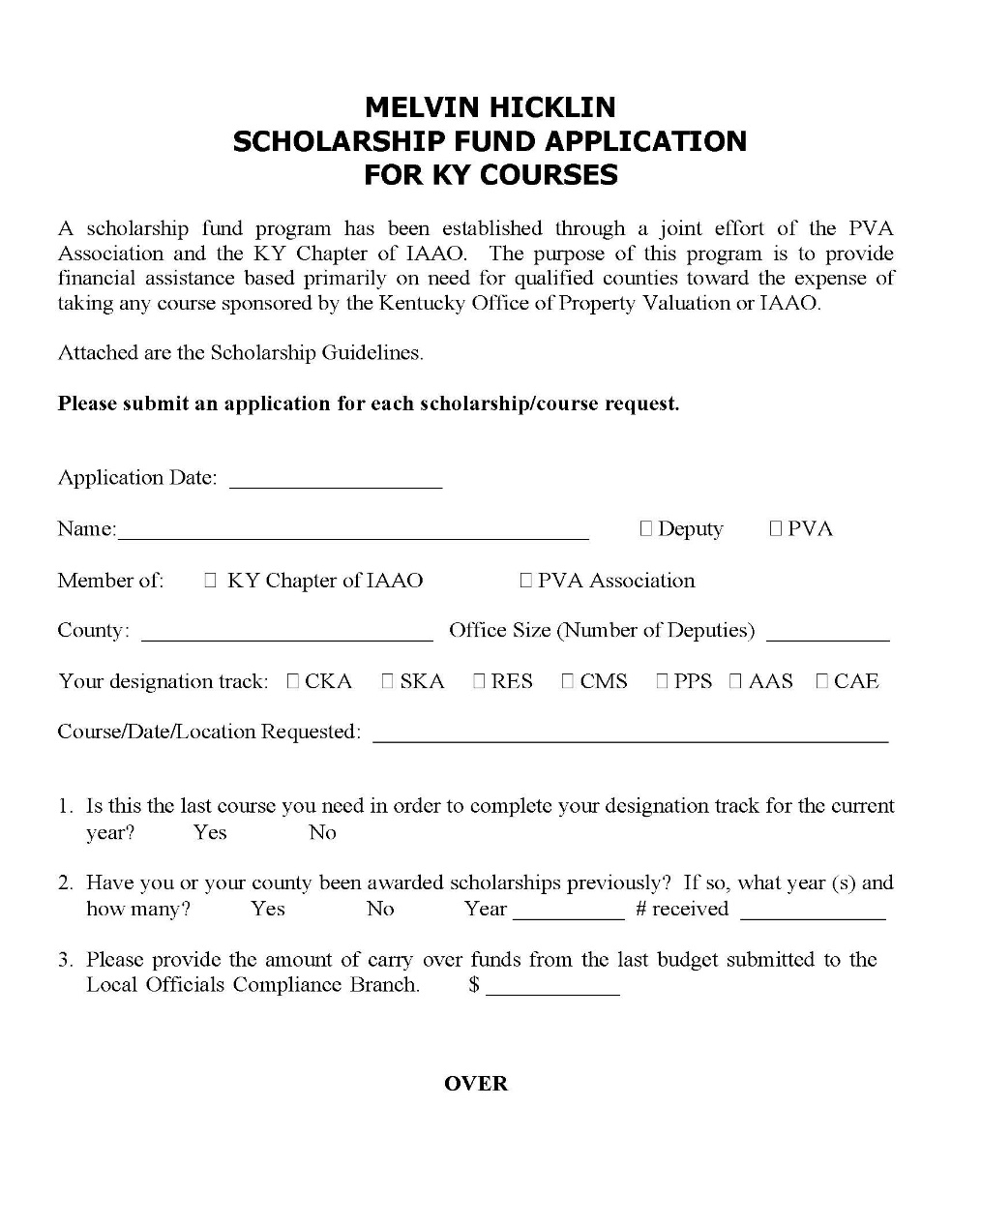
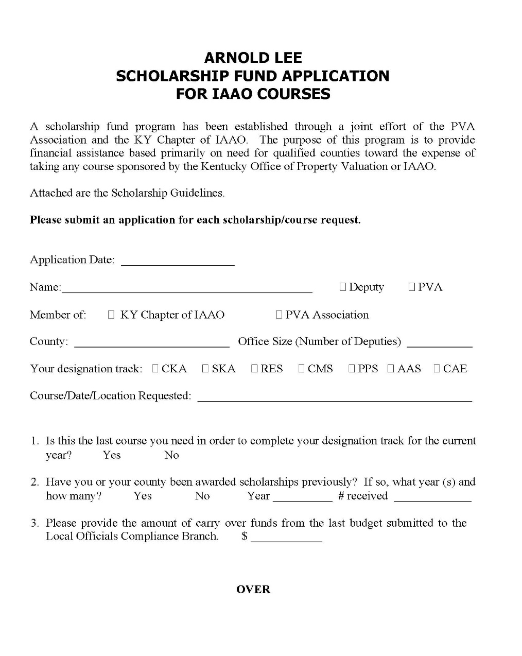
Scholarships

Slide 28
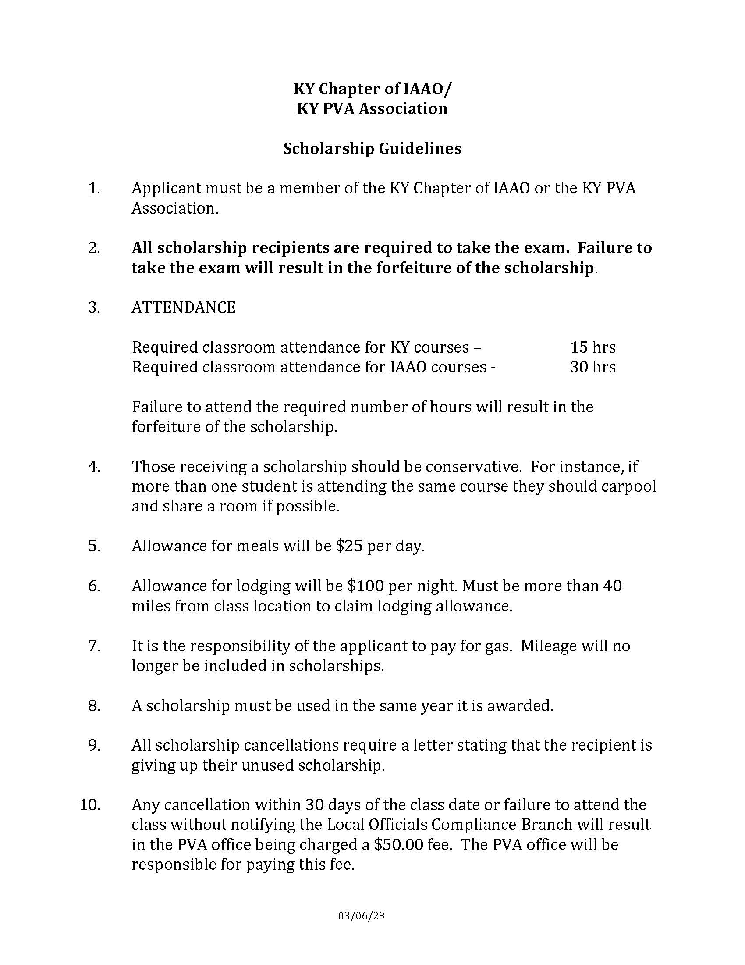
Scholarship Guidelines

Slide 29
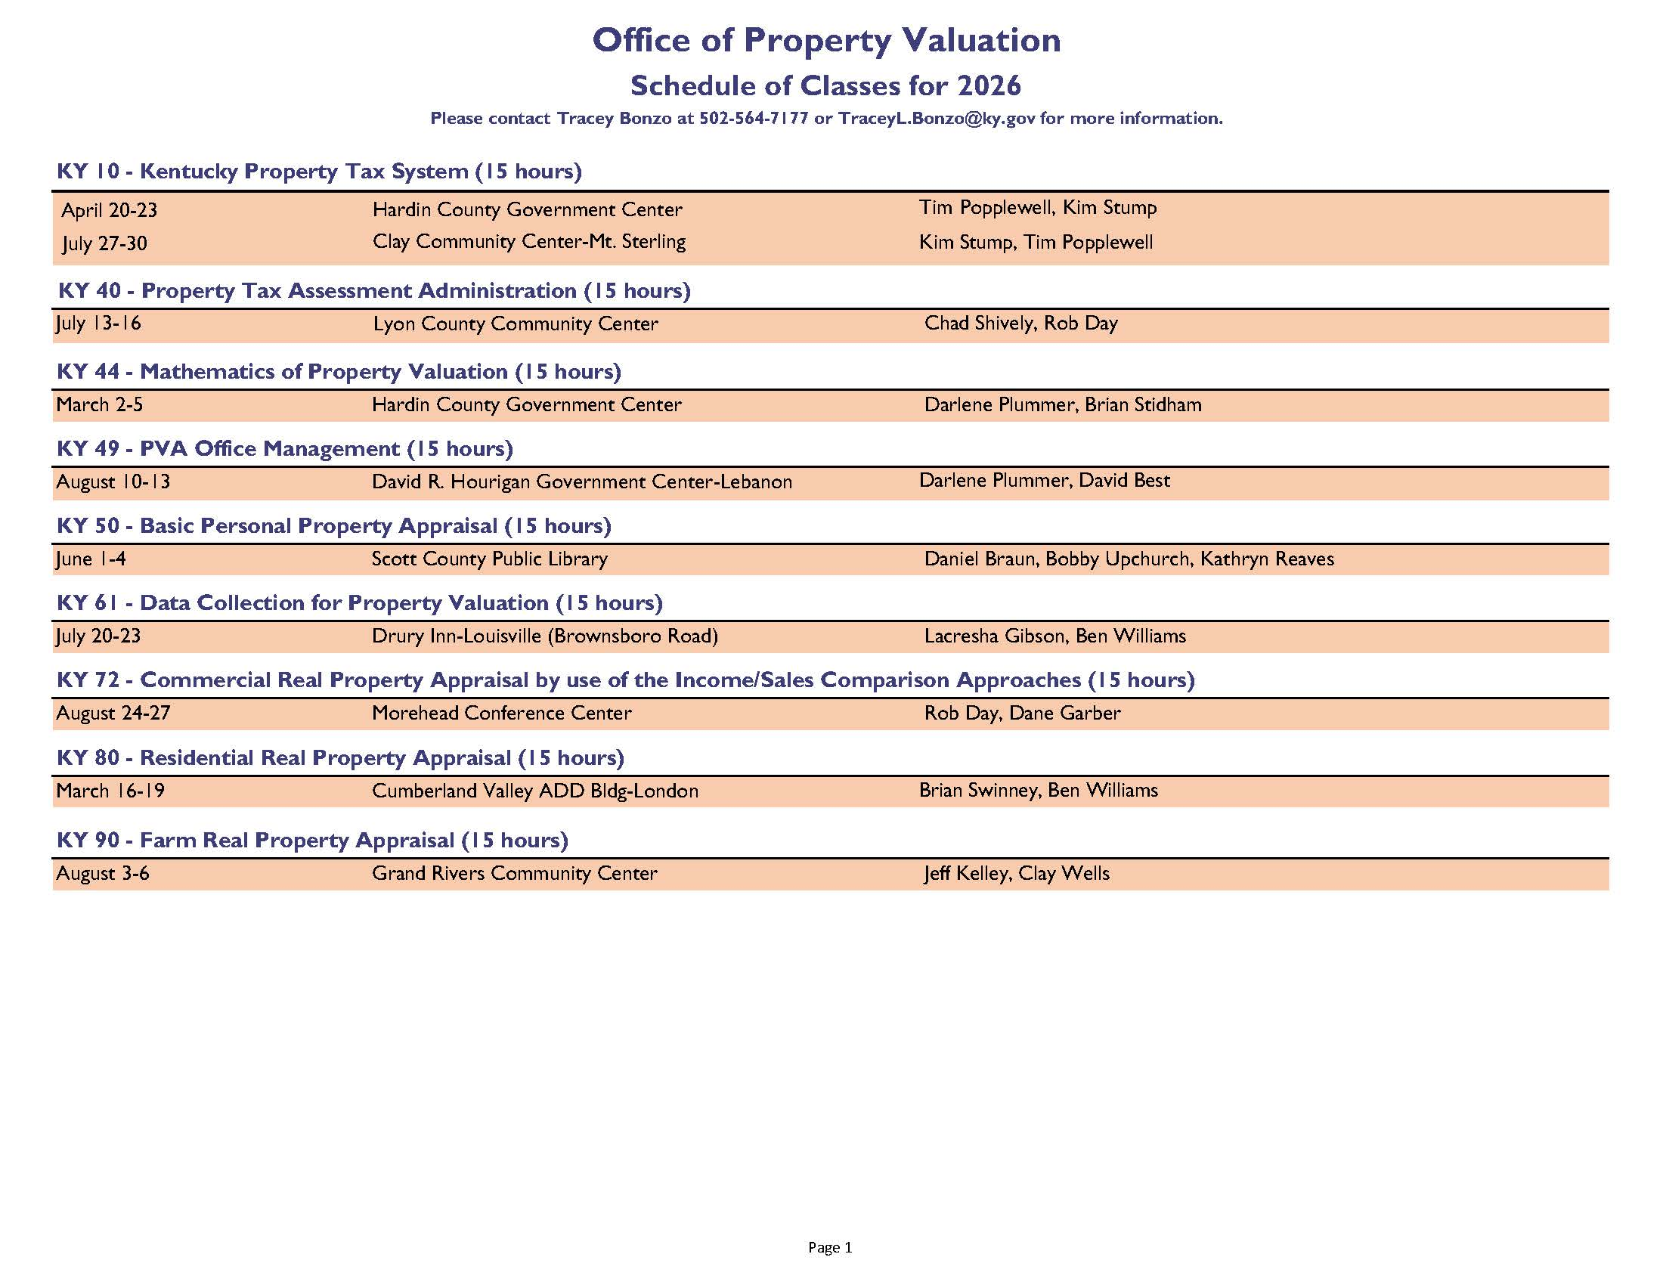
2026 Education Schedule

Slide 30
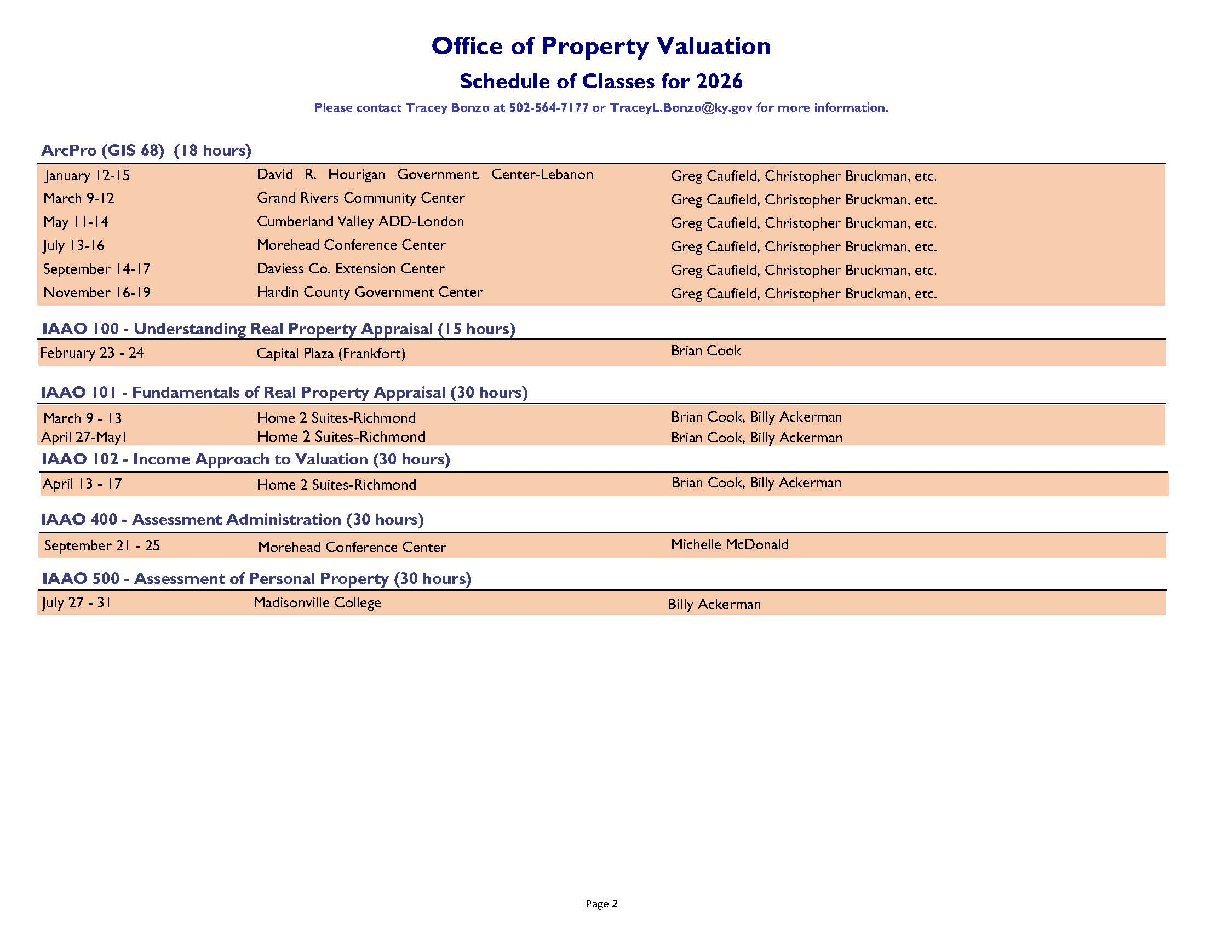
2026 Education Schedule

Slide 31
Interested in Becoming an Instructor?
How to become an instructor:
KY Course Instructors – Just need to be willing to volunteer their time
Receive one class credit for your office for each class taught.
PVA’s receive education hours for classes taught.
IAAO Course Instructors – Must attend the Instructors Training Workshop and pass the test

Slide 32
Venues
If you know of a venue in your area that will work for our classroom and testing needs, please email me the name of the venue and the contact information for the individual I need to speak with.
TraceyL.Bonzo@ky.gov

Slide 33
Questions for your Education Coordinator
QUESTIONS?

Slide 34


Education Program Workshop
Tracey L. Bonzo,
Revenue Branch Manager
KY Department of Revenue
502-564-7177
TraceyL.Bonzo@ky.gov
The information in this presentation is for educational and informational purposes only and does not constitute legal advice. Information is presented as an overall review that is subject to law changes and may not apply to all states. For accurate information on issues related to State Real Property Tax Rate, please reference KRS 132.020.
Information in this presentation is believed to be accurate as of the date of publication. However, any statement made in error that may occur during presentations made by the Department of Revenue as part of its tax education program shall not expressly or impliedly supersede the Department of Revenue’s official interpretation of the law or its policies utilized in administering the state revenue and tax laws...
Kentucky Department of Revenue • 501 High Street • Frankfort, KY 40601 • (502) 564-8338

