Slide 1
Tax Executives Institute: DOR Legislative Updates
Department of Revenue
April 24, 2025
Kentucky Department of Revenue • 501 High Street • Frankfort, KY 40601

Slide 2
Introductions
Thomas B. Miller
Commissioner, Kentucky Department of Revenue
Richard Dobson
Executive Director, Office of Sales & Excise Taxation
Barbara Quackenboss
Executive Director, Office of Income Taxation
Gary Morris
Executive Director, Office of Tax Policy
Kentucky Department of Revenue • 501 High Street • Frankfort, KY 40601

Slide 3
Commissioner Thomas B. Miller Update
Kentucky Department of Revenue • 501 High Street • Frankfort, KY 40601

Slide 4
Commissioner Miller Update
Important developments at the Department since our last TEI visit
Leadership update
Administrative Update

Slide 5
Commissioner Miller Update

Slide 6
Sales & Excise Taxes
Richard Dobson
Executive Director
Kentucky Department of Revenue • 501 High Street • Frankfort, KY 40601

Slide 7
House Bill 2 – Bullion
The Department of Revenue (DOR) will be issuing refunds to Kentucky taxpayers for sales use tax paid on the purchase of bullion and collectible currency after August 1, 2024. You do not need to file a lawsuit or go to court to get a refund. Follow the instructions below to seek a refund.
If you have questions regarding the sales and use tax refund process, please email the Division of Sales and Use Tax at krc.webresponsesalestax@ky.gov or call (502) 564-5170.
How to Get Your Refund
Under the longstanding administrative process to ensure consumers charged taxes on exempt transactions receive refunds of the over collected tax amounts (KRS 134.580), the retailer you purchased gold, other precious metals, or collectible currency from must submit a refund request.
Individual consumers seeking a refund of the sales and use tax paid on their purchase of bullion or collectible currency for periods on or after August 1, 2024, should request the refund directly from the retailer they made the purchase from. Each retailer may have a specific refund process to handle these requests. Consumers should be prepared to show proof of their purchase amounts and the tax charged by supplying their purchase receipts.

Slide 8
House Bill 2 – Bullion (cont.)
Refund requests sent directly to the DOR by the consumer without submission through the retailer cannot be processed.
Retailers using the normal refund process must apply directly to the DOR for the applicable refunds by submitting a completed Sales and Use Tax Refund Application (Form 51A209). Please include multiple customer purchases on the same refund application when possible. Most retailers are familiar with the refund process outlined below, and DOR will process the refund claims as quickly as possible.
DOR receives the completed application and verifies the reporting periods, the sales made, and the taxes paid.
DOR issues the refund to the retailer once documentation is verified.
Each retailer pays the refunded tax back to the customer as required under the provisions of KRS 139.770.
Claims for refunds must be filed within four years from the date the tax was paid to the State Treasurer. After the statute of limitations has expired, no claims for refunds or credits will be considered.

Slide 9
Cannabis-Infused Drinks
Senate Bill 202
Provides a licensing and regulatory structure specifically for “intoxicating THC-infused drinks.”
Integrates the products into the three-tier system that governs the production, distribution, and sale of alcoholic beverages in the state and addresses product safety, labeling, potency limits and restrictions on sales to minors.
House Bill 775
Sections 19-24 define cannabis-infused beverages and impose an excise tax of $1.92 on each gallon sold or distributed and a 11% wholesale sales tax, effective July 1, 2025.
This taxation has an estimated revenue growth projection of $930K. The tax reports and payments are due the 20th of the month.

Slide 10
New Qualifying Attraction Sales Tax Incentive
House Bill 775
A series of live performances or exhibitions of musical, theatrical, cultural or other artistic presentation (excluding sporting events and tournaments).
Held within the boundaries of a consolidated local government or urban-county government over at least two consecutive days.
Part of an agreement that authorizes a series of entertainment events annually for at least five consecutive years.
Open to the public with ticket purchase with total attendance over the duration of the event of at least 60,000.
Incentive provided is 50% of the sales tax generated by retail sales of tangible personal property or services generated at the qualifying attraction.
50% of the refund incentive goes to the facility operator (person who owns the venue) and 50% goes to the sponsoring entity (person hosting the qualifying attraction).
DOR is currently developing the refund application for this incentive to handle submittals for events held on or after July 1, 2025.

Slide 11
Expanded Data Center Project Sales Tax Exemption
The original exemption for a broad category of data center equipment was enacted through House Bill 8 in 2024. It was limited to sites within a consolidated government having a population equal to or greater than five hundred thousand (500,000).
House Bill 775 expands the data center exemption based upon the following investment thresholds:
For counties with a population of 100,000 or more, the capital investment is $450 million.
For counties with a population greater than 50,000 but less than 100,000, the minimum capital investment is $100 million.
For counties with a population less than 50,000, the minimum capital investment is $25 million.

Slide 12
New Lodging Facility Category for Tourism Attraction Projects
House Bill 775
Qualifications
Locates in one of the 100 least populated counties in the Commonwealth.
Locates in a county that includes, in part, the boundaries of a designated national forest or is adjacent to or includes a portion of parallel reservoirs of water surrounding a national recreation area.
Locates within an enhanced incentive county within a 1/2 mile of a state resort park and creates at least 50 new full-time jobs within that county.
Makes a capital investment of at least $100 million.
Includes accommodations of at least 100 guest room cabins or rental units with a spa, multiple on-site dining facilities, and multiple meeting or event spaces.
Benefits
Eligible for a sales tax incentive for a 20-year period.
Eligible for up to 50% of the approved costs of the development in sales tax rebates from sales generated by the project over the term of the incentive.

Slide 13
New Expanded Tourism Attraction Project Incentive
House Bill 775
For projects located in an enhanced incentive county with a population of 20,000 or less.
Allows for a 20-year sales tax incentive term.
Provides for up to 50% of approved costs of the development in sales tax rebates from sales generated by the project over the term of the incentive.

Slide 14
Tax Increment Financing
House Bill 775
Allows for a new Tax Increment Financing (TIF) area to be carved out of an existing TIF area that was established before March 27, 2007, by a city of the first class or county containing a city of the first class.
Provides for no less than 10% of the increment for the new TIF area to be paid to the agency for which the existing development area was established.

Slide 15
Income Tax & LLET
Barbara Quackenboss
Executive Director
Kentucky Department of Revenue • 501 High Street • Frankfort, KY 40601

Slide 16
Overview of the 2024 - 2025 Legislative Sessions
HB 8 (2024)
Extension of Corporate Income Tax Exemption for Disaster Response Businesses
Deferred tax deduction for Unitary Filings
Broadband Tax Credit created

Slide 17
HB 775 (2025) IRC Conformity date
For tax years beginning on or after January 1, 2025:
The IRC conformity date is December 31, 2024.
Previous conformity date was December 31, 2023.
As a result, the Internal Revenue Code in effect on December 31, 2024, is applicable for Kentucky Income Tax purposes, unless Kentucky has specific statutes that state otherwise.
Statute Reference: KRS 141.010(21)

Slide 18
Disaster Response Businesses
The exemption initially passed during the 2021 Legislative Session and was set to expire January 1, 2025. HB 8 (2024) extended the corporation income tax exemption for disaster response businesses to tax years beginning on or after January 1, 2021, but before January 1, 2027.
For purposes of this exemption, disaster response business is defined by KRS 141.010(10). Disaster response businesses eligible for the exemption:
Have no presence in Kentucky and conduct no business in Kentucky except for disaster or emergency-related work during a response period;
Services are requested by a registered business or state or local government to perform disaster or emergency-related work during a response period; and
Have no registrations, tax filings, or nexus in Kentucky other than disaster or emergency-related work during the calendar year immediately preceding the declared state disaster or emergency.
For taxable years beginning on or after January 1, 2021, but before January 1, 2027, the tax imposed by this section shall not apply to a disaster response employee or to a disaster response business. The remainder of the income received by such nonresident shall be deemed nontaxable by this state.

Slide 19
Deferred Tax Deduction
HB 8 (2024) delays the deferred tax deduction until tax years beginning on or after January 1, 2026.
The deduction is allowed for publicly traded companies and their affiliates filing a combined report that saw an increase in a net deferred tax liability, a decrease in a net deferred tax asset, or aggregate change from a net deferred tax asset to a net deferred tax liability as a result of the imposition of the combined reporting requirement.
Any combined group intending to claim the deferred tax deduction must have filed a statement with the Department of Revenue on or before July 1, 2019.

Slide 20
Broadband Expansion Tax Credit
The broadband expansion tax credit is available for tax years beginning on or after January 1, 2025, but before January 1, 2029.
The total amount of the credit awarded is capped at $5 million for each taxable year.
Companies must complete and file an application with the Department by December 31 of the calendar year in which the investment was made.
The Department will review and approve the allowable credit amount by February 1.

Slide 21
Broadband Expansion Tax Credit
This is a nonrefundable and nontransferable tax credit.
The credit is limited to 50% of the amount of sales tax paid for purchases of eligible equipment and services, reduced by any seller reimbursement allowed under KRS 139.570.
It requires that equipment and services are used to expand broadband.
The credit can be used against:
Limited Liability Entity Tax
Corporation Tax
Individual Income Tax
Statute Reference: KRS 141.391

Slide 22
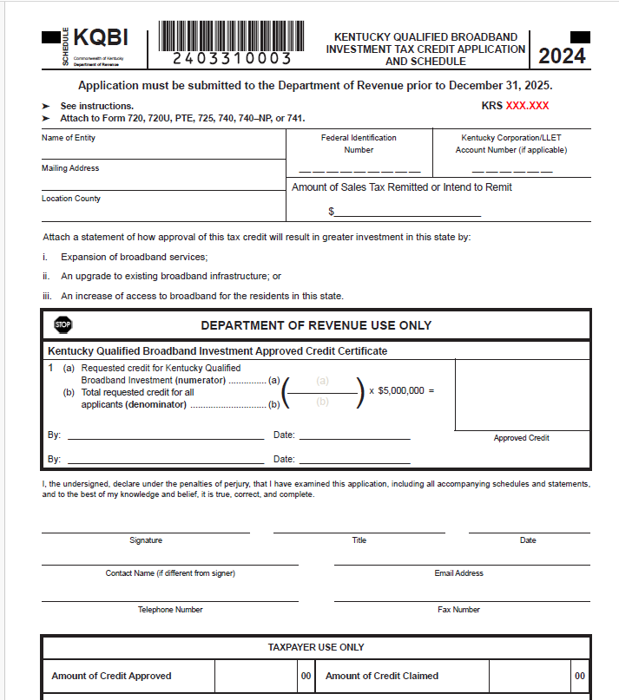
Broadband Expansion Tax Credit KRS 141.391

Slide 23
PTET Estimated Payments Required for 2024
For tax years beginning on or after January 1, 2024, an electing entity is required to make estimated payments.
Form PTET-P has been created to allow an electing entity to calculate the penalty due on the underpayment of estimated taxes for PTET.
Statute Reference: KRS 141.209

Slide 24
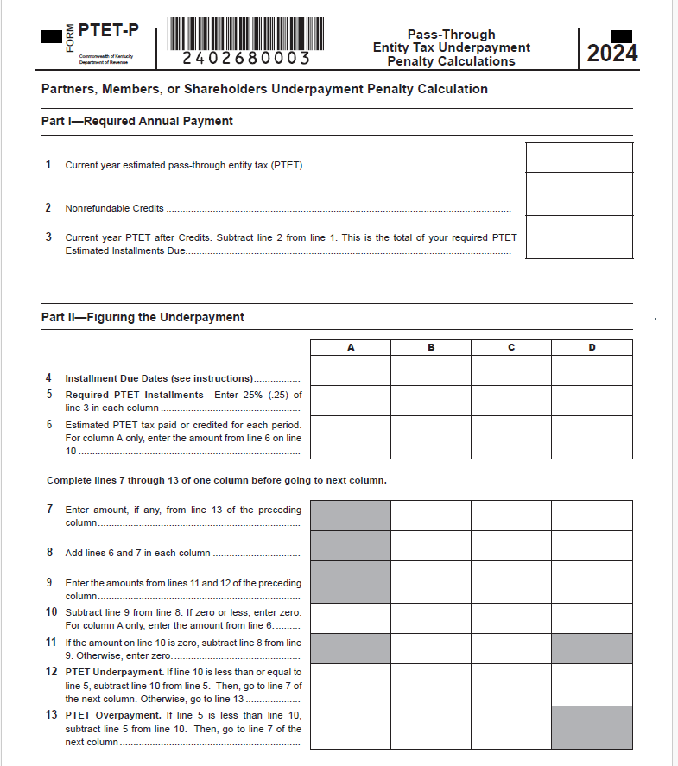
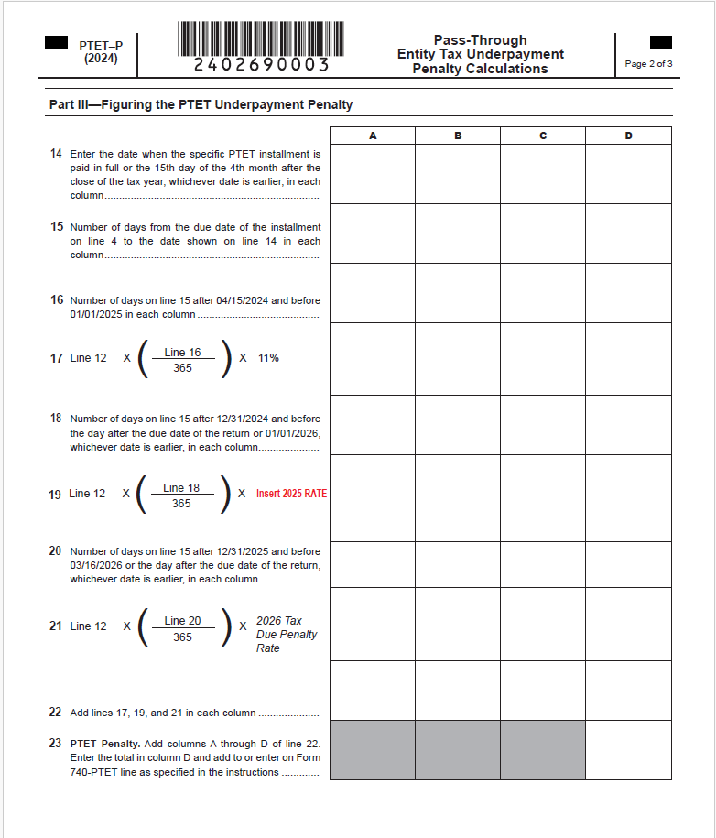
Form PTET-P Pass-Through Entity Underpayment Penalty

Slide 25
Individual Income Tax: Form Changes
All forms have been updated with year changes and any legislative threshold changes.
2024 Standard Deduction: $3,160
Individual Income Tax Rate for tax year 2024 is 4%
Schedule ITC – added Worksheet INV for the inventory tax credit and updated Family Size Tax Credit Table
Form 741 –attach Schedule ITC when necessary

Slide 26
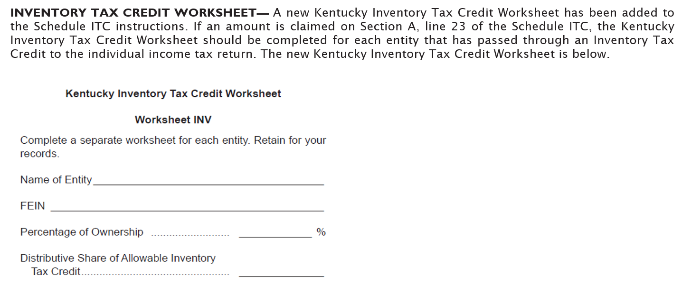
Schedule ITC: Worksheet INV

Slide 27
Form 741 – Schedule ITC
Nonrefundable credits claimed on the Fiduciary return should be included on Schedule ITC and attached to Form 741.
Language on Form 741 and Schedule ITC has been updated to clarify the need to enclose Schedule ITC when necessary.

Slide 28
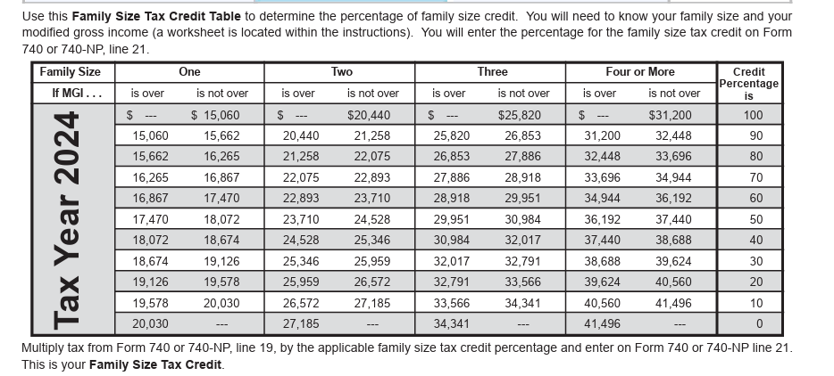
Individual Income Tax: Family Size Tax Credit

Slide 29
Reduction of Individual Income Tax Rate
HB 775 (2025)
Additional changes have been made to the rate reduction conditions.
The Budget Reserve Trust Fund will be reviewed each year and compared with the General Fund.
Individual Income Tax Rate can be reduced by 0.1% - 0.5% each tax year if fiscal requirements are met.
All future individual income tax rate reductions must be approved by the General Assembly.
The Individual Income Tax Rate for tax year 2025 is 4%.
The Standard Deduction for tax year 2025 is $3,270.

Slide 30
Looking Ahead - Reduction of Individual Income Tax Rate
HB 1 (2025)
For taxable years beginning on or after January 1, 2026, the Individual Income Tax Rate is 3.5%
Tax rate reductions depend on meeting specific fiscal conditions, including the balance in the Budget Reserve Trust Fund (BRTF) and General Fund (GF) appropriations
The department shall not implement an income tax rate reduction without an action by the General Assembly

Slide 31
Employer Payroll Withholding
All filing types are now mandated by e-file requirements.
For tax year 2025, the tax rate remains at 4%
For tax year 2026, the tax rate is 3.5%

Slide 32
Withholding on Gambling Winnings
Regulation 103 KAR 18:070 establishes the withholding rate on gambling winnings at the maximum income tax rate: 4% for tax year 2025 and 3.5% for tax year 2026.
Payments of gambling winnings subject to federal tax withholding must also deduct and withhold Kentucky income tax.
Tax withheld from gambling winnings must be reported and paid on the payer’s withholding account on Form K-1 or K-3.
Gambling winnings subject to withholding are those of more than $5,000 from the following sources:
Any sweepstakes, wagering pool, or lottery; or
Any other wager, if the proceeds are at least 300 times the amount of the bet.

Slide 33
Other Information and Reminders
Kentucky Department of Revenue • 501 High Street • Frankfort, KY 40601 • (502) 564-4581

Slide 34
Electronic Payments
Actual withdrawal of electronic payments may be later than the requested date. Please allow up to two weeks for processing.
Please do not submit duplicate payments.

Slide 35
Electronic Filing
Electronic filing is available through third-party vendors that support Kentucky.
Visit the Department of Revenue website at Revenue.ky.gov for updates of approved Tax Software Vendors under the Tax Professionals Tab and click on Software Developers.
YTD 2025:
97% of tax year 2024 individual income tax returns were e-filed
72% of tax year 2025 corporate and pass-through entity tax returns were e-filed

Slide 36
Tax Interest Rate
2025 Interest Rates
Rate charged on unpaid taxes is 10%
(Base rate of 8% plus 2%)
Rate paid when interest is due on a refund is 6%
(Base rate of 8% minus 2%)
See KRS 131.183

Slide 37
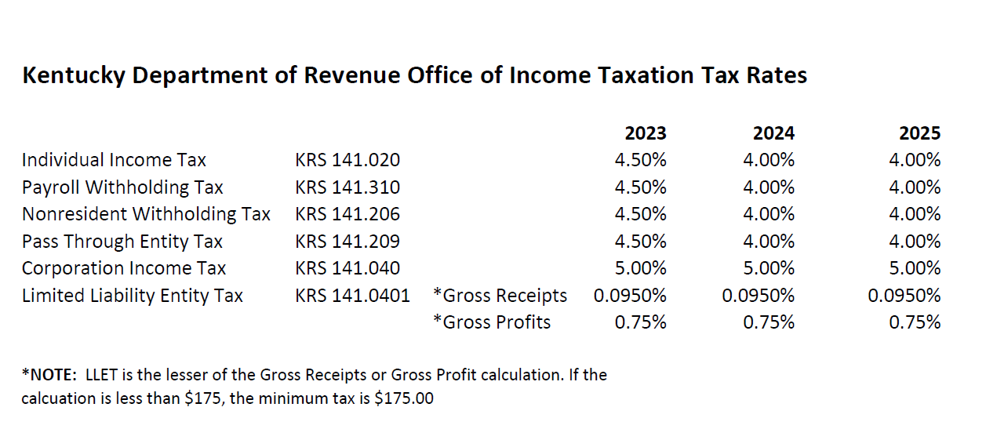
Tax Rates

Slide 38
Press Releases and Important Updates
The Kentucky Department of Revenue (DOR) provides important updates to tax information on Revenue.ky.gov.
Check the DOR website regularly for timely information on disaster relief provisions.
DOR implemented a new Integrated Tax System in March 2025.
Stay Connected: sign up for Revenue news and updates directly to your inbox.

Slide 39
Disaster Related Tax Relief for February 14, 2025 Storms
Late filing and payment penalties will be waived for affected taxpayers in all 120 counties seeking this relief, as long as taxes due are reported and paid on or before November 3, 2025
Kentucky’s tax laws have no provision to waive interest accrued after the regularly required deadlines prescribed by law determined without regard to any extension of time for filing
Interest will accrue starting April 16, 2025, until the tax is paid
NOTE: A $2,000.00 tax liability deferred until November 3, 2025, will accrue $111.23 interest

Slide 40
Stay in Touch
Department of Revenue Website
https://revenue.ky.gov

Slide 41
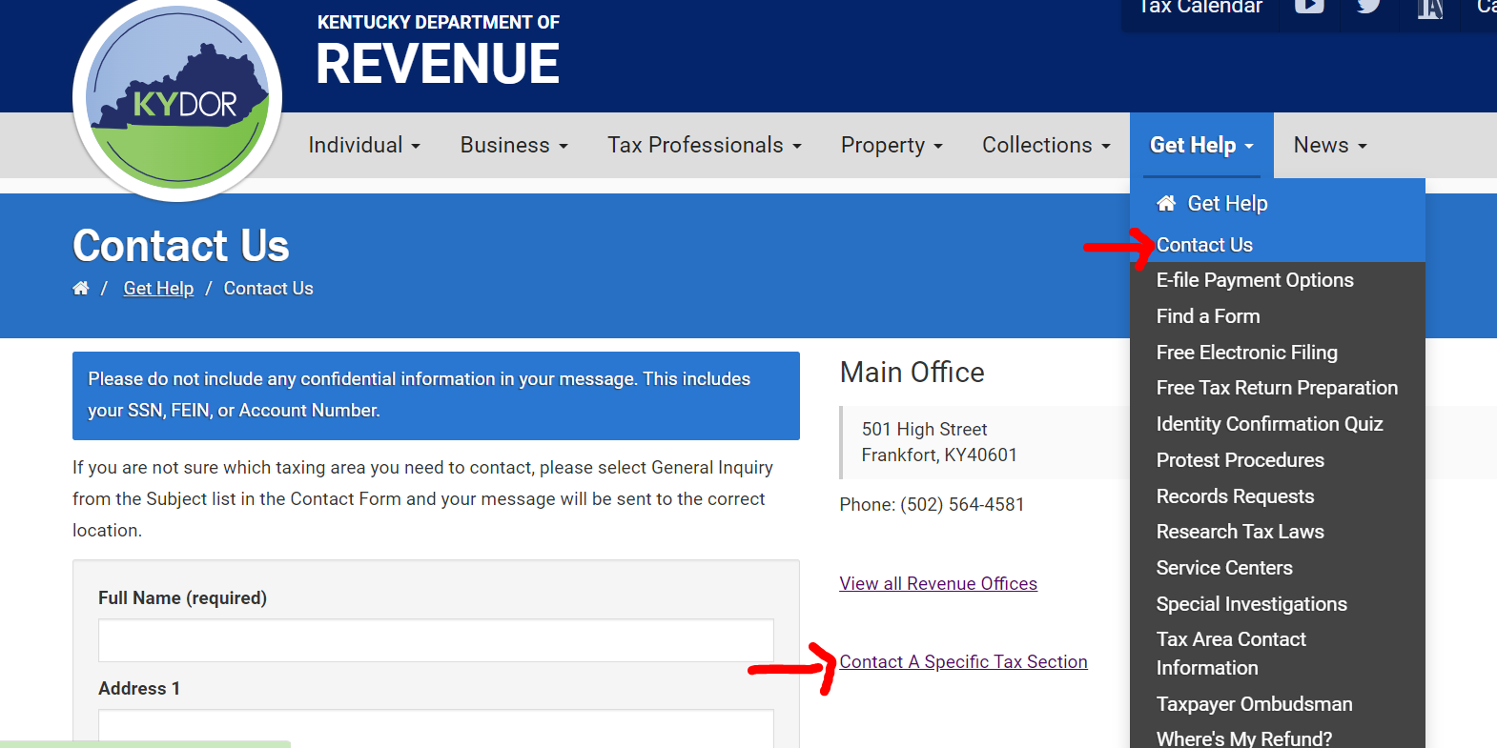
Reach out to DOR via Web Response

Slide 42
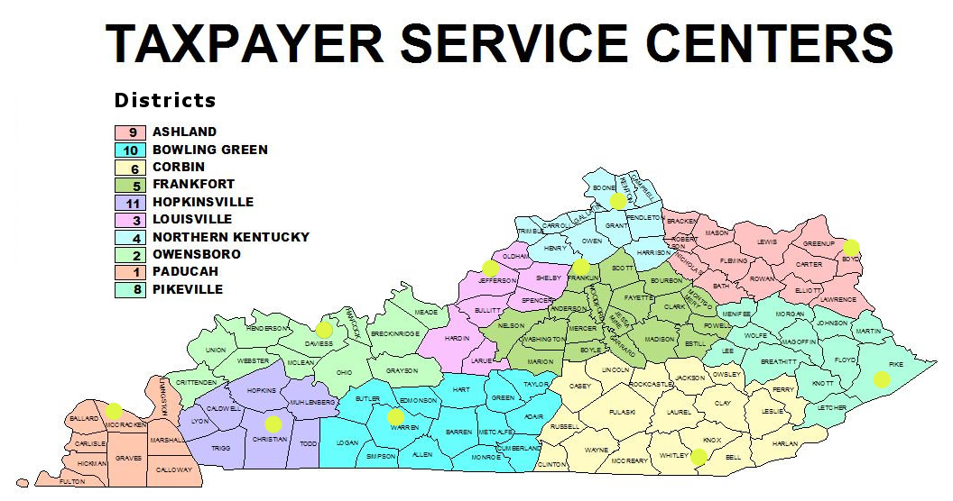
Taxpayer Service Center Map

Slide 43
Taxpayer Service Centers
Ashland Taxpayer Service Center
1539 Greenup Avenue, Suite 501 41101-7695
(606) 920-2037
Bowling Green Taxpayer Service Center
201 West Professional Park Court, 42104-3278
(270) 746-7470
Corbin Taxpayer Service Center
15100 North US25E, Suite 2, 40701-6188
(606) 528-3322
Frankfort Taxpayer Service Center
501 High Street, 40601-2103
(502) 564-4581 (Taxpayer Assistance)
Hopkinsville Taxpayer Service Center
181 Hammond Drive, 42240-7926
(270) 889-6521
Louisville Taxpayer Service Center
600 West Cedar Street, 2nd Floor West, 40202-2310
(502) 595-4512
Northern Kentucky Taxpayer Service Center
Turfway Ridge Office Park
7310 Turfway Road, Suite 190, Florence, 41042-4871
(859) 371-9049
Owensboro Taxpayer Service Center
401 Frederica Street, Building C, Suite 201, 42301-6295
(270) 687-7301
Paducah Taxpayer Service Center
Clark Business Complex, Suite G
2928 Park Avenue, 42001-4024
(270) 575-7148
Pikeville Taxpayer Service Center
Uniplex Center, 126 Trivette Drive, Suite 203, 41501-1275
(606) 433-7675

Slide 44
Revenue Contact Phone Numbers
Collections | (502) 564-4921
Corporation Tax | (502) 564-8139
DOR One Stop Help Line | (502) 564-5053
E-Filing Assistance (Business Forms) | (502) 564-7926
E-Filing Assistance (Individual Forms) | (502) 564-7862
Field Operations | (502) 564-2113
Forms and Envelopes | (502) 564-3658
Individual Income Tax | (502) 564-4581
Inheritance Tax | (502) 564-4810
Local Government & County Fees | (502) 564-8785
Miscellaneous Tax | (502) 564-2935
Motor Fuels | (502) 564-3853
Motor Vehicle Usage | (502) 564-4455
Ombudsman | (502) 564-7822
Property Tax | (502) 564-8338
Protest Resolution | (502) 564-6734
Registration | (502) 564-3306
Sales & Use Tax | (502) 564-5170
Special Investigations | (502) 564-4470
State Operator | (502) 564-3130
Withholding (also use for WRAPS) | (502) 564-7287

Slide 45
2025 Legislative Updates
Richard Dobson | Barbara Quackenboss
Executive Director Office of Sales & Excise Tax | Executive Director Office of Income Taxation
 Richard.Dobson@ky.gov |  Barbara.Quackenboss@ky.gov
 (502) 564-9977 |  (502) 564-7343
Gary Morris
Executive Director Office of Tax Policy & Regulation
 Gary.Morris@ky.gov
 (502) 564-0424
Kentucky Department of Revenue • 501 High Street • Frankfort, KY 40601

Slide 46
Disclaimer
The Department has developed this presentation to enhance taxpayer understanding of and compliance with the new tax legislation enacted by the Kentucky General Assembly during the recent regular legislative sessions. The information in this presentation is for educational and informational purposes only and does not constitute legal advice. Information is presented as an overall review that is subject to law changes. To review the amendments to Kentucky tax laws enacted during the recent regular sessions in more detail, please refer to the relevant statutory provisions of the Kentucky Revised Statutes.
Information in this presentation is believed to be accurate as of the date of publication. However, any statement in error that may occur during presentations made by the Department of Revenue as part of its tax education program shall not expressly or implied supersede the Department of Revenue’s official interpretation of the law or its policies utilized in administering state revenue and tax laws.

