Slide 1


2025 Kentucky Income Tax Changes
University of Kentucky Income Tax Seminar
Kentucky Department of Revenue • 501 High Street • Frankfort, KY 40601 • (502) 564-3226

Slide 2


Introductions
Jessica Martin
Policy/Research Consultant
Division of Individual Income Tax
Brad Asher
Tax Consultant
Kentucky Department of Revenue • 501 High Street • Frankfort, KY 40601 • (502) 564-3226

Slide 3
Corporate Income Tax/LLET
2025 Updates
Kentucky Department of Revenue • 501 High Street • Frankfort, KY 40601 • (502) 564-8139

Slide 4
HB 775 (2025) IRC Conformity date
  For tax years beginning on or after January 1, 2025:
    The IRC conformity date is December 31, 2024.
    Previous conformity date was December 31, 2023.
    As a result, the Internal Revenue Code in effect on December 31, 2024, is applicable for Kentucky Income Tax purposes, unless Kentucky has specific statutes that state otherwise.
  Statute Reference: KRS 141.010(21)

Slide 5
Overview of the 2024 Legislative Sessions
HB 8 (2024)
  Broadband Tax Credit created

Slide 6
Broadband Expansion Tax Credit
  The broadband expansion tax credit is available for tax years beginning on or after January 1, 2025, but before January 1, 2029.
  The total amount of the credit awarded is capped at $5 million for each taxable year.
  Companies must complete and file an application with the Department by December 31 of the calendar year in which the investment was made.
  The Department will review and approve the allowable credit amount by February 1.

Slide 7
Broadband Expansion Tax Credit
This is a nonrefundable and nontransferable tax credit.
The credit is limited to 50% of the amount of sales tax paid for purchases of eligible equipment and services, reduced by any seller reimbursement allowed under KRS 139.570.
It requires that equipment and services are used to expand broadband.
The credit can be used against:
    Limited Liability Entity Tax and Corporation Tax or
    Individual Income Tax
Statute Reference: KRS 141.391

Slide 8
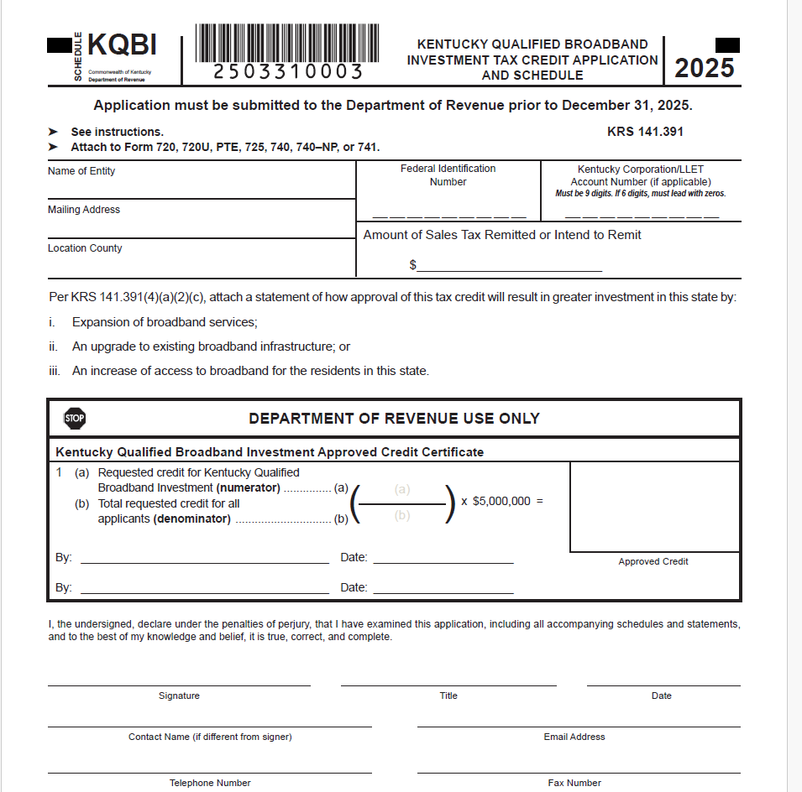
Broadband Expansion Tax Credit KRS 141.391

Slide 9
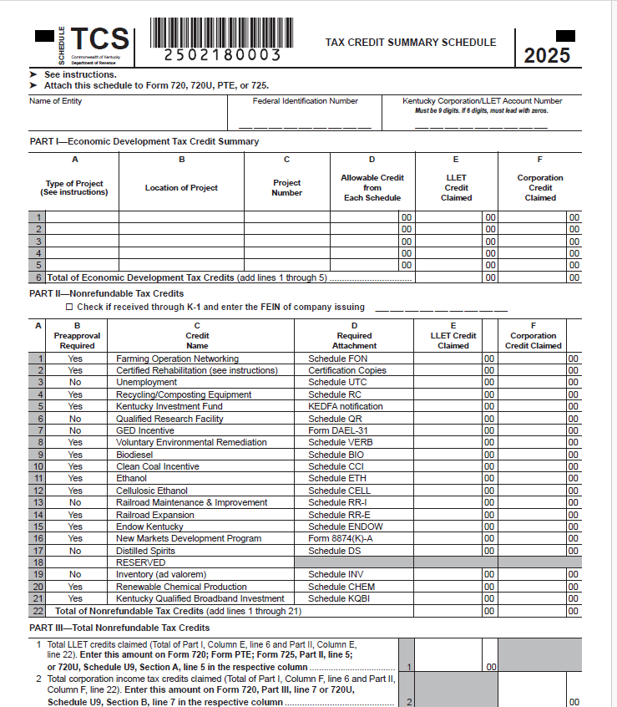
Schedule TCS
The Kentucky Qualified Broadband Investment was added to the Schedule TCS Part II, Line 21.

Slide 10
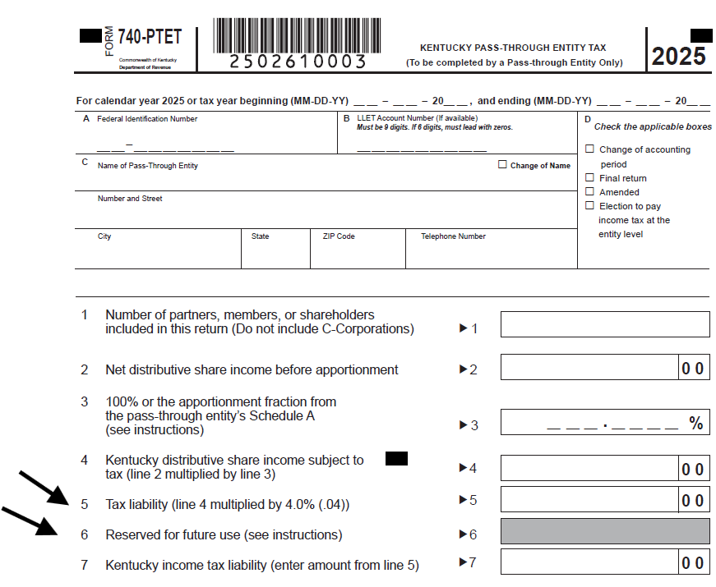
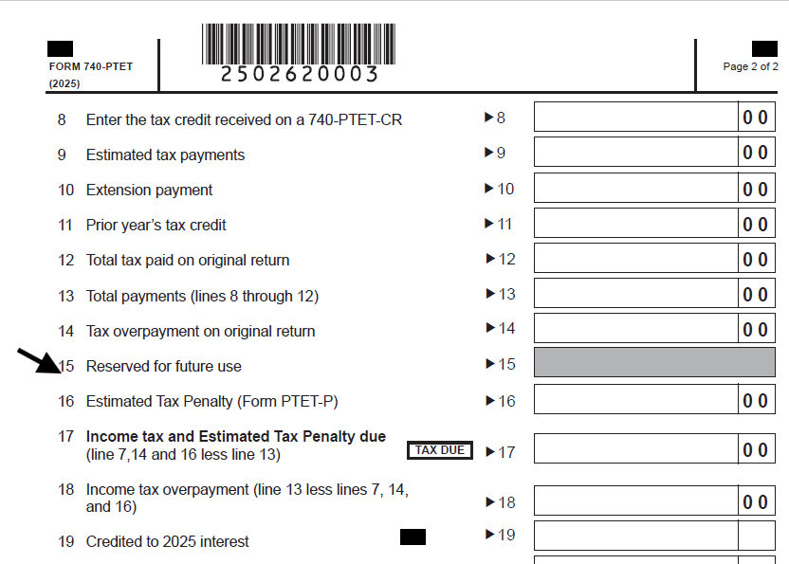
Form 740-PTET Kentucky Pass-Through Entity Tax
Line 5 changed from "Tax before credit" to
"Tax Liability“.
Line 6 marked reserved for
future use.
Line 15 marked reserved for
future use.

Slide 11
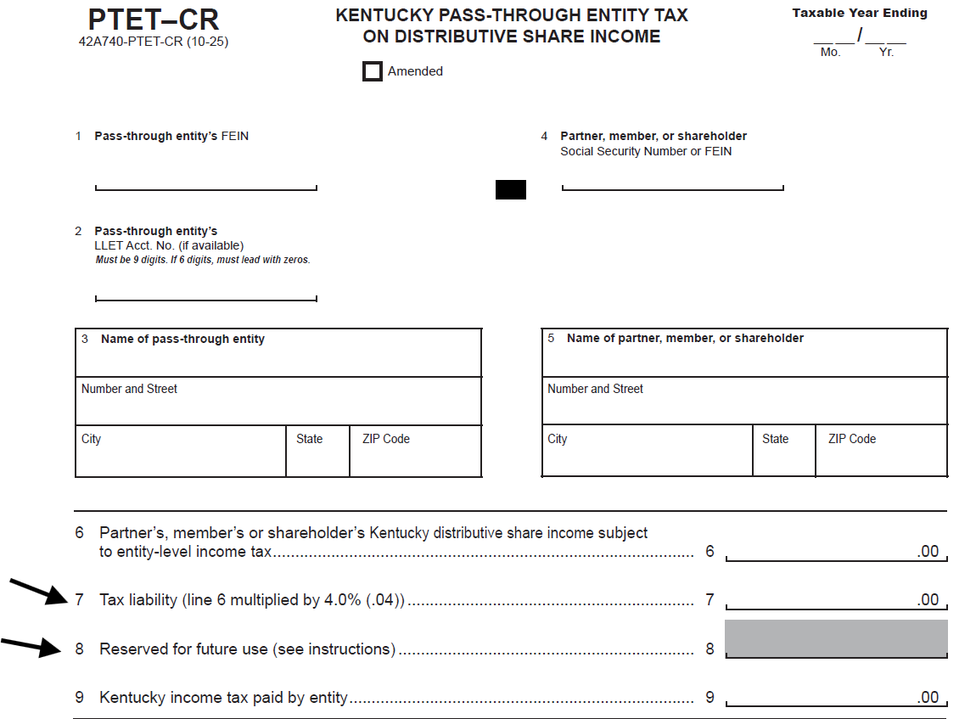
PTET-CR
Line 7 changed from
"Tax before credit" to "Tax Liability".
Line 8 marked
reserved for future use

Slide 12
PTET Estimated Payments Required
For tax years beginning on or after January 1, 2024, an electing entity is required to make estimated payments.
Form PTET-P has been created to allow an electing entity to calculate the penalty due on the underpayment of estimated taxes for PTET.
Do you owe this penalty? This has been added to the 2025 Form PTET-P in Part I.
Statute Reference: KRS 141.209

Slide 13
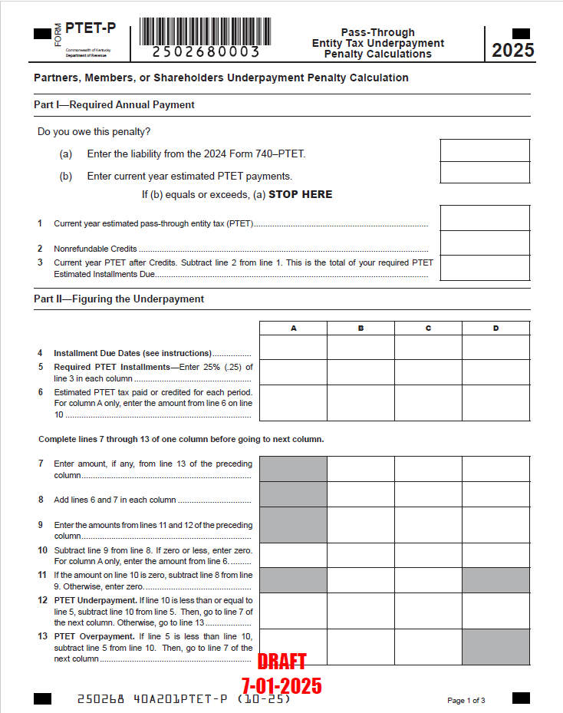
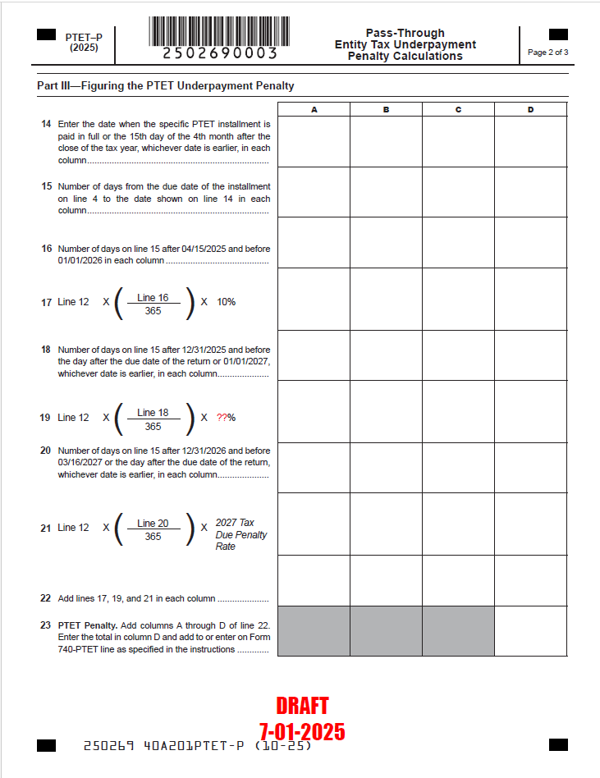

Form PTET-P Pass-Through Entity Underpayment Penalty

Slide 14
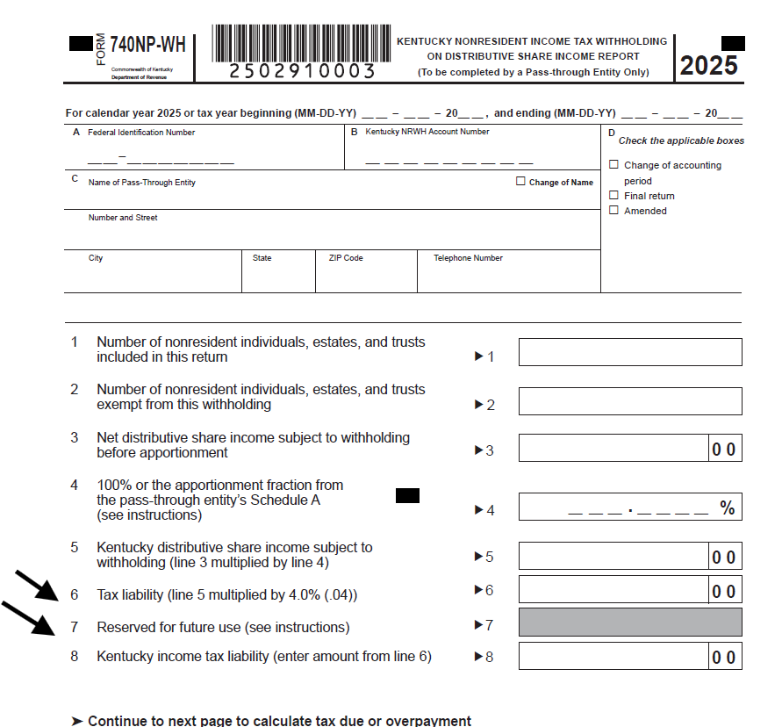
Form 740-NP-WH
Line 6 was changed from
"Tax before credit" to "Tax Liability".
Line 7 was marked as reserved for future use

Slide 15
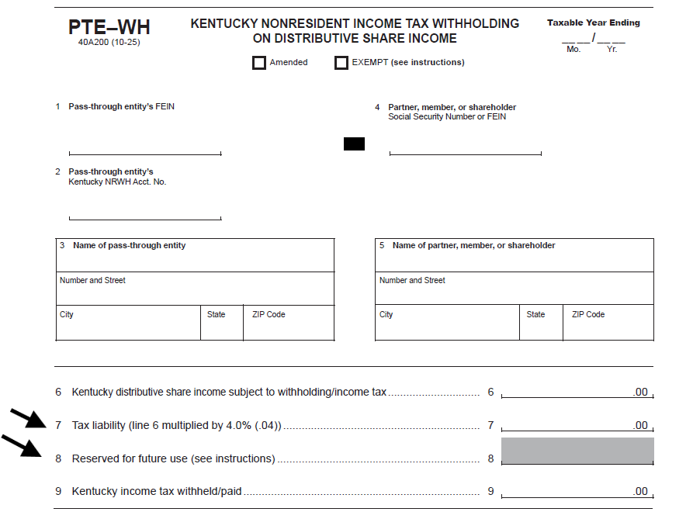
Form PTE-WH
Line 7 changed from "Tax
before credit" to "Tax Liability".
Line 8 was marked
reserved for future use

Slide 16
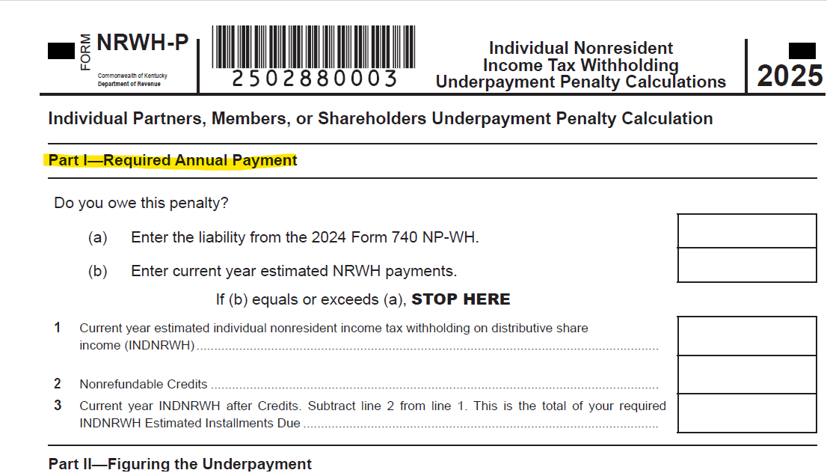
Form NRWH-P
Added (a) and (b) to Part I to
determine if a penalty is owed based on the previous year
tax liability compared to the estimated payments made for
the current year

Slide 17
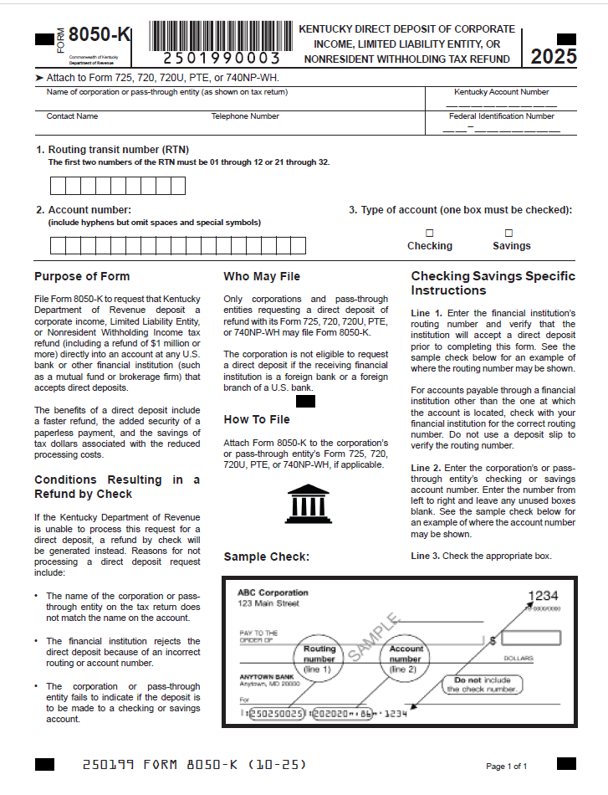

Form 8050-K Direct Deposit of Refunds
Available for Corporation Tax Returns filed via e-file or paper
Available for Nonresident Withholding Returns filed via e-file or paper
Direct deposit of refunds is not available for Pass Through Entity Tax (PTET) returns

Slide 18
Pay Outstanding Tax Bills in One Place
The MyTaxes Portal now displays your outstanding tax bills in one convenient location.
Log into your MyTaxes​ account to view and pay your outstanding bills using the "Make Payment” button.
Don’t want to login? Use the Guest Payment option on the MyTaxes login page. You will need your Account number or Federal Employer Identification Number (FEIN) and you will need your Invoice Number or Collections Case Number to make a guest payment. You’ll find this information on your bill or collection notification.

Slide 19
Making Payments in the MyTaxes Portal
For the following taxes, please use MyTaxes Portal
Consumer's Use
Motor Vehicle Tire Fee
Sales and Use
Telecommunication
Commercial Mobile Radio Service (CMRS)
Corporation Income/Limited Liability Entity Tax (LLET)
Employer's Withholding
KY Nonresident WH Tax
Transient Room
Utility Gross Receipts Tax (UGRLT)

Slide 20
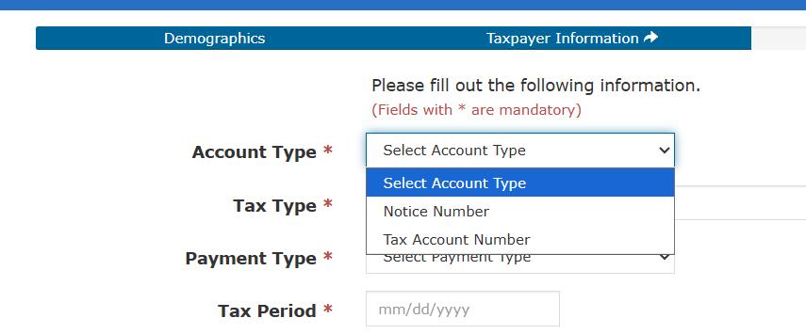
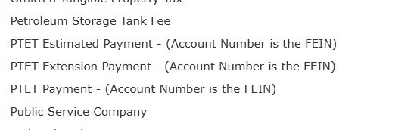
Making Payments for PTET
https://epayment.ky.gov/epay
Estimated Payments
Extension Payments
Balance on Returns filed without
payment
Use the FEIN as the Tax Account Number

Slide 21
One Big Beautiful Bill (OBBB) Act
Does Kentucky have any guidance regarding retroactive expensing of 174 research expenses under the One Big Beautiful Bill?
No, Kentucky does not have any guidance regarding retroactive expensing of 174 research expensing. Current Kentucky law defines “Internal Revenue Code” to mean the Internal Revenue Code in effect on December 31, 2024.
If or when does Kentucky plan to release guidance on conformity with the Bill?
Current Kentucky law defines “Internal Revenue Code” to mean the Internal Revenue Code in effect on December 31, 2024. We would not issue guidance on the OBBB until there is a Kentucky legislative change that adopts the new federal provisions.

Slide 22
Individual Income Tax
2025 Updates
Kentucky Department of Revenue • 501 High Street • Frankfort, KY 40601 • (502) 564-4581

Slide 23
Individual Income Tax: Form Changes
All forms have been updated with year changes and any legislative threshold changes.
The Code in effect on December 31, 2024
2025 Standard Deduction: $3,270
Individual Income Tax Rate for tax year 2025 is 4%
Schedule ITC – added Qualified Broadband Investment Credit
KW-2 – withholding account number is nine digits

Slide 24
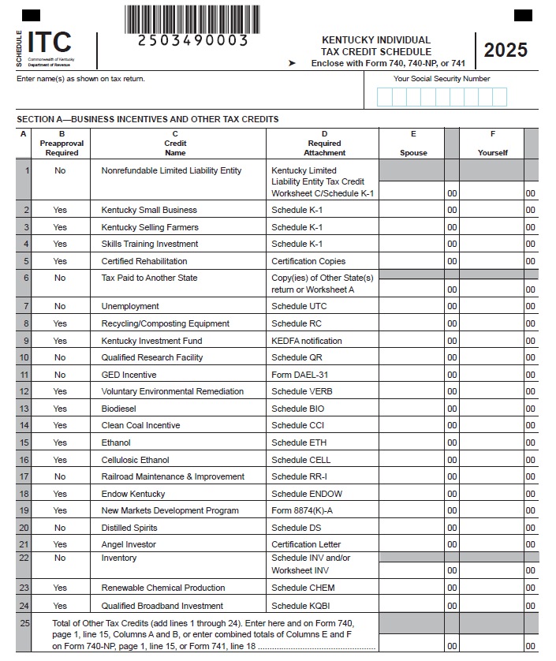
Schedule ITC
The Kentucky Qualified Broadband Investment was added to the Schedule ITC, Section A, Line 24.

Slide 25
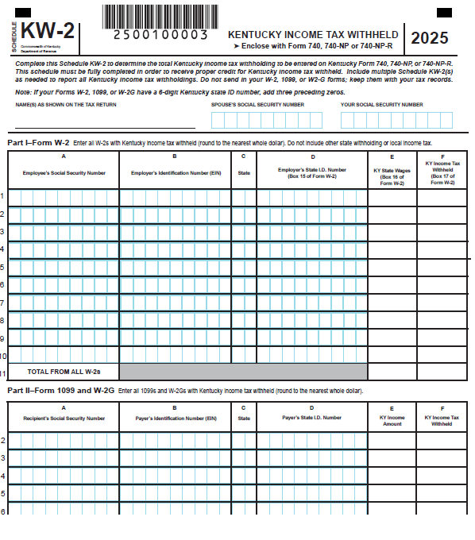
Schedule KW-2
The KW-2 Employer State ID column now has 9 digits. If the Form W-2, 1099, or W-2G received by the taxpayer displays only six digits, add three preceding zeros.

Slide 26
Reduction of Individual Income Tax Rate
HB 775 (2025)
  Additional changes have been made to the rate reduction conditions.
  The Budget Reserve Trust Fund will be reviewed each year and compared with the General Fund.
  Individual Income Tax Rate can be reduced by 0.1% - 0.5% each tax year if fiscal requirements are met.
  All future individual income tax rate reductions must be approved by the General Assembly.
  The Individual Income Tax Rate for tax year 2026 is 3.5%.
  The Standard Deduction for tax year 2026 is $3,360.

Slide 27
Looking Ahead - Reduction of Individual Income Tax Rate
HB 1 (2025)
  For taxable years beginning on or after January 1, 2026, the Individual Income Tax Rate is 3.5%
  Tax rate reductions depend on meeting specific fiscal conditions, including the balance in the Budget Reserve Trust Fund (BRTF) and General Fund (GF) appropriations
  The department shall not implement an income tax rate reduction without an action by the General Assembly

Slide 28
One Big Beautiful Bill (OBBB) Act
Does Kentucky follow “same as federal” income tax position which allows qualified tips to be excluded from gross income?
Current Kentucky law defines “Internal Revenue Code” to mean the Internal Revenue Code in effect on December 31, 2024. Qualified tips are taxable to Kentucky. A deduction for qualified tips would not be allowed on the Kentucky return.
Does Kentucky follow “same as federal” income tax position which allows overtime income to be excluded from gross income?
Current Kentucky law defines “Internal Revenue Code” to mean the Internal Revenue Code in effect on December 31, 2024. Overtime income is taxable to Kentucky. A deduction for overtime income would not be allowed on the Kentucky return.

Slide 29
OBBB Q & A Continued
Does Kentucky follow “same as federal” income tax position which allows a deduction for car loan interest?
Current Kentucky law defines “Internal Revenue Code” to mean the Internal Revenue Code in effect on December 31, 2024. A deduction for car loan interest would not be allowed on the Kentucky return.
Does Kentucky follow “same as federal” income tax position which allows a deduction for social security benefits?
Kentucky does not tax social security income per KRS 141.019(1)(e). Kentucky does not follow “same as federal” rules regarding social security income, instead it is fully deductible. Social security income can be deducted from Kentucky taxable income on Schedule M, line 10.

Slide 30
OBBB Q & A Continued
Does Kentucky follow “same as federal” income tax position which allows an increase in the deduction for state and local taxes (SALT)?
Current Kentucky law defines “Internal Revenue Code” to mean the Internal Revenue Code in effect on December 31, 2024. Kentucky does not allow a deduction for state and local taxes, therefore; the increase in limitation would not apply on the Kentucky return.

Slide 31
Other Information and Reminders
Kentucky Department of Revenue • 501 High Street • Frankfort, KY 40601 • (502) 564-4581

Slide 32
Electronic Payments to the Department of Revenue
Actual withdrawal of electronic payments may be later than the requested date. Please allow up to two weeks for processing.
Please do not submit duplicate payments.

Slide 33
Instructions on how to make an Individual Tax Payment for 2025
You can make a payment at this link https://epayment.ky.gov/EPAY. Make sure to choose the following:
Tax Type – Tax Account Number
Tax Account Number – this is your social security number
Tax Type – Individual Income Tax - (Account Number is the Social Security Number)
This should default the payment to the year we are currently taking payments for which would be tax year ending 12/31/2025.
You can also call our taxpayer assistance line at 502-564-4581, option 3 and make a payment over the phone.

Slide 34
Instructions on how to make an Individual Estimated Tax Payment - 2026
You can make a payment at this link https://epayment.ky.gov/EPAY. Make sure to choose the following:
Tax Type – Tax Account Number
Tax Account Number – this is your social security number
Tax Type – Individual Income Tax - Estimated Payment (Account Number is the Social Security Number)
This should default the payment to the year we are currently taking estimated tax payments for which would be tax year ending 12/31/2026.
You can also call our taxpayer assistance line at 502-564-4581, option 3 and make a payment over the phone.

Slide 35
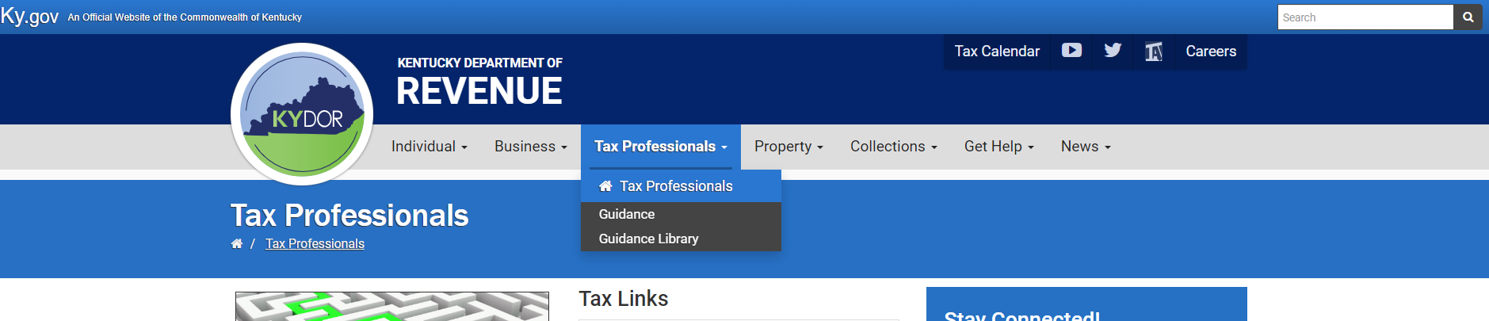
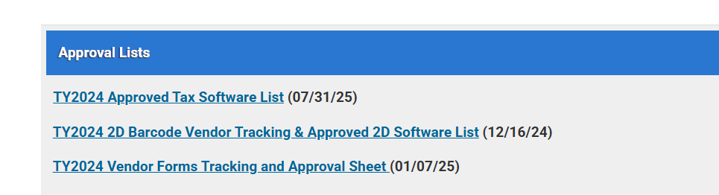
Electronic Filing
Electronic filing is available through third-party vendors that support Kentucky.
Visit the Department of Revenue website at Revenue.ky.gov for updates of approved Tax Software Vendors under the Tax Professionals Tab and click on Software Developers.
YTD 2025:
94% of tax year 2025 individual income tax returns were e-filed
72% of tax year 2025 corporate and pass-through entity tax returns were e-filed

Slide 36
Tax Interest Rate
2026 Interest Rates
Rate charged on unpaid taxes is 9%
  (Base rate of 7% plus 2%)
Rate paid when interest is due on a refund is 5%
  (Base rate of 7% minus 2%)
See KRS 131.183

Slide 37
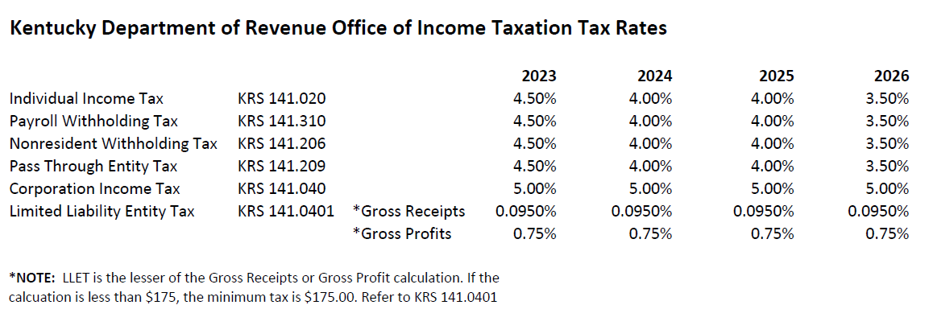
Tax Rates

Slide 38
Press Releases and Important Updates
  The Kentucky Department of Revenue (DOR) provides important updates to tax information on Revenue.ky.gov.
  Check the DOR website regularly for timely information on disaster relief provisions.
  DOR implemented a new Integrated Tax System in March 2025.
  Stay Connected: sign up for Revenue news and updates directly to your inbox.

Slide 39
Disaster Related Tax Relief for February 14, 2025 Storms
  Late filing and payment penalties will be waived for affected taxpayers in all 120 counties seeking this relief, as long as taxes due are reported and paid on or before November 3, 2025
  Kentucky’s tax laws have no provision to waive interest accrued after the regularly required deadlines prescribed by law determined without regard to any extension of time for filing
  Interest will accrue starting April 16, 2025, until the tax is paid
  NOTE: A $2,000.00 tax liability deferred until November 3, 2025, will accrue $111.23 interest

Slide 40
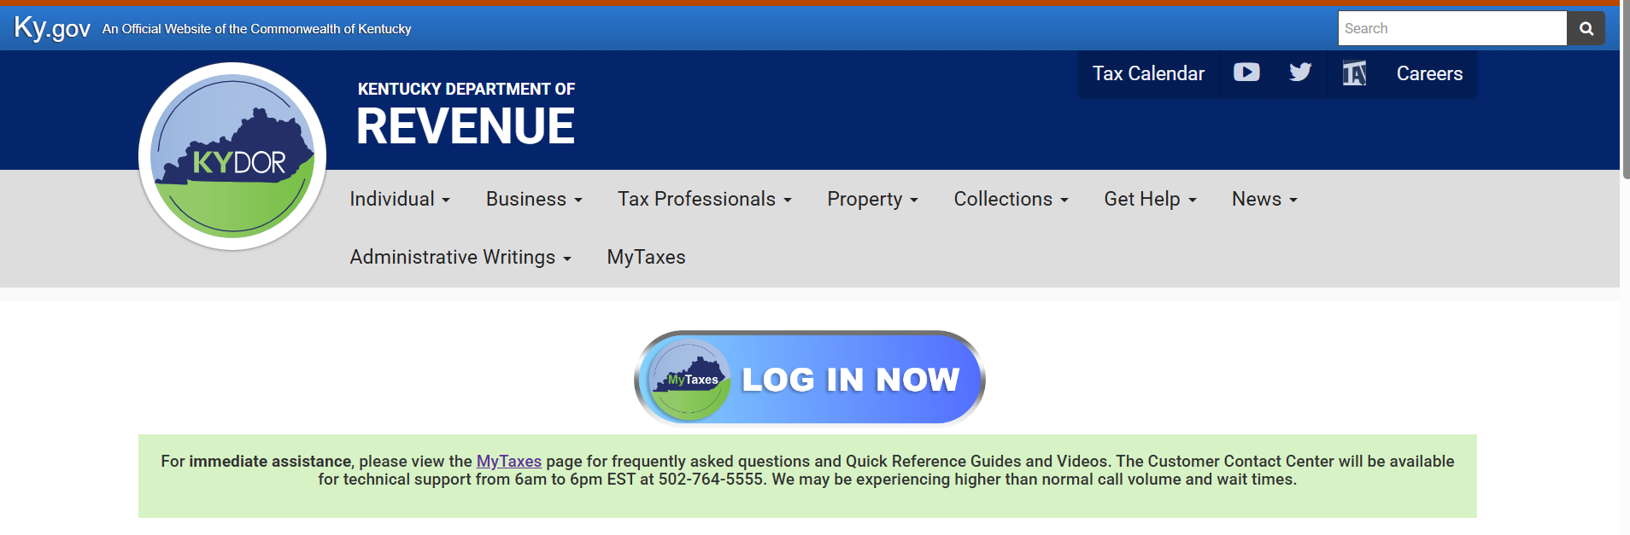
Stay in Touch
Department of Revenue Website
  https://revenue.ky.gov

Slide 41
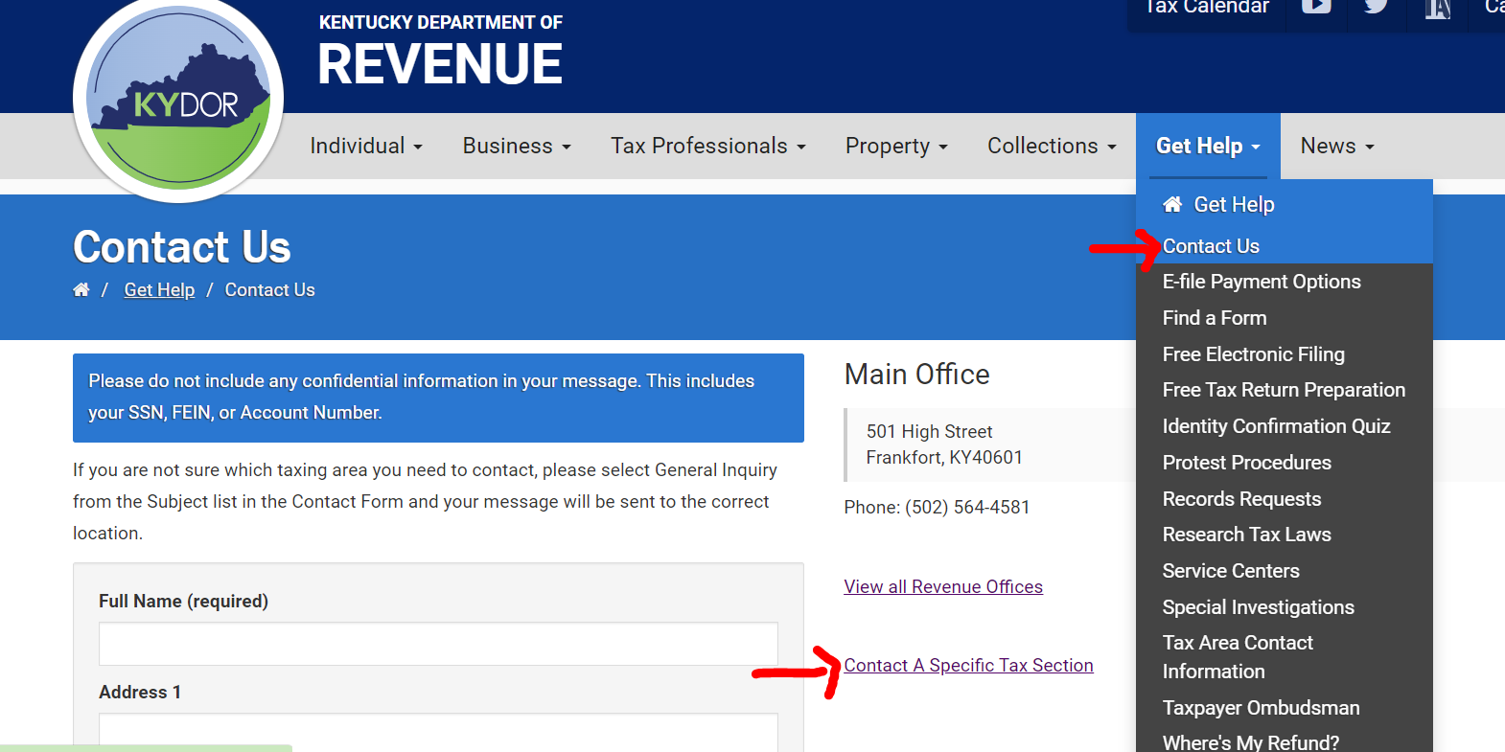
Reach out to DOR via Web Response

Slide 42
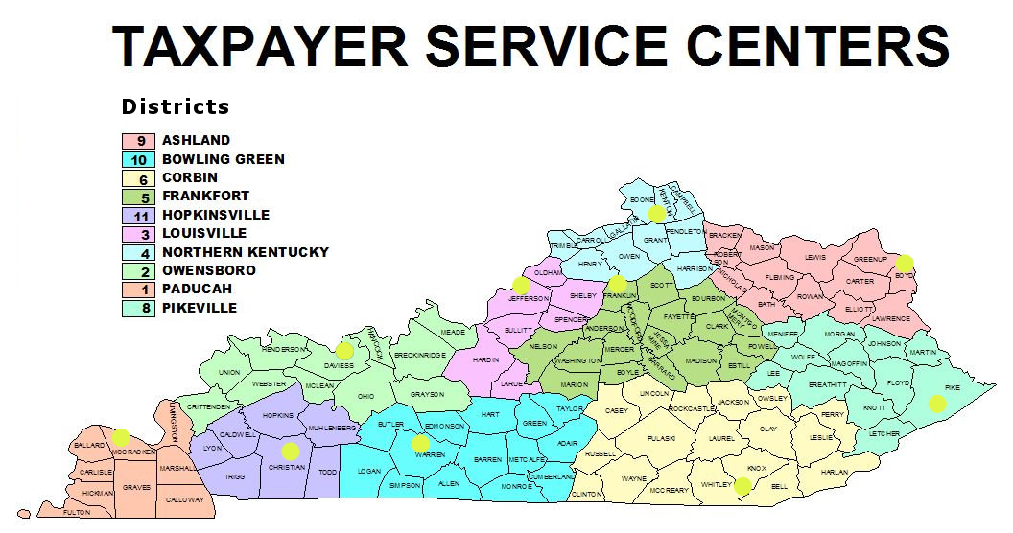
Taxpayer Service Center Map

Slide 43
Taxpayer Service Centers
Ashland Taxpayer Service Center
1539 Greenup Avenue, Suite 501 41101-7695
(606) 920-2037
Bowling Green Taxpayer Service Center
201 West Professional Park Court, 42104-3278
(270) 746-7470
Corbin Taxpayer Service Center
15100 North US25E, Suite 2, 40701-6188
(606) 528-3322
Frankfort Taxpayer Service Center
501 High Street, 40601-2103
(502) 564-4581 (Taxpayer Assistance)
(502) 564-5930 (Taxpayer Service Center)
Hopkinsville Taxpayer Service Center
181 Hammond Drive, 42240-7926
(270) 889-6521
Louisville Taxpayer Service Center
600 West Cedar Street, 2nd Floor West, 40202-2310
(502) 595-4512
Northern Kentucky Taxpayer Service Center
Turfway Ridge Office Park
7310 Turfway Road, Suite 190, Florence, 41042-4871
(859) 371-9049
Owensboro Taxpayer Service Center
401 Frederica Street, Building C, Suite 201, 42301-6295
(270) 687-7301
Paducah Taxpayer Service Center
Clark Business Complex, Suite G
2928 Park Avenue, 42001-4024
(270) 575-7148
Pikeville Taxpayer Service Center
Uniplex Center, 126 Trivette Drive, Suite 203, 41501-1275
(606) 433-7675

Slide 44
Revenue Contact Phone Numbers
Collections | (502) 564-4921
Corporation Tax | (502) 564-8139
DOR One Stop Help Line | (502) 564-5053
E-Filing Assistance (Business Forms) | (502) 564-7926
E-Filing Assistance (Individual Forms) | (502) 564-7862
Field Operations | (502) 564-2113
Forms and Envelopes | (502) 564-3658
Individual Income Tax | (502) 564-4581
Inheritance Tax | (502) 564-4810
Local Government & County Fees | (502) 564-8785
Miscellaneous Tax | (502) 564-2935
Motor Fuels | (502) 564-3853
Motor Vehicle Usage | (502) 564-4455
Ombudsman | (502) 564-7822
Property Tax | (502) 564-8338
Protest Resolution | (502) 564-6734
Registration | (502) 564-3306
Sales & Use Tax | (502) 564-5170
Special Investigations | (502) 564-4470
State Operator | (502) 564-3130
Withholding | (502) 564-7287

Slide 45


2025 Kentucky Income Tax Changes
Jessica Martin
Policy/Research Consultant Division of Individual Income Tax
 JessicaE.Martin@ky.gov
 (502) 564-7311
Brad Asher
Tax Consultant
 Brad.Asher@ky.gov
Kentucky Department of Revenue • 501 High Street • Frankfort, KY 40601 • (502) 564-4581

Slide 46
Disclaimer
The Department has developed this presentation to enhance taxpayer understanding of and compliance with the new tax legislation enacted by the Kentucky General Assembly during the recent regular legislative sessions. The information in this presentation is for educational and informational purposes only and does not constitute legal advice. Information is presented as an overall review that is subject to law changes. To review the amendments to Kentucky tax laws enacted during the recent regular sessions in more detail, please refer to the relevant statutory provisions of the Kentucky Revised Statutes.
Information in this presentation is believed to be accurate as of the date of publication. However, any statement in error that may occur during presentations made by the Department of Revenue as part of its tax education program shall not expressly or implied supersede the Department of Revenue’s official interpretation of the law or its policies utilized in administering state revenue and tax laws.

