Slide 1


ArcGIS Online and ArcPro
December 4 - 5, 2024
Kentucky Department of Revenue • 501 High Street • Frankfort, KY 40601 • (502) 564-8338

Slide 2
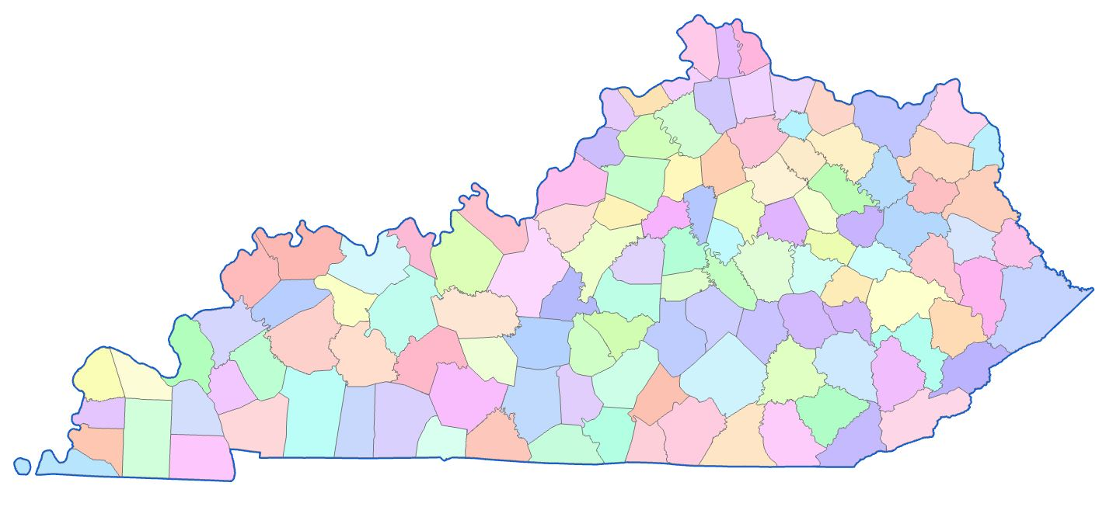


You Have A Lot of Questions
Why Use ArcGIS Online?
Why Switch to ArcPro?
What About Training?
Can We Keep Using ArcMap?
What is the GAMA Sketch Editor?
How Do We Go About Switching?

Slide 3


ArcGIS Online?
A few benefits to switching to ArcGIS Online:
Access from anywhere, anytime
Real-time sharing of editing
Easier data management
Reduction of IT infrastructure
Control over your security and users
Ability to adapt to additional programs

Slide 4
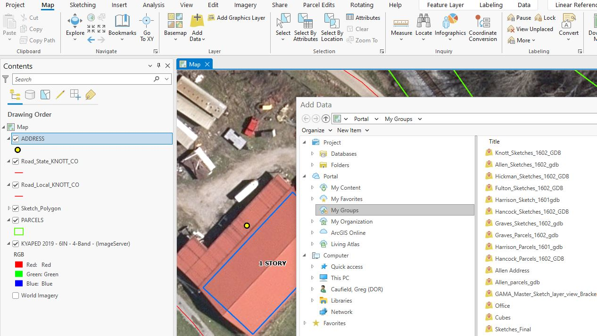
Why Switch to ArcPro?
A few benefits to switching to ArcGIS Pro:
Intuitive Interface
Integration with ArcGIS Online
64-bit Performance
3D Capabilities
Improved Data Management
Regular Updating and Support

Slide 5

Can We Continue to Use ArcMap?
YES – for now
ArcMap will no longer be supported or updated as of March 1, 2026

Slide 6
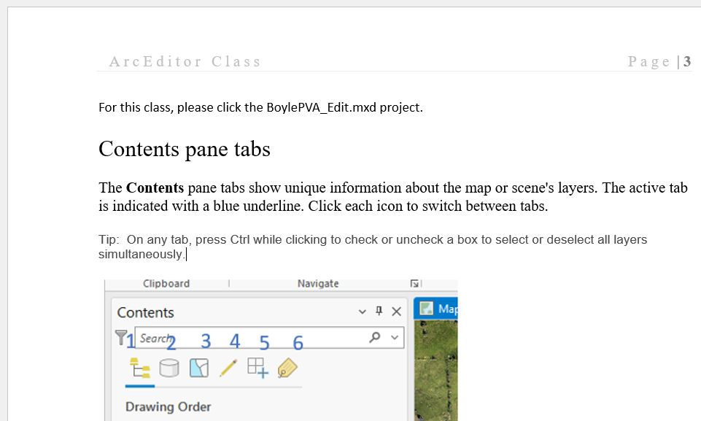
What About Training?
We will still offer KY65 course
We will offer the newly designed KY65 for ArcPro course
Newly created ArcPro Editor’s manual
Remote GAMA Sketching training sessions

Slide 7
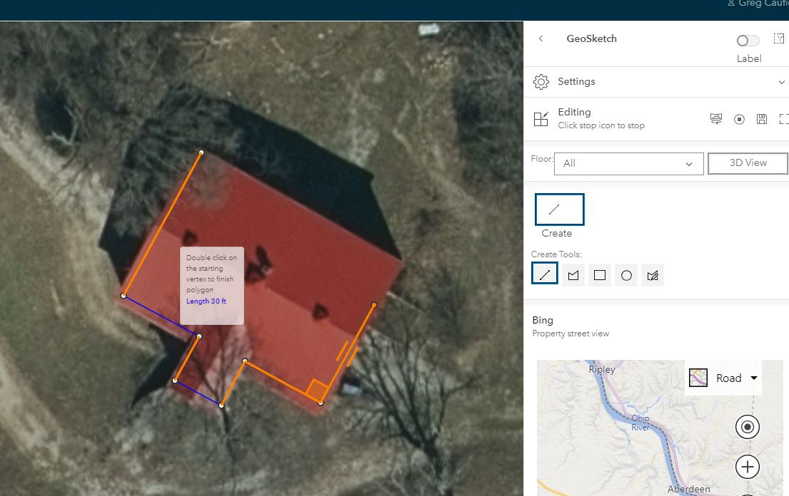
What is the GAMA Sketch Editor?
Assessment Analyst GeoSketch Structure Editor
Accessible from anywhere
Can accommodate multiple editors
Simplified tools
No additional ArcPro or ArcMap licensing
Custom built for DOR
Developers making seamless, frequent updates

Slide 8

How Do We Go About Switching?
Contact the PVA GIS Support Team at
pva.gissupport@ky.gov
We can discuss:
Your current structure
Your current users and needs
Set up county specific user groups
Install or upgrade programs
Walk you through the registration process
Plan training
Plus all the support you are used to from us

Slide 9

GIS Services Staff
GIS Services Manager
Greg Caufield greg.caufield@ky.gov
GIS Analyst III
Tom Moreland tom.moreland@ky.gov
Christopher Bruckman christopher.bruckman@ky.gov
GIS Analyst Contractor
Pamela Rodriguez pamela.rodriguez@ky.gov
Ben Collett ben.collett@ky.gov

Slide 10

Property Valuation GIS Services
Greg Caufield - GIS Services Manager
 greg.caufield@ky.gov
 (502) 564-7017
The information in this presentation is for educational and informational purposes only and does not constitute legal advice. Information is presented as an overall review that is subject to law changes and may not apply to all states. For accurate information on issues related to ArcGIS Online and ArcGIS Pro, please reference https://www.esri.com/en-us/c/product/arcgis-online and https://esri.com/en-us/arcgis/products/arcgis-pro/overview.
Information in this presentation is believed to be accurate as of the date of publication. In the event that any information in this presentation is later determined to be in error, this presentation cannot be used by taxpayers in supporting a specific position or issue before the Department of Revenue, as it does not constitute statutory or regulatory authority.
Kentucky Department of Revenue • 501 High Street • Frankfort, KY 40601 • (502) 564-8338

