Slide 1
2024 Kentucky Tax Changes
KyCPA State Tax Conference December 18, 2024

Slide 2
Sales Tax
2024 Updates
Kentucky Department of Revenue • 501 High Street • Frankfort, KY 40601 • (502) 564-4581

Slide 3
Online Sellers Tax Receipts
SST Filers | FY 22 | FY 23 | FY 24 | FY 25 - YTD
Newly Registered | 91,347,411.00 | 106,399,559.96 | 123,512,689.57 | 41,546,175.91
All | 118,940,012.00 | 151,314,862.47 | 154,538,275.26 | 52,187,468.30
Marketplace Providers | 191,898,622.00 | 215,519,514.32 | 245,096,905.72 | 103,732,766.50
Remote Retailers | 100,206,611.00 | 106,189,224.59 | 107,097,851.18 | 42,894,682.44
 | 292,105,233.00 | 321,708,738.91 | 352,194,756.90 | 146,627,448.94

Slide 4
2024 Sales and Use Tax Legislation Overview - HB 8
Effective January 1, 2025, KRS 139.470(23) and (24) are amended to provide an exemption for the first $12,000 in gross receipts from the sale of a service listed under KRS 139.200 (2)(g) to (ax) during a calendar year.
The previous exemption threshold was $6,000 per year.
Retailers only making sales of services listed under KRS 139.200 (2)(g) to (ax) which have never had gross receipts over $12,000 during a calendar year are not required to maintain an active sales tax permit if retail sales are not expected to exceed the $12,000 threshold during the current calendar year. However, for the first calendar year when gross receipts exceed $12,000, all gross receipts over $12,000 are taxable in that calendar year. All gross receipts from sales by the retailer are subject to tax in subsequent calendar years, even if below $12,000, once a seller crosses the threshold in any previous calendar year (no annual reset).
This exemption does not apply to retailers engaged in the business of selling tangible personal property, digital property, or services listed in subsection (2)(a) to (f) of KRS 139.200. The exemption also does not apply to retailers with gross receipts from sales in any combination of taxable services, tangible personal property, or digital property.

Slide 5
2024 Sales and Use Tax Legislation Overview - HB 8
Effective July 15, 2024, KRS 139.499 exempts the sale, purchase, use, storage, consumption, installation, repair, and replacement of data center equipment to or by a preliminarily approved company or an approved company.
“Data center equipment” is defined broadly within KRS 154.20-220.
The Department of Revenue (DOR) has created a new data center certificate of exemption and instructions (Form 51A140). Upon receipt of approval or preliminary approval from the Kentucky Economic Development Finance Authority, the DOR will issue the certificate of exemption to the approved company for the purchase of data center equipment. The approved company may issue its certificate of exemption individually or jointly with a contractor for its purchase of data center equipment.
Beginning September 1, 2025, any approved company must issue an annual report to the DOR providing details related to the qualified data center project and an itemized schedule of qualified data center equipment purchased during the fiscal year along with the applicable sales and use tax that was not paid as a result of the sales and use tax exemption.
Beginning November 1, 2025, and every November 1 thereafter, the DOR must report to the Kentucky Economic Development Finance Authority and the Interim Joint Committee on Appropriations and Revenue the data reported to the DOR for data center projects.
As of November 30, 2024, no data center project has received approval or preliminary approval.

Slide 6
2024 Sales and Use Tax Legislation Overview - HB 8
Notice of Governor’s Veto of Sales Tax Exemption for Bullion and Tax Amnesty Programs
Section 33 of HB 8 provided an exemption from sales and use tax for the sale, use, storage, or other consumption of “currency or bullion.” Section 43 through 47 of HB 8 created a tax amnesty program to be conducted for a period of sixty (60) days beginning October 1, 2024.
Governor Andy Beshear exercised his authority under Section 88 of the Kentucky Constitution to disapprove of any part or parts of the appropriation bill by issuing line-item vetoes of the exemption from sales and use tax for currency or bullion and the tax amnesty program. The General Assembly did not override the Governor’s line-item vetoes, leaving them intact.
Accordingly, the sale, use, storage or other consumption of currency or bullion currency continues to be subject to the sales and use tax. Taxpayers should continue to collect and remit the sales and use tax as provided under KRS Chapter 139. Further, the DOR shall not implement the amnesty program appearing in Sections 43 through 47 of HB 8 vetoed by the Governor.

Slide 7
Comparison of Contiguous States
 | State Sales Tax Rate | Maximum Combined State & Local Tax Rate | Sales Tax on Prewritten Computer Software | Sales Tax on Software Access Service/Cloud/SaaS | Taxable Services
Kentucky | 6.00% | 6.00% | Yes | Yes | 51
Illinois | 6.25% | 11.00% | Yes | No | Subject to Review
Indiana | 7.00% | 7.00% | Yes | No | Subject to Review
Missouri | 4.23% | 12.24% | Yes | No | Subject to Review
Ohio | 5.75% | 8.00% | Yes | Yes, if used in a business | Subject to Review
Tennessee | 7.00% | 9.75% | Yes | Yes | Subject to Review
Virginia | 5.30% | 7.00% | Yes | No | Subject to Review
West Virginia | 6.00% | 7.00% | Yes | Yes | Services taxable unless specific exemption

Slide 8
5 Services Taxable in KY Prior to 7/1/2018
Accommodations less than 30 days
Sewer Services (Non-residential)
Admissions (Non-participatory)
Communications Services (Telecommunications & Ancillary Services)
Distribution, transmission, or transportation services for natural gas (Non-residential)

Slide 9
2018 HB 487 – 12 New categories of Taxable Services – KRS 139.200
Effective July 1, 2018, charges for the provision of the following services became subject to sales tax:
Landscaping services - including but not limited to lawn care and maintenance services; tree trimming, pruning or removal services; landscape design and installation services; and snow plowing and removal services
Janitorial services - including but not limited to residential and commercial cleaning services, and carpet, upholstery, and window cleaning services
Small animal veterinary services - excluding veterinary services for equine, cattle, swine, sheep, goats, llamas, alpacas, ratite birds, buffalo, and cervids
Pet care services - including but not limited to grooming and boarding services, pet sitting services, and obedience training services
Industrial laundry - including but not limited to industrial uniform supply services, protective apparel supply services, and industrial mat and rug supply services

Slide 10
2018 HB 487 – 12 New categories of Taxable Services – KRS 139.200
Effective July 1, 2018, charges for the provision of the following services became subject to sales tax:
Non–coin–operated laundry and dry-cleaning services
Linen supply services - including but not limited to table and bed linen supply services and non-industrial uniform supply services
Indoor skin tanning services - including but not limited to tanning booth or tanning bed services and spray tanning services
Non–medical diet and weight reducing services
Limousine services - if a driver is provided
Extended warranty services - to cover tangible personal property or digital property that is taxable at retail to the warranty holder
Participatory admissions - the privilege of participating in an event or activity

Slide 11
2022 HB 8 and 2023 HB 360 34 New Services Subject to Sales and Use Tax - Effective January 1, 2023
Photography and photo finishing services
Telemarketing services - means services provided via telephone, facsimile, electronic mail, text messages, or other modes of communications
Public opinion and research polling services
Lobbying services – includes activities under KRS 11A.201 and KRS 6.611 for executive and legislative branch lobbying, as well as local and federal activities.
Executive employee recruitment services – services provided to locate candidates to fill open senior-level management positions. These services may include conducting interviews and contract negotiations. DOR also applies the concept of highly compensated employee under IRC Section 414(q)(2).
Web site design and development services
Web site hosting services
Facsimile transmission services
Private mailroom services - including:
Presorting mail and packages by postal code; Address barcoding; Tracking; Delivery to postal service; Private mailbox rentals

Slide 12
2022 HB 8 and 2023 HB 360 34 New Services Subject to Sales and Use Tax - Effective January 1, 2023
Bodyguard services
Residential and nonresidential security system monitoring services - excluding separately stated onsite security guard services
Private investigation services
Process server services
Repossession of tangible personal property services
Personal background check services
Parking services - including:
Valet services; and the use of parking lots and parking structures; excluding any parking services at an educational institution
Road and travel services provided by automobile clubs as defined in KRS 281.010
Condominium time-share exchange services
Rental of space for meetings, conventions, short-term business uses, entertainment events, weddings, banquets, parties, and other short-term social events - does not apply to subleases and sub-rents to exhibitors or others if tax is paid on the initial rental of the space by the primary lessee
Social event planning and coordination services
Leisure, recreational, and athletic instructional services - does not apply to certain non-profit civic and other nonprofit organizations under KRS 139.498
Recreational camp tuition and fees

Slide 13
2022 HB 8 and 2023 HB 360 34 New Services Subject to Sales and Use Tax - Effective January 1, 2023
Personal fitness training services
Massage services - except when medically necessary
Cosmetic surgery services - clarification added to exclude surgery services that are medically necessary
Body modification services - including tattooing, piercing, scarification, branding, tongue splitting, transdermal and subdermal implants, ear pointing, teeth pointing, and any other modifications that are not necessary for medical or dental health
(Laboratory) testing services - except testing for medical, educational, or veterinary reasons, with new exclusion for government related testing requirements
Interior decorating and design services
Household moving services
Specialized design services - including the design of clothing, costumes, fashion, furs, jewelry, shoes, textiles, and lighting
Lapidary services - including cutting, polishing, and engraving precious stones
Labor and services to repair or maintain commercial refrigeration equipment and systems - when no tangible personal property is sold in that transaction including service calls and trip charges
Labor to repair or alter apparel, footwear, watches, or jewelry - when no tangible personal property is sold in that transaction
Prewritten computer software access services - added to the definition of extended warranty services, storage, and use
Expanded definition of extended warranty services - now includes real property and exempt tangible personal property

Slide 14
Further Guidance - Extended Warranty Services
Effective January 1, 2023, “extended warranty services” in KRS 139.010 means “services provided through a service contract agreement between the contract provider and the purchaser where the purchaser agrees to pay compensation for the contract and the provider agrees to repair, replace, support, or maintain tangible personal property, digital property, real property, or prewritten computer software access services according to the terms of the contract, [if:
1. The service contract agreement is sold or purchased on or after July 1, 2018, and
2. The tangible personal property or digital property for which the service contract agreement is provided. Is subject to tax under this chapter or under KRS 138.460.”
The effect of this language change (deletions and additions) is to not only add extended warranty contracts for real property and prewritten computer software access services, but to also include all contracts for tangible personal property and digital property regardless of whether the property itself is taxable or exempt. For example, separately charged extended warranties purchased on exempt property such as farm equipment, machinery for new expanded industry and motor vehicles sold to certain out-of-state residents will no longer be exempt from sales and use tax. However, all entity-based exemptions are still valid so the purchase of an extended warranty contract by a tax-exempt purchaser, such as a 501(c)(3) charitable organization or a governmental entity, may still be exempt from the tax.
See chart below illustrating the impact of the expanded extended warranty services definition.
Extended Warranty | Prior Treatment | New Treatment
Water Heater | Exempt | Taxable
Garage Door | Exempt | Taxable
Building Roofing | Exempt | Taxable
Dishwasher | Exempt | Taxable
Farm Tractor | Exempt | Taxable
Semi-tractor and / or Trailer | Exempt | Taxable
Equipment (Labor Only) | Exempt | Taxable
Software Upgrade Help Desk Support | Exempt | Taxable

Slide 15
Further Guidance - Resale Exemption
When making repairs covered under an extended warranty service contract, providers may purchase materials that become part of the repair and permanently remain with the customer under a resale certificate.
Retail service providers may claim a resale exemption for the purchase of services for resale in most taxable service categories. Excludes accommodations, sewer services, and admissions.
Providers of retail services may not claim a resale exemption on purchases of products used or consumed while providing their retail services. The only tangible personal property the retailer of services may purchase exempt for resale are those items they resell to their customers that remain with the customer permanently.
Note the following administrative regulations for additional guidance on the application of the resale exemption:
KY Regulation 103 KAR 26:090 - Veterinarians and Pet Care Service Providers - https://apps.legislature.ky.gov/law/kar/103/026/090.pdf
KY Regulation 103 KAR 26:100 - Industrial Laundry and Linen Supply Services - https://apps.legislature.ky.gov/law/kar/103/026/100.pdf
KY Regulation 103 KAR 26:131 - Landscaping Services - https://apps.legislature.ky.gov/law/kar/103/026/131.pdf

Slide 16
2024 KY Sales Tax Updates
Richard Dobson
Executive Director Office of Sales and Excise Taxes
 Richard.Dobson@ky.gov
 (502) 564-5523
Kentucky Department of Revenue • 501 High Street • Frankfort, KY 40601 • (502) 564-4581

Slide 17
Corporate Income Tax/LLET
2024 Updates
Kentucky Department of Revenue • 501 High Street • Frankfort, KY 40601 • (502) 564-8139

Slide 18
Overview of the 2024 Legislative Session
HB 8
Updated IRC conformity date
Extension of Corporate Income Tax Exemption for Disaster Response Businesses
Deferred tax deduction for Unitary Filings
Broadband Tax Credit created

Slide 19
Updated IRC Conformity Date
For tax years beginning on or after January 1, 2024:
The IRC conformity date is December 31, 2023.
Previous conformity date was December 31, 2022.
As a result, the Internal Revenue Code in effect on December 31, 2023, is applicable for Kentucky Income Tax purposes, unless Kentucky has specific statutes that state otherwise.
Statute Reference: KRS 141.010(21)

Slide 20
Disaster Response Businesses
The exemption initially passed during the 2021 Legislative Session and was set to expire January 1, 2025. HB 8 extended the corporation income tax exemption for disaster response businesses to tax years beginning on or after January 1, 2021, but before January 1, 2027.
For purposes of this exemption, disaster response business is defined by KRS 141.010(10). Disaster response businesses eligible for the exemption:
Have no presence in Kentucky and conduct no business in Kentucky except for disaster or emergency-related work during a response period;
Services are requested by a registered business or state or local government to perform disaster or emergency-related work during a response period; and
Have no registrations, tax filings, or nexus in Kentucky other than disaster or emergency-related work during the calendar year immediately preceding the declared state disaster or emergency.
For taxable years beginning on or after January 1, 2021, but before January 1, 2027, the tax imposed by this section shall not apply to a disaster response employee or to a disaster response business. The remainder of the income received by such nonresident shall be deemed nontaxable by this state.

Slide 21
Deferred Tax Deduction
HB 8 delays the deferred tax deduction until tax years beginning on or after January 1, 2026.
The deduction is allowed for companies filing a combined report that saw an increase in a net deferred tax liability, a decrease in a net deferred tax asset, or aggregate change from a net deferred tax asset to a net deferred tax liability as a result of the imposition of the combined reporting requirement.
Any combined group intending to claim the deferred tax deduction must have filed a statement with the Department of Revenue on or before July 1, 2019.

Slide 22
Broadband Expansion Tax Credit
The broadband expansion tax credit is available for tax years beginning on or after January 1, 2025, but before January 1, 2029.
The total amount of the credit awarded is capped at $5 million for each taxable year.
Companies must complete and file an application with the Department by December 31 of the calendar year in which the investment was made.
The Department will review and approve the allowable credit amount by February 1.

Slide 23
Broadband Expansion Tax Credit
This is a nonrefundable and nontransferable tax credit.
The credit is limited to 50% of the amount of sales tax paid for purchases of eligible equipment and services, reduced by any seller reimbursement allowed under KRS 139.570.
It requires that equipment and services are used to expand broadband.
The credit can be used against:
Limited Liability Entity Tax
Corporation Tax
Individual Income Tax
Statute Reference: KRS 141.391

Slide 24
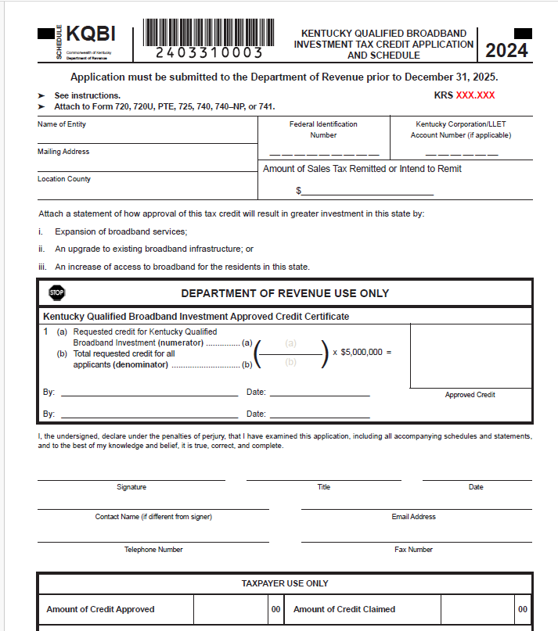
Broadband Expansion Tax Credit KRS 141.391

Slide 25
PTET Estimated Payments Required for 2024
For tax years beginning on or after January 1, 2024, an electing entity is required to make estimated payments.
Form PTET-P has been created to allow an electing entity to calculate the penalty due on the underpayment of estimated taxes for PTET.
Statute Reference: KRS 141.209

Slide 26
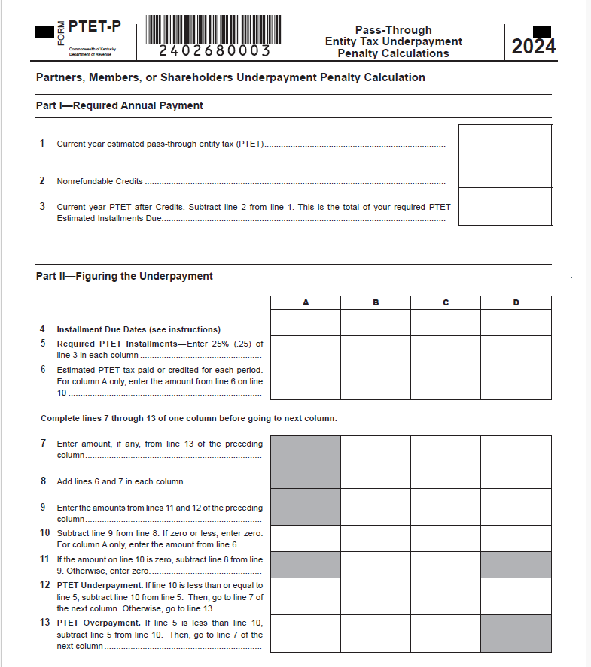
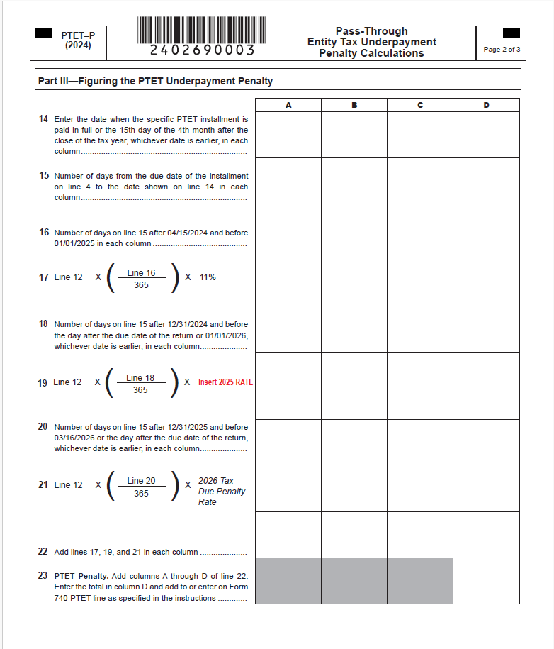
Form PTET-P Pass-Through Entity Underpayment Penalty

Slide 27
Individual Income Tax
2024 Updates
Kentucky Department of Revenue • 501 High Street • Frankfort, KY 40601 • (502) 564-4581

Slide 28
Overview of the 2024 Legislative Session
HB 8
Updated IRC conformity date to December 31, 2023, for tax years beginning on or after January 1, 2024
KRS 141.020 extended the provision for taxable years beginning on or after January 1, 2021, but before January 1, 2027, for a disaster response employee and disaster response business as defined in KRS 141.010.
Broadband Tax Credit created under KRS 141.391

Slide 29
Individual Income Tax: Form Changes
All forms have been updated with year changes and any legislative threshold changes.
2024 Standard Deduction: $3,160
Individual Income Tax Rate for tax year 2024 is 4%
Schedule ITC – added Worksheet INV for the inventory tax credit and updated Family Size Tax Credit Table
Form 741 –attach Schedule ITC when necessary

Slide 30
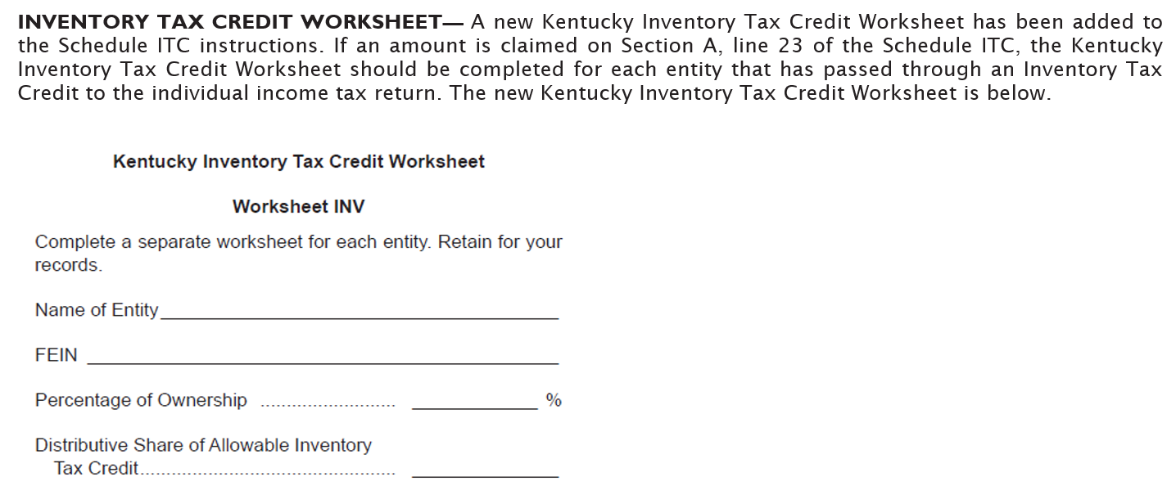
Schedule ITC: Worksheet INV

Slide 31
Form 741 – Schedule ITC
Nonrefundable credits claimed on the Fiduciary return should be included on Schedule ITC and attached to Form 741.
Language on Form 741 and Schedule ITC has been updated to clarify the need to enclose Schedule ITC when necessary.

Slide 32
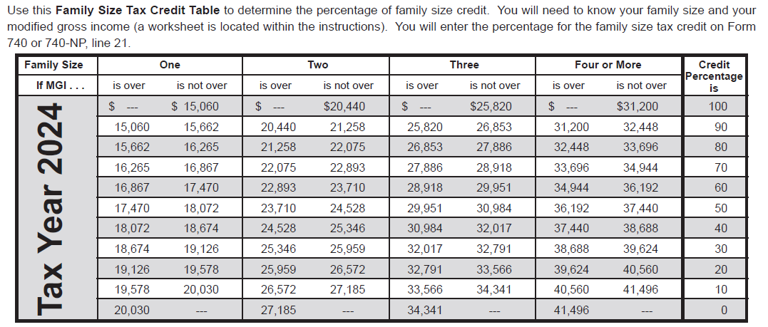
Individual Income Tax: Family Size Tax Credit

Slide 33
Looking Ahead – Reduction of Individual Income Tax Rate
HB 8 (2022) amended by HB 659 (2022)
Additional changes have been made to the rate reduction conditions.
The Budget Reserve Trust Fund will be reviewed each year and compared with the General Fund.
Individual Income Tax Rate can be reduced by 0.5% each tax year if fiscal requirements are met.
All future individual income tax rate reductions must be approved by the General Assembly.
The Individual Income Tax Rate for tax year 2025 is 4%.
The Standard Deduction for tax year 2025 is $3,270.

Slide 34
Employer Payroll Withholding
All filing types are now mandated by e-file requirements.
For tax year 2025, the tax rate will remain at 4%.
Note: If a taxpayer receives more than one W-2 annually, they may need to withhold an additional $130 for each additional W-2 received. The standard deduction is factored into the calculation for Kentucky withholding, and withholding for each W-2 will account for the standard deduction. The employee, however, will only receive this deduction once their return is filed.

Slide 35
Other Information and Reminders
Kentucky Department of Revenue • 501 High Street • Frankfort, KY 40601 • (502) 564-4581

Slide 36
Electronic Payments
Actual withdrawal of electronic payments may be later than the requested date. Please allow up to two weeks for processing.
Please do not submit duplicate payments.

Slide 37
Electronic Payments
We have noticed an increase in misapplied payments. Please caution taxpayers to choose the correct tax type when making an electronic payment.
Tax Type:
“Individual Income Tax – (Tax Account number is the Social Security Number)”
This would be used to make a payment when the return is filed to pay the balance of tax due.
“Individual Income Tax – Estimated Payment (Tax Account number is the Social Security Number)”
This would be used to make an estimated tax payment for the following tax year. The year will automatically default to the year for which we are accepting estimated tax payments.

Slide 38
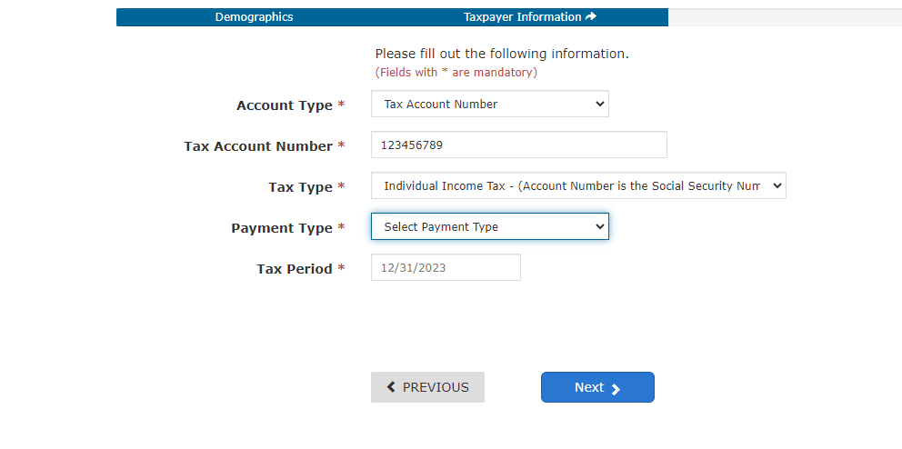
Payments for Tax Due on a Return

Slide 39
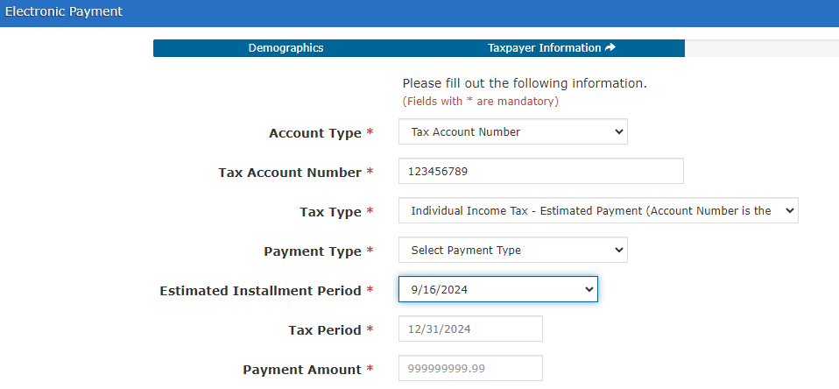
Estimated Tax Payments

Slide 40
Electronic Filing
Electronic filing is available through third-party vendors that support Kentucky.
Visit the Department of Revenue website at Revenue.ky.gov for updates of approved Tax Software Vendors under the Tax Professionals Tab and click on Software Developers.
YTD 2024:
94% of tax year 2023 individual income tax returns were e-filed
58% of tax year 2023 corporate and pass-through entity tax returns were e-filed

Slide 41
Tax Interest Rate
2025 Tax Interest Rate: 8%
Rate charged on unpaid taxes is 10%
(Base rate of % plus 2%)
Rate paid when interest is due on a refund is 6%
(Base rate of % minus 2%)
Statute Reference: KRS 131.183

Slide 42
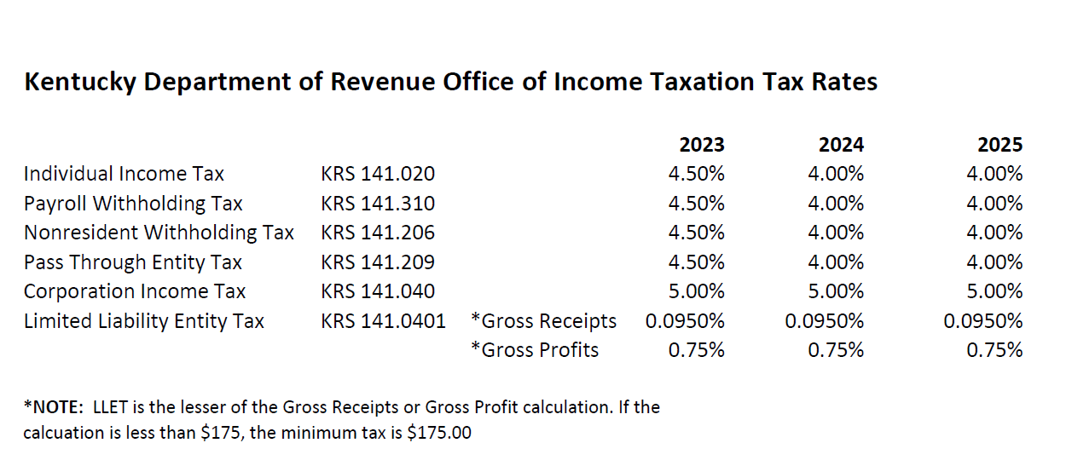
Tax Rates

Slide 43
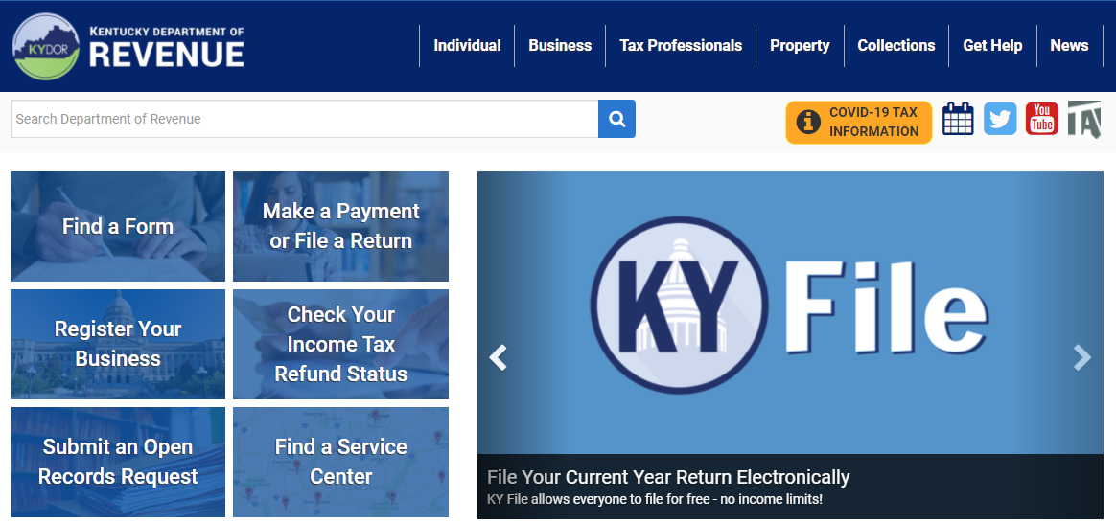
Stay in Touch
Department of Revenue Website
https://revenue.ky.gov
Kentucky Business One Stop Portal
https://onestop.ky.gov

Slide 44
Press Releases and Important Updates
The Kentucky Department of Revenue (DOR) provides important updates to tax information on Revenue.ky.gov.
Check the DOR website regularly for timely information on disaster relief provisions.
DOR will implement a new Integrated Tax System in March 2025.
Stay Connected: sign up for Revenue news and updates directly to your inbox.

Slide 45
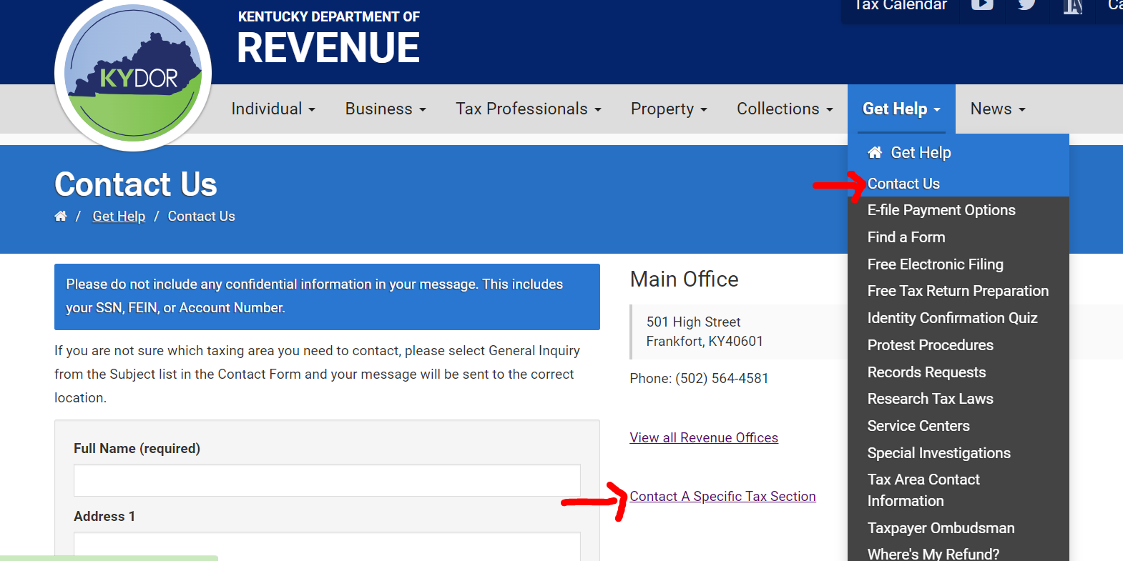
Reach out to DOR via Web Response

Slide 46
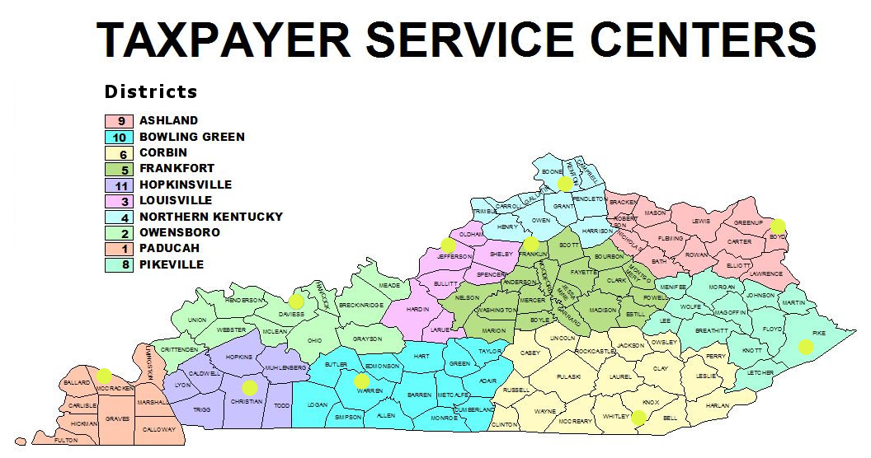
Taxpayer Service Center Map

Slide 47
Taxpayer Service Centers
Ashland Taxpayer Service Center
1539 Greenup Avenue, Suite 501 41101-7695
(606) 920-2037
Bowling Green Taxpayer Service Center
201 West Professional Park Court, 42104-3278
(270) 746-7470
Corbin Taxpayer Service Center
15100 North US25E, Suite 2, 40701-6188
(606) 528-3322
Frankfort Taxpayer Service Center
501 High Street, 40601-2103
(502) 564-4581 (Taxpayer Assistance)
Hopkinsville Taxpayer Service Center
181 Hammond Drive, 42240-7926
(270) 889-6521
Louisville Taxpayer Service Center
600 West Cedar Street, 2nd Floor West, 40202-2310
(502) 595-4512
Northern Kentucky Taxpayer Service Center
Turfway Ridge Office Park
7310 Turfway Road, Suite 190, Florence, 41042-4871
(859) 371-9049
Owensboro Taxpayer Service Center
401 Frederica Street, Building C, Suite 201, 42301-6295
(270) 687-7301
Paducah Taxpayer Service Center
Clark Business Complex, Suite G
2928 Park Avenue, 42001-4024
(270) 575-7148
Pikeville Taxpayer Service Center
Uniplex Center, 126 Trivette Drive, Suite 203, 41501-1275
(606) 433-7675

Slide 48
Revenue Contact Phone Numbers
Collections | (502) 564-4921
Corporation Tax | (502) 564-8139
DOR One Stop Help Line | (502) 564-5053
E-Filing Assistance (Business Forms) | (502) 564-7926
E-Filing Assistance (Individual Forms) | (502) 564-7862
Field Operations | (502) 564-2113
Forms and Envelopes | (502) 564-3658
Individual Income Tax | (502) 564-4581
Inheritance Tax | (502) 564-4810
Local Government & County Fees | (502) 564-8785
Miscellaneous Tax | (502) 564-2935
Motor Fuels | (502) 564-3853
Motor Vehicle Usage | (502) 564-4455
Ombudsman | (502) 564-7822
Property Tax | (502) 564-8338
Protest Resolution | (502) 564-6734
Registration | (502) 564-3306
Sales & Use Tax | (502) 564-5170
Special Investigations | (502) 564-4470
State Operator | (502) 564-3130
Withholding (also use for WRAPS) | (502) 564-7287

Slide 49
2024 Kentucky Income Tax Changes
Barbara Quackenboss
Executive Director Office of Income Taxation
 Barbara.Quackenboss@ky.gov
 (502) 564-7343
Kentucky Department of Revenue • 501 High Street • Frankfort, KY 40601 • (502) 564-4581

Slide 50
Disclaimer
The Department has developed this presentation to enhance taxpayer understanding of and compliance with the new tax legislation enacted by the Kentucky General Assembly during the 2024 regular legislative session. The information in this presentation is for educational and informational purposes only and does not constitute legal advice. Information is presented as an overall review that is subject to law changes. To review the amendments to Kentucky tax laws enacted during the 2024 regular session in more detail, please refer to House Bill 8 and the relevant statutory provisions of the Kentucky Revised Statutes. You may refer to KRS 141.209 and KRS 141.389 for relevant information from the 2023 regular session.
Information in this presentation is believed to be accurate as of the date of publication. However, any statement in error that may occur during presentations made by the Department of Revenue as part of its tax education program shall not expressly or implied supersede the Department of Revenue’s official interpretation of the law or its policies utilized in administering state revenue and tax laws.

