Slide 1


2025 Kentucky Tax Changes
KyCPA State Tax Conference December 17, 2025

Slide 2


Division of Special Investigations
Director Mark Kennedy
December 17, 2025
Kentucky Department of Revenue • 501 High Street • Frankfort, KY 40601 • (502) 564-4581

Slide 3
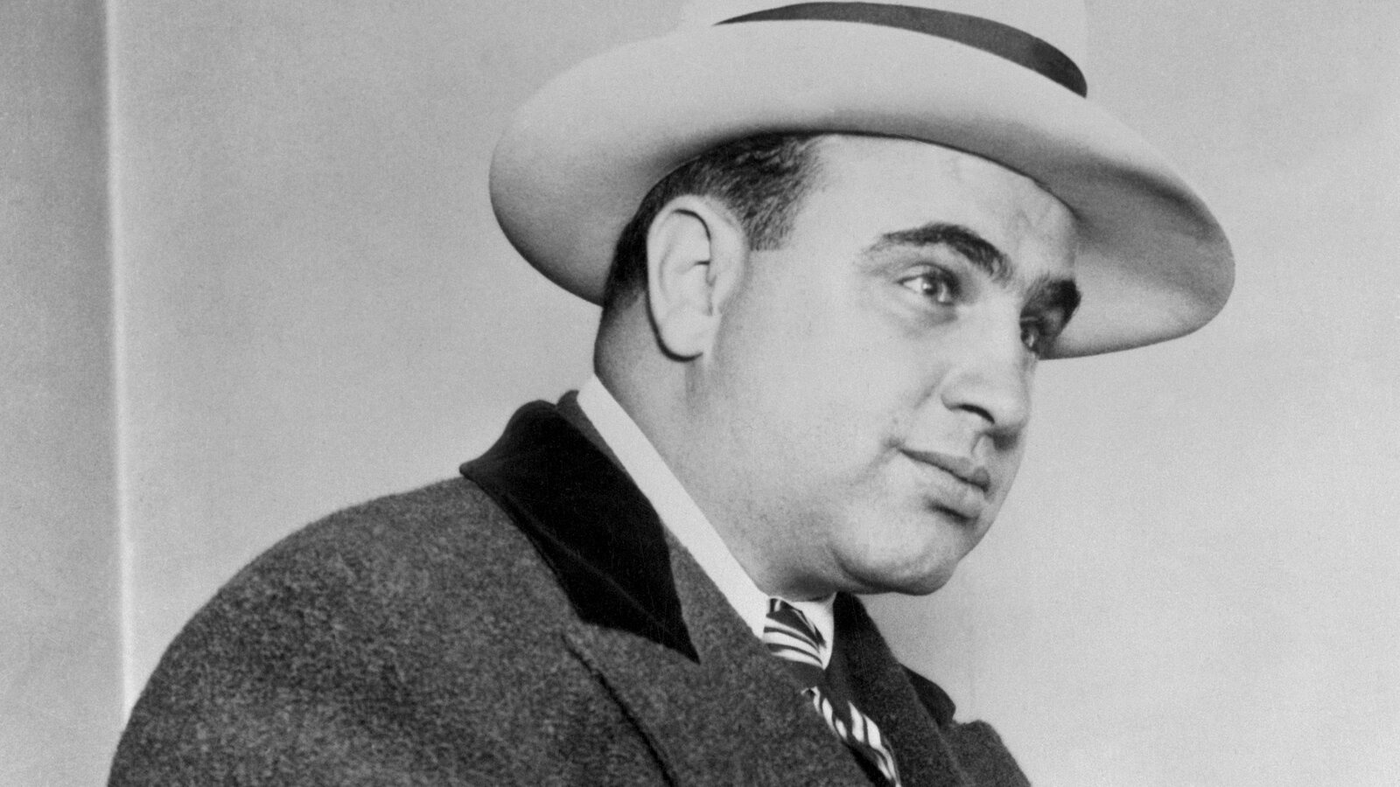

Our Mission
The Division of Special Investigations (DSI) conducts criminal investigations into alleged violations of Kentucky tax laws.
Notes:
The “Al Capone Model” Approach
I’ll discuss how our Division applies the “Al Capone model” — using financial and tax evidence to build strong cases when traditional investigative avenues don’t fully capture the scope of criminal conduct.
This strategy focuses on following the money: identifying unreported income, fraudulent filings, or other tax violations that can strengthen broader criminal cases.
For example, I’ll mention two recent Louisville cases involving copper wire theft.
While the initial evidence tied them to theft, it was the tax evasion charges that provided the leverage to secure convictions and jail time.
Those financial charges ultimately uncovered broader criminal behavior and led to successful prosecutions.

Slide 4

Case Example: Elder Abuse
The Victim
The Perpetrator
An elderly individual, with cognitive decline, who relies on a trusted person for financial management and daily care.
A trusted relative or caregiver, in this case, a nephew, holding Power of Attorney (POA) and full access to the victim's finances.
Notes:
Tax records are often the paper trail of truth…they expose financial control, concealment, or exploitation.
Elder abuse frequently overlaps with financial crimes, especially when the abuser has access to the victim’s finances.
Our Division’s financial expertise can turn a tax case into a public safety case, protecting vulnerable citizens.

Slide 5
Case Example: Elder Abuse
The Crime:
Unauthorized cash withdrawals from bank accounts.
Using the victim's debit card for personal expenses like vacations, luxury goods, and home renovations.
Writing checks to himself from the victim's account, falsely labeling them "Care Expenses" or "Repairs."
Systematic theft of retirement and investment funds.

Slide 6
Case Example: Elder Abuse
Evasion (On His Return)
Fraud (On Her Return)
The perpetrator fails to report the stolen funds as income on his own tax return, criminally evading personal income tax.
He files his aunt's tax return, fabricating deductions (e.g., "medical" or "business") to justify the theft, sometimes stealing the resulting false refund.

Slide 7
Case Example: Elder Abuse
Criminal Charges: Felony counts of Tax Evasion, Filing a False Tax Return, Financial Elder Abuse, and Theft.
Sentencing: A significant term of imprisonment for the multiple, related offenses.
Restitution: Court-ordered repayment of all stolen funds to the victim's estate.
Tax Penalties: Full payment of back taxes, plus substantial interest and civil fraud penalties to the IRS and state.

Slide 8
Reporting Tax Fraud
​​Online form (prefer​red method)
Phone/Voice​​mail: ​(502) 564-4470
​Email: ​DOR.Specialinvestigations@ky.gov
​Mail: Division of Special Investigations, ​Finance and Administration Cabinet, 501 High Street Station 18, Frankfort, KY 40601

Slide 9
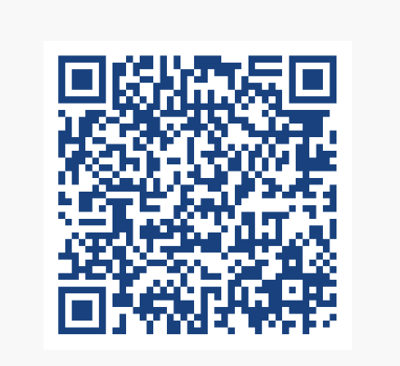
Reporting Tax Fraud
Notes:
The QR code links to the DOR Tax Fraud Reporting page

Slide 10

Questions

Slide 11
Sales Tax Updates
State Tax Conference December 2025

Slide 12
Penny Shortages
Impact on Sales Tax Calculations
On November 12, 2025, the last penny production ran at the US Mint in Philadelphia.
Each penny cost 3.69 cents to make, and the Treasury Department estimates a $56 million annual savings from ending production.
As word of this decision has spread, shortages are already occurring at the retail level with banks limiting the number of pennies provided to retailers.
Because pennies are becoming scarce, retailers may not be able to give exact change. Therefore, they must round the total amount due to the nearest nickel when customers pay with cash.
Retailers don’t need to change how they calculate sales tax. Still calculate the same way by multiplying the price of taxable items by the KY 6% sales tax rate and round that amount to the nearest penny. This method applies whether the customer pays with cash, card, or another method.

Slide 13
Penny Shortages
Although a couple of bills (SB 1575 and HR 3074) have been introduced in Congress, there is no official guidance from the federal government at this time. The KY Department of Revenue recommends using standard rounding rules for cash payments to round the total amount due to the nearest 5 cents.
The standard rounding rules are:
If the last digit is 1, 2, 6, or 7 cents → round down to the nearest nickel; and
If the last digit is 3, 4, 8, or 9 cents → round up to the nearest nickel.
This method is likely the fairest overall for both retailers and customers.
Example -
Item Sold | Tax Calculation and Rounding
Taxable Item 1 | $1.99
Taxable Item 2 | $2.39
Nontaxable Item 1 | $4.99
Nontaxable Item 2 | $3.99
Subtotal | $13.36
Sales Tax Due ($4.38 x 6%) | $0.26
Total Transaction Amount | $13.62
Rounding for Cash Payment | ($0.02)
Cash Amount Due | $13.60
Other Retailer Considerations
Retailers should also remember that some laws prohibit treating cash and non-cash payments differently.
Retailers should consult with their legal advisor to determine the best approach for their business.

Slide 14
House Bill 2 – Bullion
The Department of Revenue (DOR) will be issuing refunds to Kentucky taxpayers for sales use tax paid on the purchase of bullion and collectible currency after August 1, 2024. You do not need to file a lawsuit or go to court to get a refund. Follow the instructions below to seek a refund.
If you have questions regarding the sales and use tax refund process, please email the Division of Sales and Use Tax at krc.webresponsesalestax@ky.gov or call (502) 564-5170.
How to Get Your Refund
Under the longstanding administrative process to ensure consumers charged taxes on exempt transactions receive refunds of the over collected tax amounts (KRS 134.580), the retailer you purchased gold, other precious metals, or collectible currency from must submit a refund request.
Individual consumers seeking a refund of the sales and use tax paid on their purchase of bullion or collectible currency for periods on or after August 1, 2024, should request the refund directly from the retailer they made the purchase from. Each retailer may have a specific refund process to handle these requests. Consumers should be prepared to show proof of their purchase amounts and the tax charged by supplying their purchase receipts.

Slide 15
House Bill 2 – Bullion (cont.)
Refund requests sent directly to the DOR by the consumer without submission through the retailer cannot be processed.
Retailers using the normal refund process must apply directly to the DOR for the applicable refunds by submitting a completed Sales and Use Tax Refund Application (Form 51A209). Please include multiple customer purchases on the same refund application when possible. Most retailers are familiar with the refund process outlined below, and DOR will process the refund claims as quickly as possible.
DOR receives the completed application and verifies the reporting periods, the sales made, and the taxes paid.
DOR issues the refund to the retailer once documentation is verified.
Each retailer pays the refunded tax back to the customer as required under the provisions of KRS 139.770.
Claims for refunds must be filed within four years from the date the tax was paid to the State Treasurer. After the statute of limitations has expired, no claims for refunds or credits will be considered.

Slide 16
Cannabis-Infused Drinks
Senate Bill 202
Provides a licensing and regulatory structure specifically for “intoxicating THC-infused drinks.”
Integrates the products into the three-tier system that governs the production, distribution, and sale of alcoholic beverages in the state and addresses product safety, labeling, potency limits and restrictions on sales to minors.
House Bill 775
Sections 19-24 define cannabis-infused beverages and impose an excise tax of $1.92 on each gallon sold or distributed and a 11% wholesale sales tax, effective July 1, 2025.
This taxation has an estimated revenue growth projection of $930K. The tax reports and payments are due the 20th of the month.

Slide 17
New Qualifying Attraction Sales Tax Incentive
House Bill 775
A series of live performances or exhibitions of musical, theatrical, cultural or other artistic presentation (excluding sporting events and tournaments).
Held within the boundaries of a consolidated local government or urban-county government over at least two consecutive days.
Part of an agreement that authorizes a series of entertainment events annually for at least five consecutive years.
Open to the public with ticket purchase with total attendance over the duration of the event of at least 60,000.
Incentive provided is 50% of the sales tax generated by retail sales of tangible personal property or services generated at the qualifying attraction.
50% of the refund incentive goes to the facility operator (person who owns the venue) and 50% goes to the sponsoring entity (person hosting the qualifying attraction).
DOR is currently developing the refund application for this incentive to handle submittals for events held on or after July 1, 2025.

Slide 18
Expanded Data Center Project Sales Tax Exemption
The original exemption for a broad category of data center equipment was enacted through House Bill 8 in 2024. It was limited to sites within a consolidated government having a population equal to or greater than five hundred thousand (500,000).
House Bill 775 expands the data center exemption based upon the following investment thresholds:
For counties with a population of 100,000 or more, the capital investment is $450 million.
For counties with a population greater than 50,000 but less than 100,000, the minimum capital investment is $100 million.
For counties with a population less than 50,000, the minimum capital investment is $25 million.

Slide 19
New Lodging Facility Category for Tourism Attraction Projects
House Bill 775
Qualifications
Locates in one of the 100 least populated counties in the Commonwealth.
Locates in a county that includes, in part, the boundaries of a designated national forest or is adjacent to or includes a portion of parallel reservoirs of water surrounding a national recreation area.
Locates within an enhanced incentive county within a 1/2 mile of a state resort park and creates at least 50 new full-time jobs within that county.
Makes a capital investment of at least $100 million.
Includes accommodations of at least 100 guest room cabins or rental units with a spa, multiple on-site dining facilities, and multiple meeting or event spaces.
Benefits
Eligible for a sales tax incentive for a 20-year period.
Eligible for up to 50% of the approved costs of the development in sales tax rebates from sales generated by the project over the term of the incentive.

Slide 20
New Expanded Tourism Attraction Project Incentive
House Bill 775
For projects located in an enhanced incentive county with a population of 20,000 or less.
Allows for a 20-year sales tax incentive term.
Provides for up to 50% of approved costs of the development in sales tax rebates from sales generated by the project over the term of the incentive.

Slide 21
Tax Increment Financing
House Bill 775
Allows for a new Tax Increment Financing (TIF) area to be carved out of an existing TIF area that was established before March 27, 2007, by a city of the first class or county containing a city of the first class.
Provides for no less than 10% of the increment for the new TIF area to be paid to the agency for which the existing development area was established.

Slide 22
KY Sales Tax Updates
Richard Dobson
 Richard.dobson@ky.gov
 (502) 564-5523
The information in this presentation is for educational and informational purposes only and does not constitute legal advice. Information is presented as an overall review that is subject to law changes and may not apply to all states. For accurate information on issues related to Kentucky Sales Tax, please reference KRS 139.
Information in this presentation is believed to be accurate as of the date of publication. In the event that any information in this presentation is later determined to be in error, this presentation cannot be used by taxpayers in supporting a specific position or issue before the Department of Revenue, as it does not have the statutory or regulatory authority.
Kentucky Department of Revenue • 501 High Street • Frankfort, KY 40601 • (502) 564-4581

Slide 23
Corporate Income Tax/LLET
2025 Updates
Kentucky Department of Revenue • 501 High Street • Frankfort, KY 40601 • (502) 564-8139

Slide 24

HB 775 (2025) IRC Conformity date
  For tax years beginning on or after January 1, 2025:
    The IRC conformity date is December 31, 2024.
    Previous conformity date was December 31, 2023.
    As a result, the Internal Revenue Code in effect on December 31, 2024, is applicable for Kentucky Income Tax purposes, unless Kentucky has specific statutes that state otherwise.
  Statute Reference: KRS 141.010(21)

Slide 25
Broadband Expansion Tax Credit
  The broadband expansion tax credit is available for tax years beginning on or after January 1, 2025, but before January 1, 2029.
  The total amount of the credit awarded is capped at $5 million for each taxable year.
  Companies must complete and file an application with the Department by December 31 of the calendar year in which the investment was made.
  The Department will review and approve the allowable credit amount by February 1.

Slide 26
Broadband Expansion Tax Credit
This is a nonrefundable and nontransferable tax credit.
The credit is limited to 50% of the amount of sales tax paid for purchases of eligible equipment and services, reduced by any seller reimbursement allowed under KRS 139.570.
It requires that equipment and services are used to expand broadband.
The credit can be used against:
    Limited Liability Entity Tax and Corporation Tax or
    Individual Income Tax
Statute Reference: KRS 141.391

Slide 27
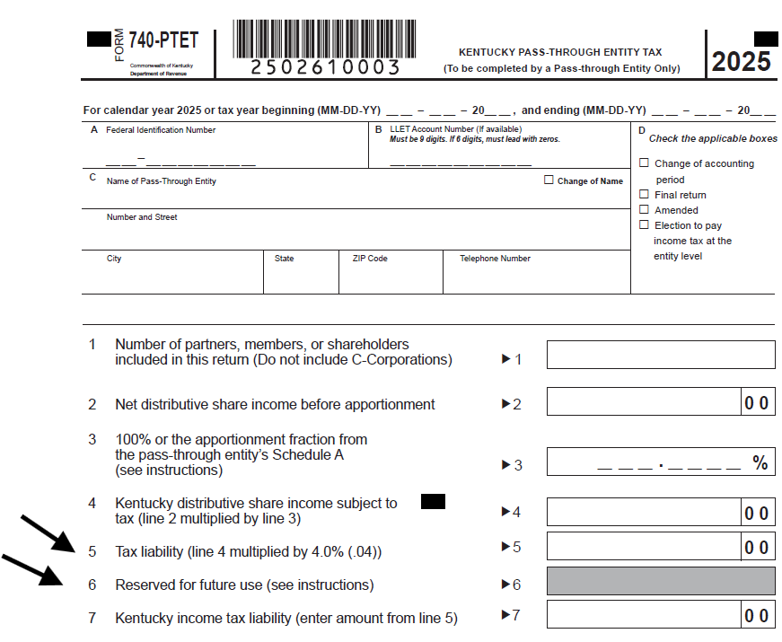
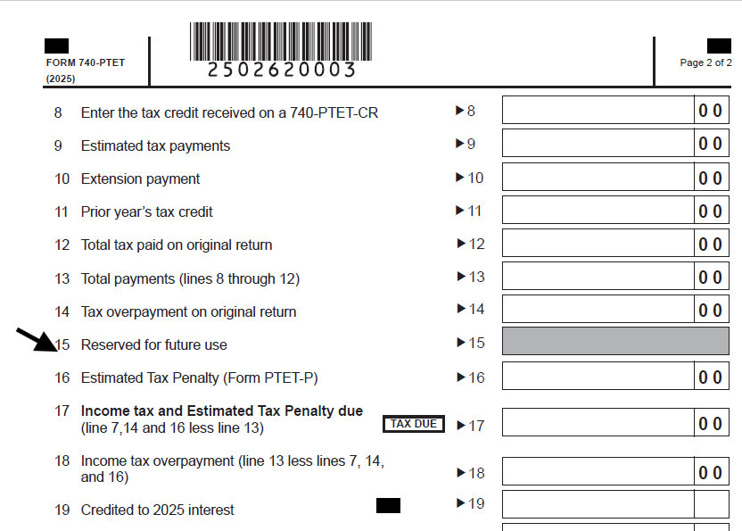
Form 740-PTET Kentucky Pass-Through Entity Tax
Line 5 changed from "Tax before credit" to
"Tax Liability“.
Line 6 marked reserved for
future use.
Line 15 marked reserved for
future use.

Slide 28
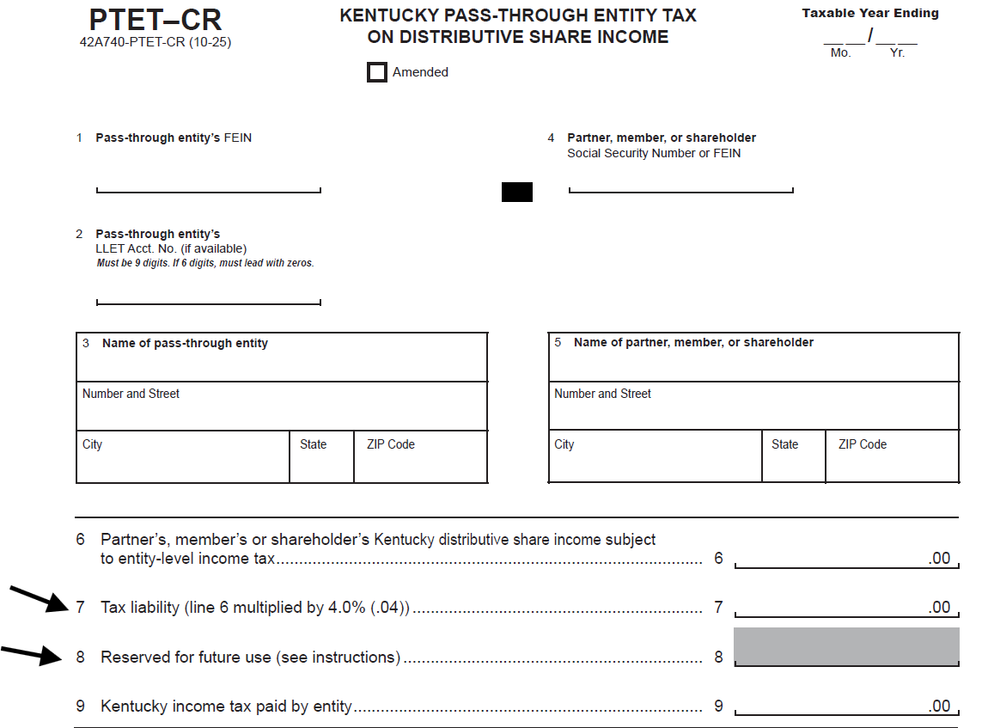
PTET-CR
Line 7 changed from
"Tax before credit" to "Tax Liability".
Line 8 marked
reserved for future use

Slide 29
PTET Estimated Payments Required
For tax years beginning on or after January 1, 2024, an electing entity is required to make estimated payments.
Form PTET-P has been created to allow an electing entity to calculate the penalty due on the underpayment of estimated taxes for PTET.
Do you owe this penalty? This has been added to the 2025 Form PTET-P in Part I.
Statute Reference: KRS 141.209

Slide 30
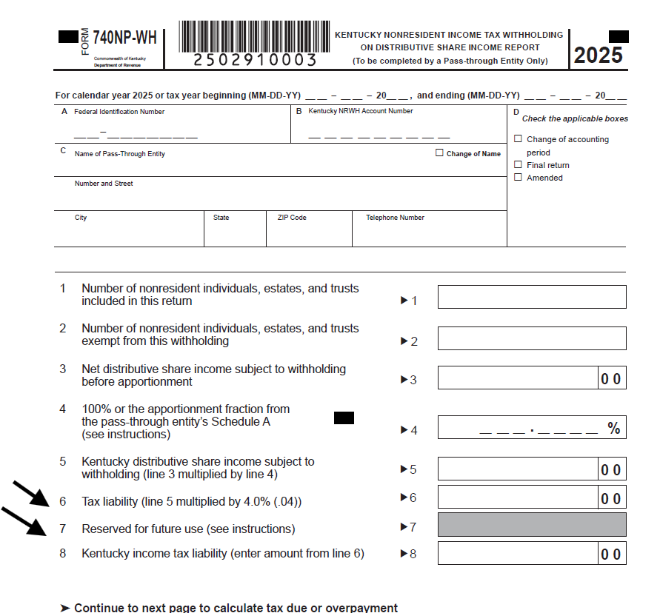
Form 740-NP-WH
Line 6 was changed from
"Tax before credit" to "Tax Liability".
Line 7 was marked as reserved for future use

Slide 31
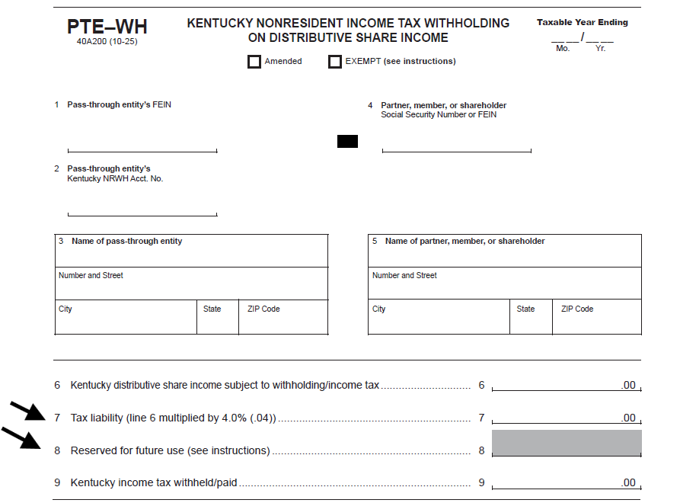
Form PTE-WH
Line 7 changed from "Tax
before credit" to "Tax Liability".
Line 8 was marked
reserved for future use

Slide 32
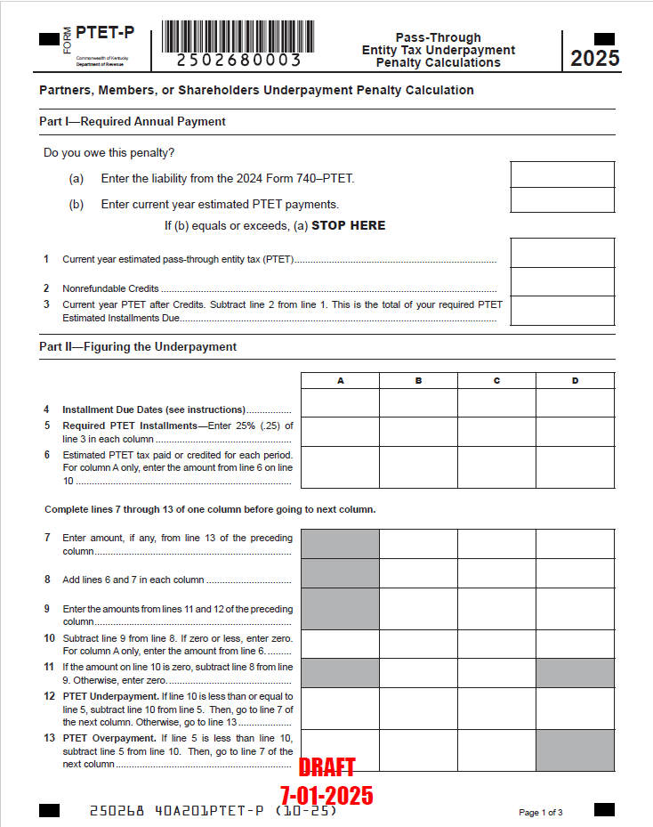
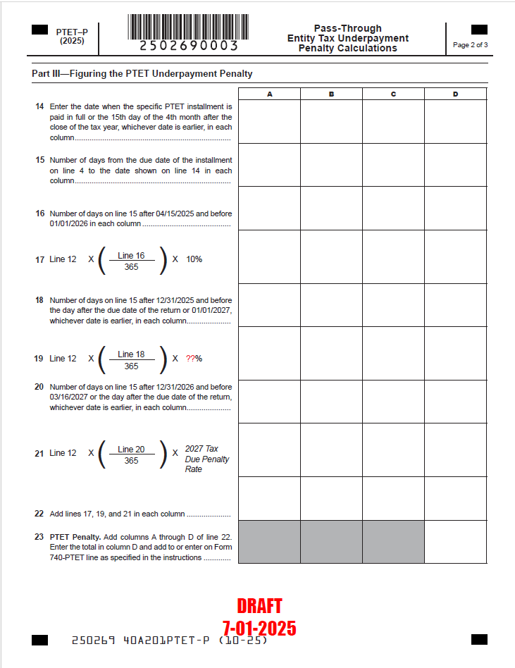

Form PTET-P Pass-Through Entity Underpayment Penalty

Slide 33
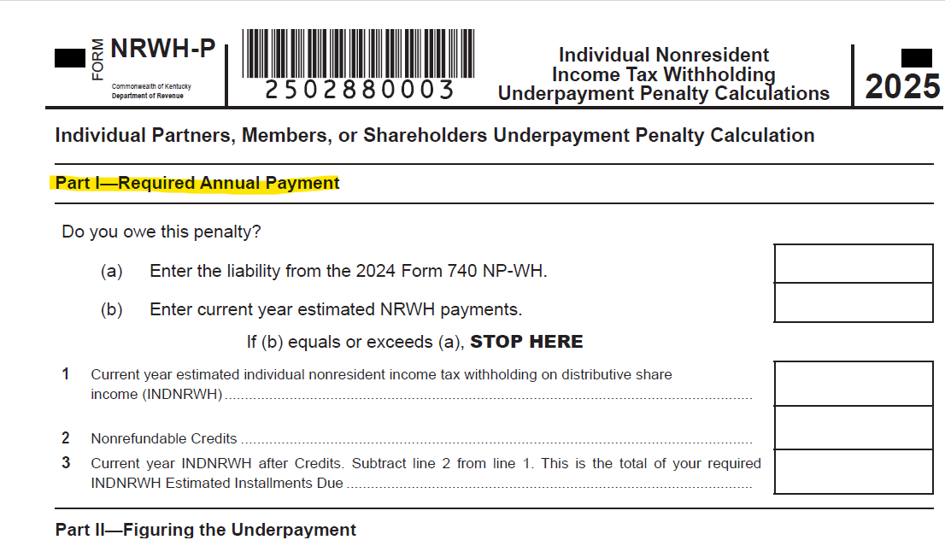
Form NRWH-P
Added (a) and (b) to Part I to
determine if a penalty is owed based on the previous year
tax liability compared to the estimated payments made for
the current year

Slide 34
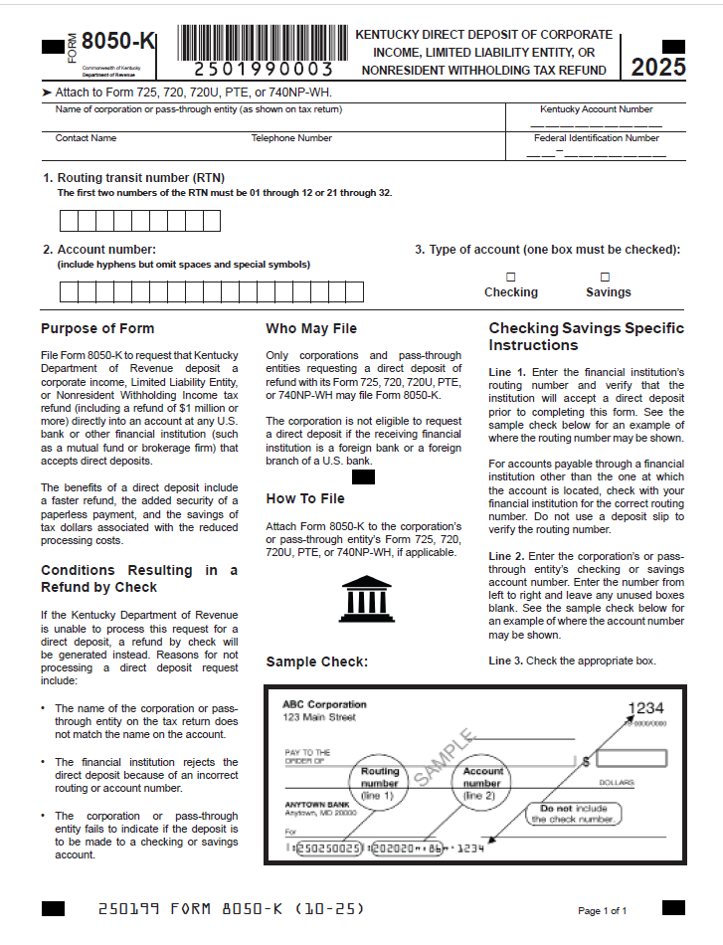

Form 8050-K Direct Deposit of Refunds
Available for Corporation Tax Returns filed via e-file or paper
Available for Nonresident Withholding Returns filed via e-file or paper
Direct deposit of refunds is not available for Pass Through Entity Tax (PTET) returns

Slide 35
Pay Outstanding Tax Bills in One Place
The MyTaxes Portal now displays your outstanding tax bills in one convenient location.
Log into your MyTaxes​ account to view and pay your outstanding bills using the "Make Payment” button.
Don’t want to login? Use the Guest Payment option on the MyTaxes login page. You will need your Account number or Federal Employer Identification Number (FEIN) and you will need your Invoice Number or Collections Case Number to make a guest payment. You’ll find this information on your bill or collection notification.

Slide 36
Making Payments in the MyTaxes Portal
For the following taxes, please use MyTaxes Portal
Consumer's Use
Motor Vehicle Tire Fee
Sales and Use
Telecommunication
Commercial Mobile Radio Service (CMRS)
Corporation Income/Limited Liability Entity Tax (LLET)
Employer's Withholding
KY Nonresident WH Tax
Transient Room
Utility Gross Receipts Tax (UGRLT)

Slide 37
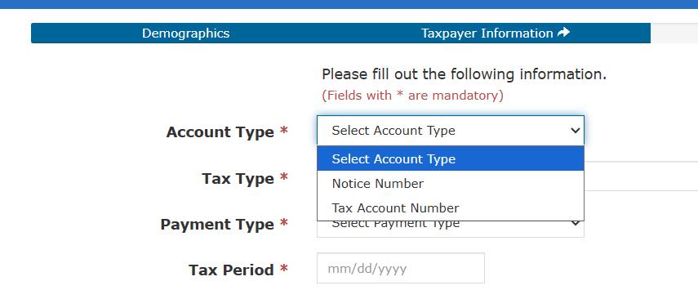
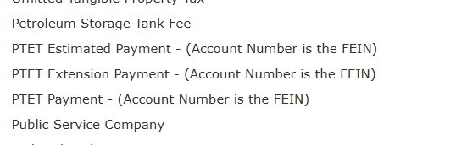
Making Payments for PTET
https://epayment.ky.gov/epay
Estimated Payments
Extension Payments
Balance on Returns filed without
payment
Use the FEIN as the Tax Account Number

Slide 38
One Big Beautiful Bill (OBBB) Act
Does Kentucky have any guidance regarding retroactive expensing of 174 research expenses under the One Big Beautiful Bill?
No, Kentucky does not have any guidance regarding retroactive expensing of 174 research expensing. Current Kentucky law defines “Internal Revenue Code” to mean the Internal Revenue Code in effect on December 31, 2024.
If or when does Kentucky plan to release guidance on conformity with the Bill?
Current Kentucky law defines “Internal Revenue Code” to mean the Internal Revenue Code in effect on December 31, 2024. We would not issue guidance on the OBBB until there is a Kentucky legislative change that adopts the new federal provisions.

Slide 39
Individual Income Tax
2025 Updates
Kentucky Department of Revenue • 501 High Street • Frankfort, KY 40601 • (502) 564-4581

Slide 40
Individual Income Tax: Form Changes
All forms have been updated with year changes and any legislative threshold changes.
The Code in effect on December 31, 2024
2025 Standard Deduction: $3,270
Individual Income Tax Rate for tax year 2025 is 4%
Schedule ITC – added Qualified Broadband Investment Credit
KW-2 – withholding account number is nine digits

Slide 41
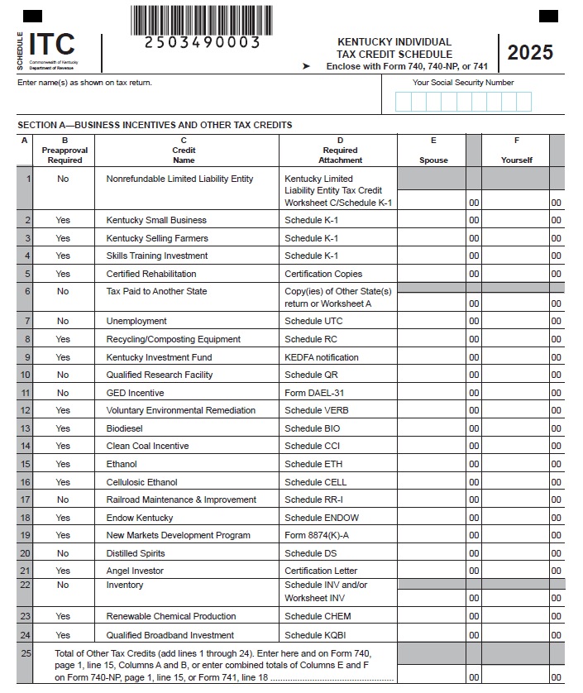
Schedule ITC
The Kentucky Qualified Broadband Investment was added to the Schedule ITC, Section A, Line 24.

Slide 42
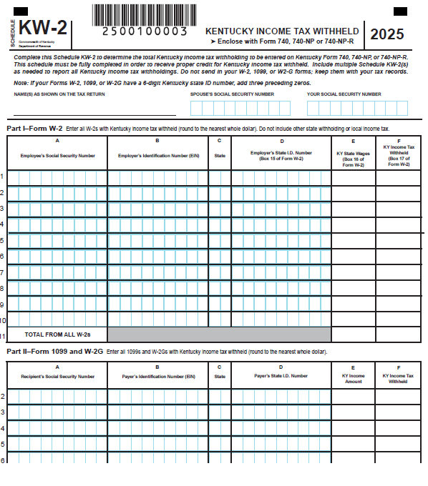
Schedule KW-2
The KW-2 Employer State ID column now has 9 digits. If the Form W-2, 1099, or W-2G received by the taxpayer displays only six digits, add three preceding zeros.

Slide 43
Reduction of Individual Income Tax Rate
HB 775 (2025)
  Additional changes have been made to the rate reduction conditions.
  The Budget Reserve Trust Fund will be reviewed each year and compared with the General Fund.
  Individual Income Tax Rate can be reduced by 0.1% - 0.5% each tax year if fiscal requirements are met.
  All future individual income tax rate reductions must be approved by the General Assembly.
  The Individual Income Tax Rate for tax year 2026 is 3.5%.
  The Standard Deduction for tax year 2026 is $3,360.

Slide 44
One Big Beautiful Bill (OBBB) Act
Does Kentucky follow “same as federal” income tax position which allows qualified tips to be excluded from gross income?
Current Kentucky law defines “Internal Revenue Code” to mean the Internal Revenue Code in effect on December 31, 2024. Qualified tips are taxable to Kentucky. A deduction for qualified tips would not be allowed on the Kentucky return.
Does Kentucky follow “same as federal” income tax position which allows overtime income to be excluded from gross income?
Current Kentucky law defines “Internal Revenue Code” to mean the Internal Revenue Code in effect on December 31, 2024. Overtime income is taxable to Kentucky. A deduction for overtime income would not be allowed on the Kentucky return.

Slide 45
OBBB Q & A Continued
Does Kentucky follow “same as federal” income tax position which allows a deduction for car loan interest?
Current Kentucky law defines “Internal Revenue Code” to mean the Internal Revenue Code in effect on December 31, 2024. A deduction for car loan interest would not be allowed on the Kentucky return.
Does Kentucky follow “same as federal” income tax position which allows a deduction for social security benefits?
Kentucky does not tax social security income per KRS 141.019(1)(e). Kentucky does not follow “same as federal” rules regarding social security income, instead it is fully deductible. Social security income can be deducted from Kentucky taxable income on Schedule M, line 10.

Slide 46
OBBB Q & A Continued
Does Kentucky follow “same as federal” income tax position which allows an increase in the deduction for state and local taxes (SALT)?
Current Kentucky law defines “Internal Revenue Code” to mean the Internal Revenue Code in effect on December 31, 2024. Kentucky does not allow a deduction for state and local taxes, therefore; the increase in limitation would not apply on the Kentucky return.

Slide 47
Other Information and Reminders
Kentucky Department of Revenue • 501 High Street • Frankfort, KY 40601 • (502) 564-4581

Slide 48
Electronic Payments to the Department of Revenue
Actual withdrawal of electronic payments may be later than the requested date. Please allow up to two weeks for processing.
Please do not submit duplicate payments.

Slide 49
Instructions on how to make an Individual Tax Payment for 2025
You can make a payment at this link https://epayment.ky.gov/EPAY. Make sure to choose the following:
Tax Type – Tax Account Number
Tax Account Number – this is your social security number
Tax Type – Individual Income Tax - (Account Number is the Social Security Number)
This should default the payment to the year we are currently taking payments for which would be tax year ending 12/31/2025.
You can also call our taxpayer assistance line at 502-564-4581, option 3 and make a payment over the phone.

Slide 50
Instructions on how to make an Individual Estimated Tax Payment - 2026
You can make a payment at this link https://epayment.ky.gov/EPAY. Make sure to choose the following:
Tax Type – Tax Account Number
Tax Account Number – this is your social security number
Tax Type – Individual Income Tax - Estimated Payment (Account Number is the Social Security Number)
This should default the payment to the year we are currently taking estimated tax payments for which would be tax year ending 12/31/2026.
You can also call our taxpayer assistance line at 502-564-4581, option 3 and make a payment over the phone.

Slide 51
Tax Interest Rate
2026 Interest Rates
Rate charged on unpaid taxes is 9%
  (Base rate of 7% plus 2%)
Rate paid when interest is due on a refund is 5%
  (Base rate of 7% minus 2%)
See KRS 131.183

Slide 52
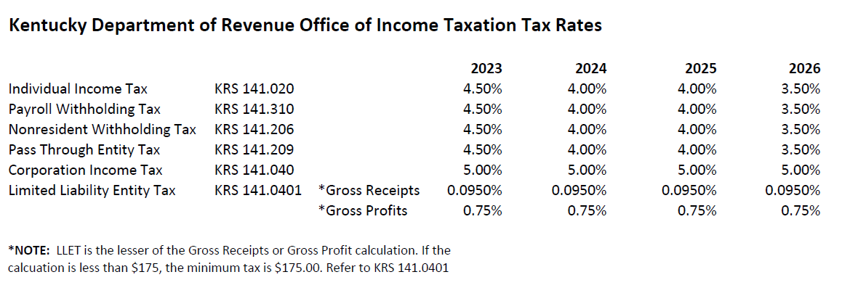
Tax Rates

Slide 53
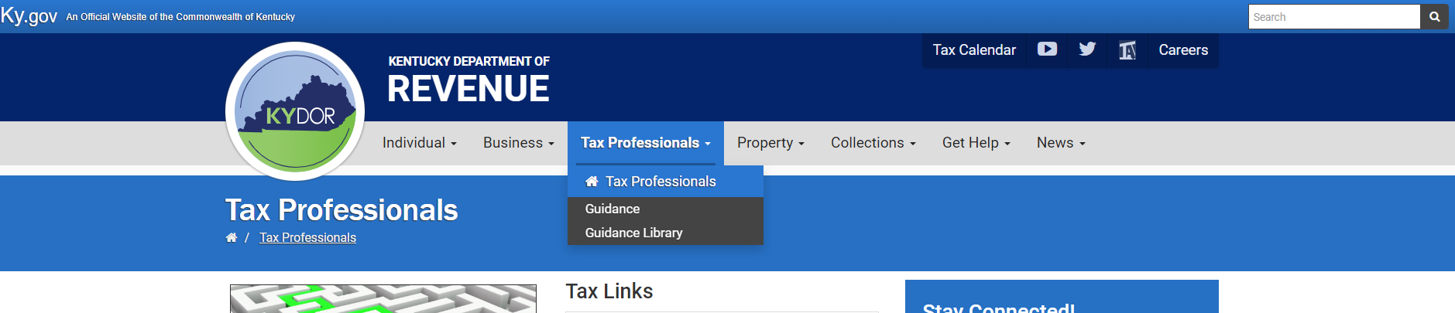
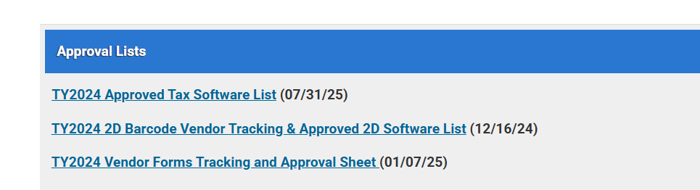
Electronic Filing
Electronic filing is available through third-party vendors that support Kentucky.
Visit the Department of Revenue website at Revenue.ky.gov for updates of approved Tax Software Vendors under the Tax Professionals Tab and click on Software Developers.
YTD 2025:
94% of tax year 2025 individual income tax returns were e-filed
72% of tax year 2025 corporate and pass-through entity tax returns were e-filed

Slide 54
Taxpayer Service Centers
Ashland Taxpayer Service Center
1212 Bath Avenue, Suite 201, 41101
(606) 920-2037
Bowling Green Taxpayer Service Center
201 West Professional Park Court, 42104-3278
(270) 746-7470
Corbin Taxpayer Service Center
15100 North US25E, Suite 2, 40701-6188
(606) 528-3322
Frankfort Taxpayer Service Center
501 High Street, 40601-2103
(502) 564-4581 (Taxpayer Assistance)
(502) 564-5930 (Taxpayer Service Center)
Hopkinsville Taxpayer Service Center
181 Hammond Drive, 42240-7926
(270) 889-6521
Louisville Taxpayer Service Center
600 West Cedar Street, 2nd Floor West, 40202-2310
(502) 595-4512
Northern Kentucky Taxpayer Service Center
Turfway Ridge Office Park
7310 Turfway Road, Suite 190, Florence, 41042-4871
(859) 371-9049
Owensboro Taxpayer Service Center
401 Frederica Street, Building C, Suite 201, 42301-6295
(270) 687-7301
Paducah Taxpayer Service Center
Clark Business Complex, Suite G
2928 Park Avenue, 42001-4024
(270) 575-7148
Pikeville Taxpayer Service Center
Uniplex Center, 126 Trivette Drive, Suite 203, 41501-1275
(606) 433-7675

Slide 55
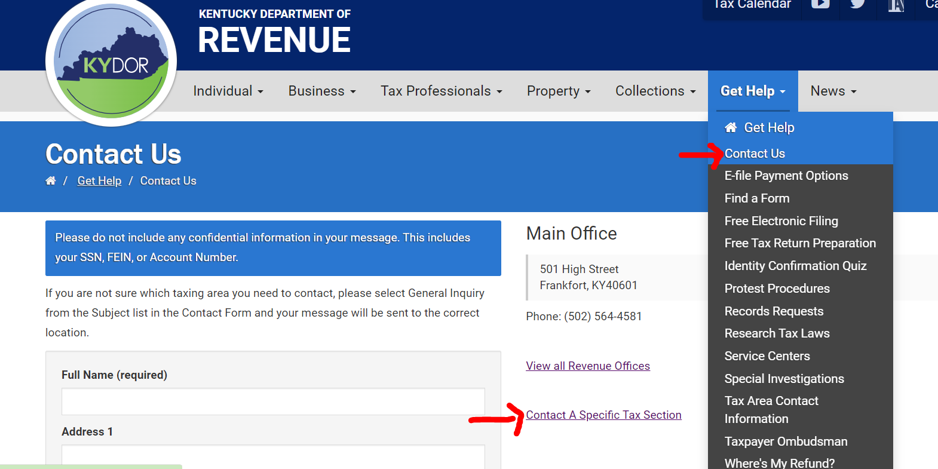
Reach out to DOR via Web Response

Slide 56
Revenue Contact Phone Numbers
Collections | (502) 564-4921
Corporation Tax | (502) 564-8139
DOR One Stop Help Line | (502) 564-5053
E-Filing Assistance (Business Forms) | (502) 564-7926
E-Filing Assistance (Individual Forms) | (502) 564-7862
Field Operations | (502) 564-2113
Forms and Envelopes | (502) 564-3658
Individual Income Tax | (502) 564-4581
Inheritance Tax | (502) 564-4810
Local Government & County Fees | (502) 564-8785
Miscellaneous Tax | (502) 564-2935
Motor Fuels | (502) 564-3853
Motor Vehicle Usage | (502) 564-4455
Ombudsman | (502) 564-7822
Property Tax | (502) 564-8338
Protest Resolution | (502) 564-6734
Registration | (502) 564-3306
Sales & Use Tax | (502) 564-5170
Special Investigations | (502) 564-4470
State Operator | (502) 564-3130
Withholding | (502) 564-7287

Slide 57

2025 Kentucky Income Tax Changes
Barbara Quackenboss
Executive Director Office of Income Taxation
 Barbara.Quackenboss@ky.gov
 (502) 564-7343
Kentucky Department of Revenue • 501 High Street • Frankfort, KY 40601 • (502) 564-4581

Slide 58
Disclaimer
The Department has developed this presentation to enhance taxpayer understanding of and compliance with the new tax legislation enacted by the Kentucky General Assembly during the recent regular legislative sessions. The information in this presentation is for educational and informational purposes only and does not constitute legal advice. Information is presented as an overall review that is subject to law changes. To review the amendments to Kentucky tax laws enacted during the recent regular sessions in more detail, please refer to the relevant statutory provisions of the Kentucky Revised Statutes.
Information in this presentation is believed to be accurate as of the date of publication. However, any statement in error that may occur during presentations made by the Department of Revenue as part of its tax education program shall not expressly or implied supersede the Department of Revenue’s official interpretation of the law or its policies utilized in administering state revenue and tax laws.

