Slide 1


Sales Codes
and the Sales Ratio Process
2025
Conference on Assessment Administration
December 2-4, 2025
Kentucky Department of Revenue • 501 High Street • Frankfort, KY 40601 • (502) 564-8338

Slide 2


The Sales Ratio Process
What is the Assessment/Sales Ratio Study?
  The ratios of the assessed values divided by their corresponding sale prices indicate the percentage of fair cash value attained within a study sample.
    Assessment / Sale Price = Ratio ($95,000 / $100,000 = 95%)
  The measure of central tendency utilized in the calculations is the median.
    The median is simply the middle value in an array of figures.
    For example, in the array of ratios (88, 90, 95, 98, 105) the median is 95%.

Slide 3
The Sales Ratio Process
What needs to be completed prior to submitting the Sales Ratio?
  All deed transfers with a sale date from the previous year needs to be completed.
  This includes all partial sales.

Slide 4
The Sales Ratio Process
When should the Sales Ratio be submitted?
  The ideal time to submit your county’s Sales Ratio is in February, March or early April.
    The field staff start Sheriff Settlements in the month of May.
    Sales Ratios submitted after May 1st may have to wait till the Sheriff’s Settlements have been completed.
  When you see the first deed with a February sale date for the current year, that is a good indication that it is time to send in your sales for the previous year.

Slide 5
The Sales Ratio Process
What sales are included in the Sales Ratio Study?
  All sales from July 1st – December 31st.
  All sales for all classes of property.
    Residential, Farm, Commercial & Exempt properties
  All sales no matter how they are coded.
    Valid & non-valid sales codes

Slide 6
The Sales Ratio Process
Who do you submit the Sales Ratio to at the Office of Property Valuation?
  Send them to Christopher Wales
    Christopher.Wales@ky.gov
  Sales need to be submitted in an excel format.

Slide 7
The Sales Ratio Process
What is the process at the Office of Property Valuation to get the Sales Ratio ready to send to the Field Rep for review?
  Verify that the excel file contains all necessary data.
    Sale Date (last six months)
    Deed Book and Deed Page
    Sale Price
    PVA Assessment
    Property Type
    Sale Code
  Reformat the excel file to be compatible with the software used by the Office of Property Valuation.
    Mostly just changing headers and calculating individual ratio scores.
    No data is changed.

Slide 8
The Sales Ratio Process
What is the process at the Office of Property Valuation to get the Sales Ratio ready to send to the Field Rep for review?
  Calculates the number of residential “H” codes to the number of residential valid sales.
    If the number of “H” codes to valid sales is more than 20%, the Field Rep will be notified to discuss the options with the PVA.
    If the number of “H” codes to valid sales is less than 20%, the Field Rep does not need to be notified.
  Uploads the reformatted excel file into the software to calculate the preliminary ratios.
  Emails the Field Rep to notify them that the file is ready for their review.

Slide 9
The Sales Ratio Process
What does the Field Rep do prior to reviewing the deeds?
  Verify the number of valid residential sales.
    Tells us what value for the sliding scale code (G) to use.
      Adjust any valid residential sales that fall below the sliding scale value to the sliding scale code.
      Adjust any residential sliding scale sales that are greater than the sliding scale value to valid unless another code is applicable.
    Tells us how many construction/deconstruction codes (H) are allowable without reviewing them.
  Check for any irregularities with the sales.
    Sales without a deed book and/or deed page.
    Sales that the deed book is not close to the majority of the other deed books.

Slide 10
The Sales Ratio Process
What sales are reviewed by the Field Rep?
  If a county has up to three deed books or less than 100 sales, then all sales will be reviewed.
  If a county has more than three deed books, three randomly selected deed books will be reviewed.
    If less than 100 sales are contained in the three deed books, the review will be expanded until 100 sales are reviewed.
    If any of the deed books have a large amount of Department of Transportation deeds or easements, then another book will be reviewed.

Slide 11
The Sales Ratio Process
What sales are reviewed by the Field Rep?
  There maybe circumstances where all deed books are reviewed.
  All sales coded as valid with a ratio of exactly 100%, under 50% and over 150% will be reviewed.
  Sales shall be reviewed for any excessive use of any codes or irregularities.
  Codes in which a significant amount of code changes were made during the review, may require that all sales for that code will need to be reviewed.

Slide 12
The Sales Ratio Process
What is looked at while reviewing the sales?
  Read the deeds to verify that we agree with the code for that sale.
    If the deed verifies the code, we move onto the next sale.
    If the deed does not verify the code, we change it to the correct code.
    If more information is needed to verify the code, we will review that sale with the PVA or Deputy before verifying the code or changing the code.
  Verify that the date of the sale is in the July 1st – December 31st date range.

Slide 13
The Sales Ratio Process
What is looked at while reviewing the sales?
  Verify that the deed sale price matches the sale price in the excel file.
  Verify that the sale has not sold previously with the past calendar year.
  Verify that there are no deeds that have been missed and not transferred.

Slide 14
The Sales Ratio Process
Steps after the sales are reviewed
  Review or ask any questions that we may have while reviewing the sales.
    Make any necessary changes.
  Verify the assessments of the valid residential, farm and commercial sales match the assessment reported on the applicable tax bill.
    The assessment is the certified assessment of the corresponding year the property is sold.
    For example, properties sold in 2025 will be compared to the 2025 certified assessment of that property.
  Calculate the overall ratios for each property type.

Slide 15
The Sales Ratio Process
Finishing the Sales Ratio and Reviewing with the PVA
  Review the overall ratios for each property type with the PVA.
  Review any or all changes that were made with the PVA at their request.
  Inform the PVA if there were significant coding issues.

Slide 16
The Sales Ratio Process
Finishing the Sales Ratio and Reviewing with the PVA
  Fill out the Sales Ratio Review Certification.
    This form is for the PVA to sign that we have reviewed the results of the Sales Ratio Study with them.
    The PVA has the option to add any comments that they wish to make on this form.
    The PVA is not signing that they agree with the results of the Sales Ratio Study, just that we have reviewed it with them.
  Once the Sales Ratio has been reviewed with the PVA, the excel file and the Sales Ratio Review Certification is submitted to the Office of Property Valuation.

Slide 17
The Sales Ratio Process

Slide 18
The Sales Ratio Process
Finalizing the Sales Ratio
  The Office of Property Valuation uploads the finalized Sales Ratio file into the software and calculates the final ratio numbers.
  If there are less than 20 valid residential sales, the residential appraisals from the Performance Audit are added to the ratio study.
  The PVA comments or concerns on the Sales Ratio Review Certification are reviewed.
  A letter is generated showing the results of the Sales Ratio study and is sent to the PVA.

Slide 19
The Sales Ratio Process
Commonly Miscoded
Sales Codes

Slide 20
The Sales Ratio Process
  Property Class Change (C Code)
  When a property has changed from one class to another.
    Example: Farm to Residential
  Must change the class in the system.
  Residential rental properties selling does not constitute this code.

Slide 21
The Sales Ratio Process
  Annual Twice – Sold Property (F Code)
  When a property has sold twice within a one-year period from the date of the first sale.
  The first sale must change hands via a valid transaction.
  To qualify for this code, the previous transaction cannot be one of the following:
    Love & Affection
    Divorce
    Via Will
    Affiliated Organizations

Slide 22
The Sales Ratio Process
  Expansion Sale (J Code)
  Sales in which the purchaser owns an established adjoining property.
    Must share a property line.
  If a road divides the property, this code can be used.
  If the purchaser owns a property down the road, this code cannot be used.

Slide 23
The Sales Ratio Process
  Other (S Code)
  Any other reason that another code cannot be used, and that the transaction is not representative of fair market value.
  Documentation MUST be provided.
  All S codes must be approved by the Office of Property Valuation.
  Quit-Claim, Deeds of Correction & Land Contracts should be coded as Obligation Transfers (Code M) and not as Other (Code S).

Slide 24
The Sales Ratio Process
  Vacant Lots / Builders (T Code)
  Sales of vacant lots by builders and developers.
  A general lot sale by a non-developer cannot use this code.
  Sales of vacant lots by a non-developer should be coded as Vacant Lots / Private Individuals (Code W) or Valid.
    Vacant Lots / Private Individuals (Code W) are considered valid.

Slide 25
The Sales Ratio Process
  Out of State Buyer (V Code)
  Residential & Farm sales only.
  Buyer must live out of state at the time of the sale.
  Documentation is required if the deed does not list the out of state address.

Slide 26
The Sales Ratio Process
  Construction / Deconstruction (H Code)
  The number of H codes should not exceed 20% of the total valid RESIDENTIAL sales.
    If your H codes are under the 20% threshold, no review of the H codes is needed.
    If your H codes exceed the 20% threshold, your field rep will review all H codes in your sales file.
    If your H codes exceed 40%, the Field Branch Manager will review all H codes in your sales file.

Slide 27
The Sales Ratio Process
  Construction / Deconstruction (H Code)
  To calculate this percentage, just take the total number of residential H codes sales and divide it to the total number of residential valid sales.
    Example #1: 20 H codes / 100 valid sales = 20% (no review needed)
    Example #2: 32 H codes / 100 valid sales = 32% (Field Rep will review all H codes and verify that the improvements meet the requirements.)
    Example #3: 45 H codes / 100 valid sales = 45% (The Branch Manager will review all H codes and verify that the improvements meet the requirements.)

Slide 28
The Sales Ratio Process
  Construction / Deconstruction (H Code)
  After your Field Rep has reviewed your sales, they will check your H code to valid percentage.
    If your percentage is less than the 20% threshold, then your Field Rep will see how many valid sales that you can move to an H code to get that percentage to 20%.
    If your percentage is above the 20% threshold, then your Field Rep will see how many H codes that you have to move to valid or to another code to get that percentage down to 20%.

Slide 29
The Sales Ratio Process
  Construction / Deconstruction (H Code)
  Documentation MUST be provided if your H code to valid percentage is over the 20% threshold.
  Additional guidelines for H codes:
    Costs of improvements should exceed 25% of the sale price in order to be considered an H code.
    Any property that has not had its assessment updated in the last 5 years will not be counted as an H code.

Slide 30
The Sales Ratio Process
Once the finalized ratio is sent to the PVA the ratios are entered into our in-house spreadsheet.
After certification, all ratios are adjusted appropriately for the assessment credit in each property class.
  When we run the level of assessment, we also calculate the amount of assessment increase from the previous year.
  For example: If your residential assessment increase is 2.5% then your residential ratio will be adjusted by 2.5%.
    Residential Ratio – 87%
    Residential Assessment Increase – 2.5%
      87% x 1.025 = 89.175 rounded 89.2%
  You will receive a final letter with this updated final ratio.

Slide 31
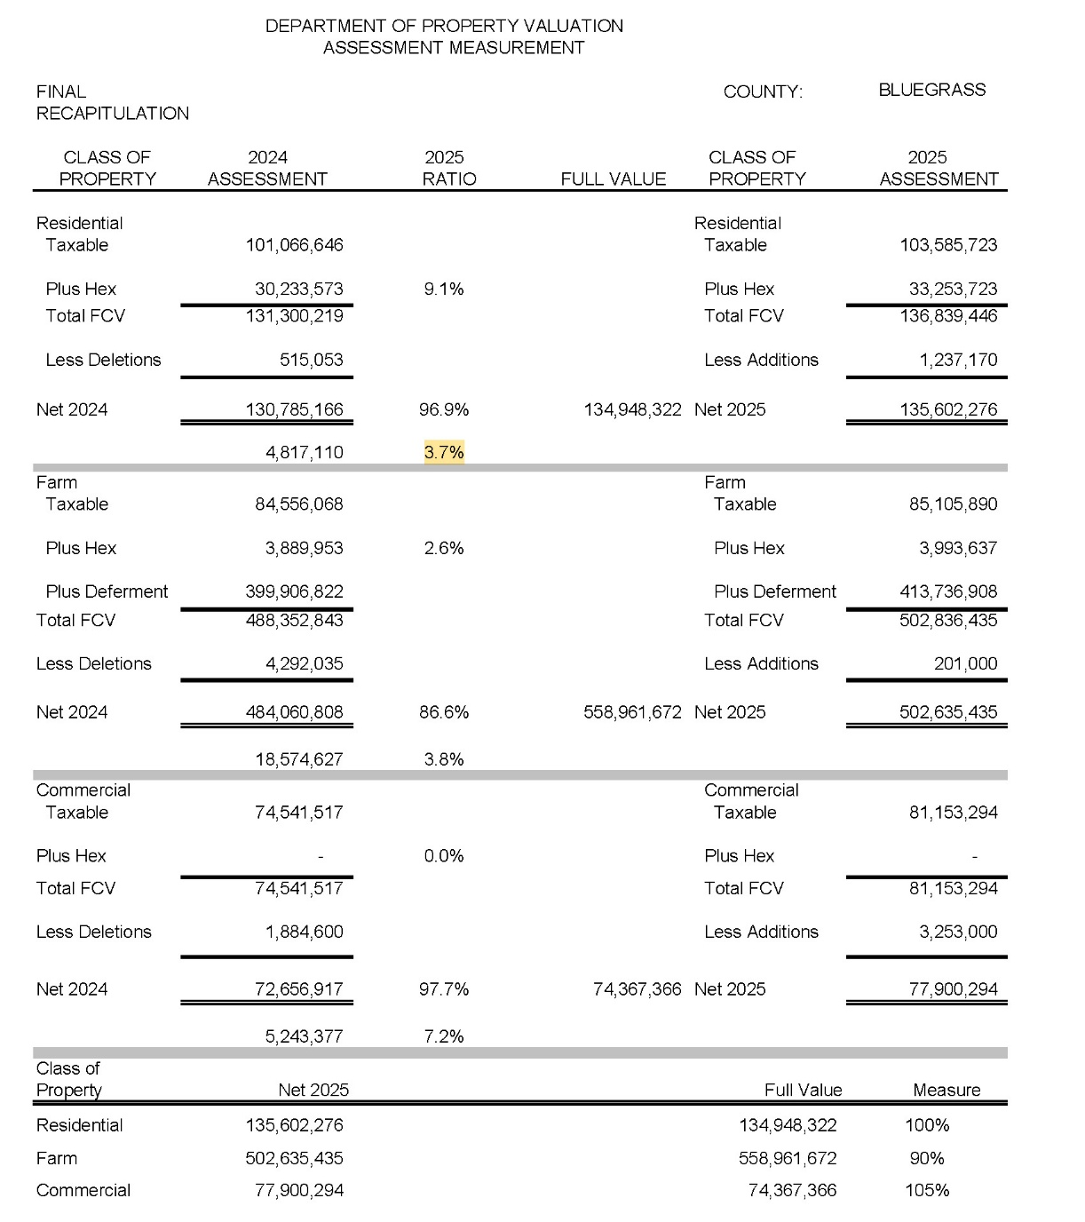
The Sales Ratio Process
  Example:
  Residential assessment increase = 3.7%
  2026 Residential Ratio = 87%
  87% x 1.037 = 90.2%

Slide 32


Sales Codes and the Sales Ratio Process
Ben Williams
Property Assessment Coordinator IV
KY Department of Revenue
606-425-6634
Ben.Williams@ky.gov
Melissa Klink, Director
Division of Local Support
KY Department of Revenue
502-564-7191
Melissa.Klink@ky.gov
The information in this presentation is for educational and informational purposes only and does not constitute legal advice. Information is presented as an overall review that is subject to law changes and may not apply to all states. For accurate information on issues related to State Real Property Tax Rate, please reference KRS 132.020.
Information in this presentation is believed to be accurate as of the date of publication. However, any statement in error that may occur during presentations made by the Department of Revenue as part of its tax education program shall not expressly or impliedly supersede the Department of Revenue’s official interpretation of the tax law or its policies utilized in administering state revenue and tax laws.
Kentucky Department of Revenue • 501 High Street • Frankfort, KY 40601 • (502) 564-8338

