Slide 1


2025 PVA Conference
Auditor of Public Accounts

Slide 2
Introduction to the Auditor of Public Accounts (APA)
Constitutional Office
The APA is an independent constitutional office responsible for auditing all state agencies, local governments, and other public entities.
Mission
To act as a vigorous guardian of taxpayer dollars, providing accountability, integrity, and leadership for Kentucky to thrive in the 21st century.
Auditor of Public Accounts

Slide 3
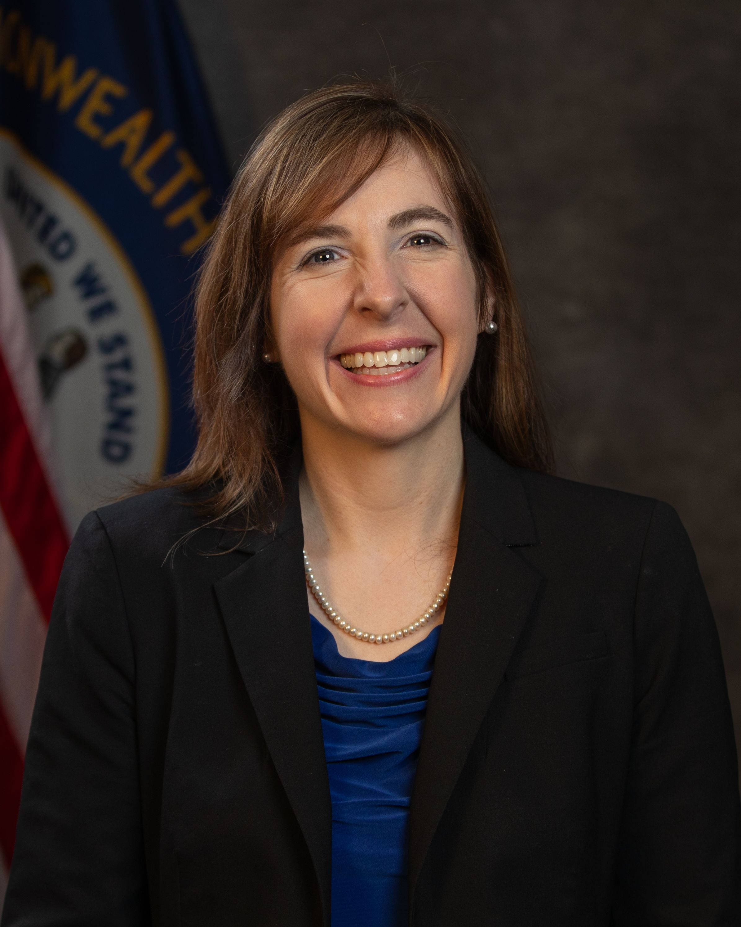
Allison Ball State Auditor
48th Auditor of Public Accounts
Former two-term State Treasurer
Watchdog of Kentucky taxpayer dollars
Notable Audits/Exams as Auditor include: Statewide Single Audit of Commonwealth, KY Dept. of Juvenile Justice, KY Dept. of Education
Advocate for KY’s most vulnerable, including investigations into the treatment of foster children in state custody, kinship care funding, and more.
Auditor of Public Accounts

Slide 4
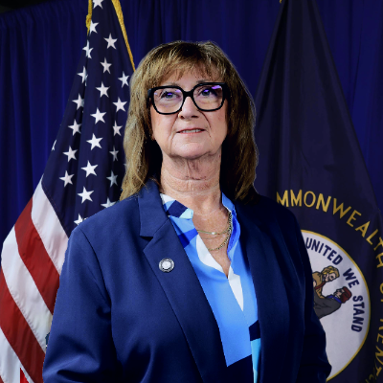
Shari Scott Deputy State Auditor
Certified Public Accountant
Served at APA since 1997 as Financial Auditor and Audit Manager
Member of AICPA, KYCPA, NASACT, AGA
Auditor of Public Accounts

Slide 5
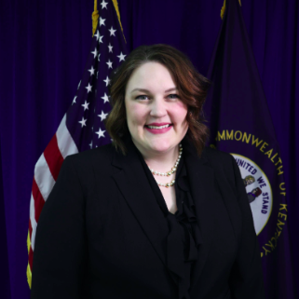
Lorran Ferguson Chief of Staff
Appointed January 2024
Previously served as Deputy State Treasurer and Chief of Staff at State Treasurer’s Office
J.D. from the University of Kentucky
Auditor of Public Accounts

Slide 6

Jim Royse, Executive Director for the Office of Local Government Audits
Certified Fraud Examiner
Over 30 years of experience at the APA
Served as both Financial Auditor as well as Audit Manager
Auditor of Public Accounts

Slide 7

APA County Assignments
NEW BRANCHES – Updated from 4 to 6

Slide 8
Auditor of Public Accounts

Slide 9
What is an AUP (Agreed Upon Procedure)
and why do I need one?
Auditor of Public Accounts

Slide 10
Agenda
What is an AUP?
How does an AUP differ from an audit?
Why are PVAs required to have AUPs?
How often are AUPs required?
What financial records must be kept in the PVA office?
Overview of PVA AUP procedures.
Additional guidance and rules.
Auditor of Public Accounts

Slide 11
What is an AUP?
An agreed-upon procedures (AUP) engagement is one in which a practitioner is engaged to issue, or does issue, a practitioner’s report of findings based on specific agreed-upon procedures applied to subject matter for use by specified parties.
Auditor of Public Accounts

Slide 12

What does that mean?
An agreed-upon procedures engagement, often referred to as an AUP, is a type of engagement where specific procedures are performed and results are reported.
Before beginning an AUP, the Auditor’s office (APA) has entered into an agreement with the Department of Revenue (and in agreement with the PVA Association) to establish the scope of work and procedures to be performed. These are agreed to by the PVA prior to beginning the AUP.
The APA would then report the findings or results of the procedures.
Auditor of Public Accounts

Slide 13
What is the difference between Audits and AUPs?
Purpose of an Audit
Auditor provides an opinion on whether the financial statements are presented fairly, in all material respects, in accordance with an applicable financial reporting requirements.
Purpose of an AUP
Auditor performs specific procedures agreed to by the official.
Written report is issued that describes the procedures applied and the findings.
Auditor of Public Accounts

Slide 14
KRS 132.601 Administrator's use of local funds accruing to office – Bank account – Expenditures – Supervision.
Why do PVAs have AUPs?
Auditor of Public Accounts

Slide 15
KRS 132.601
(1) The property valuation administrator of any county may, after receiving an approved budget from the Department of Revenue under the provisions of KRS 132.590, obligate and spend any of the local funds accruing to his office under the provisions of KRS 132.590 or KRS 132.285, over and above that actually used in compensating his deputies and assistants, for the purchase of any maps, lists, charts, materials, supplies or equipment, or for other expenses necessary to the proper assessment of property or preparation and maintenance of assessment rolls and records.
Why do PVAs have AUPs?
Auditor of Public Accounts

Slide 16
KRS 132.601
(2) The property valuation administrator shall maintain a bank account for the management of local funds received by his office under the provisions of KRS 132.590 and 132.285. Beginning with the 1990-1992 biennium, at the end of each fiscal year a cumulative carryover of local funds equivalent to the total annual local appropriation for the ending fiscal year or five thousand dollars ($5,000), whichever is greater, shall be retained. Any funds in excess of this amount shall be refunded by the property valuation administrator no later than August 1 to the appropriating local governments in direct proportion to their respective appropriations.
Why do PVAs have AUPs?
Auditor of Public Accounts

Slide 17
KRS 132.601
(3) Expenditures made by the office of the property valuation administrator under the provisions of subsection (1) of this section shall be governed by procurement procedures adopted by the fiscal court in the county administrative code required by KRS 68.005. However, after approval of the annual budget for the office of the property valuation administrator provided in KRS 132.590 by the Department of Revenue, the necessity of the expenditure shall not be questioned by the fiscal court. The Department of Revenue shall have neither authority nor responsibility in the auditing of expenditures made by the property valuation administrator from locally appropriated funds. The Auditor of Public Accounts shall assume the responsibility.
Why do PVAs have AUPs?
Auditor of Public Accounts

Slide 18
PVA AUP’s are performed on a four-year rotation. Each PVA will have one AUP performed during each 4-year term.
Additionally, any time a PVA leaves office, a close-out AUP is performed by the APA in conjunction with the Department of Revenue’s close out procedures.
How often do I need an AUP?
Auditor of Public Accounts

Slide 19
The following records must be maintained by each PVA Office:
Bank statements (including copies of cancelled checks - front and back).
Deposit tickets
Bank reconciliations
Disbursements ledger
Receipts ledger
What accounting records are required?
Auditor of Public Accounts

Slide 20
The following records must be maintained by each PVA Office:
Note: a check register does not qualify as a receipt or disbursements ledger
Paid invoices or bills
Copies of receipts issued to customers
Agreements and Contracts
Inventory list
What accounting records are required?
Auditor of Public Accounts

Slide 21
The following records must be maintained by each PVA Office:
New employees list
Ethics forms
Office closing dates
PVA office closing form
Names, phone #’s, and email addresses of city clerks
What accounting records are required?
Auditor of Public Accounts

Slide 22
The following records must be maintained by each PVA Office:
Revenue Cabinet- Request for deputy salary allocation
Final approved budget
Time sheets or daily sign in log sheets
Note: Additional items may be needed, however the items listed above are the items we would like for the PVA to have ready upon our arrival.
What accounting records are required?
Auditor of Public Accounts

Slide 23
Additional accounting procedures that should be performed by the PVA include:
Daily deposits
Issuance of receipt for all monies collected in PVA office
Establishment of internal controls to safeguard assets
Maintaining ledgers for all accounts
Inclusion of all accounts into actual financial reports
Proper classification of all expenses into the budget
What accounting records are required?
Auditor of Public Accounts

Slide 24
1. Determine if the PVA has a receipts ledger, a disbursements ledger, and reconciles bank records to books each month. Re-perform the year-end bank reconciliation (June 30, 20xx) for all bank accounts, to determine if amounts are accurate.
Current PVA AUP Procedures
Auditor of Public Accounts

Slide 25
Receipts Ledger
Disbursements Ledger
Bank Reconciliation
Bank Statements
Records Needed
Auditor of Public Accounts

Slide 26
Ledgers
Should be detailed and Accounts should match Budget Line-Items
Accounting Software (Quicken) – Set up Receipt and Disbursement accounts to match your budget line-items
Example of Accounts
Revenues: County Budgeted Statutory Contribution, City Payments, Interest, Copy Charges, etc..
Expenditures – Personnel Cost, Office Supplies, Telephone Charges, In-State Travel, Etc…
Receipts and Disbursements Ledgers
Auditor of Public Accounts

Slide 27
Performed Monthly on All Bank Accounts
Reconcile Bank to Ledgers
Documented
Bank Reconciliations
Auditor of Public Accounts

Slide 28
2. Confirm all payments made by the city to the PVA. Compare recorded city receipts to confirmed payment amounts obtained from city governments. Also compare recorded city receipts to the DOR list of cities to determine if the PVA has accounted for all city receipts.
3. Confirm all payments made by the fiscal court to the PVA. Compare the budgeted statutory contribution by fiscal court to the legally required amounts calculated by the Department of Revenue. Trace the fiscal court payments from the fiscal court statutory contribution budget account to the PVA’s local bank account.
Current PVA AUP Procedures
Auditor of Public Accounts

Slide 29
Detailed Receipts Ledger
Bank Statements
Revenue’s Statutory Contribution Letter
Records Needed
Auditor of Public Accounts

Slide 30
Select one month (July 2024 – June 2025) and review bank statement to determine if deposits were made weekly at a minimum or if receipts of $250 or more are deposited daily. Choose one week from month selected and determine if pre-numbered receipts were issued. Determine by inquiry of the PVA and scanning the receipts ledger if the PVA charges, issues receipts and deposits for all services provided.
5. Determine if the PVA has a change fund and document the amount of the PVA’s change fund.
Current PVA AUP Procedures
Auditor of Public Accounts

Slide 31
Detailed Receipts Ledger
Bank Statements
Pre-numbered Receipts
Summary of Daily Receipts
Deposit Tickets
Records Needed
Auditor of Public Accounts

Slide 32
Any collection of any public funds should be documented by the preparation of a pre-numbered receipt
All Public Funds Received Should Be Deposited Into The Official Bank Account On A Daily Basis
The Daily Deposit Should Be Reconciled To Receipts Ledger
Receipt Procedures
Auditor of Public Accounts

Slide 33
FINANCE AND ADMINISTRATION CABINET MANUAL OF POLICIES AND PROCEDURES Amended
August 2024 This manual is incorporated by reference as an administrative regulation, pursuant to 200 KAR 5:021.
This manual provides guidance over the following related subjects:
USE OF PUBLIC FUNDS
CASH HANDLING
INTERNAL CONTROLS (INCLUDING THE SEGREGATION OF DUTIES)
Auditor of Public Accounts

Slide 34
Judgmentally select 15 disbursements from PVA records and agree amounts to paid invoices or other supporting documentation and bank records. Determine if the disbursement is for official business. Inspect all credit card statements (if any) to determine if disbursements are for official business.
Compare capital outlay disbursements with supporting documentation, bank records, and proper purchasing procedures. Observe newly acquired assets. Determine if assets were added to the PVA’s Capital Asset Inventory List.
8. Scan vehicle lease agreements, personal service contracts, and professional service contracts for cost schedules and compare to actual payments. Determine if services received were appropriate, for official business, and properly authorized.
Current PVA AUP Procedures
Auditor of Public Accounts

Slide 35
Detailed Disbursements Ledger
Bank Statements
Cancelled Check (Front and Back of Check)
Original Bill, Invoice, or Detailed Receipt
Original Contract or Agreement
Credit Cards:
Credit Card Statement – Not Enough
Need the Supporting Documentation for the Purchase
Original Bill, Invoice, or Detailed Receipt
PVA Inventory List
Records Needed
Auditor of Public Accounts

Slide 36
Allowable Disbursements (Expenditures=Disbursements)
Department of Revenue (DOR) Policy - PVA Office Allowable Disbursements –PVAAllowableExpenditures.pdf
This document can be found on the DOR - PVA network
For an expense to be allowable, it must be
Necessary for the Office
Beneficial to the public/county
Not personal in nature
Reasonable in amount and content
Additionally, the expense must be evidenced by adequate supporting documentation.
What about my expenditures/ disbursements?
Auditor of Public Accounts

Slide 37
Unallowable Disbursements:
Any disbursements not meeting allowability criteria could be disallowed.
Disallowed expenses are required to be reimbursed by the PVA from personal funds.
What about my expenditures/ disbursements?
Auditor of Public Accounts

Slide 38
9. Compare the PVA’s final budget to actual disbursements to determine if the PVA overspent in any account series.
Records Needed:
Original Budget
Final Amended Budget
Detailed Disbursements Ledger – (Disbursement categories should match categories on Budget)
Current PVA AUP Procedures
Auditor of Public Accounts

Slide 39
The PVA office budget governs the use of all PVA office funds.
All funds should be accounted for in the PVA’s Budget
The PVA is required to amend the original budget when expenditures in an account series exceed the budgeted amount.
Budget
Auditor of Public Accounts

Slide 40
10. Determine whether cash balances were properly transferred from the former PVA to the new PVA.
11. For PVA office employees hired between July 1, 20xx and June 30, 20xx, determine if the Ethics Certification Form has been completed and is on file.
Determine if the PVA’s office was closed any day other than the state’s approved holidays. If so, determine if the proper procedures and forms were completed.
During county election years, determine if the PVA spent more than 40% of the allowance available to the PVA’s office from county funds during the first 5 months of the fiscal year in which the general election is held (KRS 132.590(12)).
Current PVA AUP Procedures
Auditor of Public Accounts

Slide 41
Revenue Closeout Package
Bank Statements
List on All New Employees
Ethics Form
List of Days Closed
County Judge/Executive order closing courthouse
PVA Closing Form
Records Needed
Auditor of Public Accounts

Slide 42

Other Guidance and Rules
Auditor of Public Accounts

Slide 43
The property valuation administrator shall, subject to the direction, instruction, and supervision of the Department of Revenue, make the assessment of all property in his county except as otherwise provided, prepare property assessment records, and have other powers and duties relating to assessment as may be prescribed by law or by the department.
KRS 132.420 Duties and powers of property valuation administrator
Auditor of Public Accounts

Slide 44
(1) There shall be a property valuation administrator in each county in lieu of a county assessor. Property valuation administrators shall be state officials, and all deputies and assistants of their offices shall be unclassified state employees.
KRS 132.370 Property valuation administrator's status as state official
Auditor of Public Accounts

Slide 45
KRS 132.605 Purchase of assessment supplies and equipment by county -- Purchase and loan by Department of Revenue-- Maintenance
(1) The fiscal court of each county shall have jurisdiction and the power to purchase and supply to the property valuation administrator any maps, lists, charts, materials, supplies, equipment or instruments which are reasonably necessary for a complete and accurate assessment of property in the county. The Department of Revenue is authorized to purchase and loan any property valuation administrator such maps, lists, charts, materials, supplies, equipment or instruments as are urgently needed by any property valuation administrator, provided that the Department of Revenue keeps a record thereof.
(2) The fiscal court of any county shall provide for the maintenance of all maps, lists, charts, materials, supplies, equipment or instruments owned by a county or supplied to it by the Department of Revenue or by any source in cooperation with the Department of Revenue for the purpose of facilitating the assessment of property.
Auditor of Public Accounts

Slide 46
(12) After submission to the State Treasury or to the property valuation administrator of the county funds budgeted for personnel compensation under subsection (11) of this section, the fiscal court shall pay the remainder of the county appropriation to the office of the property valuation administrator on a quarterly basis. Four (4) equal payments shall be made on or before September 1, December 1, March 1, and June 1 respectively. Any unexpended county funds at the close of each fiscal year shall be retained by the property valuation administrator, except as provided in KRS 132.601(2). During county election years the property valuation administrator shall not expend in excess of forty percent (40%) of the allowances available to his office from county funds during the first five (5) months of the fiscal year in which the general election is held.
KRS 132.590 Compensation of administrator -- Salary schedule -- Salary adjustments -- Advancement in grade -- Biennial budget -- Allowances for deputies -- Payments by fiscal court
Auditor of Public Accounts

Slide 47
KRS 132.601 – Administrator’s use of local funds accruing to office – Bank account – Expenditures - Supervision
(3) Expenditures made by the office of the property valuation administrator under the provisions of subsection (1) of this section shall be governed by procurement procedures adopted by the fiscal court in the county administrative code required by KRS 68.005. However, after approval of the annual budget for the office of the property valuation administrator provided in KRS 132.590 by the Department of Revenue, the necessity of the expenditure shall not be questioned by the fiscal court. The Department of Revenue shall have neither authority nor responsibility in the auditing of expenditures made by the property valuation administrator from locally appropriated funds. The Auditor of Public Accounts shall assume the responsibility.
Auditor of Public Accounts

Slide 48

Questions?
Auditor of Public Accounts

