Slide 1
Cyber Security
Protecting Yourself in a DIGITAL world

Slide 2
Some Current Cyber Trends
Social Engineering is the most prevalent threat out there and played a major role in nearly every breach in the last 15 years.
Ransomware is on the rise and the bad actors of the world are finding it very profitable to hold your data hostage and now are stealing it to come back later for more money.
Malware (or malicious software) is extremely prolific and has evolved to be able to protect itself from being detected.
Bad actors are no longer just individual hackers, they are often employees or members of large criminal or nation state organizations.
The art of hacking has evolved to be a ‘as a service’ offering making skill completely optional.

Slide 3
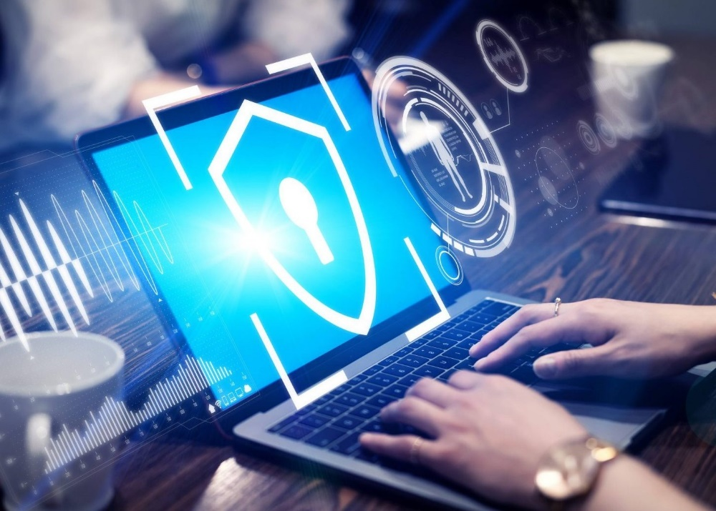
So What Can You Do?
Empower yourself with information!

Slide 4

What is ‘Phishing’?
Not as harmless as it sounds
Bad actors use carefully crafted emails to entice you to do what they want you to do using your passions, fears, interests, or trust.

Slide 5
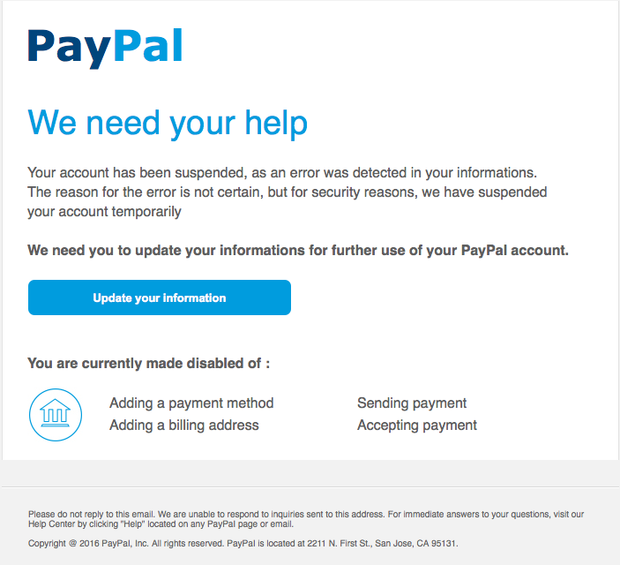
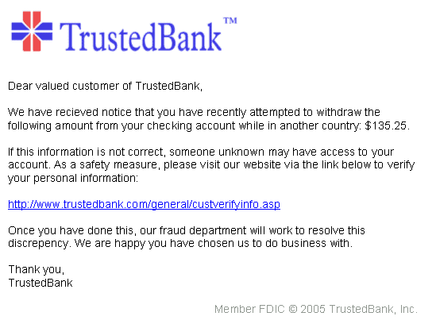
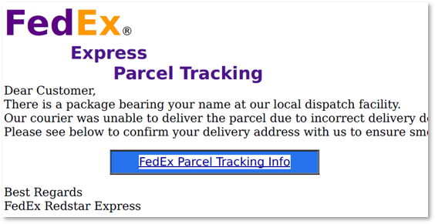
Phishing Examples

Slide 6
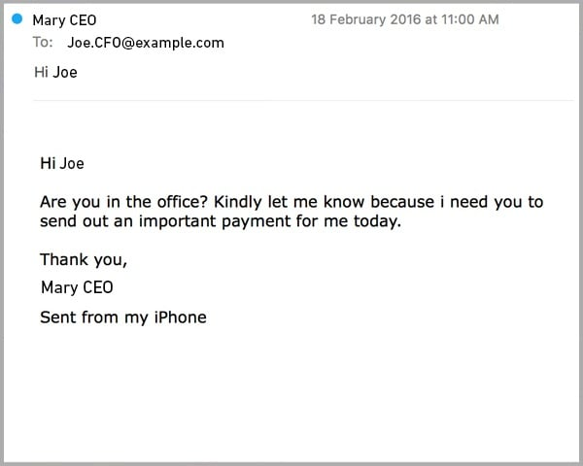
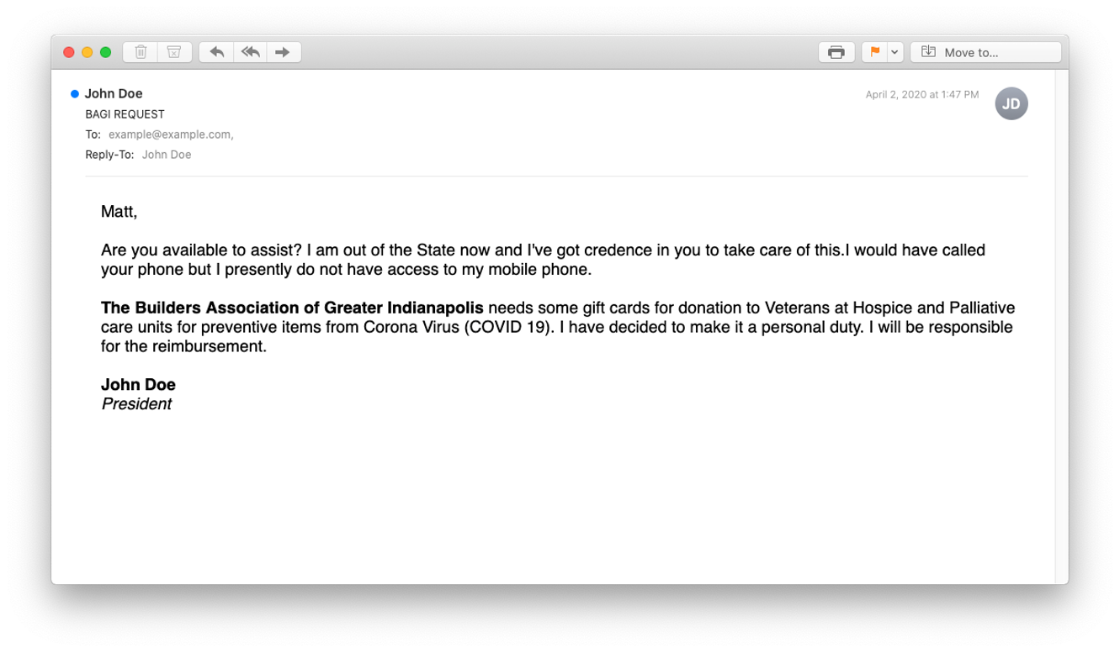
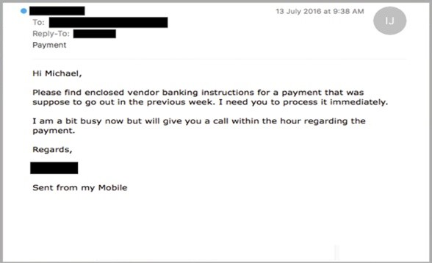
Spear Phishing

Slide 7
The Best Defense
Trust but verify.
Have solid processes in place for sensitive functions.
Watch for the unexpected.
Don’t follow links in emails, go directly to the trusted source.
Don’t open attachments that you don’t expect and cannot verify.
Feel free to question things.
If you do suspect you have fallen victim, report it immediately and update your passwords.
Train the spam filter in your email if you have one.

Slide 8
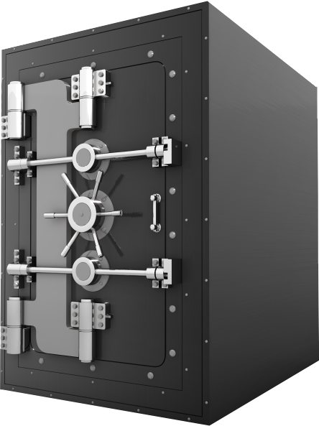
Protect Your Digital Identity
Use complex passwords or passphrases.
Use unique passwords across your accounts.
Don’t share your passwords.
Use multifactor authentication where you can.
Change your passwords periodically.
Separate business and personal identities.
Watch for suspicious activity.

Slide 9
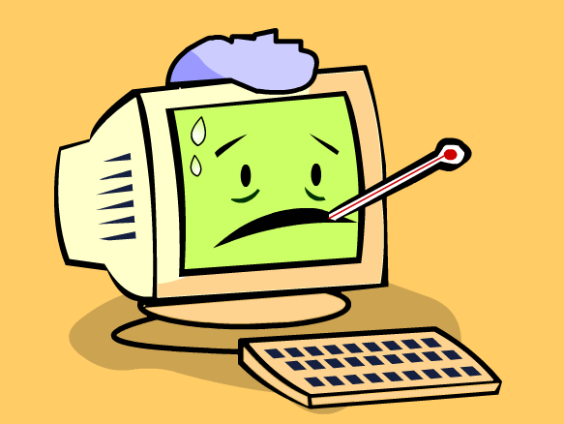
What is ‘Malware’?
Malware is short for malicious software. Some Malware is referred to as a computer virus.

Slide 10
What Can ‘Malware’ Do?
Steal your logins and credentials.
Steal your personal or business data.
Violate your privacy.
Allow someone to take over your computer.
Destroy or encrypt your data.
Track everything you do on the Internet.
Download even more Malware.

Slide 11
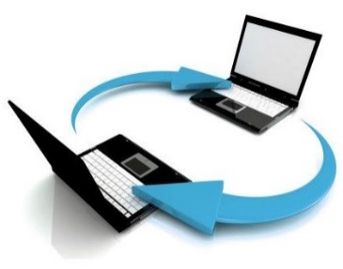


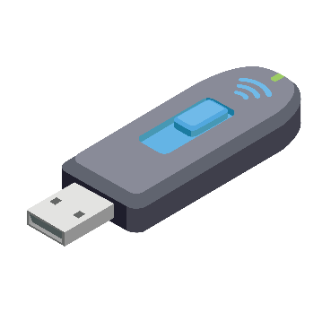
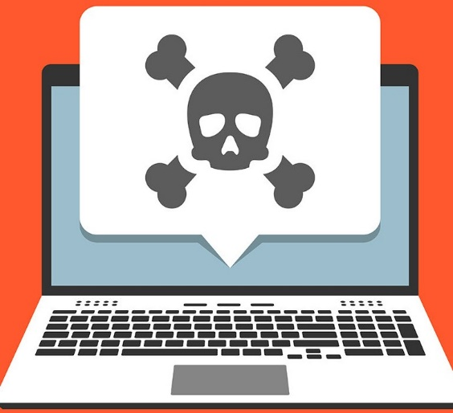

How Does ‘Malware’ Spread?

Slide 12

A Note About ‘Freeware’?
If the product is free, it is very likely YOU
are the real product.
It is not uncommon for free downloaded software to be packaged with malware that collects information about you or your data.

Slide 13
The Best Defense
Follow the guidance about phishing, this is typically how Malware gets you!
Don’t open files, websites or links you don’t trust.
Don’t install ‘freeware’ or software from untrusted sources.
Don’t plug anything into your computer you don’t trust.
Keep your system up to date with security updates.
Invest in good antivirus software from a reputable vendor and keep it up to date.

Slide 14

What is ‘Ransomware’?
Give me your money or the spreadsheet gets it.
Bad actors use malware to encrypt your critical data and hold it for ransom. They offer to give you the data back once you pay the ransom, usually by gift cards or digital currency.

Slide 15
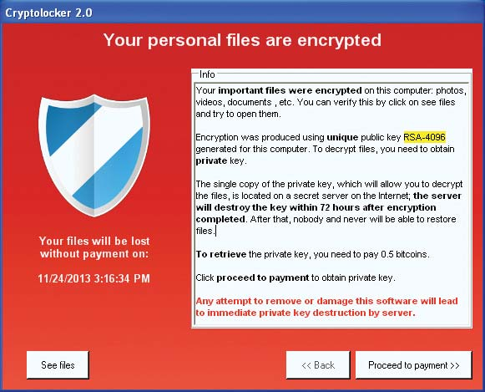
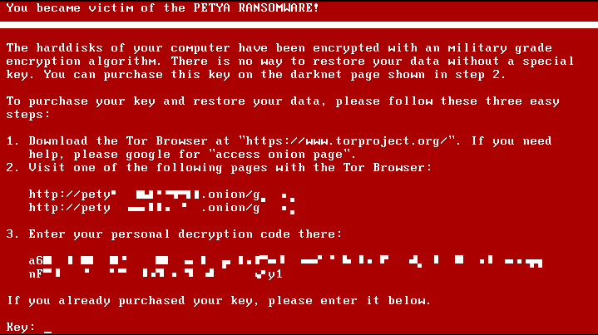
What Does ‘Ransomware’ Look Like?

Slide 16
The Best Defense
Follow the guidance about phishing, this is typically how Ransomware gets you!
Follow the guidance about malware!
Back up your data regularly and keep it somewhere safe. Keep multiple copies if you can.
If you do fall victim to Ransomware, only pay the ransom as an absolute last resort. Once you pay, you will always be marked as a target.
Report it to law enforcement. In some cases you may be able to get your data back.

Slide 17
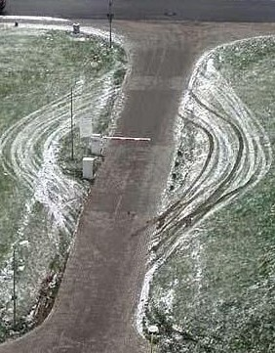
Simplified Best Practices
Don’t be the Pathway
Around Your Security
Protect your digital identity.
Think before you click.
Don’t just look for the bad, look for the unusual too.
If you don’t trust it or can’t verify it, don’t click it or use it.
It is OK to be a little paranoid, don’t hesitate to ask for verification.
If you don’t need it, don’t keep, open, or install it.
If you do need it, protect it and back it up.
Keep everything current with security patches and updates.
Stick to reputable vendors, websites, and software.
If you do see something odd, report it and address it quickly.

Slide 18

The Most Popular Slide in the Presentation
Questions?

Slide 19
David Carter
Deputy Chief Information Officer
Chief Information Security Officer
Commonwealth Office of Technology
Davidj.carter@ky.gov
(502)564-8734

