Slide 1
Fraudulent Deeds in Jefferson County
Understanding the issue
Raising awareness
Prevention and response

Slide 2
What Is Deed Fraud?
Unlawful transfer of property using falsified documents
Forged signatures or identity theft
Victims often unaware until major issues arise

Slide 3
Where Jefferson County Is Seeing Cases
Vacant Land
Inherited Properties
Properties with Liens or Violations
Unoccupied Homes
These properties are less likely to be actively monitored

Slide 4

Warning Signs
Quitclaim Deed
Multiple Transfers
Missing Marital Status
Spelling Mistakes
Post-Dated Recordings

Slide 5
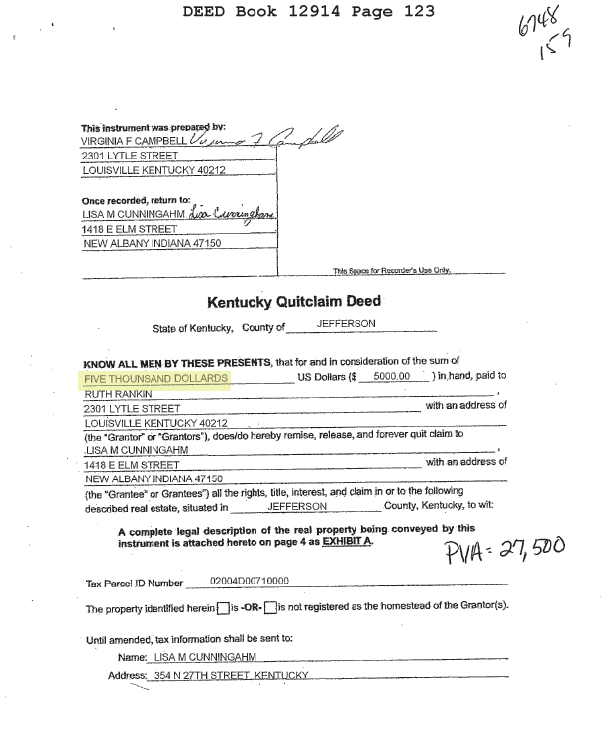

Slide 6
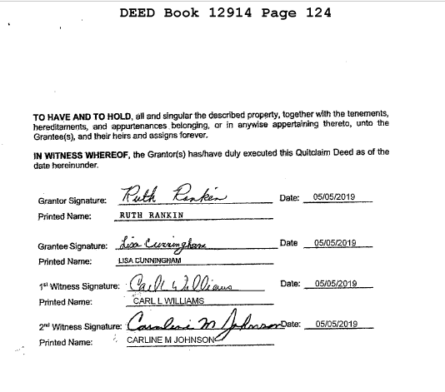

Slide 7
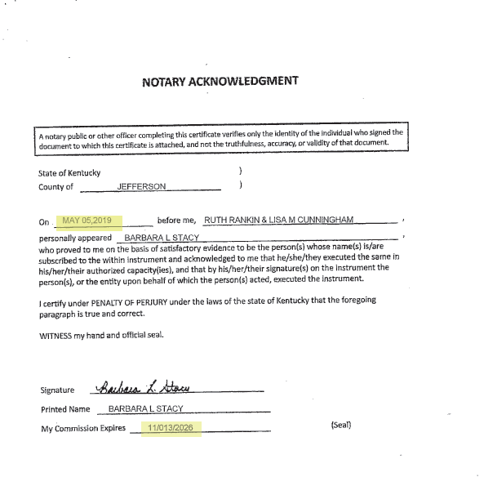

Slide 8

Impact on Victims
Financial loss
Legal fees
Eviction risk
Emotional stress
Loss of Medicaid

Slide 9

How Jefferson County Responds
Corrects Ownership
Files the Deed as Reference
Provides Affidavit of Fraudulent Deed

Slide 10
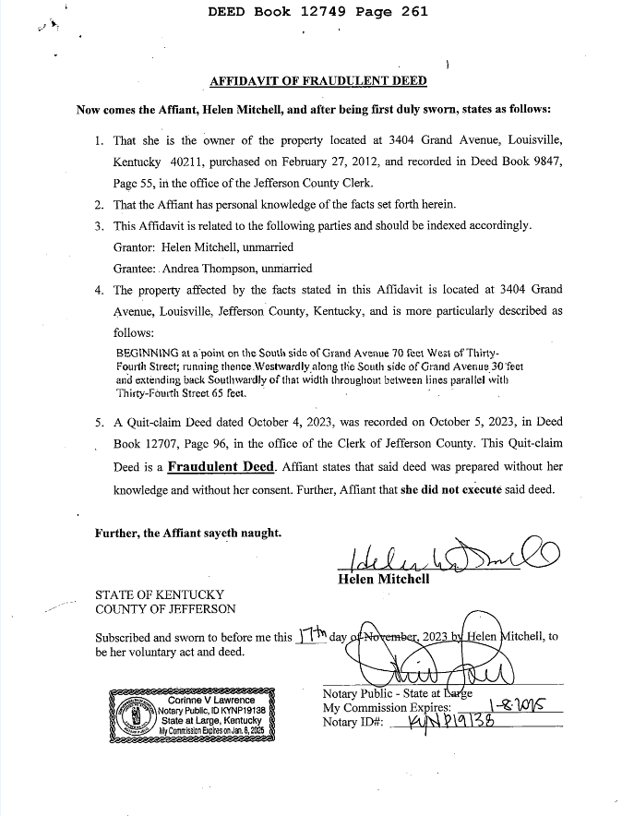

Slide 11
Prevention Steps
Sign up for Deed Alerts
The Legal Records Division of the Jefferson County Clerk's Office is the official repository for Jefferson County, and we are always looking for new ways to provide VIP service. We are proud to announce ClerkAlert, a new notification system that notifies property owners about records filed in their name or business name. ClerkAlert helps prevent mistakes, fraud, or errors by creating an extra layer of security by opting for electronic notifications when there are changes to your property. This notification system protects against scams, gives more notice, and delivers better record-keeping.
2. Check records regularly

Slide 12
If Fraud Is Suspected
Report
Report to law enforcement
File
File Fraud Affidavit
Consult
Consult an Attorney

Slide 13
Key Takeaways
Deed fraud is growing
Use of Generative AI will increase
Prevention and vigilance are crucial

Slide 14
Questions
Presenter
Jason Hancock Chief of Staff
Office of the Jefferson County Property Valuation Administrator Colleen Younger
Voice: 502.574.6106 Email: jhancock@jeffersonpva.ky.gov Website: Jeffersonpva.ky.gov

