Slide 1

PVA Fall Conference 2025
December 2-4, 2025

Slide 2
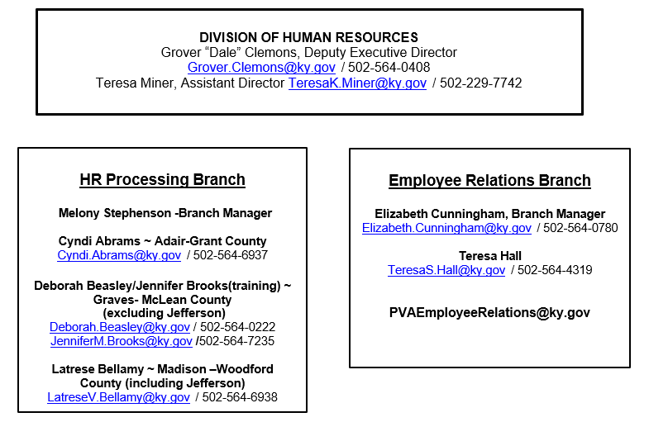

Slide 3
Employee Relations & Benefits

Slide 4
New for 2025
Qualifying Event (QE)- New tile in KHRIS
Submit your own qualifying event (30 days)
  Requires- Application & Supporting Documentation
  Allow two-week processing time
KHRIS

Slide 5
Uploading QE Steps
  Click “Qualifying Event” tile
  Log in with KHRIS credentials
  Click “Health Active Agency PDF Upload”
  Change plan year to current year
  Select “Reason for Application: Qualifying Event”
  Select “Qualifying Event”: Reason you are submitting
  Enter Employee Information: Employee ID or PERNR, enter
  Attach Application(PDF) and save
  Attached Extra Documentation (PDF) - this is the supporting documentation and save
  Click Submit

Slide 6
Common Qualifying Events
30 days from event date to submit
Event | Documentation
Marriage (Gain Spouse) | Marriage Certificate
Divorce (Remove Spouse) | Divorce Decree
Birth/Adoption | Hospital Birth Certificate/Adoption Forms
Death | No forms required
Termination of Spouse and/or Dependent Employment (adding to Employee’s Policy) | Proof of loss of coverage and/or Marriage Certificate, Birth Certificate
**Documentation would be submitted along with the Application**
*Contact Employee Relations for additional guidance not listed*

Slide 7
New for 2025
Adverse Weather Leave
Employees get a bucket of 7.5 Hours every January 1^{st.}
Effective September 30, 2025.
Time does not have to be made up.
Once 7.5 hours has been used, employees must use Annual, Comp or LNPU (if no leave time is available) if not able to be at work.
If time is not used it does NOT accumulate.

Slide 8
New for 2025
Employer Paid Leave (ERPL)
Effective: October 31, 2025
Six (6) weeks paid leave upon appointment. Renewed after the completion of 120 months and 240 months of services.
Can be utilized for one or more of the following reasons:
  Birth of a child and to care for the newborn child if the leave is taken within one year of the child's birth.
  Placement with the employee of a child for adoption or foster care if the leave is taken within one year of the child's placement.
  Serious health condition that makes an employee unable to perform the functions of the employee’s job.

Slide 9
New for 2025
Employer Paid Leave (ERPL) Continued
Rules:
Shall comply with the requirements of the FMLA
      If FMLA is applicable, an employee shall use ERPL concurrently with FMLA leave.
Qualifying leave shall be designated as ERPL and shall be exhausted prior to the employee's use of other accrued leave.
Upon exhaustion of ERPL, additional leave shall comply with the other provisions of this administrative regulation, including the requirement for medical documentation signed by a licensed medical provider certifying the employee’s continued need for leave.
Shall be used only on a continuous basis for absences of three (3) or more consecutive days.
Must request advance approval from supervisor to use ERPL.
Notes:
ERPL can not be used for all medical conditions or sickness since it does have to meet FMLA requirements
Can not be used for care of a family member.

Slide 10
New for 2025
Employer Paid Leave (ERPL) Continued
Contact PVA Employee Relation for qualifications and application at PVAEmployeerelations@ky.gov
Tracking:
  Timesheets will be completed by PVA Employee Relations once KHRIS is updated.
  Until then: Employee will need to use their leave or LNPA. Then, once the leave is active your HRG will update your timesheet and leave quotas.

Slide 11
Onboarding Reminders
Welcome Brochure - Provided to new hire once they clear in KHRIS
All emails are sent to KY.gov emails
Current forms are emailed to New Hire and PVA
Password for desktop login comes from COT
New Employee Binders are sent to Full Time Employees only
Encrypt emails when returning form. #rmsencrypt (Ky.gov emails) #encrypt (all others)
Health Insurance enrollment is complete in KHRIS (30-day time frame)

Slide 12
How does my staff…
Request Family Medical Leave
  Must meet qualification of 12 months state service employment and been paid 1250 hours.
  Contact Employee Relations Branch
Apply for Sick Leave Sharing
  Must be out 10 consecutive workdays
  Depleted all time
  Complete Sick Leave Application and send to Employee Relations Branch
Donate time
  Retain at least 75 hours in sick leave balance
  Complete Sick Leave Donation form and send to Employee Relations Branch
Submit A Workers Comp Claim
  Notify Manager
  Complete First Report of Injury on PVA Network.

Slide 13
Reminders
All Employee Relations emails can be sent to PVAEmployeeRelations@ky.gov
Visit PVA Network site PVA Human Resources - Department of Revenue
Visit Personnel Cabinet Website for more benefit details Personnel.ky.gov
LivingWell Points - Must be cashed out by December 31st
  Use the Castlight App or site to redeem
  E-gift cards are e-mailed to your KY.gov email

Slide 14
HR Processing
Branch

Slide 15
Pension Spiking - Expense Allowance
Kentucky Public Pensions Authority (KPPA) has reviewed information submitted by your agency regarding the Expense Allowance that is paid to your employees.
It has been determined that the Expense Allowance payment is considered a bonus payment. Kentucky Revised Statute 78.510(13) states that ''…A lump-sum bonus, severance pay, or employer-provided payment for purchase of service credit shall be included as creditable compensation but shall be averaged over the employee's service with the system in which it is recorded if it is equal to or greater than one thousand dollars ($1000)…‘’
In order for KPPA to properly account for all bonuses paid in a fiscal year, you must report these payments on your monthly report. These payments should be reported on a separate record with a payment reason of Bonus/Severance Payment. Payments must be reported in the month in which the member receives the bonus or severance payment.

Slide 16
Pension Spiking - Compensation
Kentucky Public Pensions Authority (KPPA) has reviewed information submitted by your agency regarding the Compensation of Property Valuation that is paid to your employees.
It has been determined that the Compensation of Property Valuation payment is not considered a bonus payment but is considered creditable compensation. Per Kentucky Revised Statute 78.510 (13) creditable compensation ''means all salary, wages, and fees, including payments for compensatory time, paid to the employee as a result of services performed for the employer or for time during which the member is on paid leave, which are includable on the member's federal form W-2 wage and tax statement…‘’
Compensatory payments should only be reported as creditable compensation for members whose participation date is prior to September 1, 2008. Creditable compensation does not include Workers' Compensation or lump sum payments for accrued vacation or sick leave, except as provided in Kentucky Revised Statute 78.616 (5).

Slide 17
Timesheet Reporting
It is very important that timesheets are submitted and approved accurately at the appointed times.
Please be reminded, do not delete or make any changes to previous pay period. Contact your HR Consultant if you need assistance.
If you plan to be out of the office, you can submit and approve using the link below. You will have to use the full version to submit and approve timesheets.
https://personnel.ky.gov/layouts/15/ESS_MobileApp/QuickAccess.aspx

Slide 18
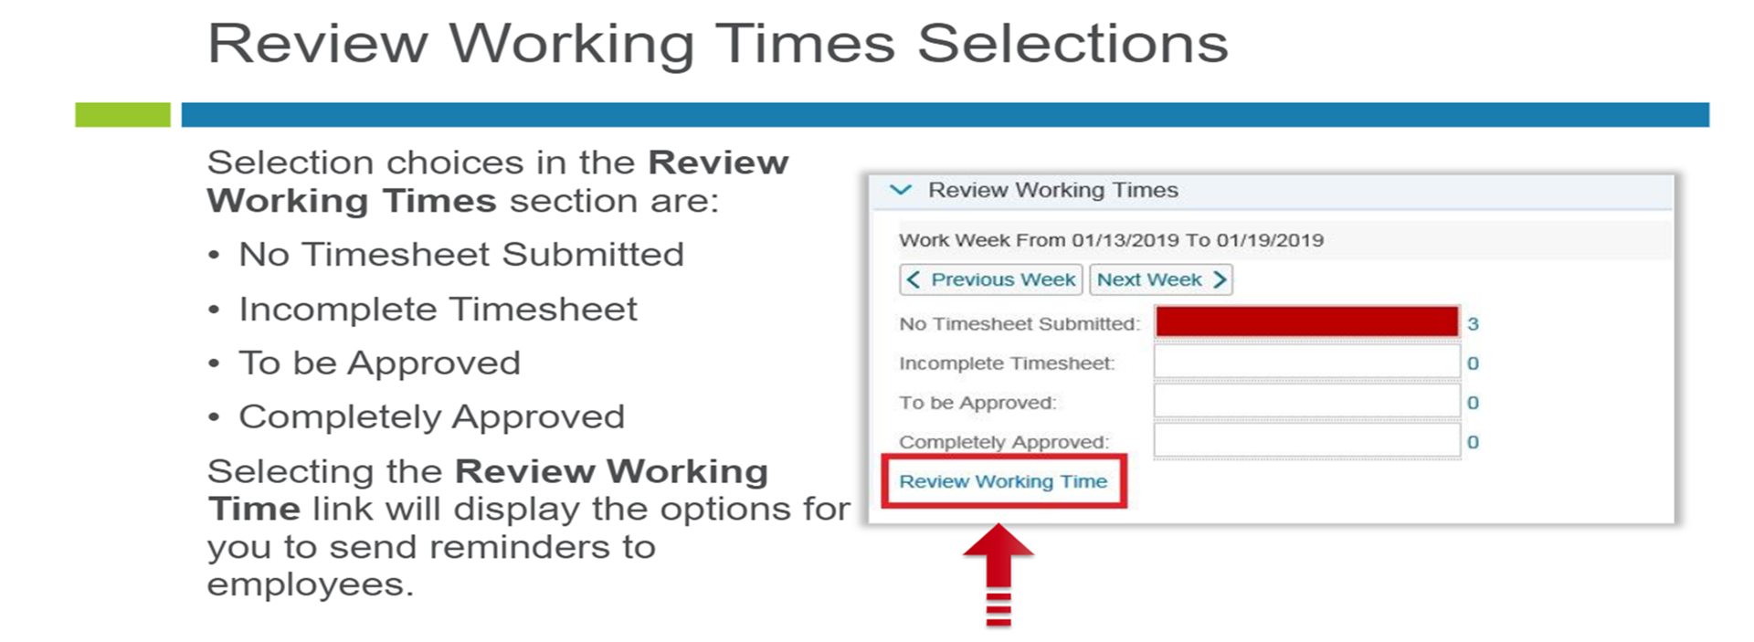
Timesheet Reporting Continued
*Part-time employees must only enter their hours worked. If they are to be paid for holidays (at the discretion of the PVA), then they must enter the code HOLP.

Slide 19
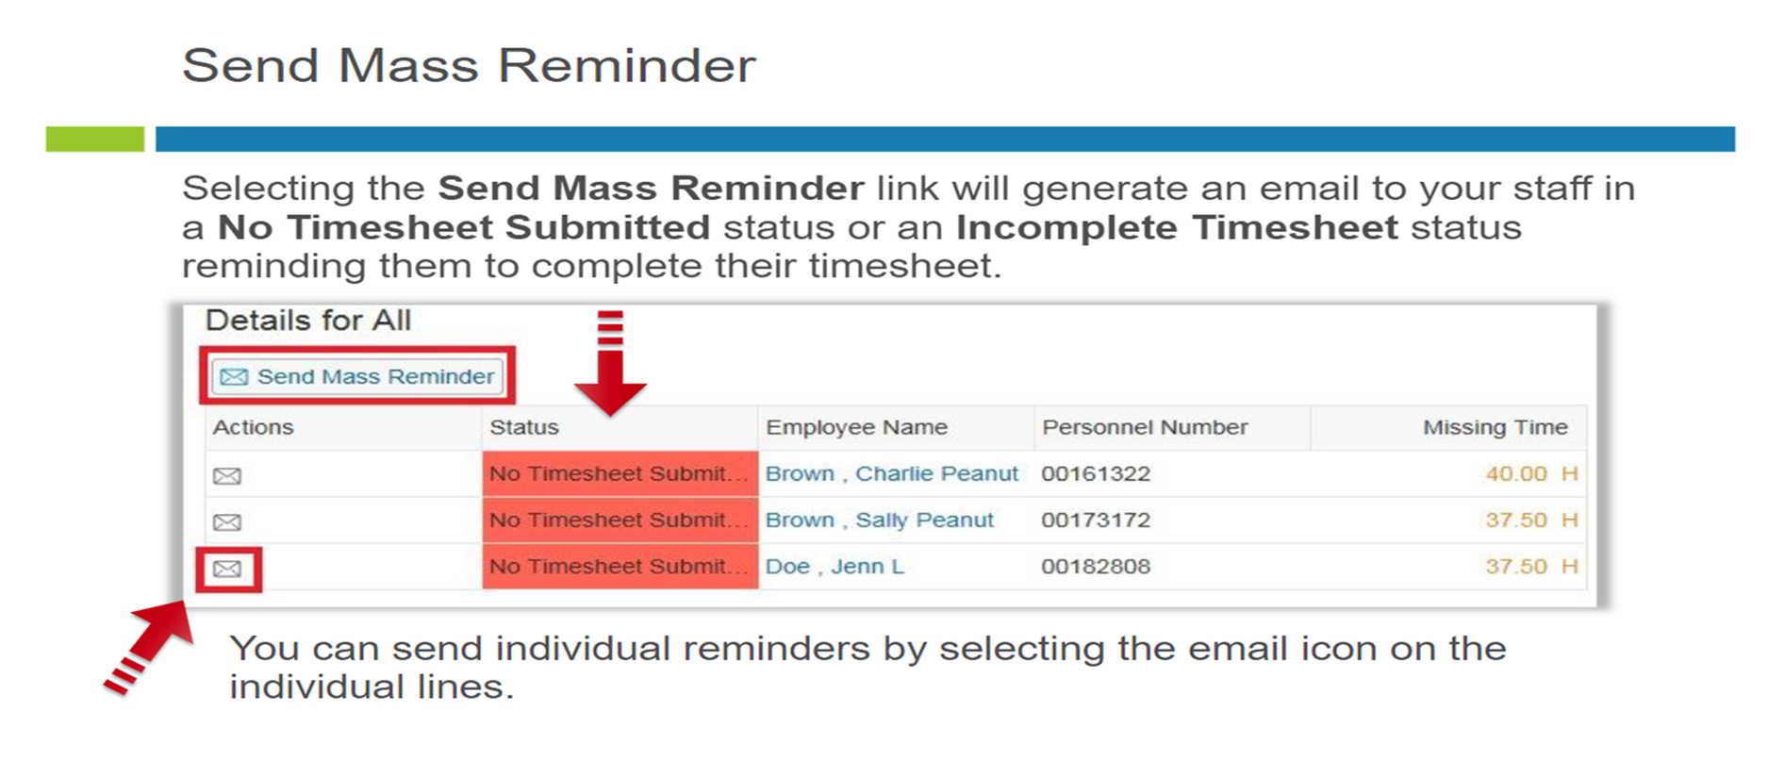
Timesheet Reporting Continued

Slide 20
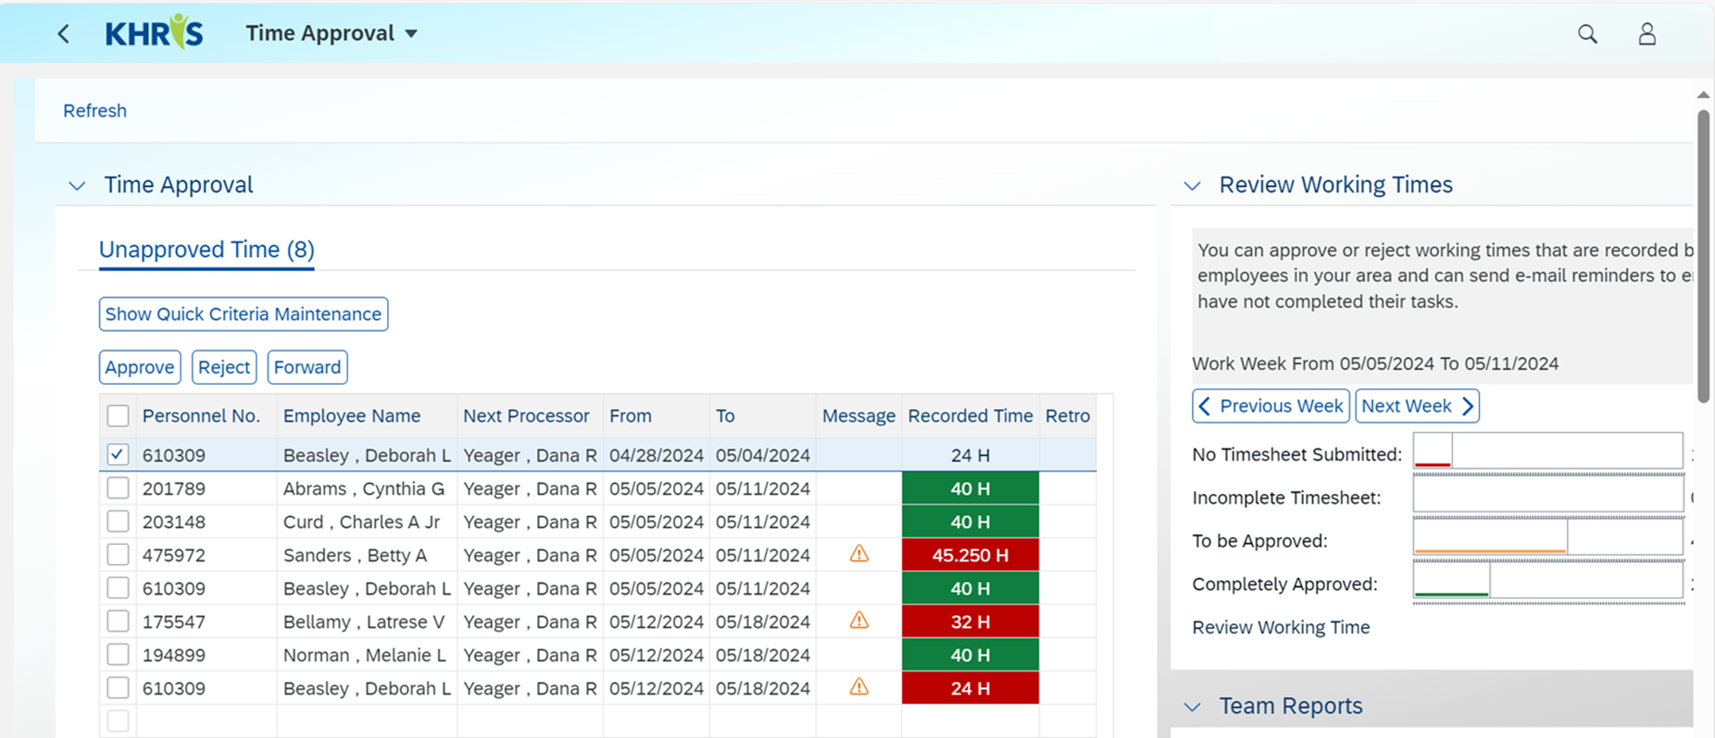
Timesheet Reporting Continued

Slide 21
Reporting Holidays and Training
Remaining State Observed Holidays
Christmas - Thursday, December 25, 2025 & Friday, December 26, 2025
New Year’s – Thursday, January 1, 2026 & Friday, January 2, 2026
If your county Judge Executive closes for a different day, the code would be CLOS.
Part-Time employees will be paid at the discretion of the PVA for half the holiday. This is included in the monthly maximum hours of 99.75 to be paid.
Full-Time employee’s holiday will auto populate. If they are 24/7, they will revert back to a 7.50 work schedule.
If you are attending training for CKA, SKA and other PVA sponsored training, the code would be 1REG but put a comment in notes the title of the training.
NOTE: When taking the PVA Exam it is considered personal, you would use your personal leave.

Slide 22
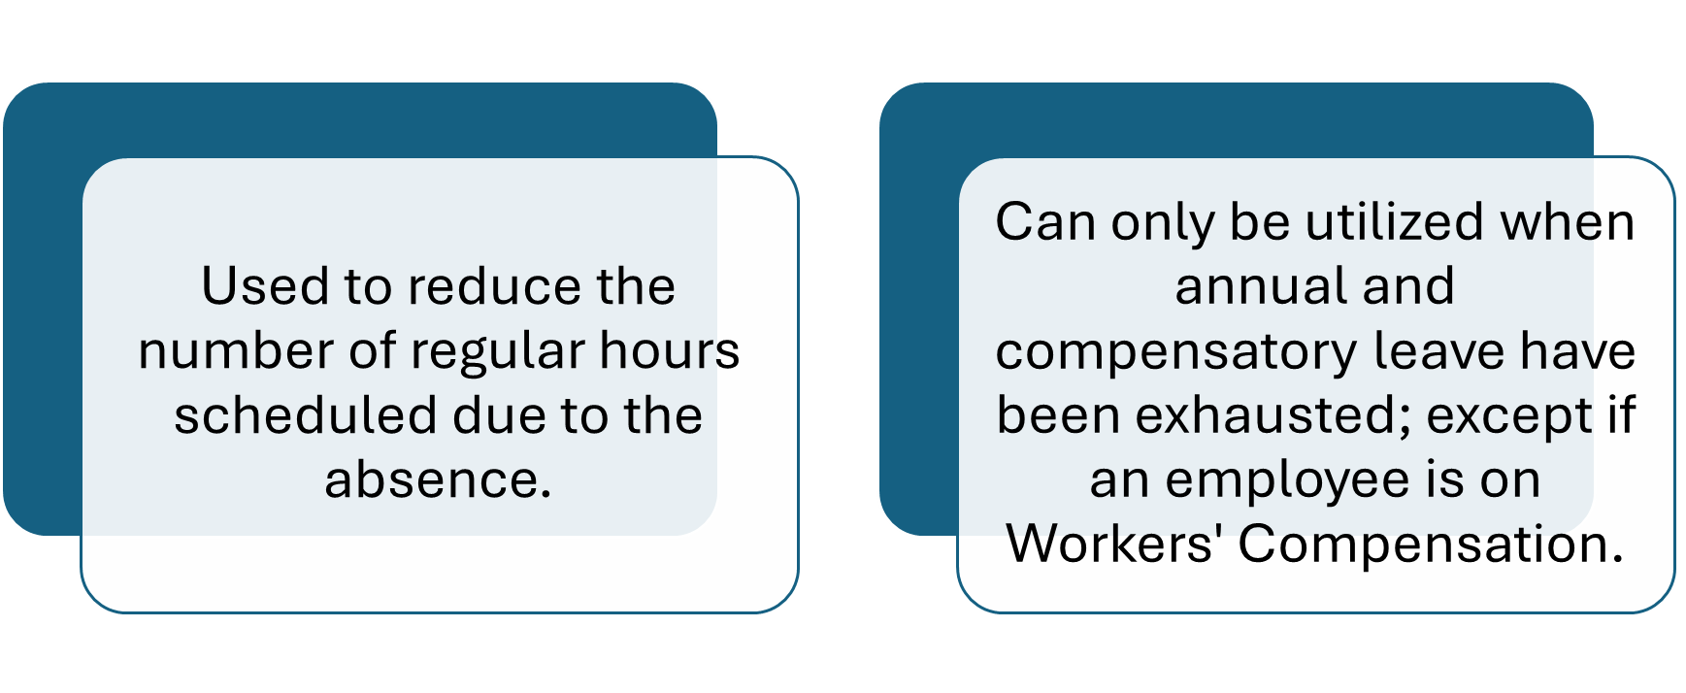
Leave No Pay Authorize= LNPA

Slide 23
Leave No Pay Authorize = LNPA Continued
An employee must have exhausted all of his or her accumulated annual and compensatory leave before leave without pay may be used under the circumstances outlined in the second type of special leave.
Regulation 101 KAR 2:102 Section 2 Sick Leave Without Pay states that an Appointing Authority shall grant sick leave without pay in 2 circumstances:
If the employee is impaired by illness or injury
  If the leave does not exceed 30 continuous calendar days; and
  The employee has utilized all of their accumulated leave (except if they requested to save 10 sick days).
OR
If it’s within an employee’s first 12 months of employment and do not qualify for FMLA.
  The employee must also have exhausted all of their leave.
  This cannot exceed a period of 30 working days.

Slide 24
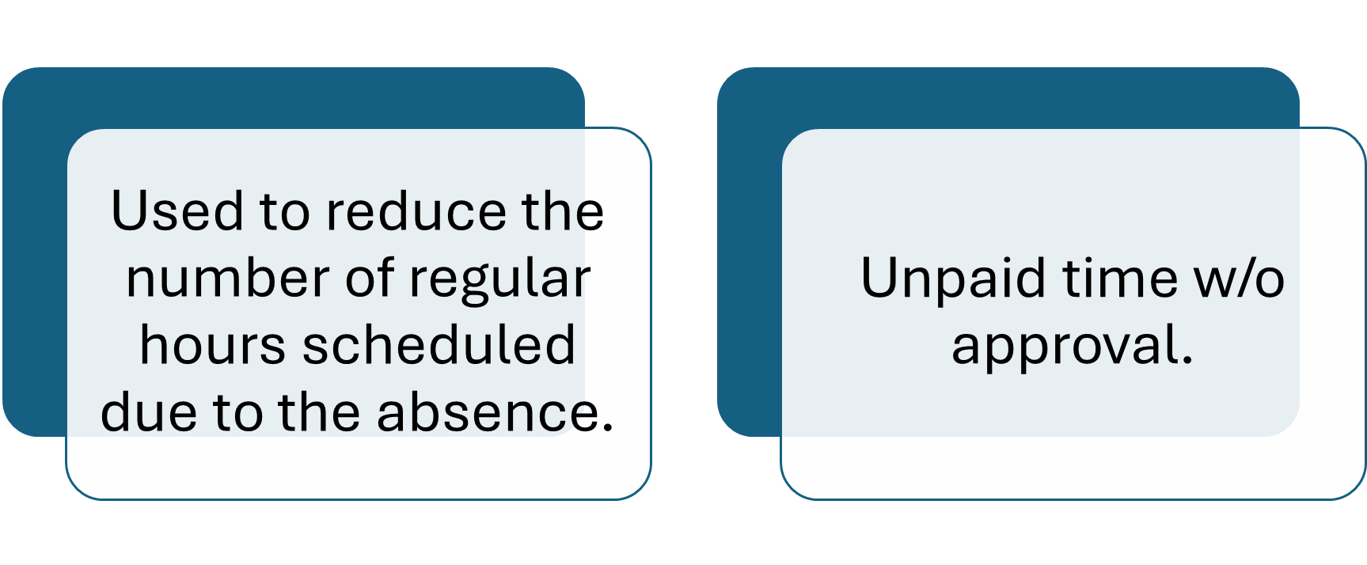
Leave No Pay Unauthorized= LNPU

Slide 25
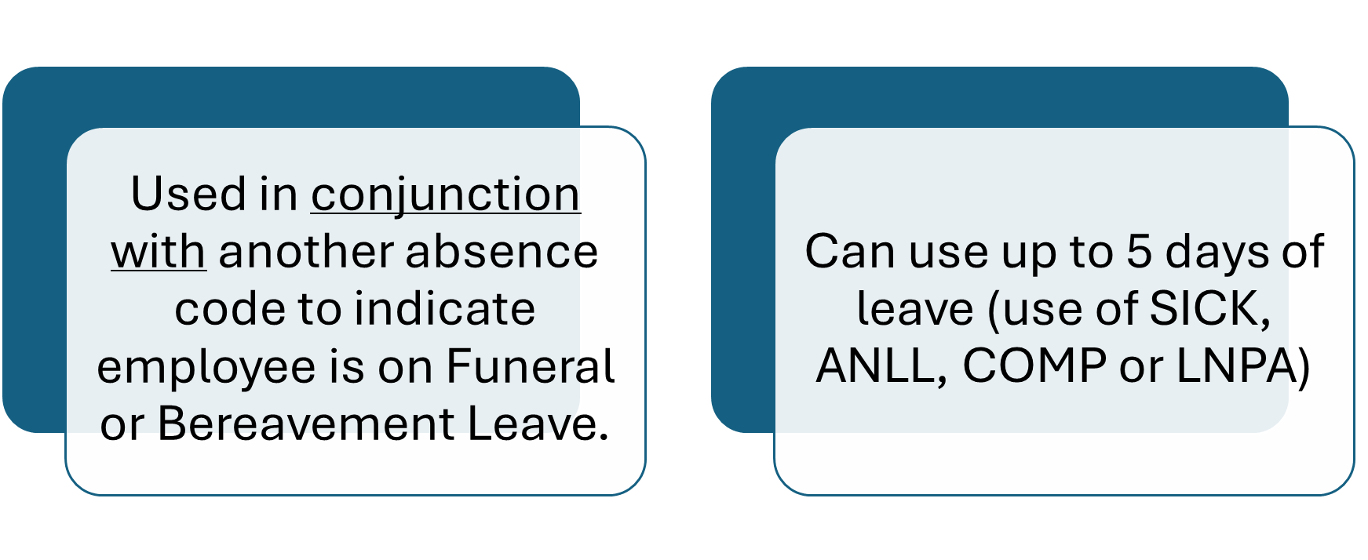
Bereavement/Funeral = BERV

Slide 26
Timesheet Reporting Tutorials
Employee Self Service (ESS)
Time Recording Basics
Accurate Time Reporting
https://personnel.ky.gov/Pages/learning-KHRIS-ESS.aspx
Manager Self Service (MSS)
Time Approval Basics
Accurate Time Reporting
https://personnel.ky.gov/Pages/learning-KHRIS-MSS.aspx

Slide 27
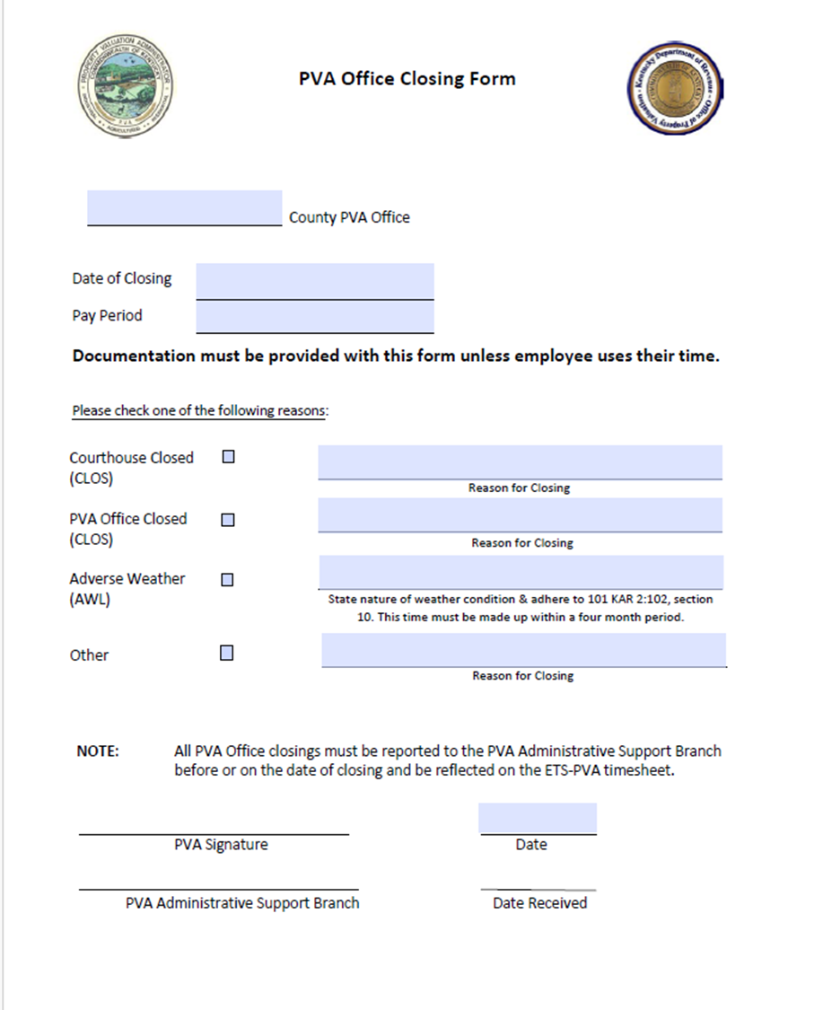
Office Closure
Options for Closure
Judge/Executive Closure
PVA Office Closure (most recent)
  Property Valuation Administrator (PVA) has the authority to close their office in the event of severe local weather conditions or other emergency events that impact the health and safety of the PVA staff (unclassified state employees).
Telework (If able to work from home)
Use personal leave

Slide 28
Fair Labor Standards Act (FLSA)
Non-Exempt and Exempt
The federal statutes and regulations require that the appropriate "test" be applied to each individual who is exempt from the overtime provisions of FLSA. Be sure to classify employees appropriately when completing the FLSA Exempt Test Form.
Non-Exempt Employees
If a position is NOT an executive, administrative, or professional job in accordance with the established guidelines and the job is paid on a salaried - not hourly - basis, the position is considered to be “non-exempt”. These positions will earn compensatory leave time for any hours worked beyond the standard 37.50 hour work week until forty hours are worked. An employee in a “non-exempt” position is entitled to receive time and a half for each hour worked over forty in a work week.
If the employee is paid by the hour or is a part-time employee working less than 100 hours per month, they will be paid for the hours worked up to forty hours per week. For work time in excess of forty in a week, these employees also have the option of being paid at one and a half times their regular rate of pay or earning one and a half hours of compensatory leave for each hour worked over forty.
Exempt Employees
If a position is considered an executive, administrative, or professional job, employees in these positions are considered “exempt” under the federal guidelines. Typical PVA office employees that would fall into this category include the Chief Deputy and Chief of Staff. Employees in exempt positions are entitled to compensatory leave time for all hours worked in excess of their regular work schedule.

Slide 29
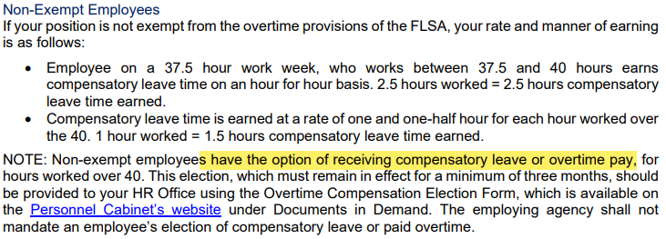
Non-Exempt Employees & Overtime
https://extranet.personnel.ky.gov/Pages/Documentsindemand.aspx

Slide 30
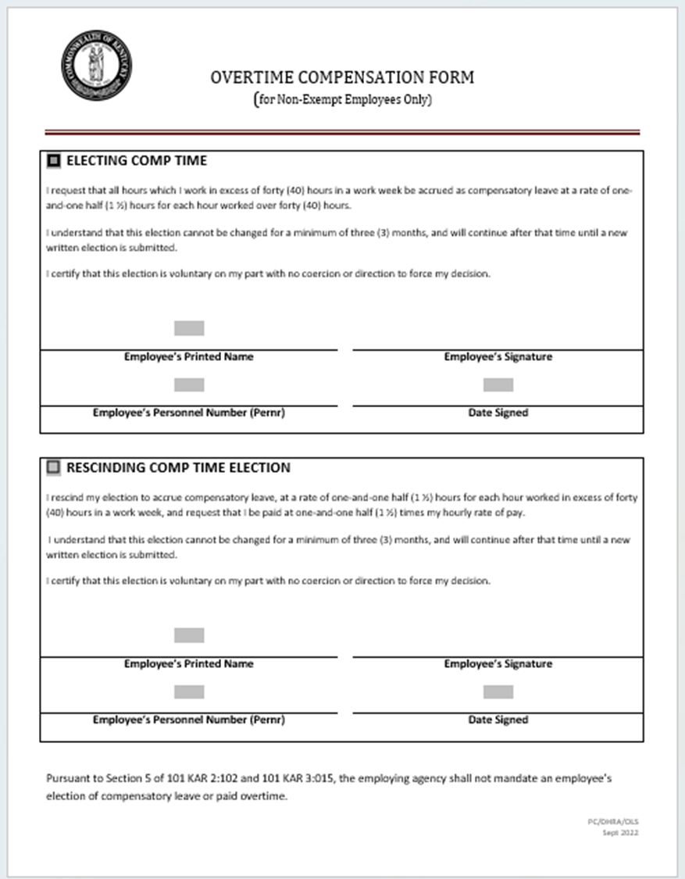
Overtime Compensation Form

Slide 31
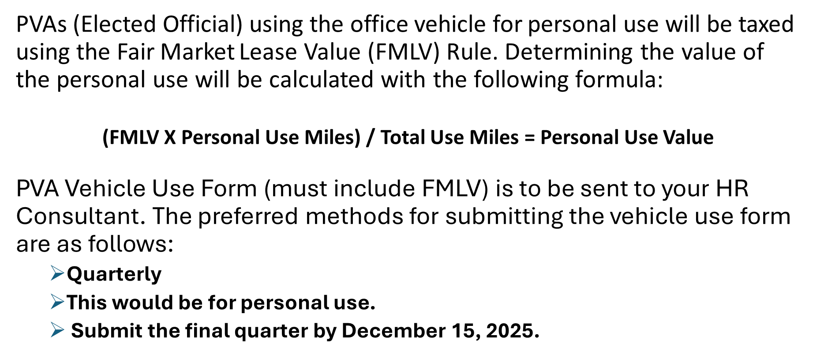
Fringe Benefits

Slide 32
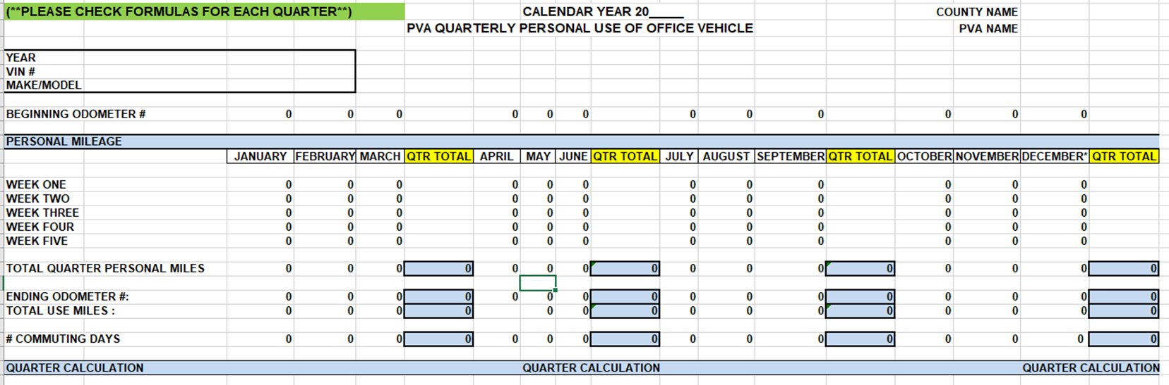
Fringe Benefits- PVA Reporting

Slide 33
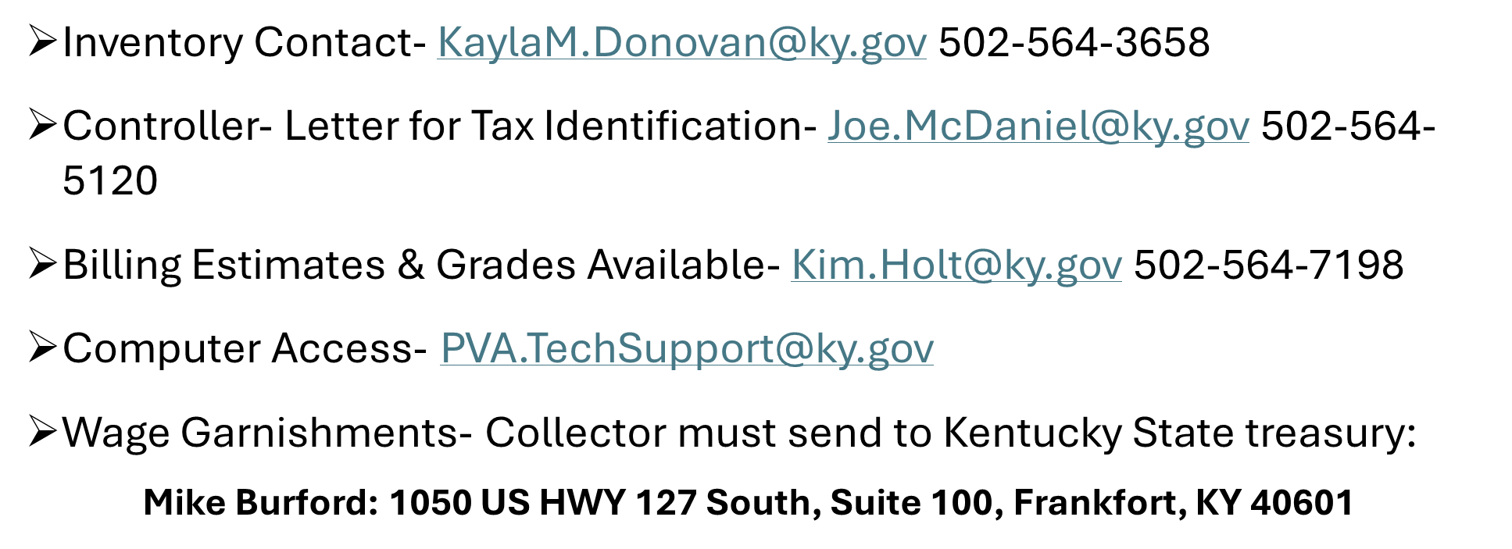
Contacts

Slide 34

Questions

