Slide 1
PVA Summer Conference 2024
June 18th – 20th

Slide 2
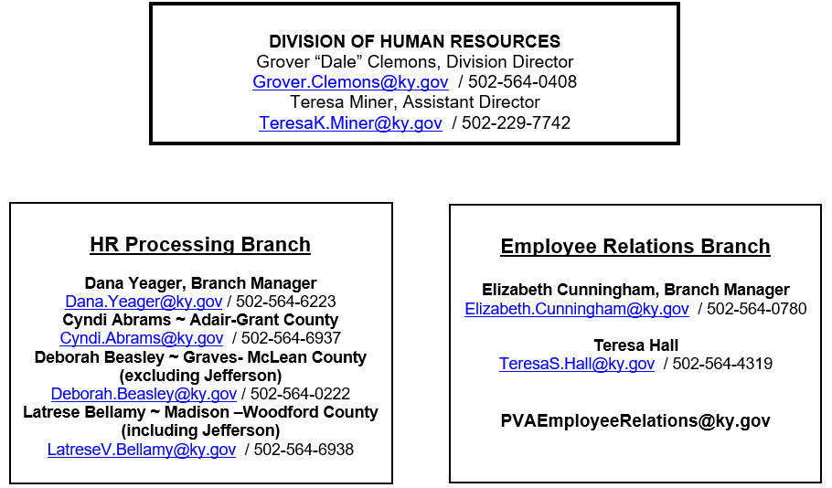

Slide 3
Hiring Process
Candidate Selected by PVA Office
Submit Employee forms to HR
Budget Approval
Budget submits RPA to HR once approved
Submit RPA(in Excel format) to DOR Budget
Emailed to DORPVAApprovals@ky.gov
CC your HR Consultant on email to DOR
15 Days prior to anticipated start date
State Application
RPA is available on the PVA Network
Copy of College Degree/Official/Notary Transcript
Copy of GED Certificate/ GED Transcripts/GED ID#

Slide 4
Hiring Process
HR Approval
New Hire Onboarding(PVA Employee Relations Branch)
New Employee Binder sent to PVA Office
Approval of new hire comes from HR and verifies start date
New Hire forms to be sent to HR
Position Description
KRC Acknowledgement of Confidentiality
Fair Labor Standards Act Test and Form
Code of Ethics Certification
Computer Access Form- Send to: PVA.TechSupport@ky.gov

Slide 5
Hiring Process
New Hire Onboarding (PVA Employee Relations Branch) Continued
Onboarding Day (Start Date)
Onboarding on First day via Microsoft TEAMS
Onboarding Emails and Meeting Request
Sent 3-4 days prior to the start date
Sent to PVA and New Hire(if action has cleared)
Cover New employee Binder and Paperwork

Slide 6
PVA Employee Relations and Benefits

Slide 7
Orientation:
Held the 1st & the 16th of each month
Via TEAMS
NEO binder mailed before
Onboarding Itinerary:
New Employee Onboarding Paperwork
Trainings
PVA Employee Handbook
Direct deposit
KHRIS portal
Metlife
Student Loan Forgiveness
Deferred Comp
Work Aids
Health Insurance
Onboarding
Process

Slide 8
New Hire Paperwork:
I9
Tax Forms (W4)
MetLife application
Direct Deposit
EEO
Work Schedule
KPPA
Membership
Beneficiary
Optional Forms:
KECC
Deferred Comp Reimbursement
Outside Employment
Encryption
#encrypt
#rmsencrypt (only when using KY.gov email)
Onboarding
Process (cont.)

Slide 9
Health Insurance
Plans
LivingWell CDHP
LivingWell PPO
LivingWell Basic
Benefits
Optional Insurance
Plans
Dental
Vision
Life

Slide 10
Health – If you have experienced a life-changing (qualifying) event a new child, divorce, marriage, loss of coverage, Medicare or Medicaid, etc. – you can adjust your health benefit options to reflect your current needs and status.
Life – Complete an enrollment /change application and submit to the Employee Relations Branch. You have 35 calendar days from the date of your qualifying event to submit your paperwork.
Dental & Vision – Please contact the Employee Relations Branch for specifics.
Qualifying Events
Benefits

Slide 11
MetLife Insurance
$20,000 Life Insurance policy provided at no cost
Option to purchase additional life insurance for you and your eligible dependents.
Estate Planning available for those who are enrolled in Supplemental Term Life Insurance
Rates available on Personnel Website
Benefits

Slide 12
Kentucky Deferred Compensation
Supplemental Retirement Savings Plan
Plans Available
IRA
Roth 401(k)
Roth 457(b)
Deemed Roth IRA
New Hire Auto Enrollment
All appointments after July 2019
90 days to opt out
Benefits

Slide 13
Visit the Personnel Cabinet Website for more Benefit details.
Personnel Portal (ky.gov)

Slide 14
FMLA
In general, the Family Medical Leave Act (FMLA) is a federal law that provides up to 12 weeks unpaid, job-protected leave to employees for certain family and medical reasons.
If an employee is out 3 or more consecutive workdays, the Supervisor must report the situation to HR.
Eligible Kentucky Executive Branch employees covered by KRS Chapter 18A are entitled to twelve (12) weeks of unpaid family and medical leave per CALENDAR YEAR.
101 KAR 2:102, Sections 3
101 KAR 3:015, Section 3

Slide 15
FMLA Eligibility
To be eligible for Family Medical Leave, an employee must have:
1. Completed at least twelve (12) months of state service; and
2. Worked or been on paid leave for at least 1,250 hours in the twelve months immediately preceding the first day of Family and Medical Leave.

Slide 16
FMLA Leave Entitlement
An eligible employee must be granted at least twelve (12) weeks of Family Medical Leave during the calendar year for one or more of the following reasons:
• For the birth of a son or daughter, and to care for the newborn child;
• For placement with the employee of a son or daughter for adoption or foster care;
• To care for the employee’s spouse, son, daughter, or parent with serious health condition.
(**LEAVE ENHANCEMENT** ‐ To care for an “immediate family member” with a serious health condition).

Slide 17
FMLA Leave Entitlement
Because of a serious health condition that makes an employee unable to perform the functions of the employee’s job;
• Because of any qualifying exigency arising out of the fact that the employee’s spouse, son, daughter, parent, or someone of similarly close relationship is a covered military member on active duty (or has been notified of an impending call or order to active duty) in support of a contingency operation;

Slide 18
FMLA Leave Entitlement
• To care for a covered service member with a serious injury or illness if the employee is the spouse, son, daughter, next of kin, or someone of similarly close relationship to the servicemember.
**NOTE: An eligible employee is entitled up to 26 workweeks of leave to care for a covered service member with a serious injury or illness during a single twelve (12) month period.

Slide 19
Types of FMLA Leave
Intermittent
Intermittent leave is Family Medical Leave taken in blocks of time due to a single qualifying reason.
A reduced leave schedule is a leave schedule that reduces an employee’s usual number of working hours per workweek, or hours per workday.
Examples
Maternity, Adoptions
Medical Treatments
Care for a Family Member
Continuous
Continuous leave is Family Medical Leave taken continuous due to single qualifying reason.
Examples
Surgeries
Maternity, Adoptions
Care for a Family Member

Slide 20
Workers Compensation
The ​Kentucky Workers Compensation Program (excludes Transportation Cabinet employees) provides medical and disability benefits to employees who may experience a work-related injury or illness. A managed care program is used to provide covered medical benefits.
Workers Comp 502.564.6847 888.860.0302
101 KAR 2:140
Workers comp (ky.gov)

Slide 21
PROCESSING AND RECRUITMENT BRANCH HUMAN RESOURCES

Slide 22
PERSONNEL ACTION PROCESS
Complete the Request for Personnel Action (RPA) in a timely manner (15 days before the effective date) and with accuracy.
Complete the state application (must meet minimum grade requirements) with any college and/or work experiences. The experiences determine the candidate’s qualifications.
All forms on the hiring checklist must be completed and/or signed. (Packets and updated forms can be obtained through the PVA Network or from your HR Consultant or the PVA Employee Relations Branch).
Notes:
RPAs are to be sent 15 days prior to the effective date
The application is to be completed and include all educational and work experience.
Complete and Submit all forms listed on the checklist. Be sure that all necessary signatures on obtained prior to submitting.

Slide 23
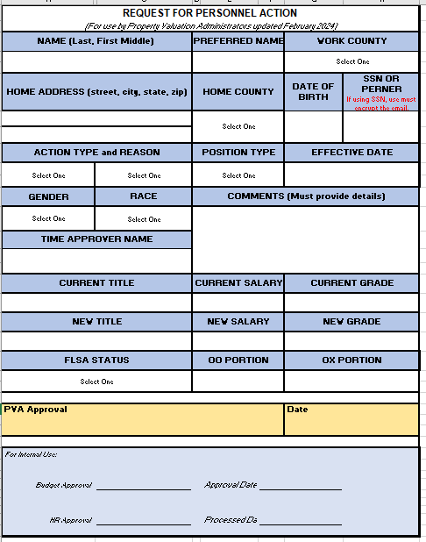
REQUEST FOR PERSONNEL ACTION (RPA)
RPAs are to be sent to DORPVAApprovals@ky.gov for budget approval. NOTE: Budget approves available funds & DHR verifies for approval that qualifications and/or experience have been met.

Slide 24
FAIR LABOR STANDARD ACT

Slide 25
APPOINTMENTS
To ensure accurate appointment actions, it is imperative that your HR Consultant is notified prior to hiring.
Please complete and submit all forms on both the hiring and benefit checklists.
Please confirm with the potential employee whether or not they have had previous service in either state, county or the education system (KPPA, CERS or KTRS).
Notes:
You have selected an applicant and your ready to appoint them. RPA is to be completed and sent encrypted to the DORPVAAPPROVALS@ky.gov mailbox.
If an employee requires proof of education to qualify for a position, they should request their transcript to be sent to DHR when they are offered the position. If they begin work and then it’s determined, they do not meet the minimum qualifications they may have to be terminated or demoted.

Slide 26
SEPARATIONS
To ensure proper separation, it is imperative that your HR Consultant is notified prior to the separation.
Please submit RPA within 15 days
Please notify us if employee has accepted a position with a government entity (KPPA, CERS or KTRS).

Slide 27
UNEMPLOYMENT INSURANCE
Unemployment Insurance is provided to an employee who is discharged from employment.
Types of Unemployment Status:
Voluntary Resignation
Dismissal
The burden of proof rests with:
Employee – to prove a forced resignation
Employer – to prove employee’s misconduct

Slide 28
DEFERRED COMPENSATION & PAYOUTS
Deferred comp is not considered pre-tax for Social Security and Medicare.
The taxes withheld are calculated based on the gross.
Local taxes are also calculated on the gross.
Example
Gross payout amount: $7,225.47 Deferral Max: $6,250.00
For Federal and State taxes, one would only be taxed on the difference between their gross less the deferral amount ($7225.47-$6250.00 = $975.47) If you take $975.47 x 22% (Federal Supplemental Rate) = $214.60 if had not deferred, the federal tax withholding would have been $1,589.60.
For State taxes, it would be calculated on $975.47 x 4.5% (state tax withholding rate) = $43.90 if not deferred, the state tax withholdings would have been $325.15. As you can see you had a substantial savings in Federal and State taxes because of the deferral.

Slide 29
EXIT INTERVIEW
Employee that will be separating due to resignation, transfer, retirement, etc. should notify their HR Consultant prior to their last day of work for an exit interview.
If retiring, the KPPA 6000 (section H) Form is to be completed by your HR Consultant.

Slide 30
PROMOTIONS AND SALARY ADVANCEMENT
All promotion and salary adjustment requests must be accompanied with an updated application and position description.
The updates would reflect any changes since the employee’s last promotion or salary advancement.
Note: Any salary advancement other than a vacancy promotion would be effective the 16th of the month.

Slide 31
LOCAL FUNDS (OX) SALARY INCREASES
If sufficient funds are available, the PVA may request to increase an employee’s salary in 5% increments, up to the mid-point of the grade. This increase must be requested and paid through local funds (OX) and can only be given once every twelve (12) months. If these funds are not available in the subsequent fiscal year or at the discretion of an incoming PVA, the employee’s salary will revert to their previous salary.
Note: Agreement is to be completed for each OX increase.

Slide 32
PART-TIME, SEASONAL & INTERIM
Per KAR 1:140
An employer participating in KPPA shall not classify an employee in more than one (1) non–participating position status during the fiscal year.
Employee cannot be in two (2) non-participating status in the same fiscal year. If they work seasonally, they must have a 3-month break before returning.
If employee does not observe a 3-month break in service, all omitted contributions (contributions not withheld and paid to KPPA) will be billed to the county.
*NOTE: Employees under 18 and without high school degree will be classified in a seasonal/interim position. Must indicate if part-time or full-time seasonal on RPA.

Slide 33
TIMESHEET REPORTING
The rule of thumb for submitting timesheets:
Submit by Noon the day after pay day and approve by the close of business the following day.
The PVA should not submit a timesheet for themself.
Best practice is to submit (deputy) daily and approve (PVA) weekly.
If orange, then timesheet has not been submitted for approval.
Holidays are automatically populated for full-time employees.
Part-time employees must only enter their hours worked. If they are to be paid for holidays, then they must enter the code HOLP. (Their timesheet will also reflect an error due to system is looking for 24 hours. Be sure to submit and approve actual hours worked).

Slide 34
TIMESHEET REPORTING (Continued…)
Time approver’s view.

Slide 36
TIMESHEET REPORTING (Continued…)

Slide 37
TIMESHEET REPORTING (Continued…)

Slide 38
TIMESHEET REPORTING (continued…)
No time reported

Slide 39
TIMESHEET REPORTING (continued…)
Reporting closure and comp used

Slide 40
TIMESHEET REPORTING (continued…)
Time has been entered but not submitted for approval.

Slide 41
TIMESHEET REPORTING (continued…)

Slide 42
TIMESHEET REPORTING (continued…)
Calendar view.
Leave balances – only can use time listed.

Slide 43
TIMESHEET REPORTING (continued…)
6ADL – Include a comment in notes when working additional hours.

Slide 44
TIMESHEET REPORTING (continued…)
For special election, the employees will use the following CODES:
VOTE 4.00 hours
1REG 3.50 hours
If they work all day then:
VOTE 4.00 hours
1REG 3.50 hours
6ADL 4.00 hours
If office is closed, then you would use the number of hours the office was closed.
For absentee voting, report on the date you cast your vote.

Slide 45
TIMESHEET REPORTING (continued…)
If rejected or changed after approved, a comment must be included in the notes section. Save & Resubmit for approval.
Deputies should notify approver if they have made changes after approval. Please contact your HR Consultant if changes are made during payroll.
For split workweeks, you will have to submit time from a previous period. (Will not be paid again for the previous period, therefore changes should not be made to timesheet).
Future time worked (1REG) is not allowed to be submitted. Only leave time can be submitted in advance.

Slide 46
TIMESHEET REPORTING (continued…)
If deputies are using the same computer to enter time, wait 30 minutes between each logging on. If not done, this could cause the previous user’s time to be changed.
PLEASE DO NOT MAKE CHANGES TO TIMESHEET IN PREVIOUS PERIODS WITHOUT NOTIFYING APPROVER.
Changes to timesheet after approval or during payroll could adversely affect payment.
Leave accrual, usage and balances can be viewed in KHRIS under Time Statement.
Comp accruals will be held until the next period during a split workweek.
Timesheets can be printed from Time Statement in KHRIS (after payroll).

Slide 47
TIMESHEET REPORTING (continued…)
Amending timesheet
Put comment in notes.
Replace erroneous hours with zero.
Enter hours under amended code.
Resubmit for approval (or re-approval).
Approver must approve (or re-approve).
For additional assistance, contact your HR Consultant.

Slide 48
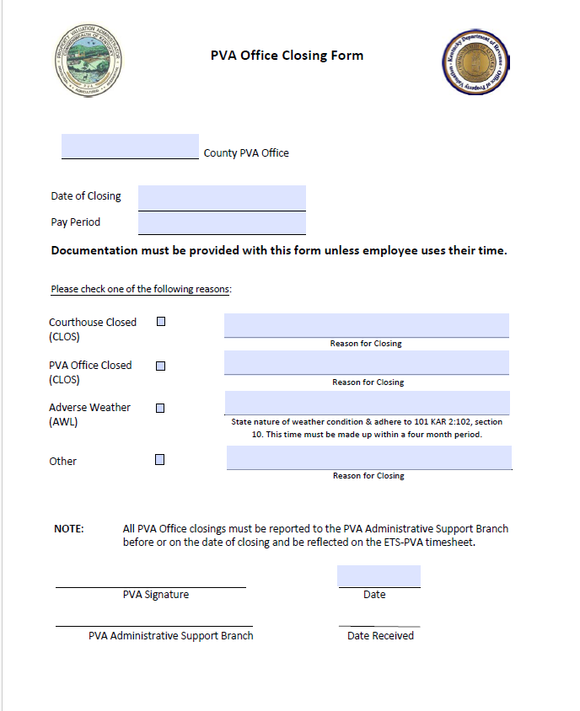
OFFICE CLOSURE
Options for Closure
Judge/Executive Closure
PVA Office Closure (new)
Property Valuation Administrator (PVA) has the authority to close their office in the event of severe local weather conditions or other emergency event, that impact the health and safety of the PVA staff (unclassified state employees).
Adverse Weather Leave (employee has one hundred twenty-three (123) days from the occurrence of the absence to make up the time lost)
Telework (If able to work from home)
Use personal leave
Notes:
The closure form is necessary for auditing purposes. You should maintain a signed copy in your records.

Slide 49
OFFICE HOURS
FULL-TIME EMPLOYEES
PART-TIME EMPLOYEES
Must work or use leave for 37.50 hours per week.
Minimum of 30 minutes for lunch break
Two rest periods (breaks), a minimum of 10 minutes each.
Not to exceed 99.75 hours a month
Meals and breaks are contingent on how many hours worked in a day.
Employees in Kentucky are required to have one paid 10-minute rest period for each 4-hour work period.

Slide 50
PVAs (Elected Official) using the office vehicle for personal use will be taxed using the Fair Market Lease Value (FMLV) Rule. Determining the value of the personal use will be calculated with the following formula:
(FMLV X Personal Use Miles) / Total Use Miles = Personal Use Value
PVA Vehicle Use Form (must include FMLV) is to be sent to your HR Consultant. The preferred methods for submitting the vehicle use form are as follows:
Monthly
Quarterly*
This would be for commuting or personal use.
Submit the final quarter by December 15, 2024.

Slide 51
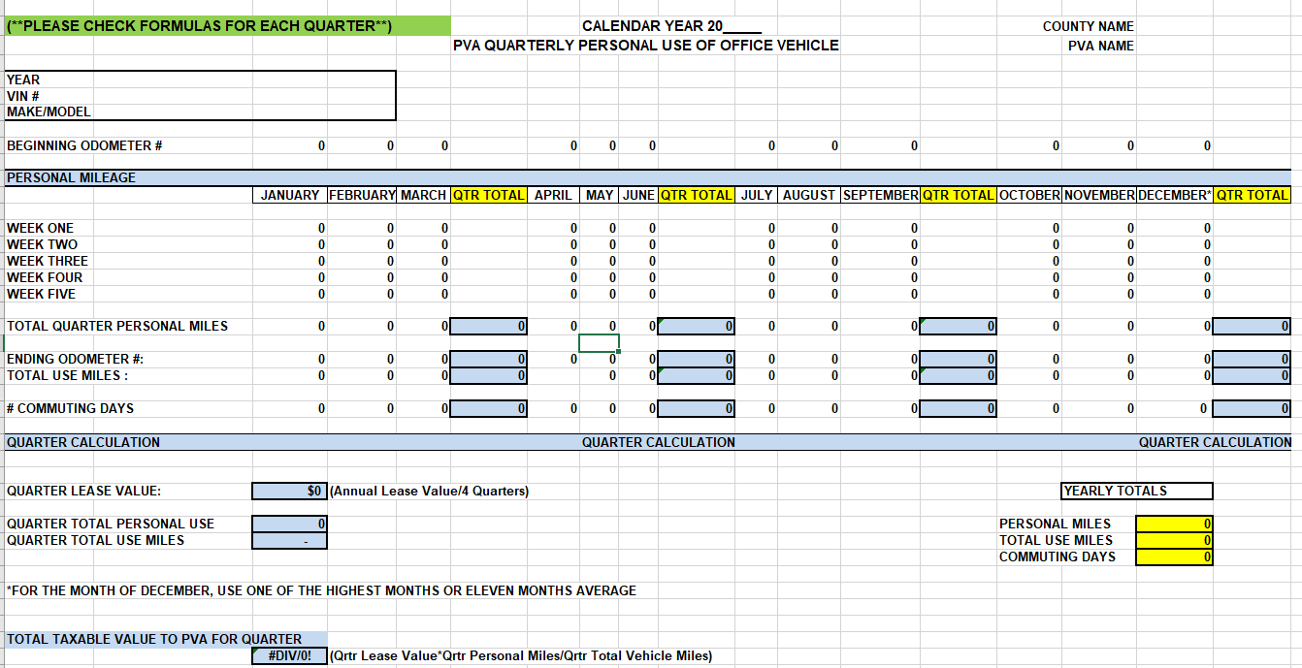
FRINGE BENEFITS – PVA REPORTING

Slide 52
Deputies should calculate the trips made and report use of the office vehicle per pay period. The use of the vehicle for commuting should be reported on the time sheet as “TRIP” and would be entered as 1 (one way) or 2 (both ways).
If the vehicle is not left on public property after working hours and is used only for the purpose of commuting to and from work the value will be $1.50 per one way or $3.00 per day.
** The PVA should maintain a Monthly Report of employees using the office vehicle and how many days, to make sure all is recorded on the time sheet. **

Slide 53
FRINGE BENEFITS REPORT
Monthly Reporting
When vehicle remains on public property, use top portion of form.
For individual usage, please use bottom portion of the form.

Slide 54
FRINGE BENEFITS

Slide 55
CLOTHING FRINGE BENEFITS REPORT
Complete and send to your HR Consultant for processing.
Submit clothing fringe benefits report at the time of receipt of clothing or no later than December 15, 2024.
Notes:
*Note: All clothing purchased for office staff are taxable fringe benefits regardless of the amount.

Slide 56
YEAR-END CLOSEOUT
Please provide and/or update the following for year-end closeout:
Submit RPA for any name changes for W-2 update by December 15, 2024.
Verify mailing address for W-2 distribution.
Note: To receive W-2 through KHRIS, be sure to elect electronic W-2. (This election will allow you to retrieve a copy at any time after they have been posted).

Slide 58
PVA Network
PVA Human Resources - Department of Revenue (ky.gov)
https://revenue.ky.gov/PVANetwork/Pages/Administrative-Support.aspx

Slide 59
Questions?

Slide 60
THANK YOU!

