Slide 1
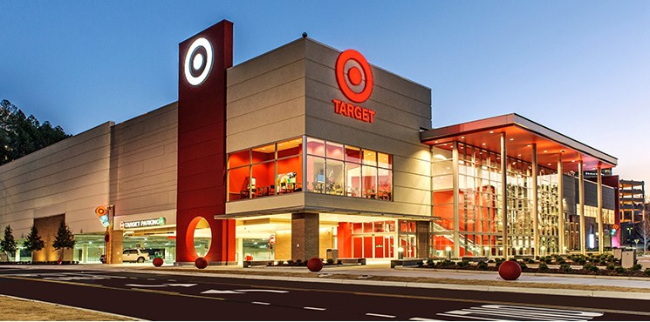
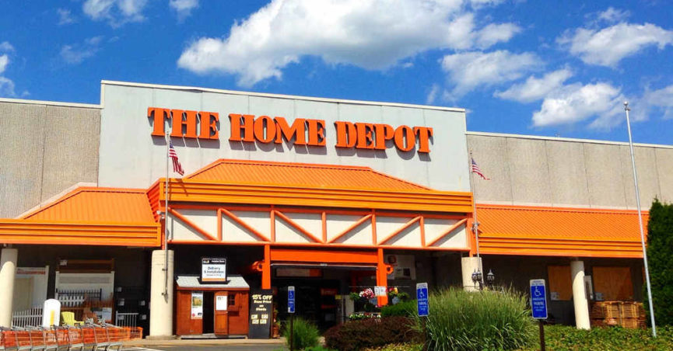
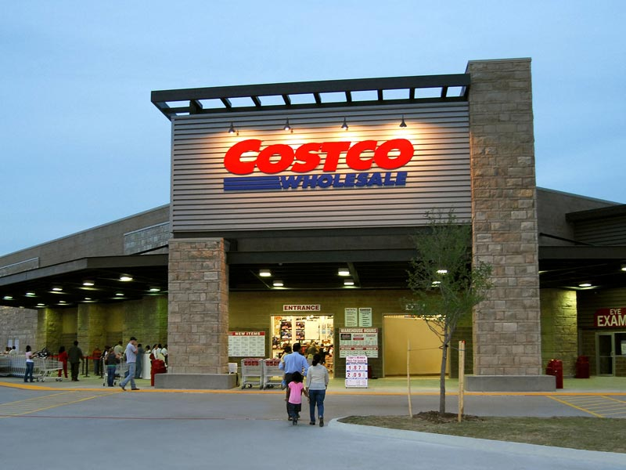
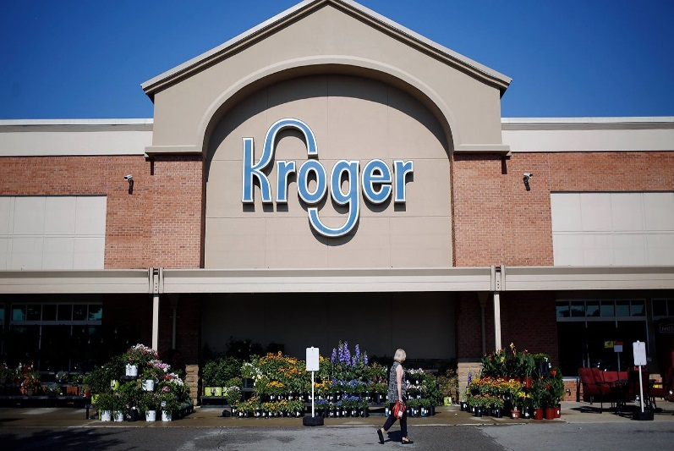
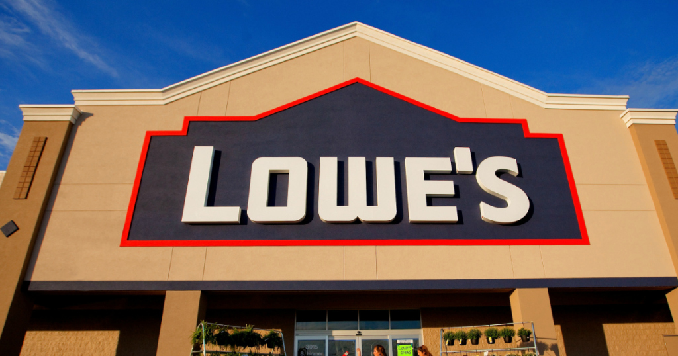
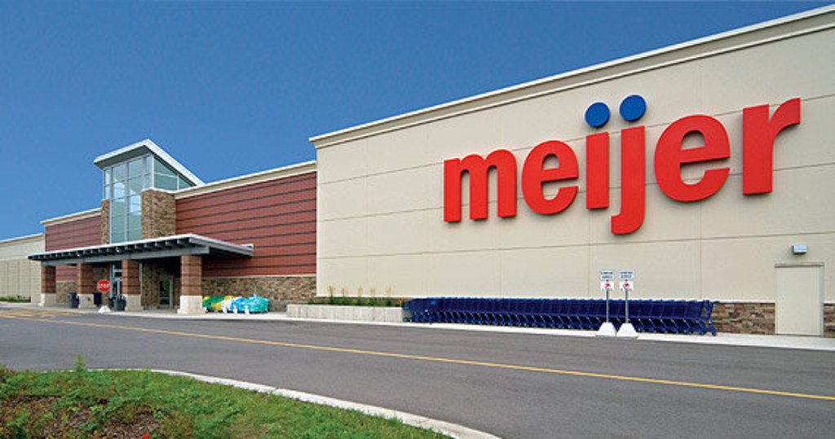
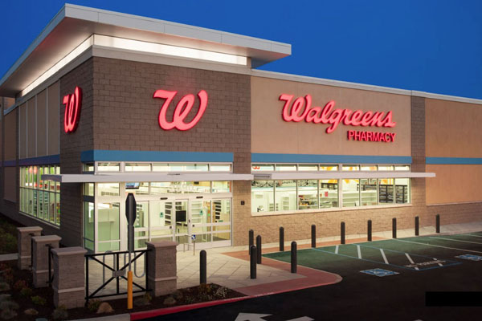
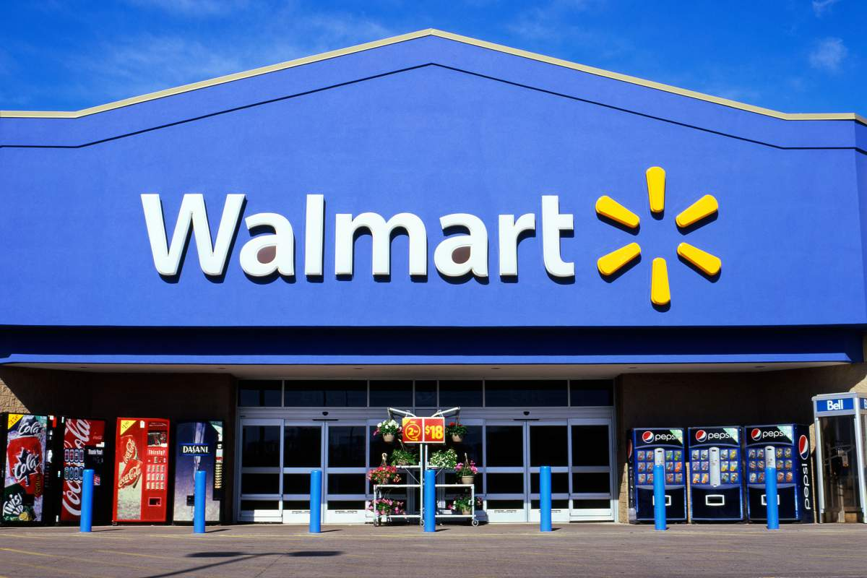
BIG BOX STORES THE “DARK STORE” THEORY
Billy Whittaker

Slide 2
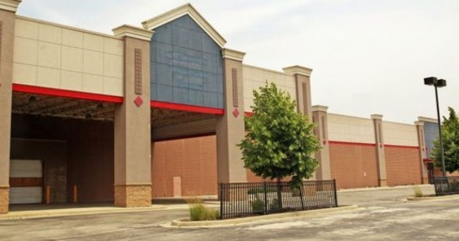
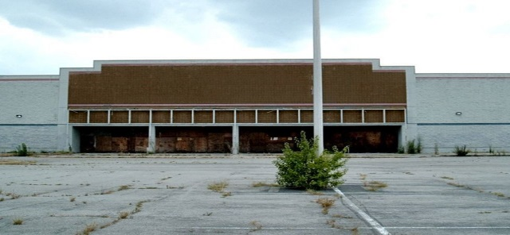
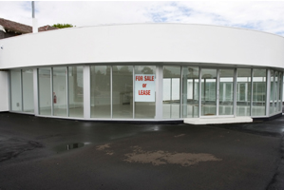
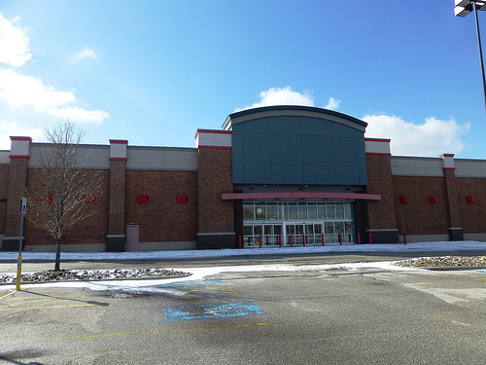
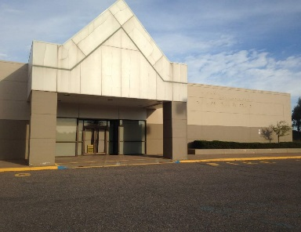
PURPOSE OF THIS WORKSHOP
This workshop will give you insight on what is happening in other states on the assessments and appeals of Big Box Stores (such as Walmart, Lowe’s etc.) using the “Dark Store Theory” as their defense. They are winning appeals before the courts and causing major revenue problems with large refunds and the lowering of assessments far below fair cash value.

Slide 3
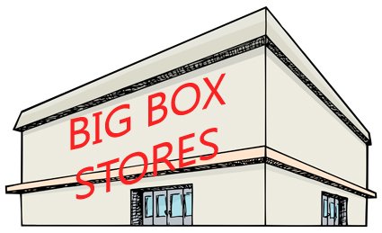
What IS a “Big Box Store” ?
Just a big box! Large in size
No curves, No angles
10,000-200,000 sqft.
Extremely high walls (over 1 story)
No unusual architecture
Located on a large site

Slide 4
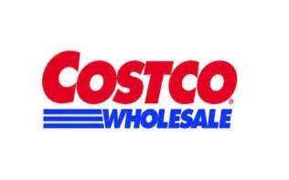
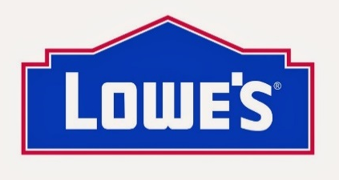
3 Categories of Big Box Stores
Discount
Department
Warehouse
Specialty

Slide 5
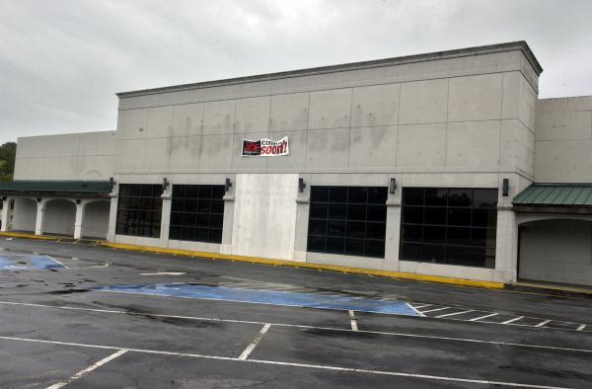
What IS the “Dark Store Theory”??
A valuation scheme that Big Box Stores are using in appealing their property valuations. The idea that Big Box Stores should be assessed according to the value of a “vacant” (dark) store.
That oversized structure is only worth as much as a similarly sized Big Box Store that has ceased operation (thus, the term DARK)!

Slide 6
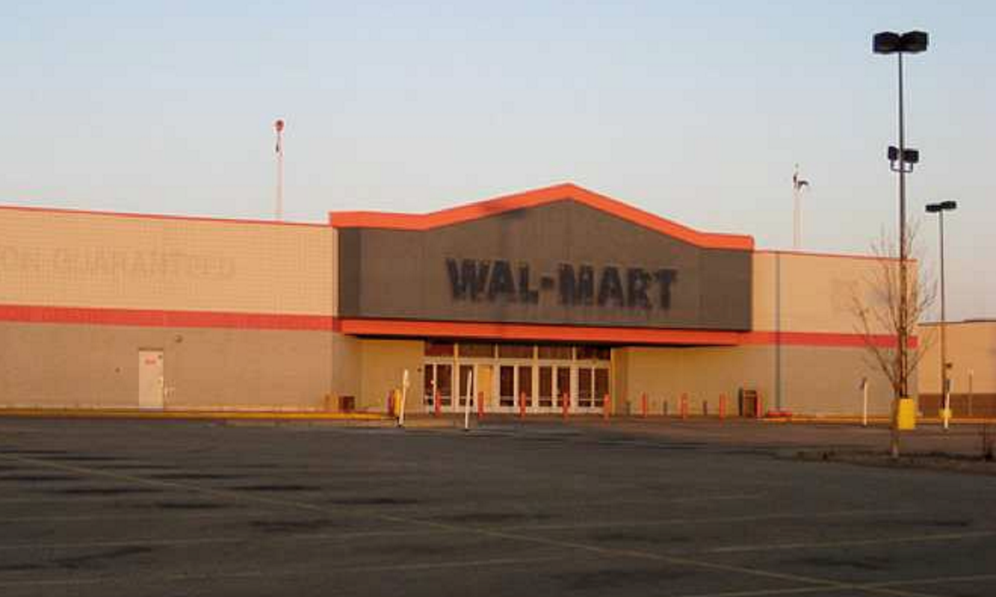
Reasons Why Stores Go “Dark”
Poorly Located
Functional Issues
Bankruptcy
Downsizing
Upsizing
Property no longer suitable for its original purpose
Highest & Best Use changes

Slide 7
States affected by Big Box Store Appeals using the “Dark Store Theory”
Alabama
North Carolina
Texas
Kentucky
Michigan
New York
Wisconsin
Ohio
Florida
Iowa
Indiana

Slide 8
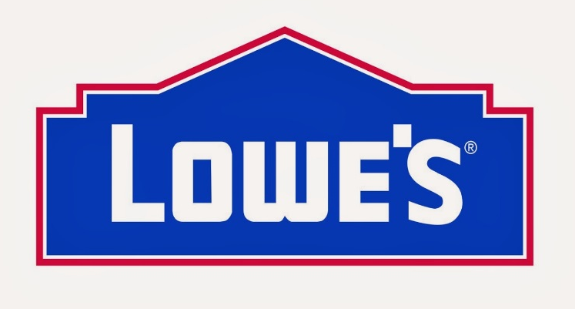
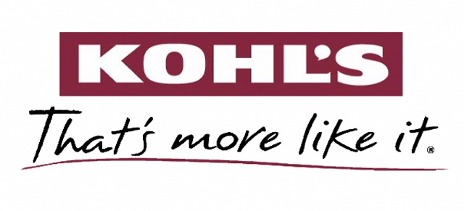
Big Box Stores that are Appealing their Assessments

Slide 9
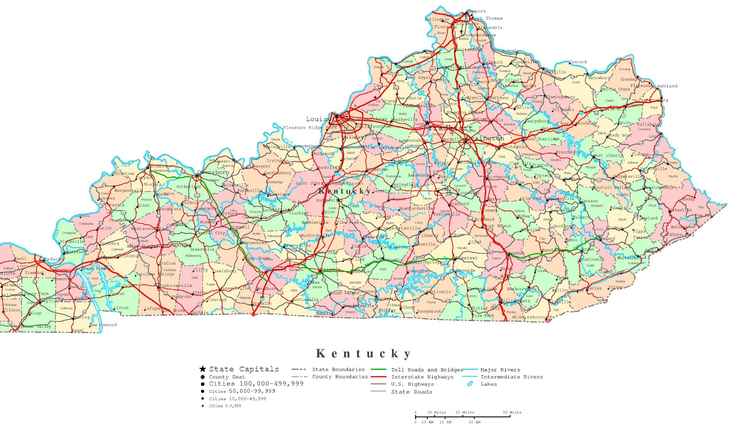
Big Box Retailers in Kentucky
KROGER | 114 STORES
WALGREENS | 95 STORES
WAL-MART | 82 STORES
CVS | 73 STORES
LOWE’S | 42 STORES
HOME DEPOT | 14 STORES
KOHL’S | 18 STORES
TARGET | 13 STORES
MEIJER | 10 STORES
SAM’S CLUB | 9 STORES
COSTCO | 3 STORES
TOTAL | 473 STORES

Slide 10
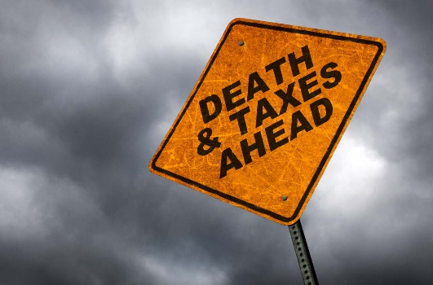
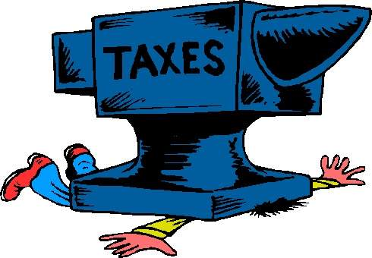
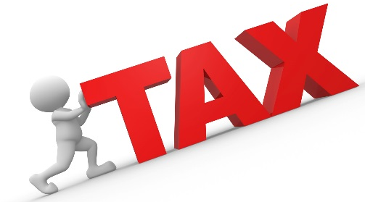
What is Happening in Other States?
Lowe’s seems to be the one retailer leading the way in appealing their assessments.
According to a 2015 study commissioned by Indiana Association of Counties, Lowe’s (in Indiana) cuts it’s property taxes by $120.8 million, resulting in a $49.9 million jump in taxes for other residents and businesses.

Slide 11
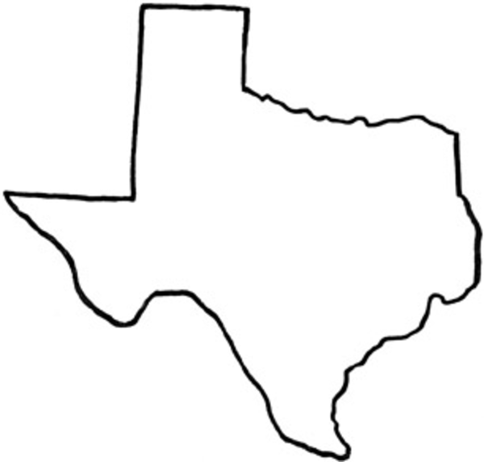
Lowe’s sued Bexar County, claiming its 11 stores were worth the same as empty stores $30 p/s/f from $80-$85 p/s/f
Have lost and refunded approximately $100 million to retailers since 2010 because of “Dark Store Theory.” One Lowe’s store (2 years old) cost $10 million to build, and taxpayers value at 3.5 million. Assessment lost and $450,000 refund granted.
TEXAS

Slide 12
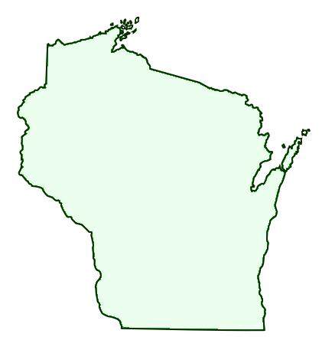
Currently facing 12 appeals from Big Box Stores. Lowe’s assessed at $16 million, company says only worth $7 million. Another store in Nordstrom, Wisconsin, assessed at $29.9 million, company says only worth $10.8 million. The fight, over the past 4 years, has cost the city $275,000 in legal fees.
Because of the “Dark Store Theory” loophole, they have lost the valuation battle with CVS, Target, and Walgreens, resulting in approximately $800,000 in refunds since 2010. They have spent approximately $250,000 on outside attorneys for legal cases against retailers seeking refunds.
Wauwatosa,
Wisconsin
Appleton,
Wisconsin

Slide 13
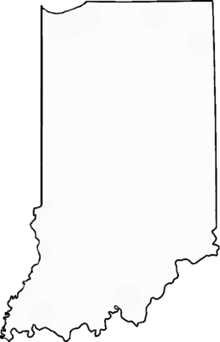
Lowe’s, a 59 billion dollar business, files lawsuits seeking assessment reductions on 27 stores using “Dark Store Theory.” The outcome of these lawsuits is yet to be determined.
Meijer used the “Dark Store Theory” and slashed assessments for $83 p/s/f to $30 p/s/f. Not stopping there, they got $2.4 million in repayment or refunds for 9 years for back taxes paid.
ALABAMA
Marion County, Indiana

Slide 14
Major Big Box Stores that have successfully convinced appraisal districts and judges to lower their property values based on the “Dark Store Theory” during the past 5 years.
Tax Year | Store | Location | Assessed Value (per sq. foot) | Store’s Proposed Value | Final Value P/S/F
2010 | Target | Novi, Michigan | $71.51 | N/A | $40.20
2011 | Lowe’s | Frenchtown Township, Michigan | $69.25 | $23.80 | $23.80
2011 | Target | Midland, Michigan | $65.17 | $23.12 | $23.99
2012 | Target | Kochville, Michigan | $83.36 | $32.08 | $32.08
2012 | Kohl’s | Kokomo, Indiana | $67.12 | $41.82 | $41.82
2012 | Lowe’s | Marquette Township, Michigan | $74.53 | $25.18 | $25.18
2014 | Lowe’s | Greenville, Texas | $61.63 | N/A | $51.64
2015 | Lowe’s (2 stores) | Abilene, Texas | $70.0* | $30.0* | $60.0
2015 | Lowe’s (4 stores) | Denton, Texas | $50-$79* | $30.0* | $45.59
* Approx. Value
Sources: Court documents in Indiana and Michigan; County property appraisers in Texas

Slide 15
Big Box Property Tax Appeal Arguments
Stores are becoming obsolete due to online shopping and large chains downsizing to smaller stores.
Highest and Best Use of a successful stores is no different than Highest and Best Use of an abandoned or vacant store
Assessors are assessing the value-in-use and not the value-in-exchange
Sales of Big Box Stores usually involve sale-leaseback transactions which values lease fee value, not fee-simple values

Slide 16
Big Box Property Tax Appeal Arguments
Sales of vacant Big Box Stores should be used because they are NOT encumbered with a lease, therefore giving fee-simple value
Retailers buildings are built to suit and are worth far less than half the construction costs because they are disposable, single-use big boxes that suit their specific purpose (functional obsolescence)
The national retailers argue that their anti-competitive business practice-deed restriction-must be considered in valuing property

Slide 17
Big Box Property Tax Appeal Arguments
Big Box Stores argue that their business and buildings are branded to such a degree that there is no market to speak of. So only comparable properties of unused/dark Big Box Stores may be used to determine the market
The vacant built-to-suit properties are the best measure of market value for operating built-to-suit properties because they reflect what the value of the property would be if listed for sale on the open market
Their properties should be appraised according to how the next occupant may use it (second generation)

Slide 18
HOW CAN WE
STOP THIS?

Slide 19
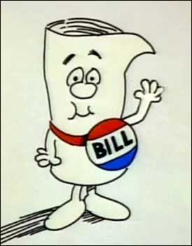
Legislation
States that are trying to close the “loophole”
Indiana >> SB 436
Michigan >> HB 4909, SB 524, HB 4397, HB 5578
Texas >> HB 27
Wisconsin >> SB 292/A.B. 386, SB 291/A.B. 387

Slide 20
What About Prohibiting Something?
Prohibiting the use of Comparable Sales with deed restrictions
(they lead to long-term vacant properties)
SB 436 (Indiana), HB 27 (Texas),
HB 4909 (Michigan), HB 4397 (Michigan), SB 292 (Wisconsin)
Example
For a period of 10 years following the date of this conveyance, no portion of the subject property shall be used for the operation of a discount department store containing more than fifty thousand square feet of floor area. No portion of the subject property shall be used as a grocery store, containing more than 25,000 square feet of floor area for use in connection with the sale of food, groceries, fruit, produce, dairy products, vegetables, bakery products, meats, or delicatessen products.
(Bexar County Clerk 2007, 1918)

Slide 21
Appraisal Tactics?
Appraisals of buildings less than 10 years old must use the
Cost Approach, which considers construction costs (SB 436-Indiana).
Comparable sales must include properties that have been on the market for less than a year, that are used for a similar purpose, and that were sold at arm’s length (SB 436-Indiana).
True fair cash value of a property shall consider the highest and best use of the property, as vacant or as improved (HB 5578-Michigan, HB 4397-Michigan).
Property must have the same highest and best use as the subject to be considered as a comparable (HB 27-Texas).

Slide 22
More Appraisal Tactics?
Ban use of the “Dark Store” argument in appealing property assessments
Use generally accepted appraisal standards and market valuations of the real property (Highest & Best Use)
Seek to reverse the 2008 Walgreen State Supreme Court Decision (Walgreens v. City of Madison) Market Rent vs. Rent Agree to in Lease (SB 291/A.B. 387-Wisconsin). (Sale-Lease Back)

Slide 23
LET’S DISCUSS!
Sources
-“Thinking Outside the Box” Article by Tim Wilmath & Pat Alesandrini CAE
-IAAO Draft Big Box Position Paper (2017)
-Newspaper articles from different states
-Court cases
-Bloomberg BNA

Slide 24
CR 76.28 (4) (c)
(c)
Opinions that are not to be published shall not be cited or used as binding precedent in any other case in any court of this state; however, unpublished Kentucky appellate decisions, rendered after January 1, 2003, may be cited for consideration by the court if there is no published opinion that would adequately address the issue before the court. Opinions cited for consideration by the court shall be set out as an unpublished decision in the filed document and a copy of the entire decision shall be tendered along with the document to the court and all parties to the action.

