Slide 1
Stacey Brown
Donna Durr-Richards
Katie Martin

Slide 2
SO…..
What IS new in Education?

Slide 3
WE ARE!

Slide 4
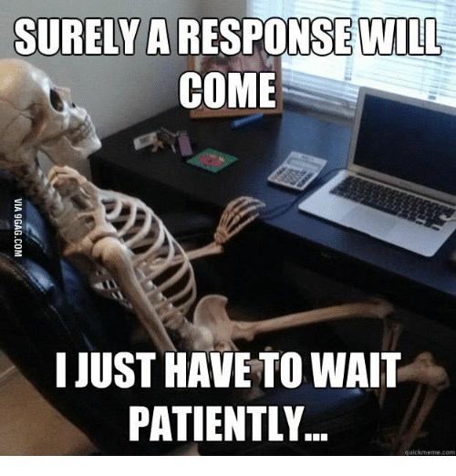
POP QUIZ!
How many counties sent back the education survey?
Why are these so important for us to get back?!

Slide 5
C L A S S E S
Registrations
Try to register more than 1 month out
Can be sent by fax/email/mail
No “spot holding” - you will be put on the roster when your check is received
Credits
Over 20 employee office: 1 credit for every 10 class registrations
Under 20 employee office: 1 credit for every 5 class registrations
Cancellations
30 days out to get a credit

Slide 6
We Our Instructors!
Winter 2017 Meetings
Technology Needs
Manual changes
Problems/Answers
Tests
Resources (ie. Marshall & Swift books)
Train the Trainer
NEW! One-day course
Next: 11/29
CE Hours + credits for teaching

Slide 7
Help US Help YOU!
If you have a location to host classes in your county, please let us know!
Would you be interested?
(Would be held at Revenue)
WOULD YOU RATHER?
Pay a little bit more for KY Classes and have them at hotels/parks
OR
Keep the registration cost the same
Please be reminded that with the new Division of Training, there is no budget.

Slide 8
Reminders!
Student/Instructor Manual will be updated once the cabinet re-structure has gone through.
Remember to send in requests for training credit BEFORE the class. Please do not send in the request along with your certificate from attending!
When sending in hours you’ve attended, please mark WHAT you went to.
New Fax Number! 502-223-2558

Slide 9
HB 538 Changes
Updated Rules coming to your email soon!
(G) “Conferences, workshops and regional meetings sponsored by Kentucky Association of Counties (KACo) and Department for Local Government (DLG).”
(J) “PVAs holding their SKA designation can earn up to 25 hours through KELMS or IAAO online courses.”
Effective January 1, 2018

Slide 10
AND NOW...
WHAT YOU'VE ALL BEEN
WAITING FOR…

Slide 12
WHAT YOU NEED TO KNOW
Only $8.68 per person
Certificates for any classes taken
You can reset your own password
Classes will not count toward designations, but will count toward hours!
https://personnel.ky.gov/ODET/ODET%20Course%20Catalog.pdf

Slide 13
Anti-Harassment Bridging the Generation Gap in the Workplace Building Trust Business Writing Career Development Communication: Creating and Sharing Meaning Conflict Management Coping With Difficult Behaviors Creative Thinking Critical Thinking Developing Character Embracing Diversity in the Workplace
INSTRUCTOR-LED TRAININGS
Employee Discipline and Documentation
Foundations of Leadership Hiring & Selection Process: Best Practices Introduction to Structured Behavioral Interviewing Leadership Communication Managing Employee Performance Managing Work Relationships Overview of the Merit System Personal Accountability Running Effective Meetings Shared Accountability Working Through Change

Slide 14
Employee Performance Overview Of The Merit System Valuing Employee Input Workplace Violence Prevention for Employees Violence Prevention for Supervisors KELMS Basics of Navigation KELMS Manager Basics
e-Learning Opportunities
Americans With Disabilities Act Anti-Harassment Awareness Basics of Effective Meetings Executive Branch Ethics Customer Service Customer Service Spanish Fundamentals of Safety and Health

Slide 16
Thanks for Attending!

