Slide 1
Clerical Errors & Amended Returns
Jehna Cornish
Revenue Section Supervisor
Personal Property Omitted Section
502-782-2507
Jehna.Cornish@ky.gov

Slide 2
CLERICAL ERRORS ON TIMELY FILED TANGIBLE RETURNS
133.110 Correction of clerical errors in assessment.
After submission of the final real property recapitulation or certification of the personal property assessment, the property valuation administrator may correct clerical, mathematical, or procedural errors in an assessment or any duplication of assessment. Changes in assessed value based on appraisal methodology or opinion of value shall not be valid.

Slide 3
A-BILL OR EXONERATIONS
Exonerations are made when clerical errors, mathematical errors, unintentional omissions, or duplications have been made on a taxpayer's bill. Revenue Form 62A366, Executive Order Correcting Erroneous Assessment, is used to correct a tax bill that is not yet delinquent.
The PVA will prepare a special exoneration form used when a refund is involved (62A366-R), which will describe the reason an assessment adjustment is being made and the amount of the change.
Some PVA offices have their own generated forms for A bills or additional bills related to clerical errors and duplications.

Slide 4
ERROR EXAMPLES
Clerical
Duplication
Unintentional Omissions
Mathematical
Clerical
Duplication
Unintentional Omissions
Mathematical
Errors made in data entry of returns
Return entered twice
Return sent to the wrong county. When reached correct county tax roll was closed. Return was completed correctly by taxpayer.
Returns misplaced
Stapled together

Slide 5
Correcting Errors
Complete the appropriate form for your PVA office.
Send exoneration and/or A-bill to the sheriff
Send copy exoneration and/or A bill and a copy of the return to OPV.
**OPV will create a ‘dummy’ assessment in the OPT database with a note stating that a bill was created at the local level due to a clerical error. This allows us to see that a bill was created and help avoid any unnecessary requests for returns or requests for an audit.

Slide 6
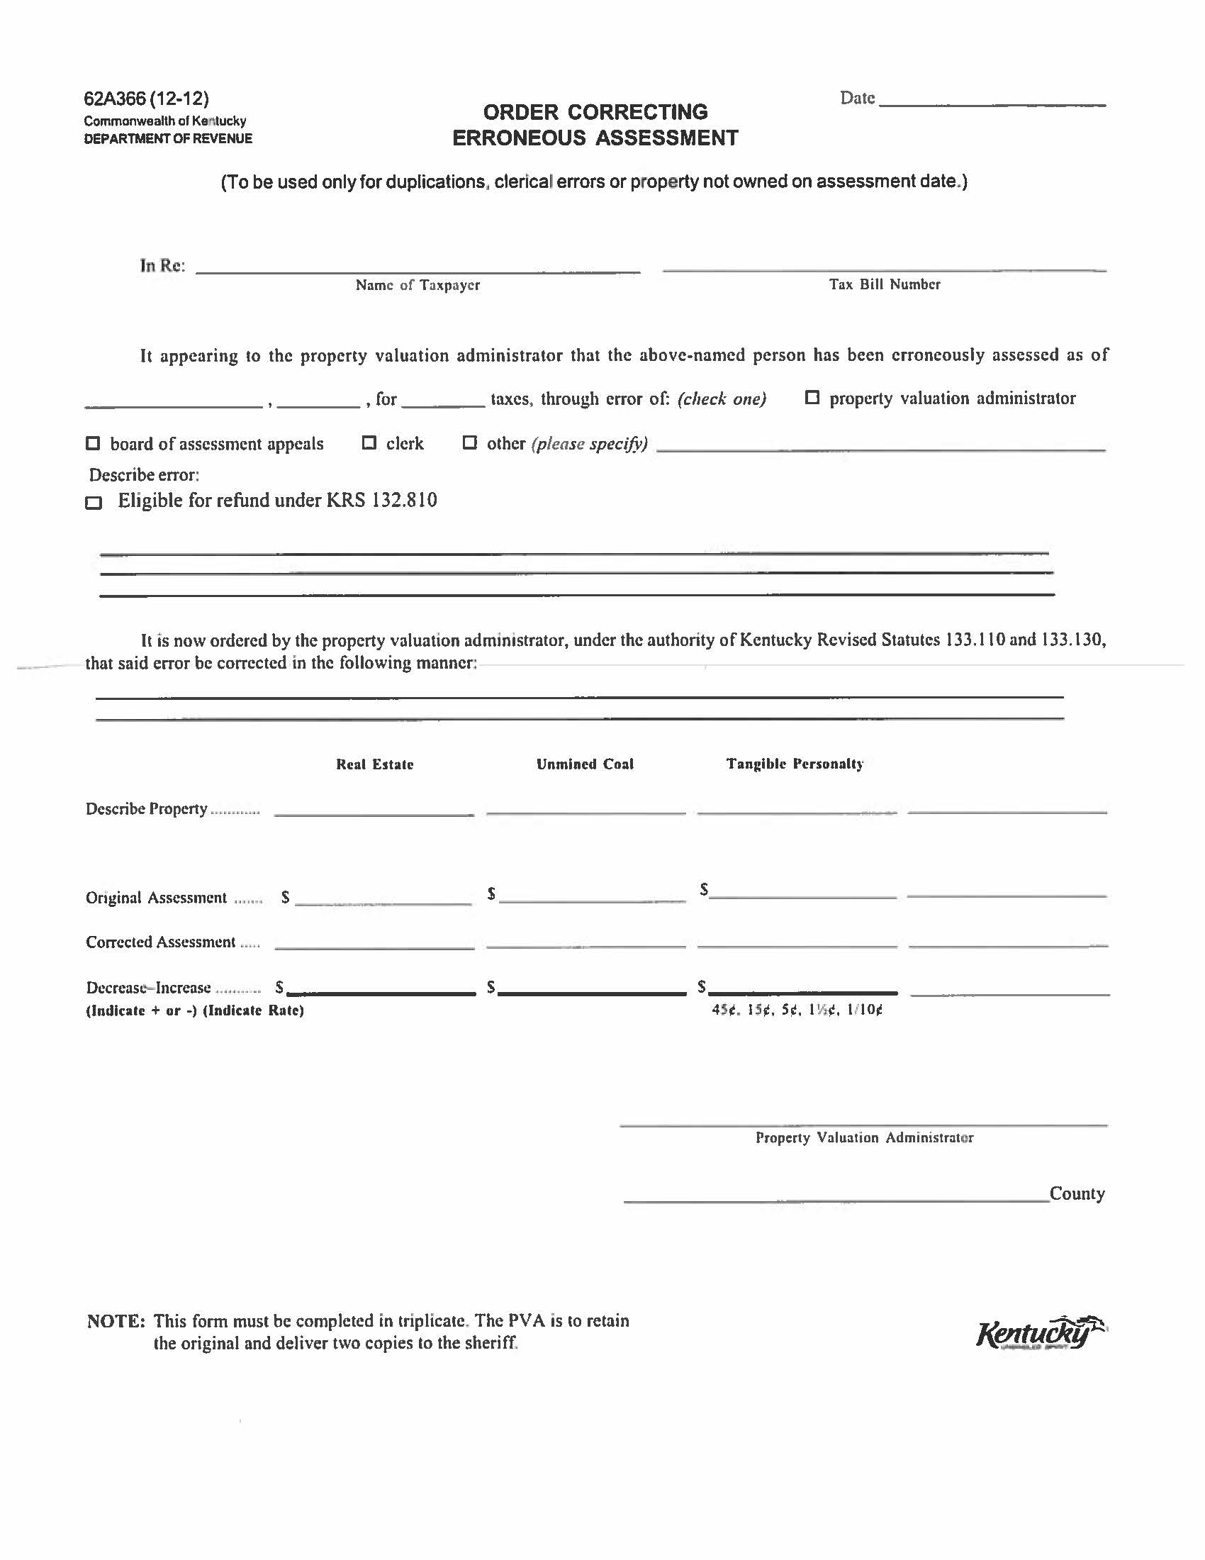

Slide 7
FORM USED TO CORRECT CLERICAL ERRORS
https://revenue.ky.gov/PVANetwork/PVA%20Forms/62A366(3-18)OrderCorrectingErroneousAssessment.pdf
**Not all offices use this form. Some offices have created their own form.**

Slide 8
BENEFITS
Allows the taxpayer to receive a corrected tax bill and pay within the discount period
The PVA office will be creating positive public relations by assisting the taxpayer
The Sheriff’s office will receive the 4.25% commission for the collection of the bill.
When OPV processes a bill interest begins to accrue on January 1st. Although, OPV staff can waive penalties, we are not authorized to waive interest. In addition, the DOR databases are not set up for the 2% discount.

Slide 9
Amended Returns
Taxpayers who discover an error was made on their personal property tax return can file and amended return along with an explanation of why the return is being amended and documentation to support the amended return.
Amended returns resulting in a possible refund should be filed within 2 years from the date of payment in accordance with KRS 134.590

Slide 10
What should the taxpayer provide?
Corrected 62A500-Tangible Personal Property Tax return
Documentation
Examples but not limited to
Fixed asset listing
Depreciation schedules
Inventory records
Refund request and/or application- if the amendment is resulting in a possible refund
KRS 134.590 (2) No state government agency shall authorize a refund unless each taxpayer individually applies for a refund within two (2) years from the date the taxpayer paid the tax. Each claim or application for a refund shall be in writing and state the specific grounds upon which it is based.

Slide 11
When to forward to OPV for review?
Complex amended returns
Alternative Valuations
When the taxpayer doesn’t provide an explanation or documentation.
Increase in assessment that was filed after the May 15th deadline. These are considered omitted and should be processed by OPV.
**If the amendment is clear, simple and you feel comfortable with the exoneration, please feel free to process without OPV authorization.**

Slide 12
OPV’s Process
Assign the amended return to an auditor or specialist
Auditor/Specialist reviews return and request any additional information required
The Auditor/Specialist will either approve or deny the amendment
If approved, the supervisor will review and send the PVA office authorization to exonerate.
Included with the authorization
Letter of authorization from the supervisor
Audit template
Exoneration Summary (Only if the bill has been paid & only if it’s a partial refund)
Refund application (Only if the bill has been paid)
Copy of the Amended Return

Slide 14
Authorizations from OVP
Authorization letters from OPV will come from Darrell Young or Jehna Cornish
Darrell Young
Phone: 502-564-2729
Fax: 502-564-8192
Darrell.Young@ky.gov
Jehna Cornish
Phone: 502-782-2507
Fax: 502-564-8192
Jehna.Cornish@ky.gov

Slide 18
Reminder!
The eligibility for a refund is determined by the date the request and/or application was received, not the date that the authorization was sent to the PVA office.
Often times, the authorization will be sent to the PVA office after the 2 year deadline because the return has been under review. These sometimes take time due to correspondence and communication between DOR and the taxpayer.

Slide 19
Questions

