Slide 1
The Local Officials Compliance Branch presents
Education 101: How to Successfully Meet Your Education Requirements!
With Kim Holt and Brian Stidham

Slide 2
Your Education Staff
Brian Stidham
Education Coordinator
Kim Holt

Slide 3
Education Committee
Michelle McDonald, Chairman
Angie Strader
William Myatt
Kim Holt
Melissa Klink
Brian Stidham

Slide 4
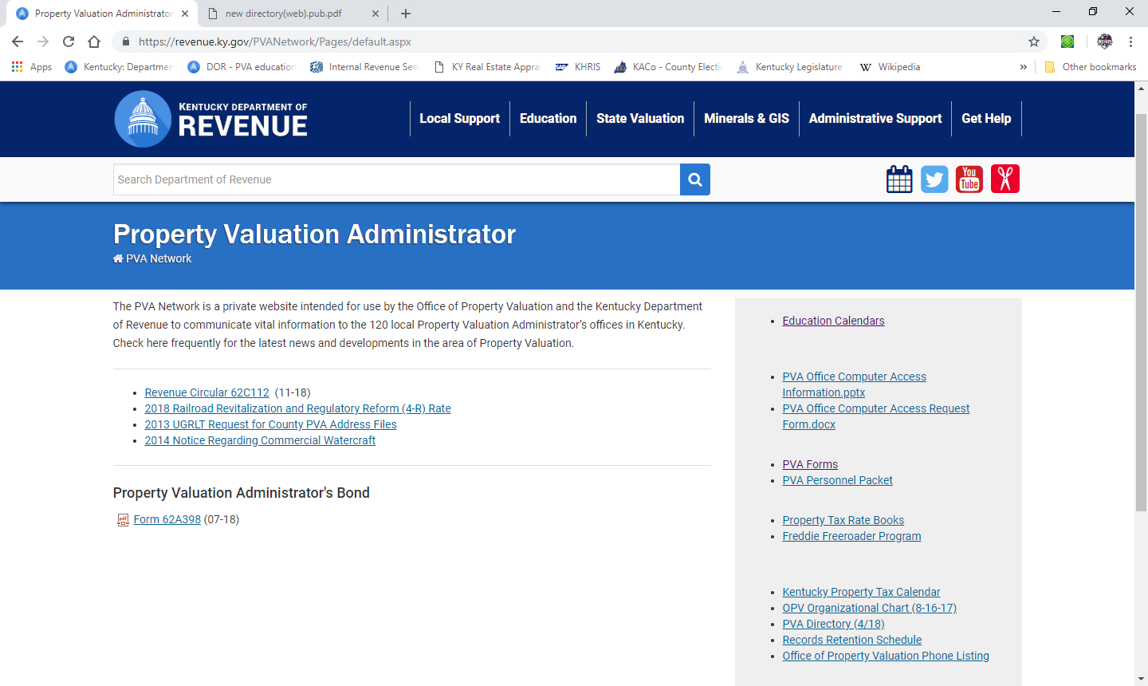
PVA Network
http://revenue.ky.gov/PVANetwork/

Slide 5
Continuing Education Requirements
Two Statutory Education Requirements
KRS 132.597 – Expense Allowance Program
30 hours (15 with SKA) per calendar year
Hours in excess of 30 can not be carried over to subsequent years

Slide 6
Continuing Education Requirements
Two Statutory Education Requirements
House Bill 538 – Training Incentive Program
40 hours per calendar year
Lump Sum payment adjusted annually
Check is issued the month following completion of hours
Hours in excess of 40 can be carried over to subsequent years
Up to 40 hours can be carried over to subsequent years

Slide 7
Continuing Education Requirements
Two Statutory Education Requirements
Hours for both requirements can be earned concurrently

Slide 8
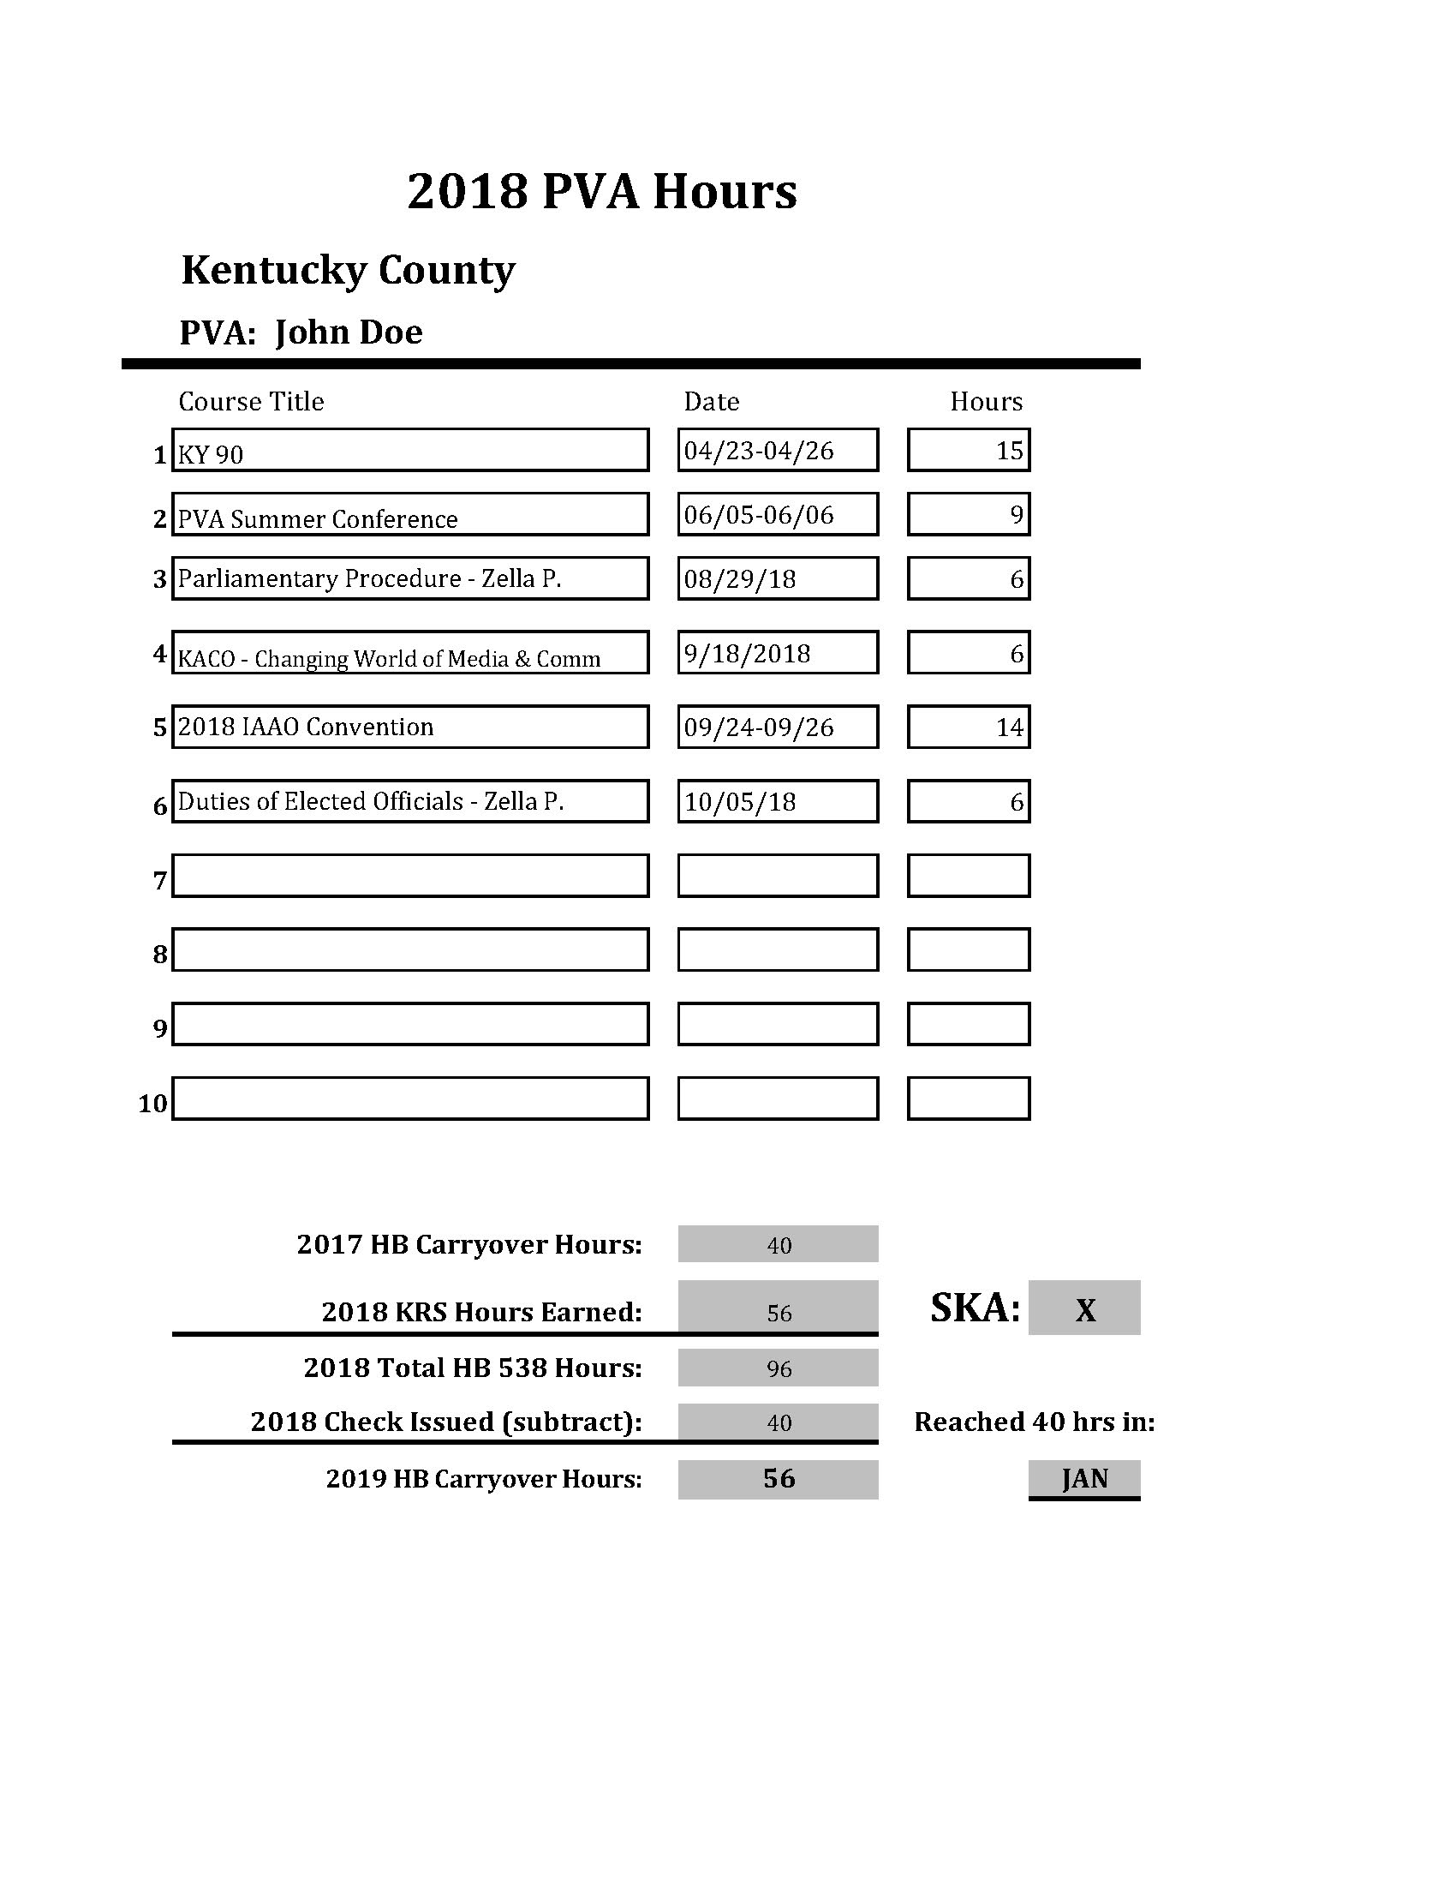
Example
PVA John Doe had 40 hours to carry over from 2017. This fulfilled his HB 538 requirement for 2018. He will received his check at the end of February.
PVA John Doe earned 56 hours during 2018. This fulfills his (15 hrs) 2018 KRS hours. Since he does have his SKA.
PVA John Doe will be able to carry over 40 of his remaining 56 hrs to 2019.
He will lose the other 16 hrs.

Slide 9
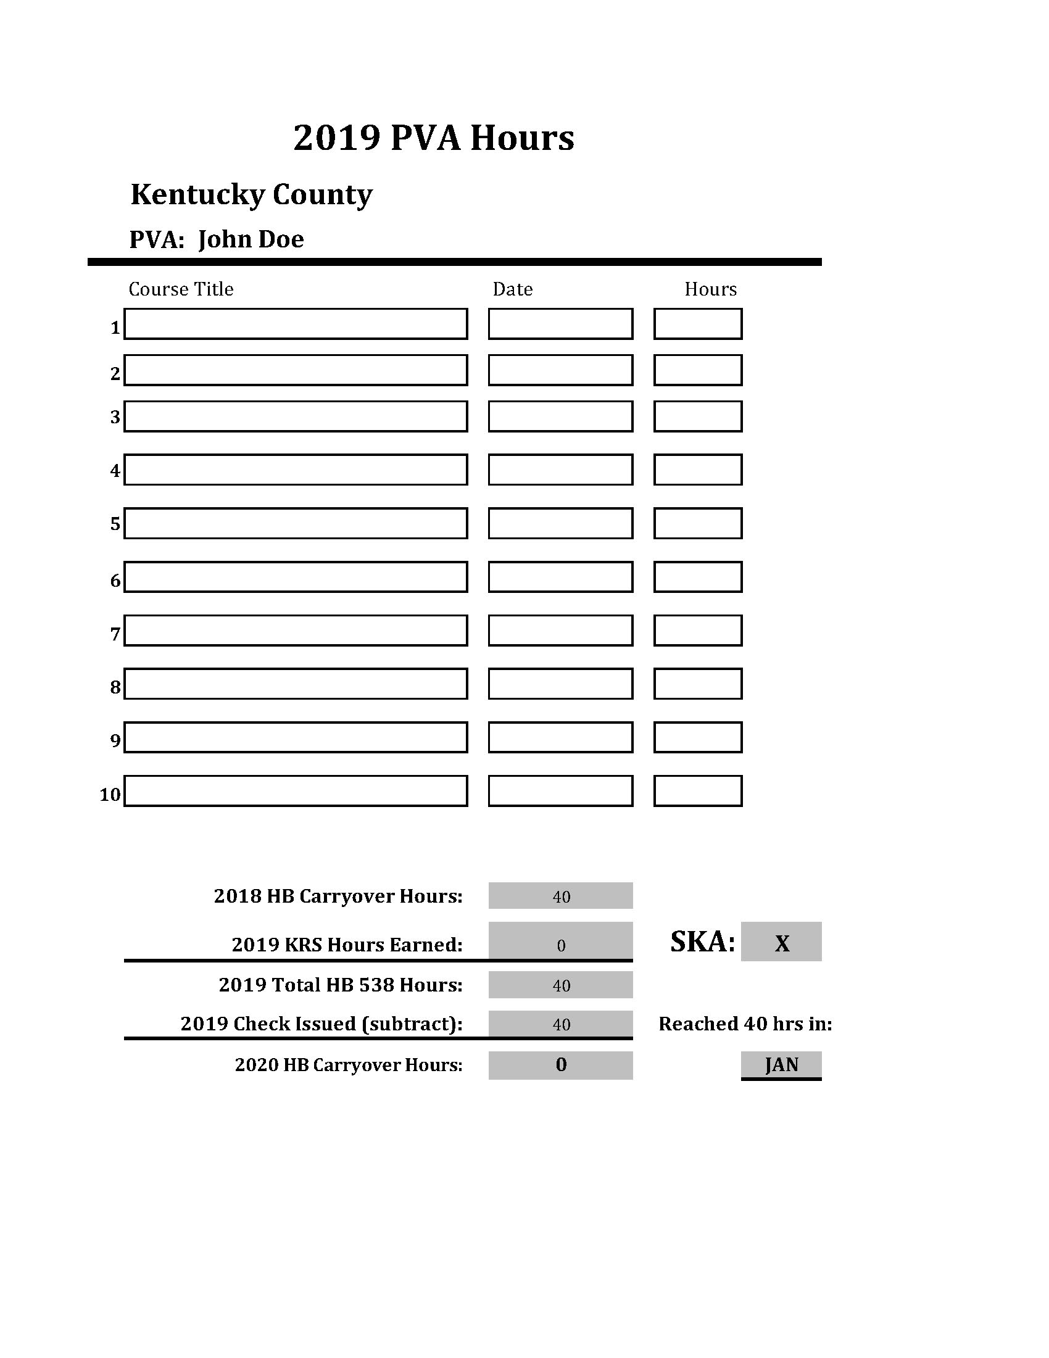
Example
He has already fulfilled his HB 538 requirement for 2019 .
He will receive his lump sum incentive check at the end of February.
He will need 15 hrs to fulfill his KRS hrs. (SKA)

Slide 10
How Do I Get My Hours
Approved Courses
KY Courses
Workshops/Conferences held by DOR
Summer Conference
IAAO Courses
KY Office of Diversity, Equality, and Training (ODE&T)
KY Association of Counties (KACo)
KY Real Estate Appraisal Board (KREAB)
Online classes from IAAO only
up to 10 hours per calendar year for all PVAs
up to 25 hours per calendar year with a SKA designation

Slide 11
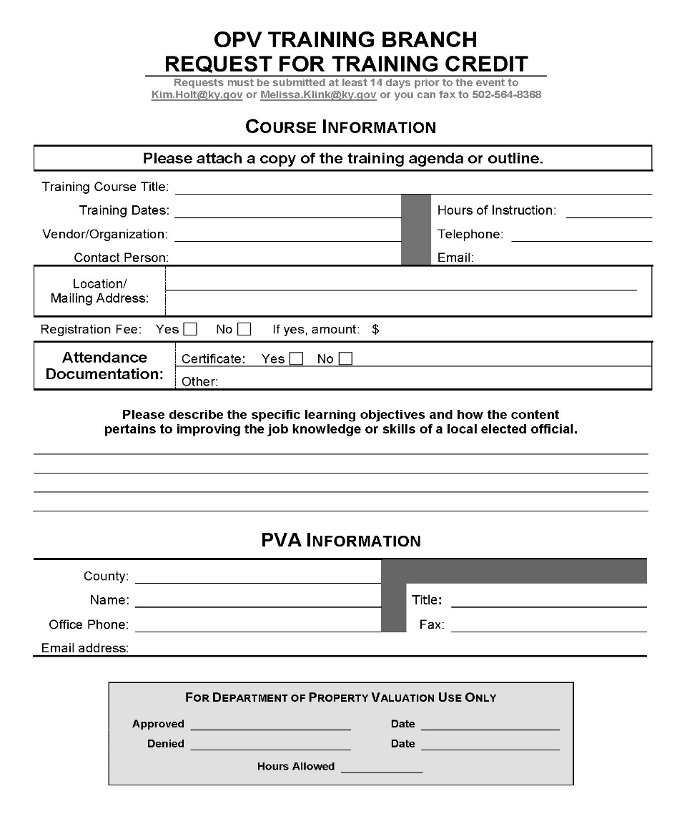
How Do I Get My Hours
Other Education Options
Outside Training Opportunities
Submit Request for Training Credit Form
Two Weeks in Advance for Approval

Slide 12
Kentucky Courses
KY 10 – The KY Property Tax System
KY 40 – Assessment Administration
KY 44 – Mathematics of Property Valuation
KY 49 – PVA Office Management
KY 50 – Basic Personal Property Assessment
KY 61 – Data Collection for Property Valuation
KY 64 – Introduction to ArcView
KY 65 – Introduction to ArcEditor
KY 71 – Commercial and Industrial Real Property Appraisal – Cost Approach
KY 72 – Commercial and Industrial Real Property Appraisal – Income and Sales Comparison Approaches
KY 80 – Residential Real Property Appraisal
KY 90 – Farm Real Property Appraisal

Slide 13
Kentucky Courses
Most KY courses are 15 hours
Begin Monday at 1:00
8:30 – 4:15 Tuesday
8:30 – 4:15 Wednesday
8:30 – 11:30 – Test
$40 cost for 15 hour class
3 hours for test
Must attend at least 12 hours of class to take exam

Slide 14
IAAO Courses
Cost
$385 for IAAO Members
$485 for Non-Members
Most IAAO Courses are 30 hours
15 hrs workshops
7.5 hrs workshops
8:30 – 5:00 Mon – Thurs
Test on Friday 8:30 (3 ½ hours)

Slide 15
Kentucky Professional Designation Program
Designations Offered
Certified Kentucky Assessor (CKA)
Senior Kentucky Assessor (SKA)

Slide 16
Kentucky Professional Designation Program
Certified Kentucky Assessor (CKA)
4 Tracks
Real Property Assessment Track
Personal Property Assessment Track
Administrative Track
Mapping Track
3 Years of Experience in Kentucky Property Tax Administration

Slide 17
Kentucky Professional Designation Program
Senior Kentucky Assessor (SKA)
Must have CKA
4 additional KY courses
1 additional IAAO 30 hr course or 2 IAAO 15 hour courses
Additional 2 years of experience in Kentucky property tax administration (total of 5 years)

Slide 18
Education Schedule
2019 Schedule will be emailed to everyone
Registrations can be mailed, faxed or emailed to Brian Stidham
If emailed or faxed your spot will be held until payment is received

Slide 19
Education Schedule
Registration forms can be found on the PVA Network
Schedule Changes will be kept current on the PVA Network

Slide 20
Education Schedule
Cancellations
Registrations can be cancelled no less than 30 days prior to the course in order to receive credit/refund
KY courses - receive class credit
IAAO course – can receive refund for cancellation
Send refund request to Kim Holt

Slide 21
Scholarships
Scholarships are available for KY and IAAO courses
Reimbursement of meals and lodging
Scholarship Guidelines and Applications can be found on PVA Network

Slide 22
Instructors
How to become an instructor:
KY Course Instructors – just have to be willing to volunteer their time
Received 1 class credit for your office for each class taught
PVA’s receive education hours for classes taught
IAAO Course Instructors – have to attend the Instructors Training Workshop and pass the test

Slide 23
Test Time

Slide 24
Where can I find the current education schedule, forms and PVA Directory?
The PVA Network:
http://revenue.ky.gov/PVANetwork/

Slide 25
What are the four tracks of the Certified Kentucky Assessor (CKA) Designation?
Real Property Assessment Track
Personal Property Assessment Track
Administrative Track
Mapping Track

Slide 26
How many years of experience are required to obtain a Certified Kentucky Assessor Designation?
3 years

Slide 27
How many years of experience are required to obtain a Senior Kentucky Assessor Designation?
5 years

Slide 28
How many hours are required for the Expense Allowance?
30 hours w/o SKA
15 hours with SKA

Slide 29
How many hours are required for HB538?
40 Hours

Slide 30
How many hours can you carry over to the next year?
40 Hours for
HB538 only

Slide 31
How many hours must I attend a Kentucky class in order to take the exam?
12 hours

Slide 32
How long are we given to take KY course exams?
3 hours

Slide 33
Who do I call to find out how many PVA education hours I have/need?
Brian Stidham
502-564-7577
Brian.Stidham@ky.gov

Slide 34
Who is the Chairman of the IAAO Education Committee?
Michelle McDonald
Nicholas County PVA

Slide 35
Which class would need pre-approval in order to count toward the PVAs’ HB 538 requirement?
A: IAAO Conference
B: PVA Summer Conference
C: Media Relations for County Officials sponsored by KACO Leadership Institute
D: Communication Workshop sponsored by outside vendor

Slide 36
Can Incentive hours for both House Bill 538 and KRS 132.597 be earned concurrently?
Yes

Slide 37
When do PVAs receive their HB 538 incentive check?
The month after the
hours are completed

Slide 38
Cancellations of KY classes must be made how many days in advance in order to receive credit:
30

Slide 39
Can I receive a refund for an IAAO class if I an unable to attend?
Yes, if cancelled at least 30 days before the class date.

Slide 40
Requests for refunds of payments for IAAO classes should be made to:
Kim Holt

Slide 41
If I am unable to attend a KY class that I have registered for, can I get a refund?
No, we will issue a credit to your office.
If you cancel at least 30 days in advance

Slide 42
What is a passing score for courses?
70%

Slide 43
What training hours can be earned online and how many hours are allowed?
IAAO only.
Up to 10 hours per calendar year for all PVAs and up to 25 hours per calendar year for SKA designation holders.

Slide 44
Can Registrations be faxed?
Yes
502-564-8368

Slide 45
Do PVA’s/Deputies received registration credits for teaching?
Yes
1 class credit for each class taught

Slide 46
How long do I have to take a re-test if I fail a course?
1 year

Slide 47
Can I call to get my test score?
No
Only pass/fail can be given over the phone

Slide 48
Are there scholarships available for classes?
Yes

Slide 49
How can you receive a scholarship?
Fill out the scholarship application
On PVA Network

Slide 50
Which of the following does a scholarship not allocate funds for?
Meals
Lodging
Mileage

Slide 51
How can I become an Instructor for KY classes?
Volunteer

Slide 52
How can I become an Instructor for IAAO classes?
ITW (Instructor Training Workshop)

Slide 53
What is the cost for IAAO Classes?
$385 for IAAO KY Chapter Members
Or
$485 for non-members

Slide 54
What is the cost for Ky Classes?
$40

