Slide 1
PVA BUDGET UPDATES
Cindy Arlinghaus Martin
Boone County PVA
Kim Holt
Department of Revenue

Slide 2
State Budget
The State Legislature allots us money every two years in their biennial budget process.
  We are completely at their mercy for funding.
The only thing the State Budget covers is:
  Personnel Expenses & Benefits (SALARIES!)
  <1% of budget is used for administrative expenses charged to us by State Government (ETS, KRIS & EMars)
Budget Committee serves as an advisory Committee to the Commissioner & Secretary so that we may manage our own budget.

Slide 3
Deputy Hire &
Shortfall Billings
The State Allotted Budget is not enough to cover all payroll expenses.
Rather than lay off a significant amount of deputies, the PVA Association has consistently voted to bill counties.
The only solution is legislative.
  KNOW your legislators!

Slide 4
Deputy Hire
Deputy Hire has been in existence for over 30 years. It began as an insignificant amount and increased over time to $3.5M in 2001, where it remains today.
It has often been written in the state budget as a restricted fund and is a CASH billing.
The formula is currently as follows
  County/City Carryover + Miscellaneous Carryover – $25,000 = Carryover¹
  (Cannot be <0)
  (Local Funds + ¹Carryover - $10,000 Exemption)
  x 30.40% = Deputy Hire Billing

Slide 5
Deputy Hire Reduction
If there is unrecognized / unanticipated savings to the Fiscal Year Budget, there may be a reduction.
This is done through Deputy Hire to maintain a cash savings.
Pay your deputy hire in quarterly installments to avoid any potential overpayment.
We try and give you good news, rather than bad news and estimate worst case scenario.

Slide 6
Current Year Reduction possible
90 Day Savings of $65,000
Current Year FAD savings $10,000
    Accumulated Annual FAD Savings $1.5M
Excess Vacancy Credits of $1,000,000

Slide 7
Shortfall Billing
Shortfall Billing has been in existence since 2010 in varying amounts to “plug the hole”
The formula is consistent with Deputy Hire but there is an additional caveat that you not pay more in D/H & S/F billing than you receive in Local Funds.
  Shortfall Billing is 35.5%
  Shortfall Billing = $4M

Slide 8
Vacancy Credits
Rather than paying shortfall billing, you may use a Vacancy Credit to offset the amount due.
Vacancy Credits must be requested using a Shortfall Plan of Action sent out with your budget .

Slide 9
Vacancy Credits Cont.
Vacancy Credits consist of the following:
  Full-Time or Part-Time Vacancy in Office
  (Not Replacing or Terminating an employee)
  Replacing a FT Employee with PT
  Not Hiring a Chief Deputy
  Foregoing PVA Education & Expense Allowance
  Hiring Two PT employees rather than FT (Saving cost of benefits)
  Replacing a Position with a Lower Available Grade

Slide 10
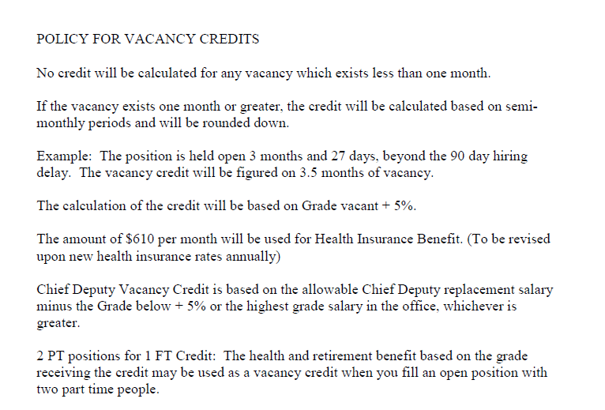

Slide 11
Your Office Budget
DOR will typically send out budget packets in May
Statutorily, these are due back June 1st
  This is especially important as we try and estimate billings for the next fiscal year
  You cannot spend money that is not budgeted
If your county information is not received, your billings will be based on the previous year or recalculated based on this year, whichever is higher.

Slide 12
City & County Funding
Your Fiscal Court & each incorporated city who use your tax roll fund your office according to KRS 132.285.
County Funding “maxes” out at $250,000
(budgetary language)
Cities max out at $60,000 (budgetary language)
Once you hit these maximums, you will not receive any additional monies.
Do not overspend in any categories! Amend your budgets.

Slide 13
Carryover Funds
County & City Carryover
  County & City Carryover may accumulate up to an amount equal to annual funding by the County & City.
    Anything over this must be refunded to the County & City
Miscellaneous Funding
  No requirements as to how much can accumulate.
  Strongly recommended to have separate accounts for each to easily account for what is “refundable” and what is not.

Slide 14
Office Structure
Grades are Locked into 2009 available grades.
Restructure Opportunities
  A PVA has the discretion to restructure current employees based on the “State Salary Grade Schedule + 10% salaries” that result in an amount equal to or less than the original grade structure amount of the salary schedule, subject to the PVA budget Committee approval and review.
  Example: Taking an office with 5 employees, restructuring to 4 employees with higher available grades

Slide 15
Restructuring
Must Pass Two Tests
  Saves Money when Compared to Current, Actual Costs
    Vacancies are tied to the Salary Schedule, Grade + 5%, not previous salary
  Saves Money to the Budget if everyone were terminated and rehired in at a +10% grade

Slide 16
90 Day Delay
A 90 Day Hiring Delay will incur for state funded positions for either terminated or resigned employees.
  You may pay for the difference if you do not wish to wait the 90 days and have funds available.
Exceptions
  A county that has 0 deputies may hire ONE
  A county that has lost 75% of their staffing levels may hire ONE
90 Day Delay has saved us over $5M since we began tracking it in 2009. We have had either a 30, 60 or 90 day delay since 2000.

Slide 17
Dismissing Employees
Each employee works at the “pleasure of the PVA” per statute.
Simply inform the employee their services are no longer needed.
  Less information is better.
  Keep documentation in personnel file for reference

Slide 18
Unemployment
When an employee is terminated, they will most likely file for unemployment (and most likely, they will win).
If unemployment costs become excessive, you may be billed for this expense.
  This has only happened once and only extended benefits were billed.

Slide 19
FAD Formula
In 2010 due to impending budget restrictions, a Formula for Attrition of Deputies was evolved.
  This formula was based on the # of deputies available at the time, # of parcels, population, # of vehicles, # of tangible returns and square miles of each individual county.
  The counties that were “over” the FAD formula, were informed that if they lost a deputy, through resignation, termination or retirement, they would not be allowed to rehire in that position.

Slide 20
FAD Formula
To date, the FAD formula has saved our budget well over $10.5M.
All losses have been absorbed.

Slide 21
Hiring Employees
New Employees should begin on the 1st or the 16th (1st day of each pay period).
Employees will be state-funded at the OO grade available. (Check with 2009 grade levels or Revenue to verify if you are unsure.)
A new employee may be brought in at a higher grade, but the difference must be paid with OX office funds and the employee must qualify for the position based on education and experience.
Employees may be +5%, +10% as eligible
Employees are eligible for a 5% raise in 6 months
  A PVA must request this on an RPA – it is not automatic

Slide 22
Request for Personnel Action Processing Workflow
Request for Personnel Action (RPA) sent to DOR for budget approval
DORPVAAPPROVALS@ky.gov
DOR returns request to the PVA with budget impact
PVA proceeds with action and sends the RPA to HR for processing
PVA decides NOT to proceed with the action and notifies DOR budget.
HR will notify PVA once the action is approved

Slide 23
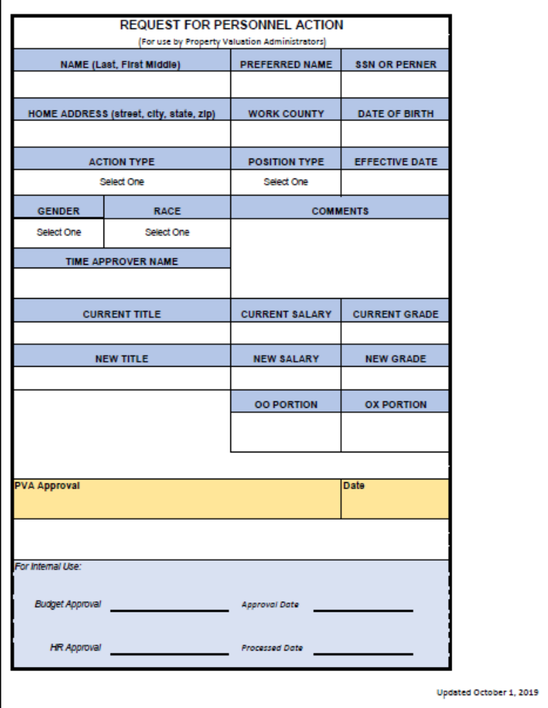
Only need SSN for New Hires
If the box has Select One, then it is a dropdown box. You don’t have to type them in.
SEND AS EXCEL DOCUMENT!
PVA Signature can be typed.

Slide 24
Who ya gonna call?
Human Resources (Stacy Perry, Cyndi & Latrese | Budget (Kim) | Other
Application Review | Office Structure Questions | Inventory & Fixed Assets – Kayla Donovan
Timesheet Questions | OX Estimates and/or Bills
Benefit Information | Vacancy Credit Calculations
KHRIS Questions/Issues | Budget Amendments

Slide 25
OX Billing
DOR will prepare OX Billings annually & quarterly
Please REVIEW your bills
This will include OX funded employees, difference in grades, raises etc
OX Billings will include retirement, social security, medicare and benefits if not included as an OO employee
  Retirement is 89%!
  Extremely expensive to pay for PT to FT as it includes ALL Benefits
  A good way to estimate billing is to take the salary and DOUBLE it.

Slide 26
Vacancy Promotions
Vacancy promotions occur when a vacancy has occurred in the office and do not require an OX bill unless outside original grade structure.
This allows you to promote from within and hire in at a lesser grade.
Example: Grades 8, 10 & 12 available.
Grade 12 resigns 10/1/19.
On or after 1/1/20, you may do the following:
  Vacancy promote the Grade 10 into the Grade 12 spot
  Vacancy promote the Grade 8 into the Grade 10 spot
  Hire a Grade 8
One 90 day hiring delay will need to be observed for every person that LEAVES. The remaining vacancies do not need to incur any additional waiting period.

Slide 27
Promoting Employees
An employee may be promoted to another grade throughout the year if they meet promotional eligibility and may be promoted to +5%/+10%/midpoint if eligible, similar to a new employee.
However, difference is paid using OX funds (plus retirement and payroll taxes).
You can only promote to what is available.
  All deputies except the Chief Deputy must be two grades below the PVA.
  Chief Deputy is one grade below PVA

Slide 28
(Up to) Midpoint Increases
NEW
Ability to increase salaries in 5% increments UP to midpoint.
Salary Schedule & Midpoint is new
NO Midpoint Applications anymore
Send RPA request to dorpvaapprovals@ky.gov & Kim will send you an estimate of a bill. You can then decide if you want to move forward by sending the RPA to Cyndi/Latrese

Slide 29
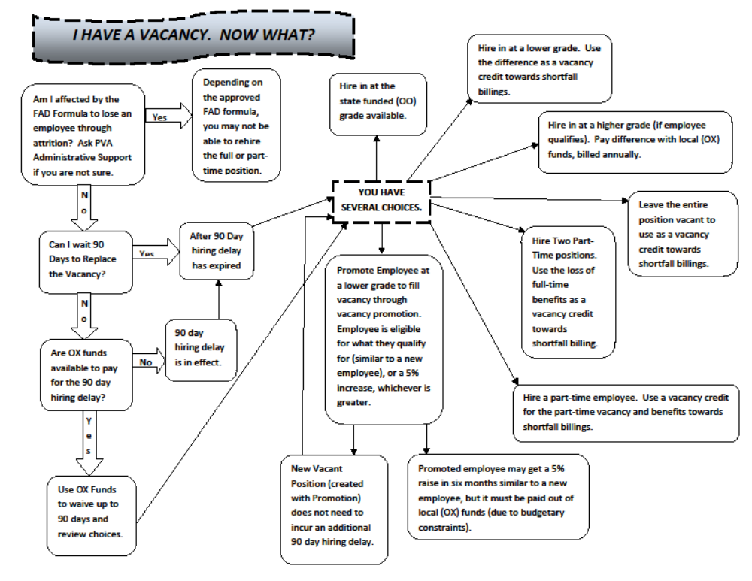

Slide 30
Budget Committee
Budget Committee meets at least quarterly but usually more often
Meetings are open to all, but we do request RSVP to ensure adequate space
Meeting minutes and expenditure information is e-mailed out after budget meetings

Slide 31
Budget Committee Members
PVA Association Officers
  Joyce Parker, President
  Bobby Upchurch, Executive VP
  Sean Curry, Legislative VP
  Michelle McDonald, Secretary
  Terry Rakes, Past President
Appointed Members (President of PVA Association, 3 Yr Terms)
  Fran Carrico
  Billy Ackerman
  Jason Scriber
  Darlene Plummer
  Cindy Martin
  Brad McDowell

