Slide 1

MOTAX Updates, Reminders and Tips
Apportioned Vehicles
NADA and Boat Values
KAVIS Boat Transactions
Freddie Freeroader Tips
December 5, 2019
Kentucky Department of Revenue • 501 High Street, St 32 • Frankfort, KY 40601

Slide 2

Apportionable Vehicle
Apportionable vehicle means (except as provided below) any power unit that is used or
intended for use in two or more member jurisdictions and that is used for the transportation of persons for hire or designed, used, or
maintained primarily for the transportation of property, and:
(i) has two axles and a gross vehicle weight or registered gross vehicle weight in excess of 26,000 pounds (11,793.401 kilograms), or
(ii) has three or more Axles, regardless of weight, or
(iii) is used in combination, when the gross Vehicle weight of such combination exceeds 26,000
A recreational vehicle, a vehicle displaying Restricted plates or a government-owned vehicle, is not an apportionable vehicle; except that a truck or truck tractor, or the power unit in a combination of vehicles having a gross vehicle weight of 26,000 pounds (11,793.401 kilograms), or less, nevertheless may be registered under the Plan at the option of the Registrant. 601 KAR 9:135

Slide 3
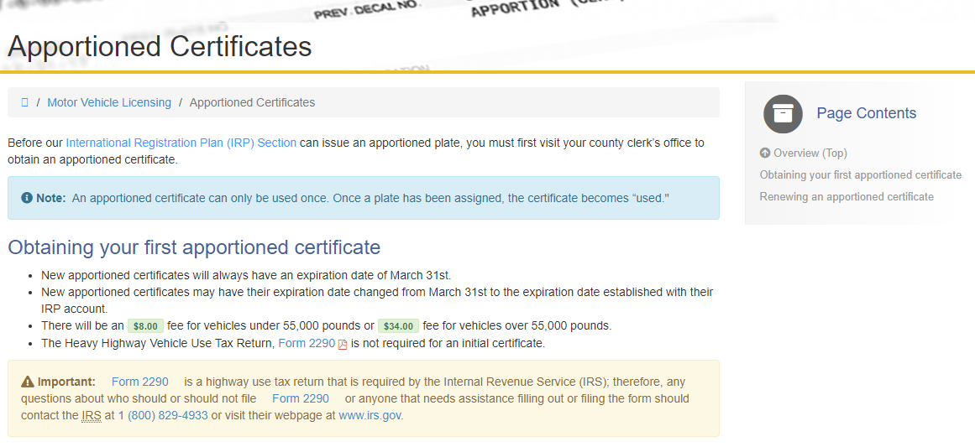
New Apportioned Certificates
Drive.ky.gov

Slide 4
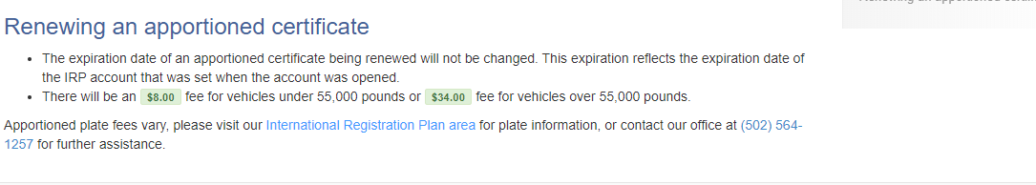
Renewing an Apportioned Certificate
Drive.ky.gov

Slide 5
Clerk and International Registration Plan (IRP) Apportioned Vehicle Coding
The clerks will issue an Apportion Certificate with a Registration Code of 21 in their offices. When the taxpayer goes to the Kentucky Transportation Cabinet the IRP area will assign the Apportioned Plate with the 33 code.
IRP assigns a plate in the IRP system and sends the plate number to AVIS which changes the Registration Code from 21 (Apportioned Certificate) to 33 (Apportion Plate). The expiration date will change from March 31st to the IRP account expiration Date. IRP cannot change this date after the account is opened.

Slide 6
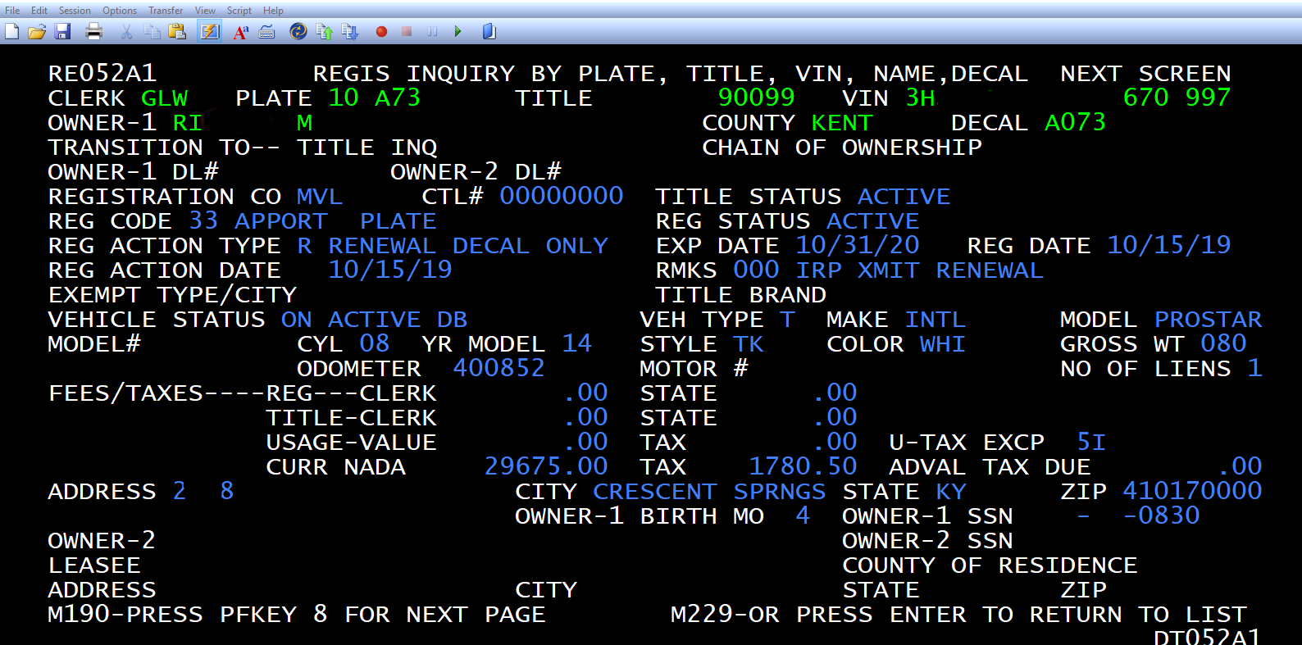
Clerk/IRP Apportioned Vehicle Coding

Slide 7
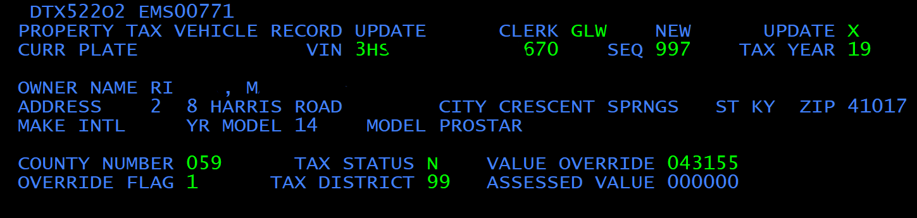
Coding Apportioned Vehicles in AVIS
The PVA should update the ‘Tax Status’ to “N” when the taxpayer brings in the apportioned certificate/ plate. The tax is collected at the Department of Transportation and sent to DOR as part of the IRP Program.
Tax segments coded with “N” will need to be coded each year as the clerk codes of 21 or 33 do not bypass the valuation process.

Slide 8
Example Question:
Taxpayer indicates he has an IRP from Indiana and local office wanted to know how to handle the situation
If he gets an apportioned plate in KY or any other 59 US or Canadian jurisdictions in the International Registration Plan (IRP), the issuing jurisdiction will collect the ad valorem tax. If he does not purchase an apportioned plate in KY or anywhere else, DOR needs to collect the ad valorem tax.
Taxpayer 1 contacted our office today about obtaining KY IRP plates. If he does, the KY IRP office will collect the ad valorem fees. If he goes back to IN and obtains an IN apportioned plate, IN will collect the ad valorem fees and send to KY thru the IRP clearinghouse monthly. At the end of each month the ad valorem fees collected by KY and the other 59 jurisdictions are transferred to the Revenue accounts.

Slide 9
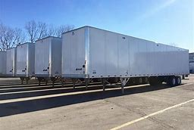
Apportioned Trailers

Slide 10
LAW
KRS 132.760(2) There shall be exempt from ad valorem tax for state and local purposes semi-trailers as defined in KRS 189.010(12) and trailers as defined in KRS 189.010(17) that are used on a route or in a system that is partly within and partly outside Kentucky. Semi-trailers or trailers required to be registered under KRS 186.655 that are used only in Kentucky shall be subject to the ad valorem tax imposed by KRS 132.487.
KRS 189.010(17) "Trailer" means any vehicle designed to be drawn by a motor truck or truck-tractor, but supported wholly upon its own wheels, intended for the carriage of freight or merchandise and having a load capacity of over one thousand (1,000) pounds.

Slide 11
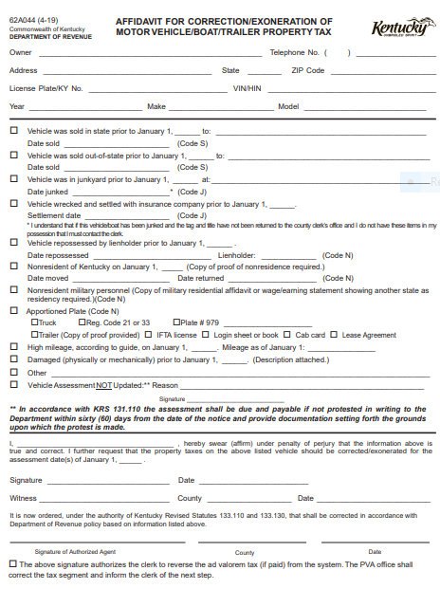
Documentation for a Single Apportioned Trailer
MOTAX Form 62A044: Affidavit for Correction/Exoneration of Motor Vehicle/Boat/Trailer Property Tax must be filed with the local PVA’s office in the county of the situs of the trailer. The affidavit must be accompanied by documentation to verify the trailer is entitled to the exemption under KRS 132.760(2). PVAs shall only require one form of documentation to verify the trailer is apportioned and entitled to the exemption.

Slide 12
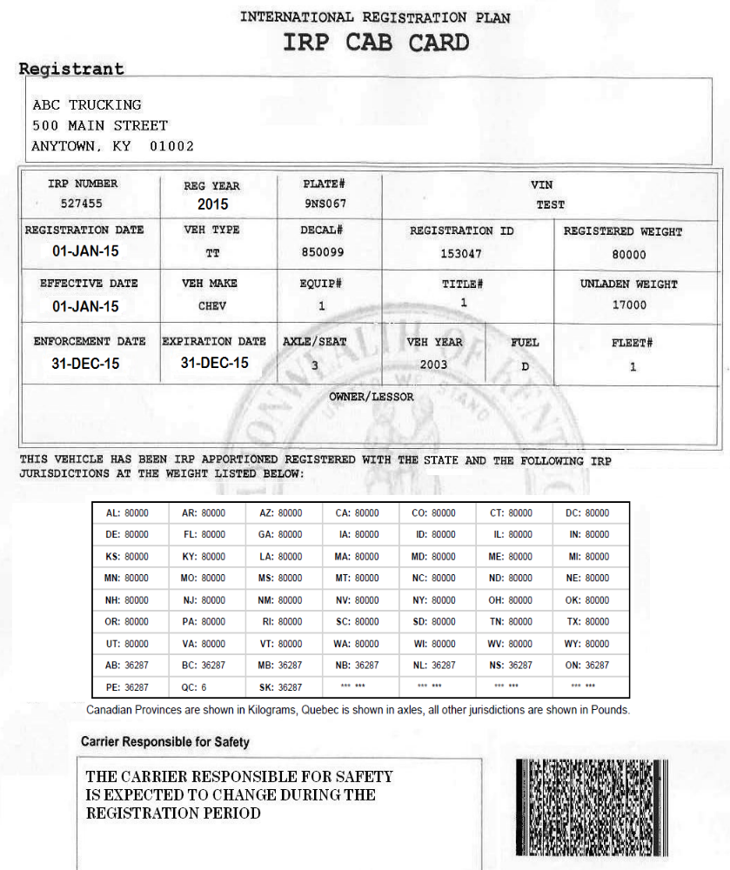
Acceptable forms include the following:
A current Cab Card
A login sheet or book
An IFTA license, or
A Lease Agreement with a trucking company.

Slide 13
Fleet Apportioned Trailers
MOTAX Form 62A044-T: Affidavit for Correction/Exoneration of Fleet Trailer Property Tax must be filed with the local PVA office in the county of the situs of the fleet trailers. The filed MOTAX Form 62A044-T shall include an apportioned trailer listing with the following identifying information for each trailer receiving the exemption:
License Plate/KY No.
VIN/HIN
Year
Make
Model
The affidavit must be accompanied by an IFTA License for the licensee owning the apportioned trailers to receive the exemption under KRS 132.760(2).
This form is available on the PVA Network:
https://revenue.ky.gov/PVANetwork/Pages/PVA-Forms.aspx

Slide 14
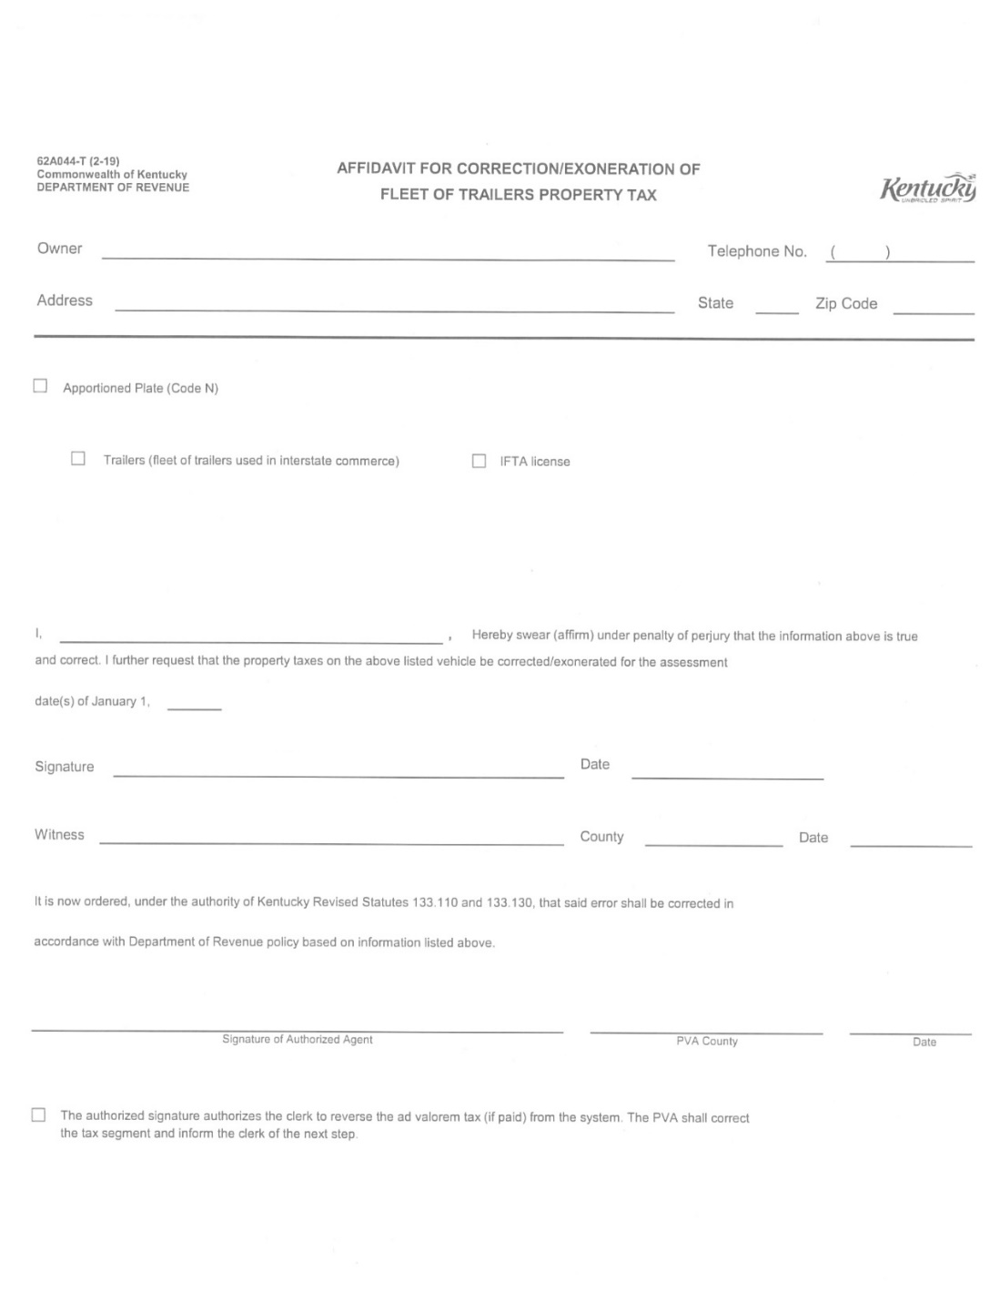

Example of 62A044-T

Slide 15
Coding Trailers in AVIS
When the PVA receives the list of trailers from the 62A044-T they will need pull up each trailer in the F3 screen to mark the ‘Tax Status’ with an ‘N’ to take the taxes out of the system.

Slide 16

NADA and Boat Values
E-Valuator (online version)
NADA Marine Guide

Slide 17
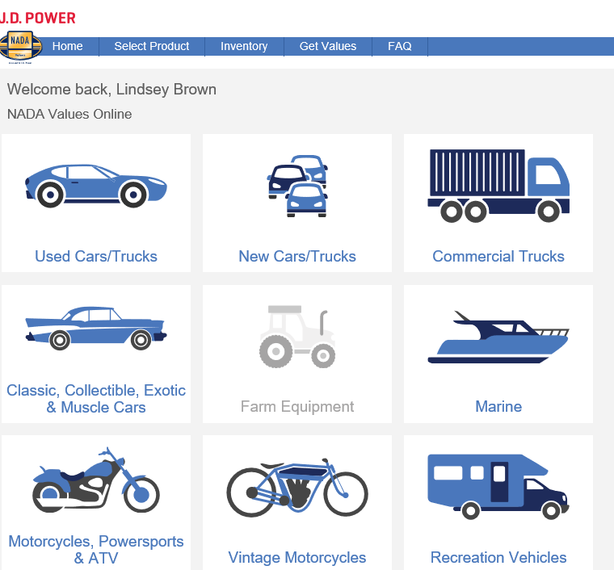
NADA E-valuator
https://extapps.nada.com/NadaOnline
Select Marine

Slide 18
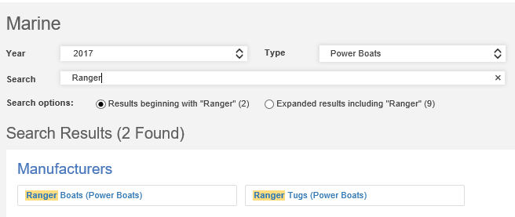
NADA E-valuator
Select Year, Type and enter make in the search box.
Example #1: Boat, Motor & Trailer included
Select Search result

Slide 19
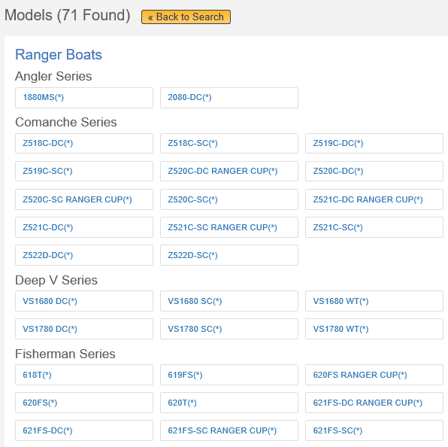
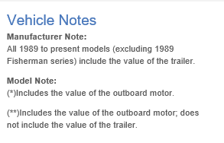
NADA E-valuator
Select boat that meets your criteria
Be sure to pay attention to vehicle notes.

Slide 20
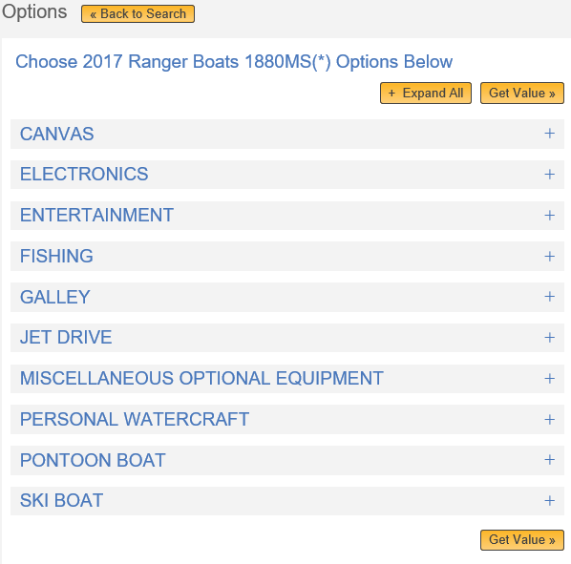
NADA E-valuator
Select ‘Get Value’.
If any of the extra option are known, you would add those here.

Slide 21
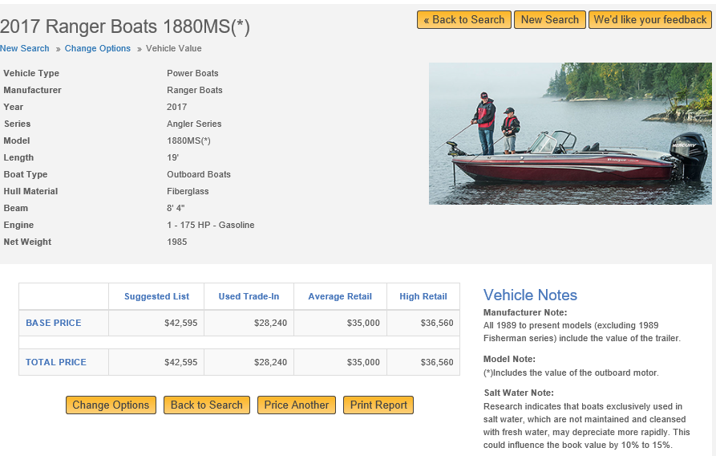
NADA E-valuator
Boats should be assessed at the Used Trade-In Value.
The NADA value is a guide and you can deviate from this value if additional information is available. KRS 132.485(1)(a)

Slide 22
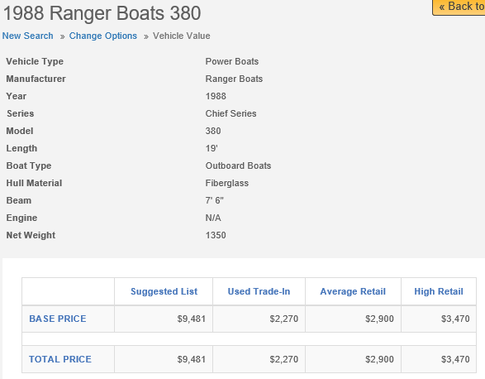
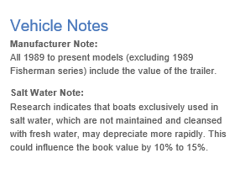
NADA E-valuator -BOAT
Example 2: Boat, Motor and Trailer valued individually
Note: The vehicle notes indicate that this value doesn’t include the trailer or motor.

Slide 23
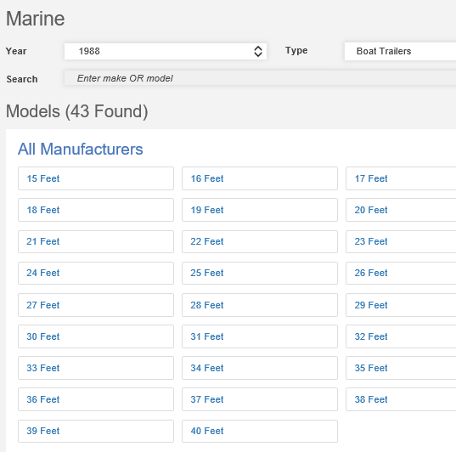
NADA E-valuator - TRAILER
Select the year, Boat Trailers & length.

Slide 24
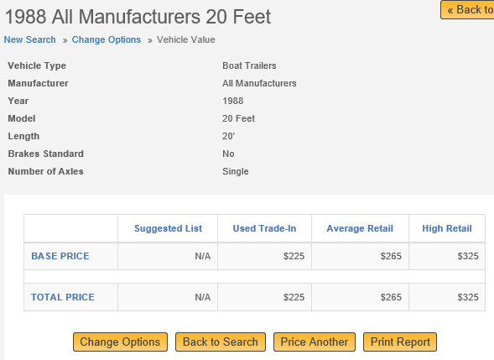
NADA E-valuator - TRAILER

Slide 25
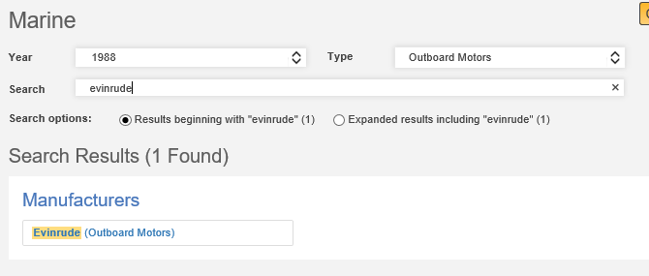
NADA E-valuator – MOTOR
Click Here
Select year, type and enter make of motor in ‘Search’.

Slide 26
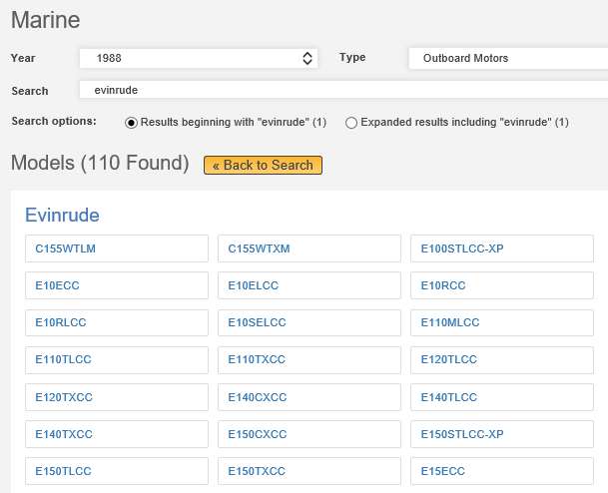
NADA E-valuator – MOTOR
Select motor that meets your criteria

Slide 27
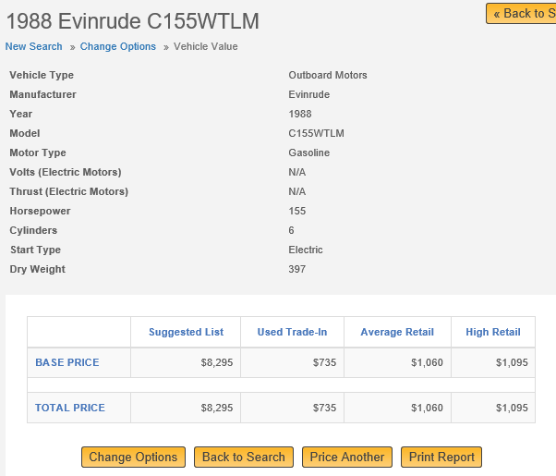
NADA E-valuator – MOTOR

Slide 28
NADA E-valuator
Example 2: Boat, Motor and Trailer valued individually
Boat $2270 NADA E-valuator Power Boats
Trailer $ 225 NADA E-valuator Boat Trailer
Motor $ 735 NADA E-valuator Outboard Motors
Total $3230

Slide 29
NADA Marine Guide
The Marine guide is divided into multiple sections including:
- Boats
- Outboard Motors
- Trailers
- Inboard Motors
As with the E-valuator version some values include the trailer, motor and other equipment combinations. It is important to review the headings for each manufacturer to determine what value option is used for their models.
If you are reviewing a boat model that does not include the combination options it will be necessary to use the manual to determine an individual value for the boat, motor and trailer to complete the assessment.

Slide 30
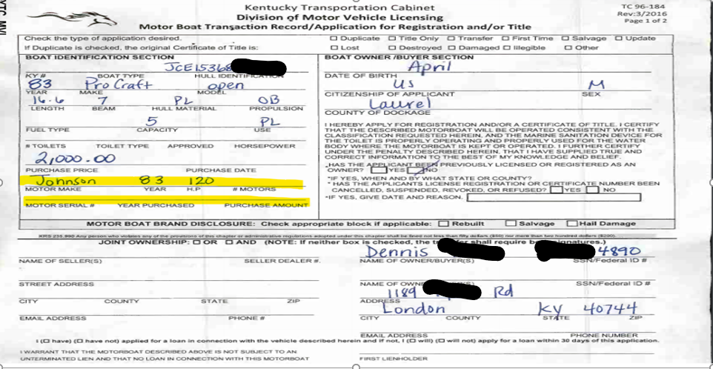
PODD BTR
The make of the motor can be found here.
If the purchase price is available, you may use as a value.
Note: must add boat & motor together.

Slide 31
Remember!
*All boats require the PVA to value the first year the boat is in the AVIS system. Unlike vehicles, there’s no NADA tape that runs to automatically value the boat.
*Its important to work your ‘No Value’ report in KAVIS since there is no automated boat tape.
*The system will automatically depreciate the entered assessed value of a boat by 5% each year.
*When the value of a boat drops below $100 it will not continue to depreciate the value by 5%.
*To avoid issues with the KAVIS system and incorrect boat assessments, do not enter a value of $1 or $2 in the boat or motor fields in the KAVIS Ad Valorem segments.

Slide 32
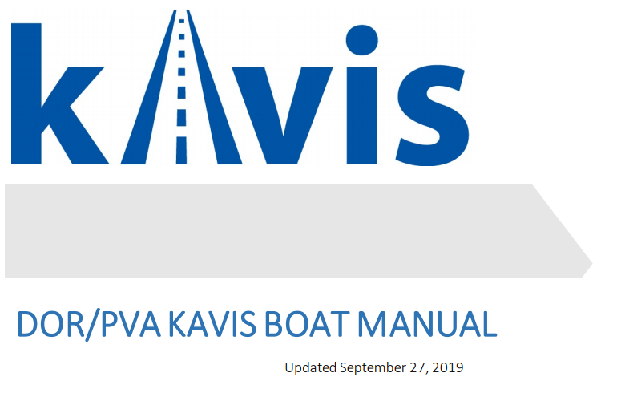
https://transportation.ky.gov/motor-vehicle-licensing/Pages/kavis2-pva.aspx
https://kavis.kytc.ky.gov/

Slide 33
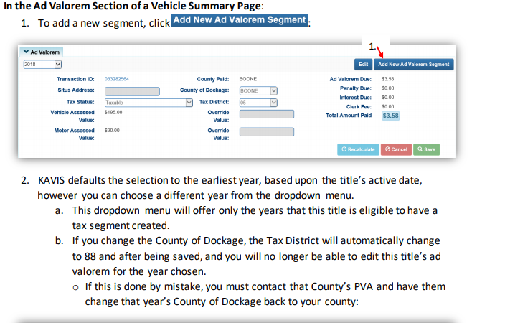
Adding a New Ad Valorem Segment

Slide 34
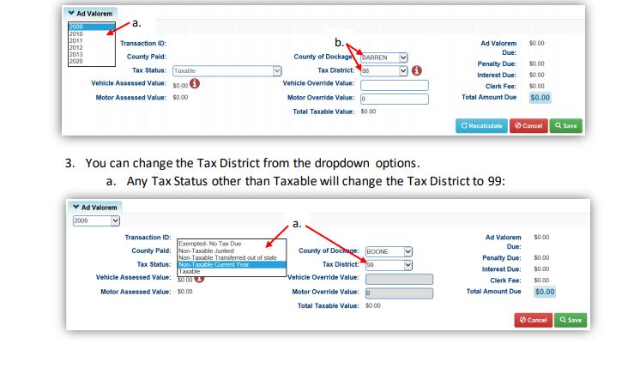
Adding a New Ad Valorem Segment (cont.)

Slide 35
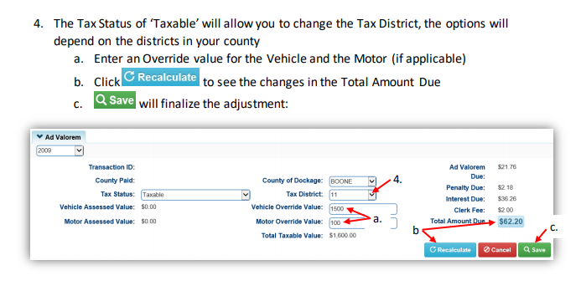
Adding a New Ad Valorem Segment (cont.)

Slide 36
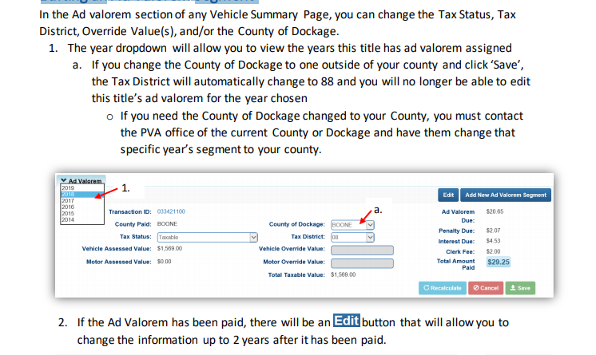
Editing an Ad Valorem Segment

Slide 37
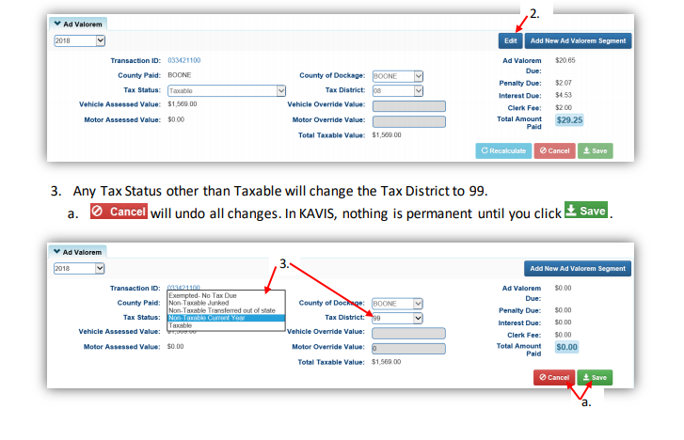
Editing an Ad Valorem Segment (cont.)

Slide 38
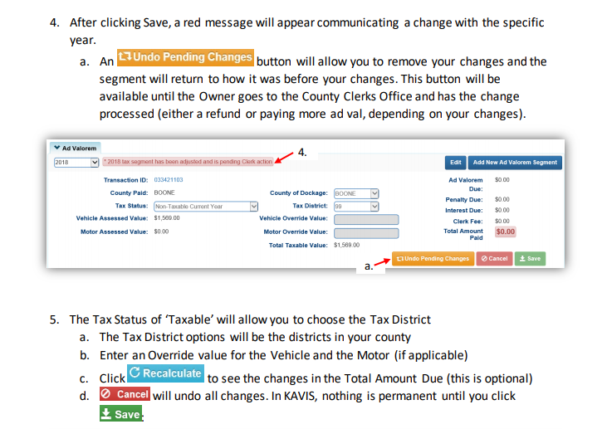
Editing an Ad Valorem Segment (cont.)

Slide 39
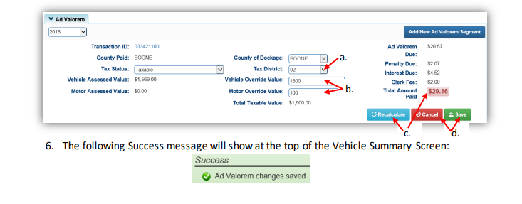
Editing an Ad Valorem Segment (cont.)

Slide 40
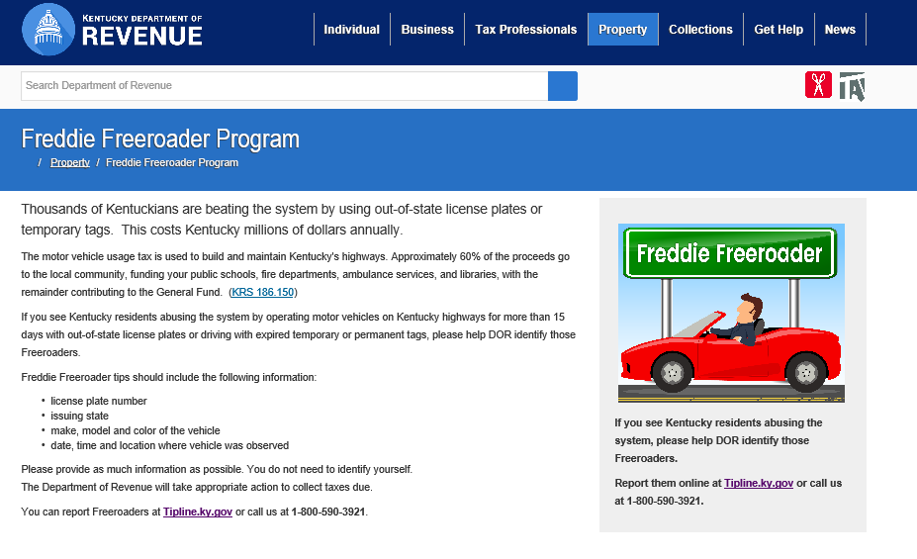
Freddie Freeroader Tips
Tips can be reported using either of the following:
- Telephone at 800.590.3921
or
- Online at www.tipline.ky.gov

Slide 41
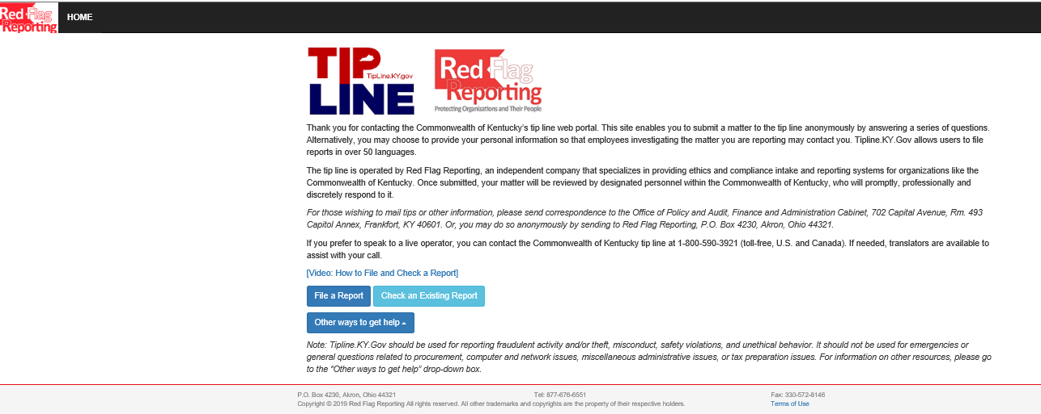

Red Flag Tip Reporting
The Commonwealth of Kentucky has a tip line web portal at www.tipline.ky.gov for fraudulent activity, theft, misconduct, safety violations and unethical behavior. The Department of Revenue has included links and information on the public website and this information can be added to PVA websites as desired.

Slide 42

Questions
Lindsey Brown- Section Supervisor
502-564-7384
LindseyN.Brown@ky.gov
Jehna Cornish- Branch Manager
502-782-2507
Jehna.Cornish@ky.gov
Glyndon Woosley- Assistant Director
502-782-9667
Glyndon.Woosley@ky.gov

Slide 43
Disclaimer
The information in this presentation is for educational and informational purposes only and does not constitute legal advice. Information is presented as an overall review that is subject to law changes and may not apply to all states. For accurate information on issues related to the this presentation, please reference KRS 132.760 (2), KRS 189.010 (17), KRS 132.485 and 601 KAR 9:135
Information in this presentation is believed to be accurate as of the date of publication. In the event that any information in this presentation is later determined to be in error, this presentation cannot be used by taxpayers in supporting a specific position or issue before the Department of Revenue, as it does not have the statutory or regulatory authority.
Presentation Date: December 5, 2019

