Slide 1

Move-it, Tax Roll
2020 Legislative Changes
End of Year Vehicle Transfers
December 4, 2019
Kentucky Department of Revenue • 501 High Street, St 32 • Frankfort, KY 40601

Slide 2

Move-it
https://ftp.ky.gov
Passwords expire every ninety (90) days
One office User ID and password
Lock outs, password resets or issues can be handled by:
  Erica Russell, Resource Management Analyst Erica.Russell@ky.gov 502-564-7125
  Glyndon Woosley, Assistant Director Glyndon.Woosley@ky.gov 502-782-9667
  Cathy Thompson, Director Cathy.Thompson@ky.gov 502-564-5117
  Recommended to use Google Chrome as browser with Move-it

Slide 3
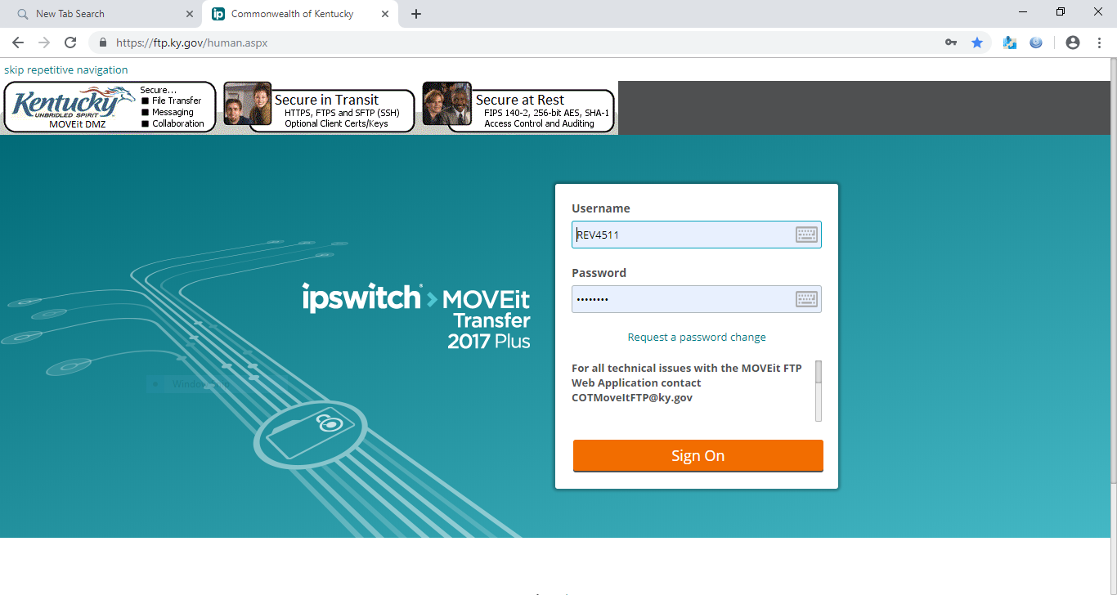
https://ftp.ky.gov

Slide 4
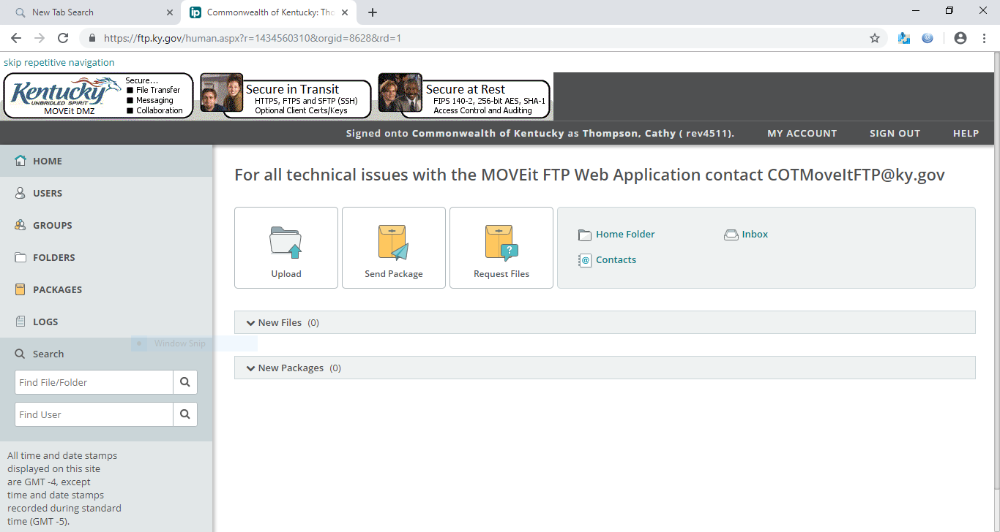
Select folders

Slide 5
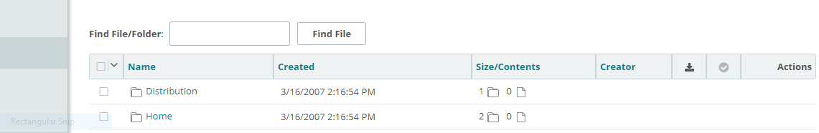
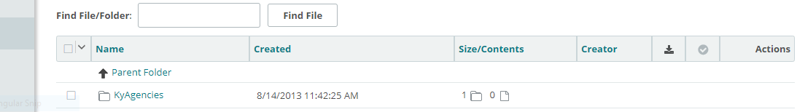
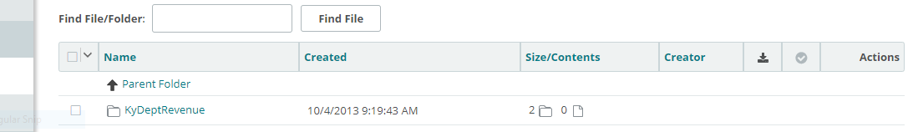
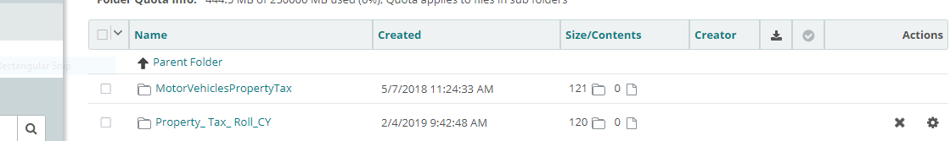
Select the folders in the black squares.

Slide 6
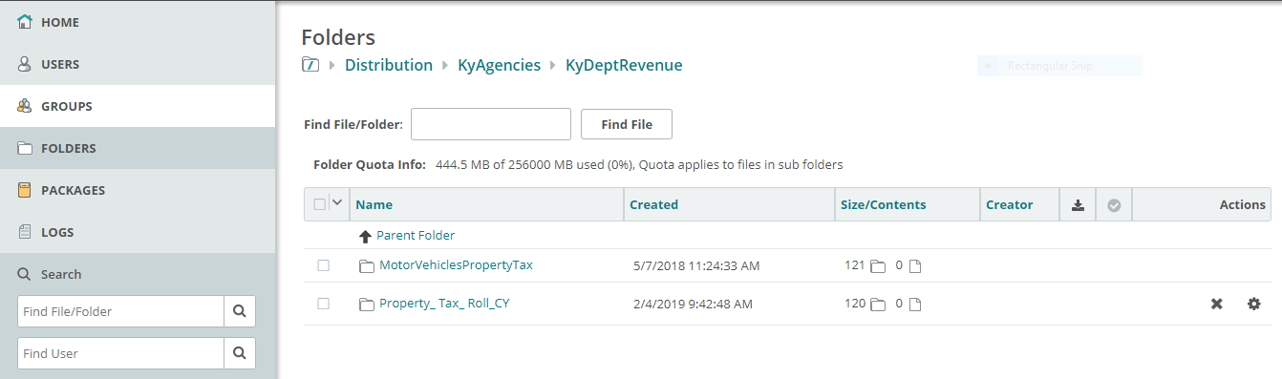
If you log in this is the path and the folders you would click on to get here.
Each PVA Office has 2 folders

Slide 7
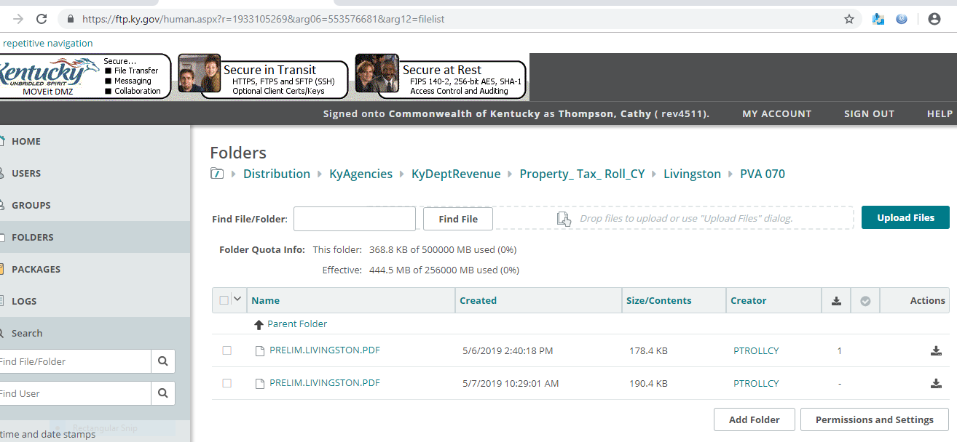

Download
Check the box

Slide 8
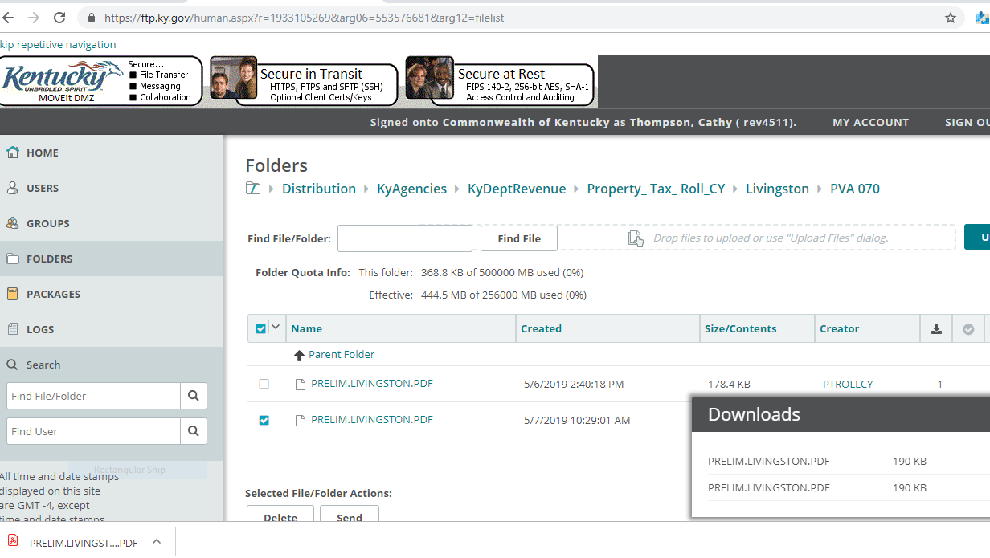
File in right corner

Slide 9
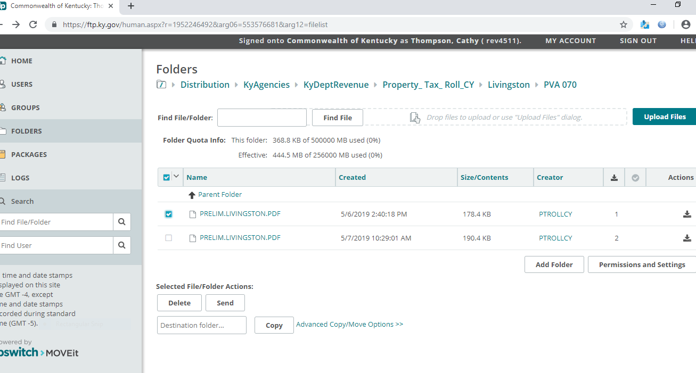
To send a file to someone. For example your dataset file to bill generator.
Check the box for the file and click “Send”

Slide 10
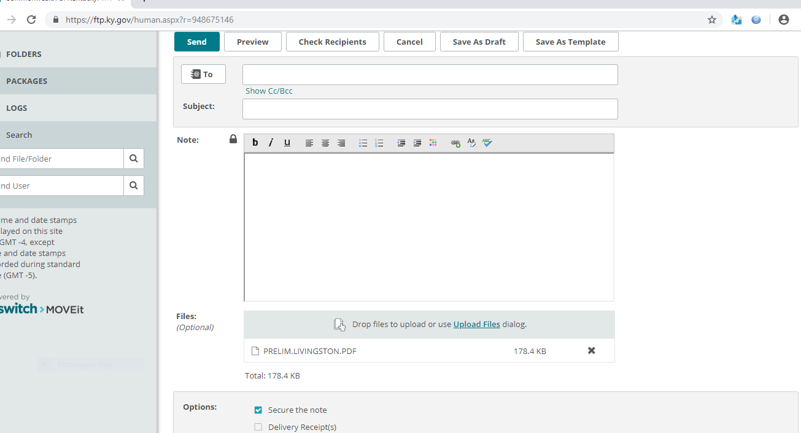
Select Send
Type in email address
Type in Subject
Type in Note to advise what it is.
The file is attached.
If you delivery response check the box

Slide 11
PERSONAL PROPERTY TAX ROLLS
Preliminary, Final, and data file will all be sent via Move-it for download by the PVA office.
Preliminary and Final tax rolls are in a PDF format
  Will be sent prior to certification
Data file will be in text format
  Will be sent after certification by Local Valuation
Will receive an email alert when something is loaded into the County library

Slide 12
BENEFITS of Move-it
Will receive much sooner will not have to wait on mail processing
PVA will have opportunity to review the tax roll and totals prior to certification and compare totals to previous year for significant changes upward or downward in valuation.
Most issues should be able to be resolved prior to Local Valuation certification
More efficient reduces cost and manual handling by staff
Downloaded files can be put on public terminals for public viewing. No requirement to print the tax roll

Slide 13

Request Preliminary Tax Roll
Preliminary – Send to Laura.Steele@ky.gov to request preliminary tax roll or call 502-564-7113. Will need to let her know what sort order:
  Alphabetical Locator Number Account Number
  Can only order prior to Closing and can order more than one
  Recommended to find errors and correct prior to closing and certification
  If changes have been made to any returns or additions made need to wait until the next day to request the preliminary report. Otherwise changes will not show up until the nightly update takes place.
  For 2020 prior to closing any County you will need to request a preliminary report.

Slide 14
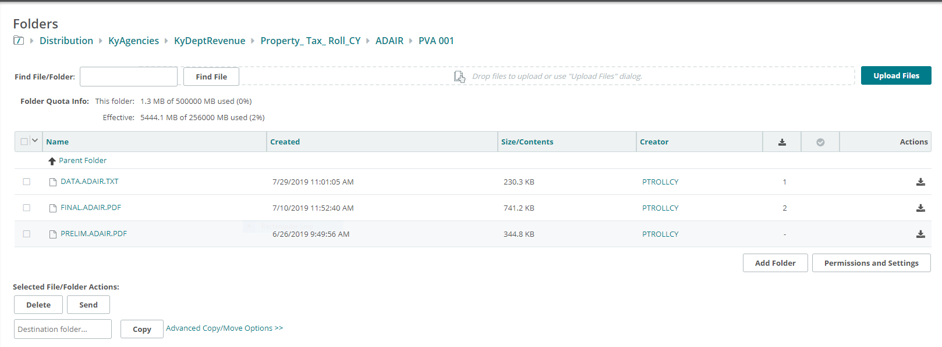
You can request more than one, each new one will replace the old file.

Slide 15
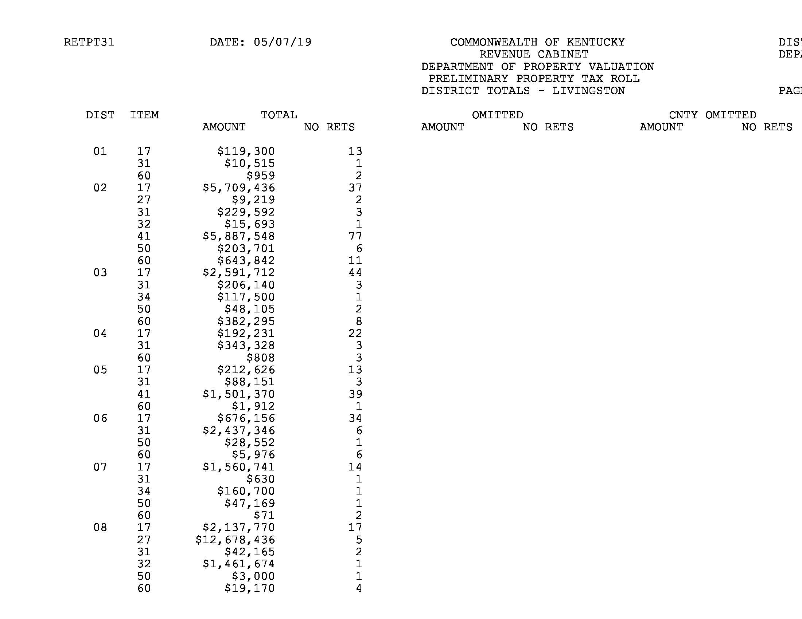
Total page from preliminary report

Slide 16

Request to Close Tangible
Closing Tangible – Send to Laura.Steele@ky.gov to close the tangible tax system or call 502-564-7113
  Will no longer be able to make changes in the mainframe
  Tax roll will be ordered from COT and will be placed on Move-it for download and review by PVA office in PDF format.
  Tax roll or totals should not be shared with taxing jurisdictions until you receive certification
  PVA should review tax roll and compare totals to previous year to check for omissions, significant increases or decreases in value. Any significant omissions from taxpayers can be sent to the Personal Property Branch Manager, Jehna Cornish for an omitted return review.
        Jehna.Cornish@ky.gov 502-782-2507

Slide 17
FINAL is after you are closed, you are not yet certified until you receive the data (txt) file.

Slide 18
Certified by Division of Local Support
Once the County is closed, Local Support has access to the files to get the personal property totals from each County.
Certification starts in July.
State Valuation is notified that the County has been certified, State Valuation sends request for the data files and they are automated to Move-it, typically the same day.
  The PVA will receive the data file prior to receiving certification letter which saves expense of printing and mailing and PVA does not have to wait on the mail.

Slide 19
DATA (TXT) is what the bills are generated from. You receive this file once you are certified by Local Valuation.

Slide 20
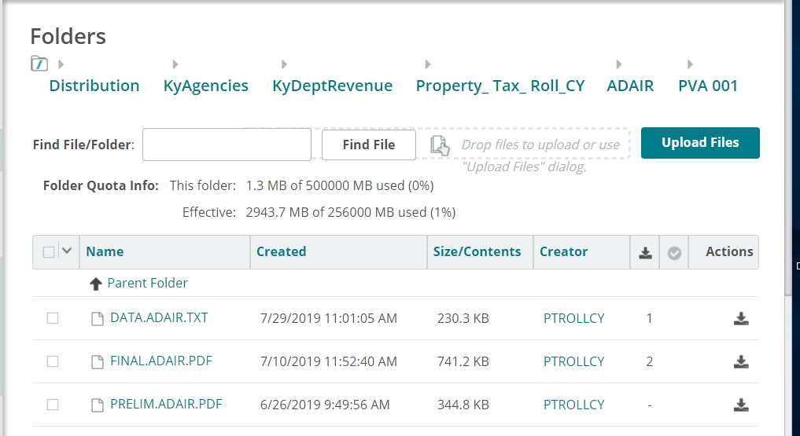
Certified by Division of Local Support
The data file is what bills are generated from.
PVA must download the file.
The final is the PDF version of the tax roll to be maintained by the PVA office per retention schedule of 5 years and transferred to the County Clerk for permanent retention.

Slide 21
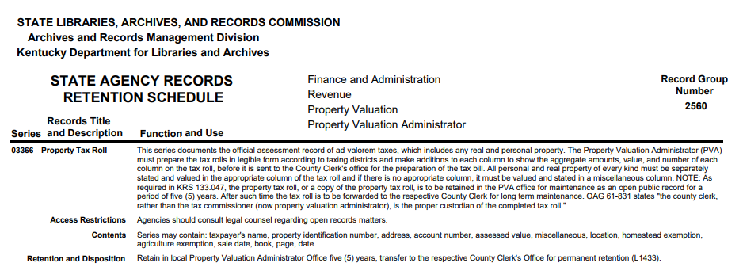
Tax Roll Retention Schedule

Slide 22
Improve Tax Roll Process
When tangible returns come in to PVA office, store in one location until entered to prevent misplacing.
Compare current return to prior year return when entering
  If significant differences in valuation, enter return send request for review.
  If no prior return and property not age 1 property send compliance request to Personal Property Branch Manager, Jehna Cornish
      Jehna.Cornish@ky.gov
      502-782-2507

Slide 23
Improve Tax Roll Process
  Check for inventory classification differences or omitted inventory
    If differences can contact taxpayer or preparer
      Will assist with less exonerations
      Tax roll will be accurate if fixed upfront
      Assist taxing jurisdictions by having more accurate valuation for budgeting and rate setting

Slide 24
Improve Tax Roll Process
  Request preliminary reports to check for errors. Can request more than one.
  Compare valuation to prior year.
  If missing significant returns, you can send a compliance request or contact taxpayer.
Time spent on the front end when entering returns and requesting preliminary reports is time saved later.

Slide 25
2019 Property Tax Legislative
Changes Effective 1/1/2020
New exemption for tangible personal property return filing
  Less than $1,000 in property
  Must keep property records
Reclassification of heavy equipment rental inventory
  Only NAICS codes 532310 and 532412
  Eligible for inventory tax credit

Slide 26
HB 354 Amends KRS 132.010 & 132.020
Defines heavy equipment rental companies; heavy equipment rental agreement; qualified heavy equipment.
This provision amends tangible personal property ad valorem tax statutes to treat heavy rental equipment as inventory since the industry sells the equipment similarly to a new or used equipment dealer.
Only NAICS codes 532310 and 532412
Eligible for inventory tax credit
The equipment was previously subject to state rate of 45 cents per $100 of value and full local rates.
  The equipment will now be subject to a state rate of 5 cents per $100 of value and full local rates.

Slide 27
HB 354 Amends KRS 132.220
Personal Property Tax Return Filing beginning with 1/1/2020.
Businesses who own very little personal property are relieved of a substantial burden by this provision to eliminate the filing of tangible personal property tax returns with property valued at $1,000 or less.
The $1,000 is for each address.
Taxpayers must maintain records of the property and its fair cash value calculation for five (5) years after the expiration of the listing period.

Slide 28


VEHICLE TRANSACTIONS
Sales Prior to Assessment Date
Titling Occurs After Assessment Date

Slide 29
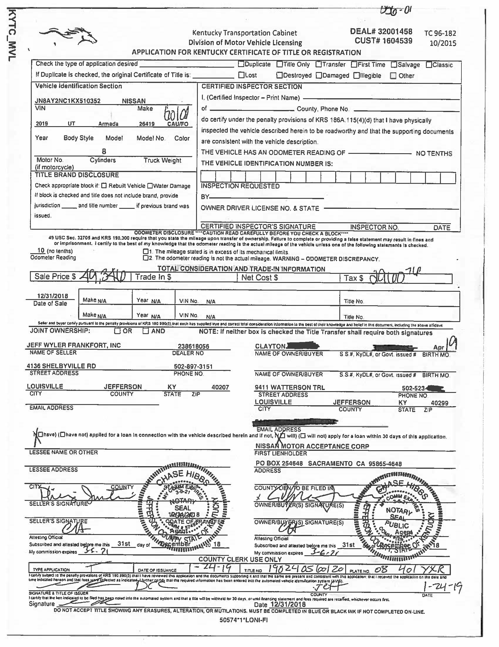
VTR FROM PODD
Sale date 12/31/18
Title date 01/24/19
Attest to Date 12/31/18

Slide 30
Sales Prior to Assessment date
Titling Occurs After Assessment Date
These transactions can occur throughout the year but primarily in January – February.
These transactions without manual intervention will not be assessed and taxes collected for the current year.
These transactions will not occur on the current year motor vehicle and boat projection reports unless segments are created prior to April 30th.
Some counties work with the County Clerk to get them to provide copies of these VTR’s or they provide title numbers so the PVA offices can find in PODD and create the segments for the current year via F3 screen and update any segments related to trade-ins.

Slide 31
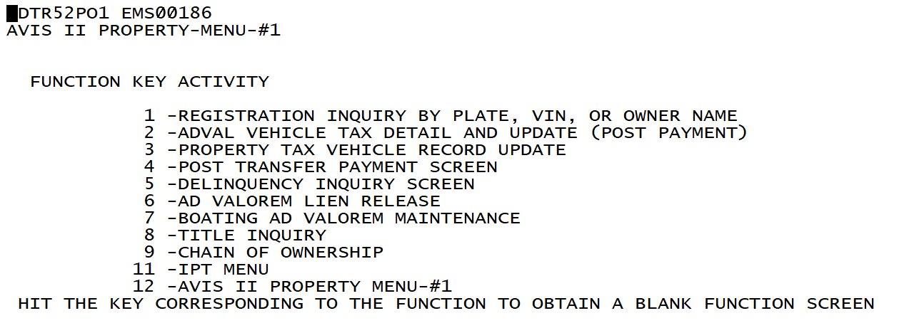
Motor Vehicle System Screens

Slide 32
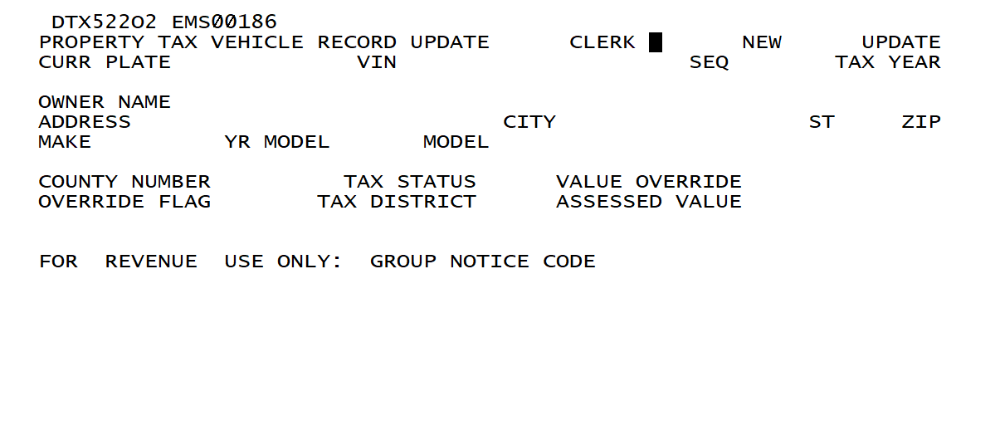
F3 Property Tax Vehicle Update
Enter Clerk initials; tab to New and put X; copy or input VIN, SEQ and TAX YEAR, hit enter verify owner name address, make, YR and model of vehicle.
Enter County number, tax status, value override, override flag for PVA = 1, tax district, hit enter segment created.

Slide 33
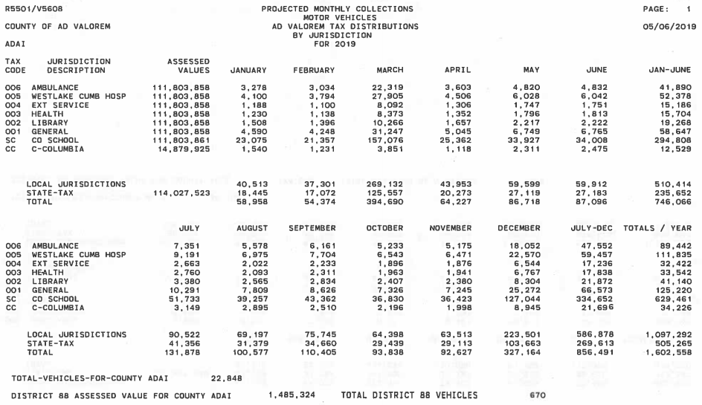

Slide 34
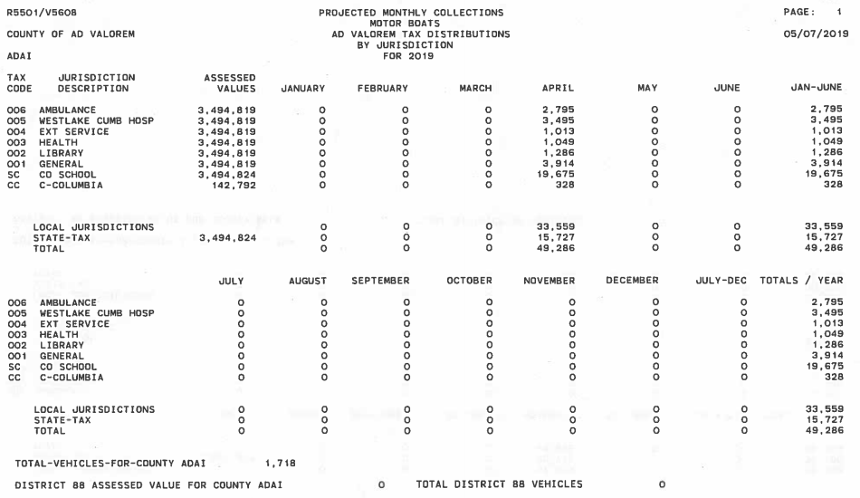

Slide 35
JUSTIFICATION AND BENEFITS TO ALL STAKEHOLDERS
County Clerks and PVAs working together to get these transactions when the taxpayer (customer) makes application for title benefits everyone.
  Confuses taxpayers when they get a bill for a motor vehicle from the State.
  State issued bills for motor vehicles are not included in projection reports.
  The correct vehicle can be assessed and any trade-ins can be removed, if applicable.
  Enhanced collection when locally done. Delinquent state motor vehicle bills do not stop taxpayer from renewing future vehicles as local delinquent bills do.

Slide 36
JUSTIFICATION AND BENEFITS TO ALL STAKEHOLDERS
  Will be included on projection reports in segments added prior to April 30th.
    Benefit to PVA since projection is part of County budget allocation.
    Benefit to local taxing jurisdictions for budgeting and tax rate setting process.
    Benefit to local taxing jurisdictions to include valuation since Apportioned Vehicle money is spread based on the projection report.
  County Clerk will receive Commission for collection.

Slide 37

FIRST QUARTER TRANSACTIONS
Transactions with birth months in January and February.
  DOR can create a special segments with an alternative date for collection the first year which will revert to birth month the following year.
  PVA can fax to DOR and we can handle these.
January and February

Slide 38
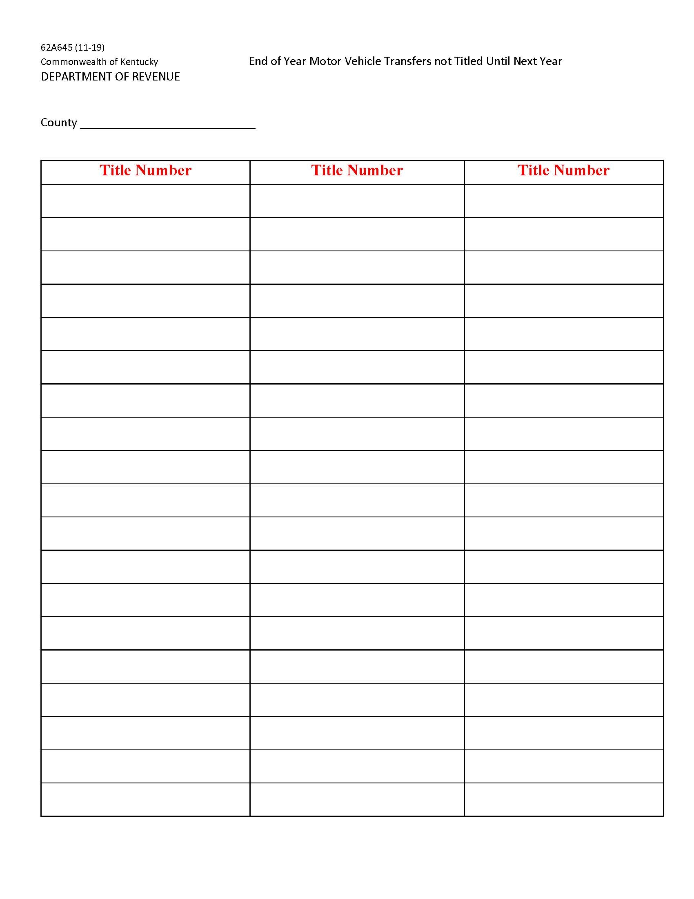
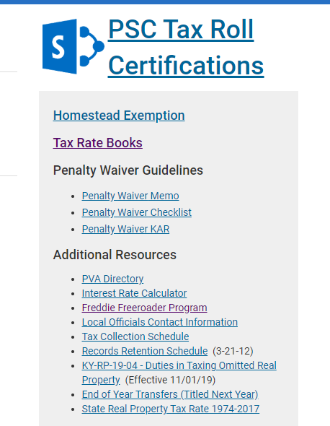
62A645 End of Year Motor Vehicle Transfers not Titled until next year.
Can copy title from mainframe system directly into PDF fillable form.
Share with PVA who can look up title in PODD and create current year segments.
Can take out trade-ins if applicable.
https://revenue.ky.gov/Pages/index.aspx

Slide 39

PVA Offices Having Any Issues or Problems
Any issues let me know
  Cathy Thompson
  cathy.thompson@ky.gov
  502-564-5117
  We maybe able to offer some on-site assistance depending on the issue and or problem.

Slide 40
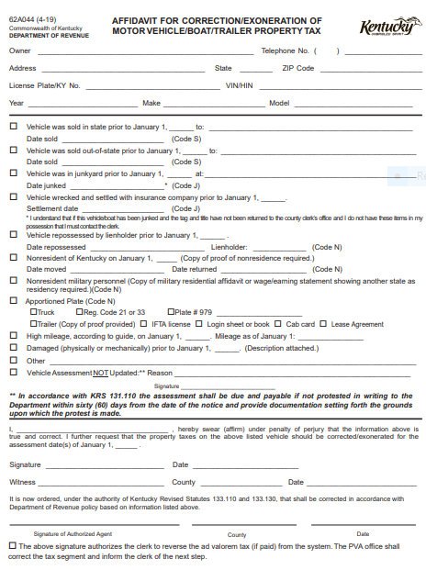
A good way to think of an affidavit is as a sort of written court testimony. Where, in a court of law, you’d have to place your hand on a Bible and swear that you’re telling the truth and nothing but the truth, on an affidavit, you simply do this in writing. You’re under oath, but you’re on paper.
It is permissible to allow an affidavit to be signed without documentation.
Reasonable professional judgement should be considered after consideration of the relevant facts and circumstances.
  When was the last time it was registered for highway use?
  Did it show back up at random?
  Donated vehicles, wrecked vehicles,
  sold out of state.

Slide 41


Slide 42
Disclaimer
The information in this presentation is for educational and informational purposes only and does not constitute legal advice. Information is presented as an overall review that is subject to law changes and may not apply to all states. For accurate information on issues related to this presentation, please reference KRS 132.010, KRS 132.020 and KRS 132.220.
Information in this presentation is believed to be accurate as of the date of publication. In the event that any information in this presentation is later determined to be in error, this presentation cannot be used by taxpayers in supporting a specific position or issue before the Department of Revenue, as it does not have the statutory or regulatory authority.
Presentation Date: December 4, 2019

