Slide 1

What’s New
From State Valuation
PVA Summer Conference June 4, 2019

Slide 2
Agenda
Inventory Credit
Kentucky Revenue Procedure KY-RP-19-01
  Apportioned Trailer Exemption
Form 62A044 & 62A044-T
2019 Legislative Changes for personal property

Slide 3

Inventory Credit
https://revenue.ky.gov/Business/Pages/Inventory-Tax-Credit-Calculator.aspx
Inventory Tax Credit
Phone: (502) 564-1555
Representatives will be available to answer questions on this dedicated phone line weekdays from
8:00 a.m. to 4:00 p.m., EST.

Slide 4
Kentucky Revenue Procedure KY-RP-19-01
SUBJECT: KRS 132.760(2) Apportioned Trailer Exemption
EFFECTIVE DATE: March 29, 2019
PUBLICATION DATE: March 29, 2019
SUPERSEDES: N/A
REFERENCE: KRS 132.760(2) KRS 189.010(17)
SCOPE: The purpose of a Revenue Procedure is to provide procedural guidance to the public and Kentucky Department of Revenue (“DOR”) personnel. It is guidance issued to assist in the administration of laws and administrative regulations (“regulations”) by providing guidance that may be followed in order to comply with the law. It is effective until withdrawn, superseded, or modified by a change in statute, regulation, case law, or other DOR guidance.

Slide 5

Purpose
To clarify the specific types of documentation a taxpayer is required to provide a county property valuation administrator (“PVA”) to verify that an apportioned trailer or trailer fleet qualifies for the exemption under KRS 132.760(2).

Slide 6
LAW
KRS 132.760(2) There shall be exempt from ad valorem tax for state and local purposes semi-trailers as defined in KRS 189.010(12) and trailers as defined in KRS 189.010(17) that are used on a route or in a system that is partly within and partly outside Kentucky. Semi-trailers or trailers required to be registered under KRS 186.655 that are used only in Kentucky shall be subject to the ad valorem tax imposed by KRS 132.487.
KRS 189.010(17) "Trailer" means any vehicle designed to be drawn by a motor truck or truck-tractor, but supported wholly upon its own wheels, intended for the carriage of freight or merchandise and having a load capacity of over one thousand (1,000) pounds.

Slide 7
Single Apportioned Trailer
MOTAX Form 62A044: Affidavit for Correction/Exoneration of Motor Vehicle/Boat/Trailer Property Tax must be filed with the local PVA’s office in the county of the situs of the trailer. The affidavit must be accompanied by documentation to verify the trailer is entitled to the exemption under KRS 132.760(2). PVAs shall only require one form of documentation to verify the trailer is apportioned and entitled to the exemption.
Acceptable forms include the following:
a current Cab Card
a login sheet or book
an IFTA license, or
a Lease Agreement with a trucking company.

Slide 8
Fleet Apportioned Trailers
MOTAX Form 62A044-T: Affidavit for Correction/Exoneration of Fleet Trailer Property Tax must be filed with the local PVA office in the county of the situs of the fleet trailers. The filed MOTAX Form 62A044-T shall include an apportioned trailer listing with the following identifying information for each trailer receiving the exemption:
Identifying Information
License Plate/ KY No.
VIN/ HIN
Year
Make
Model
The affidavit must be accompanied by an IFTA License for the licensee owning the apportioned trailers to receive the exemption under KRS 132.760(2).

Slide 9
PROCEDURE FOR CODING APPORTIONED TRAILER
PVA’s shall code apportioned trailers “N”.
Apportioned trailers shall be coded every year.

Slide 10
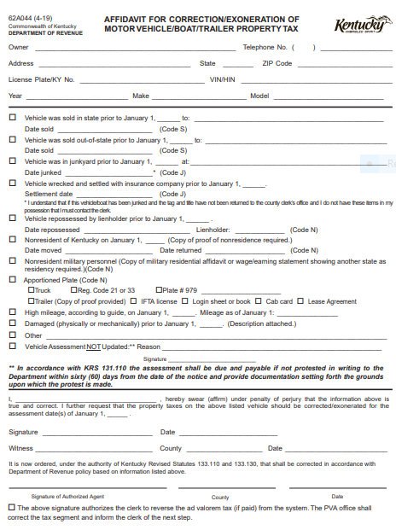

Slide 11
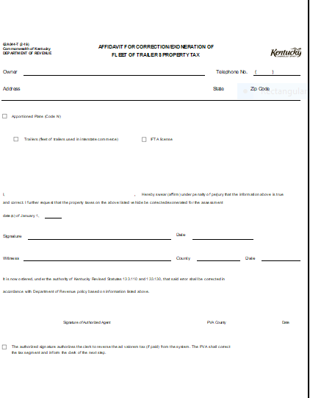
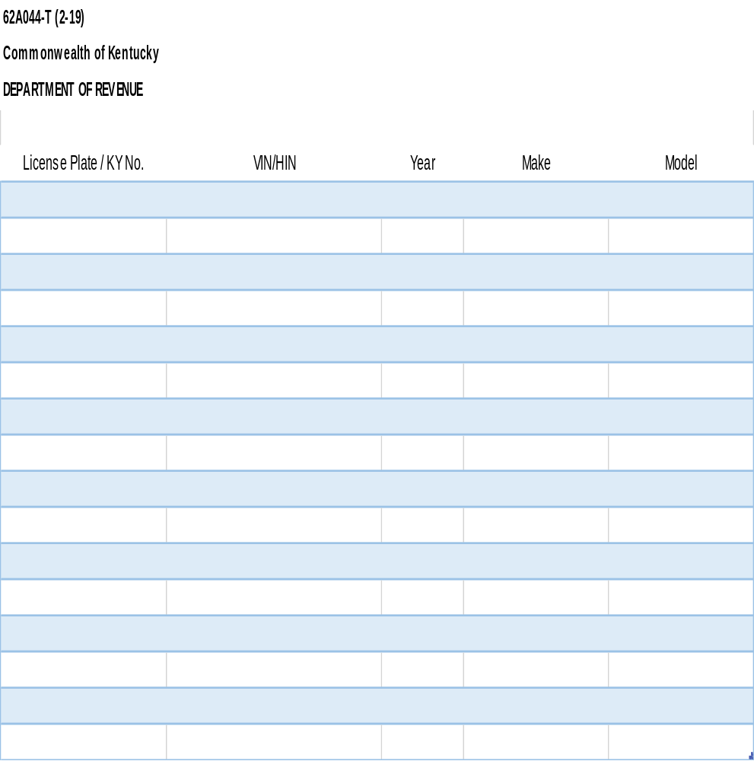

Slide 12

Protest Language
Vehicle Assessment NOT Updated

Slide 13
Protest Language
Vehicle Assessment NOT Updated
To ensure Taxpayers are aware of their appeal rights.
Provide written record to taxpayer to show they met with PVA office first. PVA office should provide a copy to the taxpayer and advise of additional protest procedures.
All protests to the Department must be in writing and filed within 60 days of the date of notice.
  The notices are mailed out 60 days prior to the due date.
  If taxpayer comes in on the last day of his renewal month he will need to pay the taxes and registration fees to the County Clerk to avoid any delinquent charges.
    The taxpayer will also need to submit a protest to the Department postmarked on the last day to be considered a timely and valid protest.

Slide 14
Address to Send Protests
Kentucky Department of Revenue
Attn: Motor Vehicle Section
501 High Street, Sta 32
Frankfort, KY 40601
Fax: 502-564-8192

Slide 15
2019 Property Tax Legislative Changes
New exemption for tangible personal property return filing
  Less than $1,000 in property
  Must keep property records
Reclassification of heavy equipment rental inventory
  Only NAICS codes 532310 and 532412
  Eligible for inventory tax credit

Slide 16
HB 354 Amends KRS 132.010 & 132.020
Defines heavy equipment rental companies; heavy equipment rental agreement; qualified heavy equipment.
This provision amends tangible personal property ad valorem tax statutes to treat heavy rental equipment as inventory since the industry sells the equipment similarly to a new or used equipment dealer.
Only NAICS codes 532310 and 532412
Eligible for inventory tax credit
The equipment was previously subject to state rate of 45 cents per $100 of value and full local rates.
  The equipment will now be subject to a state rate of 5 cents per $100 of value and full local rates.

Slide 17
HB 354 Amends KRS 132.220
Personal Property Tax Return Filing
Businesses who own very little personal property are relieved of a substantial burden by this provision to eliminate the filing of tangible personal property tax returns with property valued at $1,000 or less.
The $1,000 is for each address.
Taxpayers must maintain records of the property and its fair cash value calculation for five (5) years after the expiration of the listing period.

Slide 18

Disclaimer
The information in this presentation is for educational and informational purposes only and does not constitute legal advice. Information is presented as an overall review that is subject to law changes and may not apply to all states. For accurate information on issues related to the this presentation, please reference KRS 141.408, Kentucky Revenue Procedure KY-RP-19-01, KRS 132.760 (2), KRS 131.110, KRS 132.010, KRS 132.020, and KRS 132.220.
Information in this presentation is believed to be accurate as of the date of publication. In the event that any information in this presentation is later determined to be in error, this presentation cannot be used by taxpayers in supporting a specific position or issue before the Department of Revenue, as it does not have the statutory or regulatory authority.
Presentation Date: June 04, 2019

