Slide 1


2021 Conference on
Assessment Administration
Ratio Study Options, Recap Tips, LOA Calculations & 2022 Recap Submission
Presented by: Tom Crawford, Melissa Klink, Kim Holt & Leslie Mayes
Kentucky Department of Revenue • 501 High Street • Frankfort, KY 40601 • (502) 564-4581

Slide 2


ASSESSMENT / SALE RATIO OPTIONS FOR 2022
Typically, the starting point for the 2022 assessment year is the ratio based upon the 2020 sales that has been adjusted for the reassessment work completed in 2021.
Due to the extraordinarily strong real estate market that currently exists, additional ratio options will be calculated this year.
    A two year average – using the 2019 and 2020 ratios;
    A three year average – using he 2018, 2019 and 2020 ratios; and
    A four year average – using the 2017, 2018, 2019 and 2020 ratios
The highest ratio of the four options will be selected as the starting point for the 2022 assessment year.
Using the ratio results from any of these options, the level of assessment requirements for the 2022 assessment year will be 95%.
PVAs will also continue to have the option of using a ratio based upon the last six months of sales from 2021. If the ratio based on sales from this timeframe is used, then the level of assessment requirement will be 90% since those sales go right up to the January 1, 2022 assessment date.

Slide 3
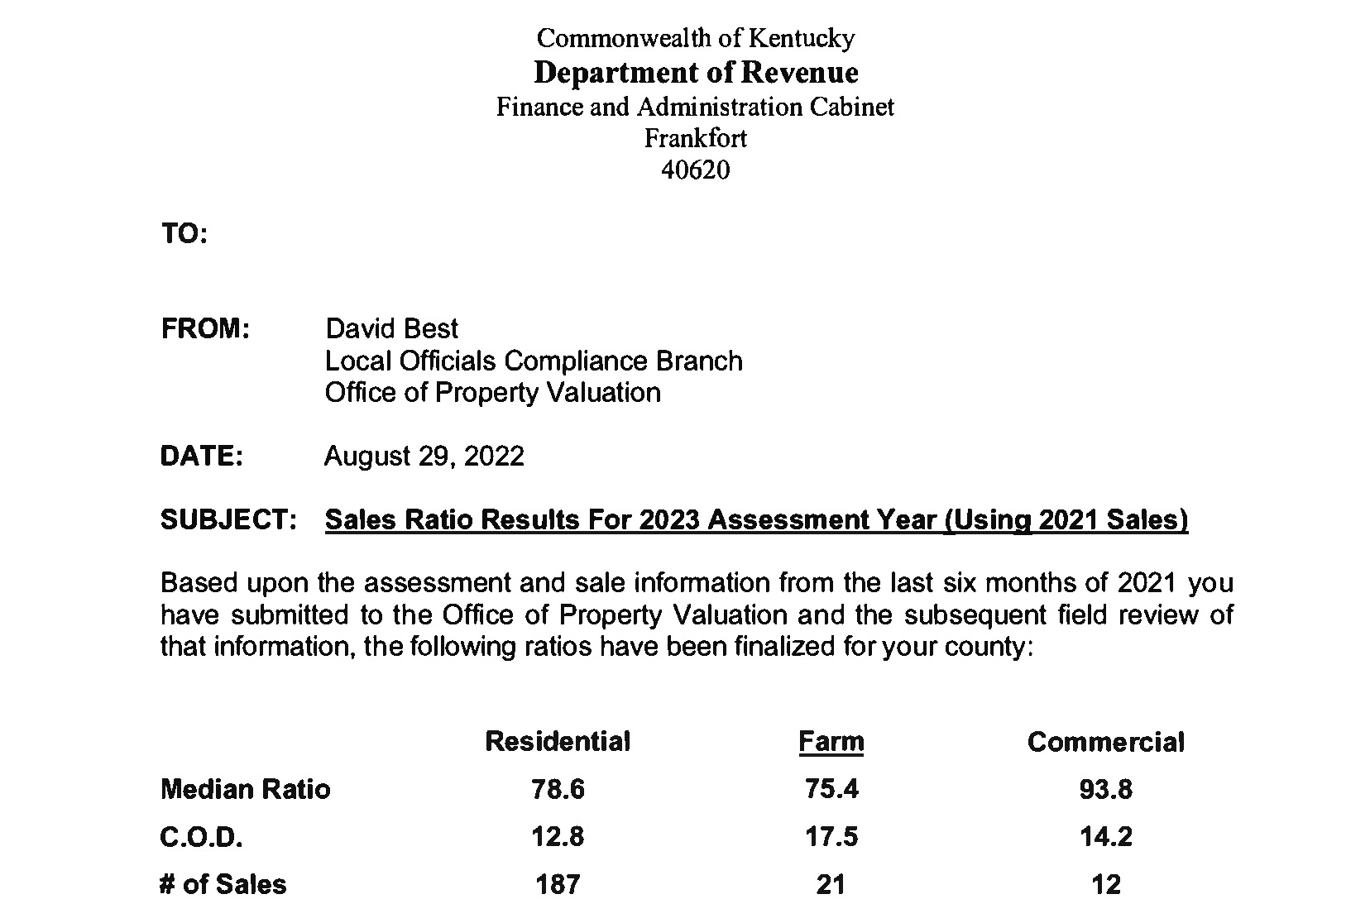
ASSESSMENT / SALE RATIO OPTIONS FOR 2022

Slide 4
ASSESSMENT / SALE RATIO OPTIONS FOR 2022

Slide 5

Calculation of ratios
  A separate ratio is calculated for each class of property within the county
  DOR uses an in-house statistical software program to calculate the individual ratio of assessment to sale price for each sale
  Ratios are ranked from lowest to highest for each class of property and the median ratio is found
  The initial median ratio is provided to the PVA
  Upon certification you receive an assessment credit that is applied to your median ratio

Slide 6
Calculation of ratios
Basic Ratio Calculation
Step 1
ASSESSED VALUE OF THE SAMPLE PROPERTY ....................................................................$90,000
SALE PRICE OF THE PROPERTY ...................................................................................$100,000
THIS RATIO = $90,000
$100,000 = .90 OR 90%
RATIO = ASSESSED VALUE/SALE PRICE

Slide 7
Calculation of ratios
COMPUTATION OF THE ASSESSMENT/SALES RATIO
Step 2
PVA Assessment Sale Price Ratio
$ 11,000 ÷ $ 20,000 0.55
$ 64,000 ÷ $ 59,000 1.08
$ 40,000 ÷ $ 40,000 1.00
$ 38,000 ÷ $ 30,000 1.27
$ 92,000 ÷ $ 88,000 1.05
$ 6,000 ÷ $ 25,000 0.24
$122,000 ÷ $250,000 0.49
$ 65,000 ÷ $ 81,000 0.80
$ 59,000 ÷ $ 66,000 0.89
$ 50,000 ÷ $ 19,000 2.63
$ 44,000 ÷ $ 50,000 0.88
$ 66,000 ÷ $ 71,000 0.93
$ 36,000 ÷ $ 48,000 0.75
$ 35,000 ÷ $ 50,000 0.70
$ 68,000 ÷ $ 80,000 0.85
Total Number of Sales = 15

Slide 8
Calculation of ratios
RANKING OF THE ASSESSMENT/SALES RATIO
Step 3
PVA Assessment Sale Price Ratio
$ 6,000 ÷ $ 25,000 = .24
$122,000 ÷ $250,000 = .49
$ 11,000 ÷ $ 20,000 = .55
$ 35,000 ÷ $ 50,000 = .70
$ 36,000 ÷ $ 48,000 = .75
$ 65,000 ÷ $ 81,000 = .80
$ 68,000 ÷ $ 80,000 = .85
$ 44,000 ÷ $ 50,000 = .88 - MEDIAN
$ 59,000 ÷ $ 66,000 = .89
$ 66,000 ÷ $ 71,000 = .93
$ 40,000 ÷ $ 40,000 = 1.00
$ 92,000 ÷ $ 88,000 = 1.05
$ 64,000 ÷ $ 59,000 = 1.08
$ 38,000 ÷ $ 30,000 = 1.27
$ 50,000 ÷ $ 19,000 = 2.63
The MEDIAN is the middle value of a set of ranked numbers.
In this example there are fifteen numbers (ratios).
The MEDIAN is the eighth position or at the halfway point.
There are seven numbers above it and seven numbers below it.

Slide 9
Level of Assessment
Level of Assessment is the calculation used to certify your recapitulation each year.
  The Ratio is used in the calculation of the Level of Assessment

Slide 10
Level of Assessment and Certification Procedures
  Level of Assessment
  The extent to which the PVA has achieved the statutory requirement of 100% fair cash value for all classes of property during a particular year.
  The median ratio is used to set a level of assessment requirement for each property class: Residential, Farm & Commercial.

Slide 11
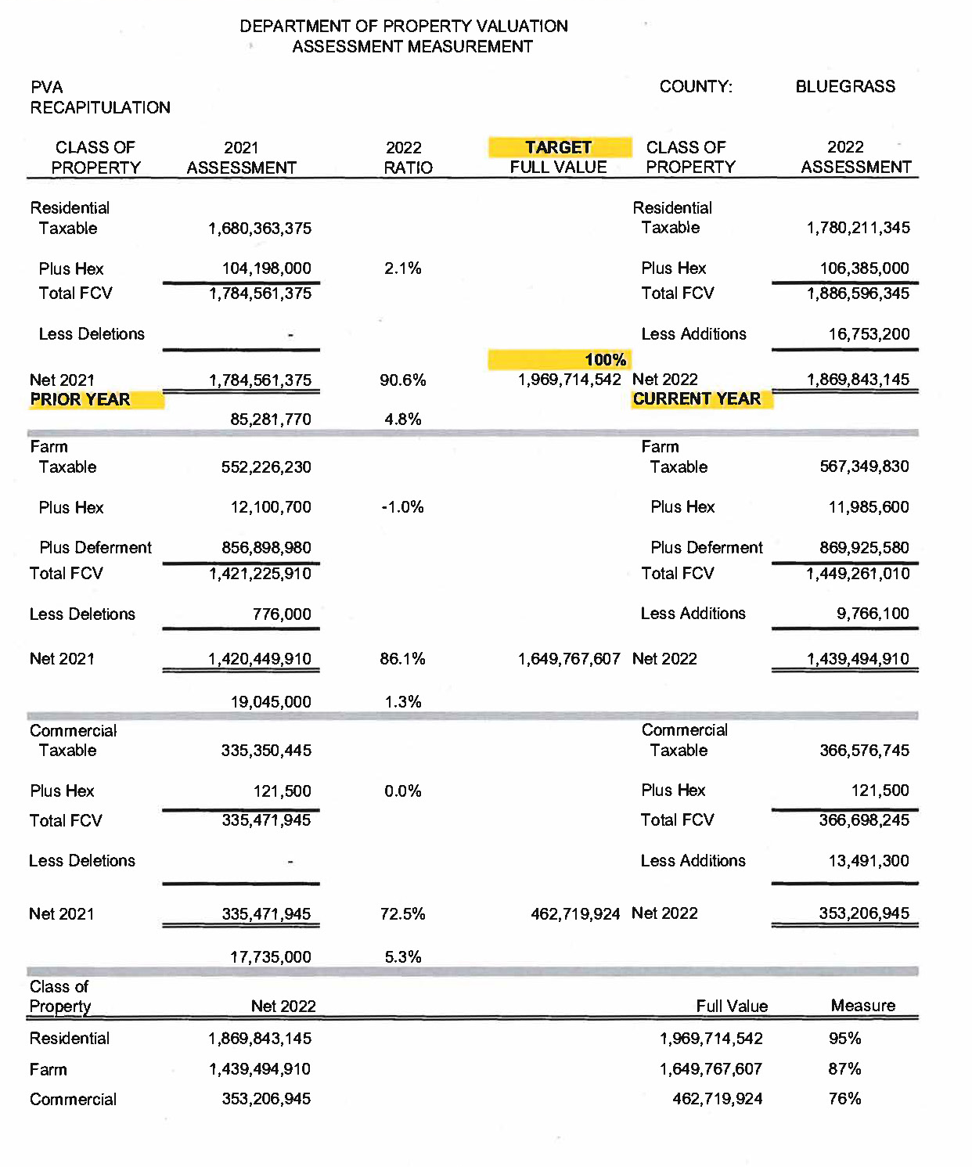
Full Value Target = Previous Net Assmt/ Current Ratio
Level of Assmt = Current Assmt/
Full Value Target

Slide 12
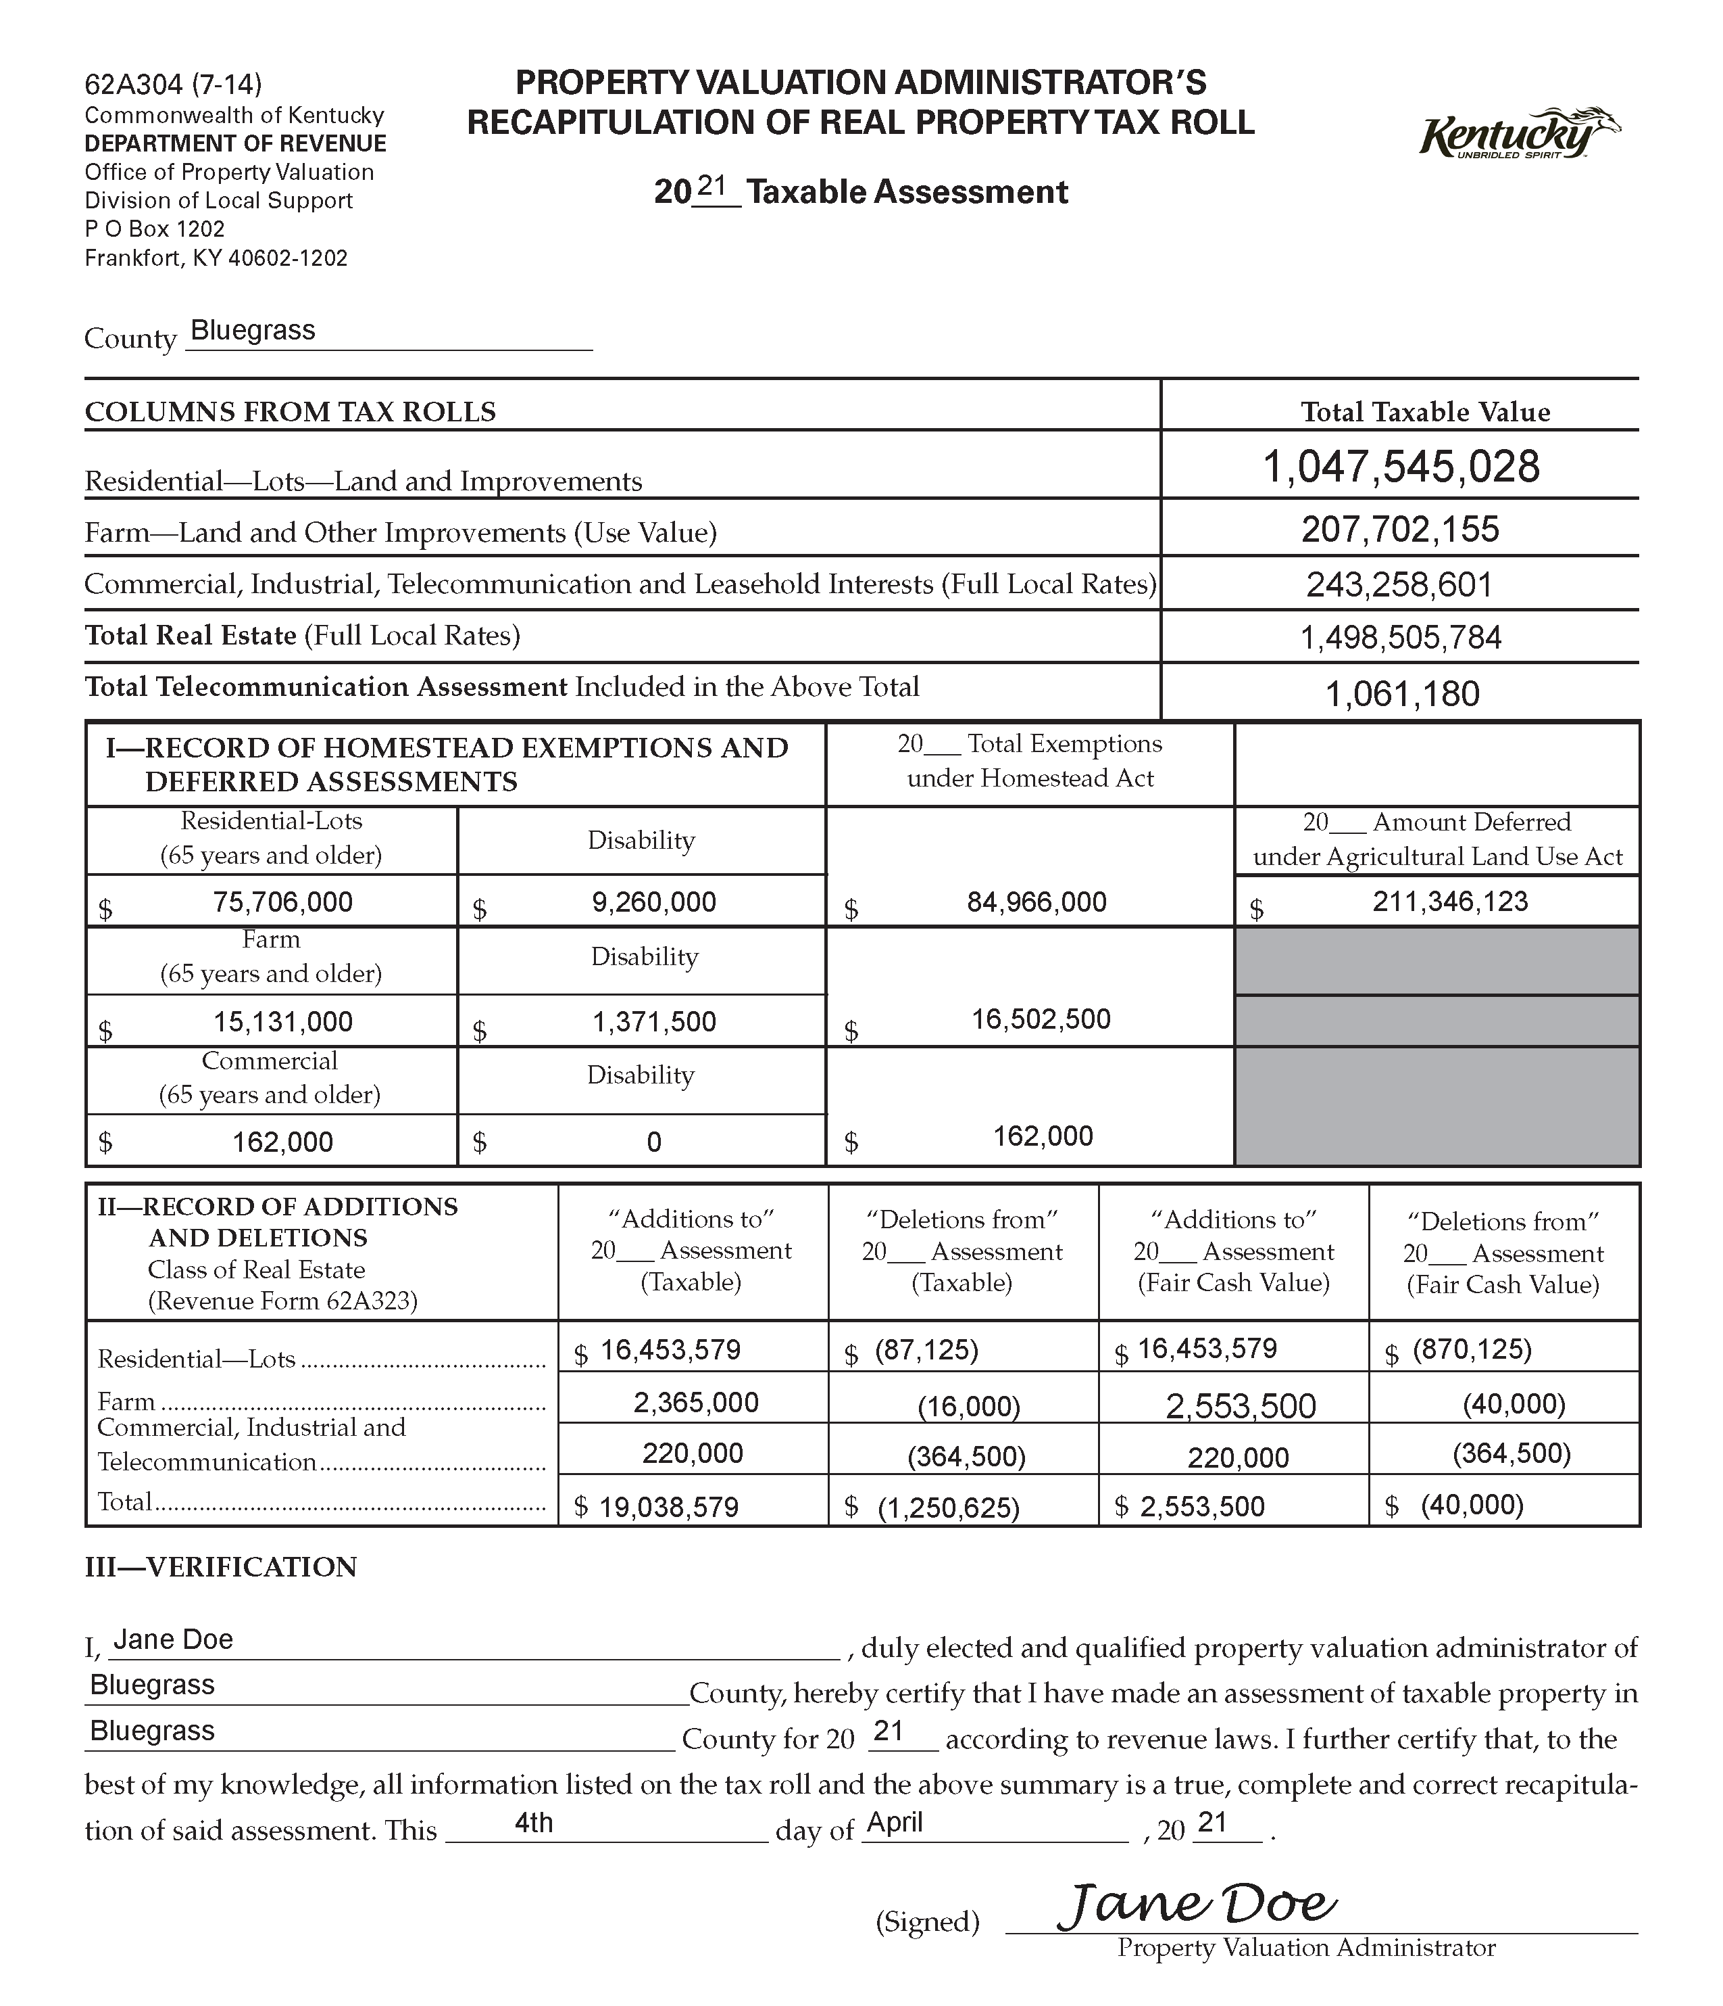

Slide 13
Level of Assessment and Certification Procedures
  Certification Procedures
  For the 2022 assessment year, DOR will use the most favorable ratio from the 4 options that were presented at the beginning of the workshop.
    Using this ratio the acceptable range of the level of assessment will be 95%-105% for the 2022 tax year.
  If the level of assessment is below 95% then there are two options:
    The last six months of 2021 can be submitted and a new ratio will be calculated. Since sales from a more recent time period are being used, the acceptable range for the level of assessment can be expanded to 90%-110%.
    To continue to base the acceptance of the recapitulation on the ratio study results that utilized the 2020 sales. This option would require the PVA to reassess property so that the level of assessment would fall in the 95%-105% range.

Slide 14
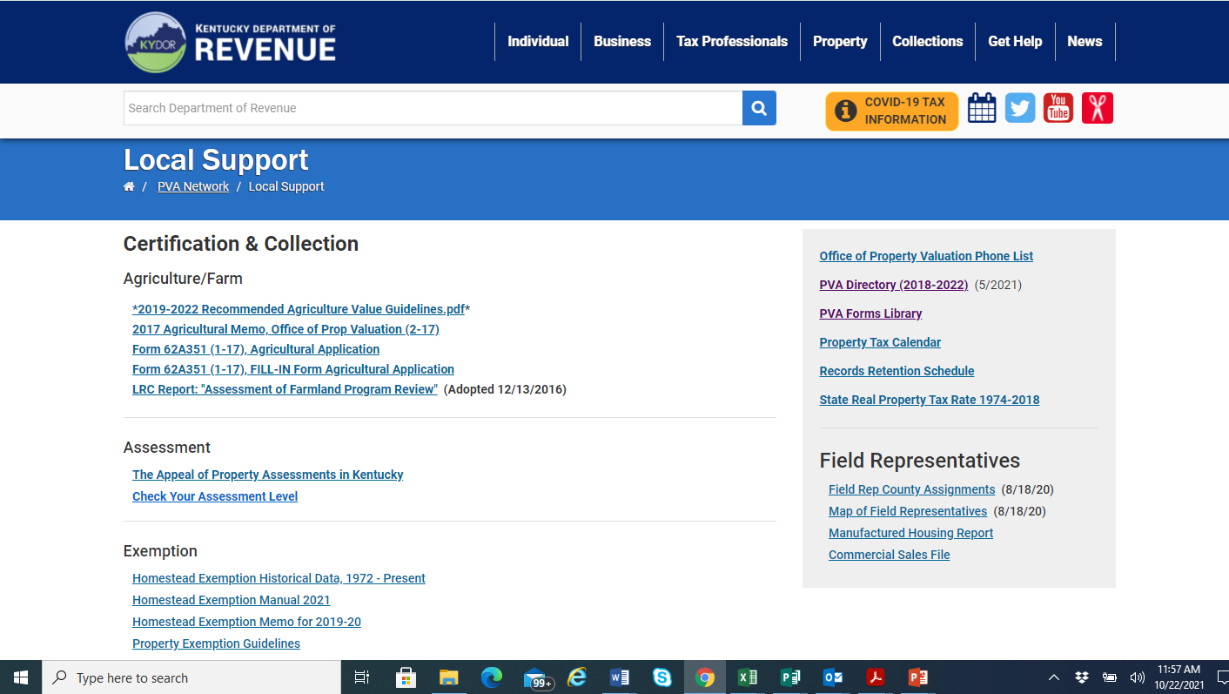
Check Your Assessment Level Tool

Slide 15
Check Your Assessment Level Tool
Assessment Level
2020 Taxable
Plus 2020 HEX
Total FCV |  |  | -
Less 2021 Deletions
2020 Net Assessment |  |  | -
2020 Ratio
Full Value |  |  | 0
2021 Taxable
Plus 2021 HEX
Total FCV |  |  | -
Less 2021 Additions
2021 Net Assessment |  |  | -
Assessment Measurement |  |  | #DIV/0!

Slide 16

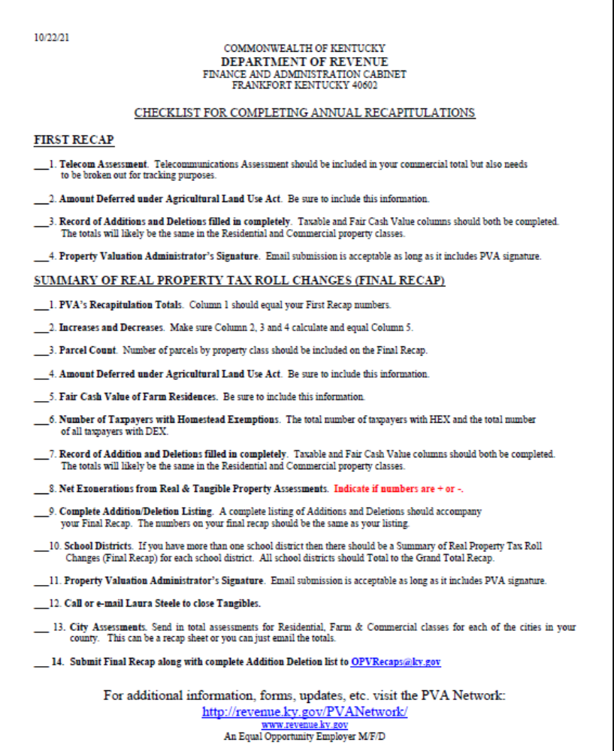
Recap Checklist

Slide 17
New Email Address for Recaps
OPVRecaps@ky.gov

Slide 18
CONTACT INFORMATION
For more information go to the
Kentucky Department of Revenue website: http://www.revenue.ky.gov
or Contact:
Tom Crawford at 502-564-7179
Melissa Klink at 502-564-7191
Kim Holt at 502-564-7198
Leslie Mayes at 502-564-1258

Slide 19

Ratio Study Options, Recap Tips, LOA Calculations & 2022 Recap Submission
Tom Crawford
 Tom.Crawford@ky.gov
 (502) 564-7179
The information in this presentation is for educational and informational purposes only and does not constitute legal advice. Information is presented as an overall review that is subject to law changes and may not apply to all states. For accurate information on issues related to [topic covered by training materials], please reference [list sources of laws, regulations, etc].
Information in this presentation is believed to be accurate as of the date of publication. In the event that any information in this presentation is later determined to be in error, this presentation cannot be used by taxpayers in supporting a specific position or issue before the Department of Revenue, as it does not have the statutory or regulatory authority.
Kentucky Department of Revenue • 501 High Street • Frankfort, KY 40601 • (502) 564-4581

