Slide 1
PVA Briefing
Kentucky Department of Veteran Affairs
Donald Walbert

Slide 2
Disability Status
PVA Requirements-Individual must be age 65 or older or totally disabled in the year for which the application is made.
VA Definition-
100% Disability-total disability evaluation assigned to an individual because of any service-connected impairment (or combination of impairments) of mind or body that that meets the criteria for a total disability rating under the Schedule for Rating Disabilities.

Slide 3
Application Based on Disability
• If the application is based on the disability of the homeowner, then the homeowner must have been classified as totally disabled under a program authorized or administered by an agency of the United States government or any retirement system located within or outside of Kentucky.
• The homeowner must have been receiving payments pursuant to his or her disability for the entire assessment period.

Slide 4
Application Based on Disability
The homeowner must apply annually to con​tinue to receive the exemption based upon a total disability, unless:
•They are a veteran of the United States Armed Forces and have a service connected disability;
•They have been determined to be totally and permanently disabled under the rules of the Social Security Administration
•They have been determined to be totally and permanently disabled under the rules of the Kentucky Retirement Systems.

Slide 5
Qualifying as Totally Disabled
100% rating with a future exam
Qualifies as total disability for the calendar year it is awarded.
Future exams generally held 1-5 years later
100% Permanent and Total
Chapter 35 DEA benefits awarded

Slide 6
Qualifying as Totally Disabled
Individual Unemployability
• Total disability evaluation assigned to an individual because of any service-connected impairment (or combination of impairments) of mind or body that fails to meet the criteria for a total disability rating under the Schedule for Rating Disabilities but that nonetheless renders it impossible for that person to follow substantial gainful employment.

Slide 7
Homestead Exemption Allowance for 2021-2022
• KRS 132.810 (2)(e) provides that the homestead exemption shall be adjusted for inflation every two years. In accordance with this statutory requirement, the Office of Property Valuation has determined that the homestead exemption amount for the 2021 and 2022 tax years shall be $40,500. Please contact your computer programmer or computer service company to ensure the appropriate software updates are made.

Slide 8
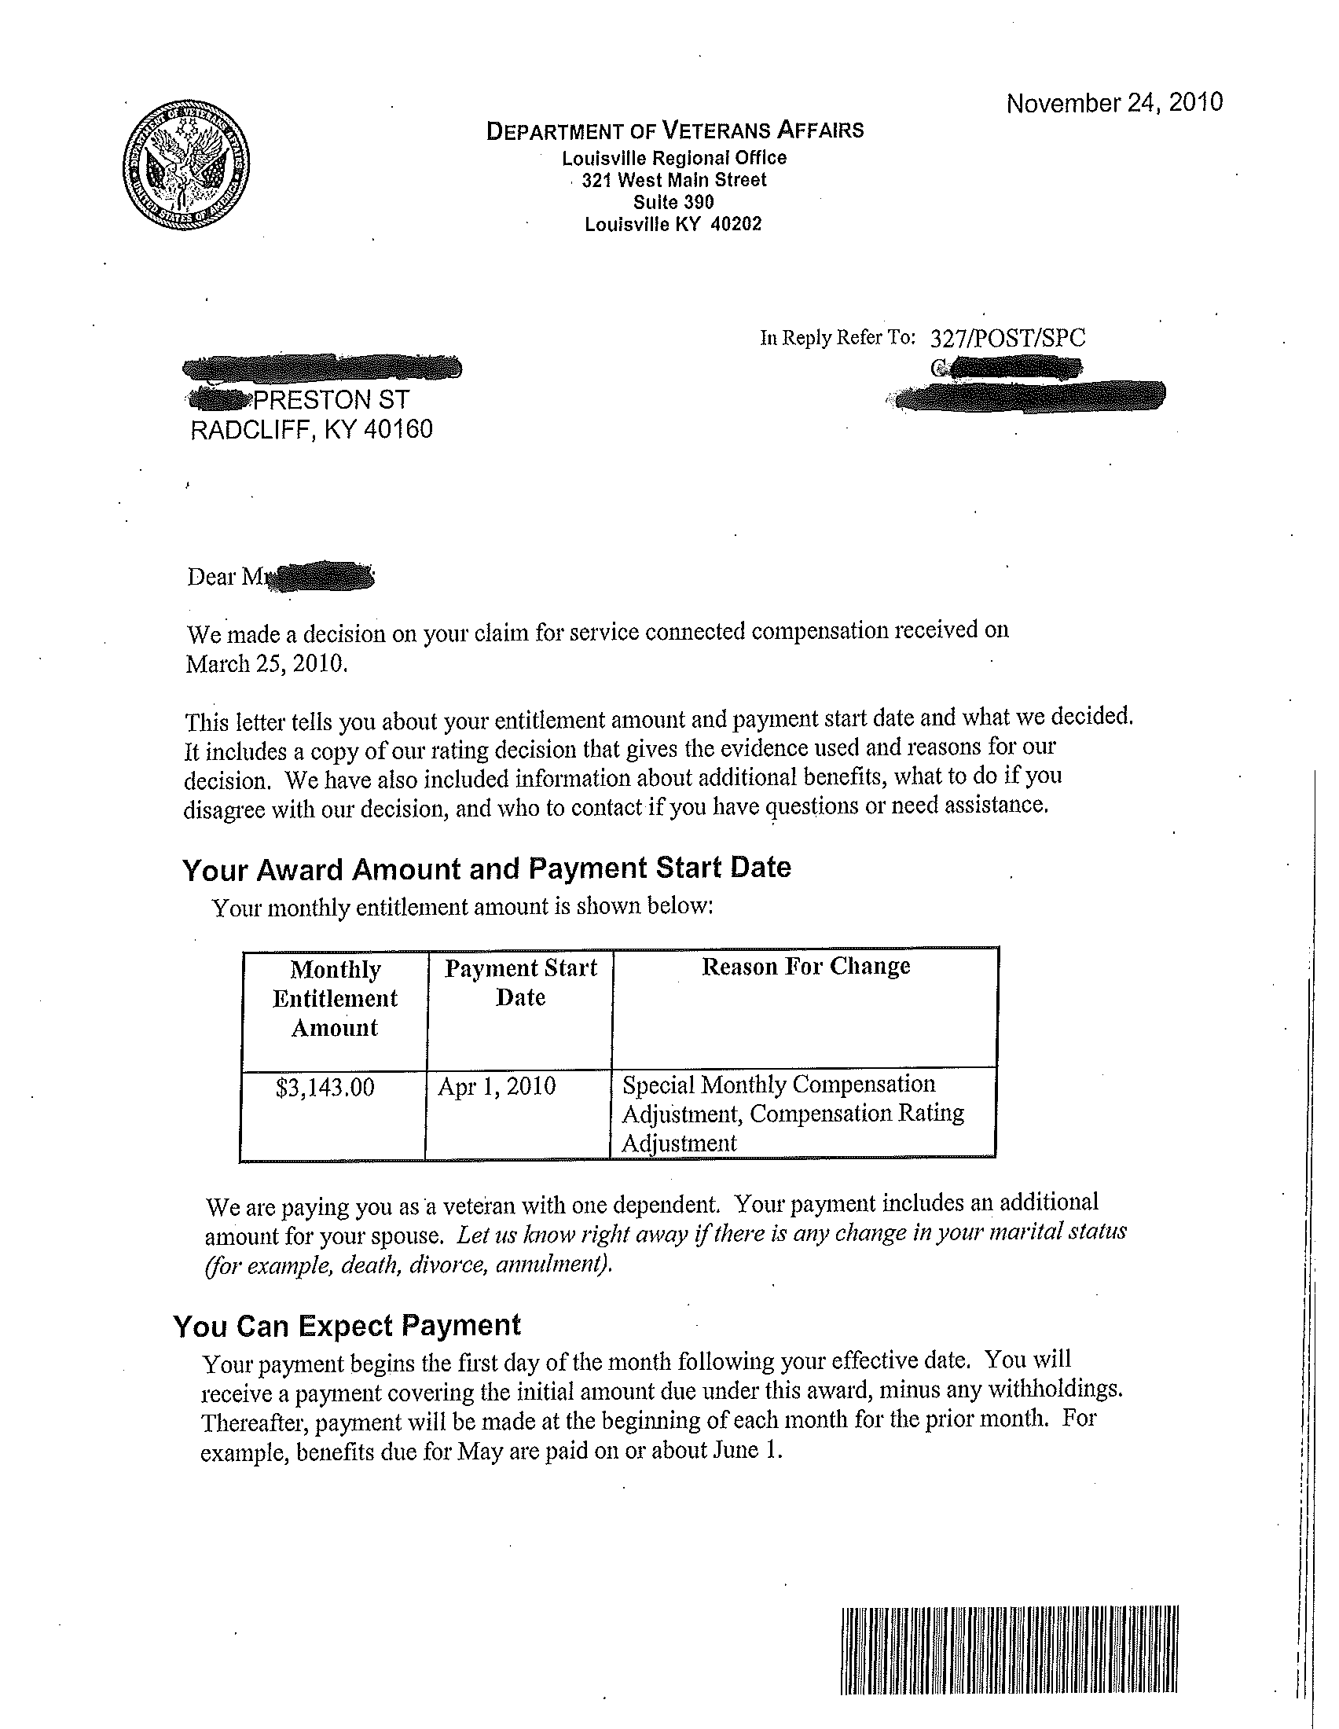
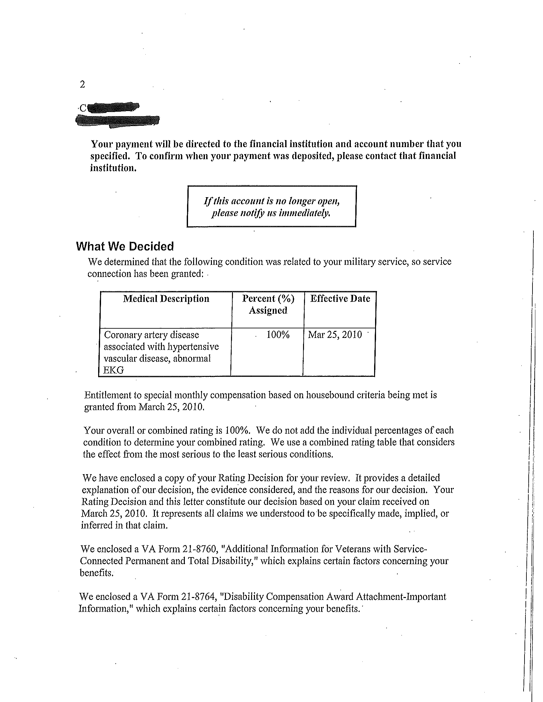
100% Notification Letter
Rating percentage

Slide 9
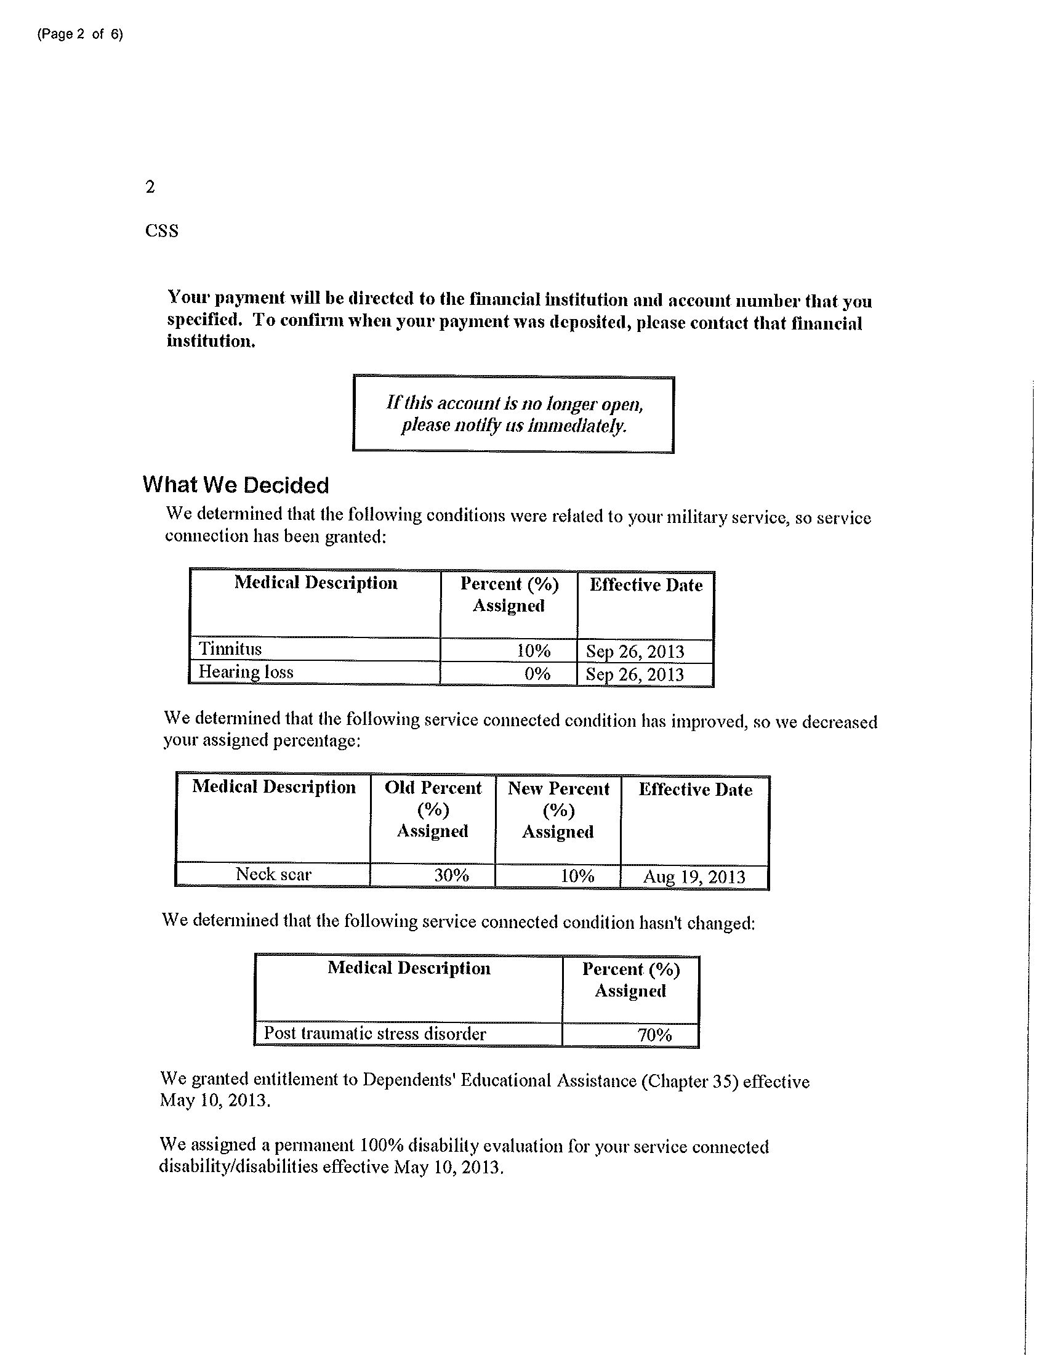
100% Permanent Notification Letter
Permanent Rating

Slide 10
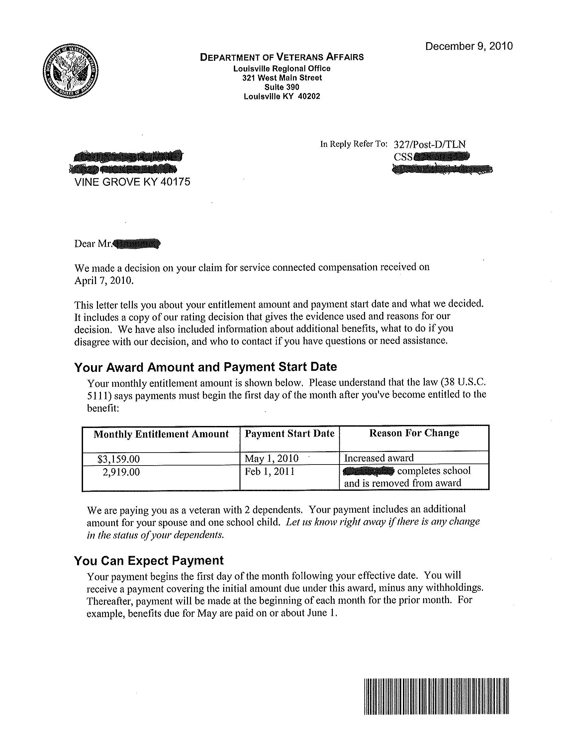
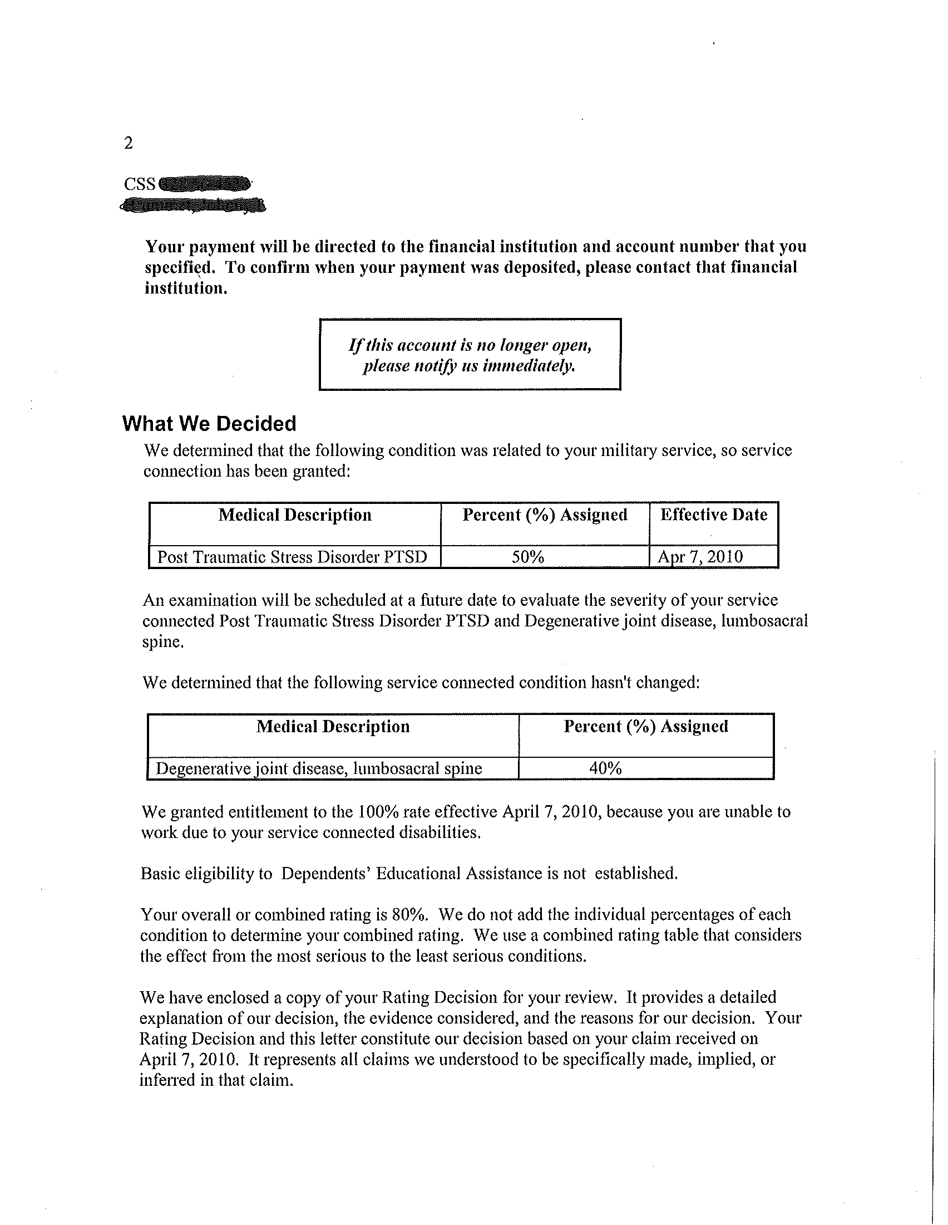
Individual Unemployablity
100% entitlement

Slide 11
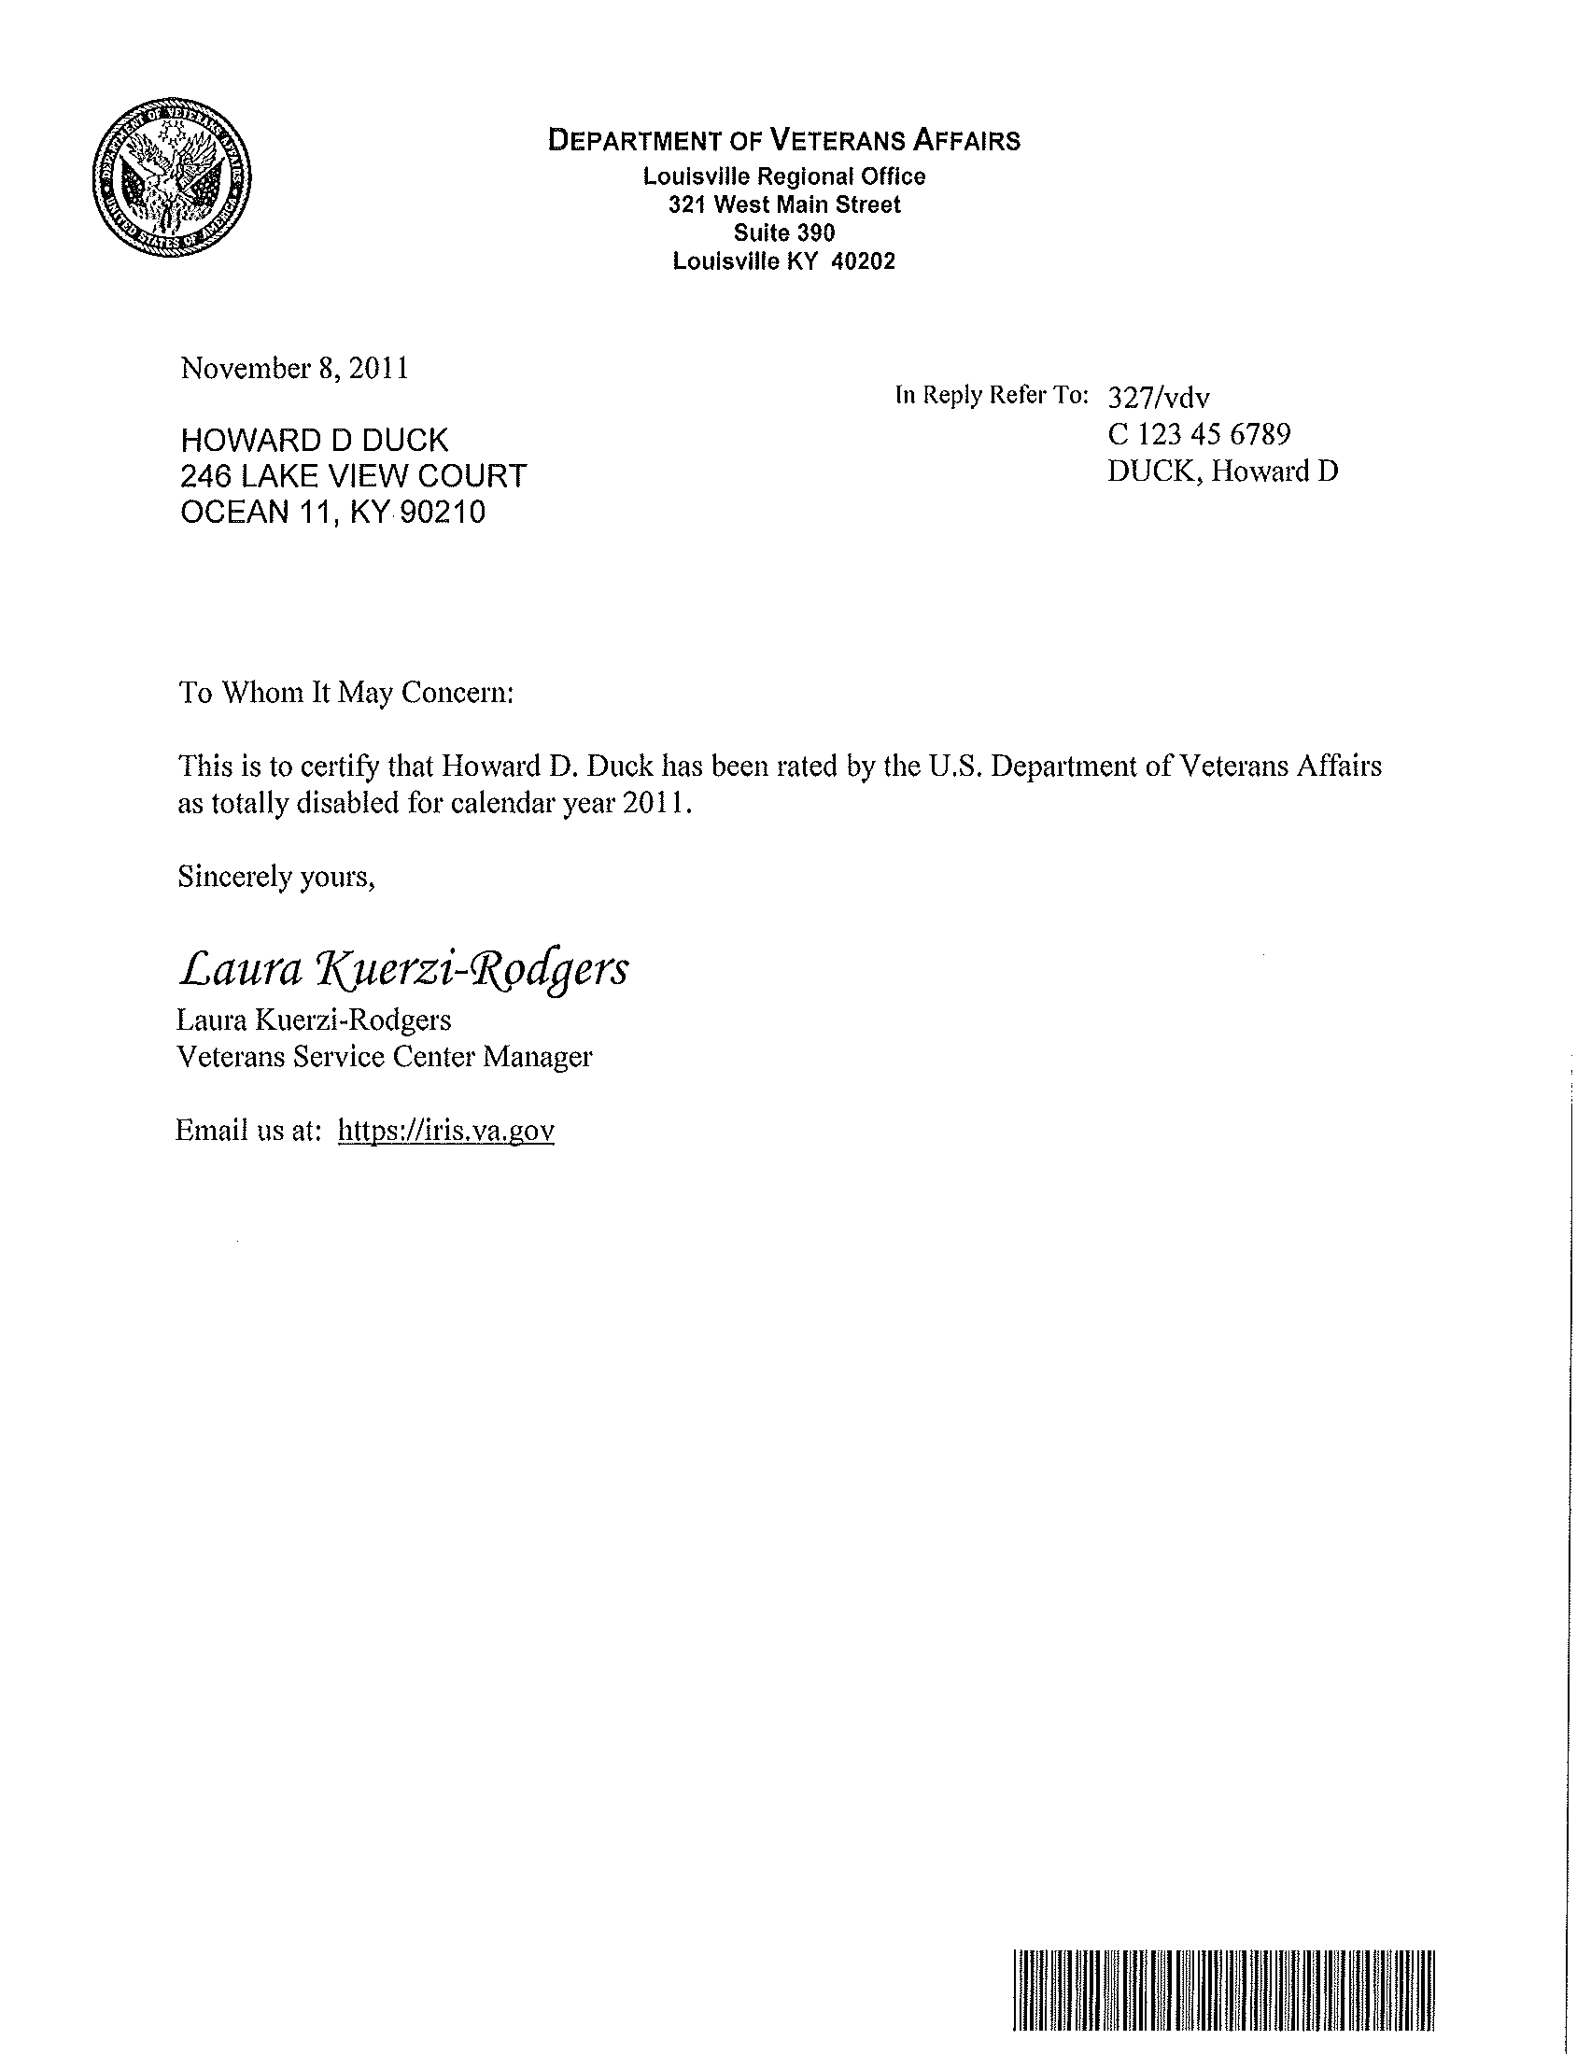
VA Award Example Letter
VA letterhead
Service Center
Manager’s Signature
VA Email Address
VA Barcode

Slide 12
Application for Exemption
•
Form 62A350 (3-16)
•The application form can be found at 62A350.pdf (ky.gov)

Slide 13
Helpful Links
https://revenue.ky.gov/Property/Residential-Farm-Commercial-Property/Pages/Homestead-Exemption.asp
• Homestead Exemption - Department of Revenue (ky.gov)
62A350.pdf (ky.gov)

Slide 14
Point of Contacts
www.veterans.ky.gov – KDVA
1-800-827-1000 – VA Hotline
Email: Donald.walbert@ky.gov

Slide 15
Questions?

