Slide 1
Utility Scale Solar
REVIEW & UPDATE
Office of Property Valuation
Department of Revenue December 8, 2022

Slide 2
The new challenges faced with…
UTILITY-SCALE SOLAR PROPERTY
ASSESSMENTS ??

Slide 3
P.V.A.’s Role – Commercial Solar
Once construction begins, land classification changes from Agricultural to Commercial
Assess all property associated with the project: land, fences, buildings, driveways, etc.
Company must file Tangible Personal Property Return form 62A500 while in construction

Slide 4
P.V.A.’s Role – Commercial Solar…continued
Each project must be reviewed on an individual basis
Obtain copy of Leases per solar project
In the event of an IRB, the project may be treated differently
When the Solar Farm (Company) goes online and selling electricity, the property MUST BE IDENTIFIED on the Tax Roll as (ie. Franchise, Exempt Other, etc.). Property will then be centrally assessed as a Public Service Company

Slide 6
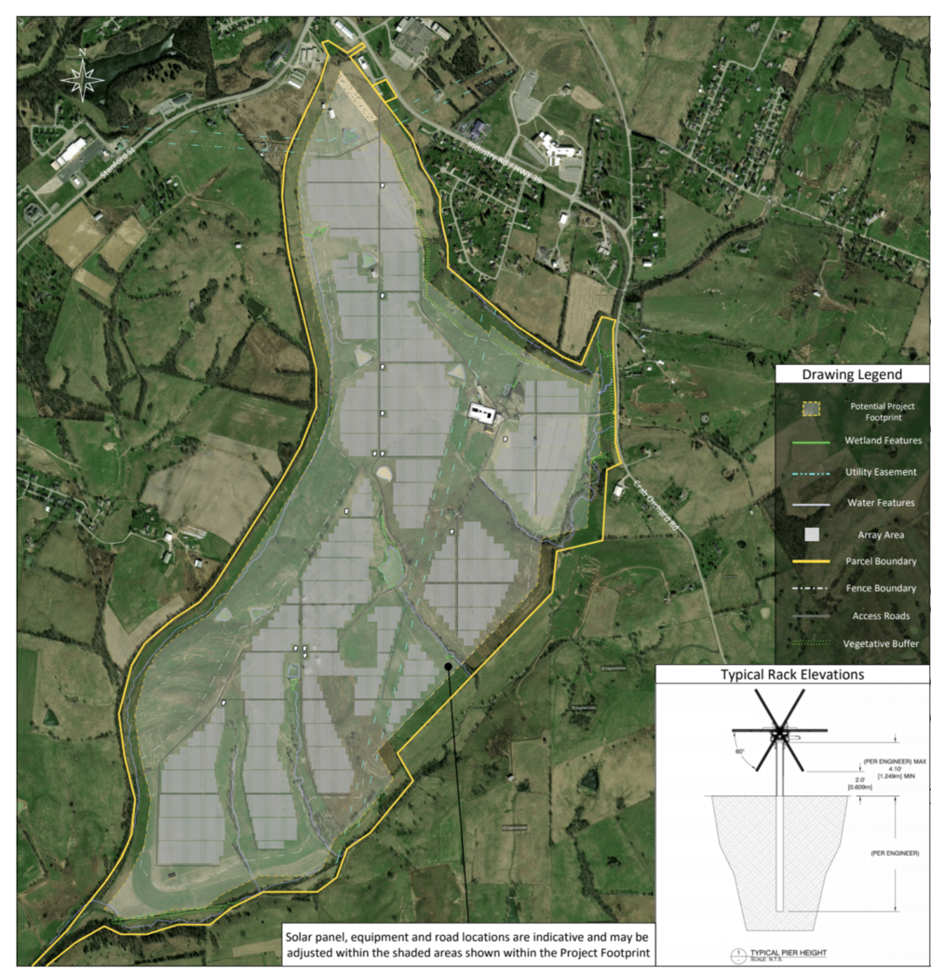
Turkey Creek Solar Farm-Carolina Solar Energy Lancaster, Kentucky – Garrard County

Slide 7
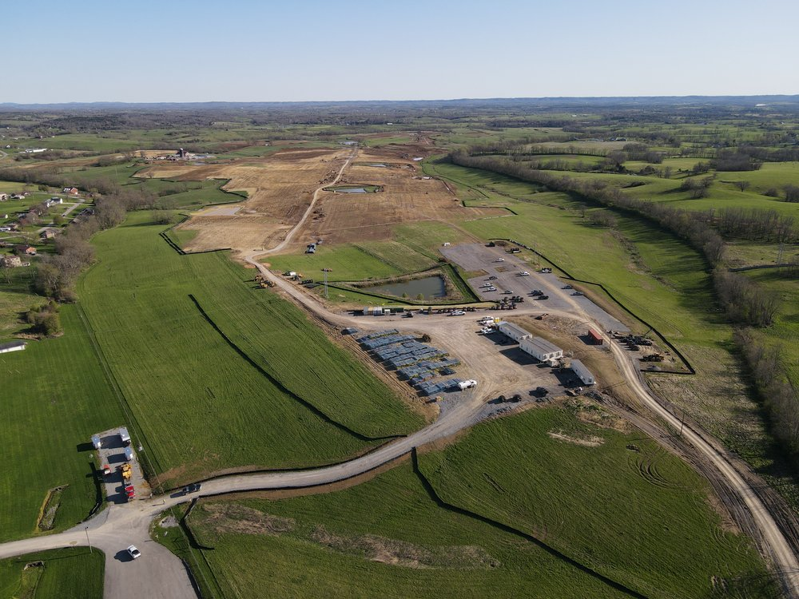
Turkey Creek Solar Farm-Carolina Solar Energy Lancaster, Kentucky – Garrard County (Beginning Construction)

Slide 8
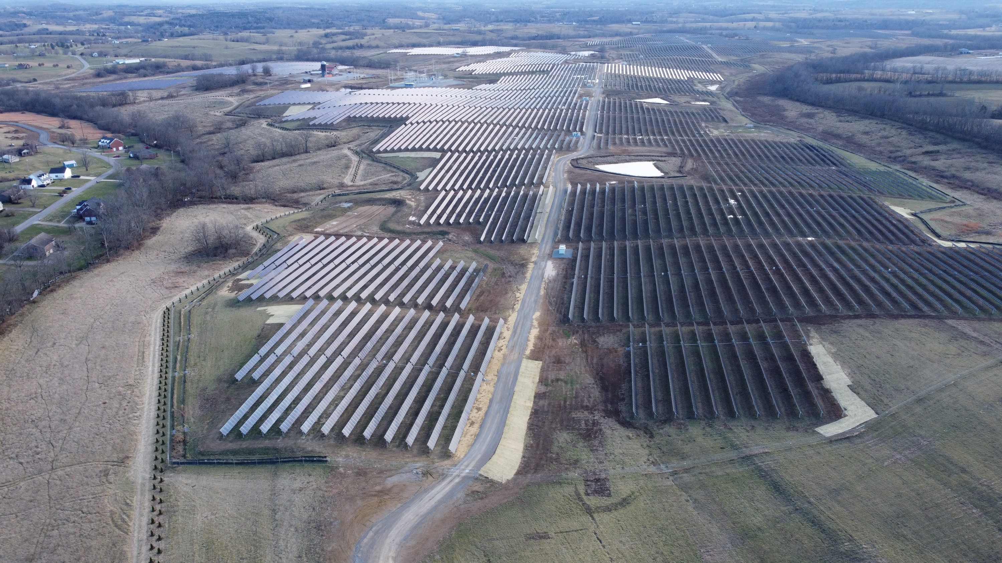
Turkey Creek Solar Farm-Carolina Solar Energy Lancaster, Kentucky – Garrard County

Slide 9
Kentucky Technical Advice Memorandum April 22,2021
KY-TAM-21-01
How does Kentucky ad valorem tax apply to solar power companies and common machinery and other equipment used in generating solar power?
How does Kentucky sales and use tax apply to common machinery and other equipment used in generating solar power
https://revenue.ky.gov/TaxProfessionals/Pages/Guidance-Library.aspx

Slide 10
LEXOLOGY Frost Brown Todd LLC – Mark F. Sommer, Daniel G. Mudd and Elizabeth D. Mosley April 30, 2021
Article summarizing TAM-21-01
Possible misinterpretation by Residential & Commercial (private solar) Taxpayers
Reference article https://www.lexology.com/library/detail.aspx?g=404b2c6b-29ff-44ef-ae71-1be44db3349a

Slide 11
Local Tax Incentives
Excerpt from Cabinet for Economic Development fact sheet on IRBs:
“Communities may negotiate for payments by industrial tenants to replace portions of local property taxes lost through public title to property. These agreements are commonly referred to as Payment in Lieu of Tax (PILOT) agreements.”
According to Commissioner Katie Smith of the Cabinet for Economic Development, local tax incentives can be granted without approval of the Cabinet. If a company wishes to receive State tax incentives or an IRB through the State, they must complete application and seek approval through the Cabinet.
For the complete fact sheet on IRBs, see https://ced.ky.gov/kyedc/pdfs/irb.pdf

Slide 12
Tax Exempt? Purchase vs. Lease?
103.285 Property acquired under KRS 103.200 to 103.280 exempt from taxation.
All properties, both real and personal, which a city or county may acquire to be rented or leased to an industrial concern according to KRS 103.200 to 103.280, shall be exempt from taxation to the same extent as other public property used for public purposes, as long as the property is owned by the city or county.
History: Amended 1962 Ky. Acts ch. 268, sec. 9. -- Created 1960 Ky. Acts ch. 78, sec. 1.

Slide 13
Summary of References
https://ced.ky.gov/kyedc/pdfs/KBIFactSheet.pdf?15
https://ced.ky.gov/kyedc/pdfs/keia.pdf?15
https://ced.ky.gov/kyedc/pdfs/irb.pdf
https://ced.ky.gov/kyedc/pdfs/irbprocedures.pdf?90
Also reference KRS 154.32-020 – Incentives to induce location of economic development projects in the Commonwealth. https://apps.legislature.ky.gov/law/statutes/statute.aspx?id=48552

Slide 14
Questions of Interest
Can Utility Scale Solar companies receive state tax incentives and/or IRBs, and if so, what are the qualifications?
ANSWER: YES, if qualifications are met.
Can Utility Scale Solar companies receive local tax incentives and/or IRBs without approval from the Cabinet for Economic Development?
ANSWER: YES
3. Was the land purchased or leased?
ANSWER: Depending on how the land was acquired will impact valuation and IRB status.

Slide 15
QUESTIONS
For additional questions or information, please call or email:
Robert Carbin, Business Appraiser Branch Manager, Office of Property Valuation PH: (502) 564-7148 EMAIL: Robert.Carbin@ky.gov
David Best, Local Officials Compliance Branch Manager, Office of Property Valuation PH: (502) 564-7139 EMAIL: David.Best@ky.gov
For companies with questions concerning State IRBs or tax incentives on solar projects, direct them to:
Andy Luttner, Business Development Specialist, Kentucky Cabinet for Economic Development Email: andy.luttner@ky.gov, PH: (502) 564-7670 –main phone line to C.E.D.

Slide 16
Disclaimer
The information in this presentation is for educational and informational purposes only and does not constitute legal advice. Information is presented as an overall review that is subject to law changes and may not apply to all states. For accurate information on issues related to this presentation, please reference KRS 136.120.
Information in this presentation is believed to be accurate as of the date of publication. In the event that any information in this presentation is later determined to be in error, this presentation cannot be used by taxpayers in supporting a specific position or issue before the Department of Revenue, as it does not have the statutory or regulatory authority.
Presentation Date: December 08, 2022

