Slide 1
KAVIS Training and Engagement Update
By: Krista Taylor

Slide 2
Agenda
KAVIS Project Update
What does PVA/DOR training look like?
Overview of what we will cover in PVA/DOR training
Training Timeline/Dates

Slide 3
Kavis
Project Timeline
Training
Continuous Education/Training
Clerk/User Training
NMVTIS
NMVTIS
Data
Phase 1 Certification
Phase 2 Integration
Data Migration
NMVTIS
Open Lab
AAMVA Testing
UAT
UAT
Incremental testing
Incremental testing
Solution testing
Development Effort
Performance Testing
Load/Performance
Go-Live
Analysis, Design, Develop, Deliver
Turn off AVIS
Incremental delivery for user acceptance and testing
Dec 2023
May
July
September
November
April
June
August
October
December
Notes:
Phased rollout-
Week of go-live:
All counties will be closed for all, some or none of the week based on their appetite for adoption.
Mail In Pilot: Process Mail in work on Saturday/Sunday
1st wave: Controlled group opens on Monday. This is Jefferson County offices.
2nd Wave: 10-20 offices open on Tuesday
3rd Wave: 20-50 offices open on Wednesday
4th wave: 20-30 offices open on Thursday
5th wave: remaining offices open on Friday
Details grouping will be based on feedback from clerks regarding their adoption plan (Early/Late adopters)

Slide 4
What Does PVA/DOR Training Look Like?
We will offer a 3-hour virtual class on Microsoft Teams/Instructional Videos.
Training will consist of KAVIS functionality that will be new to PVAs/DOR and is different from what is currently used for boats.
The end of the class will be used to ensure that everyone has access to the KAVIS Test Environment which can be used for practice and open labs.
We will offer practice scenarios, open labs, and a PVA/DOR –specific KAVIS manual.

Slide 5
What We Will Cover:
Tax Assignment Queue Overview.
Creating Tax Segments
PVA Ad Valorem Actions
PVA Override Reports/All Other Reports.

Slide 6
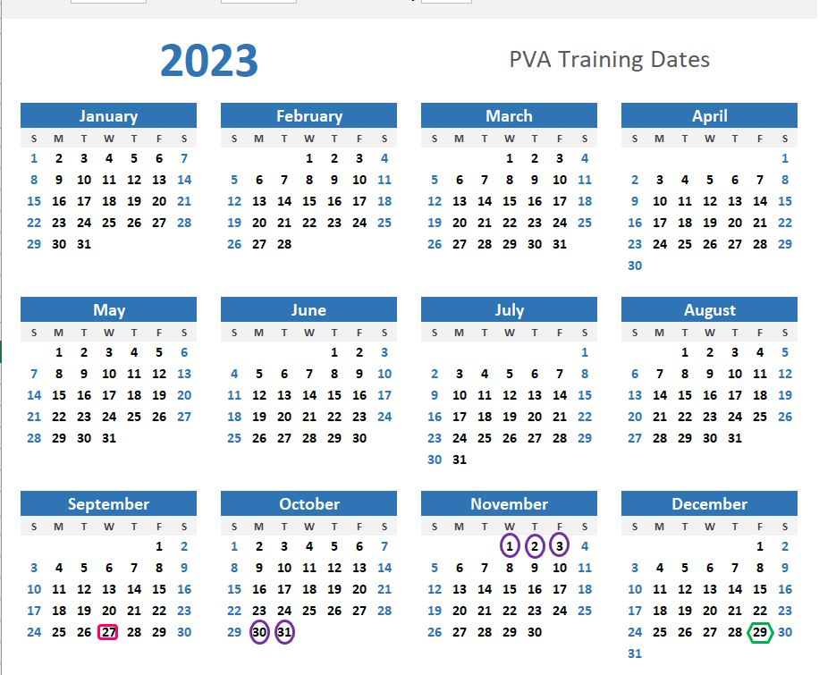
Training Timeline/Dates (subject to change)
Virtual Training Class
PVA Open Lab Opportunities
PVA Manual Release

Slide 7
Thank you!
Thank you for your time and patience as we get KAVIS ready to go live :)
Please reach out to KAVIS@ky.gov with any questions or concerns.

