Slide 1
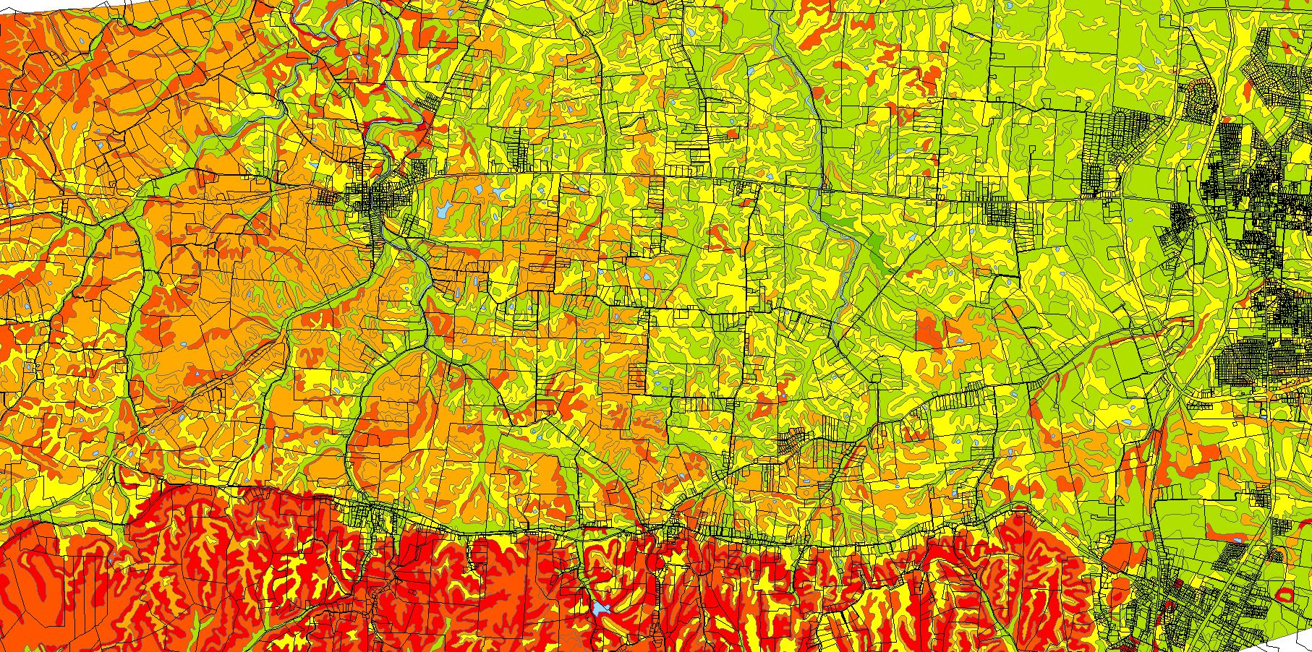
GIS & AgValues
Let’s save about 2-5 years

Slide 2
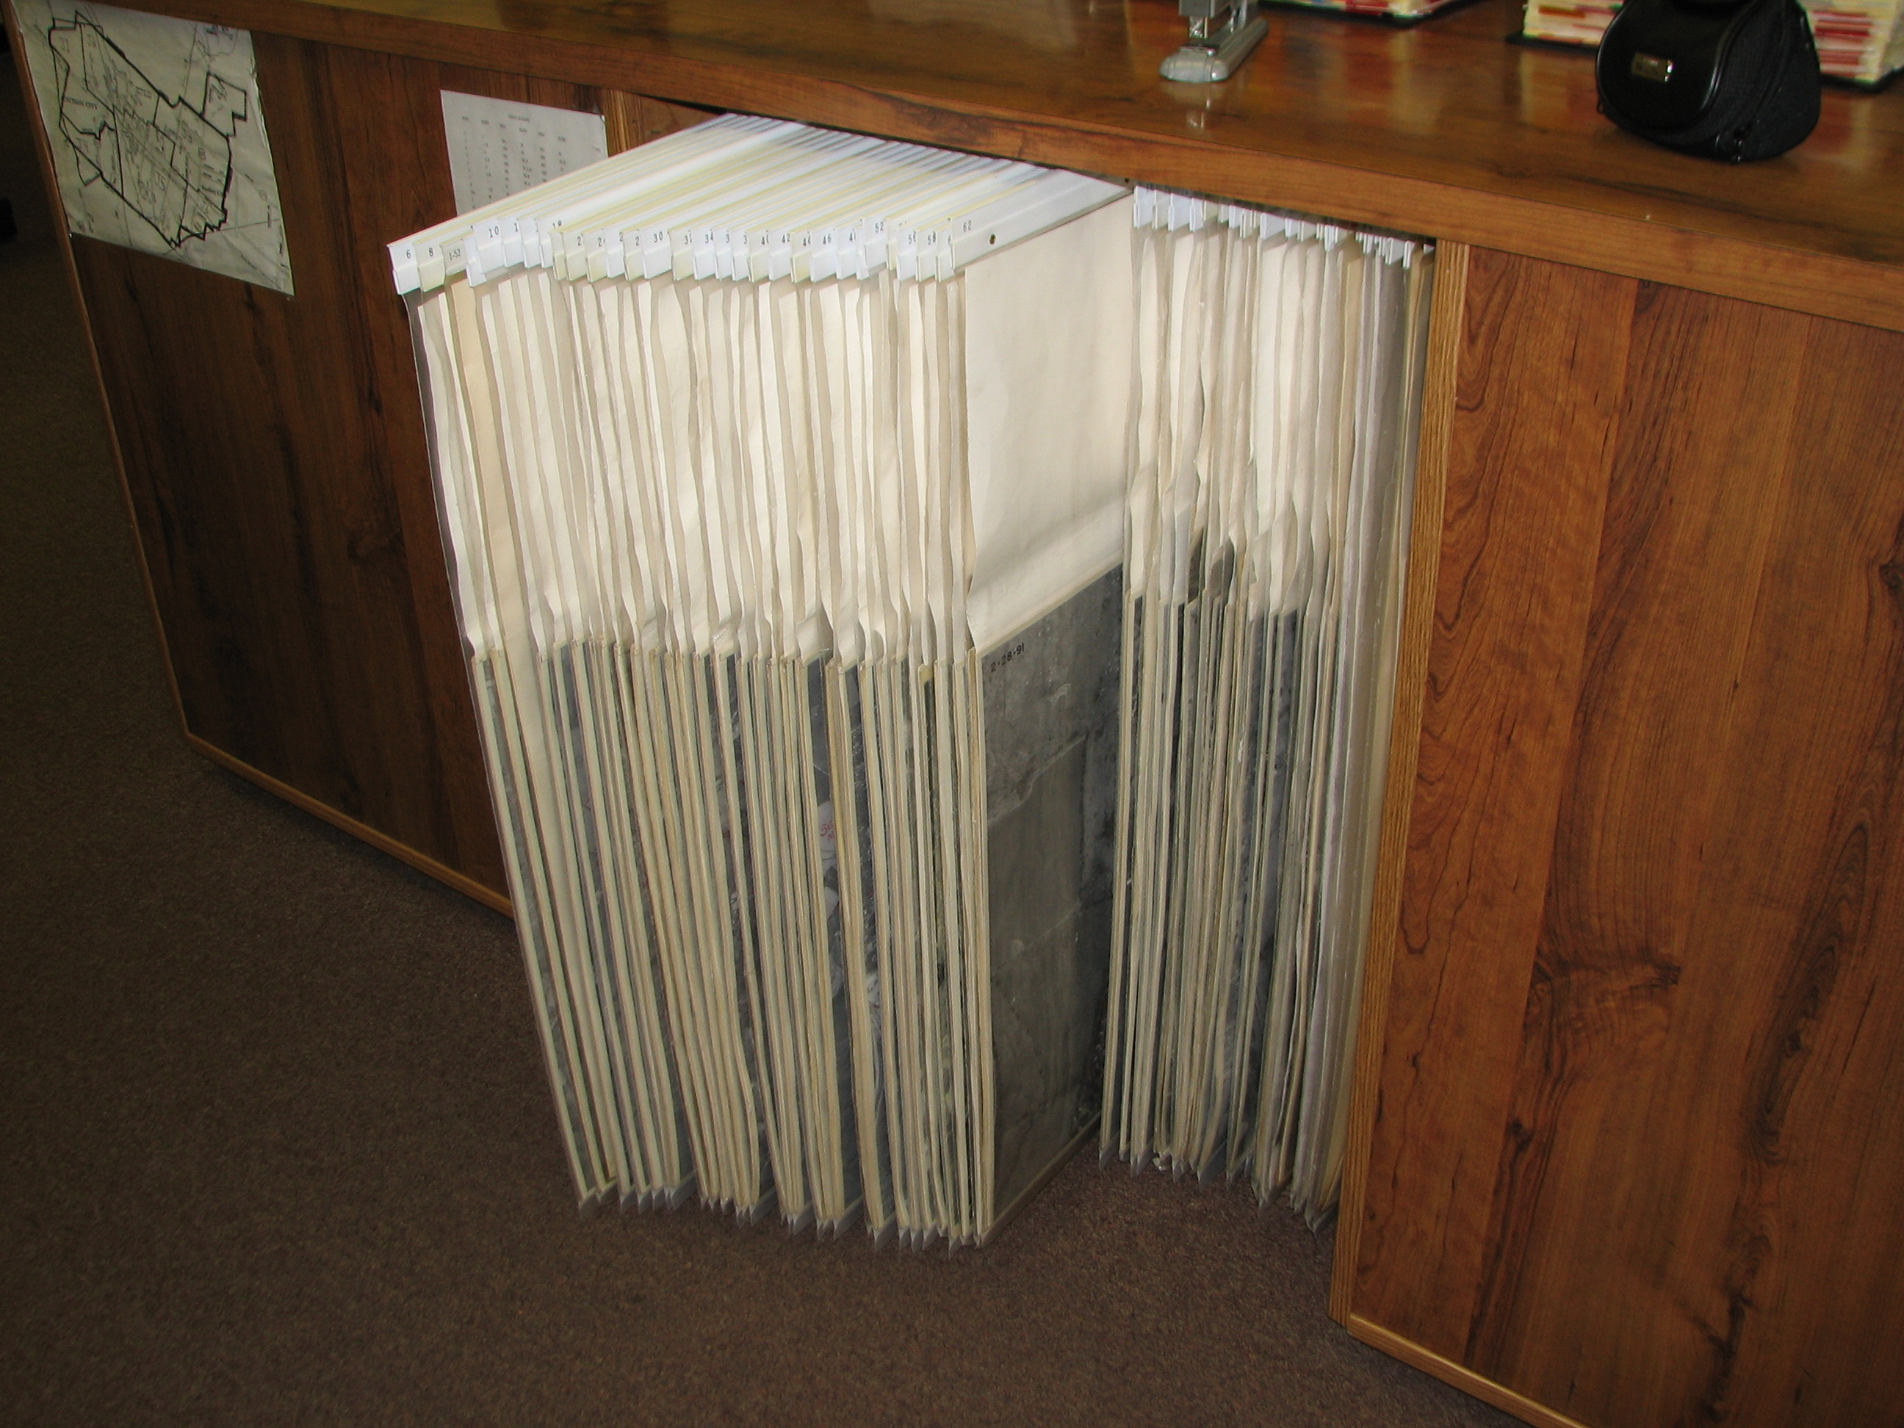
Until 1999, Parcel maps were only in three forms:
Black & White aerial photos, mylar, or Blue Lines

Slide 3
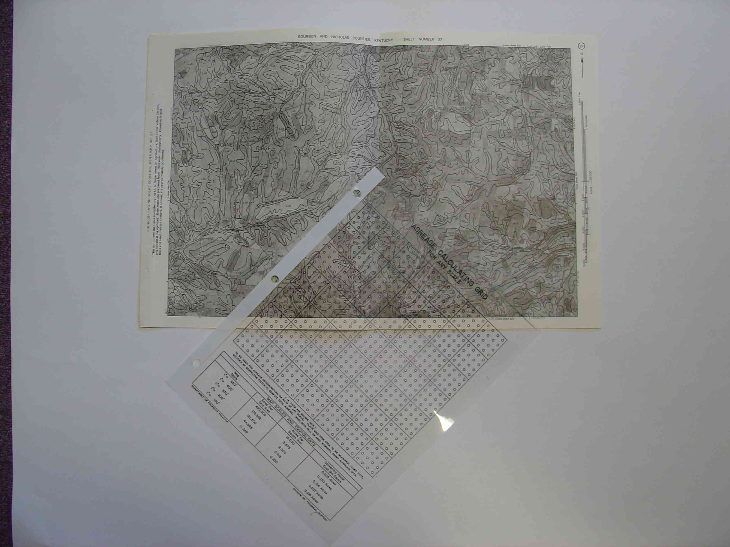
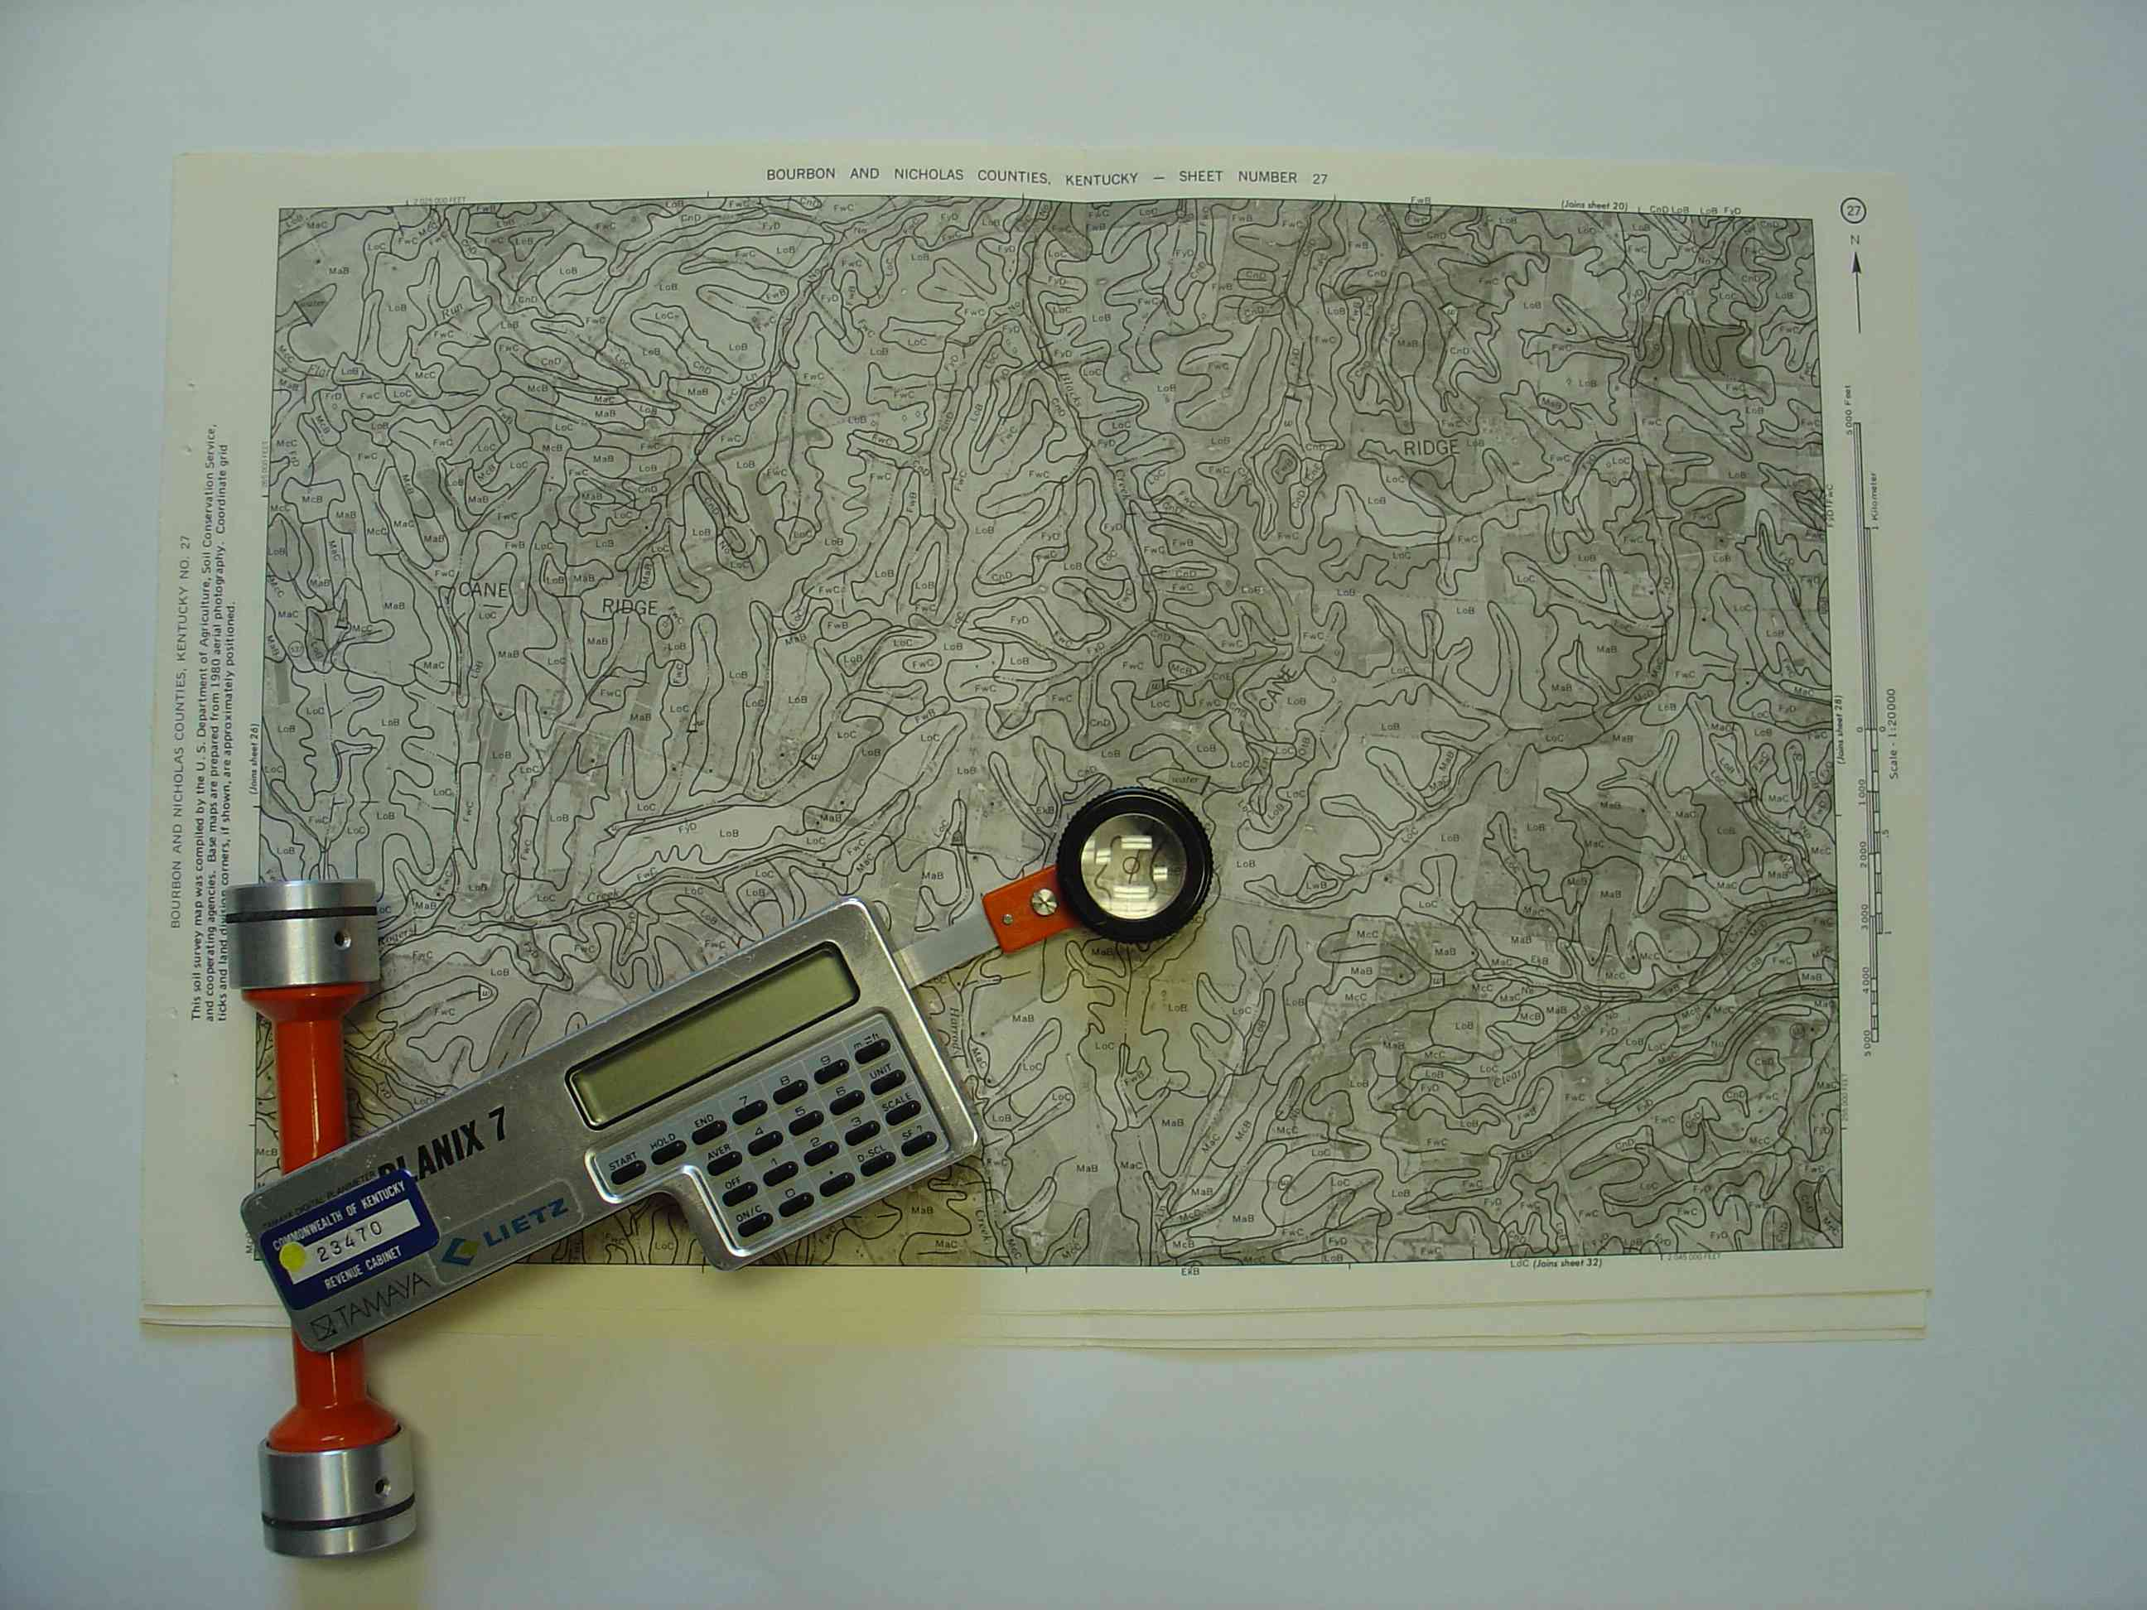
Soils values are done with USDA GIS SURGO Soils instead of Dot Grid Maps & a PLANIMETER
This process would take around two to five years.

Slide 4
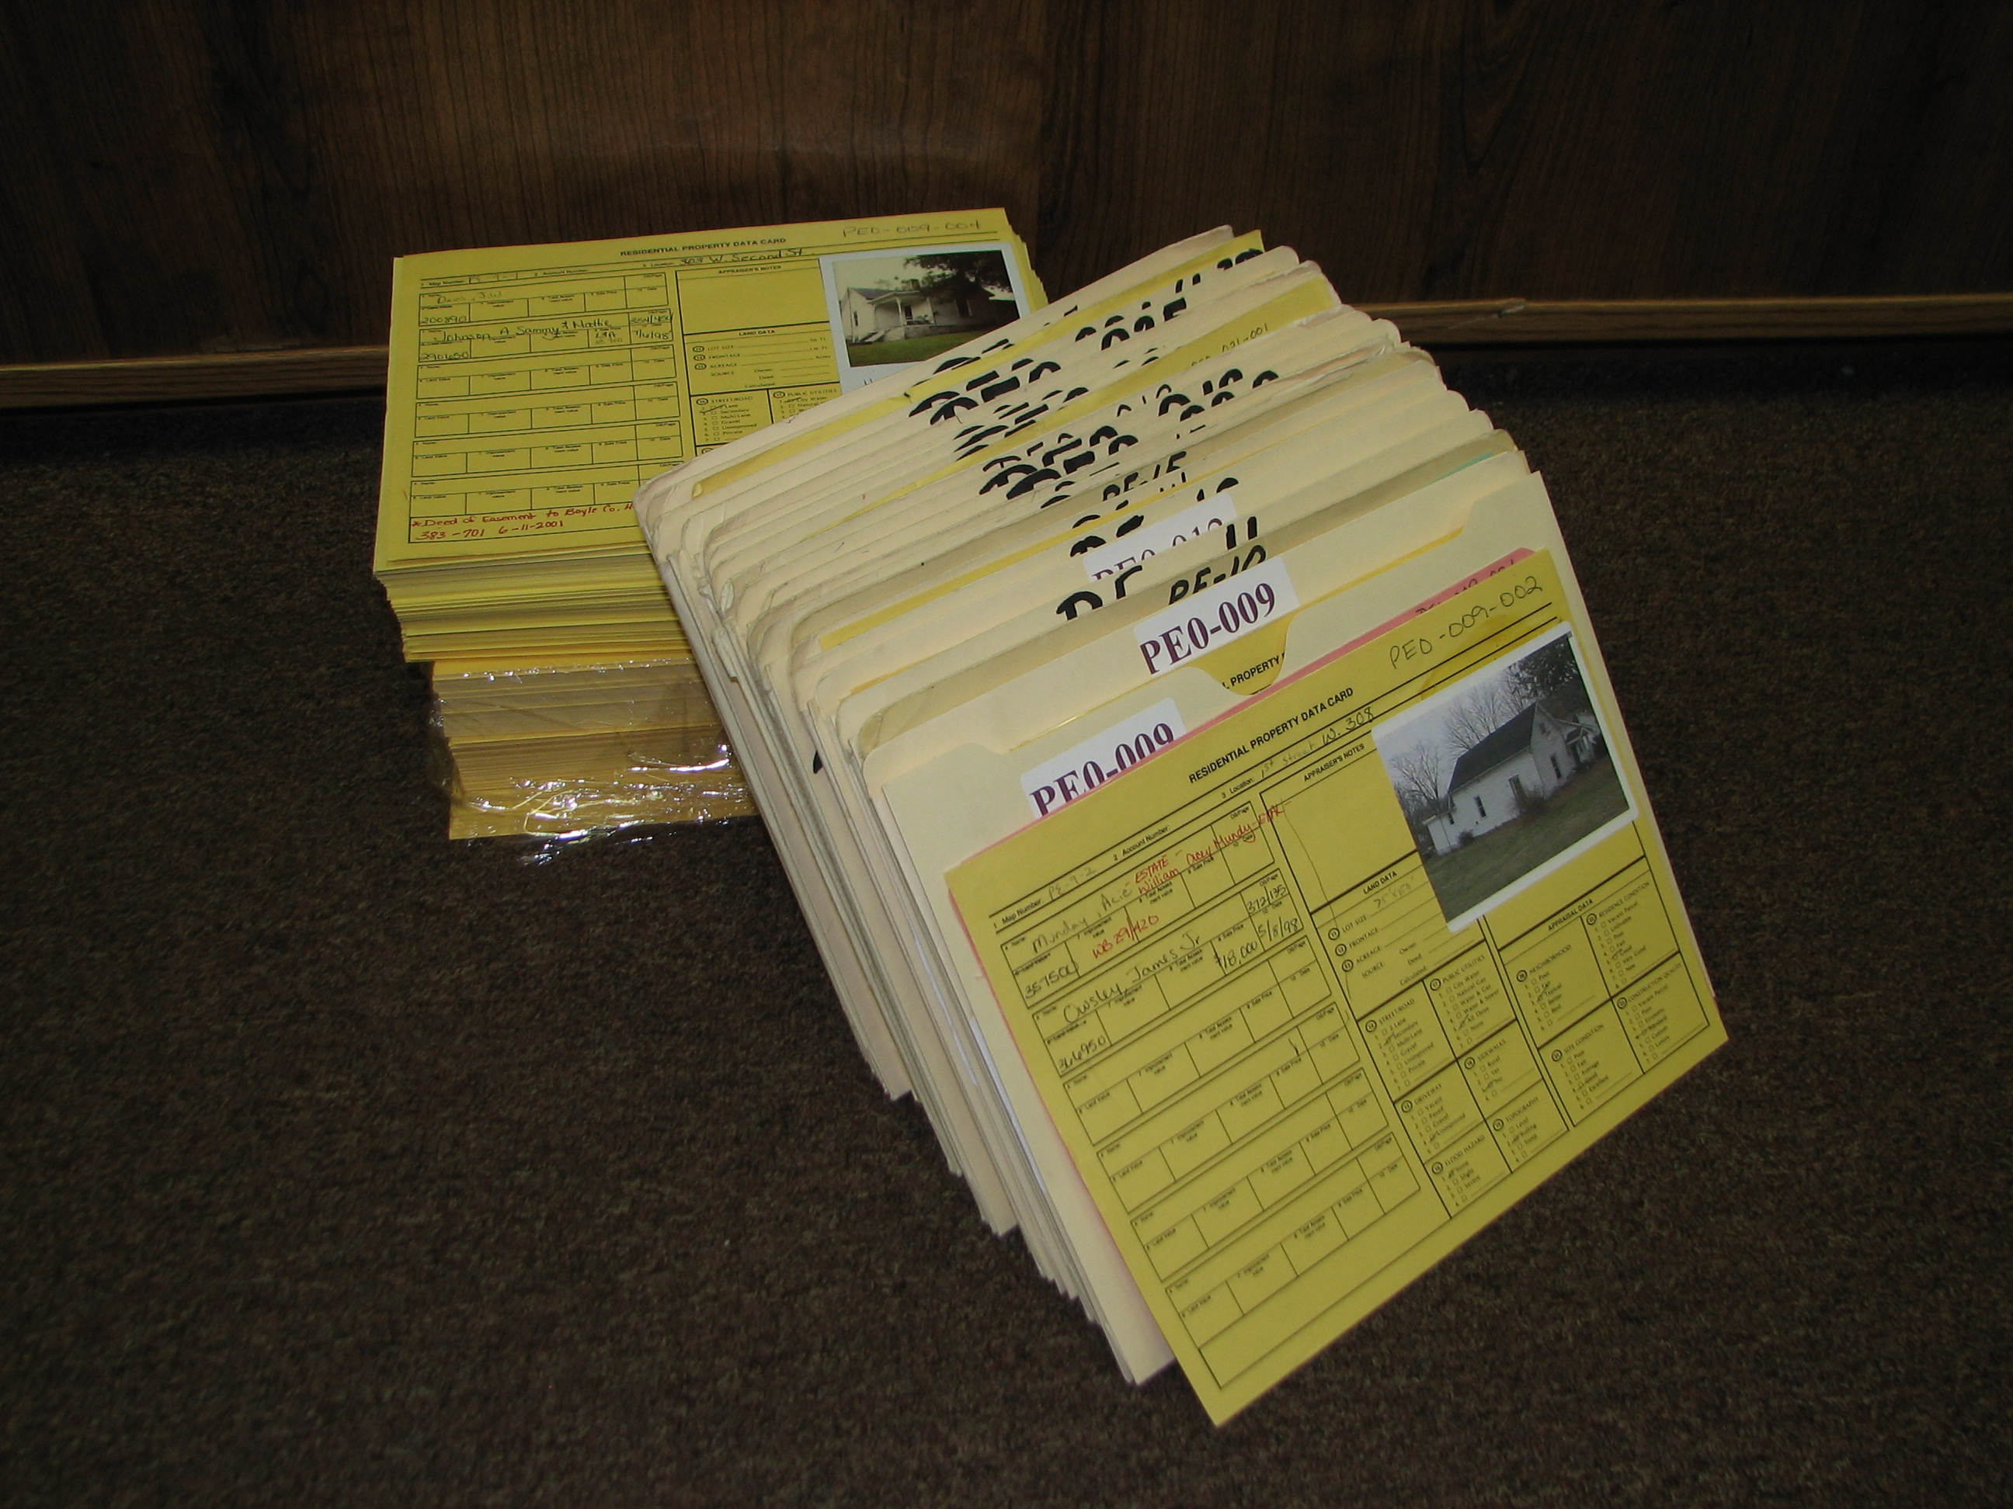
Soil measurements would be transferred from maps to PVA cards and in tax roll system (TRIM)

Slide 5
GIS & AgValues
At first, GIS Could process most counties in under 2 hours
GIS can now process soils in under 15 minutes

Slide 7
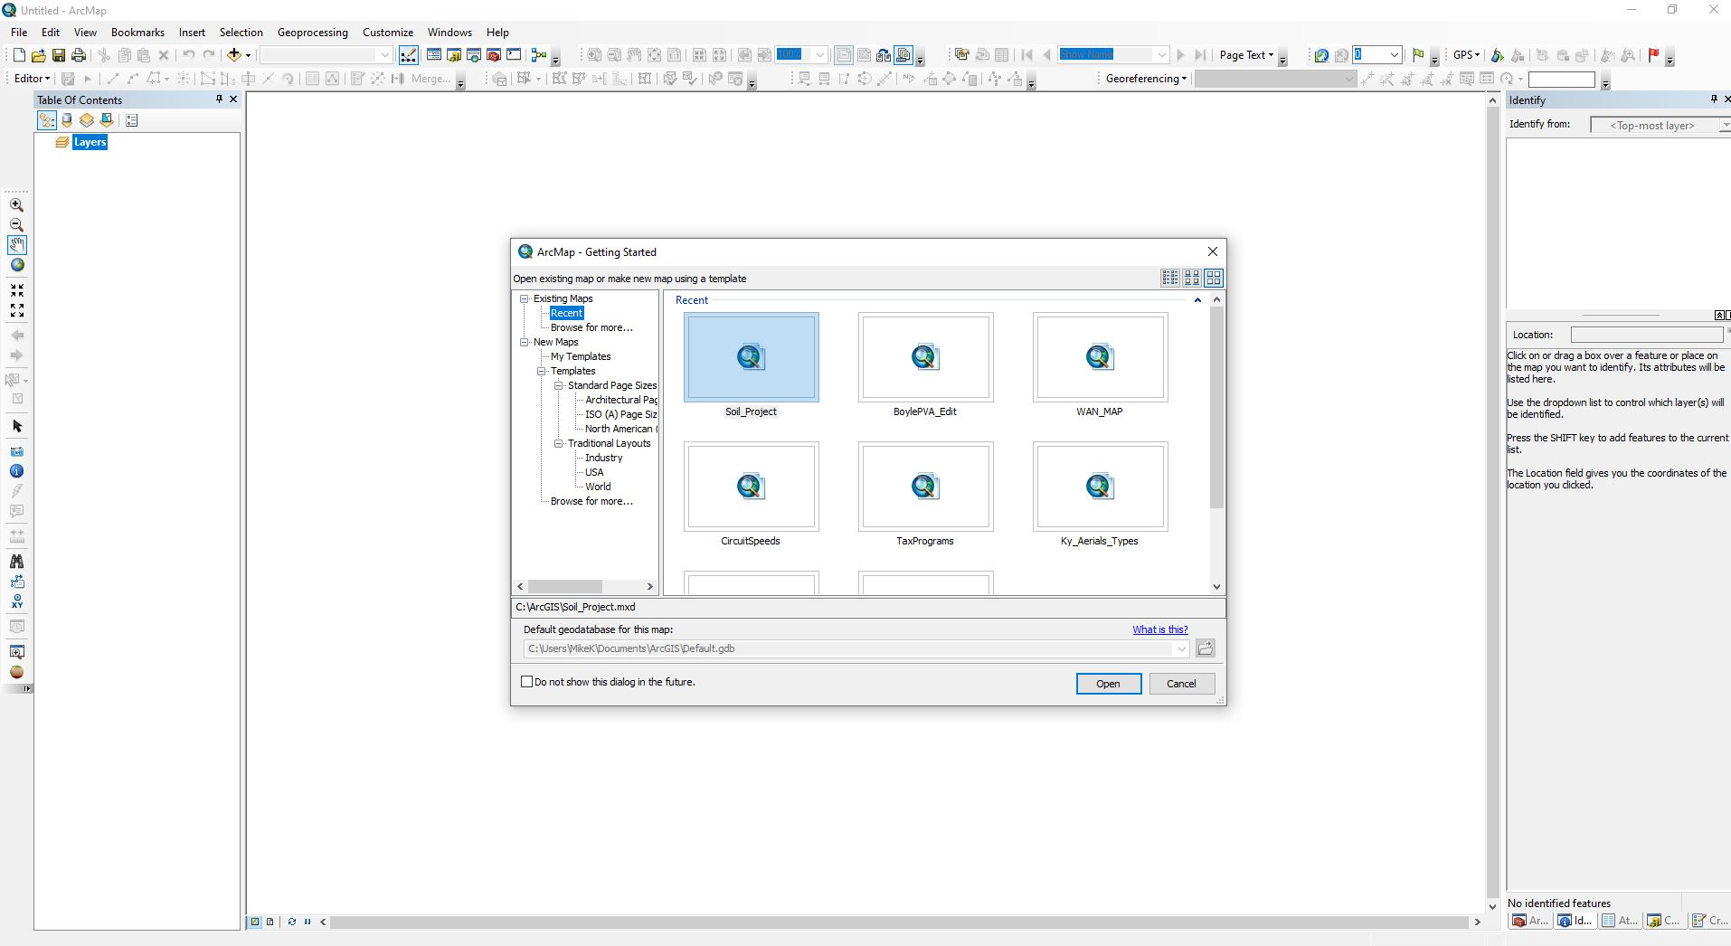

Slide 14
Soil
Classification
tool

Slide 16
At first, and the first minute

Slide 17
After about a minute

Slide 18
After another minute

Slide 19
Click on the Save Soil Assessment Box

Slide 20
K

Slide 40
Right
Click

Slide 42
The End

