Slide 1
Current Assessment Issues 2016
Presented by: Rick Bertelson, Tom Crawford, David Gordon
Topics Include (but are not limited to!):
Farms
KBTA Rulings, OAG Opinions
Kentucky Claims Commission
Property Tax Training for Local Officials
Use of PVA Assessments

Slide 2
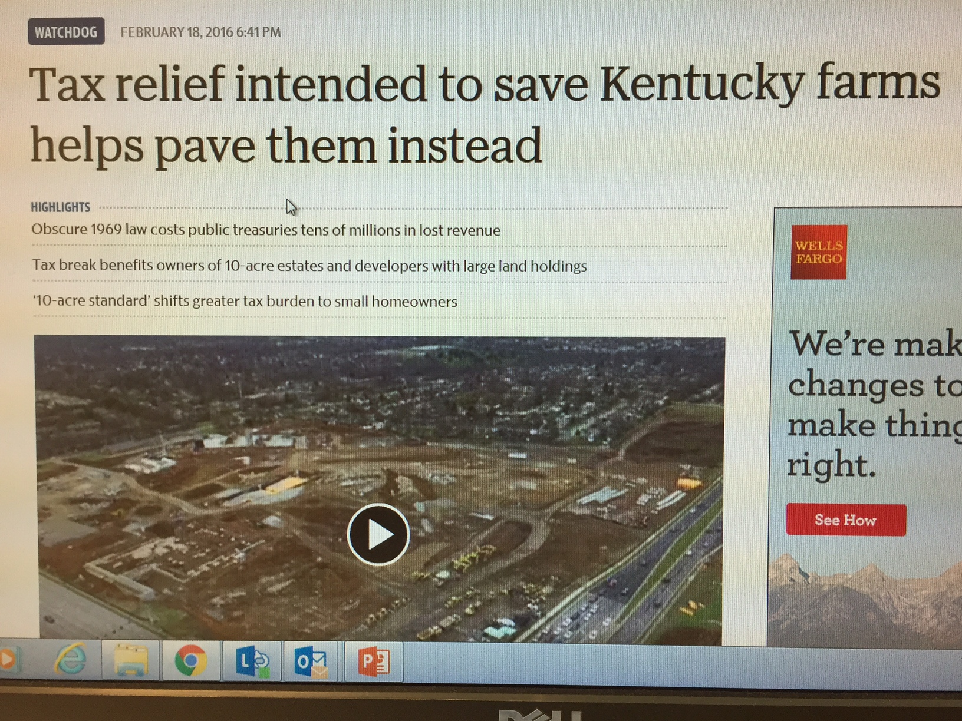

Slide 3
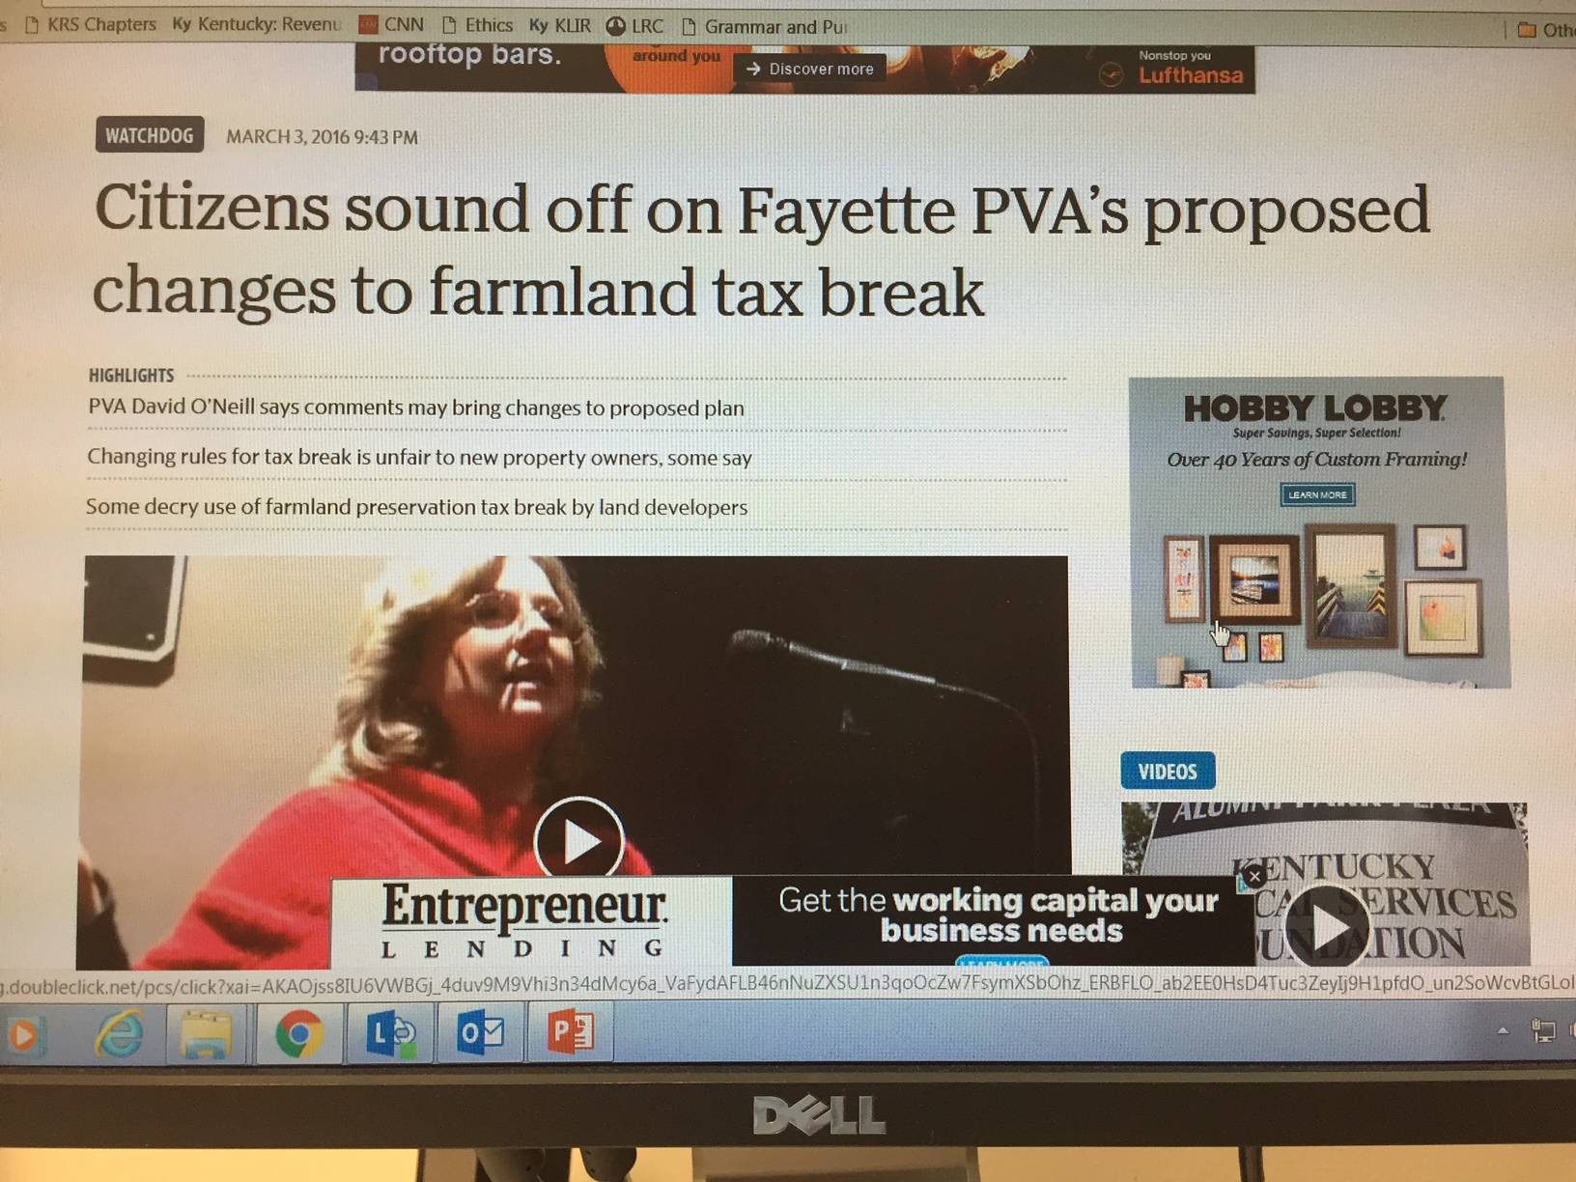

Slide 4
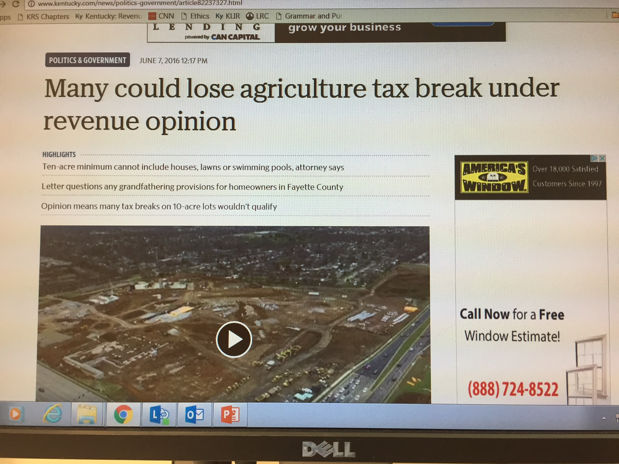

Slide 5
What do KRS 132.010(9) and (10) say?
(9) "Agricultural land" means:
(a) Any tract of land, including all income-producing improvements, of at least ten (10) contiguous acres in area used for the production of livestock, livestock products, poultry, poultry products and/or the growing of tobacco and/or other crops including timber;
(b) Any tract of land, including all income-producing improvements, of at least five (5) contiguous acres in area commercially used for aquaculture; or
(c) Any tract of land devoted to and meeting the requirements and qualifications for payments pursuant to agriculture programs under an agreement with the state or federal government;
(10) "Horticultural land" means any tract of land, including all income-producing improvements, of at least five (5) contiguous acres in area commercially used for the cultivation of a garden, orchard, or the raising of fruits or nuts, vegetables, flowers, or ornamental plants;

Slide 6
KRS Chapter 100, Planning and Zoning
(2) "Agricultural use" means the use of:
(a) A tract of at least five (5) contiguous acres for the production of agricultural or horticultural crops, including but not limited to livestock, livestock products, poultry, poultry products, grain, hay, pastures, soybeans, tobacco, timber, orchard fruits, vegetables, flowers, or ornamental plants, including provision for dwellings for persons and their families who are engaged in the agricultural use on the tract, but not including residential building development for sale or lease to the public;
(b) Regardless of the size of the tract of land used, small farm wineries licensed under KRS 243.155;
(c) A tract of at least five (5) contiguous acres used for the following activities involving horses: …
(d) A tract of land used for the following activities involving horses:
This paragraph shall only apply to acreage that was being used for these activities before July 13, 2004; -KRS 100.011(2)

Slide 7
KBTA Rulings, OAG Opinions

Slide 8
KBTA, Lyvers Living Trust v Washington Co PVA
“The PVA’s assessment is based solely upon the capability of the soil as set forth by the USDA – or, using the words of the statute as set forth above, her valuation was based solely upon ‘(b)the degree of productivity of the soil.’ This soil productivity factor, however, is only one of several factors enumerated in the statute that should be considered when assessing agricultural property.”

Slide 9
(11) "Agricultural or horticultural value" means the use value of "agricultural or horticultural land" based upon income-producing capability and comparable sales of farmland purchased for farm purposes where the price is indicative of farm use value, excluding sales representing purchases for farm expansion, better accessibility, and other factors which inflate the purchase price beyond farm use value, if any, considering the following factors as they affect a taxable unit:
(a) Relative percentages of tillable land, pasture land, and woodland;
(b) Degree of productivity of the soil;
(c) Risk of flooding;
(d) Improvements to and on the land that relate to the production of income;
(e) Row crop capability including allotted crops other than tobacco;
(f) Accessibility to all-weather roads and markets; and
(g) Factors which affect the general agricultural or horticultural economy, such as: interest, price of farm products, cost of farm materials and supplies, labor, or any economic factor which would affect net farm income;

Slide 10
OAG, Use of Digital Imaging Technology
“The use of digital imaging technology by the PVA of a Kentucky county to examine each parcel of taxable real property or interest therein satisfies the requirement under KRS 132.690(1) that each parcel of taxable real property or interest therein be physically examined at least once every four (4) years, so long as such use fairly and equitably assesses property based on its individual physical characteristics.
OAG 16-003, April 29, 2016

Slide 11
OAG, Board of Assessment Appeals as Public Agency
The Bourbon County Board of Assessment Appeals is a local government board that is created pursuant to state statute whose governing body is appointed by a public agency, the Bourbon County Fiscal Court, and two local officers, specifically, the county judge/executive and the mayor. It therefore falls squarely within the definition of the term “public agency.” In the absence of any conflicting legal authority or exclusionary statutory language, we find that the Board of Assessment Appeals is a public agency, as defined in KRS 61.805(2)(a), (d), (e), and (f), and subject to all requirements established in KRS 61.800 to KRS 61.848.
OAG 15-OMD-154, August 12, 2015

Slide 12
OAG, Presence of PVA Office During Deliberations
Summary: Jefferson County board of Assessment Appeals violated KRS 61.8109(1) by not opening all meetings to the public and improperly allowed Property Valuation Administrator to be present during closed deliberations under KRS 61.810(1)(j). OAG 16-OMD-183, August 29, 2016
61.810 Exceptions to open meetings. (1) All meetings of a quorum of the members of any public agency at which any public business is discussed or at which any action is taken by the agency, shall be public meetings, open to the public at all times, except for the following:…
(j) Deliberations of judicial or quasi-judicial bodies regarding individual adjudications or appointments, at which neither the person involved, his representatives, nor any other individual not a member of the agency's governing body or staff is present, but not including any meetings of planning commissions, zoning commissions, or boards of adjustment;

Slide 13
OAG, Training for Local Board of Appeals
Summary: Calloway County Board of Assessment Appeals violated KRS 61.810(1) by excluding members of the public from its hearings and preliminary proceedings.
A county board of assessment appeals has authority under KRS 133.120 to hear appeals from taxpayers in protest of assessments by the PVA. The Board is a public agency for purposes of the Open Meetings Act. 15-OMD-154. …KRS 61.810(1) provides that, in the absence of a listed exception, “[a]ll meetings of a quorum of members of any public agency at which any public business is discussed or at which any action is taken by the agency, shall be public meetings, open to the public at all times.”
OAG, 16-OMD-214, October 4, 2016

Slide 14
Kentucky Claims Commission
Formerly the Kentucky Board of Tax Appeals
Gov. Bevin entered an Executive Order in August to create the Kentucky Claims Commission by combining what were the separate Crime Victims’ Compensation Board, Board of Tax Appeals and Kentucky Board of Claims.
The new commissioners are:
Carlo Wessels of Villa Hills, Kentucky whose term expires Sept. 30, 2017;
Jessica Burke of Stearns, Kentucky whose term expires Sept. 30, 2018; and,
Marcus S. Carey of Sparta, Kentucky whose term expires Sept. 30, 2019. Carey is also appointed to serve as chairperson.
The new Executive Director of the KCC is Patrick Flanery (eff. July 1, 2016).

Slide 15
Other Uses of PVA Assessments
Used for Property Bonds to get someone out of jail.
“Please raise the assessment.”
Used for Medicaid purposes as part of Estate Recovery. (WHAT IS MEDICAID ESTATE RECOVERY? When a person who received Nursing Home or Waiver Services dies, Medicaid will ask the estate to pay back some or all of the amounts paid, on behalf of the deceased, for services. May not have to pay if the total assessed value is $10,000 dollars or less.)
“Please lower the assessment.”
Used for Inheritance Tax purposes.

Slide 16
HB 491, 2015 Session, HB 197, 2016 Session, No Hearings were held.
AN ACT relating to the consideration of the fair market value of property when determining Medicaid eligibility.
Be it enacted by the General Assembly of the Commonwealth of Kentucky: SECTION 1. A NEW SECTION OF KRS 205.510 TO 205.630 IS CREATED TO READ AS FOLLOWS:
If the Department for Medicaid Services considers the fair market value of an applicant's property for purposes of determining eligibility, "fair market value" means:
An estimate of the value of an asset if sold at the prevailing price at the time it was actually transferred, based on:
(a) The gross assessed value of the property as listed by the local property valuation administrator; or
(b) The professional opinion of an independent, licensed appraiser; or
(2) The price brought on the property at a public auction conducted by a licensed auctioneer.

Slide 17
Training for Local Officials
Tax rate training for local jurisdictions
Property Tax Assessment training for County Attorneys

Slide 18
QUESTIONS????

