Slide 1
E911 Service Fee Implementation
2016 PVA Fall Conference
Daniel K. Braun
Campbell County PVA

Slide 2
911 Funding Problem
Funded by a Fee on Landlines ($3 per month at the time)
Number of land lines decreasing each year
Severely Under-funded

Slide 3
KRS 65.760
Authority to Establish 911 Emergency Telephone Service
Provisions and Authority to levy a fee to fund 911 Service

Slide 4
KRS 65.760
65.760 Establishment of 911 emergency telephone service by city, county, or urban-county government -- Funding.
(1) Any city, county, or urban-county government may establish 911 emergency telephone service upon approval of the governing body of the city, county, or urban-county government and may adopt regulations concerning the provision of this service by ordinance.
(2) Any city, county, or urban-county government, or any combination thereof, may with the approval of their governing bodies enter into an interlocal cooperation agreement creating a joint 911 emergency telephone service.
(3) The funds required by a city, county, or urban-county government to establish and operate 911 emergency telephone service, or to participate in joint service with other local governments, may be obtained through the levy of any special tax, license, or fee not in conflict with the Constitution and statutes of this state. The special tax, license, or fee may include a subscriber charge for 911 emergency telephone service that shall be levied on an individual exchange-line basis, limited to a maximum of twenty-five (25) exchange lines per account per government entity. Any private commercial telephone service or owner of a dispersed private telephone system (DPTS) that provides local and 911 emergency service to subscribers for compensation shall collect and remit the subscriber charge to the local government on the same basis as the primary local exchange carrier, except that this requirement shall not apply to a state agency that currently maintains an independent 911 system with its own public safety answering point. All revenues from a tax or fee expressly levied to fund 911 emergency services shall be expended solely for the establishment, operation, and maintenance of a 911 emergency communications system; this may include expenditures to train communications personnel and to inform the public of the availability and proper use of 911 service.
(4) The governing body may apply for and accept federal moneys and may accept contributions and donations from any source for the purpose of funding 911 emergency telephone service.
(5) Nothing in this section shall preclude other means of establishing or funding a 911 emergency telephone service within any local area or exchange, nor require the operation of such service by any local government.
Effective: July 15, 1998
History: Amended 1998 Ky. Acts ch. 521, sec. 4, effective July 15, 1998. -- Amended 1986 Ky. Acts ch. 114, sec. 1, effective July 15, 1986. -- Created 1984 Ky. Acts ch. 154, sec. 3, effective July 13, 1984.

Slide 5
MAIN PIECE OF ADVICE: COLLECT BY OTHER METHOD
If possible, convince your F.C. to collect through some other entity:
Self-billing
Electric company
Water Company

Slide 6
Fiscal Court Adoption of Fee
Ordinance O-04-13 adopted August 7, 2013
Assessed a $45 per occupied residential and commercial unit fee on each parcel as determined by the PVA (will get into that)
Fee was based upon number of units in the county and the amount of funding needed for the E911 dispatch center to operate
First year gave a 50% discount to owners of rental property
Added to the property tax bills to be collected by Sheriff – reasons behind this decision and alternative methods of collection
Establishment of an appeals board
Class A Misdemeanor
Included in handout

Slide 7
Legal Battle
Greater Cincinnati/N.KY. Apartment Association sued stating the fee was unconstitutional
Campbell Circuit Court Judge Fred A. Stine V ruled in county’s favor
October 29, 2015 Court of Appeals affirmed Judge Stine’s ruling that the fee is an statutorily valid exercise of the F.C.’s authority
Supreme Court of KY denied Apartment Associations request for a hearing, thus affirming the Appeals Court’s decision
The ordinance, as written and implemented, has been deemed legal
Opinion of the court included in the handout

Slide 8
The PVA’s Part:
PVA to determine number of individual commercial & residential units on each parcel
Field work performed by myself and chief deputy over summer 2013
Count store fronts, number of apartments or businesses etc
Difficult to always determine apartments – gas meters, mail boxes, city licenses, conference records, etc. used to determine
Now part of every day field work data collection
Possibility to have F.C. hire workers to collect data if needed
Computer system update to accept # of units – paid by F.C.
Issues, problems, and clarifications on units:
Single family, multi-family, strip malls, churches, gov’t, schools, commercial retail stores, nursing homes, senior living, etc.
Fiscal Court made to give decisions and clarifications
Vacancy credit and appeals of units – F.C. & PVA

Slide 9
Single Family = 1 unit

Slide 10
Farm Residence = 1 unit
Residence on farm is only unit assessed fee – outbuildings do not get fee

Slide 11
Commercial Buildings – 1 fee per commercial or residential unit
5 unit apartment = 5 fees = $235 fee
80 unit senior living center (plus office) – 81 units = $3,645 fee
Strip Mall with 20 store fronts – 20 units = $900 fee
Store front with 2 apartments above – 3 units = $135 fee
Church with parsonage and event hall – 3 units = $135 fee
Nursing home with administration office – 2 units = $90 (F.C. deemed since the rooms are not individual self contained units they did not get assessed fee for each one. Same with college dorms)
Apartment owners furious – led to previously mentioned lawsuit

Slide 12
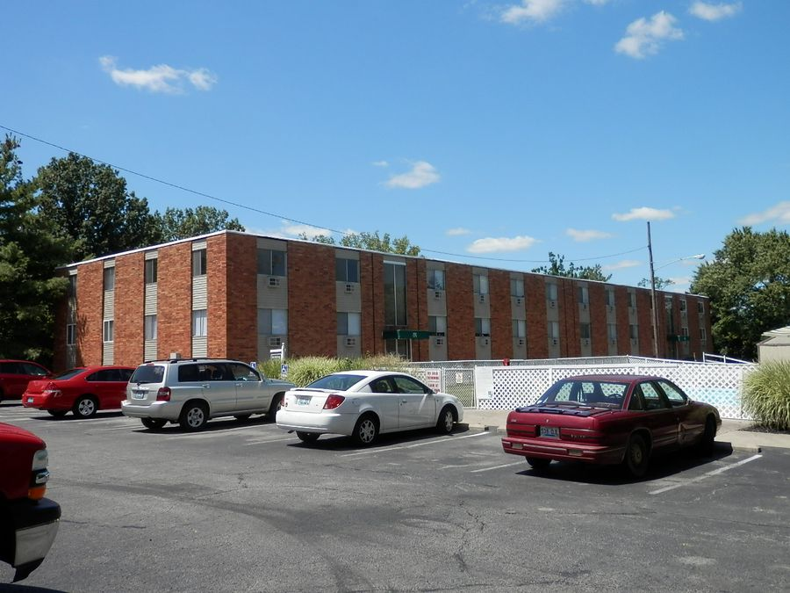
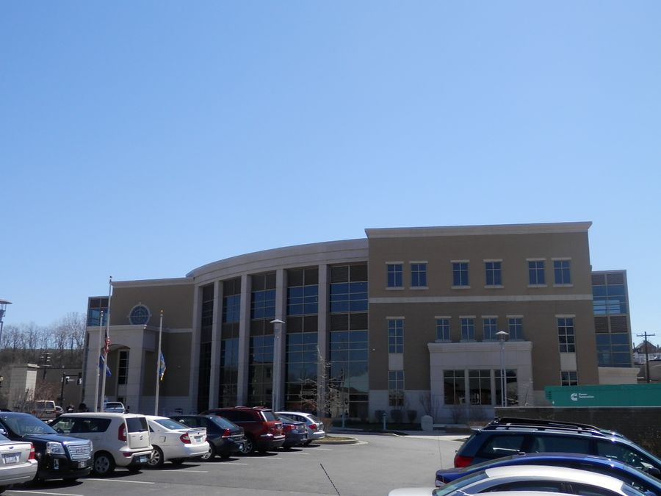

Slide 13
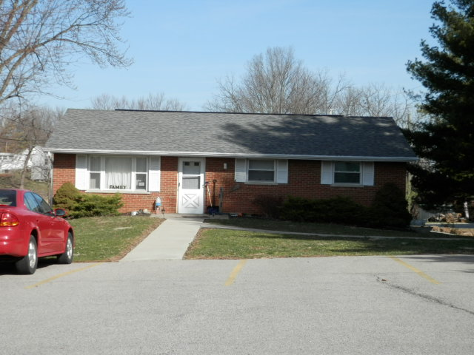
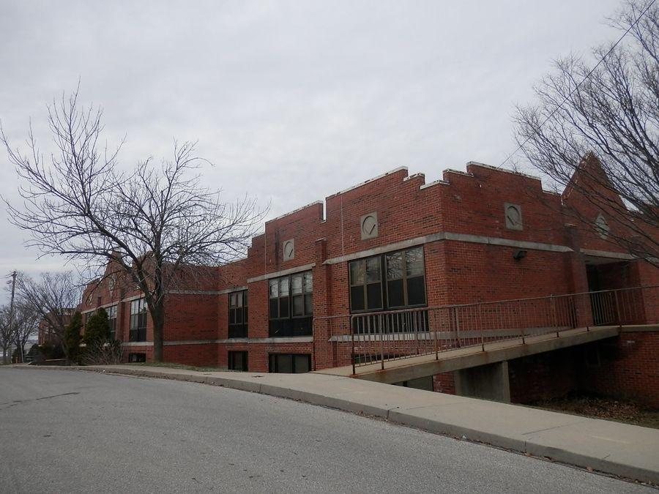

Slide 14
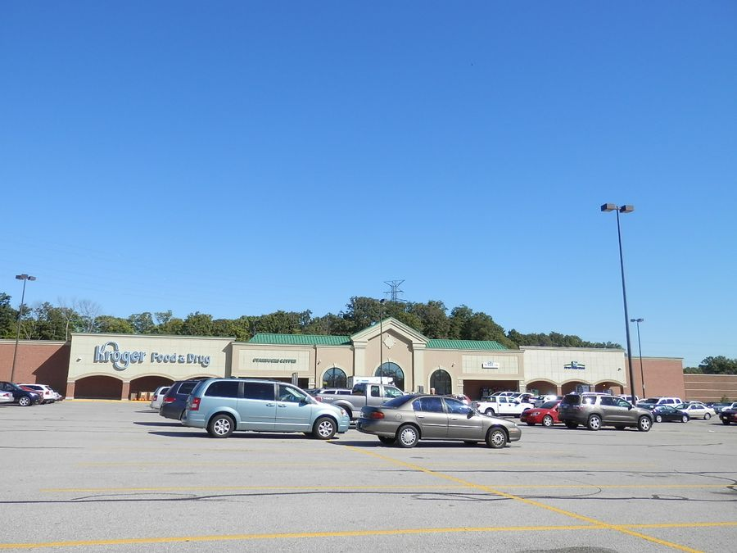
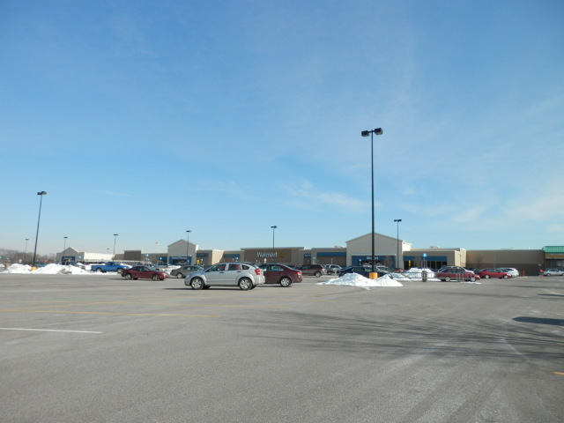
Kroger Marketplace – 4 units – Kroger, Starbucks, Little Clinic, BB&T Bank
Walmart – 5 units – Walmart, Da-Vi Nails, Woodcrest Bank, Subway, Smart Style Hair Salon
Stores such as pharmacy or optometrist operated by Kroger or Walmart were considered part of main unit and not considered individual

Slide 15
Problems With Fee on Tax Bills
HEX / DEX recipients who previously did not receive a bill, were still sent a bill for the $45 fee.
Tax exempt entities were confused on getting a “tax bill”. KYTC tried to claim they were exempt. Many exempt organizations failed to pay.
No longer able to automatically exonerate bills under $10. All bills, regardless of amount, were mailed out. Could be considered discrimination
Major increase in call volume. I put an option on our phone system to transfer calls to F.C. regarding the fee. Year one the volume was extremely high. F.C. did not do an adequate job of informing the taxpayers of the upcoming fee.

Slide 16
Collection, Exoneration, Refund, and Auditing of 911 Service Fee
Sheriff does receive commission on collection of fee – this percentage is negotiated between Sheriff & F.C.
Sheriff’s system had to be changed to accept and report 911 fee payments
Is not a TAX. 2% discount and late penalties do not apply.
Taxpayer could pay tax amount and elect not to pay fee – Sheriff still had to collect the tax portion & mark bill paid then report unpaid fees to F.C.
Mailed payments without fee had to be collected and fee reported as not paid as well.
Audit tracking was difficult. Auditors were and still are unsatisfied with tracking of nonpayment of the fees. Could lead to mishandling of funds.
Exonerations of just 911 fee led to $0 assessment changes on exoneration reports.
Refunds of 911 Fee had to be handled by F.C. only

Slide 17
Delinquent Taxes
E911 is a FEE, not a TAX. It has to be removed from the tax bill when bills are transferred to County Clerk on April 15.
Bills paid with 911 fee unpaid are not considered delinquent and not given to the County Clerk for collection.
Handed over to the County Attorney as Class A Misdemeanor which is $200 fine
Campbell County Attorney has not pursued these. It would cost the county more money to pursue than they would collect.

Slide 18
Collection Statistics
2013 - $1,701, 304.34 collected by Sheriff & F.C.
2014 - $1,793,793.25 collected by Sheriff & F.C.
2015 – $1,818,638.67 collected by Sheriff & F.C. to date
(Housing Authority still owes approx. $12,000 – they have an arrangement
to make a payment after collection has ceased due to budget)

Slide 19
QUESTIONS? COMMENTS?

Slide 20
Contact Info:
Daniel Braun
859-292-3871 office
dbraun@campbellcountyky.gov

