Slide 1
Coal: Past, Present and Future
Greg A. Jennings
Director
Greg.Jennings@ky.gov
Jay Wallen
Branch Manager
James.Wallen@ky.gov
Kentucky Department of Revenue
Division of Minerals and GIS Services
502-564-2011

Slide 2
coal: past, present and future
2016 PVA Conference

Slide 3
Overview
Kentucky Coal Production, 1790-2015
Kentucky Coal Prices & Severance Taxes, 1987-2015
Kentucky Coal Markets, 1983-2015
Kentucky Coal Outlook, 2015-2080
United States Coal Outlook, 2015-2060
The Future
3

Slide 4
Kentucky Coal Production, 1790-2015
4

Slide 5
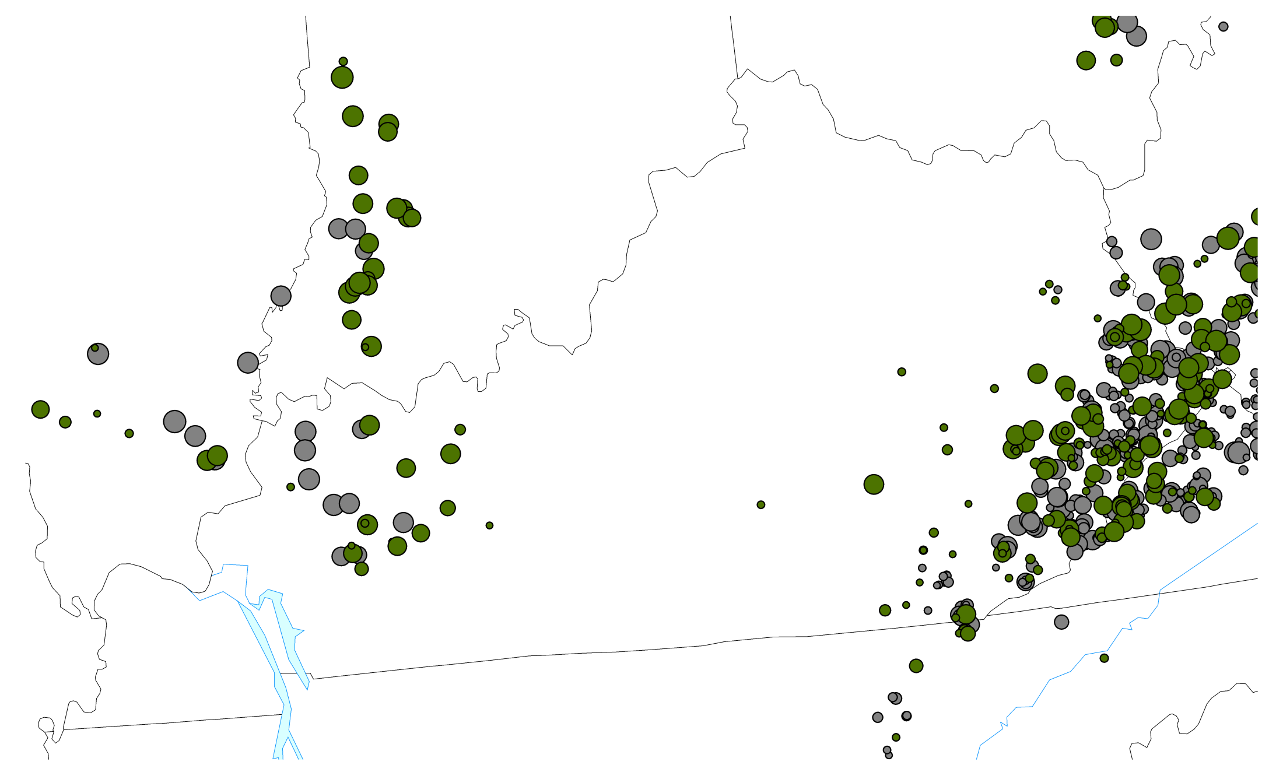
Kentucky Coal Production, Q1-2000
21.1 MT
Underground
14.2 MT
Surface
Kentucky Energy Database, EEC-DEDI, 2014 energy.ky.gov

Slide 6
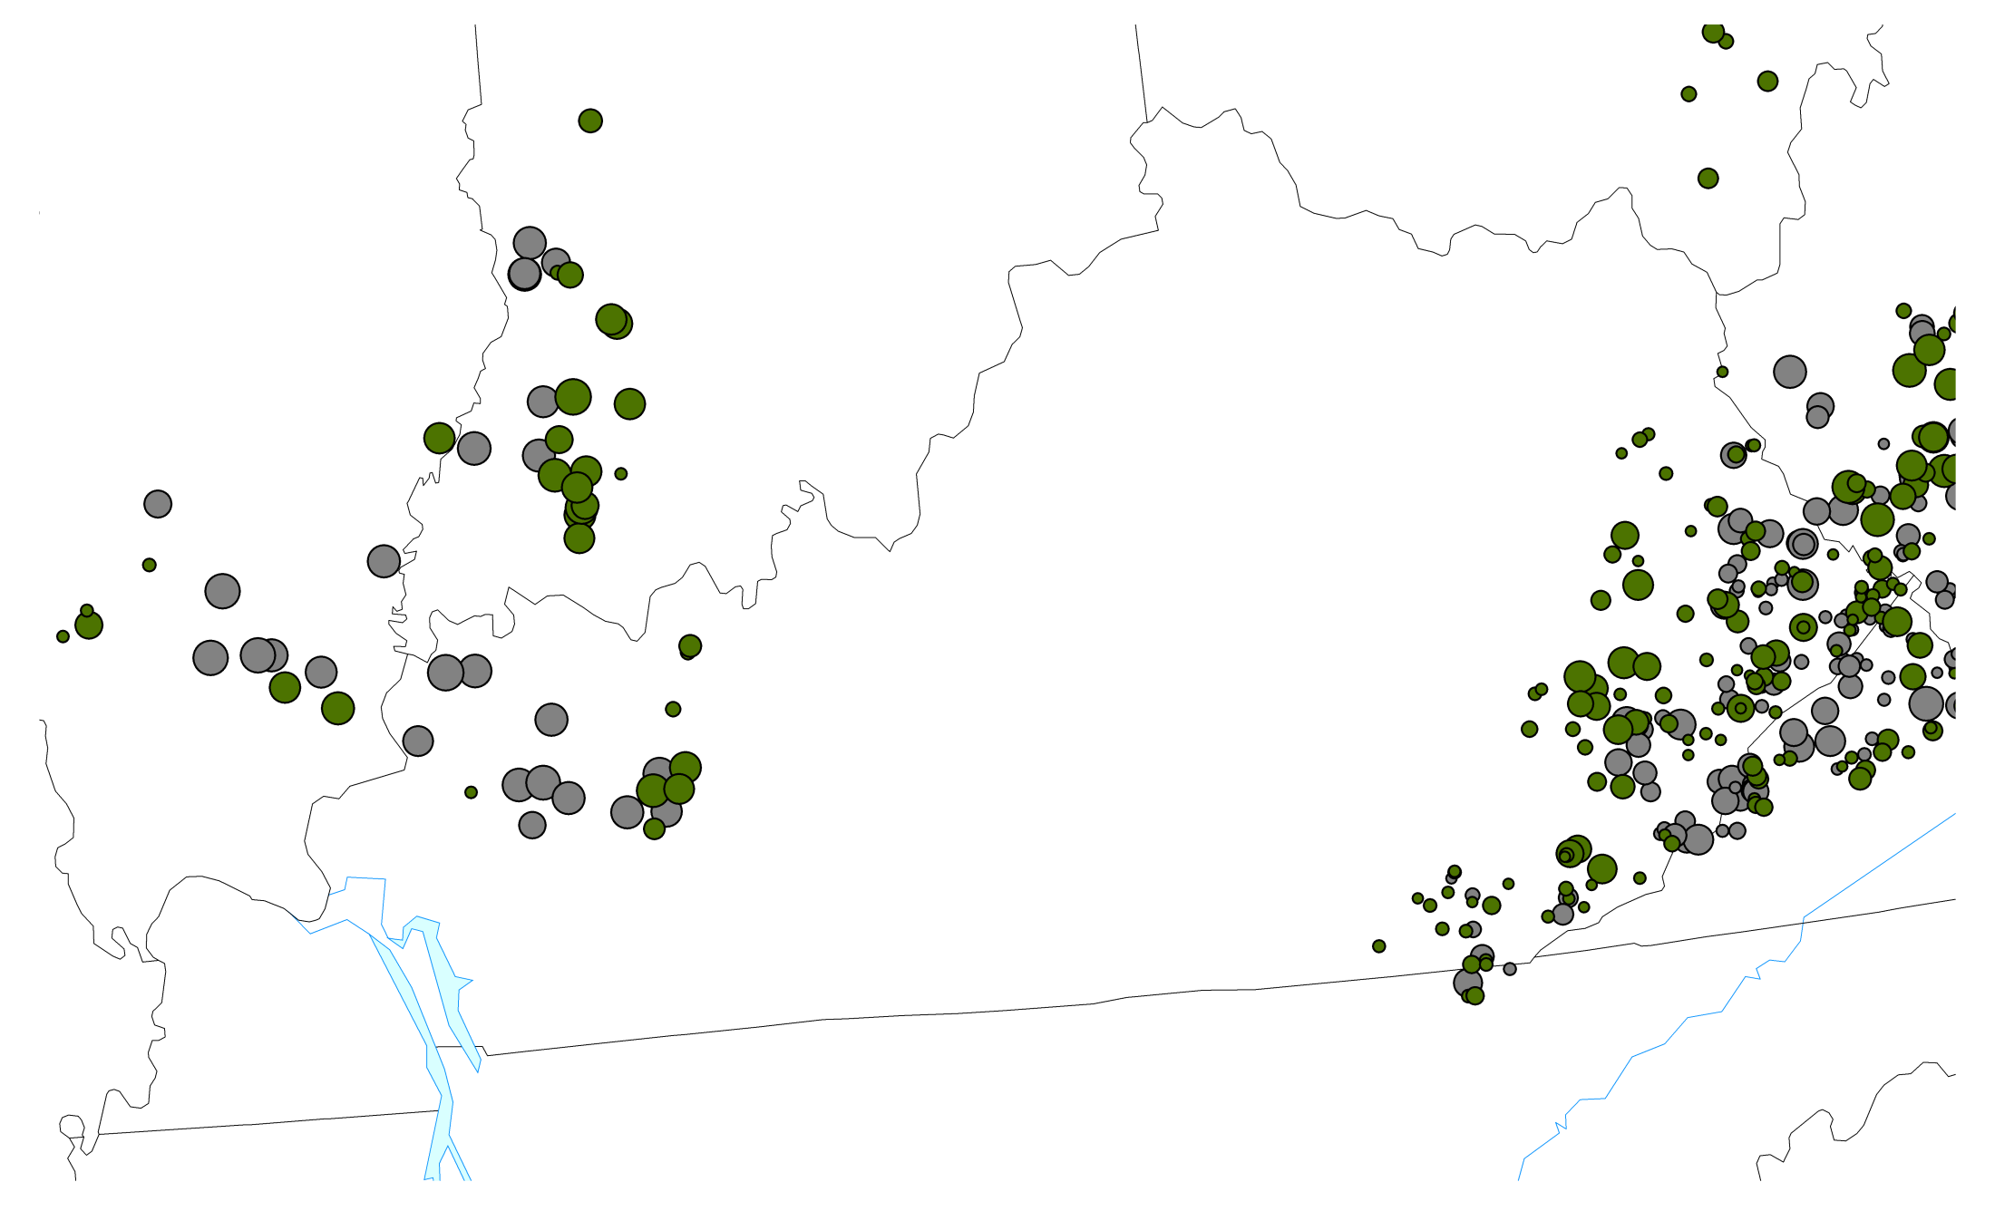
Kentucky Coal Production, Q4-2013
13.0 MT
Underground
6.1 MT
Surface
Kentucky Energy Database, EEC-DEDI, 2014 energy.ky.gov

Slide 7
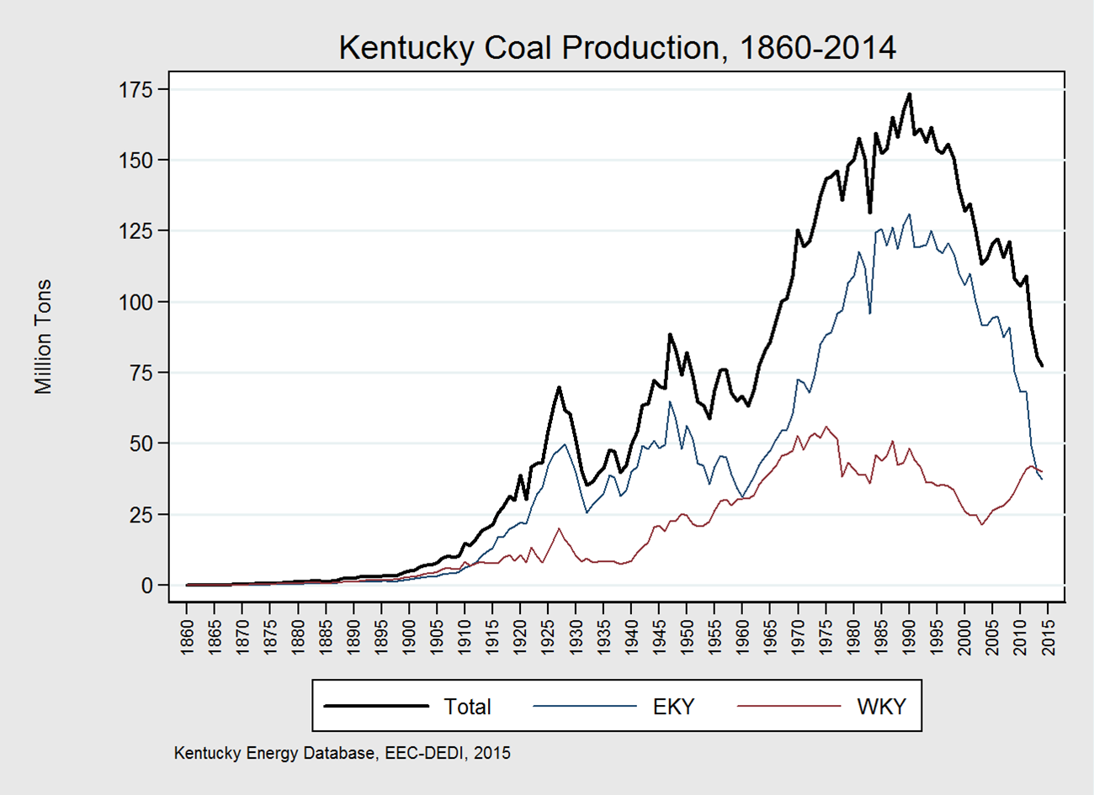
Kentucky coal production increased in the early twentieth century as the nation industrialized.
The two World Wars drastically increased demand for coal mined in Kentucky.
7

Slide 8
Kentucky Coal Prices & Severance Taxes
8

Slide 9
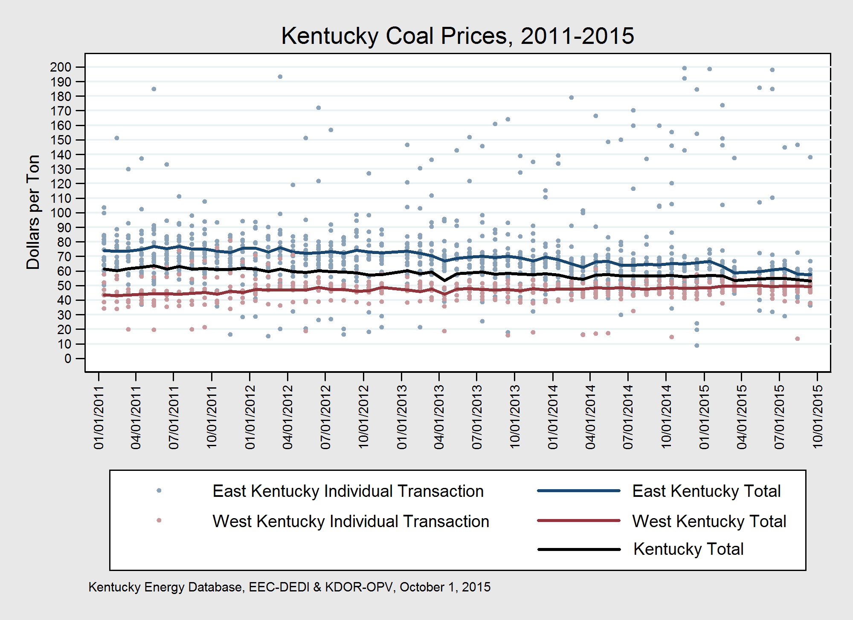
Eastern Kentucky coal prices have declined since 2011, while western Kentucky coal prices have remained stable.
9

Slide 10
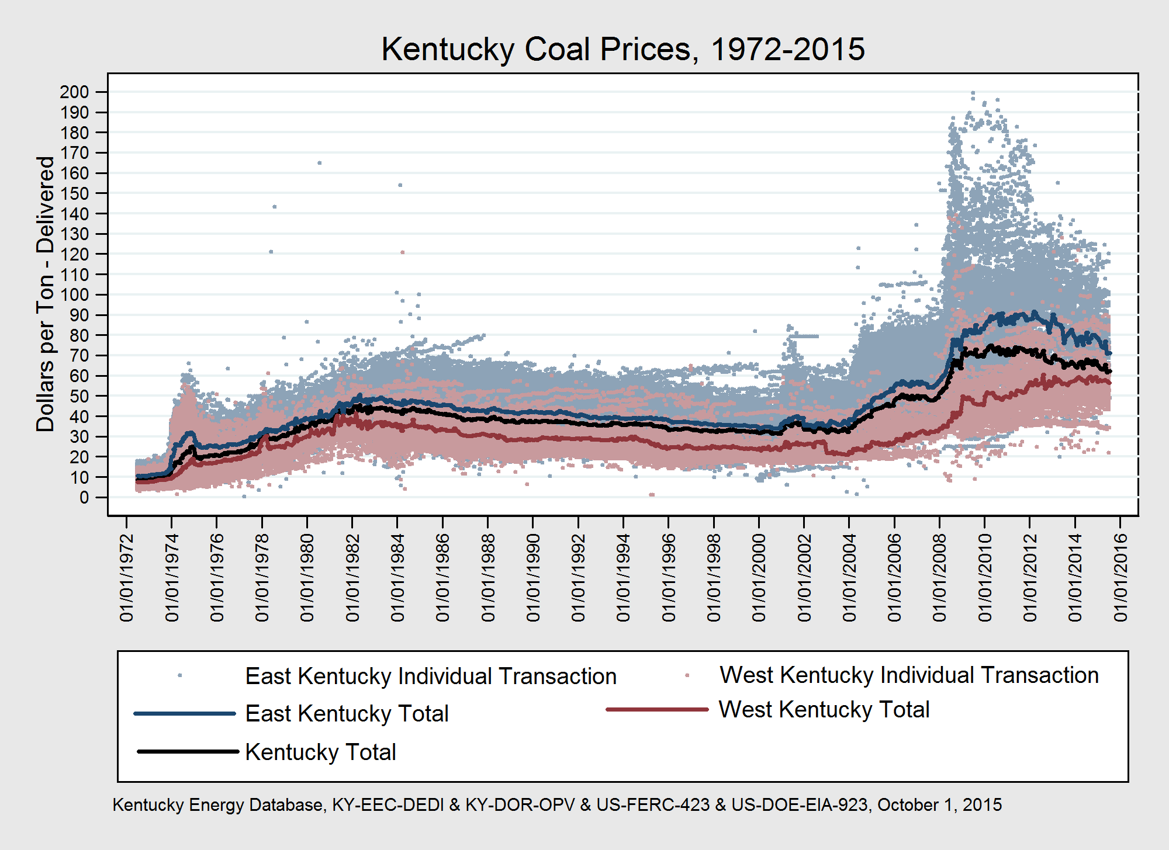
Kentucky Coal prices rose from 1972 to 2011, but have fallen substantially since 2011.
10

Slide 11
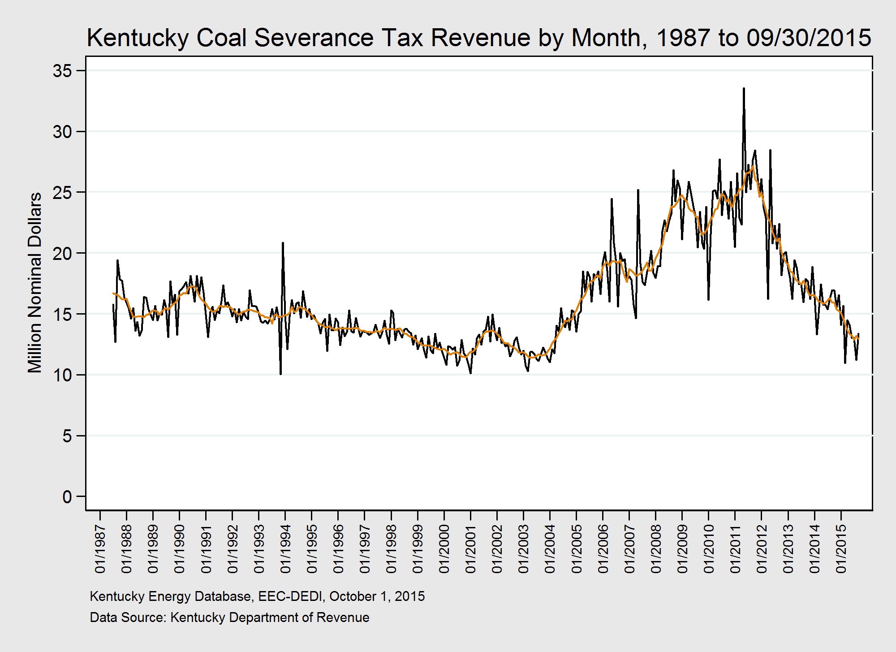
The combination of price and tons of coal mined affect coal severance revenue.
High prices and production meant than $310 million coal severance revenue was collected in calendar year 2011.
$191 million in coal severance revenue was collected in calendar year 2014, a decrease of 39 percent.
Notes:
For fiscal year ending 2016 severance coal revenues were even lower with $120,607,931 received.

Slide 12
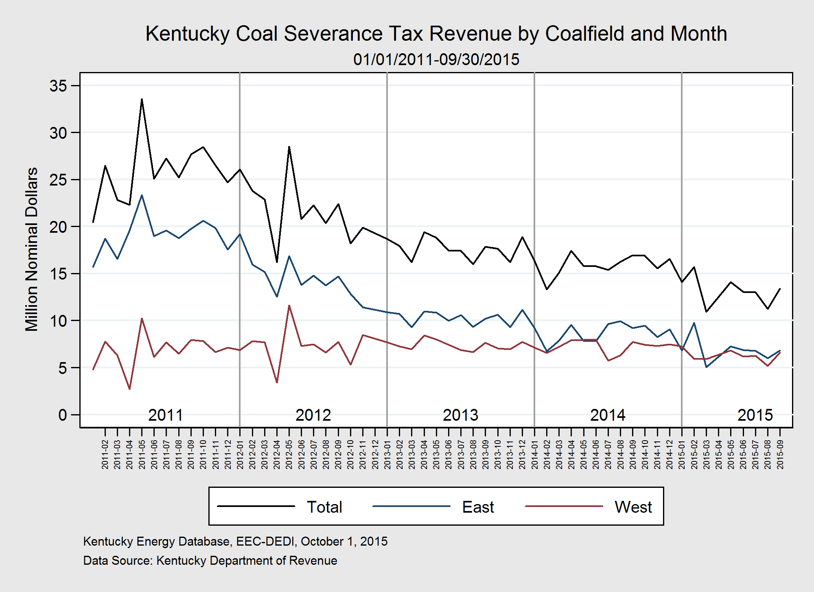
Coal severance tax revenues have decreased by half since 2011.

Slide 13
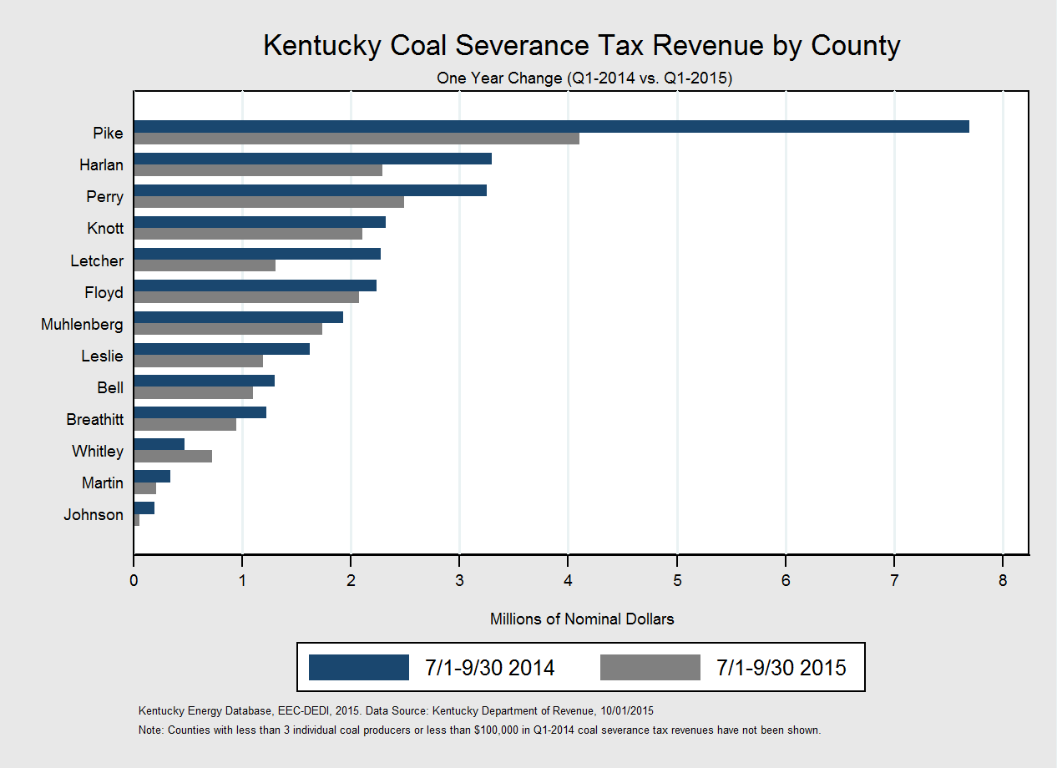
Coal severance tax revenues have decreased by half in the past year, with revenue from certain counties more-severally affected.

Slide 14
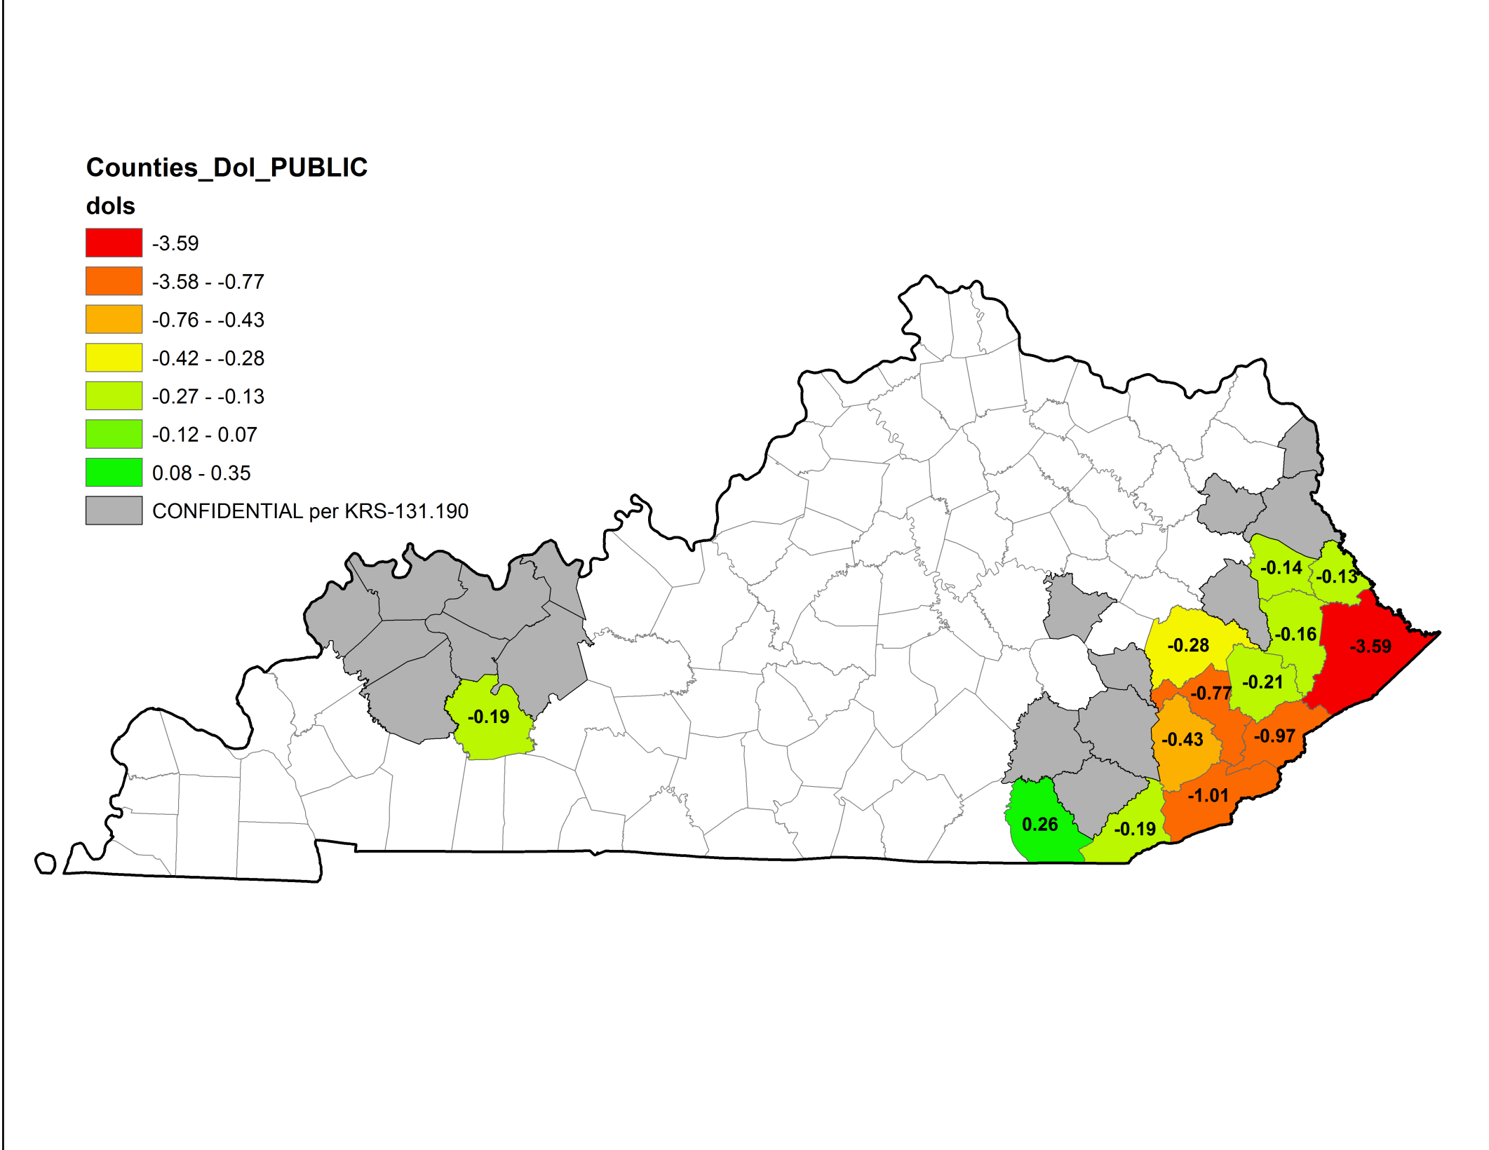
Kentucky Coal Severance Tax Revenue Change
July-September 2014 vs. July-September 2015
The data summarized in this map are not confidential.
* Denotes fewer than three (3) filers in the county and is CONFIDENTIAL, and shall not be disclosed to any third party, nor used in any way or manner that would cause it to become part of a public hearing or proceeding, or to become part of a public hearing or proceeding, or to become public record except as provided in KRS 131.190.
Change in Revenues (Million $)
*
-$3.59M
+0.350M

Slide 15
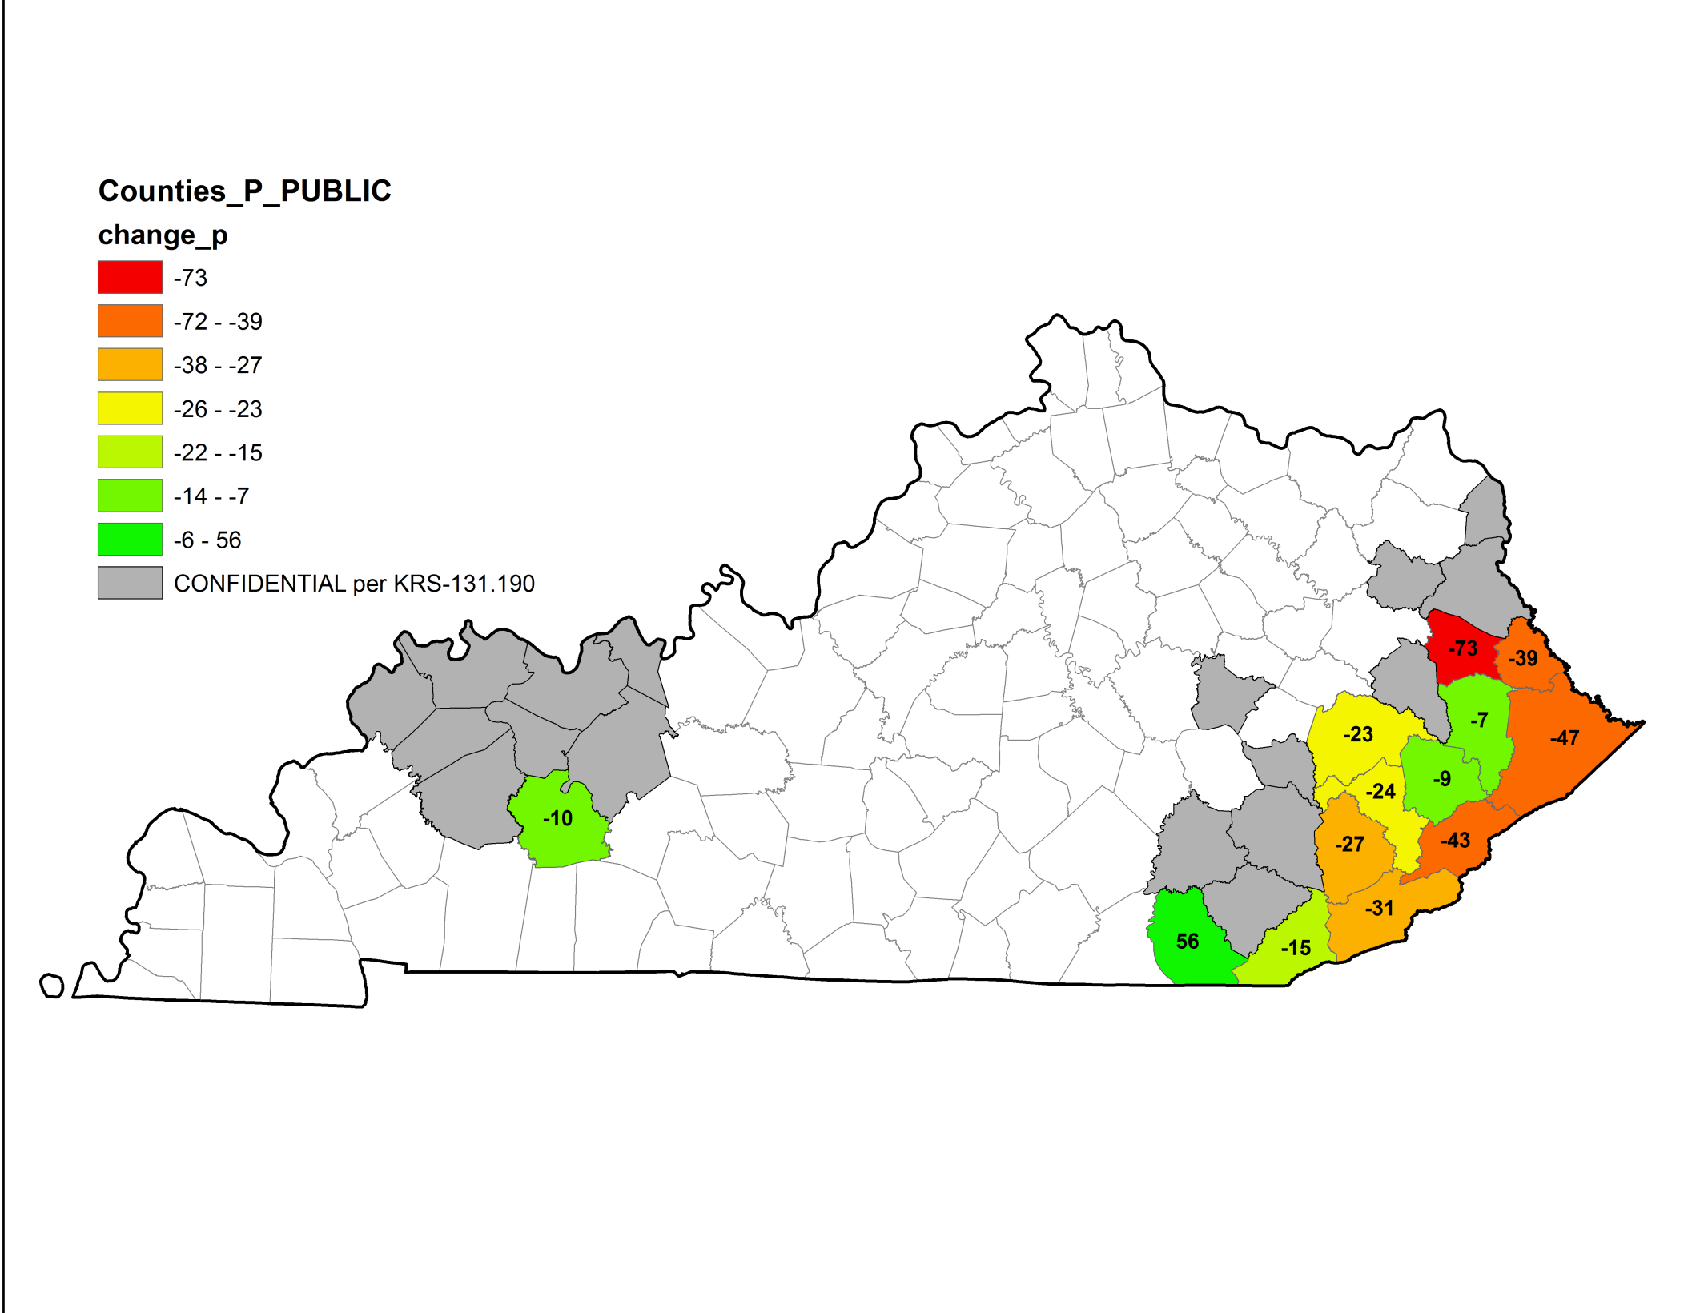
Kentucky Coal Severance Tax Revenue Change
July-September 2014 vs. July-September 2015
The data summarized in this map are not confidential.
* Denotes fewer than three (3) filers in the county and is CONFIDENTIAL, and shall not be disclosed to any third party, nor used in any way or manner that would cause it to become part of a public hearing or proceeding, or to become part of a public hearing or proceeding, or to become public record except as provided in KRS 131.190.
Change in Revenues (%)
*
-100%
+353%

Slide 16
Kentucky Coal Markets, 1983-2015
16

Slide 17
Most of the coal mined in Kentucky is used for electricity generation in the United States.
17

Slide 18
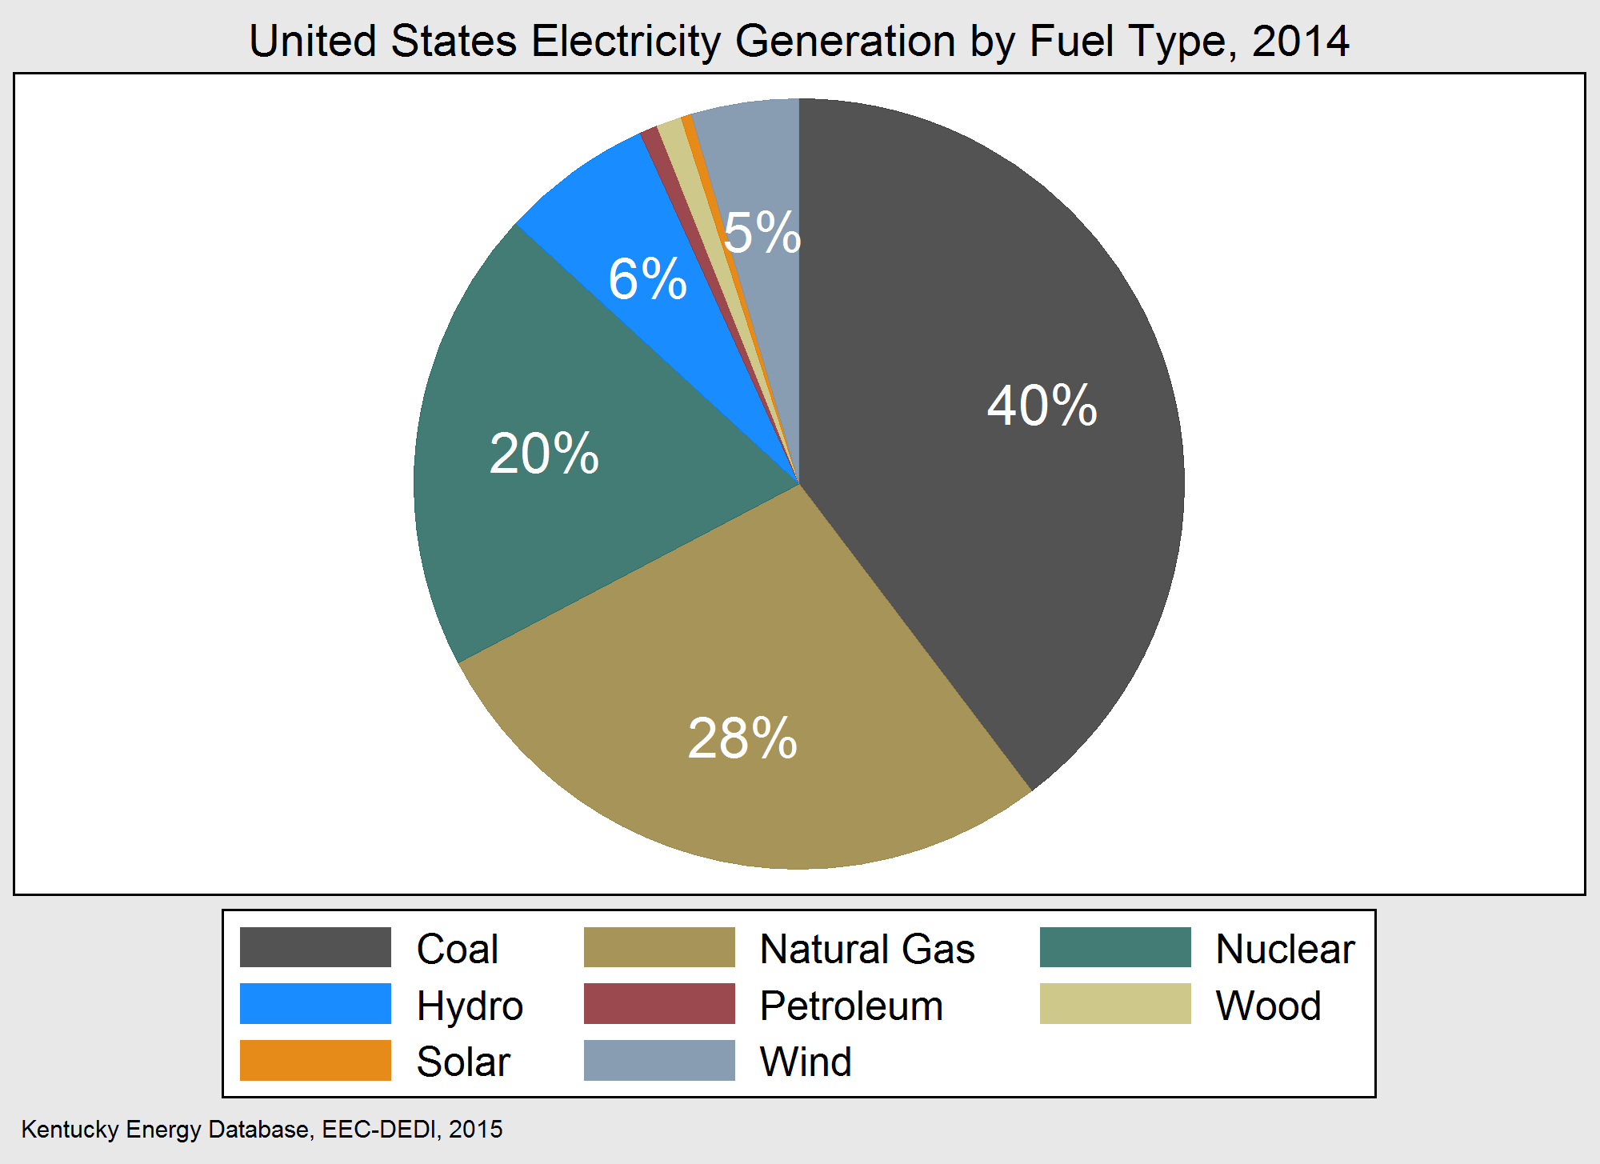
The United States generates 40% of electricity from coal-fired power plants.
18

Slide 19
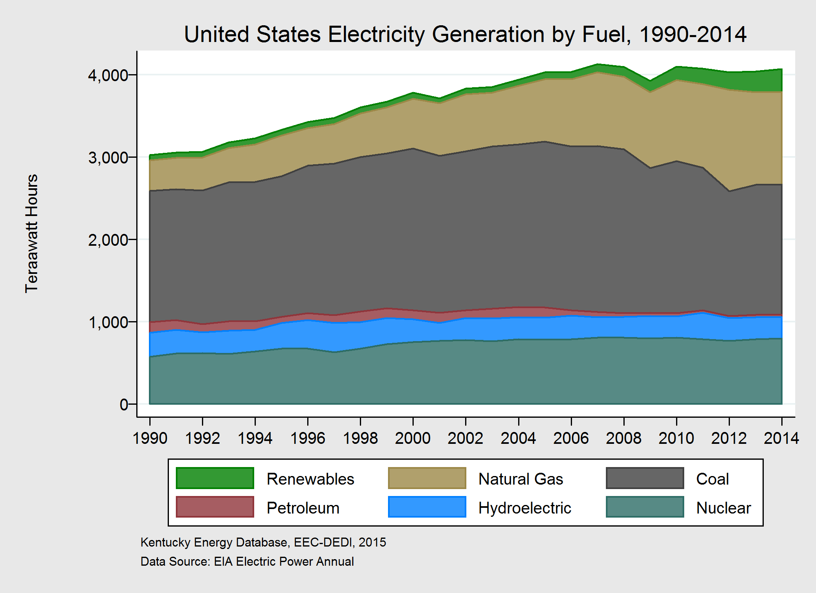
In the decade since 2005, electricity demand has stopped growing.
Natural gas and renewable generation is increasing.
Coal-fired generation is decreasing.
19

Slide 20
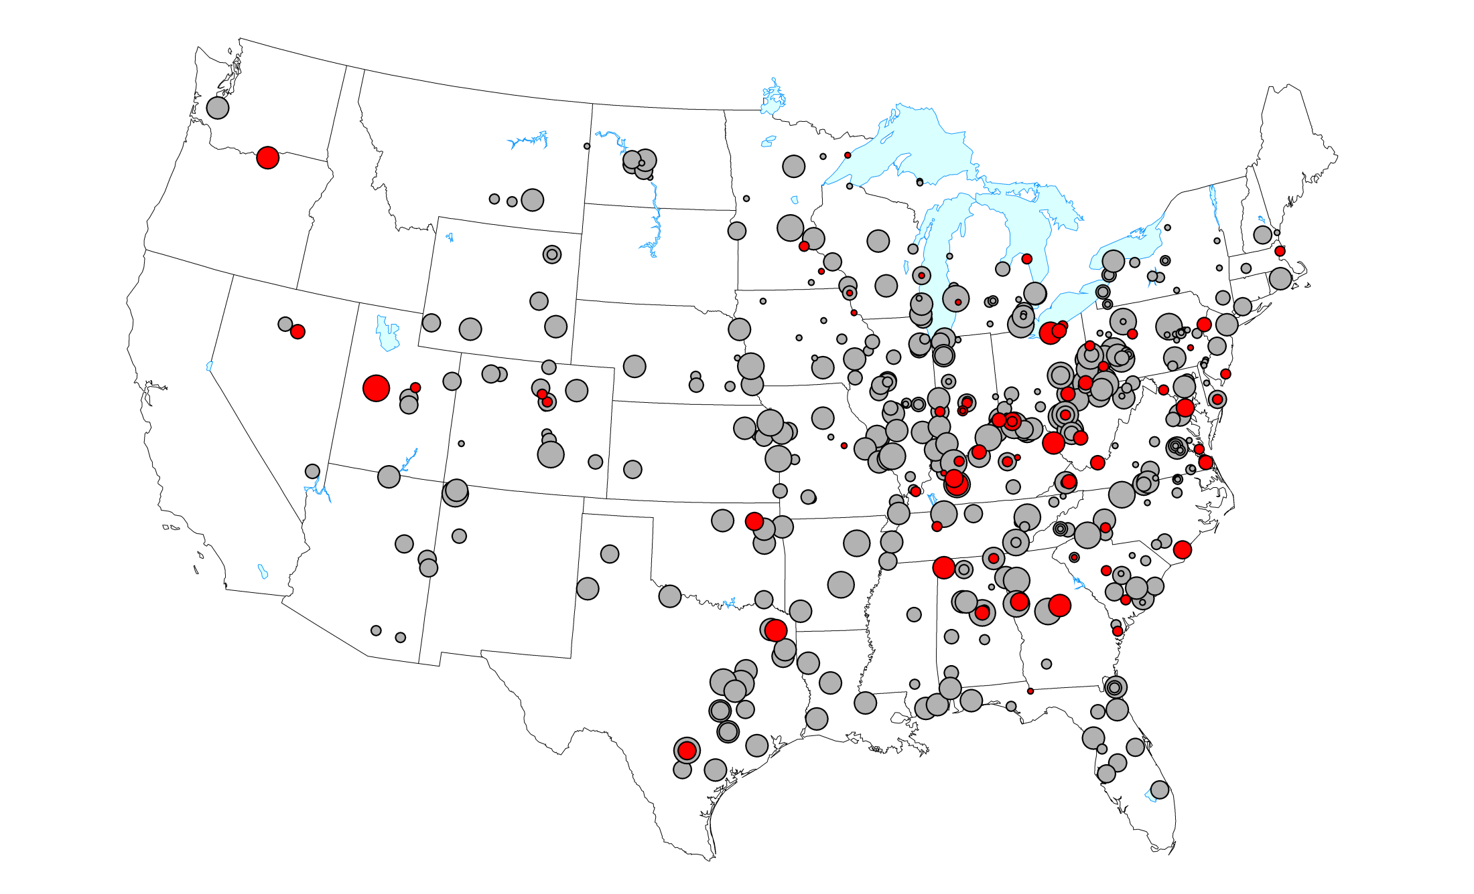
United States Coal-Fired Power Plants, 2012
Nameplate Capacity
33 GW
Retirement 2013-2018
312 GW
Unknown Future Retirement
Kentucky Energy Database, EEC-DEDI, 2014 energy.ky.gov

Slide 21
1963-2016 Kentucky Power implodes the Big Sandy Unit 2 Cooling Tower

Slide 22
Energy Policy
In 2011 President Obama called for a goal “By 2035 80% of Americas electricity will come from “Clean Energy Sources””
MATS: Mercury and Air Toxics Standards for Power Plants revises standards that reduce air pollution from coal and oil fired power plants under sections 111 and 112 of the 1990 Clean Air Act amendments.
These rules set technology-based emissions limitation standards for mercury and other toxic air pollutants, reflecting levels achieved by the best performing sources currently in operation.
The final rules set standards emitted by coal and oil fired electric generating units (EGU’s) with a capacity of 25megawatts or greater.
Existing sources will have up to 4 years to comply with MATS.

Slide 23
EPA Clean Power Regulation
EPA’s plan for existing power plants is to reduce carbon dioxide emissions from the electricity generation sector by 30% from 2005 levels by 2030. To do so, EPA provides states with reductions that they must meet and 3 building blocks that they suggest states can use to get to their assigned tragets. These building blocks are:
Bulding Block 1: Improving the thermal efficiency of individual affected sources (heat rate improvement)
Building Block 2: Dispatching the generating fleet to substitute less-carbon-intensive affected sources for more-carbon-intensive affected sources (re-dispatch for reduced emissions)
Building Block 3: Expanding the use of low- or zero- carbon generation in order to displace affected sources (Low and Zero carbon capacity expansion)

Slide 24
EPA Clean Power Regulation (Cont.)
The EPA issued separate CO2 regulations for new power plants (9/13) and existing units (6/14). Under section 111(b) of the Clean Air Act, the EPA established New Source Performance Standards that set a threshold for fossil-fuel-fired electric steam-generating units at 1,100 pounds of C02 per megawatt hour (mwh).
No existing fossil-fuel-fired plant in Kentucky can meet this standard unless the plant switches to natural gas. The closest a fossil-fuel fired power plant in Kentucky can reach is located in LaGrange, Kentucky and generates roughly 1,700 pounds of C02 MWH.
On February 9, 2016, the United States Supreme Court granted a stay requested by more than two dozen states and numerous industry groups pending review by several lower federal courts of the regulation and final review by the U.S. Supreme Court. Chamber of Commerce, Et AL. v. EPA, ET AL.

Slide 25
Coal Fired Power Plants
September 25, 2016 a cooling tower at the AEP power plant in Louisa used to cool 248,000 gallons of water per minute was demolished.
New EPA regulations prohibited the use of coal at the plant and it went idle in May 2015.-WSAZ News Staff; Chad Hedrick, 9/25/2016.
In May of 2016 the plant powered up the southern cooling tower, this time with natural gas.
Kentucky Power provides electricity to 169,000 customers in 20 eastern Kentucky counties.
Kentucky utility companies retired 10% (18 gigawatts) of the state’s coal-fired power generating capacity in 2015.

Slide 26
Coal-Fired Power Plants (cont.)
Louisville Gas & Electric’s Cane Run plant idled its two remaining coal units in July. A new, 640-megawatt natural gas plant replaced them.
Kentucky Utilities closed it’s two remaining coal units at the 161-megawatt Green River plant on September 30th.
East Kentucky Power Cooperative shut down two of its four units at the William C. Dale plant near Winchester in early 2015.
By the end of 2017 the TVA will shut down two units at its Paradise Plant in Western Kentucky.
Ohio -15%, Georgia -18%, Kentucky -10%, Indiana -6%, West Virginia -8%. Reductions in coal power generating capacity.

Slide 28
The Law
Ky. Const. section 172 requires all property to be assessed at its fair cash value.
All property…shall be taxed in proportion to its value unless exempted and pay the same rate of taxation. Ky. Const. section 174; Gillis v. Yount, 748 S.W.2d 357(Ky. 1988).
Taxes must be “uniform upon all property of the same class.” Ky. Const. section 171.
KRS 132.820(1) states that all unmined coal is valued “as a distinct interest in real property separate and apart from the surface real estate….”
Constitutional provisions do not guarantee that all properties will be valued at 100% of their fair cash values at all times. Revenue Cabinet, Com of Ky v. Gillig, 957 S.W.2d 206 (Ky. 1997).
The assessment of unmined minerals at fair cash value was implemented as a result of court case, Kentuckians for the Commonwealth v. Blanton, 4/25/05.
The Compensating tax rate will continue to allow local jurisdictions to collect the same amount of tax revenue as coal continues its slide in use and value. KRS 132.010 (6).

Slide 29
Current Valuation methods set by Blanton Case
The Valuation procedure for active and idle coal is based on the income approach.
Categories for the assessment of unmined coal is 1 year, 2-5 years and 6-15 years for active coal. Anything over 15 years is considered idle coal and assessed accordingly.
The Department reviews the discount rate used in the assessment of active coal reserves on an annual basis.
The Department uses the average price of coal for the preceding three (3) years in assessing unmined coal reserves.
Idle rates were set based on the assumption that Eastern Kentucky would be mined within thirty (30) years discounted to the midpoint (15 years). Western Kentucky idle coal rates were set at sixty (60) years discounted to the midpoint (30) years. These assumptions appear to no longer be viable rates under current market conditions.

Slide 30
Kentucky Coal Outlook, 2015-2080
30

Slide 31
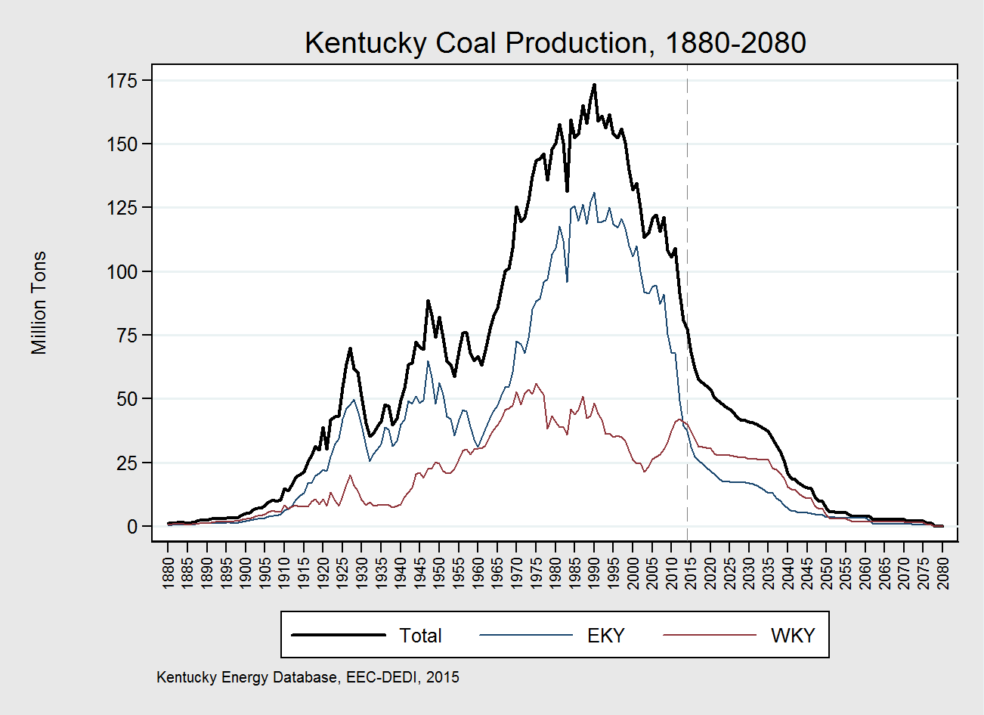
Future power plant closures will reduce demand for Kentucky coal by 40% from 2014 levels to 46MT by 2025, by 54% to 17MT in eastern Kentucky and 30% to 28MT western Kentucky respectively.
← Historical
2015 Forecast→
31

Slide 32
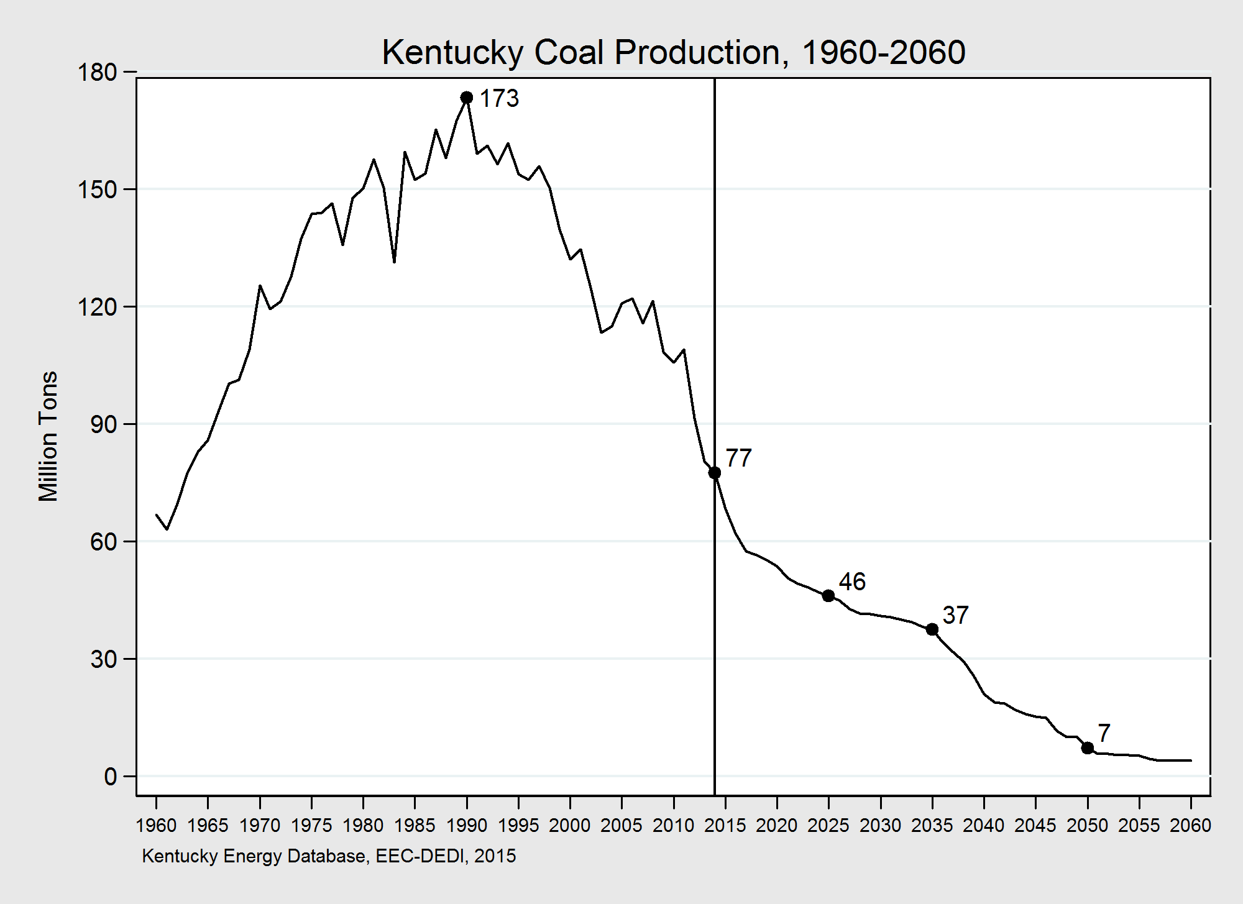
← Historical
2015 Forecast→
Kentucky coal production is expected to decline by 40% from 2014 levels to 46MT by 2025, 37MT by 2035, and 7MT by 2050. Demand for Kentucky coal will be marginal after 2050.
32

Slide 33
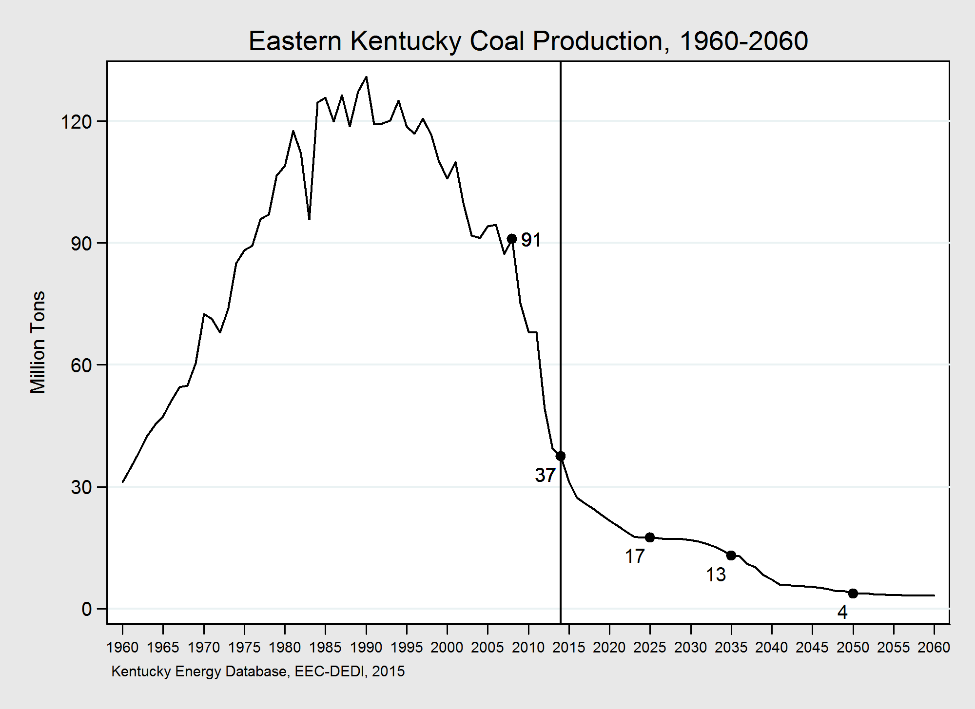
← Historical
2015 Forecast→
Eastern Kentucky coal production is expected to decline by 54% from 2014 levels to 17MT by 2025, 13MT by 2035, and 4MT by 2050. Demand for eastern Kentucky coal will be marginal after 2050.
33

Slide 34
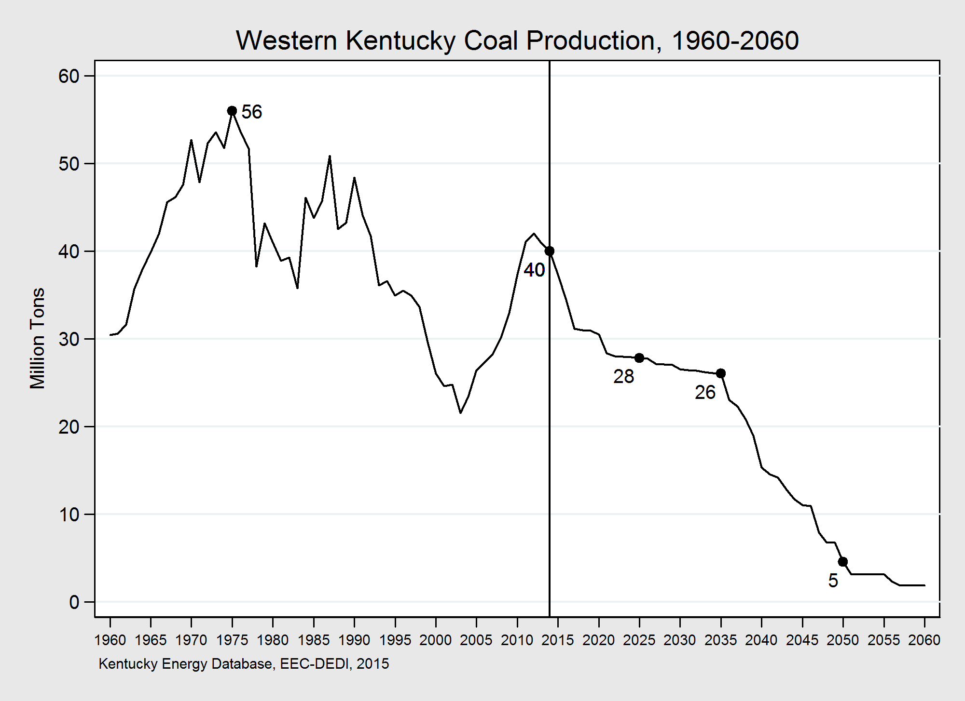
← Historical
2015 Forecast→
Western Kentucky coal production is expected to decline by 30% from 2014 levels to 28MT by 2025, 26MT by 2035, and 5MT by 2050. Demand for western Kentucky coal will be marginal after 2050.
34

Slide 35
United States Coal Outlook, 2015-2060
35

Slide 36
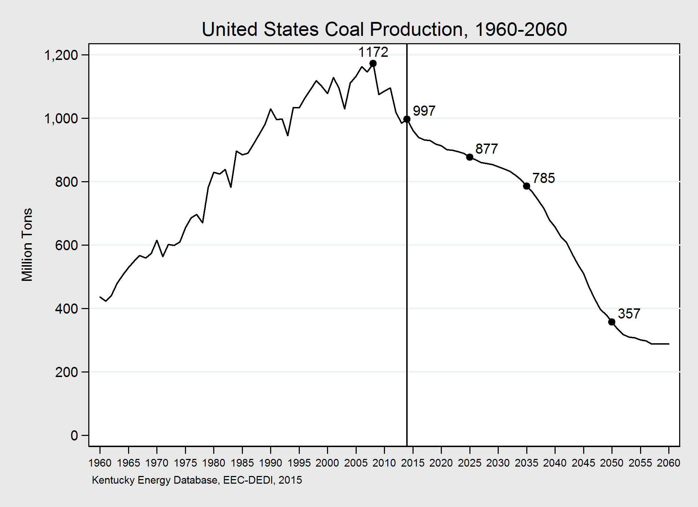
2015 Forecast→
Future power plant closures will reduce demand for coal across the United States by 12% from 2014 levels to 877MT.
36

Slide 37
The Future of Coal

Slide 38
Canary in the Code Mine

