Slide 1
Amended Return Processing

Slide 2
Why would a taxpayer want to amend their tangible return?
1. What was originally reported was incorrect due to error.
2. Taxpayer doesn’t agree with their tangible property tax bill. (Alternative Valuation)
3. An audit was performed on the taxpayer and they were authorized to amend their tangible property tax returns based on what was conducted during the audit.

Slide 3
Notes
OPV’s Amount of Amended/Alternative Valuations Received
Notes:
198 amount received for 2014; 416 received for 2015; 339 received for 2016.

Slide 4
Procedures for reviewing
1. All amended returns received are scanned and logged into a spreadsheet.
2. Each amended return is assigned by the Branch Manager accordingly to an auditor.
3. Auditor checks with Field Operation’s ATS for any current assignments. If so, returns are forwarded off to the Office of Field Operations along with a memo.
4. Auditor reviews information received and checks to see if the business has any missing periods. (5 years per statute.) Uses DOR resources to review information.

Slide 5
Cont……
5. Auditor checks with the PVA or PVA's resources to see if the bill was paid. The taxpayer has 2 years to request a refund from date of payment per KRS. 134.590. A refund memo 21A218 must be filled out by the taxpayer.
6. The auditor will request for any additional information as needed.
7. If approved, an exoneration letter and audit template is sent off along with the refund memo, if bill was previously paid. If denied for any reason, the auditor will inform the taxpayer by letter and give his reasons why. The auditor will inform the taxpayer their 45 days to protest. A brochure “Your Rights As A Kentucky Taxpayer,” is included with the denial letter.

Slide 6
Amended Return Tracker
Taxpayer name and Fein
Additional T/P information.

Slide 7
Field Operation’s Tracking System

Slide 8
Cont….

Slide 9
Compliance Work
Makes sure tp has previously filed. (5 years)

Slide 10
Check for prior years filing history and review what was reported
Check to see how they file prior years.

Slide 11
Where can we find Tangible Property Tax information??
One of our resources available are MEF and Fastrieve.
Fastrieve provides both individual and corporate scanned tax return information.
MEF can also provide the same kind of information. More so if the taxpayer is a sole proprietor and he or she does not have a FEIN#.
Depreciation schedule/fixed asset listing.

Slide 12
What is reviewed in Fastrieve?
Schedule Q
Schedule A
Form 4562
Form 4797
Form 1125-A
Schedule L (Balance Sheet)
Form 1120
Supporting Statements

Slide 13
Schedule Q
Checking yes to question 8 informs us they have filed a return with the local PVA.

Slide 14
Schedule A
Provides infor if the business has tangible property. Ex. Inventory, equipment, and other tangible assets.

Slide 15
Form 4562

Slide 16
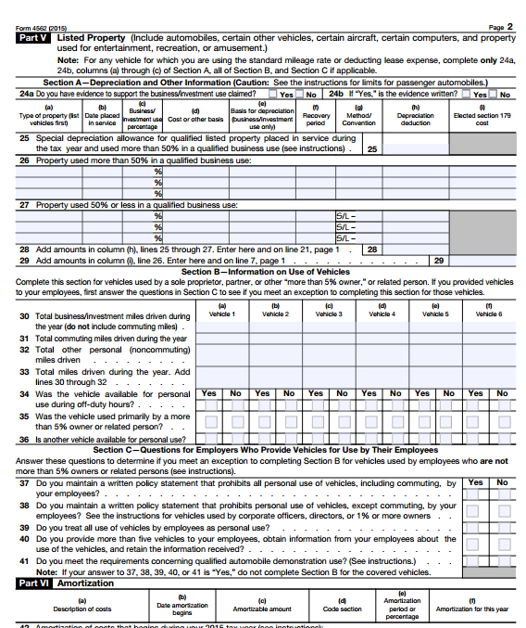

Slide 17
Form 4797
Informs us that property is no longer in the TP possession

Slide 18
Balance Sheet Schedule L
Informs amounts of inventory if applicable
Taxpayer will provide $ amounts of their buildings/ depreciable assets

Slide 19
Fixed Asset Listing
Gives us the list of depreciable assets that is owned by the business.

Slide 20
Supporting Documents
Fastrieve can provide us with other supporting documents provided by the taxpayer/business.
The information usually includes a fixed asset listing, other deductions, and information that can be beneficial to the auditor working on the amended return.

Slide 21
Refund memo form 62A366R
Taxpayer fills out the information indicated. This applies if the TP has paid the bill(s)

Slide 22
Audit Template
This template should be attached with the exoneration letter. It provides you with what was originally reported on the return and what is being changed.

Slide 23
Exoneration Letter
A letter is sent to the PVA’s office.
The letter informs the PVA office with what year the property tax bill is being exonerated, the name of the business, and why.
The exoneration letter will have management’s signature and the auditor’s initials.

Slide 25
Compliance Tangible Personal Property Tax Branch Staff
Omitted and Compliance Branch contact: 502 564-2557
Manny Gonzalez, Branch Manager
phone: 502 564-7119 email: manuel.gonzalez@ky.gov
Darrell Young
phone: 502 564-2729 email darrell.young@ky.gov
William Lawson
phone 502 564-7125 email: william.lawson@ky.gov
Donna Durr-Richards
phone: 502 564-2722 email: donna.durr-richards@ky.gov

