Slide 1
DIVISION OF STATE VALUATION
Together Everyone Achieves More

Slide 2
Cathy Thompson
Division Director
502-564-5117
cathy.thompson@ky.gov
Jehna Cornish
Taxpayer Services Specialist II
Omitted Tangible Branch
502-782-2507
jehna.cornish@ky.gov

Slide 3
CLERICAL ERRORS ON TIMELY FILED TANGIBLE RETURNS
133.110 Correction of clerical errors in assessment.
After submission of the final real property recapitulation or certification of the personal property assessment, the property valuation administrator may correct clerical, mathematical, or procedural errors in an assessment or any duplication of assessment. Changes in assessed value based on appraisal methodology or opinion of value shall not be valid.
www.revenue.ky.gov

Slide 4
A-BILL OR EXONERATIONS
Exonerations are made when clerical errors, mathematical errors, unintentional omissions, or duplications have been made on a taxpayer's bill. Revenue Form 62A366, Executive Order Correcting Erroneous Assessment, is used to correct a tax bill that is not yet delinquent.
The PVA will prepare a special exoneration form used when a refund is involved (62A366-R), which will describe the reason an assessment adjustment is being made and the amount of the change.
Some PVA offices have their own generated forms for A bills or additional bills related to clerical errors and duplications.

Slide 5
ERROR EXAMPLES
Clerical
Returns misplaced and or stapled to processed returns.
All information not carried forward to summary page on return, i.e. supplies on schedule C not carried forward to line 60.
Duplication
Unintentional Omissions
Return filed timely in wrong County when reached correct County tax roll was closed.
Mathematical
Errors
Errors made in data entry of returns.
Return entered twice.

Slide 6
CORRECTING ERRORS
Complete the appropriate form for your PVA office.
When Sheriff receives regular tax bills send exoneration and or A bill to sheriff.
Send copy of return, exoneration and/or A bill to OPV. OPV will create dummy assessment in the OPT database and adjust off any applicable tax dollars. A memo note will be put in system that bill created at local level due to clerical error. This ensures return or adjustment is entered into system so taxpayers do not receive any unnecessary requests for returns or requests for audit.

Slide 7
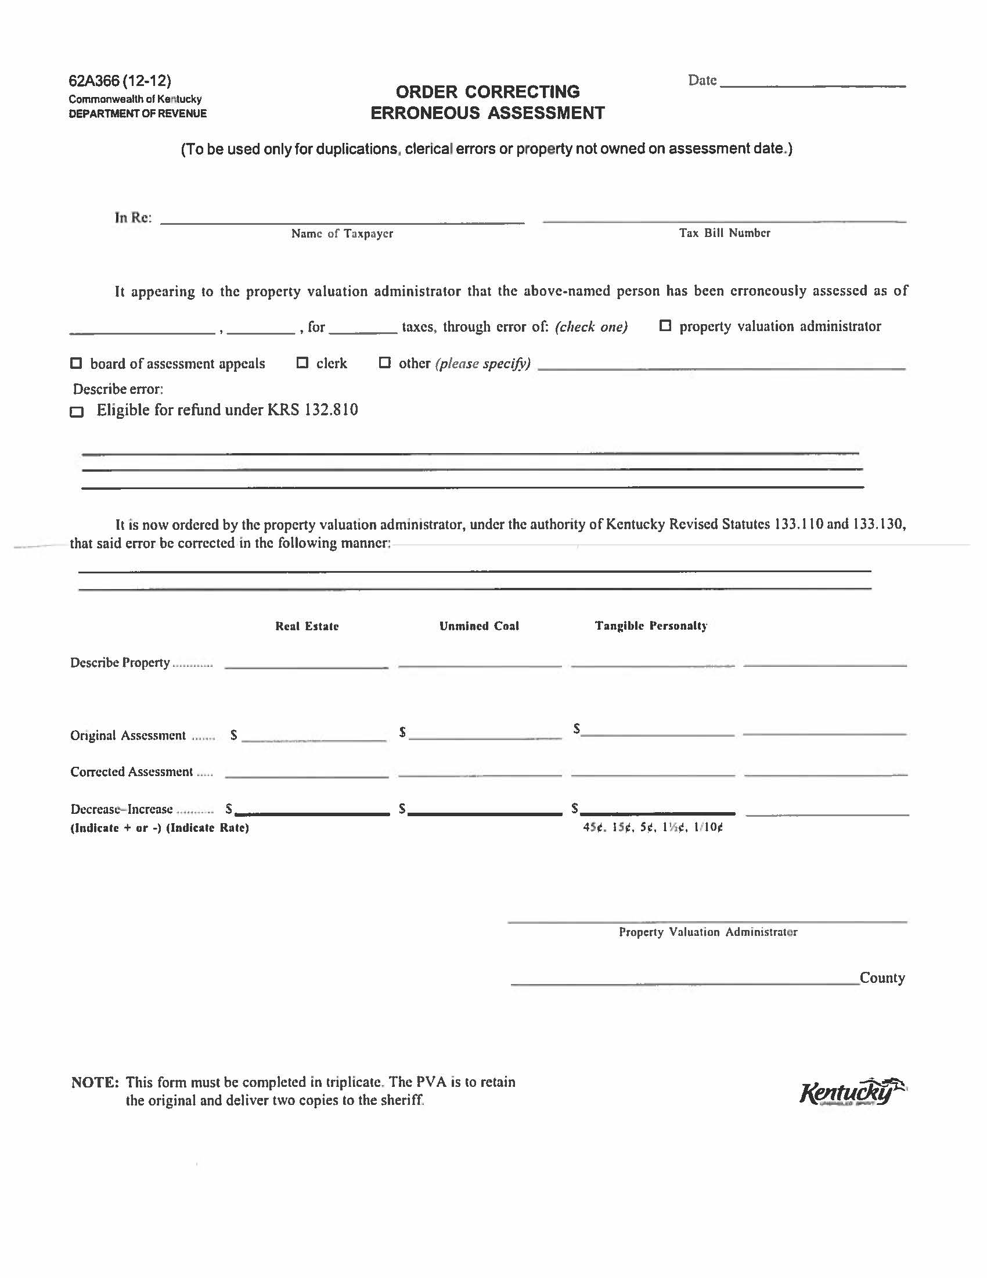

Slide 8
FORM USED TO CORRECT CLERICAL ERRORS
http://revenue.ky.gov/PVANetwork/PVA%20Forms/62A3661212.pdf

Slide 9
BENEFITS
Allows the taxpayer to receive corrected tax bill and pay within the discount period.
When processed by OPV, interest begins to accrue on January 1. While OPV staff can waive penalties, we are not authorized to waive interest. In addition the DOR omitted databases are not set up for discounts.
The receipt of tax rate information is occasionally delayed thus delaying the creation of tax bills.
The PVA office will be creating positive public relations by assisting the taxpayer in a timely manner. Effective “PR” is proactive and responsive.
The Sheriff’s Office will receive the 4.25 commission for collection of the bill.

Slide 10
NEW OR CHANGES TO TAX DISTRICTS
Additions or changes to tax districts require a ticket to (COT) Commonwealth Office of Technology.
COT implements any program changes so the new district will be recognized when trying to enter a tangible property tax return.
Notification should be sent to Cathy Thompson who will contact COT concerning the change. This can be done via email at cathy.thompson@ky.gov.
Will need the new district code along with the taxing jurisdictions that make up the new district code. This information will be used to also create the district in OPT (Omitted Property Tax).

Slide 11
Omitted Property Tax Assessments
Company LOGO
Valuations for Omitted assessments are provided to local valuation each year which are used when calculating assessments for the Counties.

Slide 12
TAX RATES

Slide 13
COUNTY AVERAGE TAX RATES
CLASS OF PROPERTY | 2014 | 2015
COUNTIES
Average Real Estate Rate | 30.6437 | 31.5239
Average Tangible Rate | 37.5715 | 38.427
Average Motor Vehicle Rate | 24.6404 | 24.8092

Slide 14
CITIES AVERAGE TAX RATES
CITIES | 2014 | 2015
Average Real Estate Rate(Zero Rates Excluded) | 22.397 | 22.4835
Average Real Estate Rate(Zero Rates Included) | 22.0155 | 22.2093
Average Tangible Rate(Zero Rates Excluded) | 28.6329 | 28.3298
Average Tangible Rate(Zero Rates Included) | 20.8303 | 20.7291
Average Motor Vehicle Rate(Zero Rates Excluded) | 24.8764 | 24.9053
Average Motor Vehicle Rate(Zero Rates Included) | 16.4632 | 16.5833

Slide 15
SCHOOL AVERAGE TAX RATES
SCHOOL DISTRICTS | 2014 | 2015
Average Real Estate Rate | 60.3354 | 61.9253
Average Tangible Rate | 60.3764 | 61.9865
Average Motor Vehicle Rate | 56.0966 | 55.9994

Slide 16
SPGE AVERAGE TAX RATES
SPECIAL TAX DISTRICTS | 2014 | 2015
Average Real Estate Rate(Zero Rates Excluded) | 10.264 | 10.2641
Average Real Estate Rate(Zero Rates Included) | 10.264 | 10.2221
Average Tangible Rate(Zero Rates Excluded) | 10.4155 | 10.4134
Average Tangible Rate(Zero Rates Included) | 6.6591 | 6.7004
Average Motor Vehicle Rate(Zero Rates Excluded) | 10.044 | 10.0661
Average Motor Vehicle Rate(Zero Rates Included) | 6.2158 | 6.2707

Slide 17
TAX RATES
KY DLG
Fiscal Court
KY DOR OPV
Local
PVA
Schools
Cities
Extension Services
Libraries
Fire Districts
Hospitals
County Clerk
KY DOR OPV State
Health

Slide 18
COLLECTION OF TAX RATES
The county clerk continues to be the local official who obtains the official property tax rates from each taxing district.
The tax rate information needs to be provided in writing by the appropriate official of the taxing district to the clerk’s office.
The county clerk should then make sure that the rates have been entered correctly into the computer software program that is used to print the tax bills.

Slide 19
KRS 132.0225 – Deadline to establish rate
(1) A taxing district that does not elect to attempt to set a rate that will produce more than four percent (4%) in additional revenue, exclusive of revenue from new property as defined in KRS 132.010, over the amount of revenue produced by the compensating tax rate as defined in KRS 132.010 shall establish a final tax rate within forty-five (45) days of the department's certification of the county's property tax roll. A city that does not elect to have city ad valorem taxes collected by the sheriff as provided in KRS 91A.070(1) shall be exempt from this deadline. Any nonexempt taxing district that fails to meet this deadline shall be required to use the compensating tax rate for that year's property tax bills.

Slide 20
Limits on Tax Rates
Kentucky Constitution Section 157 Maximum tax rate for cities, counties, and taxing districts.
132.0225 Procedure if increased revenue is greater than four percent.
132.017 Recall call petition

Slide 21
Kentucky Constitution Section 157 Maximum tax rate for cities, counties, and taxing districts.
The tax rate of cities, counties, and taxing districts, for other than school purposes, shall not, at any time, exceed the following rates upon the value of the taxable property therein: For all cities having a population of fifteen thousand or more, one dollar and fifty cents on the hundred dollars; for all cities having less than fifteen thousand and not less than ten thousand, one dollar on the hundred dollars; for all cities having less than ten thousand, seventy-five cents on the hundred dollars; and for counties and taxing districts, fifty cents on the hundred dollars.
Text as Ratified on: November 8, 1994. History: 1994 amendment was proposed by 1994 Ky. Acts ch. 168, sec. 2; original version ratified August 3, 1891, and revised September 28, 1891.

Slide 22
132.0225 Procedure if increased revenue is greater than four percent.
(2) A taxing district that elects to attempt to set a rate that will produce more than four percent (4%) in additional revenue, exclusive of revenue from new property as defined in KRS 132.010, over the amount of revenue produced by the compensating tax rate as defined in KRS 132.010 shall follow the provisions of KRS 132.017. (recall petition)

Slide 23
Tax Rate Calculation Assistance
132.585 State local finance officer to provide tax rate calculation assistance.
In the event that a special taxing district desires assistance in the area of property tax rate calculation, the state local finance officer may provide such assistance.
Department for Local Government
1024 Capital Center Drive, Suite 340
Frankfort, KY 40601
Phone
(502) 573-2382
Toll Free
(800) 346-5606

Slide 24
KRS 133.220
(2) the county clerk shall prepare for the use of the sheriff or collector a correct tax bill for each taxpayer in the county whose property has been
assessed and whose valuation is included in
the certification provided in KRS 133.180.
The county clerk can contract with a vendor or the property valuation administrator to do the actual printing of the tax bills.

Slide 25
Division of State Valuation collects tax rates on:
REAL PROPERTY
MOTOR VEHICLES
TANGIBLE
PROPERTY

Slide 26
Why State Valuation Collects Rates
Collect tax rates to apply to motor vehicle assessments
Tax rates to assess omitted property
Publication of Annual Tax Rate Book

Slide 27
Motor Vehicle Tax Rates
KRS 132.487
(2) Except as otherwise provided by law, the tax rate levied by the state, counties, schools, cities, and special tax districts on motor vehicles shall not exceed the rate that could have been levied on motor vehicles by the district on the January 1, 1983 assessments. All counties, schools, cities, and special taxing districts proposing to levy an ad valorem tax on motor vehicles shall submit to the department on or before October 1 of the year preceding the assessment date, the tax rate to be levied against valuations as of that assessment date. Any district that fails to timely submit the tax rate shall receive the rate in effect for the prior year.

Slide 28
Motor Vehicle Tax Rates
KRS 132.487
(3)The compensating tax rate and maximum possible tax rate allowable for counties, schools, cities, and special taxing districts on property other than motor vehicles for the 1984 and subsequent tax periods shall be calculated excluding all valuations of and tax revenues from motor vehicles from the base amounts used in arriving at these general rates.

Slide 29
Questions on January 1, 1983 Rate
Department for Local Government
1024 Capital Center Drive, Suite 340
Frankfort, KY 40601
Phone
(502) 573-2382
Toll Free
(800) 346-5606

Slide 30
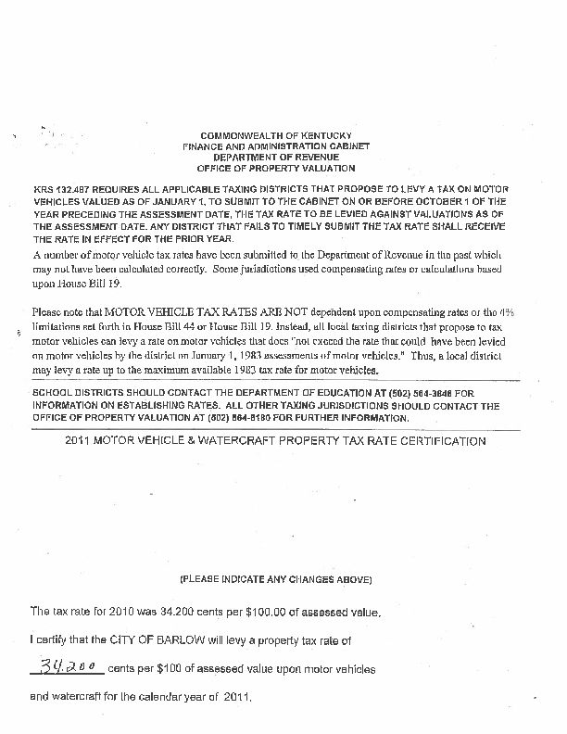
Motor Vehicle Branch
Mails out tax rate requests forms August 1^{st.}
Mails out 2nd request forms September 1st.
KY DOR Motor Vehicle Branch
502-564-8180

Slide 31
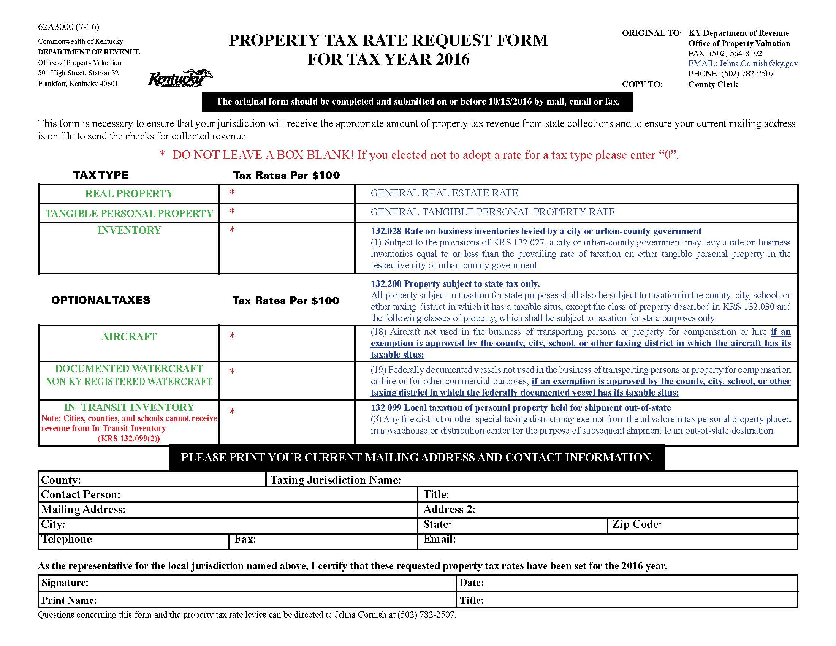

Slide 32
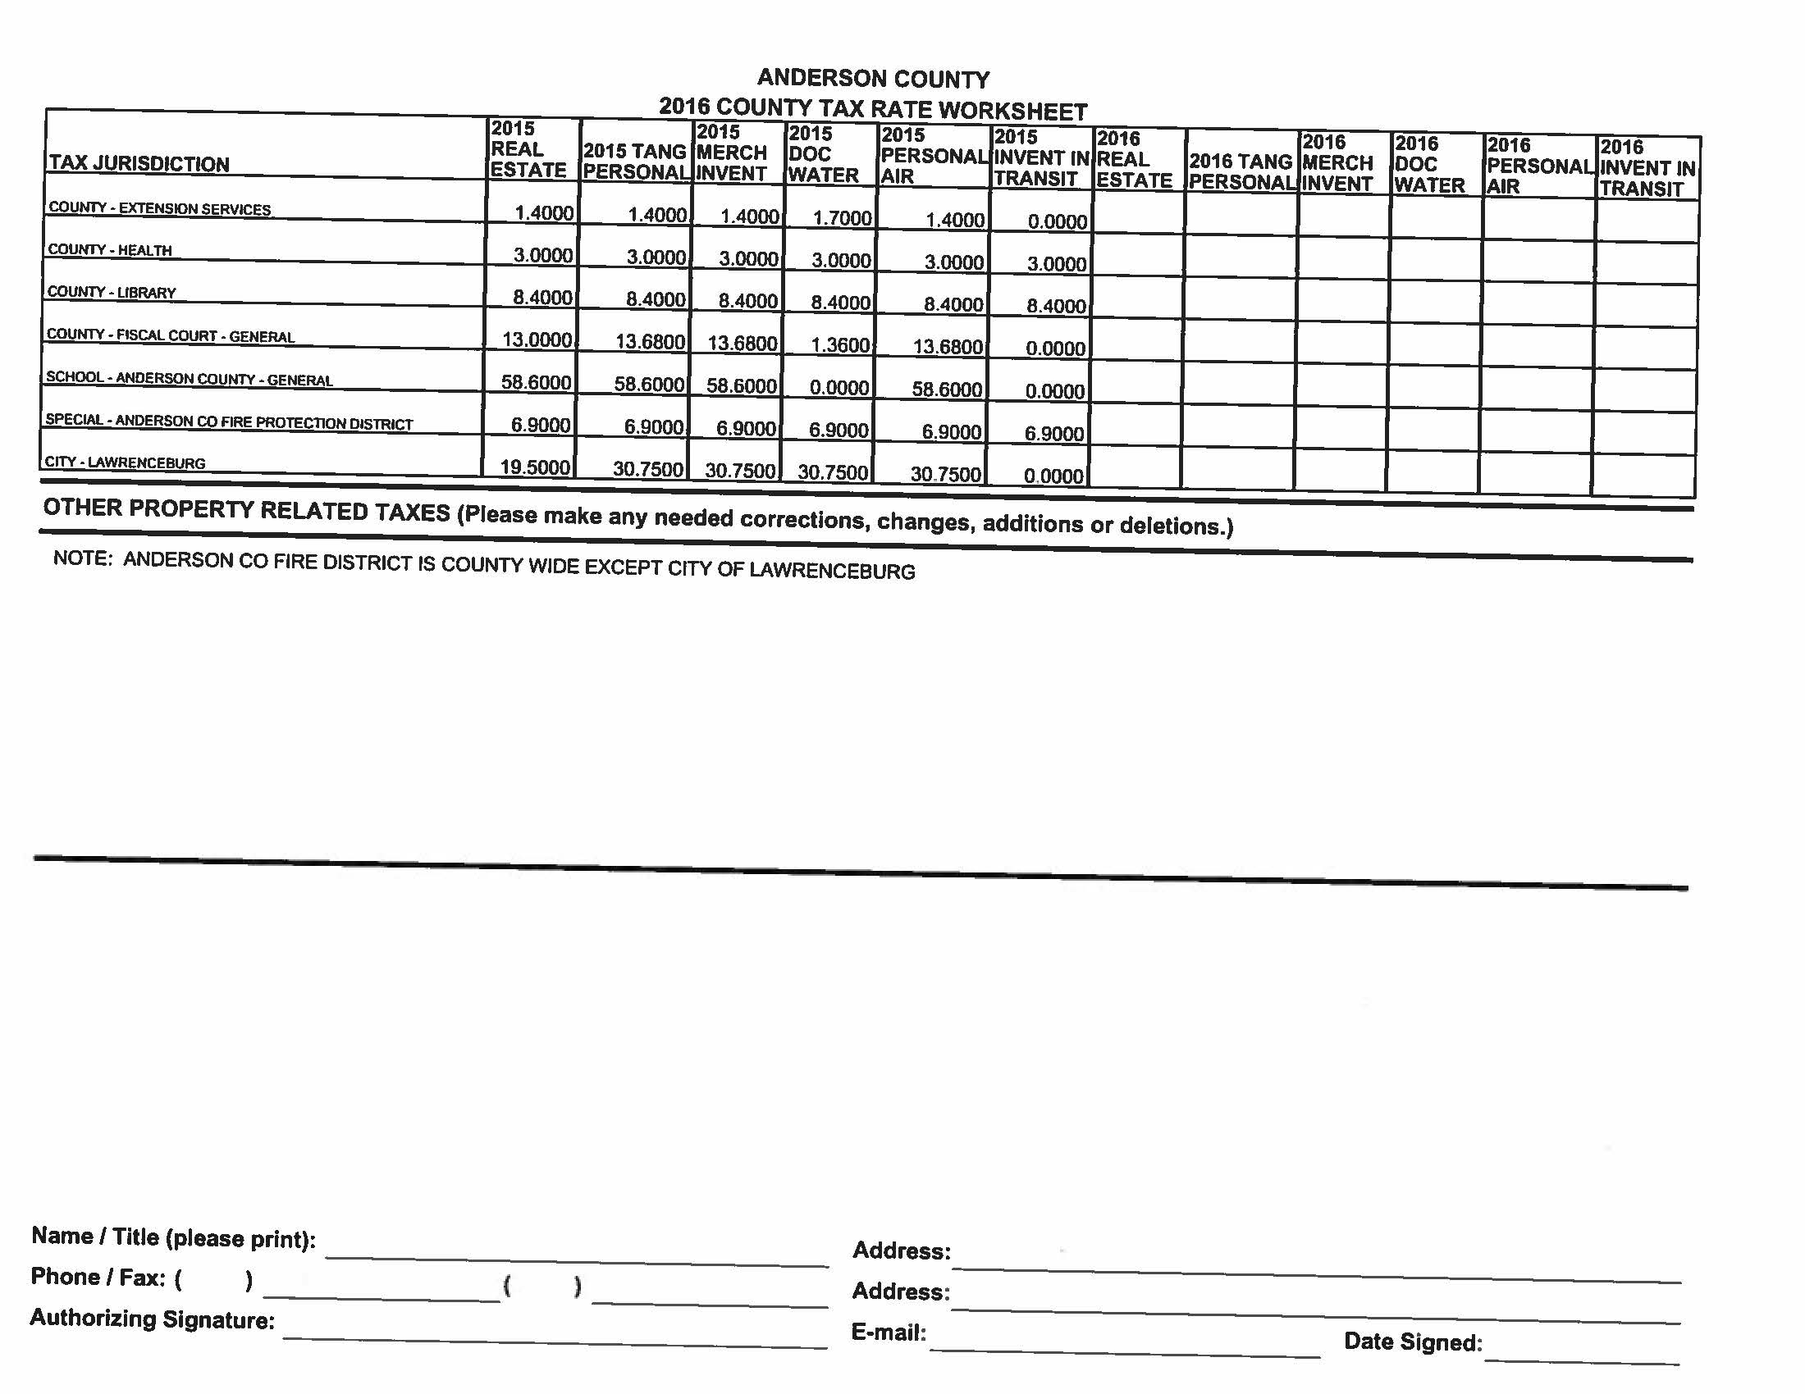

Slide 33
TAX RATE FORM
http://revenue.ky.gov/Forms/62A3000%20(7-16).pdf

Slide 34
Tax Rate Process
Mail Tax Rate Form July 15th to 1400+ taxing jurisdictions
Mail every county clerk a tax rate worksheet
Due 45 days from certification date
DOR enters rates for Omitted Tangible & Tax Rate Book
Update addresses for quarterly distribution
2nd request mailed in November

Slide 35
2016
29 counties complete
24%
As of 10/24/2016
2015
3 counties complete
2.5%
As of 10/31/2015

Slide 36
Benefits
GET THOSE RATES IN EARLY!!!
No interest on Omitted Tangible bills if billed & paid by January 1st.
Jurisdictions get their money FASTER! If taxpayer pays bill before January 1st the jurisdiction will receive funds in their January distribution.
Rate Book complete by January

Slide 37
Problems
Inventory
Jurisdictions are marking ‘0’ for inventory when they shouldn’t be! Only cities, urban-county government and fiscal courts have statutory authority to levy a rate on inventory less than prevailing rate on other tangible property.
132.028 Rate on business inventories levied by a city or urban-county government. (1) Subject to the provisions of KRS 132.027, a city or urban-county government may levy a rate on business inventories equal to or less than the prevailing rate of taxation on other tangible personal property in the respective city or urban-county government
68.246 Rate on business inventories levied by fiscal court. Subject to the provisions of KRS 68.245, a county fiscal court may levy a rate on business inventories equal to or less than the prevailing rate of taxation on other tangible personal property in the respective county.

Slide 38
Inventory is included in the certification or equalized assessment under 5 cent state rate (full local rates) and included on the worksheet for certification assessment for local government under item “G” Tangible Personality.

Slide 39
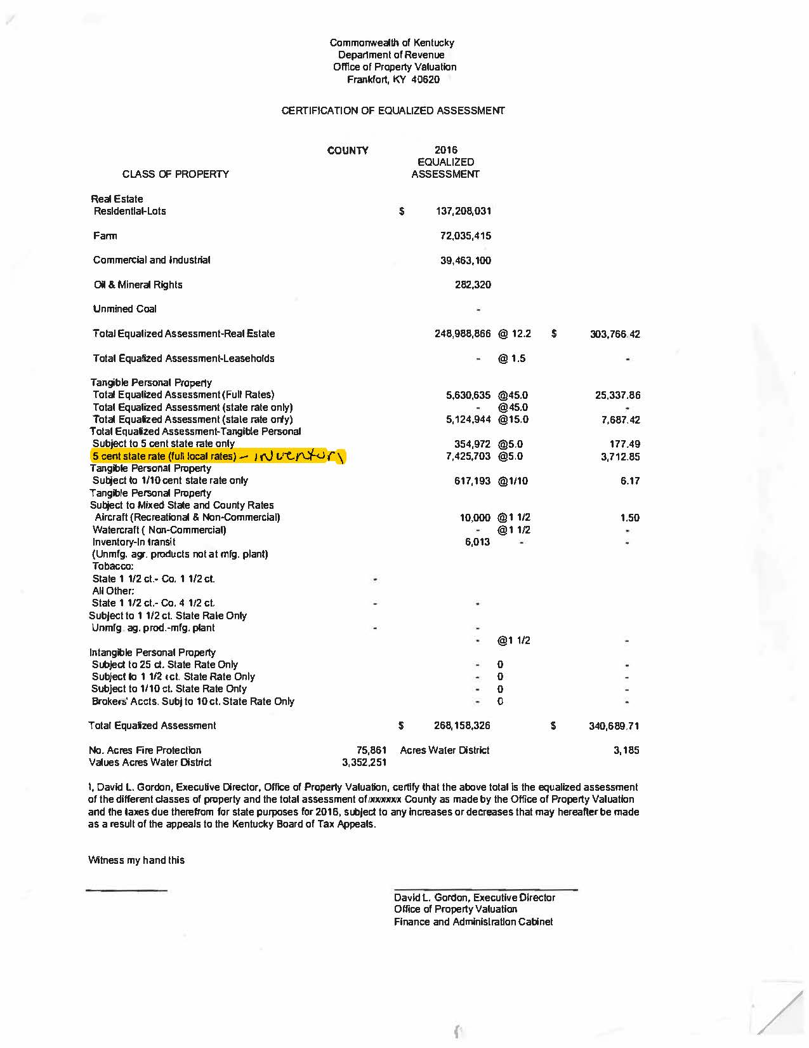

Slide 40
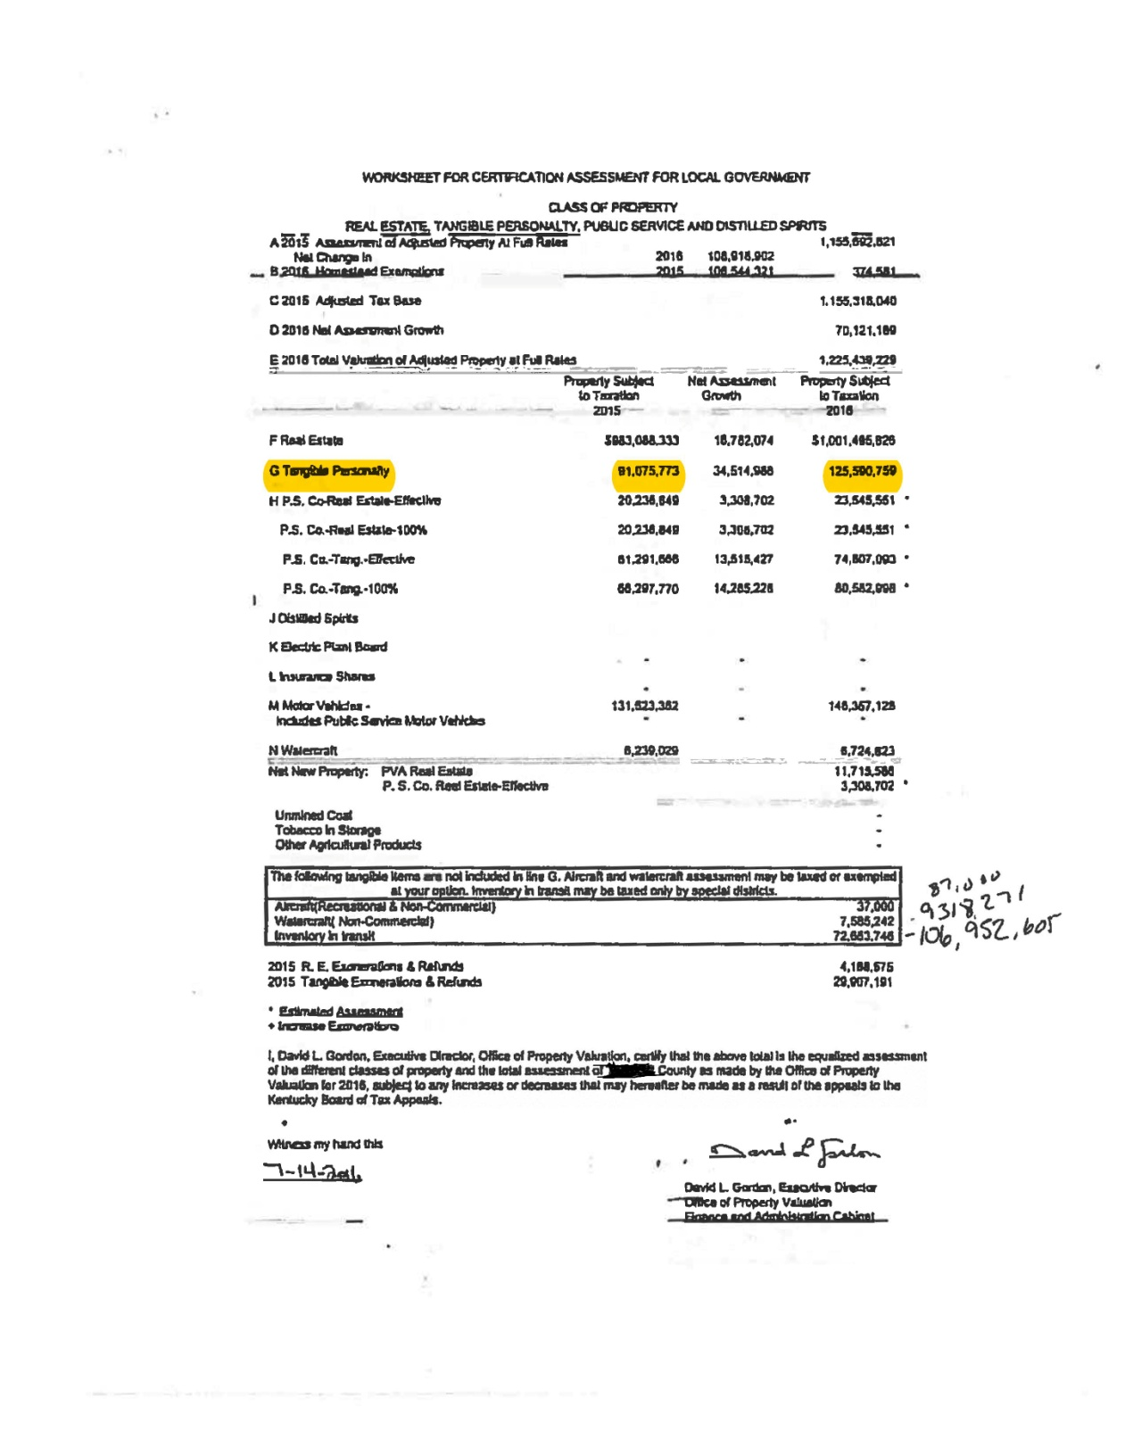

Slide 41
Problems
Optional Taxes
Jurisdictions are reporting their Motor Vehicle rate for Aircraft, Documented Watercraft & Inventory In-Transit when they shouldn’t be!
Motor Vehicles are not part of the calculation of the compensating rate.
Jurisdictions should elect to exempt or use the prevailing tangible rate
NO MOTOR VEHICLE RATES ON THIS FORM (62A300)

Slide 42
Summary
Motor Vehicle rates are due by October 1 by statute or previous year rate is used.
Motor vehicle rate cannot exceed rate set 1/1/1983.
Motor vehicle and registered watercraft assessments are not included in calculation of compensating rates.
Form 62A3000 includes real and tangible rate and does not include motor vehicle rates.
Only fiscal court, cities or urban county governments have statutory authority to exempt inventory.

