Slide 1
Preparing Your Office Budget
Karen Bushart, Clark County PVA

Slide 2
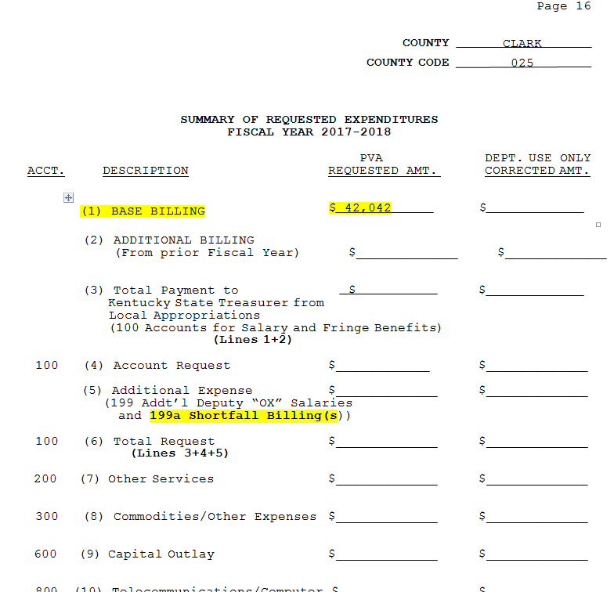
Receive Budget Packet In the packet is estimated deputy hire

Slide 3
Estimates come from the amount you expect to have at year end

Slide 4
Actual funds on hand at year end(6/30/17) when you submit your budget. The formula will change!

Slide 5
Great News!!!
No Need to Change Budget!

Slide 6
Budgeted Amount Based on estimate
199 $42,042
Actual Deputy Hire $41,703
Only $339 Difference

Slide 7
What historically has happened
PVA Fiscal would change your budget to the actual deputy hire amount.
This leaves you with an unbalanced budget
In my example I was under budgeted $339
Forced to do a budget amendment for minimal amount
Ridiculous! Waste of Time and Effort

Slide 8
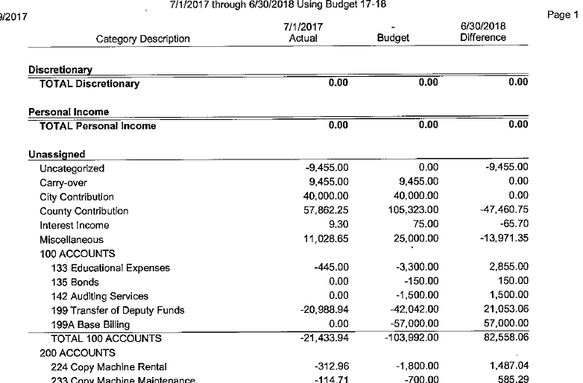
Example A 100 Accounts do NOT exceed

Slide 9
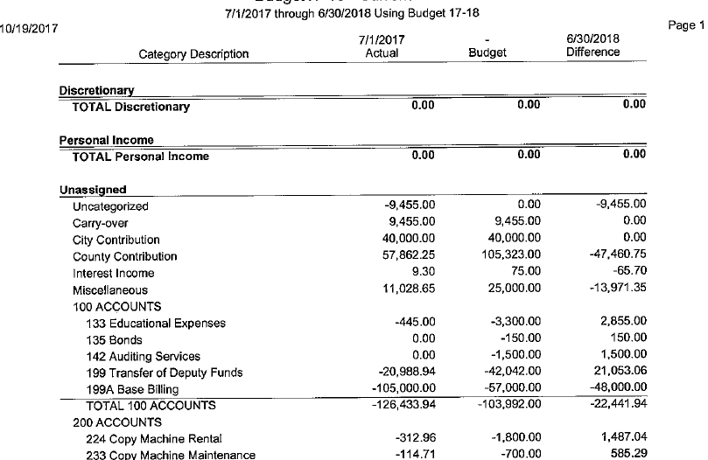
Example B 100 Accounts EXCEED Budget

Slide 10
Amend budget WHEN?
Total of the 100, 200, 300, 600 or 800 exceed the budgeted amount

Slide 11
Why would it exceed?
Could have been a much larger deputy hire bill, as county appropriation increased
Hired an OX employee so had unanticipated expenditure

Slide 12
What to do?
Fill out an amended budget form
Move money from another category account, i.e. 200, 300, 600, 800 to your 199 account.

Slide 13
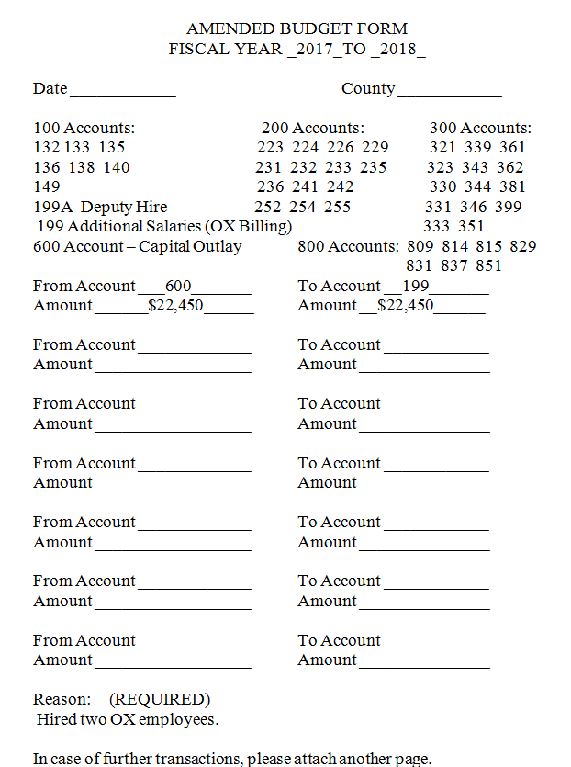
Amended Budget Form

Slide 14
What will happen 2018-2019?
PVA Fiscal will send you a blank budget page
PVA Fiscal will send you a deputy hire estimate on a separate page
You will fill out your budget based on the estimate sent or a slightly higher estimate
For example, I may have budgeted $45,000 based on my $42,042 estimate

Slide 15
Not necessary to amend budget
If my actual deputy hire came in at $44,000…no budget amendment
If my actual deputy hire came in at $46,500, may not be necessary to amend budget depending on my total 100 account expenditures
If my actual deputy hire came in at $57,000, due to appropriation increase, I would amend my budget.

Slide 16
Questions?
??????????????????????????????????????

