Slide 1
Tax Rolls, Reports and More

Slide 2
Real Estate and Personal Property form the tax base from which tax rates are applied to fund government services
Property assessed by PVA or self reporting forms
Tax rolls created and certified
Tax Bills prepared and mailed
Tax rates set by local taxing authorities
Taxpayer receives tax bill and pays to tax collector
Collector distributes to Taxing Authorities
Taxing Authorities use money to provide services

Slide 3
Current Tax Roll Process

Slide 4
TPT system is shut down, except for inquiry purposes in preparation for the new tax year.
TPT can be opened back up at the request of the PVA for demographic changes when the tax bills are mailed out.
November - January

Slide 5
TPT systems are preparing to open back up. There will be an e-mail sent out to all PVA offices and/or the message screen will indicate the system is up for entering returns.
FEBRUARY

Slide 6
Data entry (through TPT System) is still going on in the counties.
Preliminary tax rolls can be requested during this time up until your county closes and is highly recommended.
Preliminary Reports
Request through Laura Steele (laura.steele@ky.gov). Needed information includes: sort order and print or document direct.
MARCH - JUNE

Slide 7
Data Entry still going on and preliminary tax rolls processed by request of PVA office. Preliminary reports are recommended to check the tax rolls
Ready to Close – Sent email to Laura Steele (laura.steele@ky.gov) or call 502-564-7113. All requests communicated by 3:00 pm will be submitted on that day.
NO PROCESSING REQUESTS FOR CLOSING TAX ROLL UNTIL 30 DAYS AFTER DUE DATE OF RETURN – JUNE 15
JUNE - SEPTEMBER

Slide 8
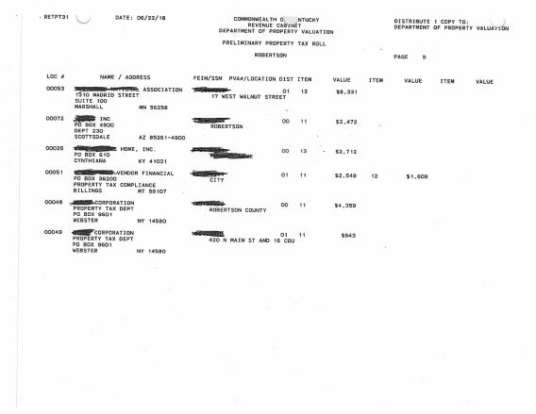
CERTIFIED BY LOCAL VALUATION
Once certified by Local Valuation the tax rolls are mailed to the County along with the dataset (CD) via certified mail.
Local Valuation Certification Process Starts in July.

Slide 9
New Tax Roll Process
All will be the same with the exception of how you will receive the tax roll and data set (CD).
The tax roll and preliminary tax rolls will be put on a server in which the PVA office will have access to download the report and review totals prior to certification. SHOULD NOT BE SHARED UNTIL CERTIFIED.
The dataset file (CD) will be put on the server when local valuation certifies the totals.

Slide 10
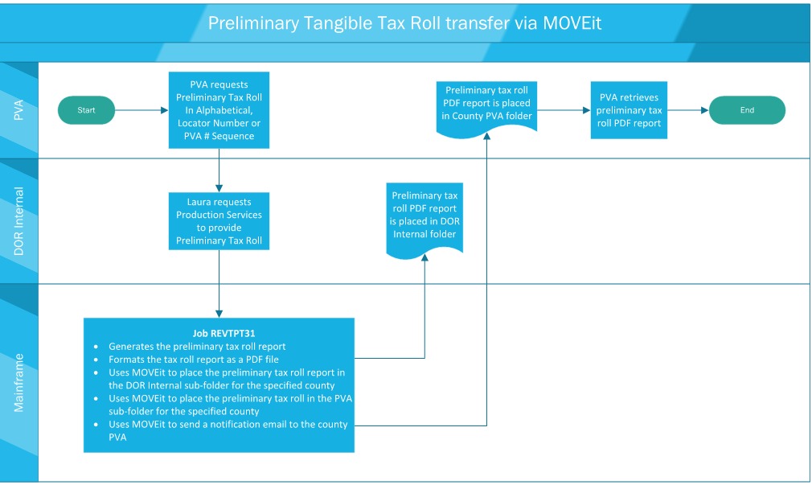

Slide 11
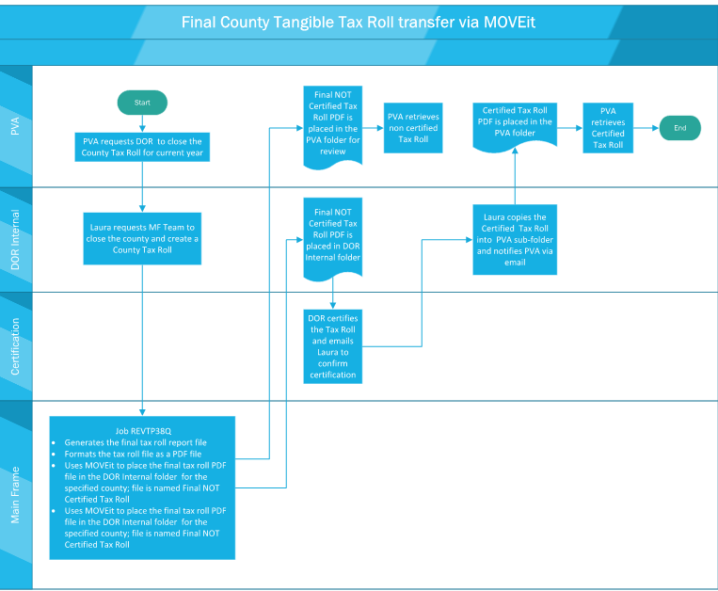

Slide 12
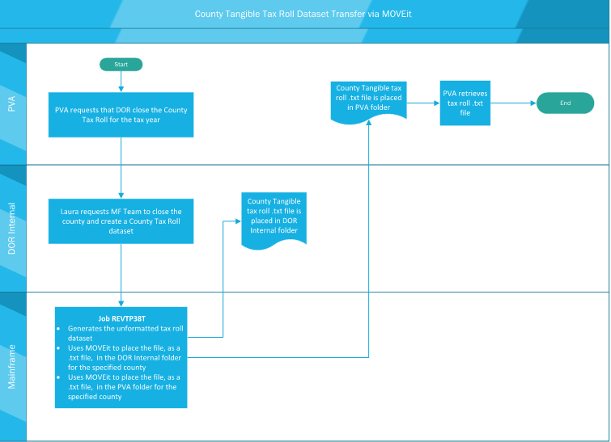

Slide 13
Share Drive for Tangible Tax Rolls
//eas/dfs/REVShared/Property_Tax_ Roll_CY
FOLDERS BY COUNTY
PVA Subfolder under each County Folder

Slide 14
BENEFITS
You will have access to the tax roll prior to certification to allow you to review and check totals, compare to prior years, etc.
More efficient you will receive immediately when uploaded to the site so will not have to wait on the mail.
You will be able to save the document to a public terminal for viewing and if you choose to you can print the document.
Save time, resources such as mailing and handling cost.

Slide 15
Access to Share Drive
I will be sending a form out via email to complete and return for you to tell us who is to have access to the share drive. The PVA will have access and whomever they designate.
If possible it should be someone who already has an AD account set up. If not we will set one up.
If the form is not completed and returned only the PVA will have access to download and obtain the tax rolls.

Slide 16
Projection reports for Boats and Motor Vehicles are provided to DOR in May and then will be provided to each PVA office via fax, mail or Move-it.
The projection reports provide assessed values estimate collections by Month by taxing jurisdiction.
The taxing jurisdictions may request this during their budgeting and rate setting process.
MOTOR VEHICLE AND BOAT PROJECTION REPORTS

Slide 17
Currently receive a statewide tax roll in a text document via Move-it previously via CD.
Not User Friendly
Hard to read or get County information from entire state wide tax roll.
Working with DOR and Transportation to provide a tax roll by County for vehicles and boats.
Will be in format that is user friendly, PDF, excel or both.
Break out via County
Will be able to download and put on public terminal if taxpayers inquire about the roll.
MOTOR VEHICLE & BOAT TAX ROLLS

Slide 18
Share Drive Access Form

Slide 19
RPT_5504/V5607 Vehicle Batch Report
88 report
This report lists all address changes, which have occurred within the AVIS system. The PVA shall properly assign the new situs county and/or district to all vehicles listed on this report. The PVA should properly district the vehicles on this report upon receipt. These reports must be worked in proper sequential order. As long as the customer notifies the county clerk of an address change within 15 days of moving, the PVA will be informed of such address change via this report.

Slide 20
R5532 On-line Transfer Report
On-line transfer report is printout of all motor vehicle records, which have been transferred into a PVA’s county form another jurisdiction. During the month, PVAs will correct the designation for county of ad valorem by changing their own county code to that of another county. This should only be done when the taxpayers address was actually in that other county and the vehicle was located in that other county as of January 1st of the tax year. Transfers can only be made from your county to another county. PVAs can never change another county’s code.

Slide 21
R5537 On-line change 88 report
This report informs the PVA of all changes of value, tax status, county code and taxing district. This report informs PVA of the date of transaction and initials used by the one who performed transactions. The PVA should verify all transactions for accuracy and compare them to their documentation. DOR may rescind any transaction which is not properly documented.

Slide 22
PSC TAX ROLL

Slide 23
PSC TAX ROLL

Slide 24
PSC TAX ROLL Important Points
The PSC tax roll contains public service and centrally assessed companies.
The PSC tax roll is fluid or has a tendency to change.
Is available upon request to the PVA.
The PSC Branch begins certifications in the fall and continues up into the next year when the complex assessments are completed.

Slide 25
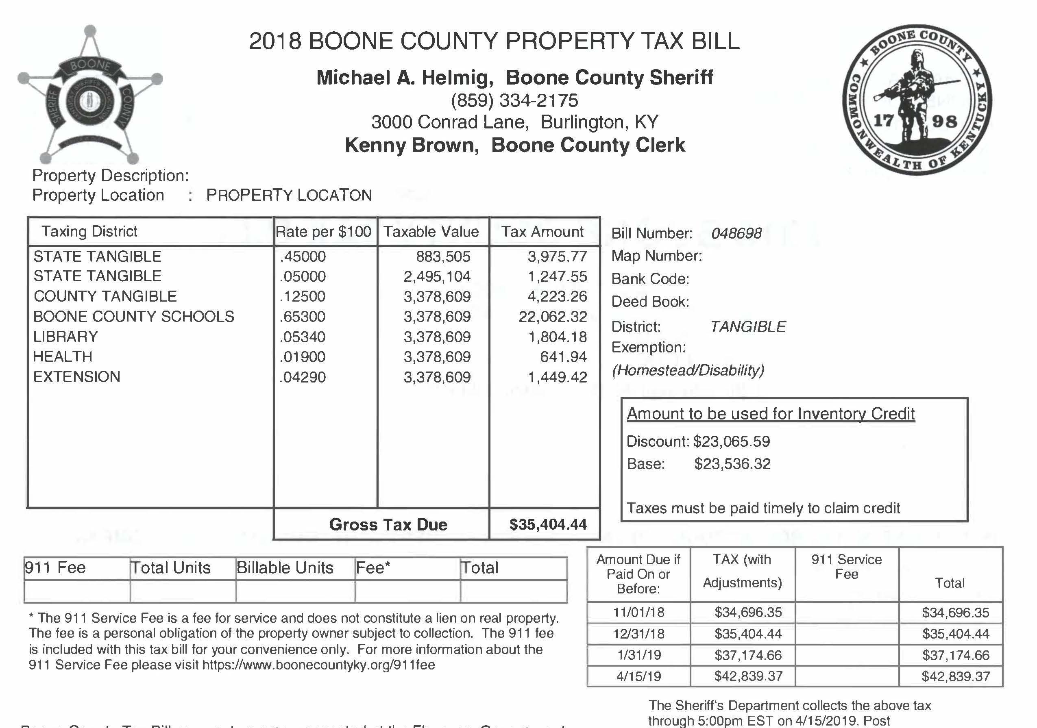
Inventory Credit

Slide 26
BOONE COUNTY PVA
CINDY ARLINGHAUS MARTIN
BOONE COUNTY SHERIFF
BOONE COUNTY FISCAL COURT
BARRY-INFORMATION SYSTEMS DEPARTMENT (IN HOUSE TAX SYSTEM)

Slide 28
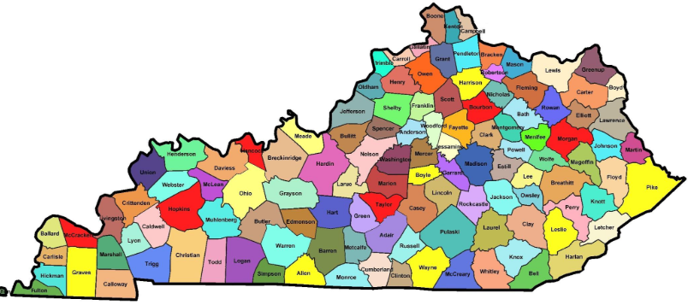
You can also split your content
Can you collaborate with your local government offices and third party vendors to create tax bills with the inventory credit information?

Slide 29
WHY?
Positive forward thinking approach that assist the taxpayers you serve.
Will show taxpayers that government is seeking to assist them.
Can benefit your offices by reducing phone calls when taxpayers begin to learn more about the inventory tax credit.
Creates positive public relations that is proactive and responsive.

Slide 30
PVA websites and District codes
Some PVA offices have the district code “AVIS” code on the website.
Taxpayers can then utilize the website to find their district code.
Multiple location returns
Inventory calculator presented on Thursday they will need the district code to use effectively.

Slide 31
Local Distributions Omitted Personal Property

Slide 32
Boats &Vehicles; Freddie Free roader; Apportioned Vehicles;
RR Carlines; Commercial Watercraft

Slide 33
Public Service & Centrally Assessed Assessments
2016
REAL
6,235,334,027
PERSONAL
14,714,801,408
2017
REAL
6,322,861,405
PERSONAL
14,547,824,947

Slide 35
CONTACTS
Cathy Thompson, Director State Valuation
Cathy.Thompson@ky.gov
502-561-5117
Glyndon Woosley, Assistant Director State Valuation
Glyndon.Woosley@ky.gov
502-782-9667
Robert Carbin, Business Appraiser, Public Service Branch
Robert.Carbin@ky.gov
502-564-7148
Jehna Cornish, Section Supervisor, Personal Property Omitted Section
Jehna.Cornish@ky.gov
502-782-2507
Darrell Young, Section Supervisor, Personal Property Compliance Section
Darrell.Young@ky.gov
502-564-2729
Carin Brumback, Section Supervisor, Motor Vehicle Section
Carin.Brumback@ky.gov
502-782-5862

