Slide 1
Property Tax Collections
Justin Taylor, Section Supervisor
Megan Greene, Taxpayer Specialist II
Andy Himmel, Revenue Collection Officer
Jon Owens, Revenue Program Officer

Slide 2
What Does the Department Of Revenue (DOR) Collect?
Real & Personal Property
Certificate of Delinquencies
Real Property: KRS 133.010(4) & KRS 134.010(11)
Personal Property: KRS 133.010(5) & KRS 134.010(8)

Slide 3
What Happens When DOR Get Bills?
DOR receives bills after the Clerk’s Sale
Skip research is completed to ensure proper billing
Bills are entered into the Delinquent Property Tax System (DPT)
Collection action
begins

Slide 4
Skip Research
Skip research is a vital part of the collection process. To ensure that bills are sent to the correct taxpayer, it is essential that research is thorough and correct.
DOR must have the following to collect:
The correct SSN or FEIN
The name of the taxpayer or business
The most current mailing address
If the taxpayer is deceased the names of heirs.
The “ In care of” if someone other than the taxpayer should received notices.

Slide 5
What Resources are Available for Skip Research?
Allows you to research by name, address, SSN, FEIN, date of birth
Runs Comprehensive Reports for current addresses
Lists possible relatives, neighbors, or associates
Provides possible phone numbers
National obituary archive
Allows you to search for deceased taxpayer by name, date of death, or state
Locates obituaries which usually list possible heirs
Allows you to search for businesses that are registered with Secretary of State
Will tell you if business is active, defunct, etc.
Lists possible contacts for businesses

Slide 6
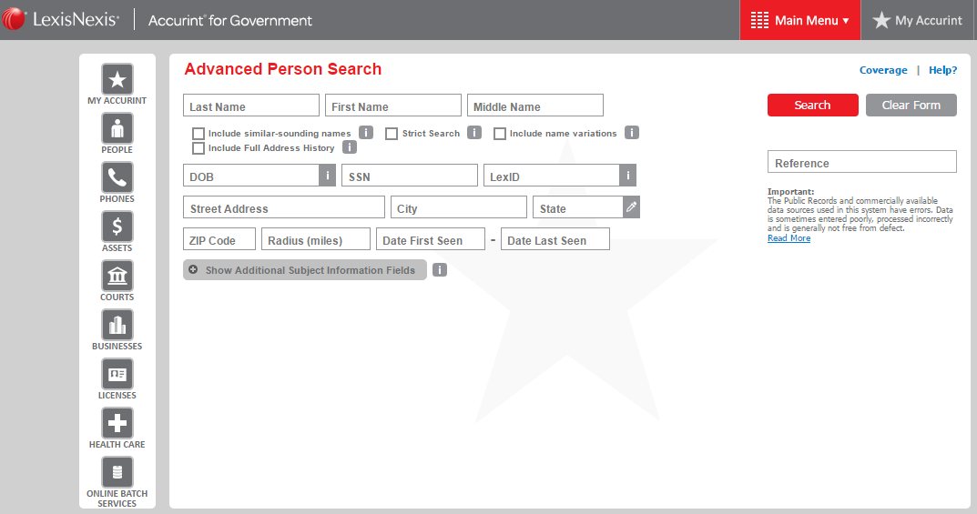

Slide 7
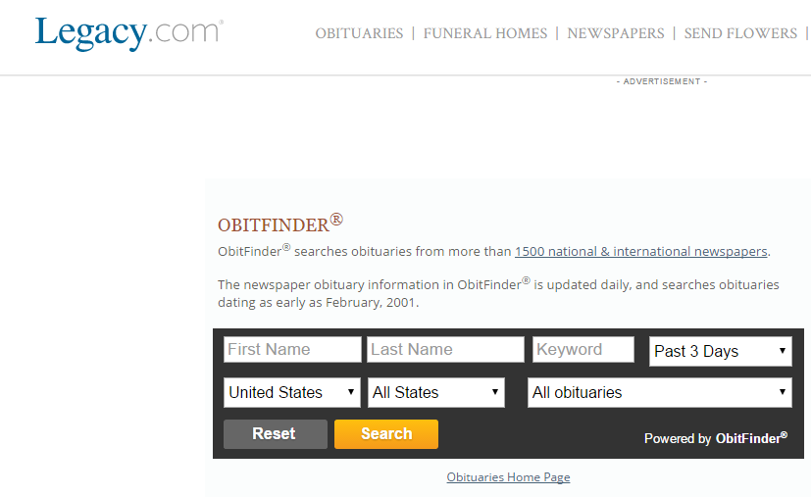

Slide 8
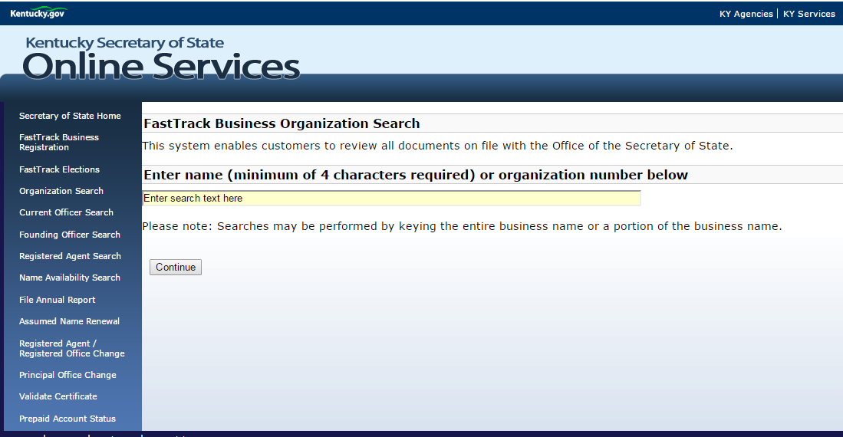

Slide 9
Mobile Homes/Parks Owners vs. Renters Collections of Both
132.260 Rental space for parking mobile homes and recreational vehicles -- Report -- Right to inspect. Every person providing rental space for the parking of mobile homes and recreational vehicles shall by February 1 of each year report the Name of the Owner and type and size of all mobile homes and recreational vehicles not registered in this state under KRS 186.655 on his premises on the prior January 1 to the property valuation administrator of the county in which the property is located…

Slide 10
Delinquent Property Tax System (DPT)
DPT is:
A web-based billing system for delinquent property tax bills
Bill entry available for years 1998-present.
Bills entered into DPT are eligible for offsets. Either Federal and/or State vendor offsets and/or KY Income Tax refunds.
County Attorney retains 20% fee when bills are entered by the county for offset purposes only.

Slide 11
Options for DPT
Option
The County Attorney retains control of all collection efforts
Option
The Count Attorney forfeits their 20% fee
Option
The County Attorney retains control of collections and 20% fee for a desired number of years
The county retains the 20% County Attorney fee
When bills are paid in full to DOR, funds are distributed to the county on a quarterly basis
The County Attorney retains control indefinitely
Bills are sent to Frankfort for DOR staff to research and enter bills
When bills are paid in full to DOR, funds are distributed to the county on a quarterly basis
The Count Attorney can specify a year for the system to convert the bills to DOR control (at this time 20% fee is forfeited)
When bills are paid in full to DOR, funds are distributed to the county on a quarterly basis
Offset Only
Full DOR Control
Partial DOR Control

Slide 12
DPT Reports
DPT creates 6 reports that assist in communication and record-keeping.
30 and 60 day Notices: Gives DOR the ability to file with the county clerks a list of names and addresses of notices mailed
30 and 60 Day Return Notices Undeliverable: Gives DOR the ability to file with the county clerk and PVA a list of names and addresses of notices that were returned undeliverable by the postal service
Bills Paid/Payment Reversal: Gives the county clerks the ability to view bills paid in full and bills with reversed payments.
County Tax Summary: Provides search capabilities to determine the number of bills and total liability entered by a particular user per county per year
DPT Bills Entered: Gives a detailed list of all bills entered into DPT by the county, year, taxpayer, name, and tax bill number.
Query Balance: Gives county clerks a real-time total due on an individual’s bill

Slide 13
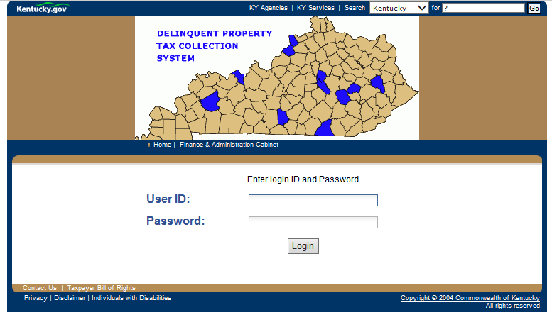
Is DPT User Friendly?
Using DPT does not require one to be “computer savvy”. DPT is an easy to follow, step by step software.

Slide 14
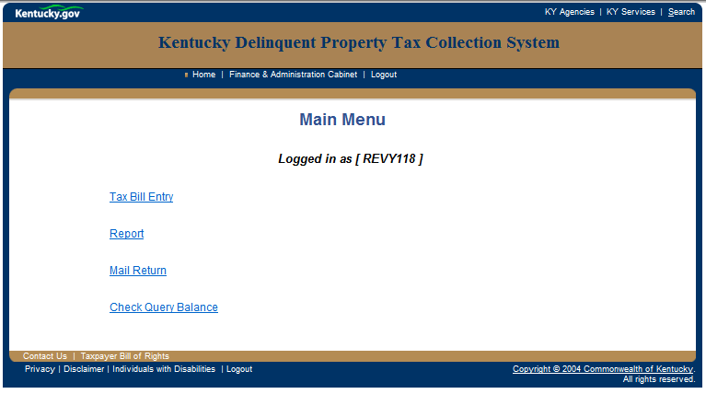

Slide 15
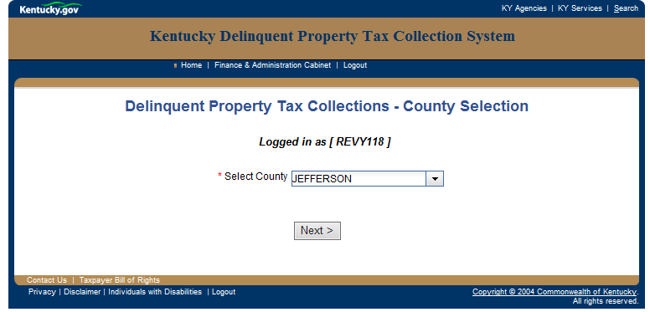
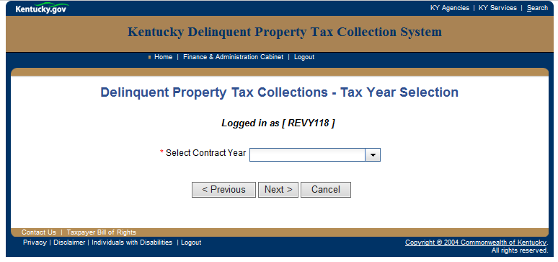
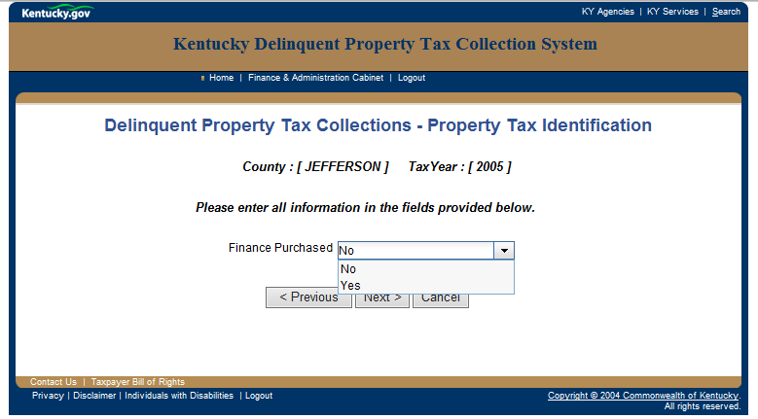
Tax Bill Entry
Page 1
Page 2
Page 3

Slide 16
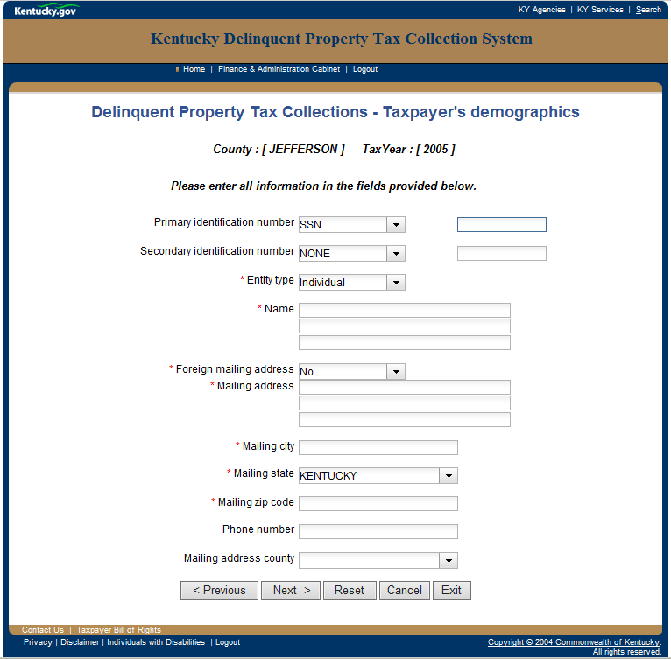
Page 4

Slide 17
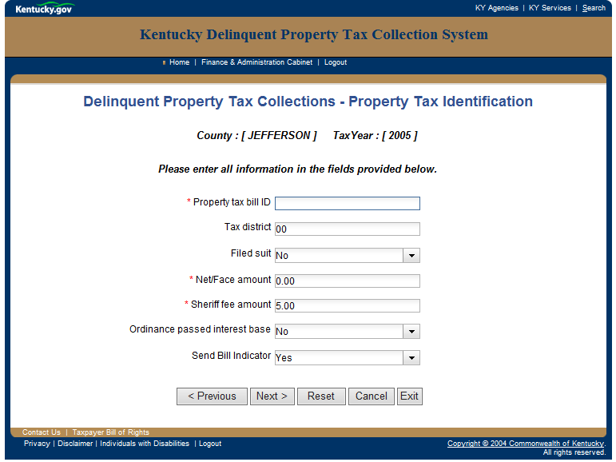
Page 5

Slide 18
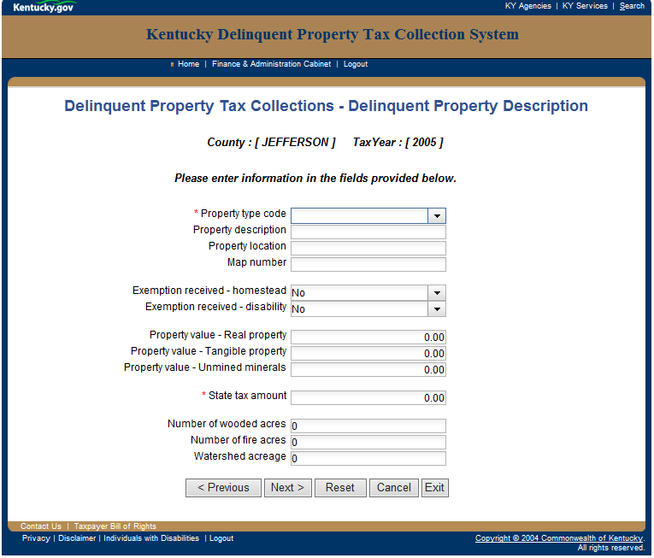
Page 6

Slide 19
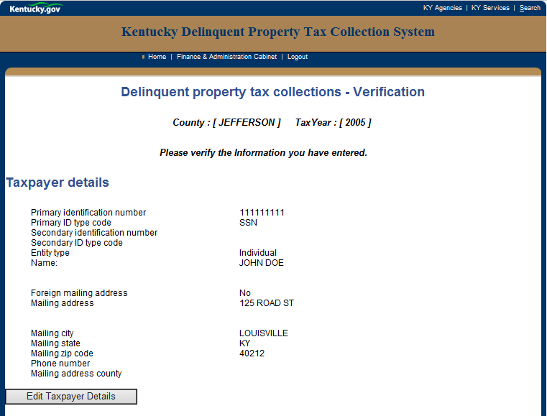
Summary Page
Page 7

Slide 20
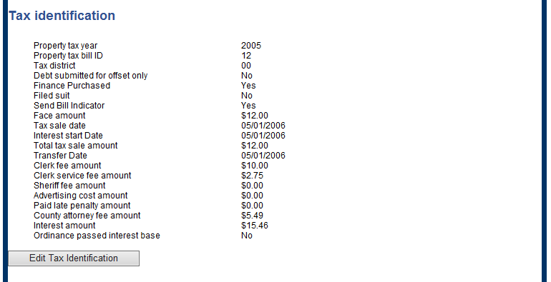
Summary Page Continued
Page 7 Continued

Slide 21
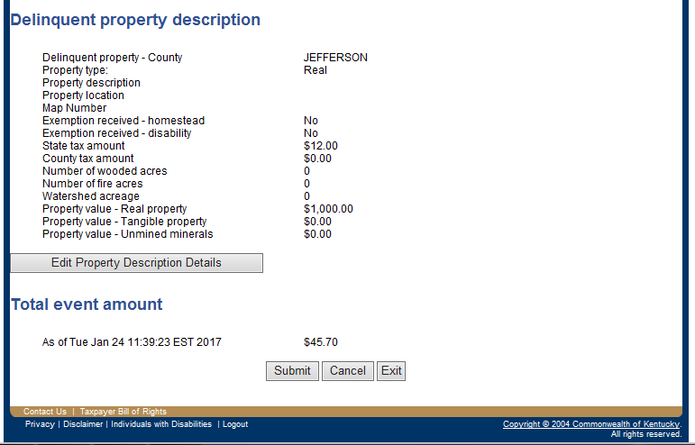
Summary Page Continued
Page 7 Continued
One this page you can edit information if needed, cancel the bill, or submit the bill.

Slide 22
What Are the Benefits of DPT?
Increased Collection Opportunities: Whether bills are entered for offset only or for full DOR enforced collections, DPT allows additional avenues for collections not available at the local level. DPT also aids in collecting bills that are past the Statute of Limitations.
Increased Resources to Find Taxpayers: When DPT letters are returned due to bad addresses, DOR personnel are able to utilize skip research tools for taxpayers who may have moved out of state or have had an address change.
Increased Revenue for the County: Counties utilizing DPT have seen a drastic increase of revenue from the collection of delinquent property taxes. Some counties experienced a 50% increase in collection totals over previous years.

Slide 23
After Bills are Entered into DPT the Collection Process Begins
Bank Levies
Wage Garnishments
Seize Property
Issue State Claims
KY Individual Income Offsets
Federal Vendor Offsets
State Vendor Offsets

Slide 24
DPT Letter
After bills are entered in DPT, our system issues taxpayers this letter. The letter details our interest rates, where to mail payments, and contact information for questions.

Slide 25
Computer Assisted Collections System-Government (CACS-G)

Slide 26
CACS-G System-Legal Actions

Slide 27
CACS-G Financials

Slide 28
CACS-G Cross Reference

Slide 29
CACS-G List of Assets

Slide 30
CACS-G Assets Continued

Slide 31
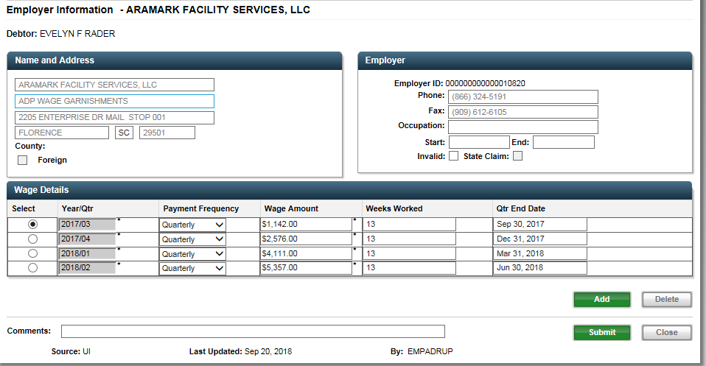
Bank & Wage Assets

Slide 32
Federal/State Vendor Offsets
Federal/State Vendor Offsets are government contract payments that DOR intercepts to pay delinquent property taxes.

Slide 33
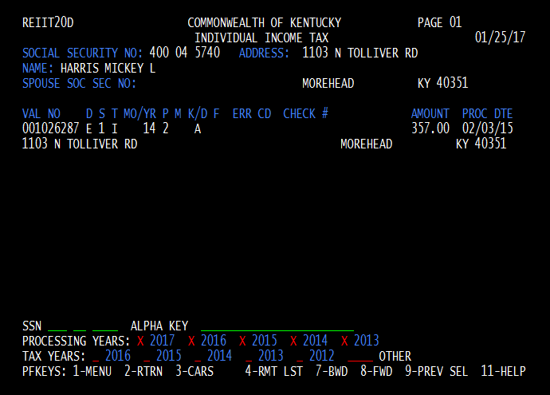
KY Individual Income Refund Offset
DOR will offset any state income tax refund that a taxpayer may be eligible for and apply funds to their delinquent tax bills .
Indicates a refund is flagged for offset
Amount of refund that DOR has flagged

Slide 34
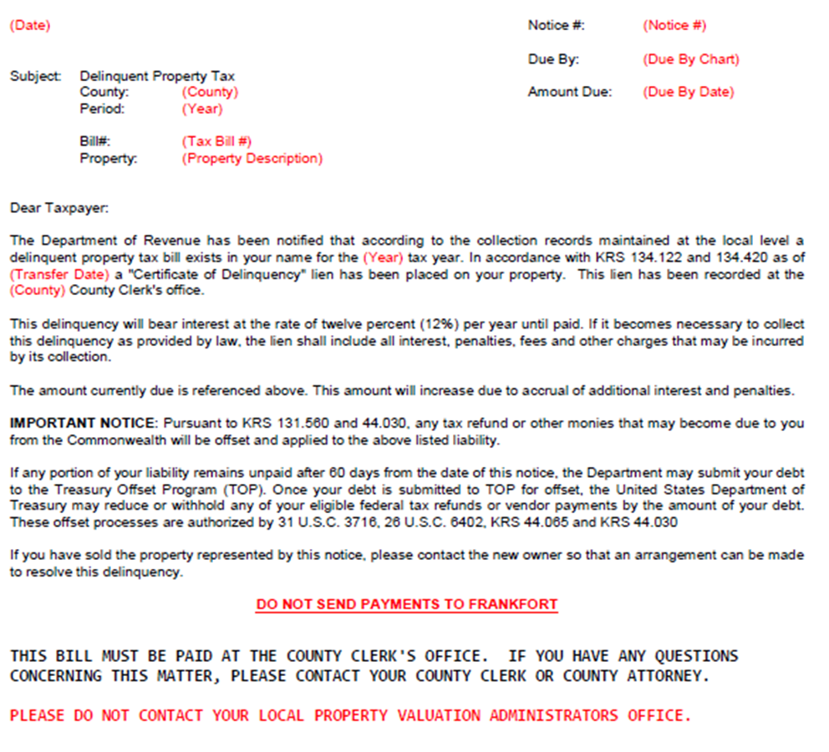
DPT Vendor Offset Correspondence

Slide 35
Wage garnishments for state employees
Can garnish up to 100% of the taxpayer’s paycheck
State
Claims

Slide 36
**Important**
Once a taxpayer has made a payment to either DOR or the county (this includes any offset DOR may get), payments must continue to be made at that locale. A taxpayer (if at all possible) should avoid making payments to both locations on the same bill. This can create distribution errors as our systems are not compatible.

Slide 37
How do we all stay connected?

Slide 38
Clerk Reports
Each month DOR receives reports for bills that are in DOR control that have been paid on or in full to the county. These bills are then voided from our systems to prevent overpayment.

Slide 39
Quarterly Distribution Reports
DOR will send monthly reports to show money received by DOR for delinquent property tax bills. Counties then receive the payments quarterly.

Slide 40
Exonerations
When bills need adjusted (name changes, full exonerations, etc.) DOR can only make those changes if we receive an exoneration from the county. In the slides that follow you will see examples we have received from other counties. The only exoneration you will receive from DOR is for bankruptcy purposes. That exoneration example is also provided.

Slide 41
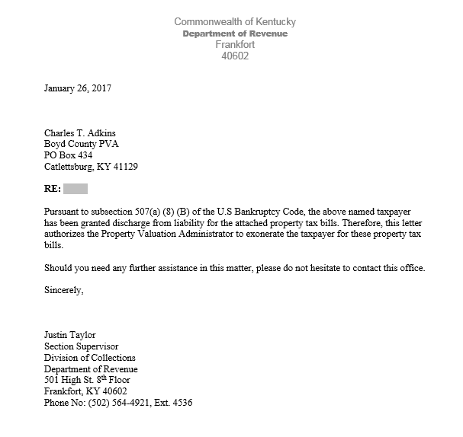
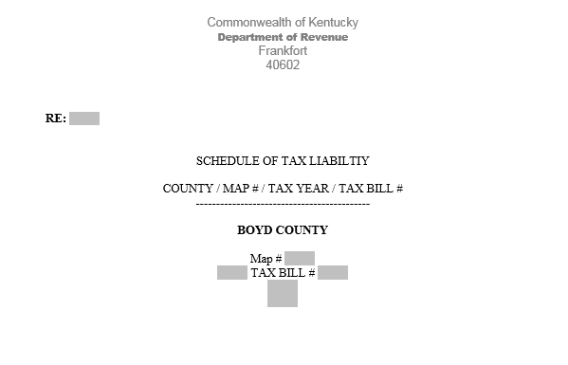
Bankruptcy Exoneration
This is the only type of exoneration you will receive from DOR.

Slide 42
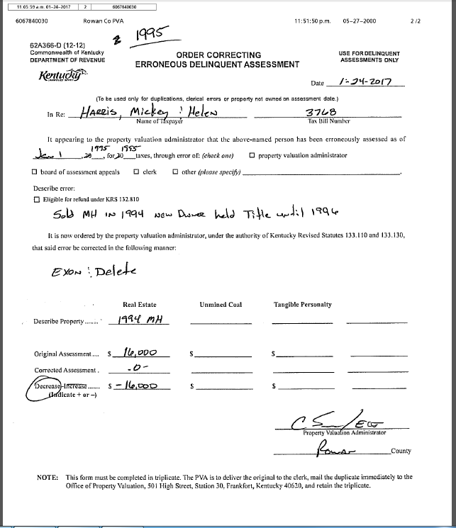
Example of an exoneration from another county to DOR.

Slide 43
But What Happens if You Need Help with DPT?
You can also call DOR Property Tax Collections any time for help at 502-564-4921 ext. 5356.
DOR will provide hands on training for any county that wishes to use DPT. This includes us coming to your county and teaching your staff how to properly do skip research, enter bills, and look up reports in DPT.
DOR will provide you with a DPT manual. This manual provides examples, screenshots, samples of letters issued, and report samples.

Slide 44
Contact Information
Section Supervisor:
Justin Taylor
Phone: 502-564-4921 ext. 4536
Fax: 502-564-9571
Revenue Officers:
Andy Himmel, Megan Greene, Jon Owens
Phone: 502-564-4921 ext. 5356
Fax: 502-564-9571
Email: Justin.taylor@ky.gov
Email: dor.realproperty@ky.gov

