Slide 1
What is an AUP (Agreed Upon Procedure)
and Why do I need one?

Slide 2
Today we will discuss:
What an AUP is,
The differences between an audit and an AUP,
Why PVAs have AUP’s,
How often an AUP is required,
Financial records that should be kept by the PVA office, and
Other Guidance and Rules….

Slide 3
What is an AUP?
An agreed-upon procedures (AUP) engagement is one in which a practitioner is engaged to issue, or does issue, a practitioner’s report of findings based on specific agreed-upon procedures applied to subject matter for use by specified parties.

Slide 4
What Does That Mean?
An agreed-upon procedures engagement often referred to as an AUP, is a type of engagement where specific procedures are performed and results are reported.
Before beginning an AUP, the Auditor’s office (APA) has entered into an agreement with the Department of Revenue (and in agreement with the PVA Association) to establish the scope of work and procedures to be performed. These are agreed to by the PVA prior to beginning the AUP.
The APA would then report the findings or results of the procedures.

Slide 5
What is the difference between Audits and AUPs.
Purpose of an Audit
Purpose of an AUP
Auditor provides an opinion on whether the financial statements are presented fairly, in all material respects, in accordance with an applicable financial reporting requirements.
Auditor performs specific procedures agreed to by the official.
Written report is issued that describes the procedures applied and the findings.

Slide 6
Why do PVAs have AUPs?
KRS 132.601 Administrator's use of local funds accruing to office -- Bank account -- Expenditures – Supervision

Slide 7
Why do PVAs have AUPs?
KRS 132.601
(1) The property valuation administrator of any county may, after receiving an approved budget from the Department of Revenue under the provisions of KRS 132.590, obligate and spend any of the local funds accruing to his office under the provisions of KRS 132.590 or KRS 132.285, over and above that actually used in compensating his deputies and assistants, for the purchase of any maps, lists, charts, materials, supplies or equipment, or for other expenses necessary to the proper assessment of property or preparation and maintenance of assessment rolls and records

Slide 8
Why do PVAs have AUPs?
KRS 132.601
(2) The property valuation administrator shall maintain a bank account for the management of local funds received by his office under the provisions of KRS 132.590 and 132.285. Beginning with the 1990-1992 biennium, at the end of each fiscal year a cumulative carryover of local funds equivalent to the total annual local appropriation for the ending fiscal year or five thousand dollars ($5,000), whichever is greater, shall be retained. Any funds in excess of this amount shall be refunded by the property valuation administrator no later than August 1 to the appropriating local governments in direct proportion to their respective appropriations.

Slide 9
Why do PVAs have AUPs?
KRS 132.601
(3) Expenditures made by the office of the property valuation administrator under the provisions of subsection (1) of this section shall be governed by procurement procedures adopted by the fiscal court in the county administrative code required by KRS 68.005. However, after approval of the annual budget for the office of the property valuation administrator provided in KRS 132.590 by the Department of Revenue, the necessity of the expenditure shall not be questioned by the fiscal court. The Department of Revenue shall have neither authority nor responsibility in the auditing of expenditures made by the property valuation administrator from locally appropriated funds. The Auditor of Public Accounts shall assume the responsibility.

Slide 10
What about my expenditures/ disbursements?
Allowable Disbursements (Expenditures=Disbursements)
Department of Revenue (DOR) Policy - PVA Office Allowable Disbursements –PVAAllowableExpenditures.pdf
This document can be found on the DOR - PVA network
For an expense to be allowable, it must be
Necessary for the Office
Beneficial to the public/county
Not personal in nature
Reasonable in amount and content
Additionally the expense must be evidenced by adequate supporting documentation.

Slide 11
What about my expenditures/ disbursements?
Unallowable Disbursements:
Any disbursements not meeting allowability criteria could be disallowed.
Disallowed expenses are required to be reimbursed by the PVA from personal funds.

Slide 12
How often do I need an AUP?
PVA AUP’s are performed on a four year rotation. Each PVA will have one AUP performed during each 4 year term.
Additionally, any time a PVA leaves office, a close-out AUP is performed by the APA in conjunction with the Department of Revenue’s close out procedures.

Slide 13
PVA Accounting Records
The following records must be maintained by each PVA Office:
Bank statements (including copies of cancelled checks (Front and Back).
Deposit tickets
Bank reconciliations
Disbursements ledger
Receipts ledger

Slide 14
PVA Accounting Records
The following records must be maintained by each PVA Office:
Note: a check register does not qualify as a receipt or disbursements ledger
Paid invoices or bills
Copies of receipts issued to customers
Agreements and Contracts
Inventory list

Slide 15
PVA Accounting Records
The following records must be maintained by each PVA Office:
New employees list
Ethics forms
Office closing dates
PVA office closing form
Names, phone #’s, and email addresses of city clerks

Slide 16
PVA Accounting Records
The following records must be maintained by each PVA Office:
Revenue Cabinet- Request for deputy salary allocation
Final approved budget
Time sheets or daily sign in log sheets
Note: Additional items may be needed, however the items listed above are the items we would like for the PVA to have ready upon our arrival.

Slide 17
PVA Accounting Procedures
Additional accounting procedures that should be performed by the PVA include:
Daily deposits
Issuance of receipt for all monies collected in PVA office
Establishment of internal controls to safeguard assets
Maintaining ledgers for all accounts
Inclusion of all accounts into actual financial reports
Proper classification of all expenses into the budget

Slide 18
Current PVA AUP Procedures
1. Determine if the PVA has a receipts ledger, a disbursements ledger, and reconciles bank records to books each month. Re-perform the year-end bank reconciliation (June 30, 2018) for all bank accounts, to determine if amounts are accurate.
2. Confirm all payments made by the city to the PVA. Compare recorded city receipts to confirmed payment amounts obtained from city governments. Also compare recorded city receipts to the DOR list of cities to determine if the PVA has accounted for all city receipts.
3. Confirm all payments made by the fiscal court to the PVA. Compare the budgeted statutory contribution by fiscal court to the legally required amounts calculated by the Department of Revenue. Trace the fiscal court payments from the fiscal court statutory contribution budget account to the PVA’s local bank account.

Slide 19
Current PVA AUP Procedures
4. Judgmentally select 15 disbursements from PVA records and agree amounts to paid invoices or other supporting documentation and bank records. Determine if the disbursement is for official business. Inspect all credit card statements (if any) to determine if disbursements are for official business.
5. Compare capital outlay disbursements with supporting documentation, bank records, and proper purchasing procedures. Observe newly acquired assets. Determine if assets were added to the PVA’s Capital Asset Inventory List.
6. Scan vehicle lease agreements, personal service contracts, and professional service contracts for cost schedules and compare to actual payments. Determine if services received were appropriate, for official business, and properly authorized.

Slide 20
Current PVA AUP Procedures
7. Compare the PVA’s final budget to actual disbursements to determine if the PVA overspent in any account series.
8. Determine whether timesheets are completed, maintained, approved, and support hours worked by inspecting one pay period’s timesheets
9. Determine whether cash balances were properly transferred from the former PVA to the new PVA.
10. For PVA office employees hired between July 1, 2017 and June 30, 2018, determine if the Ethics Certification Form has been completed and is on file.
11. Determine if the PVA’s office was closed any day other than the state’s approved holidays. If so, determine if the proper procedures and forms were completed.

Slide 21
Other Guidance and Rules:

Slide 22
132.420 Duties and powers of property valuation administrator
The property valuation administrator shall, subject to the direction, instruction, and supervision of the Department of Revenue, make the assessment of all property in his county except as otherwise provided, prepare property assessment records, and have other powers and duties relating to assessment as may be prescribed by law or by the department.

Slide 23
KRS 132.370 Property valuation administrator's status as state official
(1) There shall be a property valuation administrator in each county in lieu of a county assessor. Property valuation administrators shall be state officials and all deputies and assistants of their offices shall be unclassified state employees.

Slide 24
132.605 Purchase of assessment supplies and equipment by county -- Purchase and loan by Department of Revenue-- Maintenance
(1) The fiscal court of each county shall have jurisdiction and the power to purchase and supply to the property valuation administrator any maps, lists, charts, materials, supplies, equipment or instruments which are reasonably necessary for a complete and accurate assessment of property in the county. The Department of Revenue is authorized to purchase and loan any property valuation administrator such maps, lists, charts, materials, supplies, equipment or instruments as are urgently needed by any property valuation administrator, provided that the Department of Revenue keeps a record thereof.
(2) The fiscal court of any county shall provide for the maintenance of all maps, lists, charts, materials, supplies, equipment or instruments owned by a county or supplied to it by the Department of Revenue or by any source in cooperation with the Department of Revenue for the purpose of facilitating the assessment of property.

Slide 25
132.590 Compensation of administrator -- Salary schedule -- Salary adjustments -- Advancement in grade -- Biennial budget -- Allowances for deputies -- Payments by fiscal court
(12) After submission to the State Treasury or to the property valuation administrator of the county funds budgeted for personnel compensation under subsection (11) of this section, the fiscal court shall pay the remainder of the county appropriation to the office of the property valuation administrator on a quarterly basis. Four (4) equal payments shall be made on or before September 1, December 1, March 1, and June 1 respectively. Any unexpended county funds at the close of each fiscal year shall be retained by the property valuation administrator, except as provided in KRS 132.601(2). During county election years the property valuation administrator shall not expend in excess of forty percent (40%) of the allowances available to his office from county funds during the first five (5) months of the fiscal year in which the general election is held.

Slide 26
FINANCE AND ADMINISTRATION CABINET MANUAL OF POLICIES AND PROCEDURES Amended February 2016 This manual is incorporated by reference as an administrative regulation, pursuant to 200 KAR 5:021.
This manual provides guidance over the following related subjects:
USE OF PUBLIC FUNDS
CASH HANDLING
INTERNAL CONTROLS (INCLUDING THE SEGREGATION OF DUTIES)

Slide 27
Questions………..

Slide 28
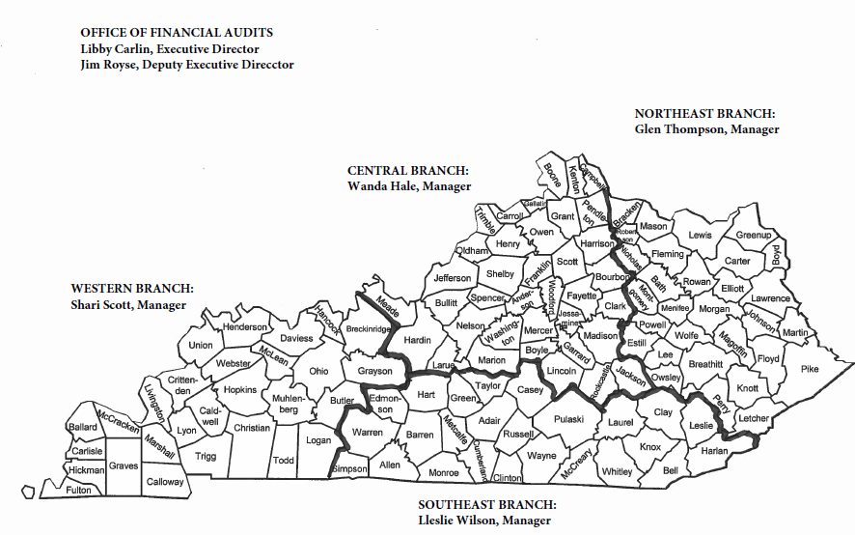
APA County Assignments

Slide 29
Contact Information Auditor of Public Accounts 209 St. Clair Street Frankfort, KY 40601 502-564-5841
PVA AUP/Western Branch Manager- Shari Scott
502.209.2881 shari.scott @ky.gov
Northeast Branch-Glen Thompson
502.209.2919 glen.thompson@ky.gov
Central Branch-Wanda Hale
502.209.2862 wanda.hale@ky.gov
Southeastern Branch-Lleslie Wilson
502.209.2886 lleslie.wilson@ky.gov

Slide 30
Additional Contact Information
Quality Assurance Branch Manager- Mary Hopkins
502.209.2900 mary.hopkins@ky.gov
Deputy Executive Director-Jim Royse
502.209.2924 james.royse@ky.gov
Executive Director- Libby Carlin
502.209. 2868 libby.carlin@ky.gov
Assistant State Auditor – Farrah Petter
502.209. 2902 farrah.petter@ky.gov

