Slide 1
Researching Historical Deeds
This workshop will assist you in research methods to locate old deeds.

Slide 2
The problem
Properties for which the PVA office has no deed reference
In many cases it is because the owner has been dead for many years

Slide 3
Long ago and far away…
A relative, in many cases one of the heirs, of the last fee simple owner told the PVA office, “just send me the bill.”

Slide 4
What happens when the “in care of” person dies
Sometimes yet another generation will tell the PVA “start sending me the bill.”
In other cases the “in care of” person dies and no one steps forward and the taxes go unpaid.

Slide 5
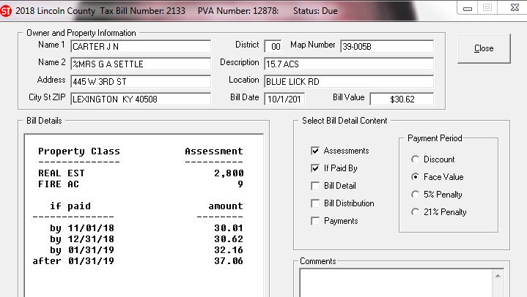
This 2018 bill was returned with a note
“Mrs. G A Settle has been dead for 18 years!”

Slide 6
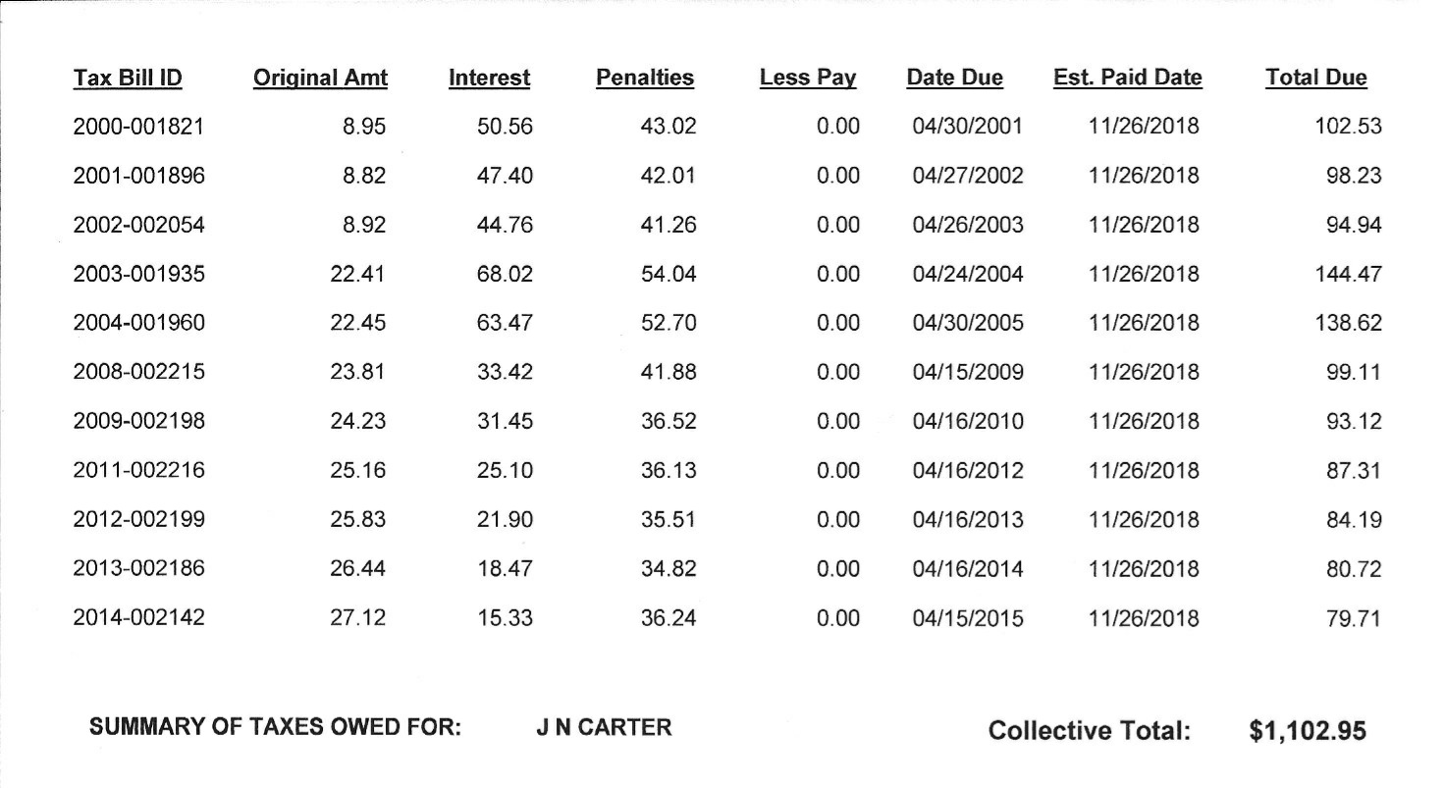
As a results no taxes have been paid in years…

Slide 7
To complicate matters several years of taxes have been bought by third party purchasers!

Slide 9
What are the problems associated with not having a deed reference?
At some point it creates an extra burden on the PVA, Sheriff, County Clerk and County Attorney and eventually on the tax payers.

Slide 10
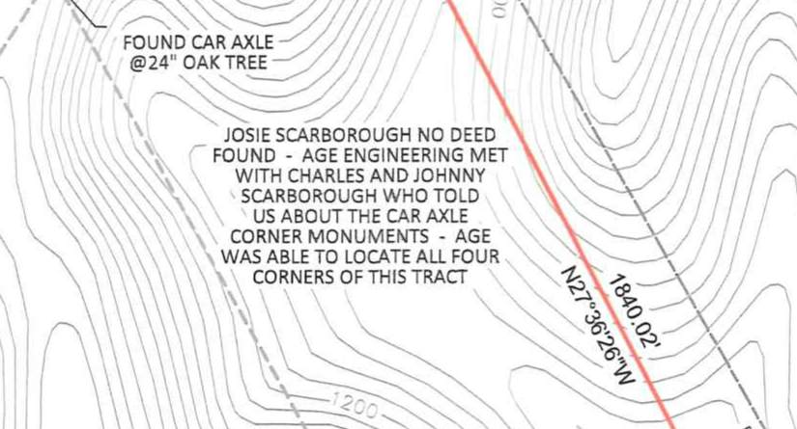
What are the problems associated with not having a deed reference?
Adjoining property owners who need to have their property surveyed have greater expense because it takes the surveyors more time. More time, more money!

Slide 12
What are the problems associated with not having a deed reference?
Without a fee simple deed the rightful owners or heirs cannot enjoy the full “bundle of rights”
Right to use
Right to sell
Right to lease or rent
Right to enter or leave
Right to give away
Right to refuse to do any of these

Slide 13
Here is a prime example right behind the pVA office… within sight of the courthouse

Slide 14
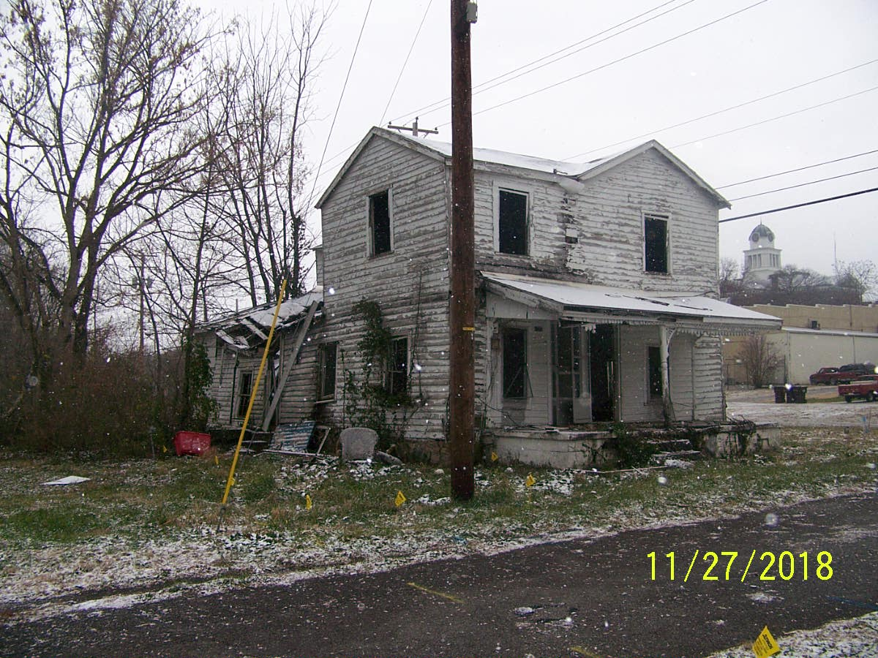

Slide 15
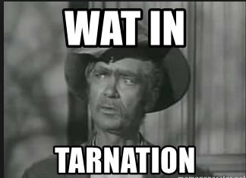

Slide 16
In order to effectively conduct historical research you must remember this acrostic…

Slide 17
O d d

Slide 19
ORGANIZE

Slide 20
WITHOUT ORGANIZATION
You will wind up…

Slide 22
Develop a series of questions
Begin by trying to get basic information on the person whose name is on the property record.
When and where were they born?
When and where did they pass away?
Were they married, did they have children or siblings?
DID THEY HAVE A WILL?

Slide 23
These questions will give you timeline for the person

Slide 24
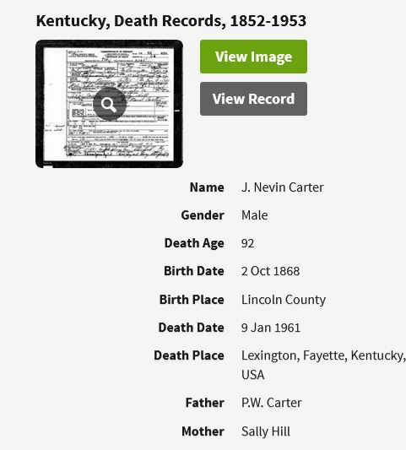

Slide 25
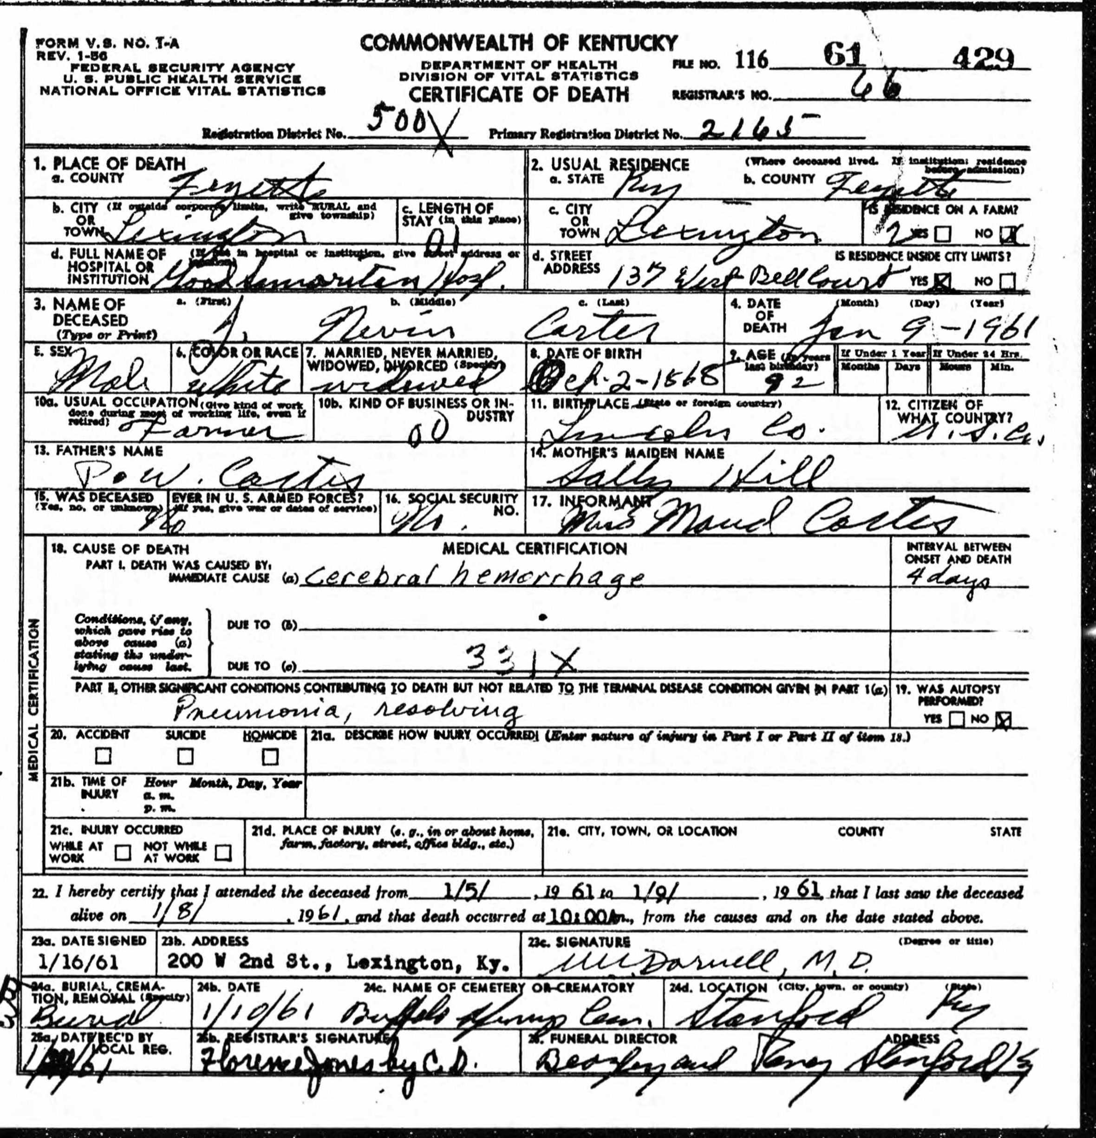
I saved actual death certificate

Slide 26
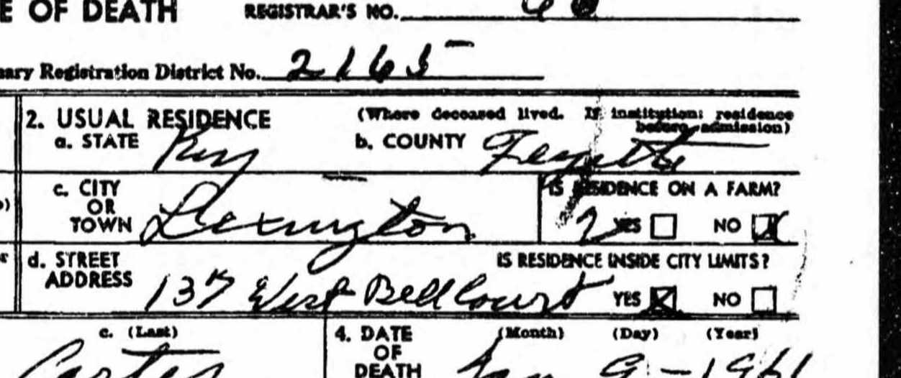
This provided a couple of crucial tidbits of information
# 1 Address at the time of death

Slide 27
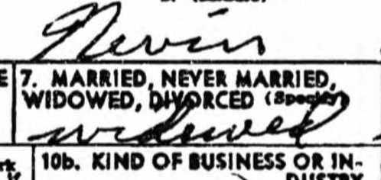
# 2 Marital status at the time of death

Slide 28
NOW THAT I HAD A DATE OF DEATH I CHECKED FOR A WILL
Keep in mind his death certificate says he was widowed

Slide 29
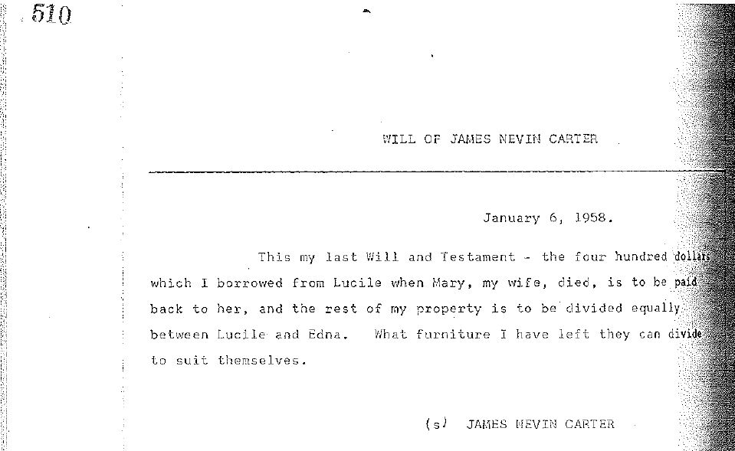

Slide 30
So when trying to locate a deed reference establishing a time frame is extremely helpful
This narrows your search to a specific time period
This is extremely helpful especially if the person had a very common name or bought and sold a lot of property.

Slide 31
A returned tax bill raised a red flag

Slide 32
Zora brown was born in 1897 and died in 1966
This information narrowed my search for a deed from 1918 to 1966

Slide 33
Is there a quick way to narrow the search even more?
YES!

Slide 34
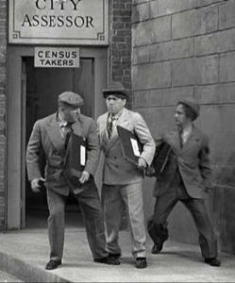
To The
Census!

Slide 35
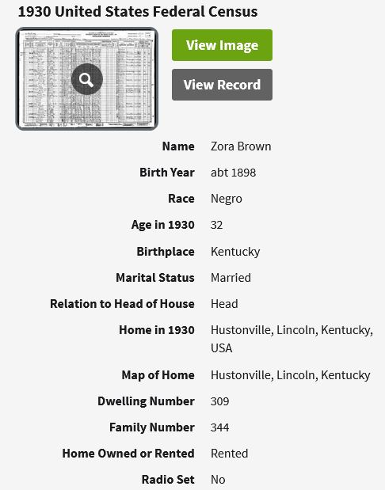
On the 1930 Census Zora Brown reports that he “rents” where he lives

Slide 36
Now we know not to look for a deed before 1930

Slide 37
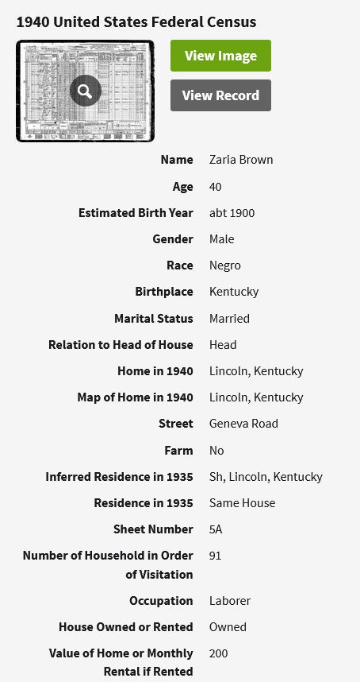
On the 1940 Census Zora Brown reports that he “owns” where he lives

Slide 38
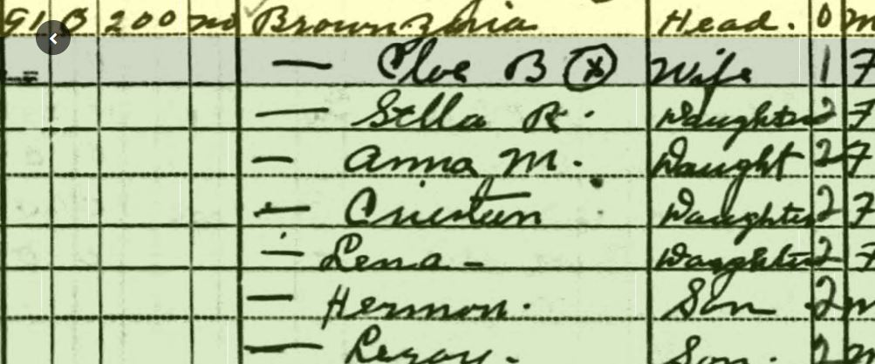
Now instead of searching over 48 years
(1918-1966) we can search for a 10-year time frame
(1930-1940)

Slide 39
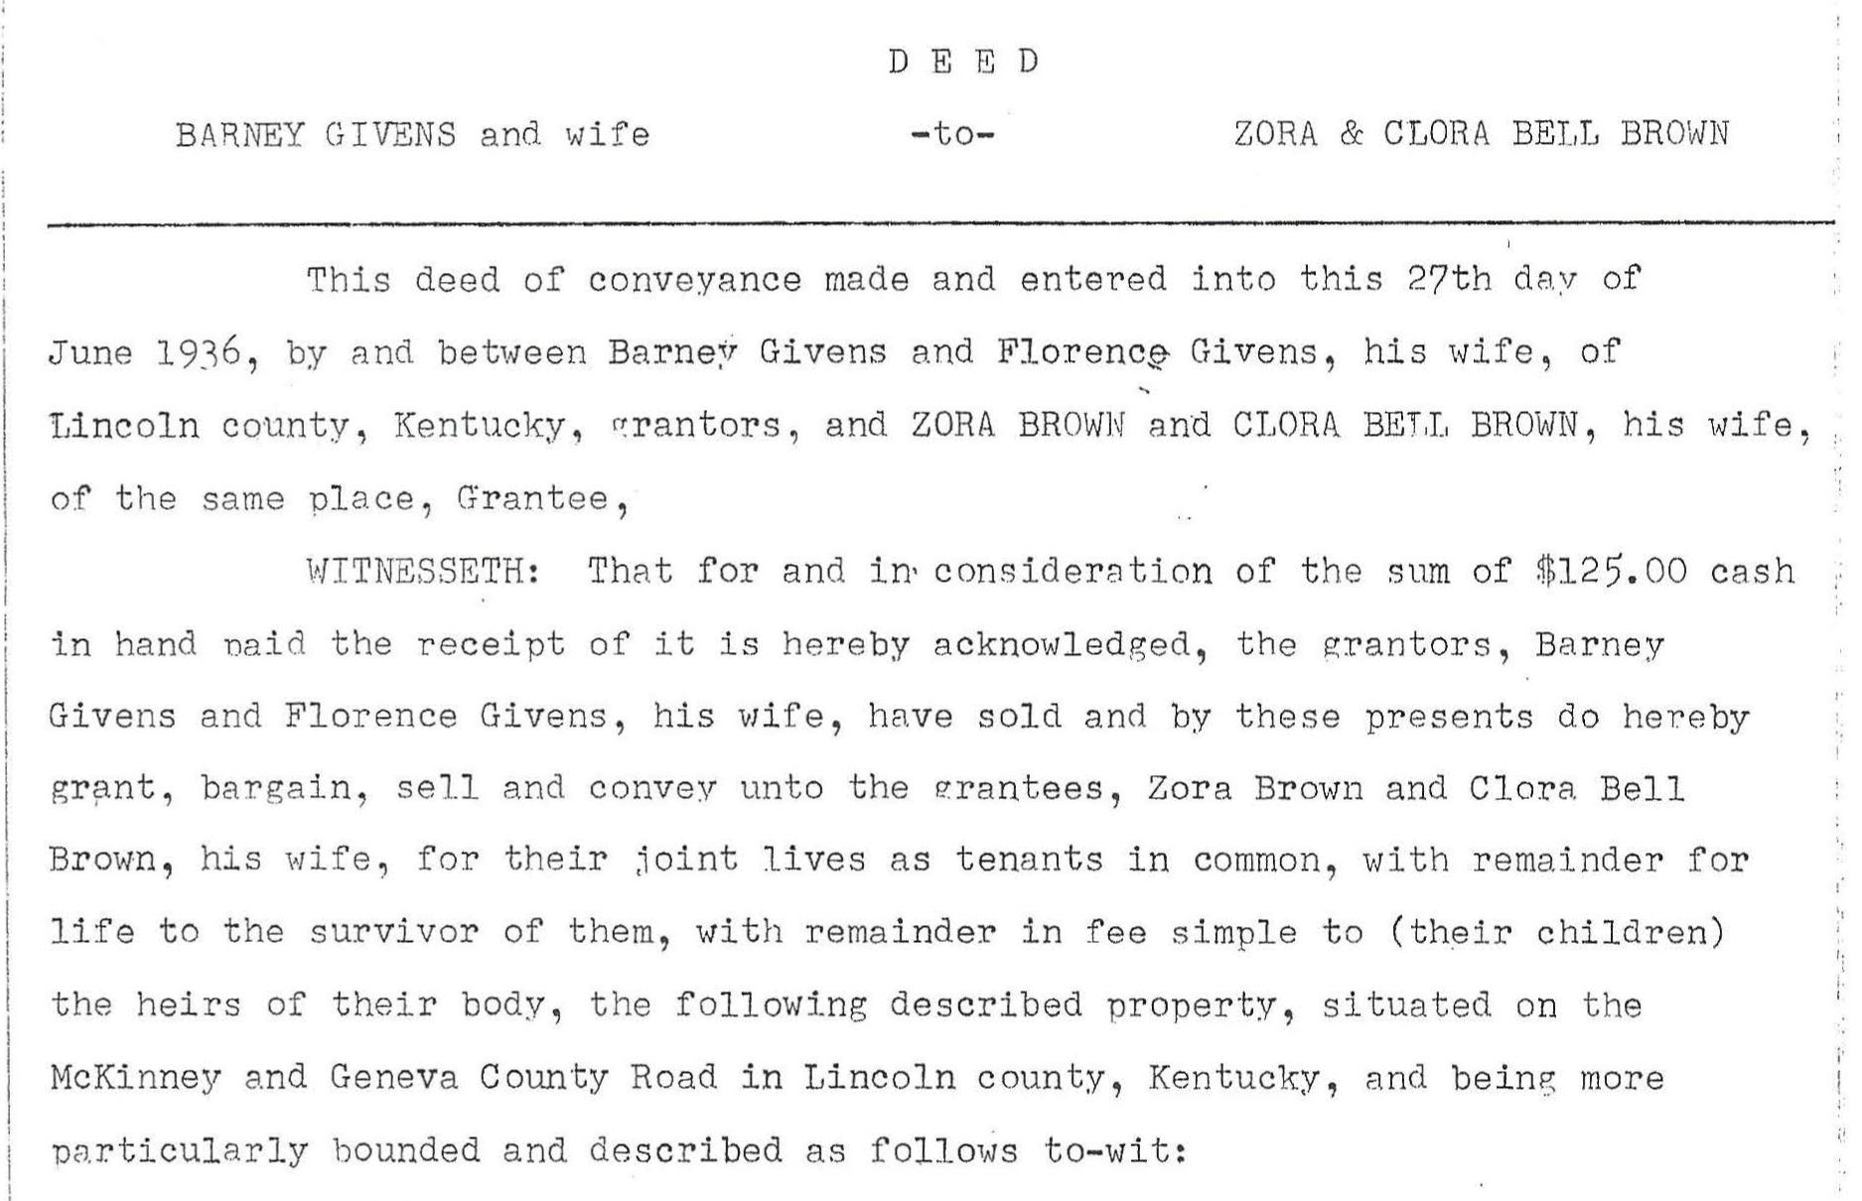
Don’t you love it when a plan works!

Slide 40
Organizational suggestions
Be consistent in how you record the data
For example in the case of both J N Carter and Zora Brown Once I discovered they were deceased I changed the owner’s name to reflect that
In the past sometimes these properties have been listed various ways
Heirs
Hrs
Estate
-EST-
I made the decision to list ALL estate property as -EST-
This allows for a consistent method of searching the, “-” is a unique character
This is a good practice for ALL forms of data entry in the PVA office

Slide 41
In order to effectively conduct historical research you must remember this acrostic…

Slide 42
O d d

Slide 43
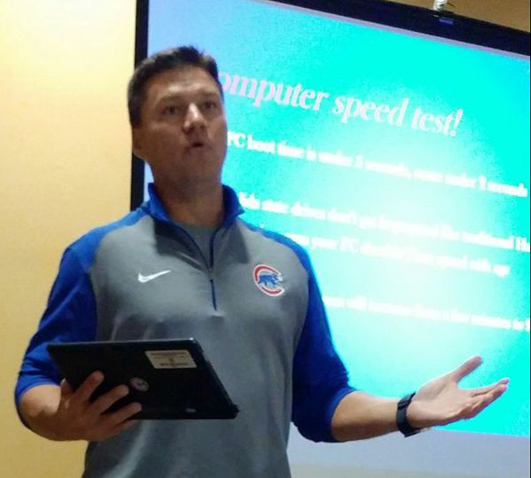

Slide 44
Document

Slide 45
Documentation sources
Social Security Death Index
Death Records
Census Records
Other online genealogy records
Newspaper obituaries
Wills (sometimes but not often will provide deed source)
Adjoining properties

Slide 46
A few resources
Ancestry.com
This is a subscription service. However, many local libraries offer this for free in their research rooms.
Familysearch.org
Free but you must sign up. This does not provide the volume of records as ancestry but is a wonderful resource.
Newspapers.com
This is a subscription service. However, many local libraries offer this for free in their research rooms and at home by utilizing your library card number.
Findagrave.com
This is a totally free website and a prime example of you get what you pay for. There is a lot of poorly researched memorials on this site. The best use for findagrave is obituaries that are included in the memorials. In some cases photos of tombstones will also include the name and birthdate of surviving spouse.
Interviews with relatives or long time residents
Ask your questions carefully while making it understood the purpose of the interview is to empower the property owners.
Deeds from adjoining properties

Slide 47
Ancestry.com

Slide 48
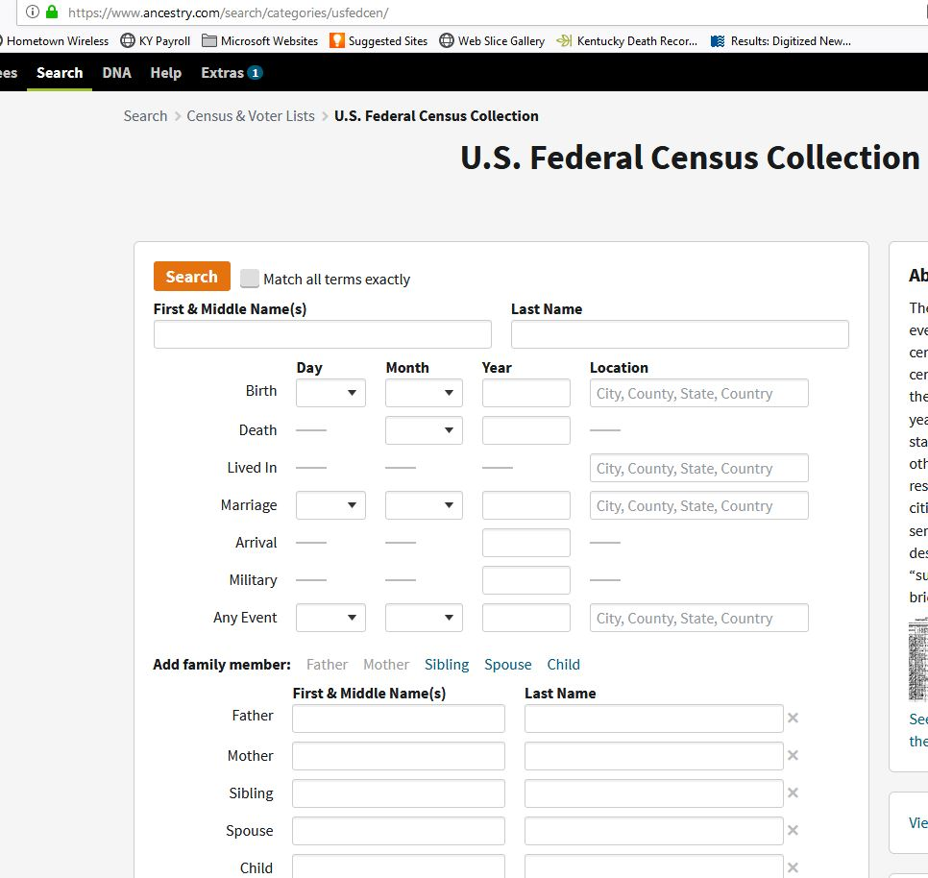
Census search

Slide 49
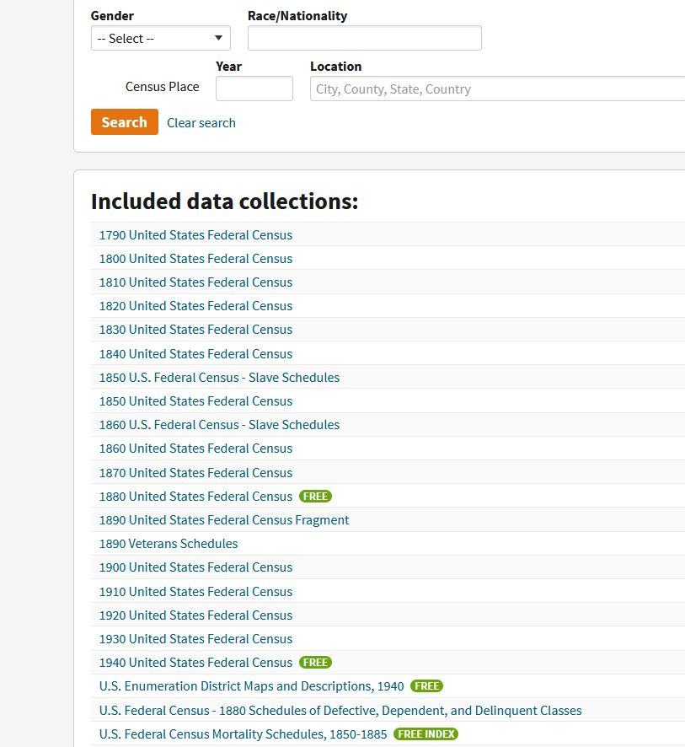
search by year
1900 is first census to ask “rent” or “own” and the 1940 is the most recent available

Slide 50
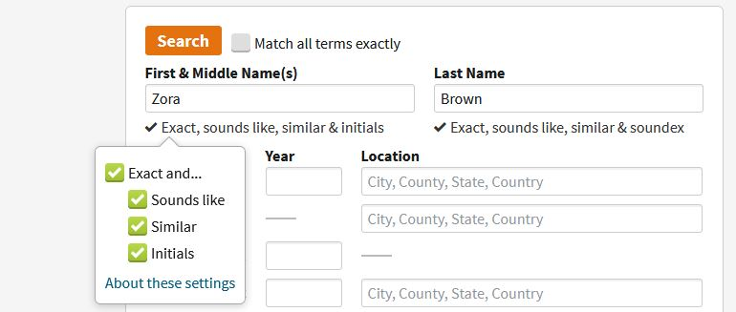
Choose these options

Slide 51
I usually right click and open in new tab

Slide 52
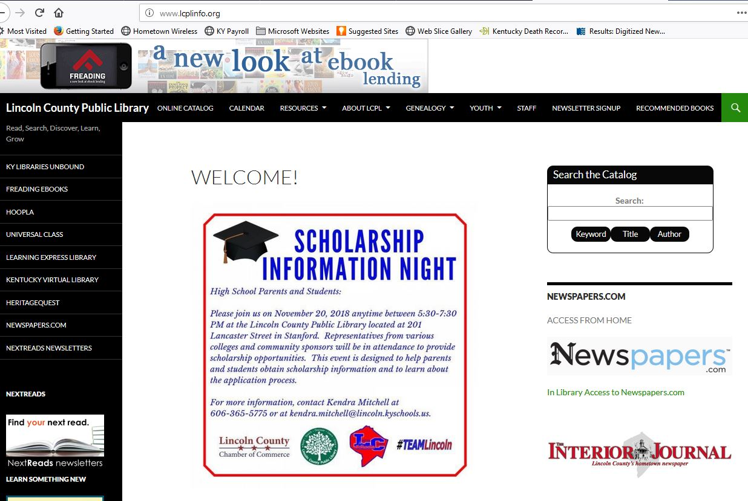
Newspapers.com

Slide 53
Put your library card number here

Slide 54
Once logged in do standard “google type” search

Slide 55
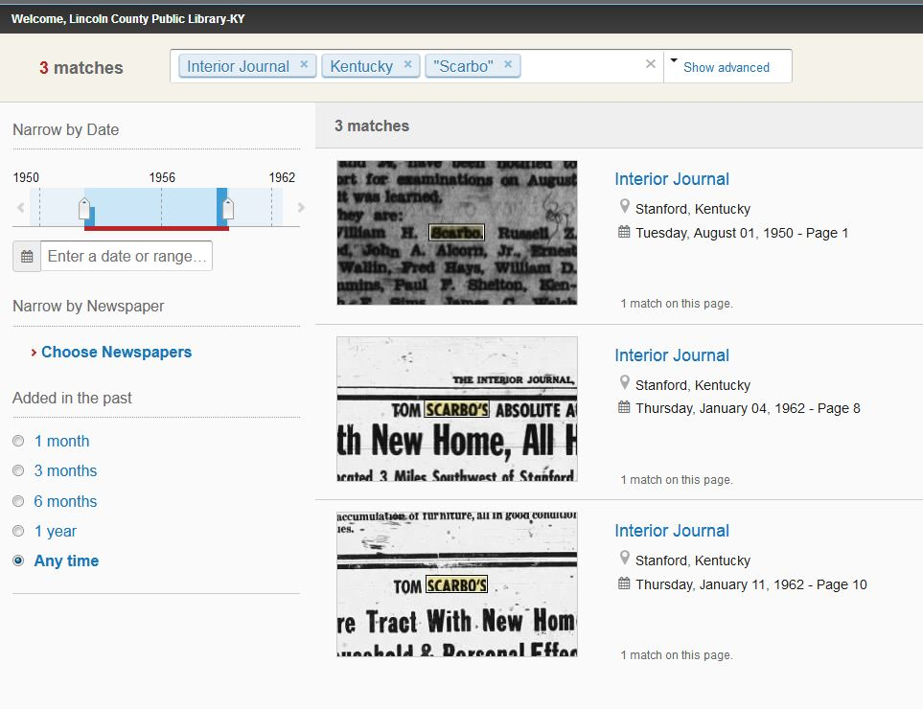
You can narrow search by state, year and a specific newspaper

Slide 56
Adjoining properties

Slide 57
persist
Keep going back until the source of title says “being part of the same property”
Often the deed cited for source of title in the “part” sale will include your subject property or at least is a link in the chain of title for your subject property.
Keep in mind source of title was not required on deeds in Kentucky until the very early 1900s. (Mc deeds even later)

Slide 58
Notes are your best friend
Whatever you find or don’t find it is crucial to make good notes.

Slide 59
Notes are your best friend
This will be an aid to someone else should they need your research and help you to remember what you have already done.

Slide 60
Notes are your best friend
Notes are also excellent idea for other reasons. They are especially beneficial when you’ve had concerns expressed by a taxpayer.

Slide 61
Notes are your best friend
Believe it or not sometimes a taxpayer will tell the deputy one story and the PVA a completely different story.

Slide 62
J N CARTER NOTES
2014 TAX BILL RETURNED; NO NEW ADDRESS.
2018 TAX BILL RETURNED WITH NOTE "BEEN DEAD ABOUT 18 YEARS"
J N CARTER IS THE SAME PERSON AS JAMES NEVIN CARTER. HE DIED TESTATE 9 JAN 1961 (WB 8 PAGE 510) BILL HAD BEEN GOING TO HIS DAUGHTER MARY EDNA CARTER SETTLE (MRS G A SETTLE) SHE DIED IN FAYETTE COUNTY 5 JAN 1999 HER OLDEST SON IS HOWARD A SETTLE ADDRESS FROM MOTAX I SUSPECT THIS IS PROPERTY ORIGINIALLY OWNED BY EDNA ELIZABETH MILLER HILL SINCE THE MAP NUMBER IS 39-059B 23 oct 2018 dkg

Slide 63
Link documents
Any time we find a document that aids in the assessment or description of the property we link it to the property record.
We keep these in a folder called “docs attached to parcels.”

Slide 64
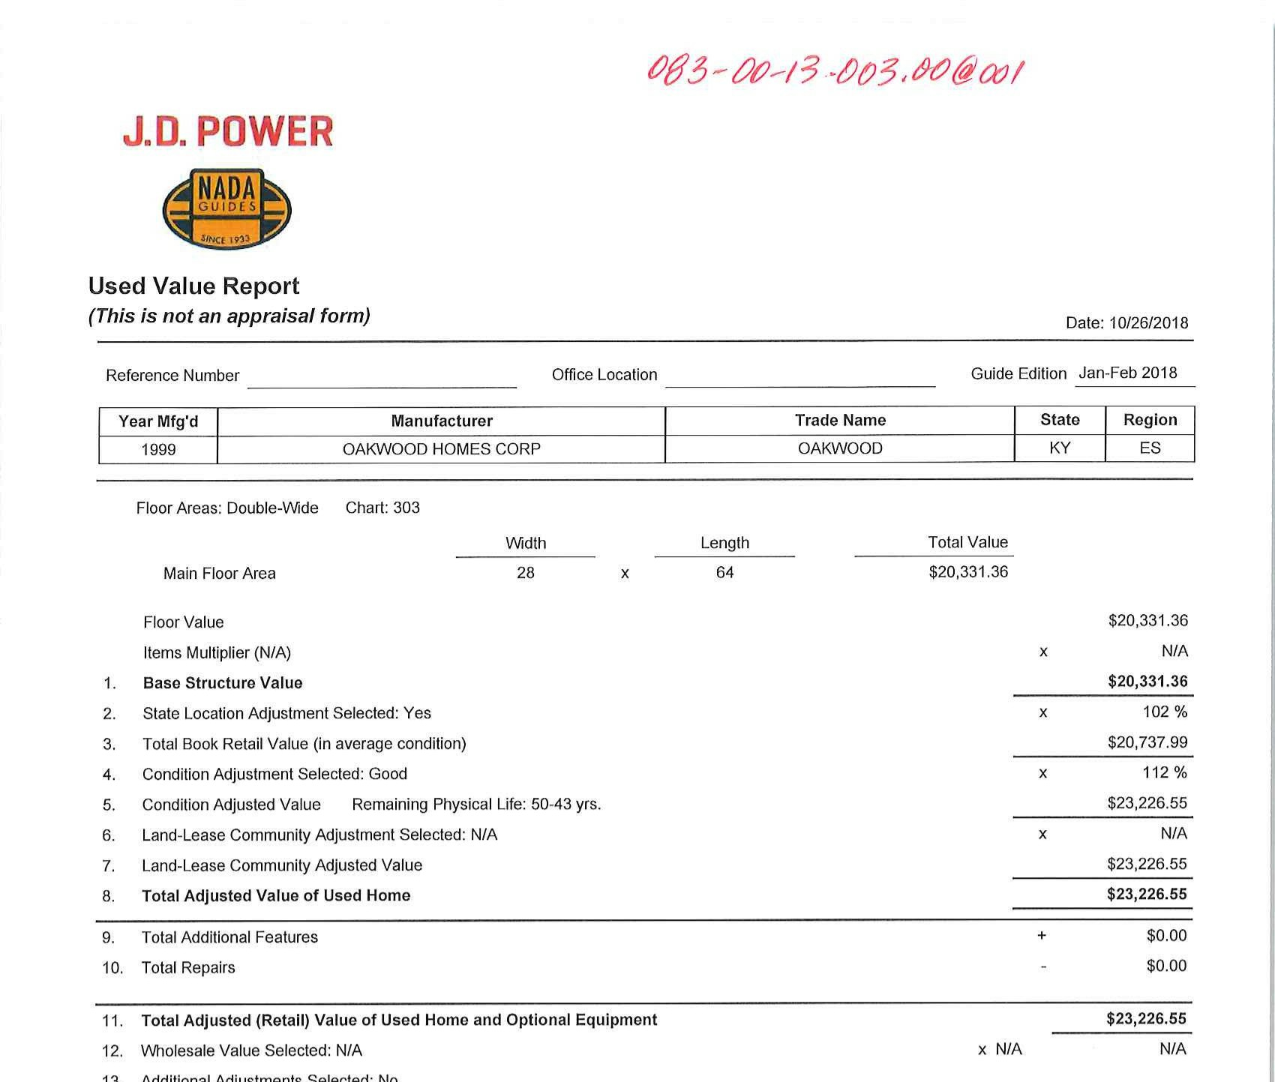
For example this mobile home owner did not return form requesting information so we used NADA to value

Slide 65
In order to effectively conduct historical research you must remember this acrostic…

Slide 66
O d d

Slide 67
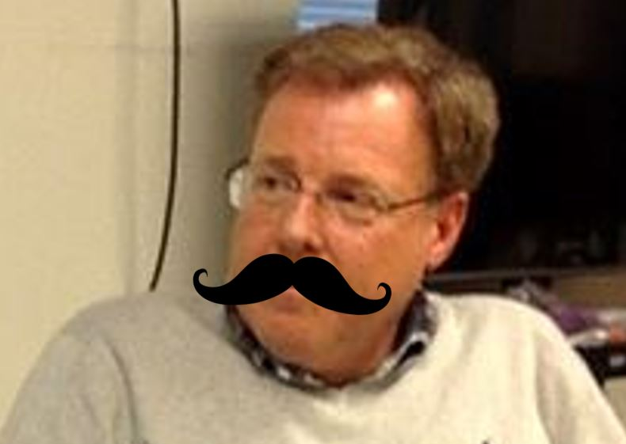

Slide 68
and

Slide 69
Don’t assume

Slide 70
Don’t assume
That the name on the property record is the correct owner.
Years ago the PVA was in a sense a “list taker.” People sometimes listed property in the name of ONE of the heirs or the surviving spouse. They assumed because everyone else had died it was their property.

Slide 71
Don’t assume
They had a good lawyer. Perhaps they had employed the services of “Somebody Said Attorney At Law”
Somebody said, “If you pay the taxes for so many years it’s yours.”
Somebody said, “When you get to be a certain age you don’t pay taxes anymore.”

Slide 72
Don’t assume
That the spelling of the name is correct.
There can be lots of variants on the spelling of names.

Slide 73
Don’t assume
That information contained in an affidavit is correct.
Sometimes affidavits reflect the information that makes it the easiest to resolve the property issue.
For example I found an affidavit of descent for Jessie Simpson Hays Hamlet that states her second husband Dee Hamlet had died before her.
However, Dee Hamlet was the informant for Jessie’s death certificate. Perhaps he rose from the grave and provided the information.

Slide 74
Remember this?

Slide 75
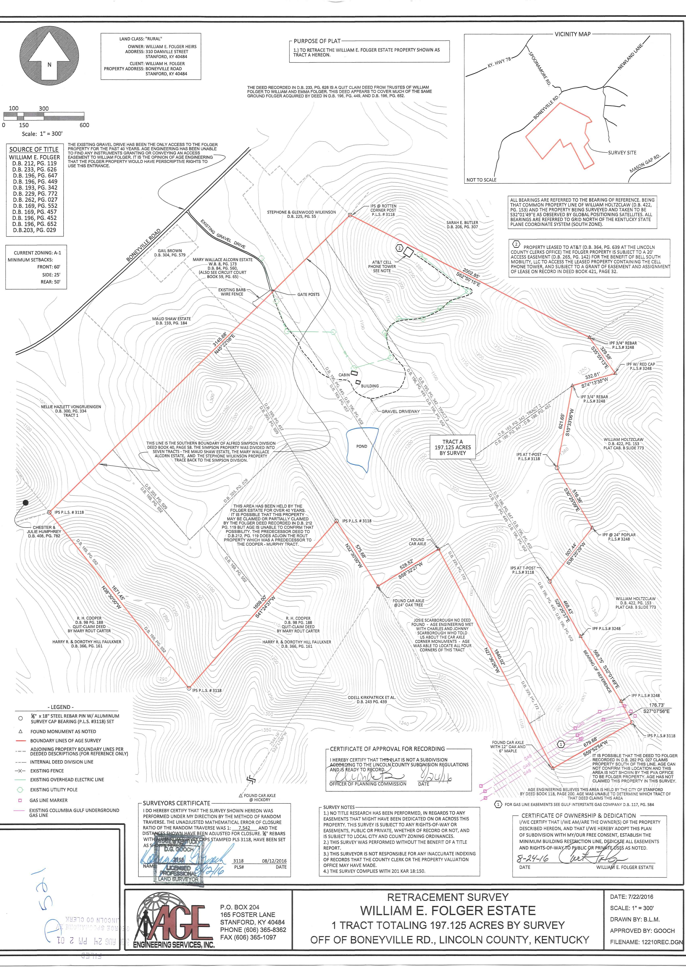

Slide 76
Wrong name
Josephine Brock Scharbrough who died March 18, 1952 had been listed as owner for many years.
Her grandson Charles had paid the taxes for the past 50 years. When Charles died this summer his stepson came in to see me. After asking him what he knew about the property the stepson said Josie’s husband David had bought it on a land contract, but didn’t know when.

Slide 77
Wrong name
David, a Civil War veteran, had married the much younger Josephine Brock after his first wife died. He died intestate in Lincoln County on March 28, 1927.
He had no will and no Affidavit of Descent was filed for him

Slide 78
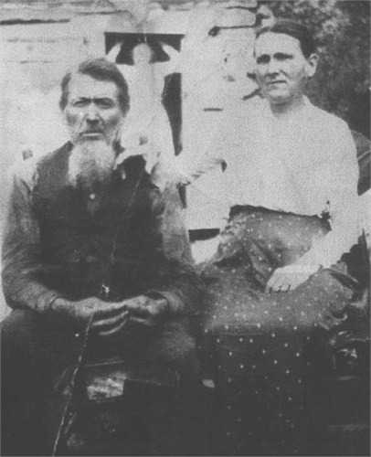
David & Josie

Slide 79
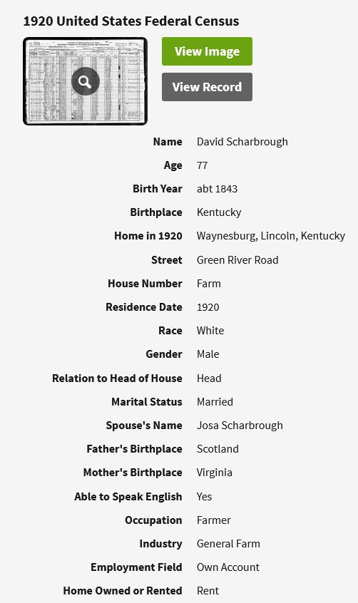
On the 1920 Census David reports that he “rents” where he lives
Census was taken January 8, 1920

Slide 80
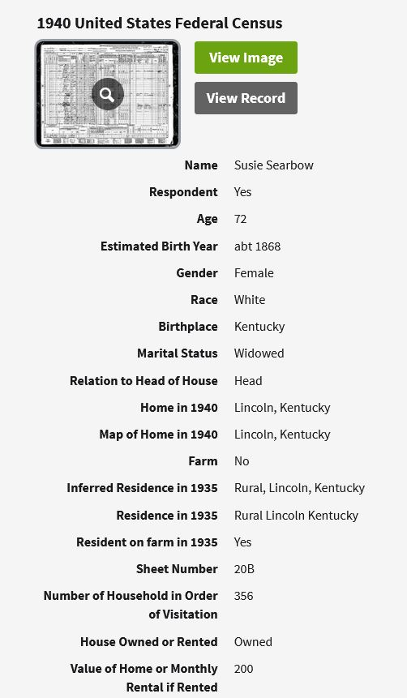
On the 1940 Census Josie reports that she “owns” where she lives.
(She didn’t answer on the 1930 census)

Slide 81
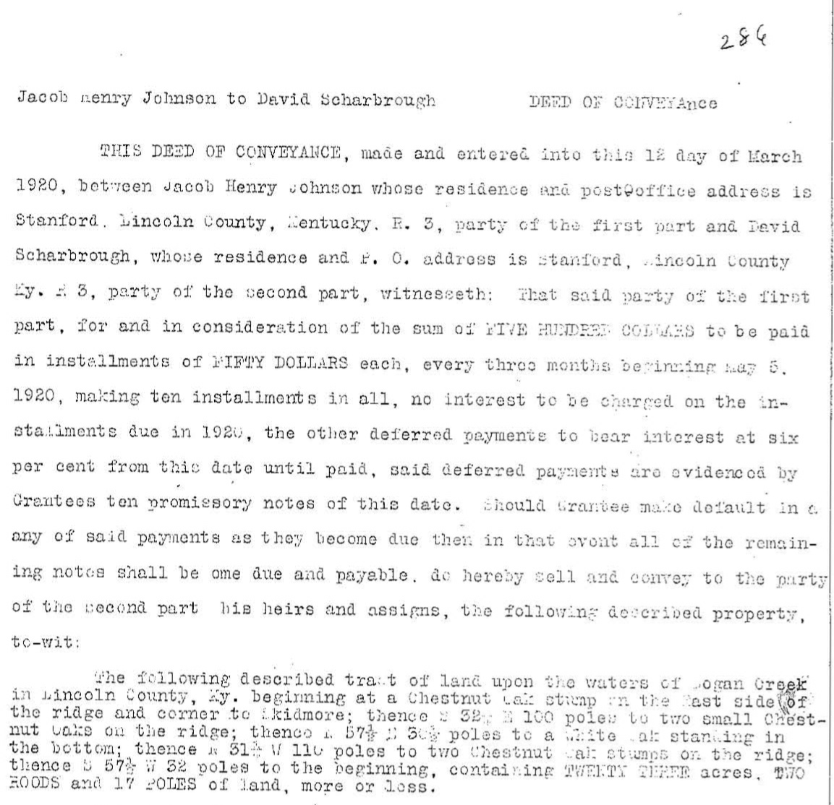

Slide 82
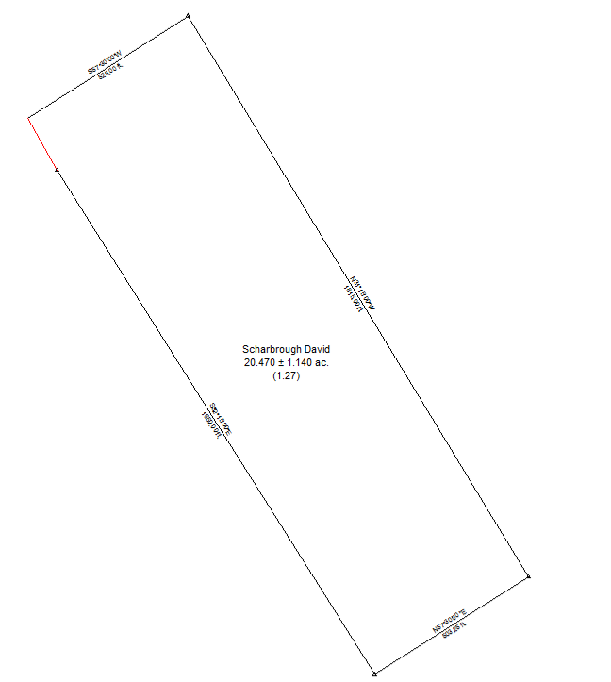
Here are the calls from the deed. It confirms the survey by AGE!

Slide 83
NOTES
This Josie Scharbrough appears to be same person as Josephine Brock Schbrough who died 18 Mar 1952 and was married to David Scharbrough (1840-1927). 20 Feb 2018 dkg
This has been listed as Josie Scarbough Estate. However, no deed could be located for her. Per Eddie Humprhey stepson of Charles Scharough, who had been paying the taxes, property had been bought on land contract. On 1920 census David Scharbrough states he rents property and on 1940 census his widow Josie states she owns. Therefore, a search of deeds from that time period revealed DB 61 Page 387 in which David Scharbrough purchased property for sum of $500 paid in installments $50 each every three months. Deed notes amount was paid in full on March 10, 1923. David Scharbrough died intestate on March 28, 1927 no documentation has been located transferring ownership from David Scharbrough to Josie. Therefore, starting in 2019 will be listed to Estate of David Scharbrough and per conversation with Eddie Humprhrey bill will be mailed to Rose dkg 19 sep 18

Slide 84
Don’t assume
That the spelling of the name is correct.
While working on the Scharbrough properties I noticed a tract in the name of David and Josie’s youngest son Tom Scharbrough.
Tom’s property also had no deed reference. In researching David and Josie I had already established a timeline for Tom.
I also found about four different ways of spelling their last name.
Now that I had established a timeline I checked various spellings.

Slide 85
Don’t assume
That the spelling of the name is correct.
So I checked for how the name was pronounced “Scarbo.”

Slide 86
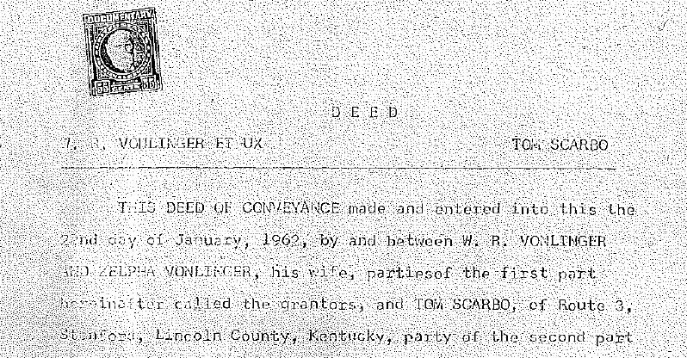
Don’t you love it when a plan works!

Slide 87
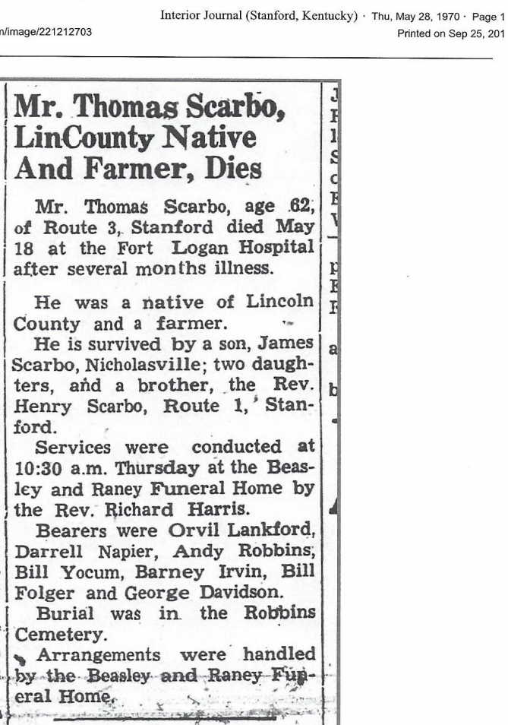
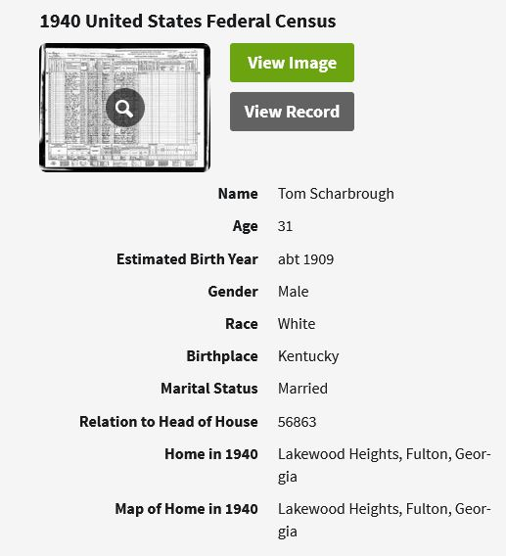
Notice this difference in spelling on the 1940 census and his obit

Slide 88
His nephew Charles’ obit

Slide 89
So at the end of the day I wound up finding two deeds and confirming three property lines!

Slide 91
Another happy ending. After interviewing the 90-year-old gentleman who has paid these taxes I located a deed. He is selling it to the local bank.

Slide 92
So if you will follow

Slide 94
You can find the source of title for your properties

Slide 95
Keep in mind it’s like…

Slide 97
…eating an elephant, take one bite at a time
- General Creighton Abrams

