Slide 1
HOUSE BILL 44

Slide 2
OVERVIEW OF HOUSE BILL 44
Enacted by the 1979 Special Session of the General Assembly
Designed to limit property tax revenue increases at a time when property values were rapidly appreciating
Current law allows a taxing district to set a compensating tax rate, a 4% increase tax or a rate that will generate revenue growth in excess of 4%. However, any rate that will generate more than a 4% increase in revenues is subject to a recall petition.
The compensating rate was defined as “that rate when applied to the current year’s assessment of real property, excluding new property, will produce an amount of revenue approximately equal to that produced in the preceding year from real property”.
The 4% increase rate will provide the taxing district with approximately a 4% increase in property tax revenues on real property that was taxed the preceding year. The taxing district would also receive additional revenues from new property.

Slide 3
COMPENSATING TAX RATE CALCULATION
Given: 2018 Total Real Property Assessment $100,000,000
2018 Tax Rate - Real Property 27.8¢ per $100
2018 Revenue Potential ($100,000,000 x .00278) $ 278,000
2019 Total Real Property Assessment $120,000,000
2019 Net New Property $ 5,000,000
Calculation: 2019 Total Real Property Assessment $120,000,000
Less: 2019 New Property Assessment - $ - 5,000,000
2019 Existing Real Property Assessment $115,000,000
2018 Real Property Revenue Potential $ 278,000
2019 Existing Real Property Assessment / $115,000,000
2019 Compensating Tax Rate ($278,000/115.000,000) .002417
24.2¢ (Round up to 24.2¢ per $100)
4% Increase Rate
Compensating Rate 24.2¢
x 1.04
25.168¢
2019 4% Rate: 25.1¢ (Round down to 25.1¢ per $100)

Slide 4
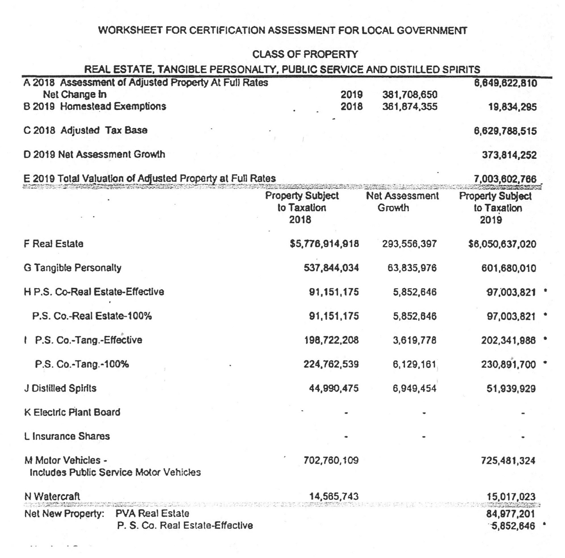

Slide 5
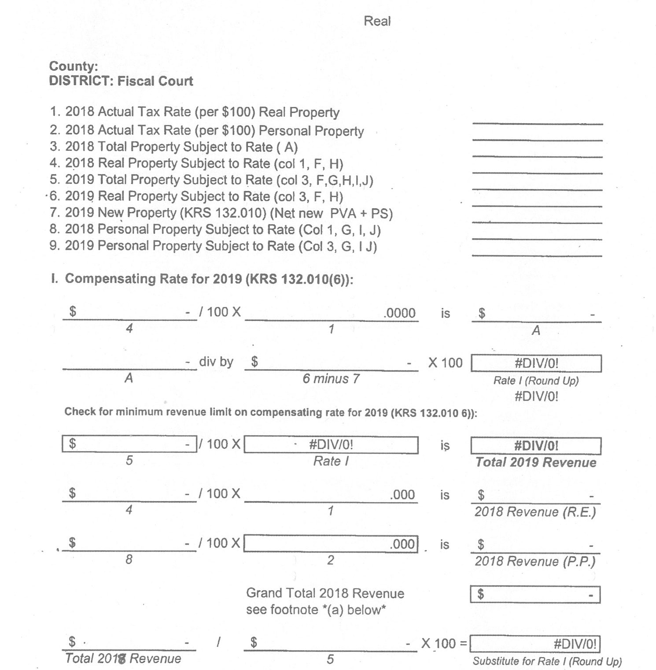

Slide 6



Slide 7
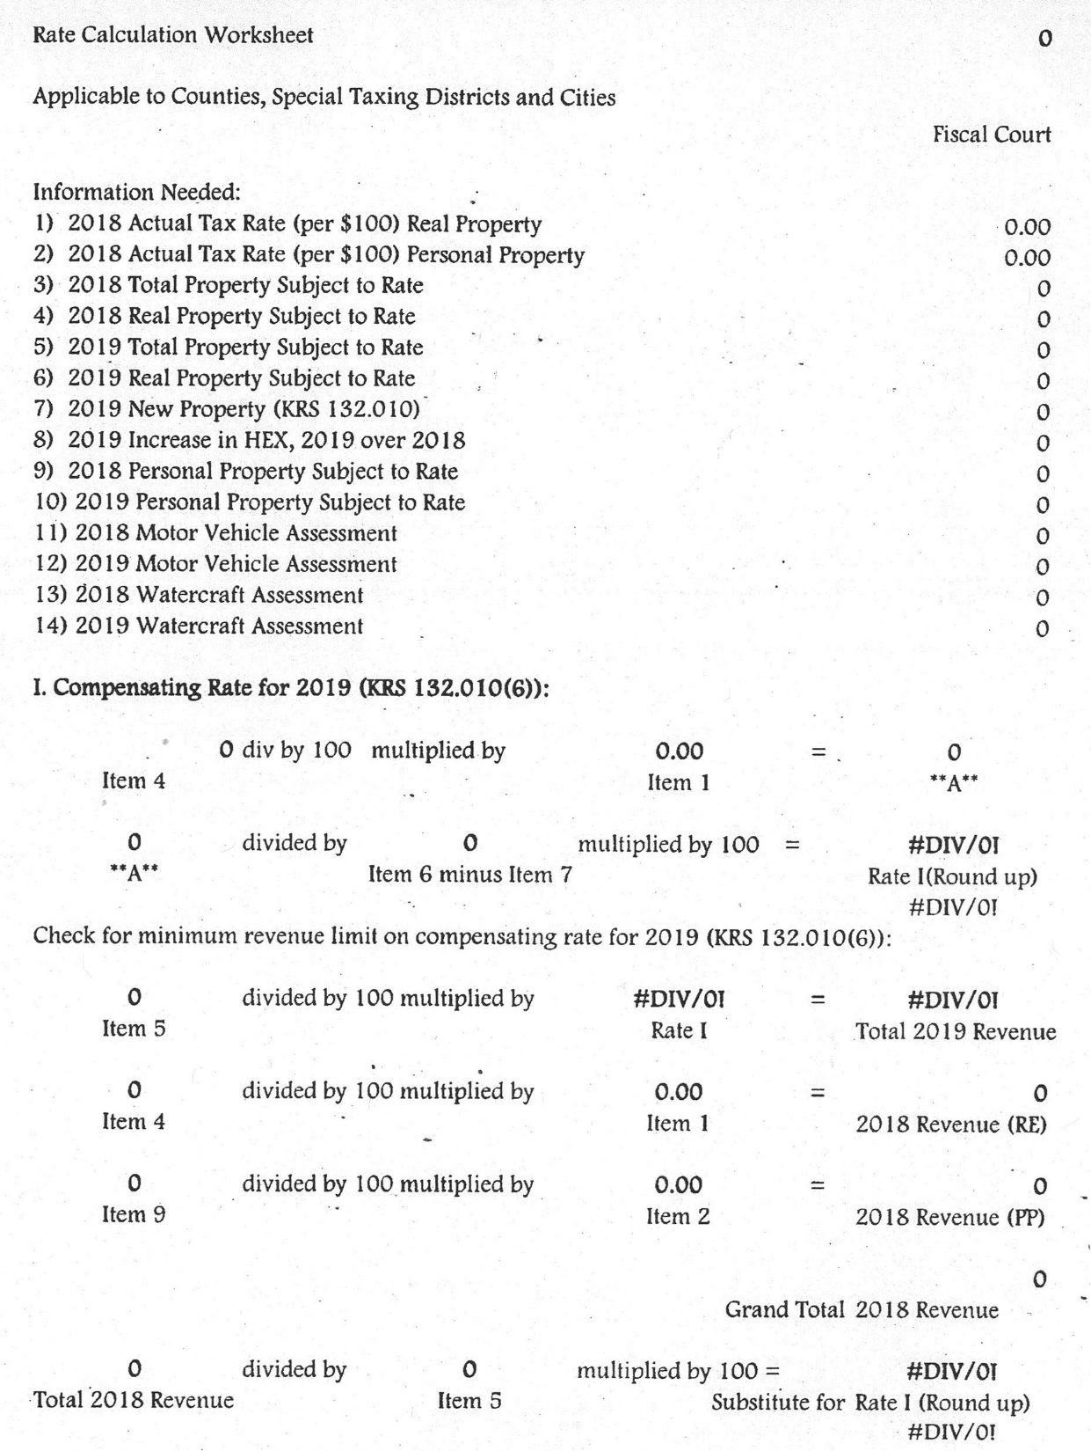

Slide 8
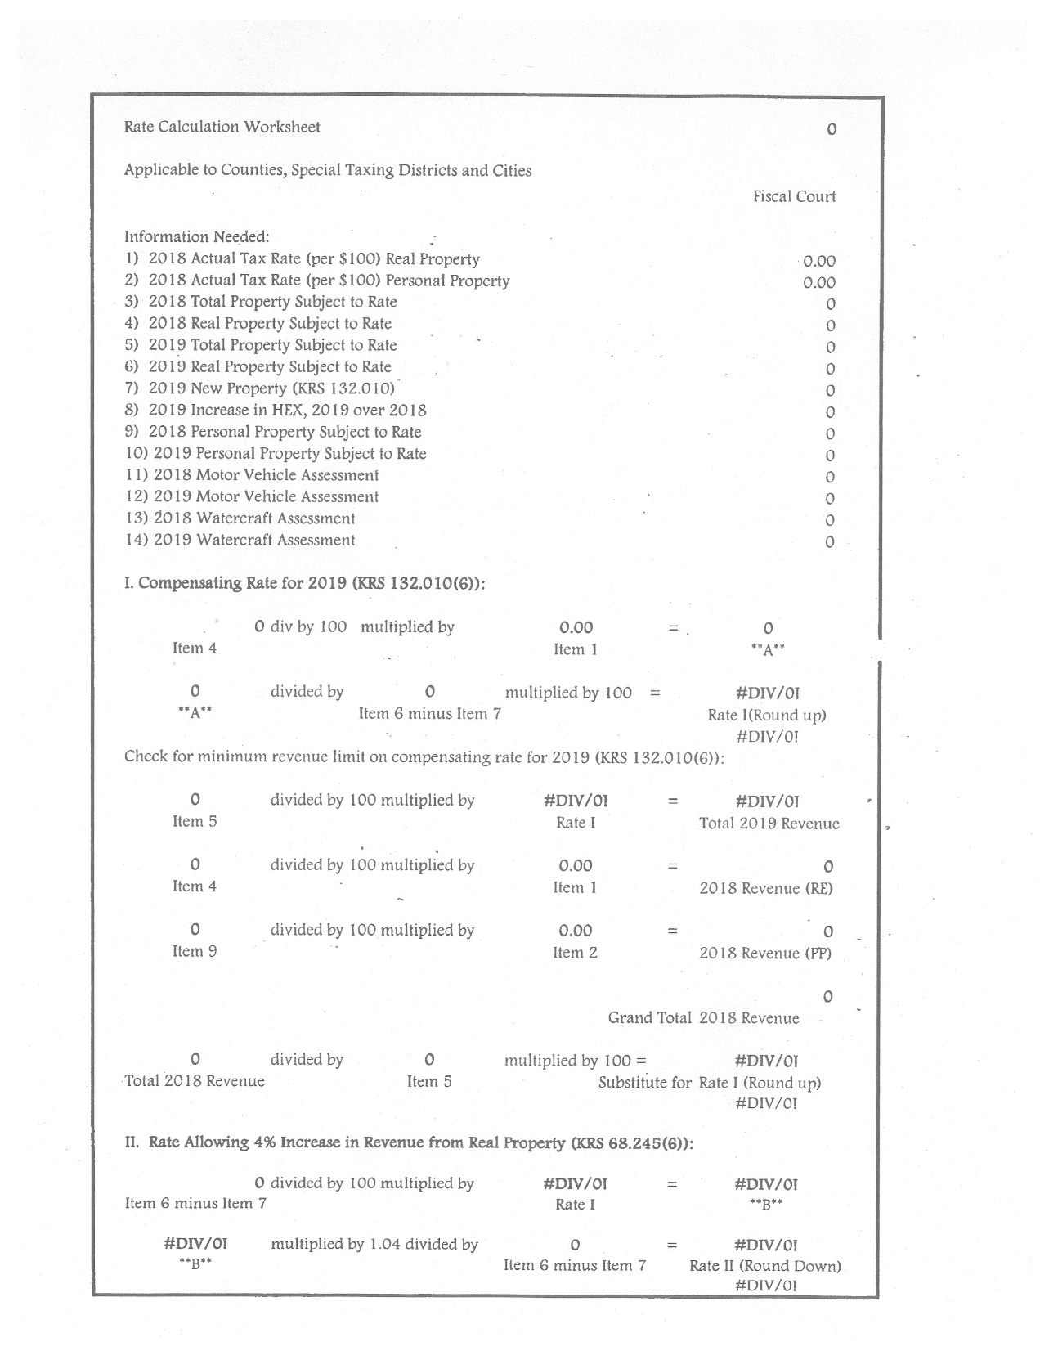

Slide 9
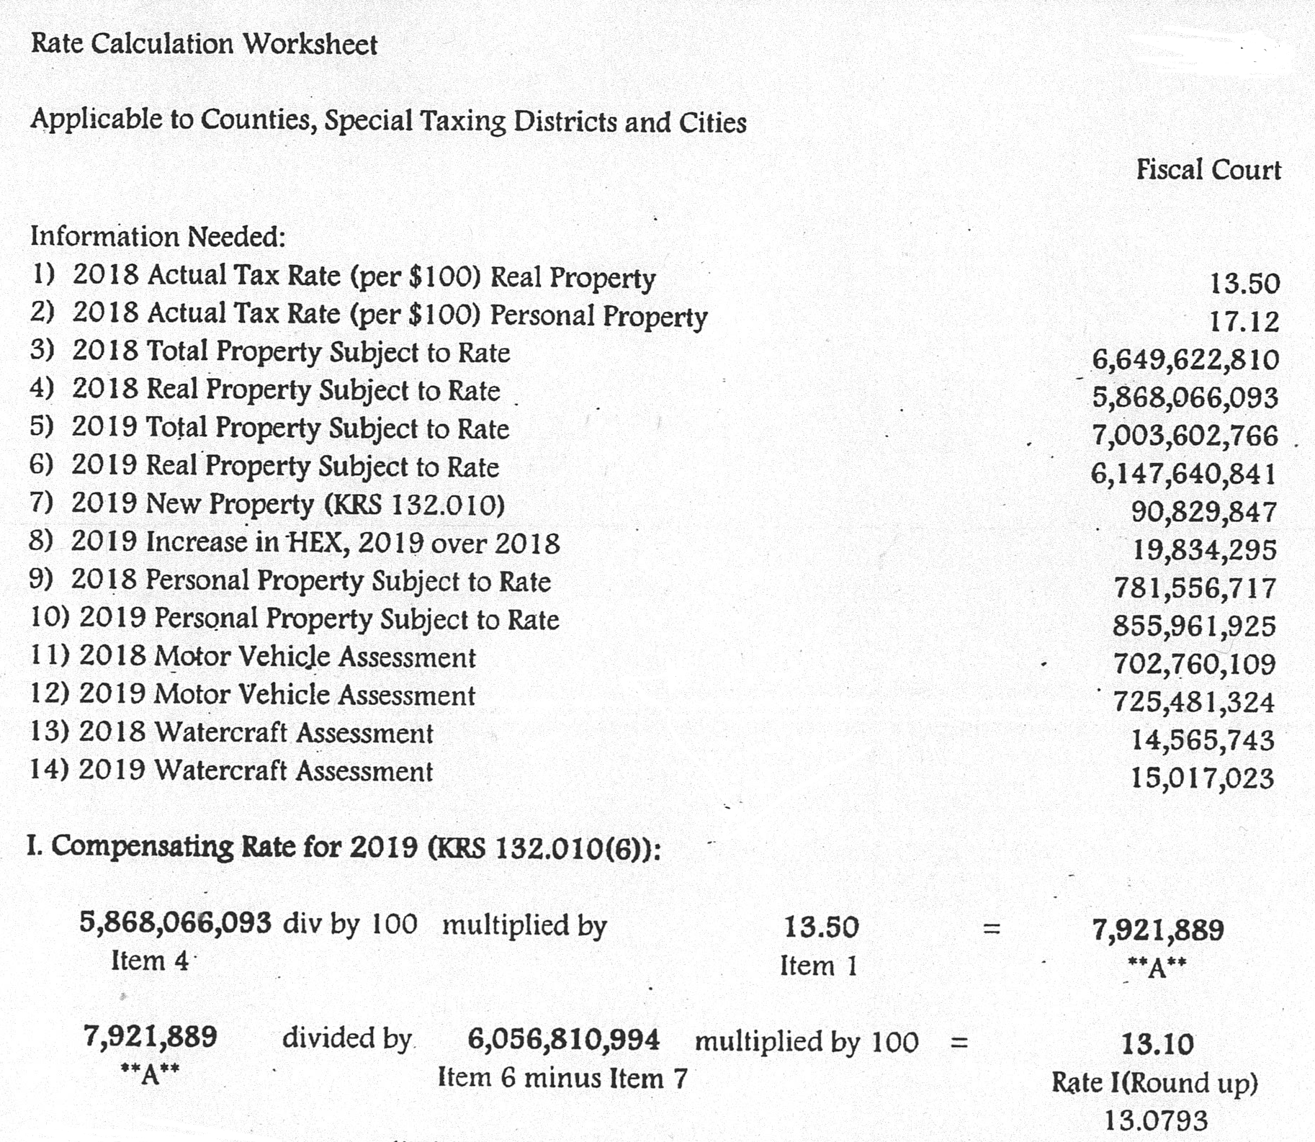

Slide 10
KRS 132.010 Definitions for chapter.
(6) “Compensating tax rate” means that rate which, rounded to the next higher one-tenth of one cent ($0.001) per one hundred dollars ($100) of assessed value and applied to the current year’s assessment of the property subject to taxation by a taxing district, excluding new property and personal property, produces an amount of revenue approximately equal to that produced in the preceding year from real property. However, in no event shall the compensating tax rate be a rate which, when applied to the total current year assessment of all classes of taxable property, produces an amount of revenue less than was produced in the preceding year from all classes of taxable property. For purposes of this subsection, “property subject to taxation” means the total fair cash value of all property subject to full local rates, less the total valuation exempted from taxation by the homestead exemption provision of the Constitution and the difference between the fair cash value and agricultural or horticultural value of agricultural and horticultural land;

Slide 11
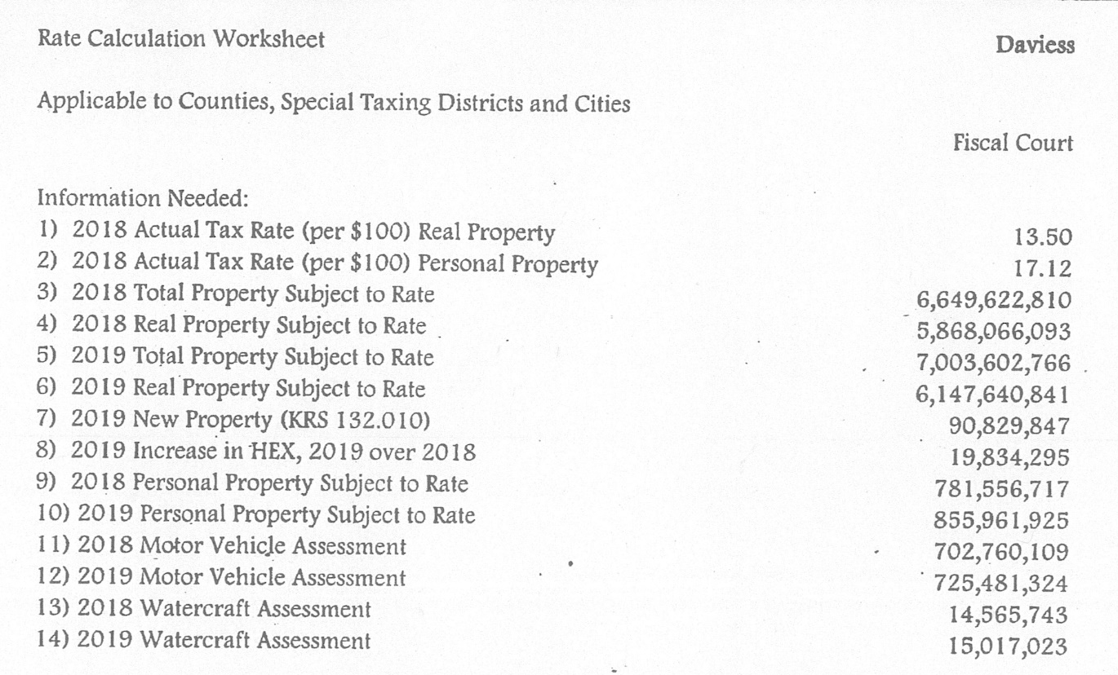


Slide 12
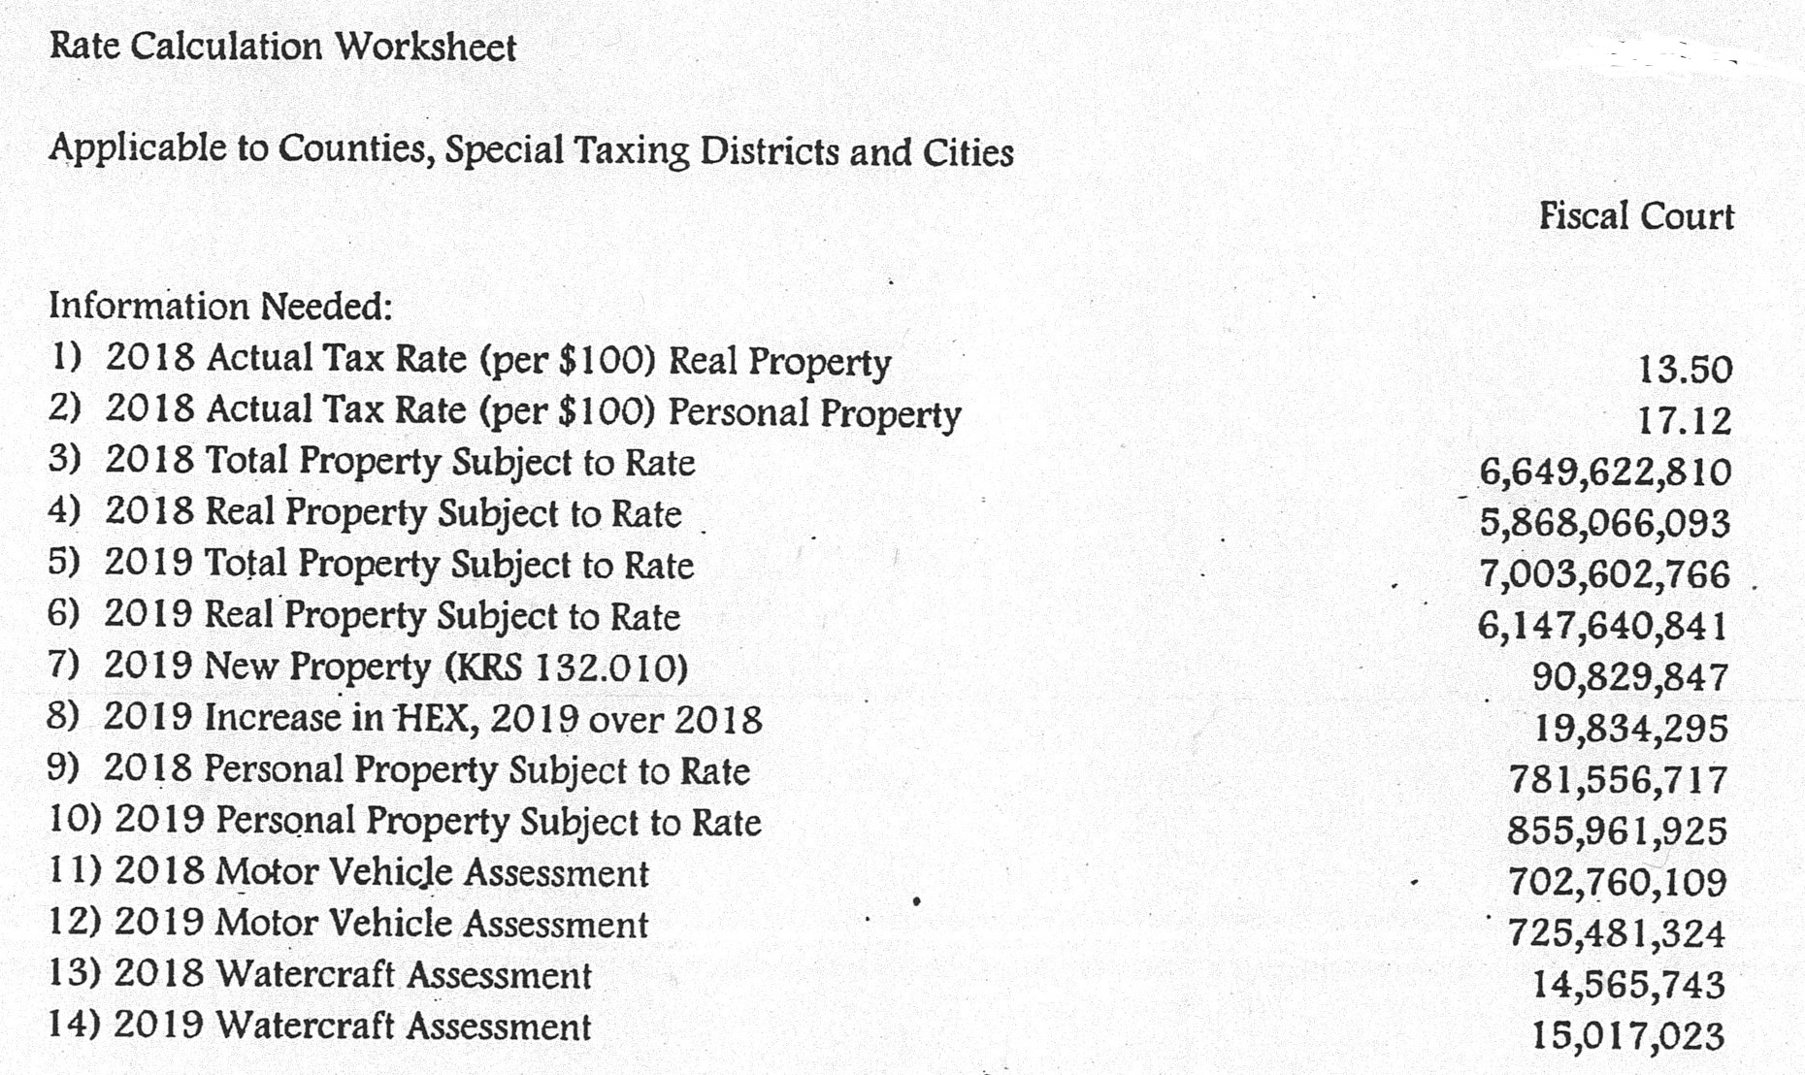
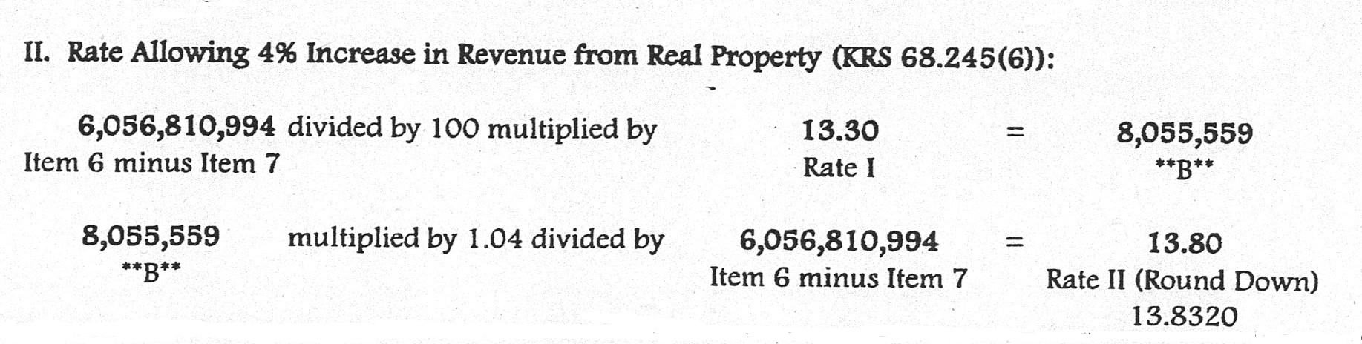

Slide 13
KRS 68.248 County revenue limits on tax rate applicable to personal property.
In the event that the tax rate applicable to real property levied by a county fiscal court will produce a percentage increase in revenue from personal property less than the percentage increase from in revenue from real property, the county fiscal court may levy a tax rate applicable to personal property which will produce the same percentage increase in revenue from personal property as the percentage increase in revenue from real property.
The tax rate applicable to personal property levied by a county fiscal court under the provisions of subsection (1) of this section shall not be subject to the public hearing provisions of KRS 68.245(5) and to the recall provisions of KRS 68.245(6).

Slide 14
KRS 132.024 Limits for special purpose governmental entities on personal property tax rate.
If the tax rate applicable to real property levied by a special purpose governmental entity will produce a percentage increase in revenue from personal property less than the percentage increase in revenue from real property, the special purpose governmental entity may levy a tax rate applicable to personal property which will produce the same percentage increase in revenue from personal property as the percentage increase in revenue from real property.
The tax rate applicable to personal property levied by a special purpose governmental entity under the provisions of subsection (1) of this section shall not be subject to the public hearing provisions of KRS 132.023(2) and to the recall provisions of KRS 132.023(3).

Slide 15
KRS 132.029 Limits for city and urban-county government on personal property tax rate.
In the event that the tax rate applicable to real property levied by a city or urban-county government will produce a percentage increase in revenue from personal property less than the percentage increase from in revenue from real property, the city or urban-county government may levy a tax rate applicable to personal property which will produce the same percentage increase in revenue from personal property as the percentage increase in revenue from real property.
The tax rate applicable to personal property levied by a city or urban-county government under the provisions of subsection (1) of this section shall not be subject to the public hearing provisions of KRS 132.027(2) and to the recall provisions of KRS 132.027(3).

Slide 16
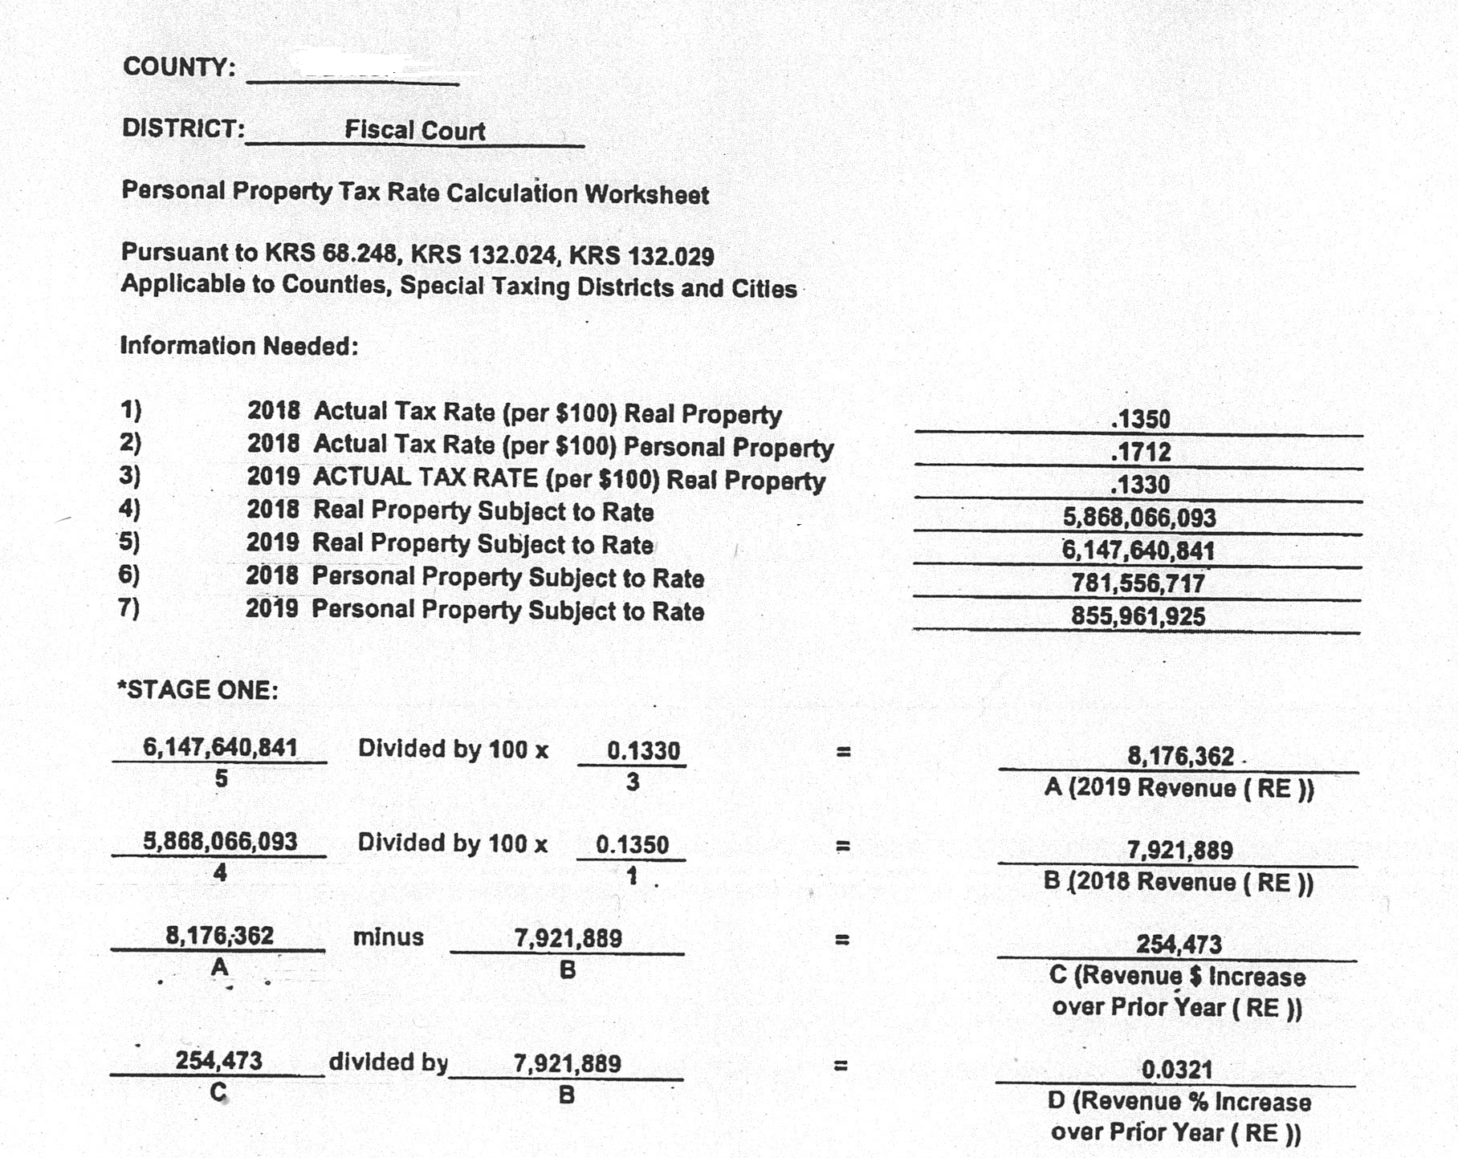

Slide 17
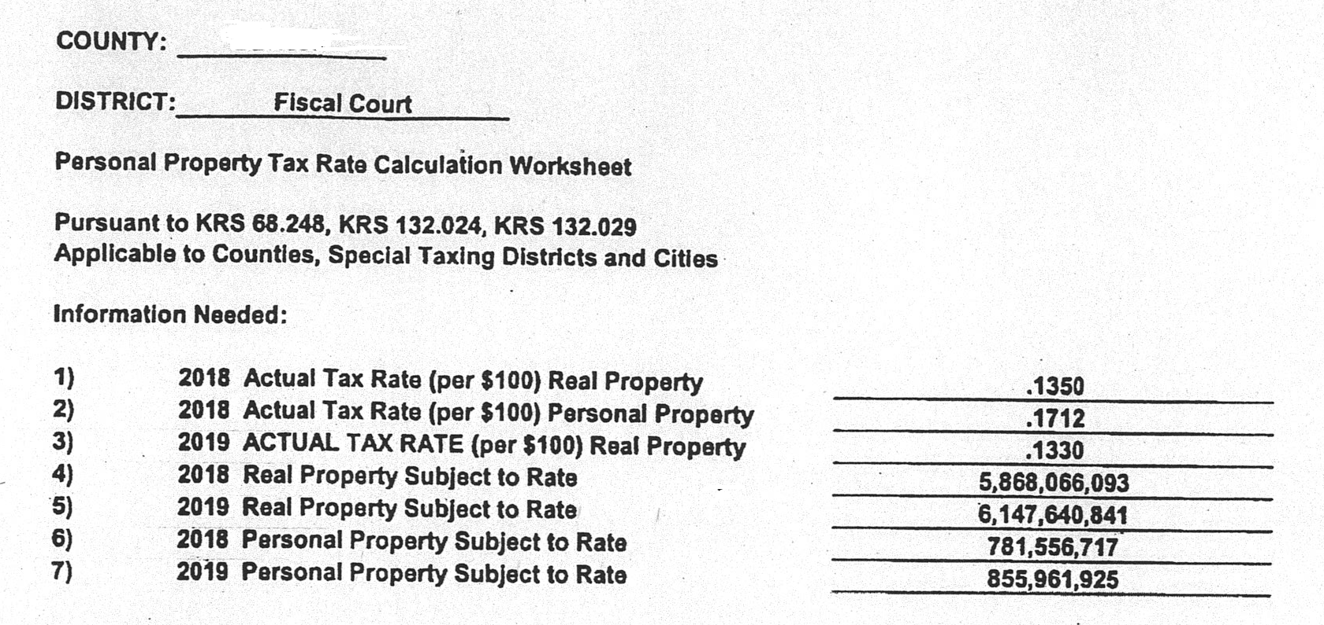
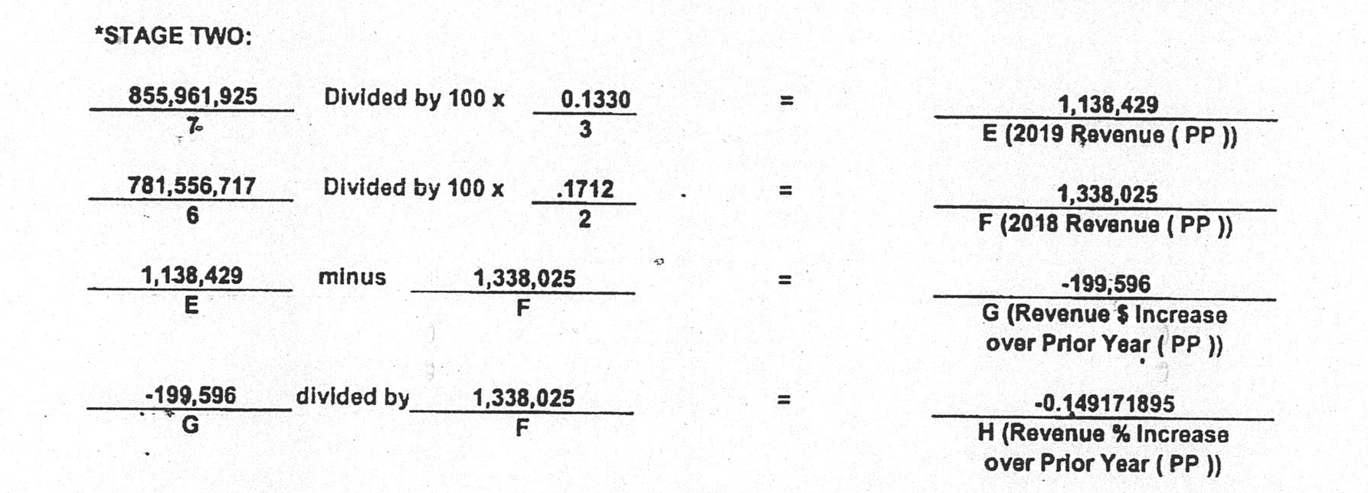

Slide 18

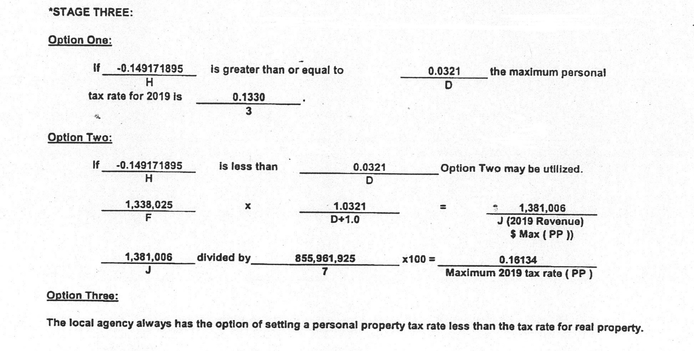

Slide 19
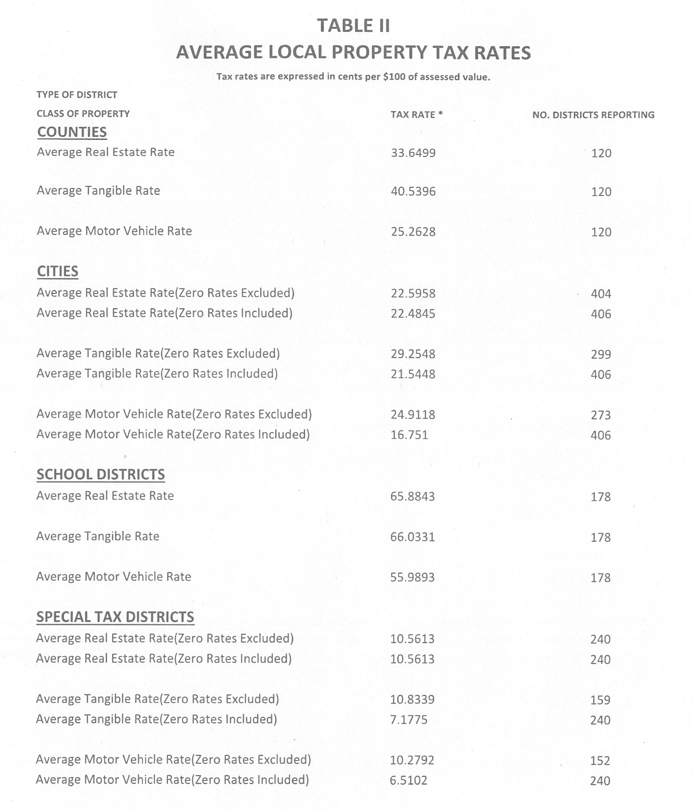

Slide 20
Disclaimer
The information in this presentation is for educational and informational purposes only and does not constitute legal advice. Information is presented as an overall review that is subject to law changes and may not apply to all states. For accurate information on issues related to this presentation, please reference HB 44, KRS 132.010, KRS 132.024, KRS 132.029 and KRS 68.248.
Information in this presentation is believed to be accurate as of the date of publication. In the event that any information in this presentation is later determined to be in error, this presentation cannot be used by taxpayers in supporting a specific position or issue before the Department of Revenue, as it does not have the statutory or regulatory authority.
Presentation Date: December 4, 2019

