Slide 1
Everything You’re Dying to Know about….
…OIL AND NATURAL GAS

Slide 2
A Little bit of History….Oil in KY
WAYNE COUNTY, KY
1815 - Kentucky’s 1st oil well is reported drilled about 2 miles south of Monticello.
The well was being drilled for salt water, and was found to be contaminated with enough oil to be considered useless, so it was abandoned.

Slide 3
MCCREARY COUNTY
1818 –- At the Oil Well Branch and the Big South Fork of the Cumberland River, while drilling for salt water, oil was hit and flowed at 100 barrels daily. Unable to float the barrels downstream because of a dangerous area known as Devil’s Jump, they attempted to haul it across land by wagon. The venture was finally abandoned due to the expense.
CLINTON COUNTY
1820 –- The first oil well was drilled in Clinton County by Capt. G.W. Hurt who was looking for medicinal salt brine. The brine was found, but because it was contaminated with oil and gas, the well was considered unfit for use and abandoned.

Slide 4
CUMBERLAND COUNTY
1829 -In the search for salt brine, using spring-pole technology, Col. Emerson drilled to a depth of 171 feet on the Lemuel Stockton farm along Little Renox Creek near Burkesville.
On March 11, 1829, he hit oil, the drill bit and rope were shot out of hole and a solid stream of oil was "thrown to the top of the surrounding trees." Oil flowed into the Cumberland River and covered the surface of the river downstream for 40 or 50 miles.
The oil ignited, catching many miles of the river on fire and halting riverboat traffic. It burned for 3 weeks.

Slide 5
Col. Emerson used a spring-pole technology when he drilled the well.
This spring-pole technology was used in China as early as 450 A.D.
The Cumberland County well was drilled using “an apparatus consisting of a spring pole made from a strong sapling, set in the crotch of a tree, with a short ‘bit’ fastened to the free end of the pole.”

Slide 6
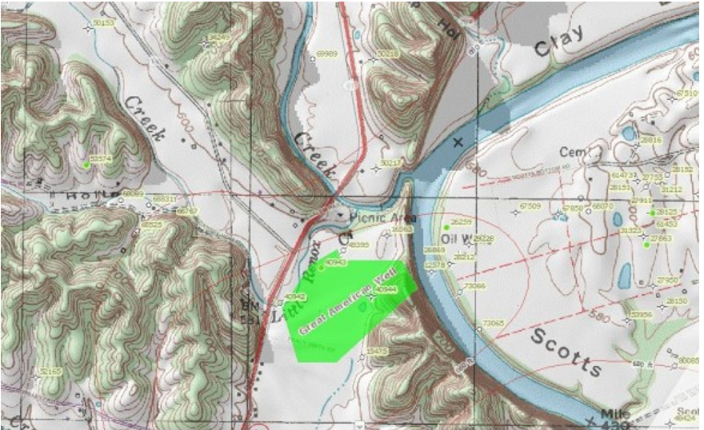

Slide 7
This well came to be known as the Old American Well and was an early "gusher".
Between 1829 and 1860 the Old American Well is estimated to have produced 50,000 barrels of oil. Much of that oil ended up in Pittsburgh, Pennsylvania, sold for medical purposes or refined into lamp oil.
It was among the earliest wells used for commercial purposes within the United States.

Slide 8
The Great American Oil Well’s historic marker – a large mill stone topped by a bronze tablet – was erected in 1934 by the Kentucky Legislature.

Slide 9
1852-ESTILL COUNTY
Oil and gas were discovered in borings made for coal 3 to 6 miles northwest of Estill Furnace in the valley of Hardwicks Creek, 10 miles northeast of Irvine, KY.
Black shale is associated with coal in the Pennsylvanian of eastern Kentucky. It was thought the presence of black shale in this area might indicate coal that could become an abundant fuel for the area's iron furnaces.
In one of the borings the upper portion of the auger was blown out into the air by gas, and the lower part of the auger was so bent in the boring as to stop the work.

Slide 10
Breckinridge and Edmonson Counties
1856, Kentucky: An oil distilling plant was established in Breckinridge to use the local cannel coals in the production of kerosene and paraffin. (Miller, 1919)
In his second survey of Kentucky, D. D. Owen describes the tar sands of Edmonson County. "At several localities in this neighborhood coal naptha, or petroleum, oozes from near the place of one of the coals of this part of Edmonson county, which, after becoming inspissated, forms a kind of consistent mineral pitch or coal-tar." (Owen, 1856)

Slide 11
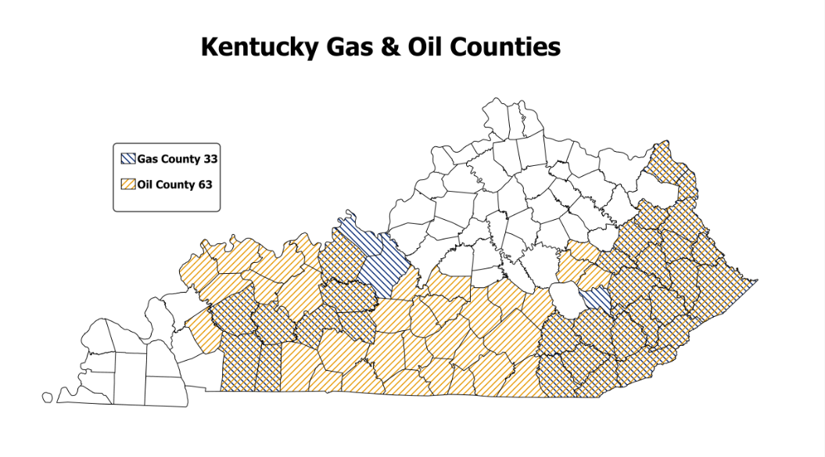

Slide 12
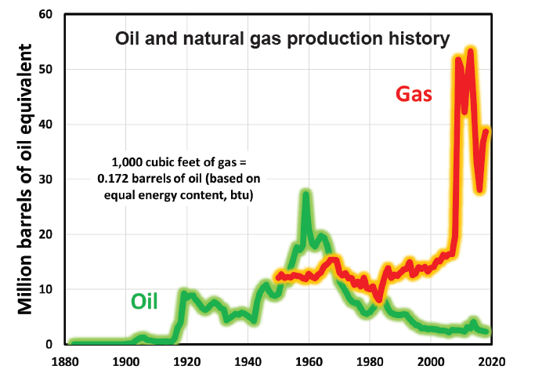

Slide 14
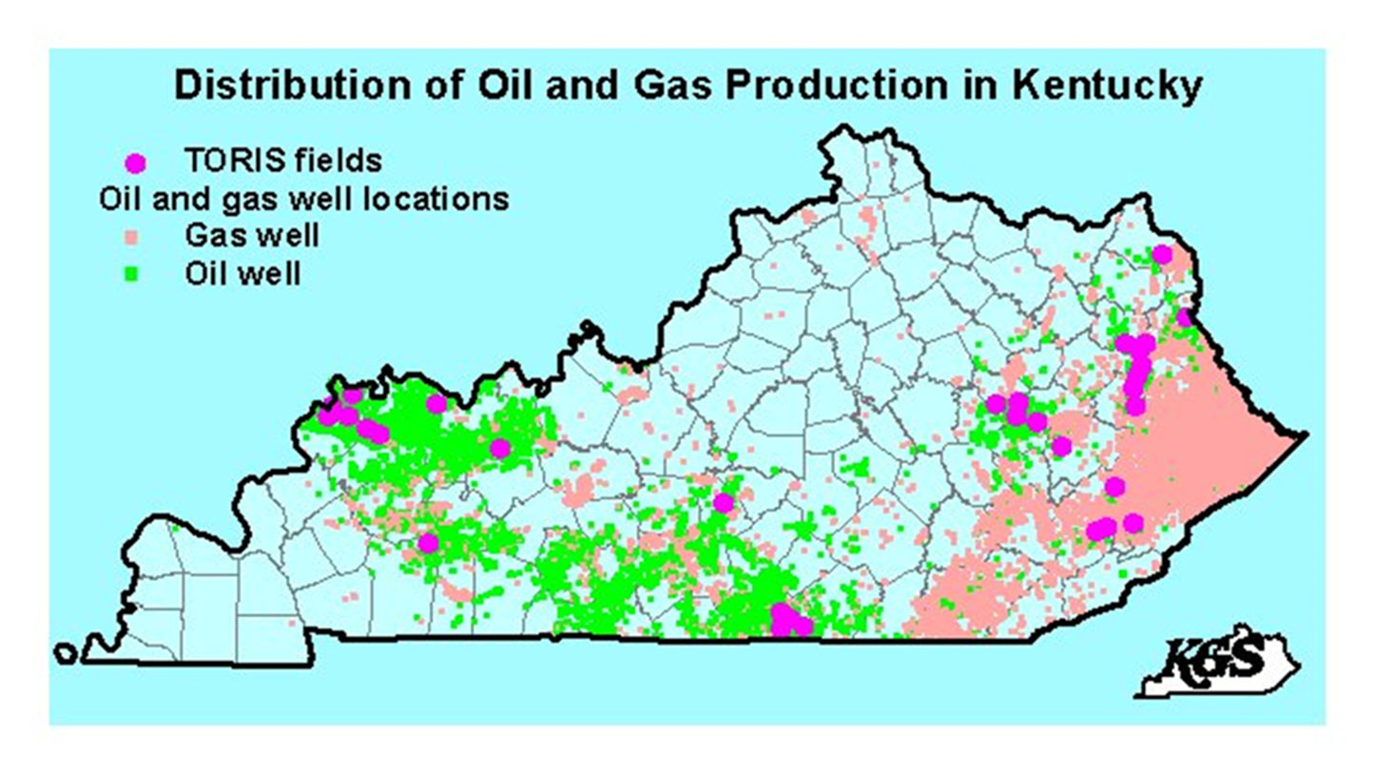
As of 2015, the deepest well in KY is the Chesapeake Appalachia Northup No. 1 LAW, which is in Lawrence County. It is 15,950 feet.

Slide 15
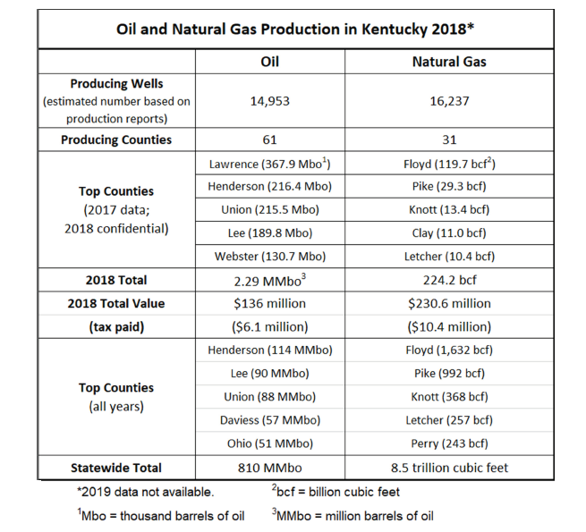

Slide 16
Differences in valuing natural resources:
For property tax assessments, unmined coal is able to be measured even while in the ground due to core log drill holes, which have been provided to our office by the companies. These allow for accurate readings of what amount of coal is in the ground, and our office uses this information in the assessment process.
Oil and Natural Gas are liquids/gases; it is very costly and requires a lot of expensive equipment and staffing to attempt to get readings of what is underground, and is out of scope for Revenue. Therefore, these assessments are based on the prior year’s production. This still provides an assessment based on fair cash value, just based on what we know to have been there after extraction.

Slide 17
The Process of Valuing Oil/Natural Gas
The Commonwealth uses an income approach to value, wherein the taxable value of a gas/oil well is based on the estimated present worth of an expected income stream.
This value is meant to be no more than the fair-market value of the property.
The income approach is intended to be market responsive, based on current prices, and up-to-date financial information.

Slide 18
In 1995, Department of Revenue employees and Kentucky Oil and Gas Association (KOGA) representatives had several meetings regarding how best to calculate the fair-cash value of the mineral rights in the Commonwealth of Kentucky. These meetings updated the calculation of the taxes from the 1966 agreement between the Department and KOGA.
The system developed by the Commonwealth in 1995 was still used until just last year.

Slide 19
In 2018, the Department met again with representatives from KOGA to review and adopt a procedure for updating the factors used in valuating the gas/oil mineral rights.
This was done with the idea of making the factors more market-responsive.
The conclusion was to adopt a procedure that would look at multiple market sources as a survey and average the results to come to an annual factor for calculating fair-market value of the property.

Slide 20
The market sources used by the Department are listed below:
West Virginia – Band of Investment and Summation Technique
Texas Comptroller of Public Accounts Industry Study (18 companies)
Society of Pretroleum Evaluation Engineers (32 companies)
Damodaran Industry Study through NYU (330 companies)

Slide 21
Another aspect of valuation that has not been reviewed since 1995, with regard to gas/oil property is the income/production reported to the Department to arrive at the cost per unit.
This too has not been adjusted since the original agreement between Revenue and KOGA in 1995.
As part of the new procedure, the Department now reviews and adjusts the cost per unit for gas and oil as reported by the producers/operators through the Severance Tax Branch.
This was done with the idea of basing the factors on current prices with up-to-date financial information.

Slide 22
As you can see, a lot of work goes into the assessment valuation process. But as for what taxpayer’s see, it comes down to one formula.
The assessment valuation of each owner is the net income for the well multiplied by the owned interest and factor.
2019 Factors
 | Gas | Oil
All | 2.855505 | 3.267640
Working | 2.590561 | 3.061573
Royalty | 4.710112 | 4.710112
Example:
Working Oil Interest: $10,000 x 87.5% x 3.061573 = $16,073
Royalty Gas Interest: $6,500 x 12.5% x 4.710112 = $3,827

Slide 23
Thank you -
Justin Woodside, Branch Manager, Natural Resources Property Tax
Division of Minerals Taxation and GIS Services
Other Resources for Information:
Kentucky Geological Survey Maps – https://uky.edu/KGS
Energy and Environment Cabinet – https://eec.ky.gov

