Slide 1
Solar Energy-Solar Farms Property Tax Administration
Covington, KY
December 5, 2019
Office of Property Valuation
Department of Revenue

Slide 2
Main Incentives for KY going Solar
$500 Tax Credit – State Income Tax
30% Federal Tax Credit
Net Metering policy – Law that requires Utility Companies to give full credit for any surplus electricity put back on the grid. Not CASH credit, but KILOWATT credit

Slide 3
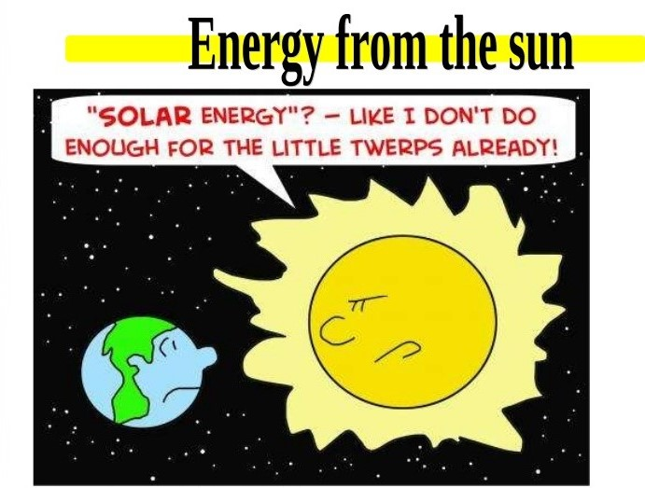

Slide 4
The distance from Earth to the Sun is approximately 92,955,887.6 or 93,000,000 miles

Slide 5
The light from the Sun reaches the Earth in 8 minutes and 20 seconds. The distance from Earth to the Sun is 0.000158 light years.

Slide 6
The sun has a diameter of 1,390,000 km or 863,706 miles

Slide 7
The sun is so large that 960,000 spherical Earths could easily fit inside it.

Slide 8
The energy output of the Sun is about 386 billion megawatts.

Slide 12
In 1954, the first modern solar cell was invented at Bell Laboratories.
* Cable repairman adjusts the Bell Solar Battery to make the first sun-powered telephone call near Americus, Georgia, on October 4, 1955.

Slide 13
Jimmy Carter
The “Solar President”
The White House itself once harvested the power of the sun. On June 20, 1979, the Carter administration installed 32 panels on the West Wing designed to harvest the sun’s rays and use them to heat water.

Slide 14
Jimmy Carter
The “Solar President”
Continued…
The White House solar was short lived…
By 1986, the Reagan administration had gutted the research and development budgets for renewable energy.
In 1986 the Reagan administration quietly dismantled the White House solar panel installation while resurfacing the roof.

Slide 15
1979: Solar panels fitted to the roof of a row of terraced houses

Slide 16
This ship-shaped, 1,033-foot long solar power generator, equipped with 5,000 solar cell panels by Sanyo Electric Co., was completed in the village of Anpachi, Japan, in 2001.

Slide 17
Photovoltaic array atop a parking garage, Arizona State University-Tempe. Solar power supplies nearly 50% of the peak daytime electric load at ASU’s four campuses and Research Park.

Slide 18
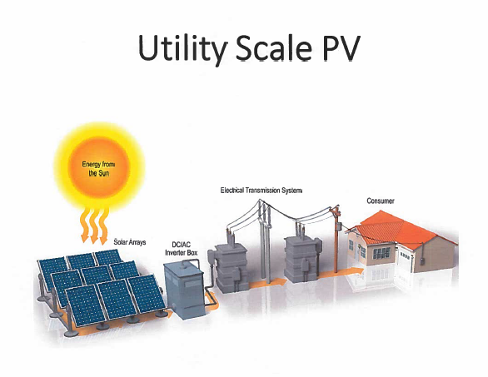

Slide 19
Utility-Scale PV without Battery Storage System

Slide 20
Utility-Scale PV with Battery Storage System

Slide 21
Solar Energy - Kentucky
National Ranking: 45th in 2019
State’s electricity from solar energy: 3% in 2014, approximately 10% in 2019
Projections over next 5 years: Kentucky would be ranked 32nd Nationally
Solar companies in the State: 57
Solar investments in the State so far, through 2019: approximately $75,000,000

Slide 22
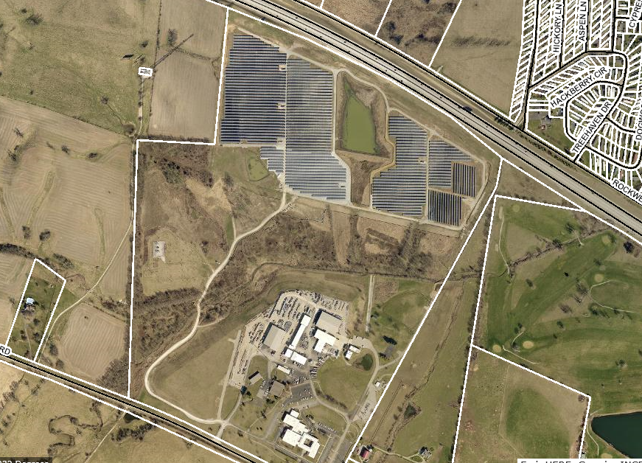
East KY Power Co-op Solar Farm – Clark County

Slide 23
East Kentucky Power Cooperative Solar Farm
Clark County Winchester, KY
Project area contains * 60 acres * 32,300 panels * 8.5 megawatts max production capacity

Slide 24
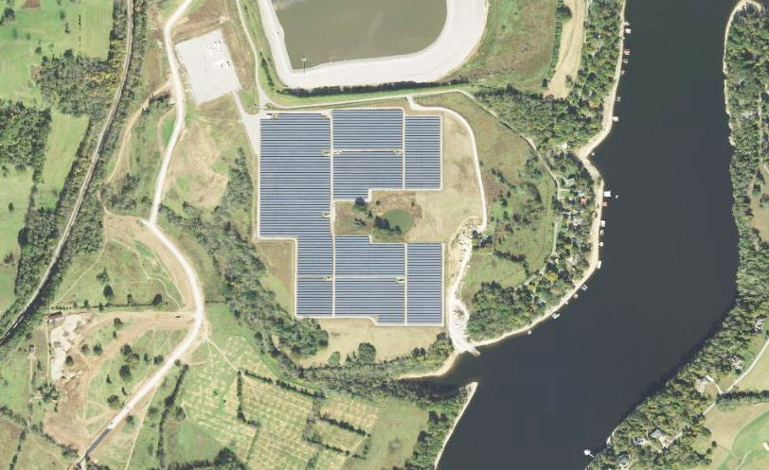
K.U./L.G.&E. E.W. Brown Power Plant – Mercer County

Slide 25
K.U./L.G.&E. E.W. Brown Power Plant Solar Farm
Mercer County Harrodsburg, KY
Project area contains * 50 acres * 44,000 panels * 10 megawatts capacity * On-site power storage

Slide 26
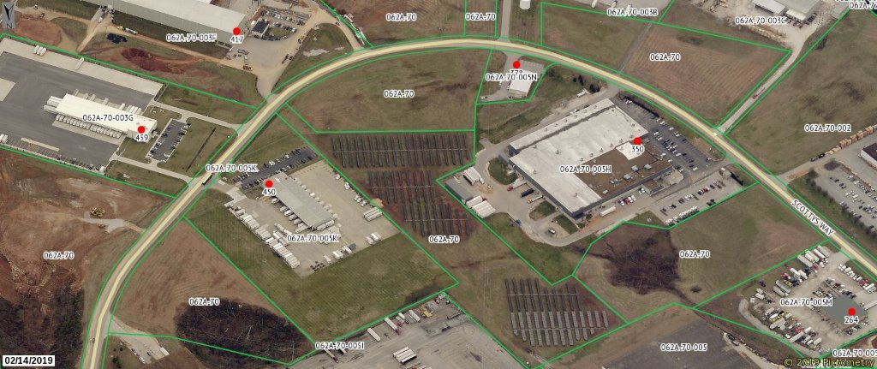
Scotty’s Development – Bowling Green, KY 8.8 acre site

Slide 27
Scotty’s Development – Bowling Green, KY 8.25 acre site

Slide 28
Scotty’s Development Bowling Green, KY
Project area contains
Site 1 – 8.8 acres
Site 2 – 8.25 acres
Total of 7,000 panels
Both sites produce 2 megawatts combined or a max total of 2.9 million kwh/year

Slide 29
GM Corvette Plant – Bowling Green, KY

Slide 30
GM Corvette Plant
Bowling Green, KY
Project area contains
4.25 acres
3,546 panels
.85 megawatts at peak
1.2 million kwh annually
Enough energy to produce 850 Corvettes annually

Slide 31
Duke Energy – Crittenden Solar Power Plant Grant County, KY

Slide 32
Duke Energy Crittenden Solar Power Plant Grant County, KY
Project area contains
Portions of a 110 acre site
12,500 panels
Generating more than 2.7 megawatts

Slide 33
Duke Energy – Walton Solar Power Plants 1 & 2 Kenton County, KY

Slide 34
Duke Energy
Walton Solar Power Plants 1 & 2
Kenton County, KY
Project area contains
Portions of a 60 acre site
19,000 panels
Capable of producing more than 4 MWe

Slide 35
The new challenges faced with…
UTILITY-SCALE SOLAR PROPERTY
ASSESSMENTS ??

Slide 36
The Burning Questions…
P.V.A.’s Role in Assessment?
- Residential Solar
- Commercial Solar
Office of Property Valuation’s Role in Assessment?
- Commercial Solar Public Service Companies

Slide 37
Typical solar installation on a single family residence

Slide 38
Solar installation - off structure

Slide 39
Advancements in Technology available NOW! What could be next on the Horizon???

Slide 42
P.V.A.’s Role – Residential Solar
Solar installations are assessed on a case by case basis
Personal home systems are assessed as Real Property
May or may not add value to property

Slide 43
P.V.A.’s Role – Commercial Solar
Once construction begins, land classification changes from Agricultural to Commercial
Assess all property associated with the project: land, fences, buildings, driveways, etc.
Company must file Tangible Personal Property Return form 62A500 while in construction

Slide 44
P.V.A.’s Role – Commercial Solar…continued
Each project must be reviewed on an individual basis
Obtain copy of Leases per solar project
In the event of an IRB, the project may be treated differently
When the Solar Farm (Company) goes online and selling electricity, the property MUST BE DELETED from the Tax Roll. Property will then be centrally assessed as a Public Service Company

Slide 45
Office of Property Valuation’s Role – Commercial Solar
All commercial solar farms classified as public service companies (PSC)
Titled as an Electric Power Company, subject to central taxation by the DOR as directed by KRS 136.120
Solar Farms should only start filing the form 61A200 after the farm becomes operational and begins selling electricity to customers

Slide 46
Construction of Solar Farm
Desire nearly level Land
Project must be in close proximity to transmission lines
Time Period
- 2 to 3 years for permitting and studies
- 12 to 18 months for construction
- Total time for completion of project, approximately 4 – 5 years

Slide 47
Legal Considerations/Concerns
Leases
Usually 20 year initial period
Additional 5 to 10 year increments
Total lease term is usually 40 years
Options to opt out of lease during time permits are being obtained and studies conducted

Slide 48
Legal Considerations/Concerns
Leases…continued
Lease Agreement stays with the land even if the current owner sells the property or dies
Lease payments are typically paid to owner bi-annually or annually (reported $200 to $500/acre/yr)
Leases involving Industrial Revenue Bonds (IRB) possibly real and/or personal

Slide 49
Legal Considerations/Concerns…continued
Taxes
Real Estate Property Taxes usually the responsibility of the developer
In the case of Leases, property tax bill (for land) remains in the name of the owner, but sent in care of (C/O) Lessee
Increase in taxable value due to classification change from Agricultural to Commercial

Slide 50
INTEREST SHOWN?
Have you heard the NEWS?
What about your County?

Slide 53
Billy says……….
BURN IT IN YOUR MIND!

Slide 54
QUESTIONS
For additional questions or information, please call or email:
Robert Carbin, Business Appraiser Branch Manager, Office of Property Valuation PH: (502) 564-7148 EMAIL: Robert.Carbin@ky.gov
David Best, Property Valuation Program Coordinator, Office of Property Valuation PH: (502) 564-7139 EMAIL: David.Best@ky.gov

Slide 55
Disclaimer
The information in this presentation is for educational and informational purposes only and does not constitute legal advice. Information is presented as an overall review that is subject to law changes and may not apply to all states. For accurate information on issues related to this presentation, please reference KRS 136.120.
Information in this presentation is believed to be accurate as of the date of publication. In the event that any information in this presentation is later determined to be in error, this presentation cannot be used by taxpayers in supporting a specific position or issue before the Department of Revenue, as it does not have the statutory or regulatory authority.
Presentation Date: December 5, 2019

