Slide 1
Personal Property Tax Roll Automation
PVA Summer Conference June 4, 2019

Slide 2
PERSONAL PROPERTY TAX ROLLS
Preliminary, Final, and data file will all be sent via Move-it for download by the PVA office.
Preliminary and Final tax rolls are in a PDF format
Will be sent prior to certification
Data file will be in text format
Will be sent after certification by Local Valuation
Will receive an email alert when something is loaded into the County library

Slide 3
Move-it
https://ftp.ky.gov
Passwords expire every ninety (90) days
One office User ID and password
Lock outs, password resets or issues can be handled by:
Erica Russell, Resource Management Analyst Erica.Russell@ky.gov 502-564-7125
Glyndon Woosley, Assistant Director Glyndon.Woosley@ky.gov 502-782-9667
Cathy Thompson, Director Cathy.Thompson@ky.gov 502-564-5117
Recommended to use Google Chrome as browser with Move-it

Slide 4
BENEFITS
Will receive much sooner will not have to wait on mail processing
PVA will have opportunity to review the tax roll and totals prior to certification and compare totals to previous year for significant changes upward or downward in valuation.
Most issues should be able to be resolved prior to Local Valuation certification
More efficient reduces cost and manual handling by staff
Downloaded files can be put on public terminals for public viewing. No requirement to print the tax roll

Slide 5
Request Preliminary Tax Roll
Preliminary – Send to Laura.Steele@ky.gov to request preliminary tax roll or call 502-564-7113. Will need to let her know what sort order:
Alphabetical Locator Number Account Number
Can only order prior to Closing and can order more than one
Recommended to find errors and correct prior to closing and certification

Slide 6
Request to Close Tangible
Closing Tangible – Send to Laura.Steele@ky.gov to close the tangible tax system or call 502-564-7113
Will no longer be able to make changes in the mainframe
Tax roll will be ordered from COT and will be placed on Move-it for download and review by PVA office
Tax roll or totals should not be shared with taxing jurisdictions until you receive certification
PVA should review tax roll and compare totals to previous year to check for omissions, significant increases or decreases in value. Any significant omissions from taxpayers can be sent to the Personal Property Omitted Section, Jehna Cornish for an omitted return review
Jehna.Cornish@ky.gov 502-782-2507

Slide 7
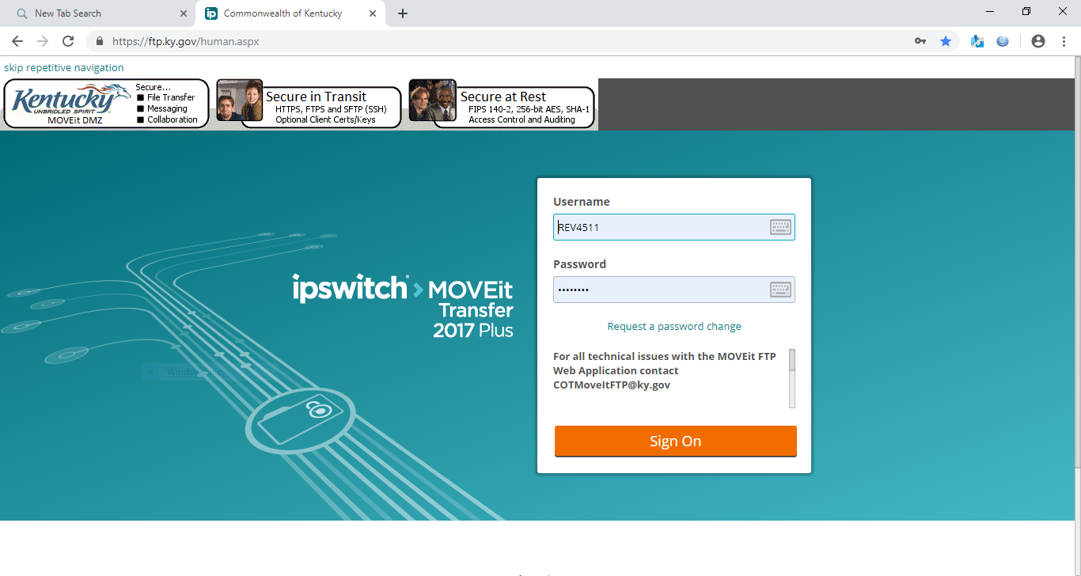
https://ftp.ky.gov

Slide 8
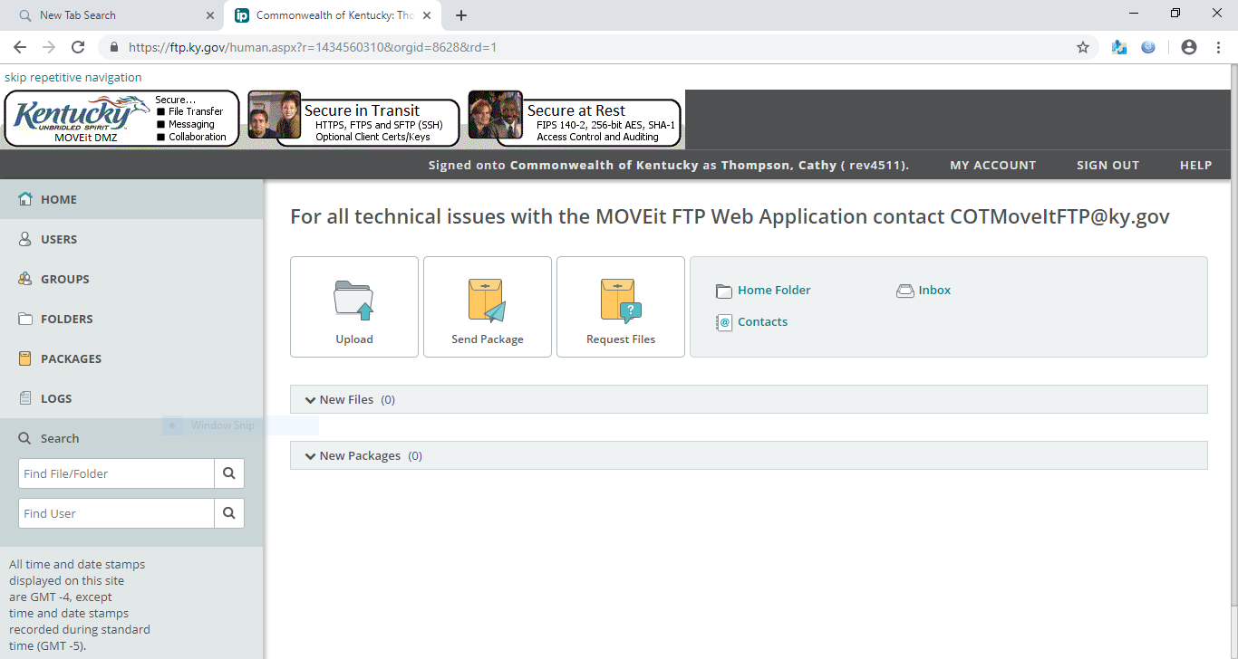
Select folders

Slide 10
If you log in this is the path and the folders you would click on to get here.
Each PVA Office has 2 folders

Slide 11
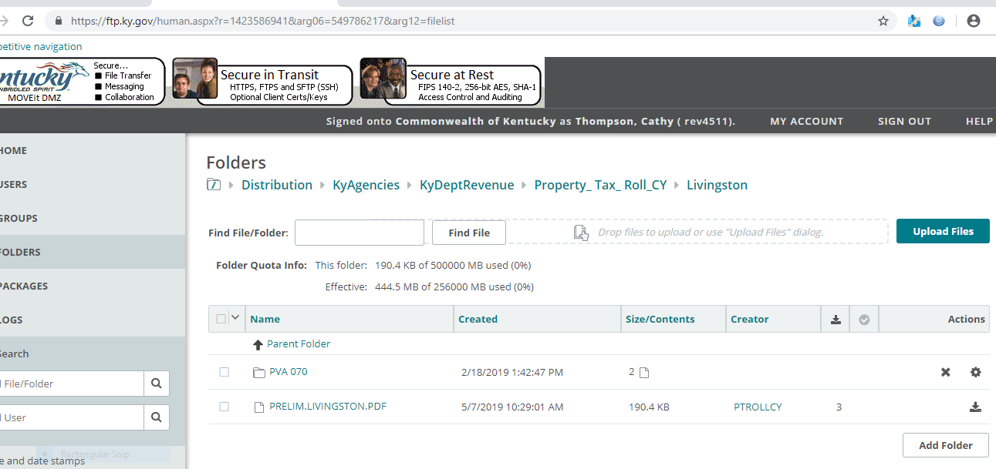

Slide 12
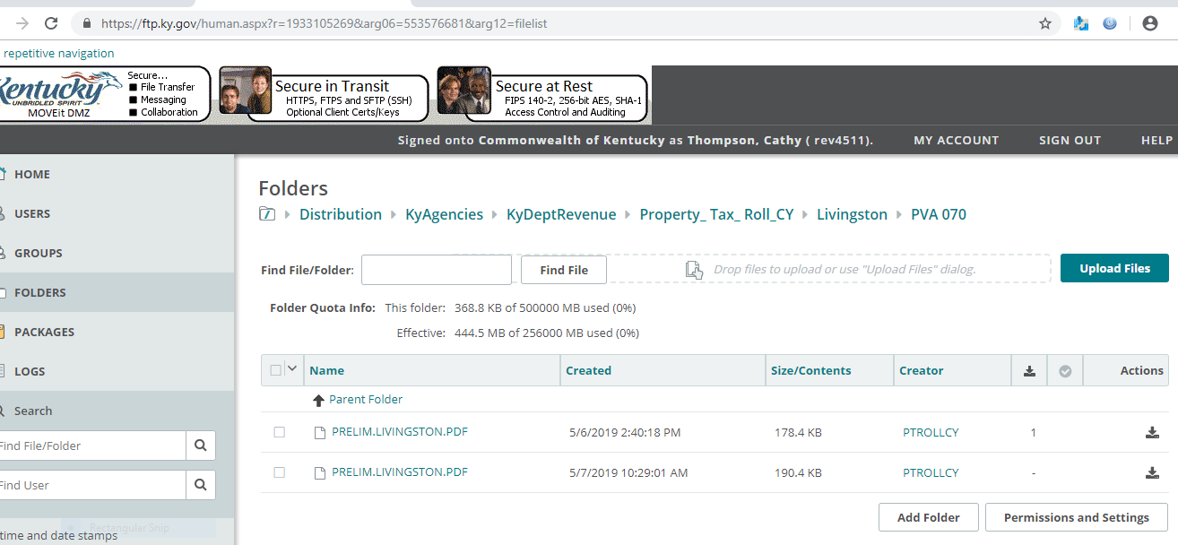
Download
Check the box

Slide 13
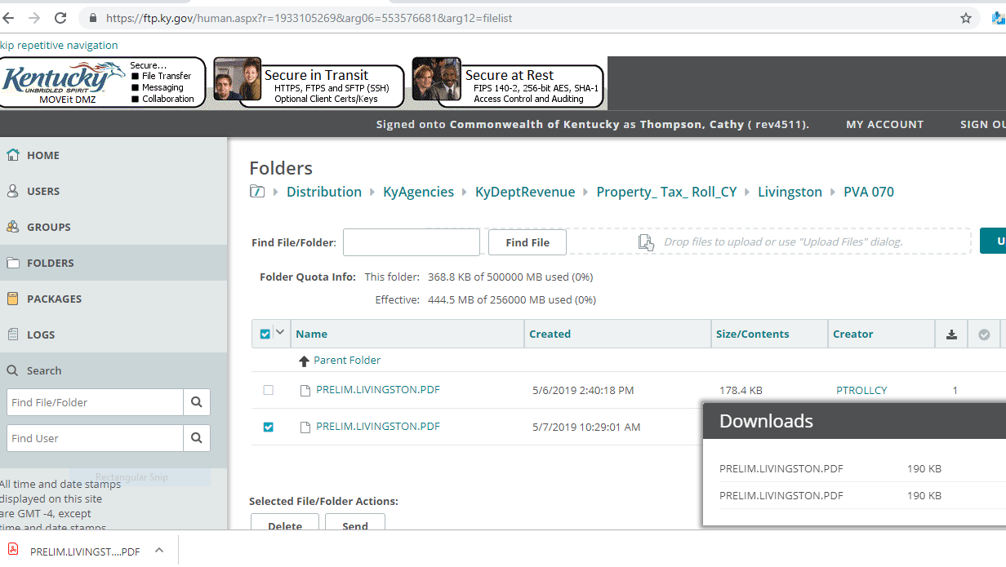
File in right corner

Slide 14
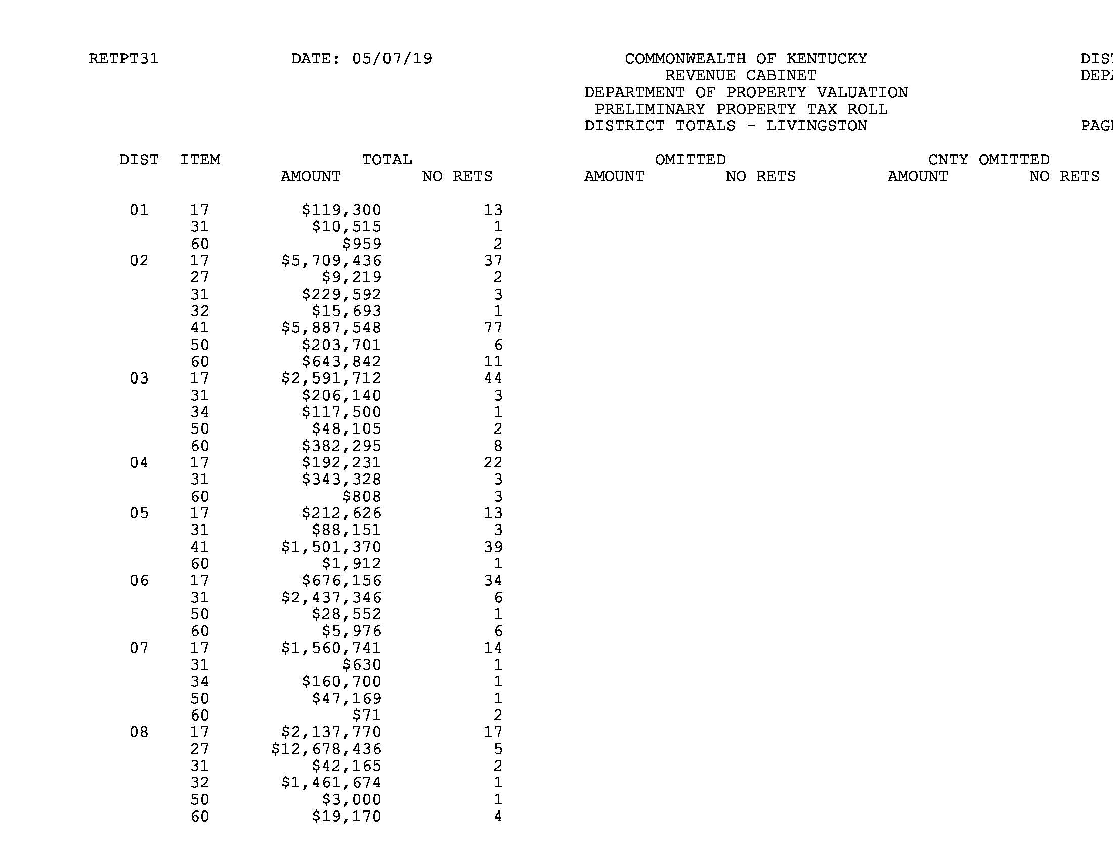
Total page from preliminary report

Slide 15
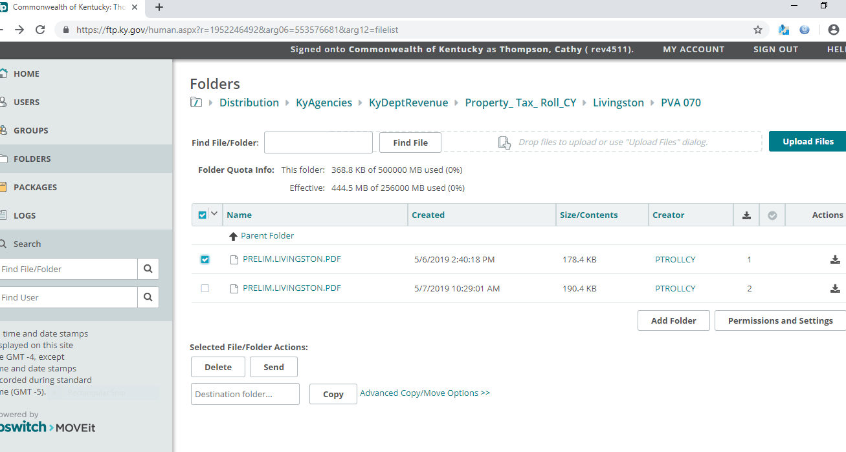
To send a file to someone. For example your dataset file to bill generator.
Check the box for the file and click “Send”

Slide 16
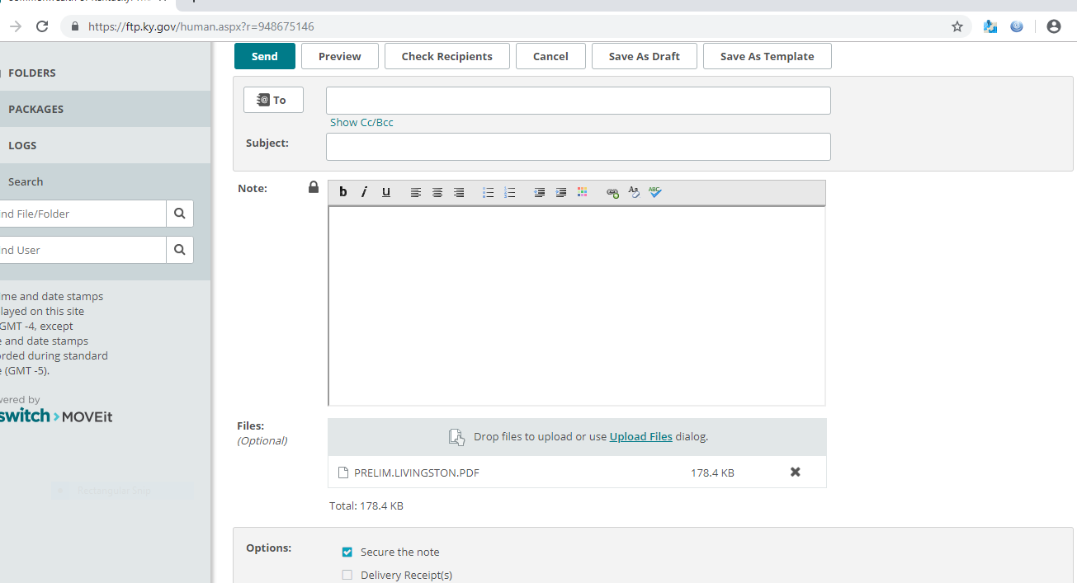
Select Send
Type in email address
Type in Subject
Type in Note to advise what it is.
The file is attached.
If you delivery response check the box

Slide 18
Cathy Thompson, Director State Valuation
Cathy.Thompson@ky.gov
502-561-5117
Glyndon Woosley, Assistant Director State Valuation
Glyndon.Woosley@ky.gov
502-782-9667
Erica Russell, Resource Management Analyst
Erica.Russell@ky.gov
502-564-7125
Laura Steele, Administrative Specialist
Laura.Steele@ky.gov
502-564-7113

Slide 19
Robert Carbin, Business Appraiser Branch Manager (Public Service)
Robert.Carbin@ky.gov
502-564-7148
Jehna Cornish, Section Supervisor Personal Property Omitted
Jehna.Cornish@ky.gov
502-782-2507
Darrell Young, Section Supervisor Personal Property Compliance
Darrell.Young@ky.gov
502-564-2729
Carin Brumback, Section Supervisor Motax
Carin.Brumback@ky.gov
502-782-5862

