Slide 2
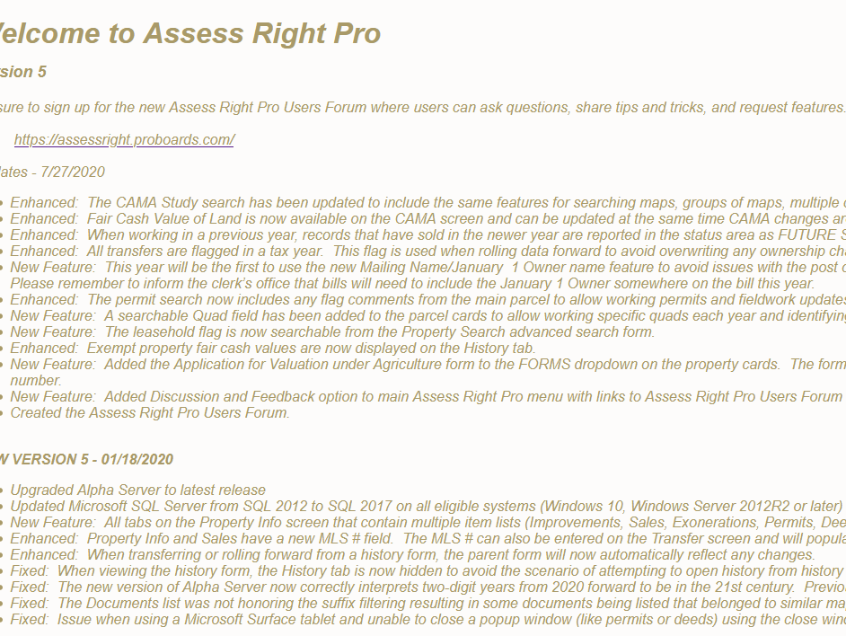
Property info all updates to the software are listed and dated for view by all clients

Slide 3
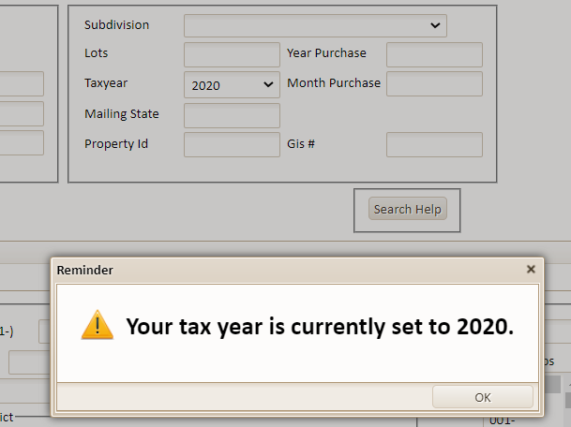
Assess Right pro will alert you to what tax year you are accessing

Slide 4
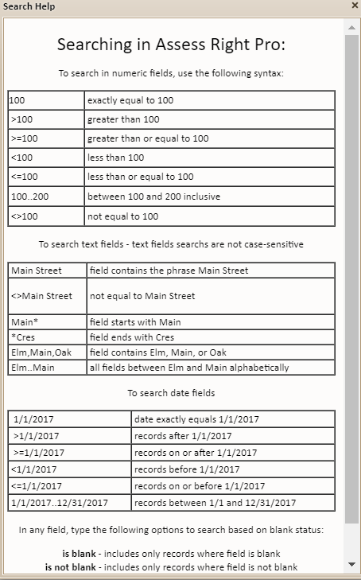
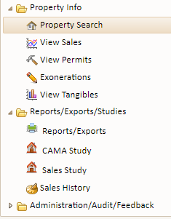
Primary search

Slide 5
WITH THE ADVANCED SeARCH YOU CAN REFINE YOUR SEARCH ON A VERY DETAILED LEVEL

Slide 6
Info/assessment tab
THE PRIMARY DETAILS of the property and the ownership ALONG WITH THE TAX YEAR ARE ALWAYS SHOWN AT THE TOP OF THE PAGE

Slide 7
Search on properties in the Bradford subdivision purchased in august 2008 two properties were identified To view a property click THE view/edit Button

Slide 8
Info/assessment tab mailing address sales data lot characteristics

Slide 9
Info/assessment tab assessment breakdown exemptions/other taxes/totals

Slide 10
Info/assessment tab additions deletions

Slide 11
Main structure tab characteristics of main structure

Slide 12
additional STRUCTUREs TAB ALL STRUCTURES CHARACTERISTICS OTHER THAN THE MAIN STRUCTURE

Slide 13
SALES TAB CURRENT AND PREVIOUS SALES DATA ARE VIEWABLE VIEW DEED TAB IF SCANNED DEEDS ARE AVAILABLE

Slide 14
HISTORY TAB VIEW CURRENT YEAR AND PREVIOUS YEAR ASSESSMENTS

Slide 15
FARMLAND TAB CALCULATE AGRICULTURE AND FAIR CASH VALUE FOR FARMLAND BASED ON PREDEFINED VALUES

Slide 16
Comments/flags tab unlimited commentS field. Flags are used for reviewing properties and have a separate comment field

Slide 17
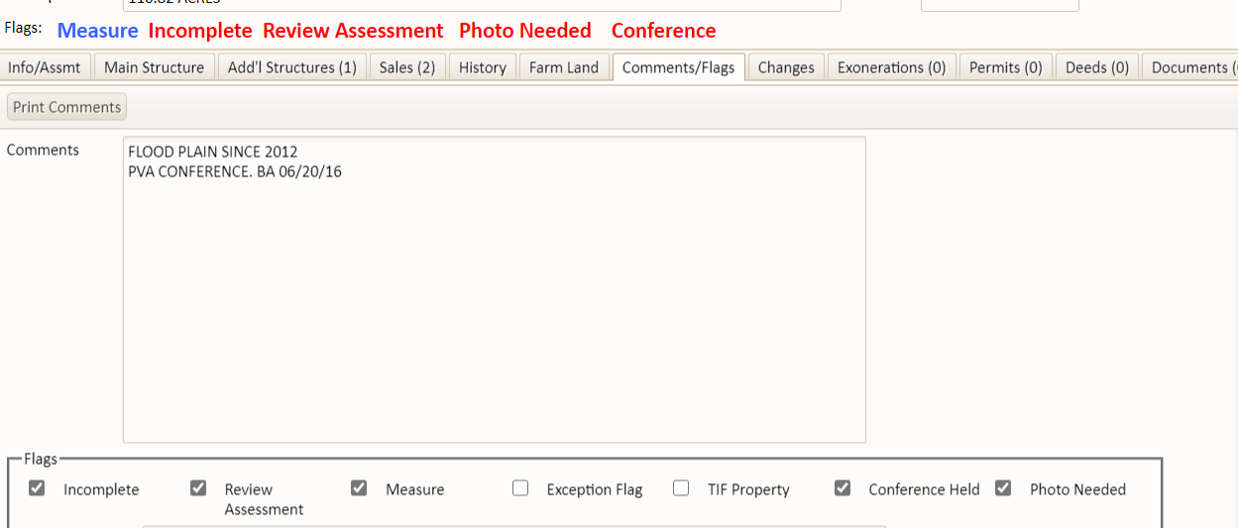
FLAGGED PARCELS SHOW UP AT THE TOP OF EACH SCREEN IN THE FLAG STATUS LINE. FLAG INDICATORS ALSO APPEAR IN SEARCH RESULTS TO ALERT USERS TO PROBLEMS WITH A PARCEL

Slide 18
CHANGES TAB ALL CHANGES ARE TRACKED WITH PRIOR VALUES, NEW VALUES, UPDATE DATE AND WHO THE CHANGES WERE MADE BY

Slide 19
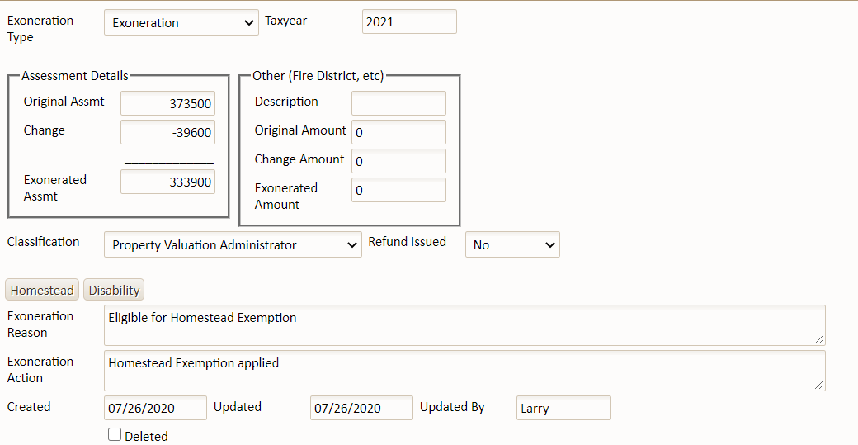
EXONERATIONS ARE EASY TO CREATE. JUST CLICK
ADD EXONERATION
AND FILL IN THE FORM

Slide 20
EXONERATIONS PRINT ON THE STATE FORM

Slide 21
PRINT REFUNDS ON THE STATE FORM

Slide 22
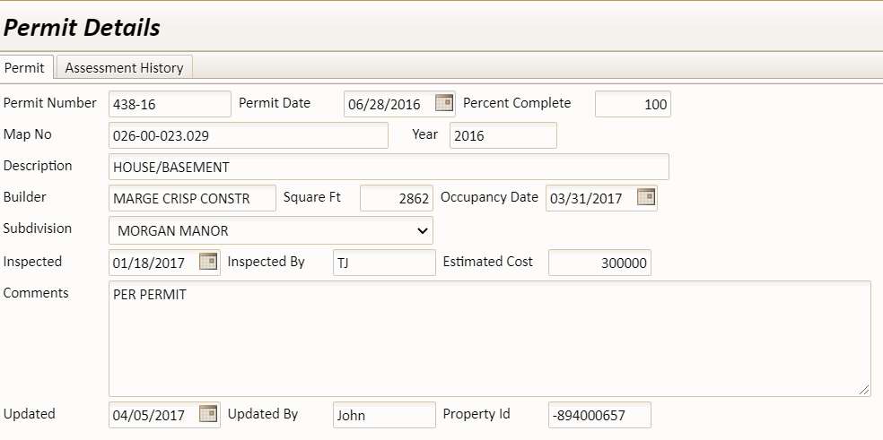
PERMIT TAB
Lists all permits on a parcel
CLICK VIEW/EDIT
TO VIEW OR CHANGE PERMIT DATA

Slide 23
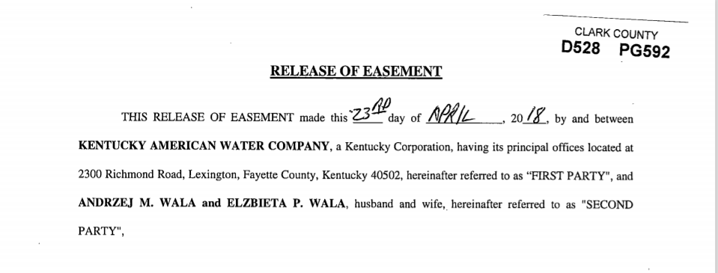
ADDITIONAL DEEDS TAB
CLICK VIEW TO SEE THE SCANNED DEEDS

Slide 24
DOCUMENTS TAB Additional DOCUMENTS CAN BE saved and ACCESSED BY CLICKING THIS TAB

Slide 25
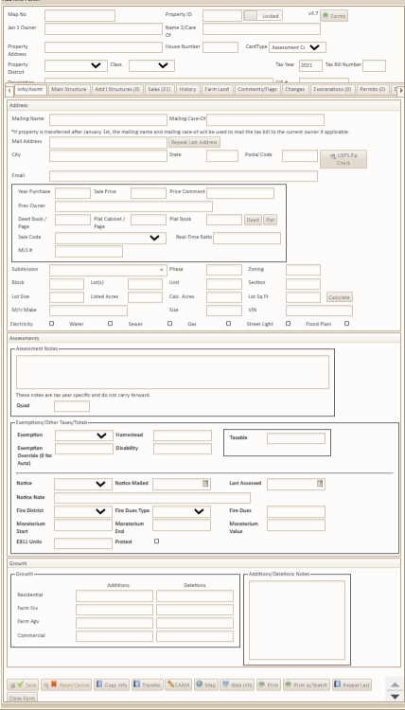
To add a new record click the green plus sign on the search screen a new blank record will appear for entry

Slide 26
A BUTTON BAR AT THE BOTTOM OF EACH PAGE ALLOWS USERS TO QUICKLY ACCESS COMMONLY USED functions

Slide 27
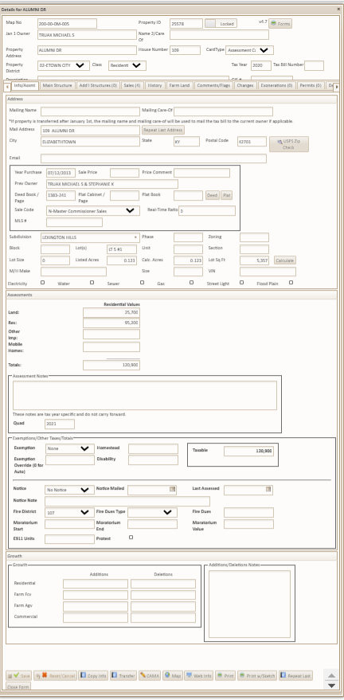
Copy info button when you have a record that is split into tracts A subdivision is a good example click the BUTTON to copy the current screen

Slide 28
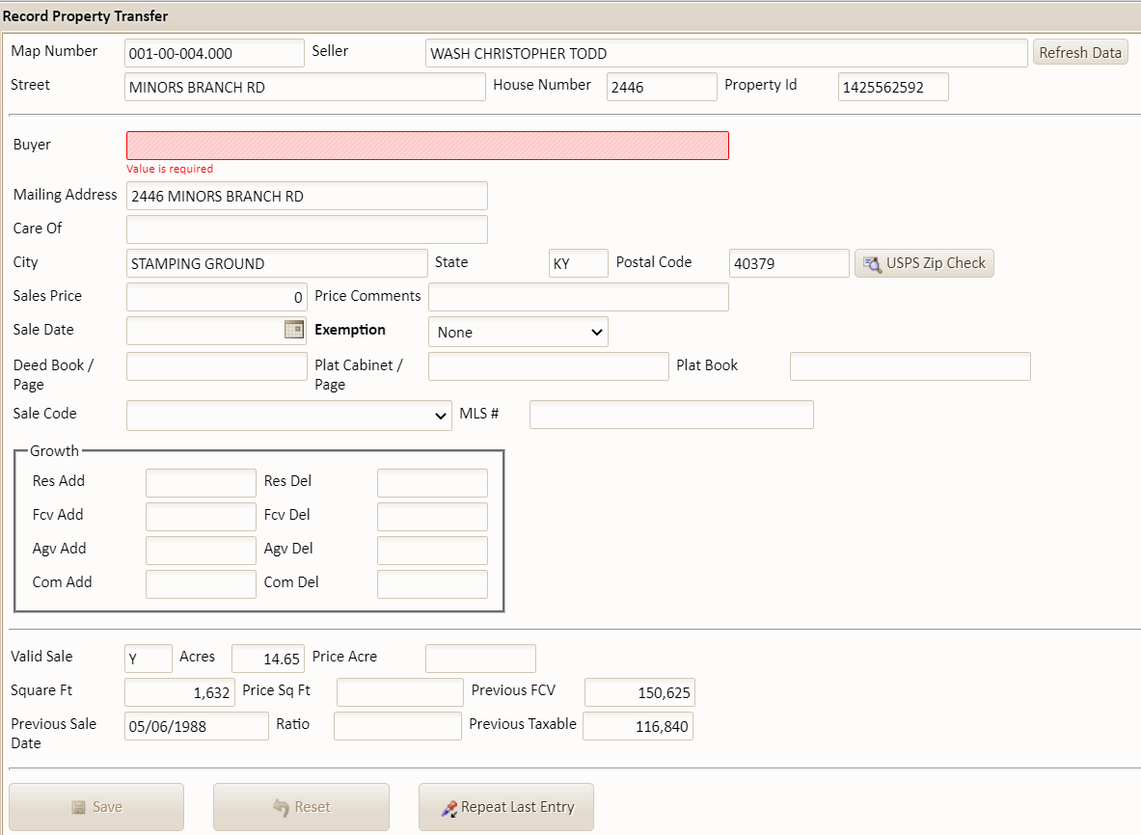
Transferring a property is easy click THE transfer button a sales transfer screen appears with prefilled data from info/assmt screen

Slide 29
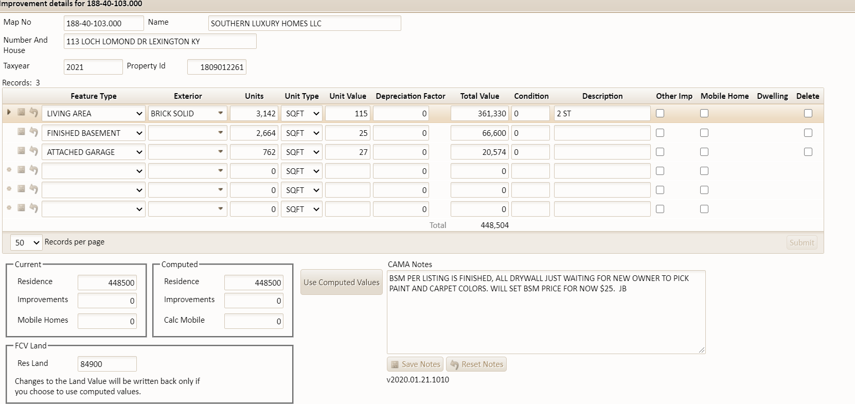
CAMA BUTTON
USED TO BREAK OUT IMPROVEMENTS TO THE PROPERTY
SQUARE FOOTAGE AND OTHER IDENTIFIERS ARE RECORDED
CALCULATE THE VALUE OF THE IMPROVEMENT BASED ON THE SQ. FT.
A UNIT $PSF VALUE ARRIVES AT A TOTAL IMPROVEMENT VALUE
A DEPRECIATION FACTOR CAN ALSO BE APPLIED
VALUES ARE LISTED IN A COMPUTED AREA ON THE WORKSHEET
IF USING VALUES – CLICK THE COMPUTED VALUES BUTTON
NEW FIGURES WILL BE SENT TO THE ASSESSMENT SCREEN.

Slide 30
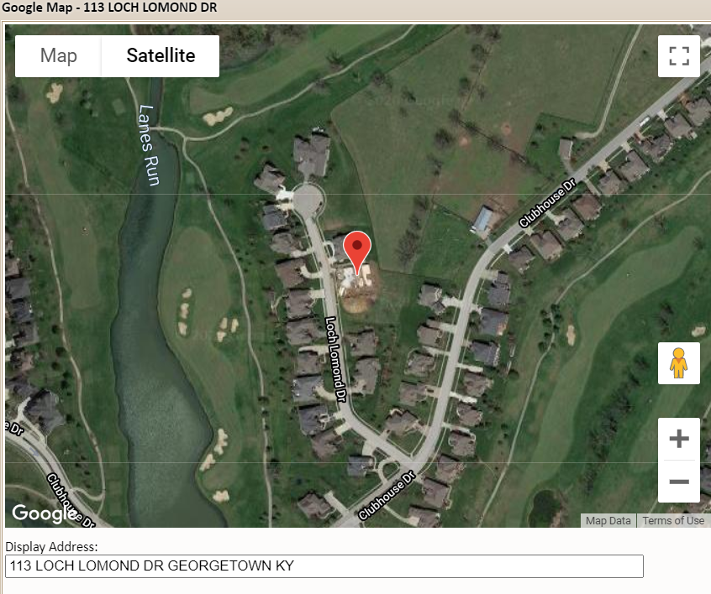
map button BRINGS up google mapS showing the location of the selected parcel.

Slide 31
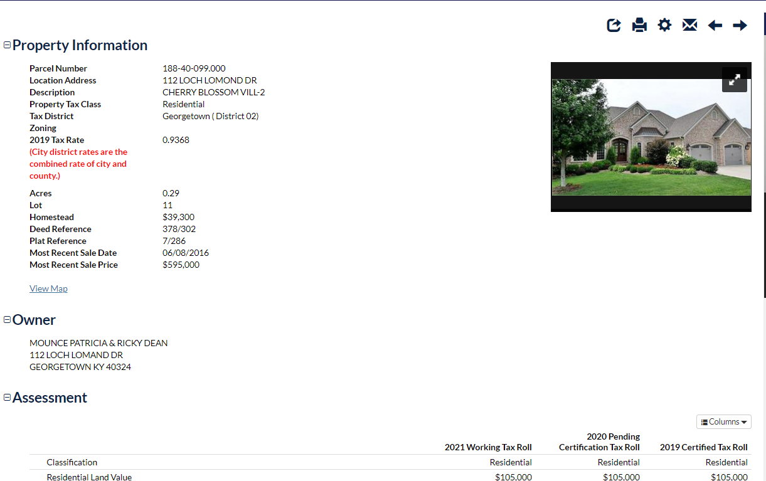
Web info tab DISPLAYS THE PARCEL ON YOUR qpublic WEB PAGE

Slide 32
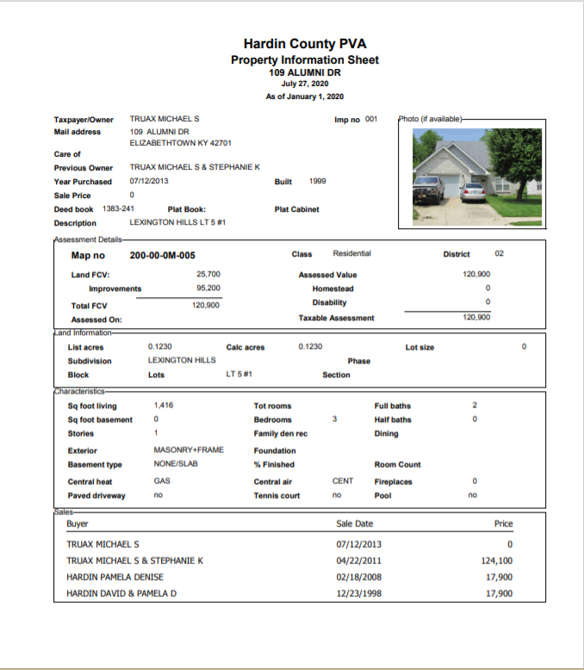
Print BUTTON prints a data sheet for current property with no sketch.

Slide 33
Print w/sketch will print both a data sheet and sketch

Slide 34
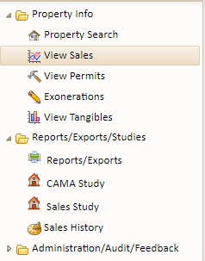
View sales

Slide 35
ADVANCED SALES search

Slide 36
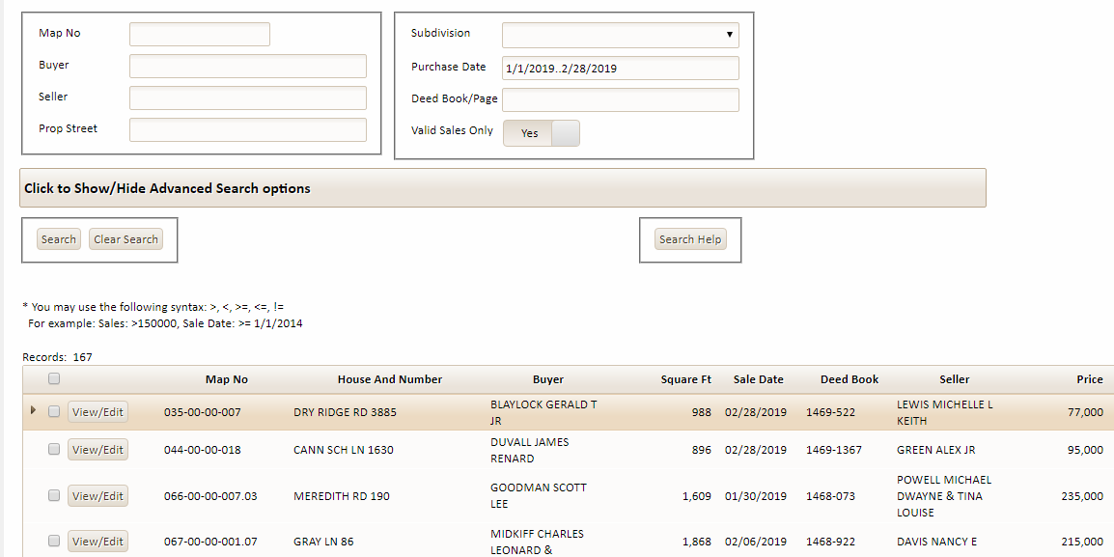
in the above sales SEARCH WE SPECIFIED All properties sold FROM January 1, 2019 through march 1, 2019 sales need to be valid sales The search found 167 properties meeting that criteria

Slide 37
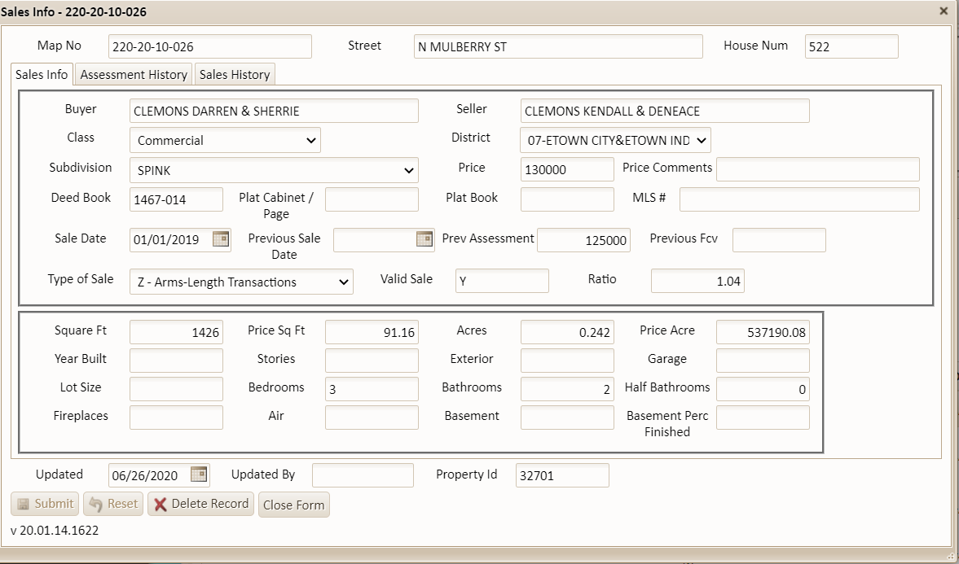
FROM THE SALES SEARCH RESULTS CLICK VIEW/EDIT
SALE FILE FOR PARCEL APPEARS
DATA IS CURRENT SALES INFORMATION
ASSESSMENT HISTORY & SALES HISTORY TABS
REVIEW CURRENT AND PRIOR YEAR ASSESSMENTS
VIEW ALL PRIOR SALES HISTORY

Slide 38
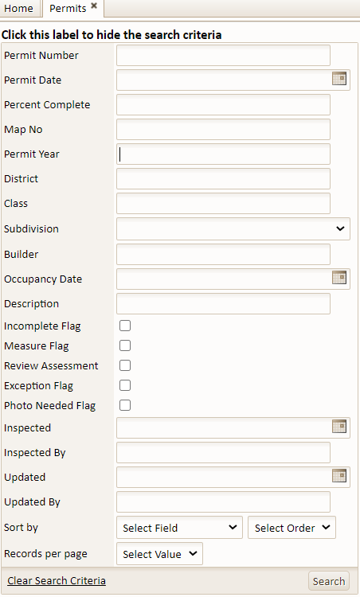
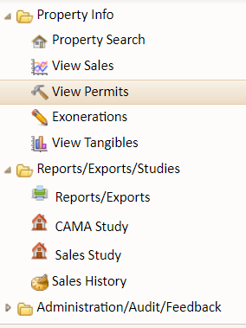
View permits

Slide 39
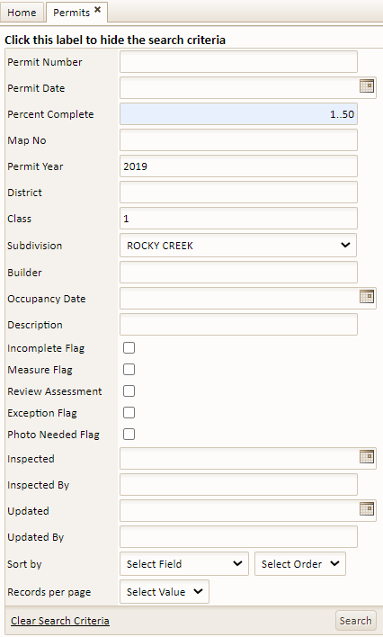
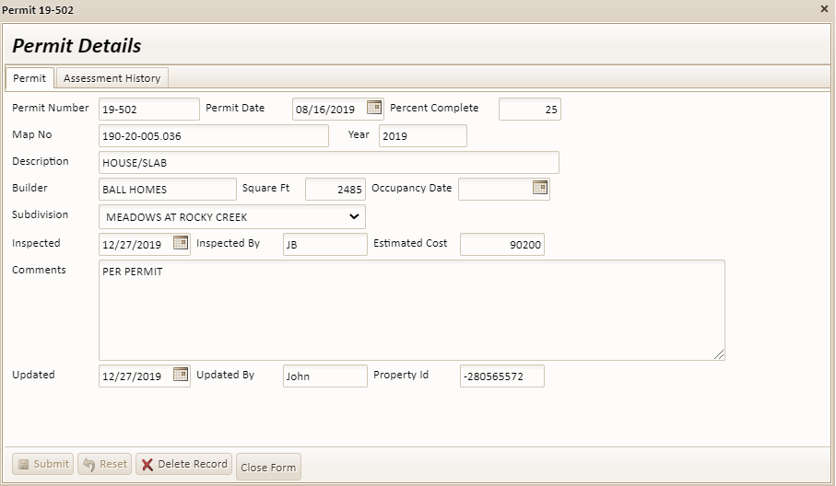
SEARCH PERMITS BY:
PERCENT COMPLETE
PERMIT YEAR
CLASS & SUBDIVISION
SEVEN PROPERTIES FOUND

Slide 40
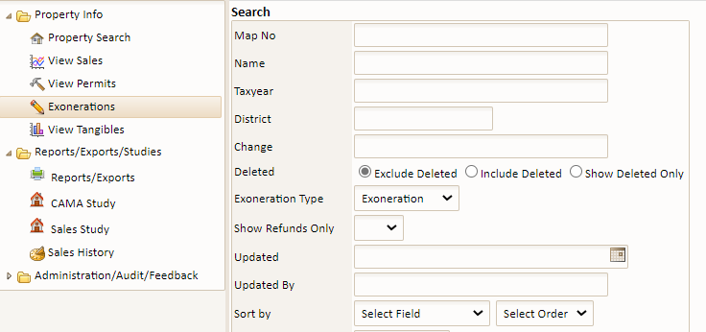
Exonerations

Slide 41
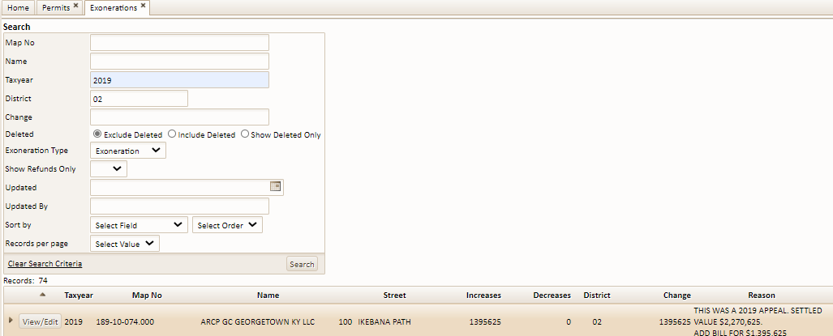
Searching for exonerations for tax year 2019 & district is “02” An excel spreadsheet can be printed for viewing and submission

Slide 42
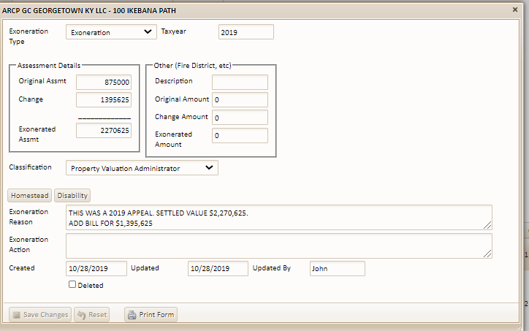
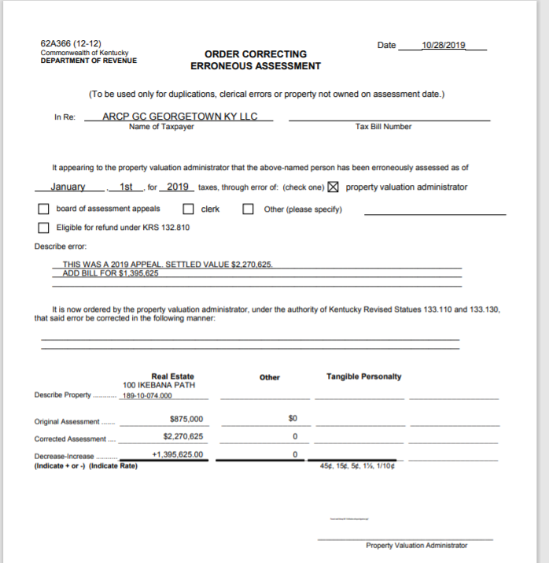
search returns the exoneration document AND a print form feature at the bottom of page

Slide 43
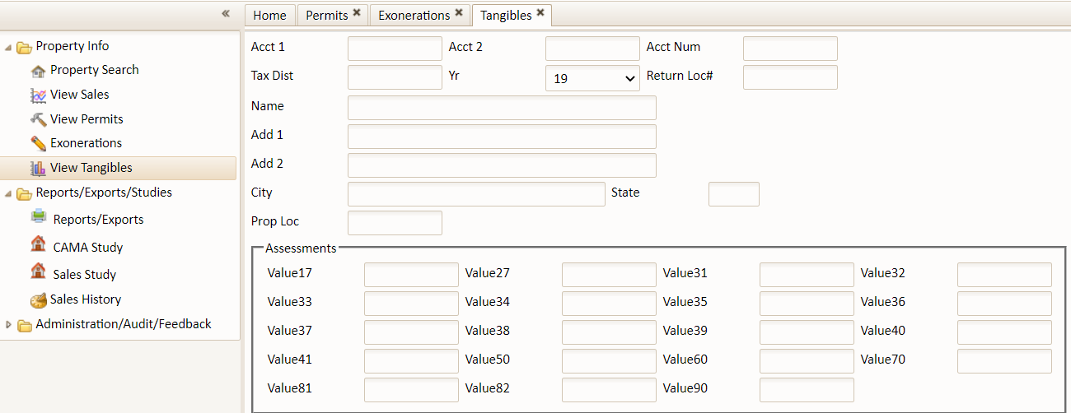
View tangible download the tangible disk for the current year This feature IS used for viewing taxpayers that have filed a tangible return

Slide 44
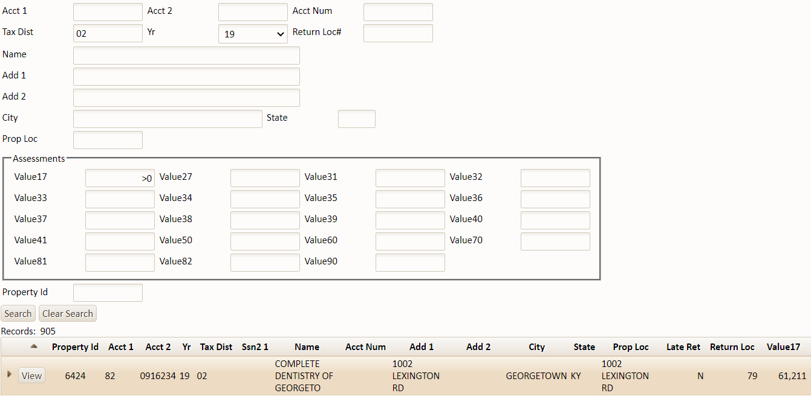
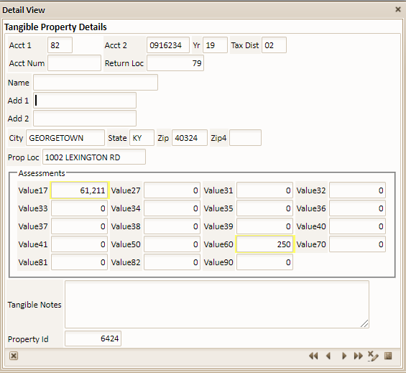
Search for tangible returns based on tax dist “02” Value “17”and value greater than “0” Search returns 905 records.

Slide 45
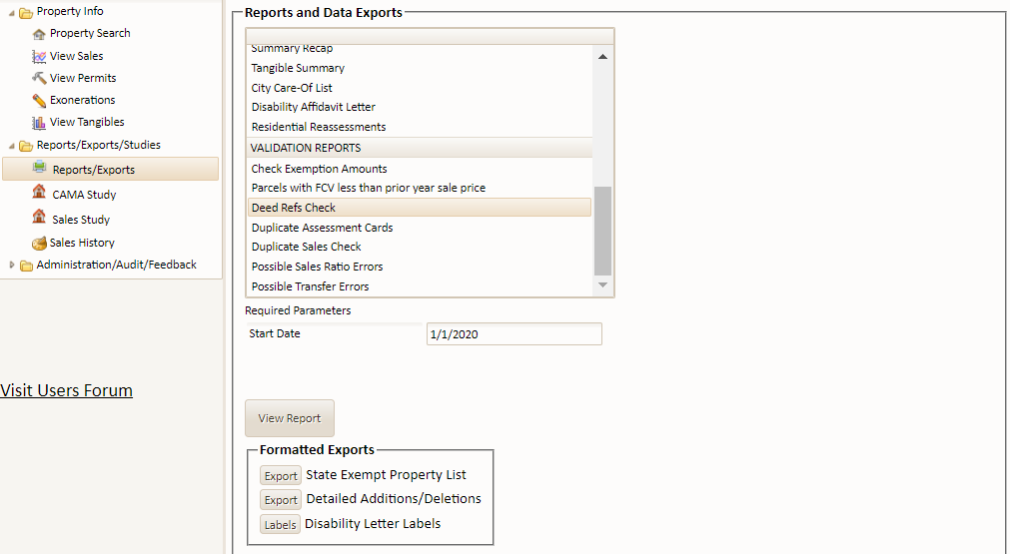
Reports/exporTS ACCESS various pva reports - key reports INCLUDE: sales ratio study summary recap report state exempt property list and detailed additions/deletions report

Slide 46
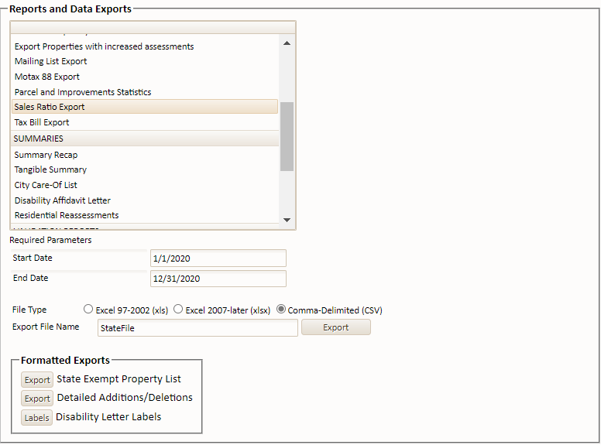
Sales ratio report GENERATES AN EXCEL EXPORT FOR SUBMISSION TO THE REVENUE CABINET

Slide 47
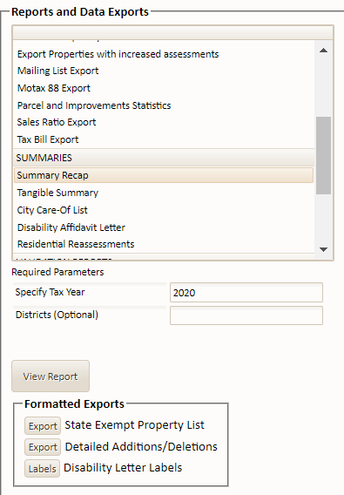
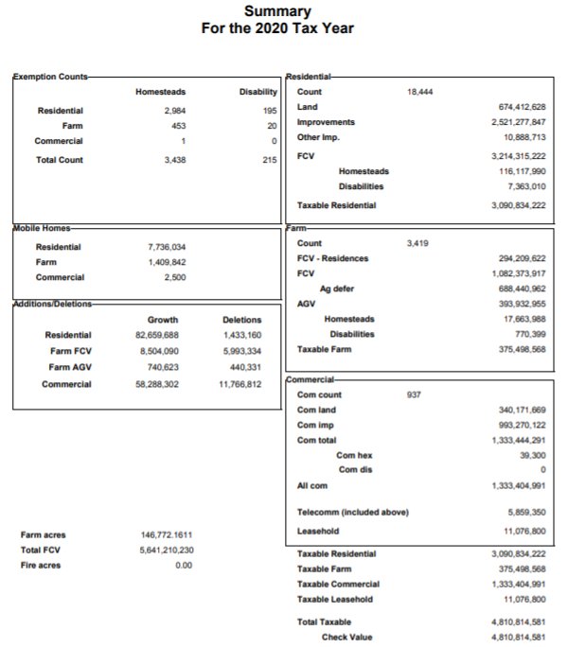
Summary recap this report can be run ANYTIME AND PROVIDES the total assessments for the county OR ANY DISTRICT OR COMBINATION OF DISTRICTS

Slide 48
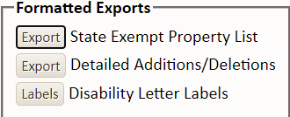
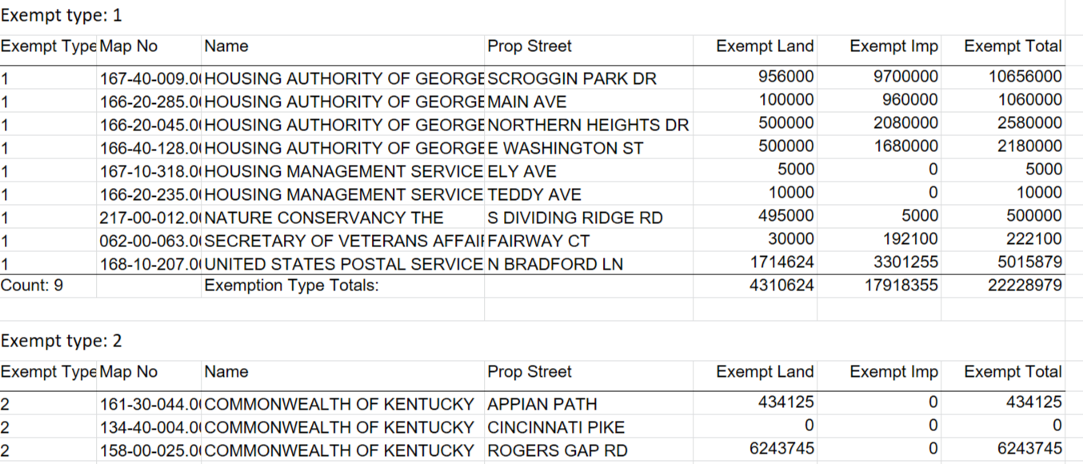
state exempt property list click THE export BUTTON TO CREATE AN excel spreadsheet READY FOR SUBMISSION TO FRANKFORT

Slide 49
Detailed additions/deletions fill in tax year/district click THE export additions/del BUTTON ASSESS RIGHT PRO GENERATES AN excel SPREADSHEET READY TO SUBMIT

Slide 50
Cama study search screen
Used to analyze property sales.

Slide 51
Cama study Search was for properties in Bradford place subdivision sold between 09/01/2019 and 12/31/2019 sale price – $150,000 and $175,000 one record was returned. Key values in the search are: cost living price/sq.ft assessed living price/sq.ft

Slide 52
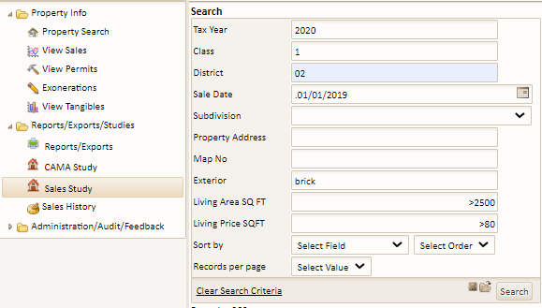
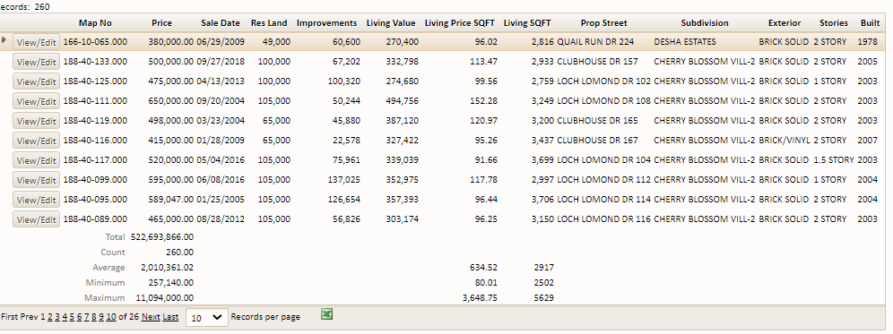
Sales study used for searching comparable sales The search is for properties in 2009 tax year in district 02 with a sale date of 01/01/2019 having a brick exterior and living area greater than 2500 and living area $psf greater than $90 the search returned 260 properties.

Slide 53
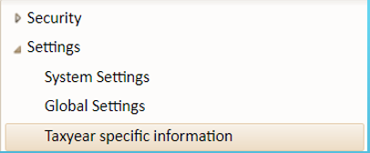
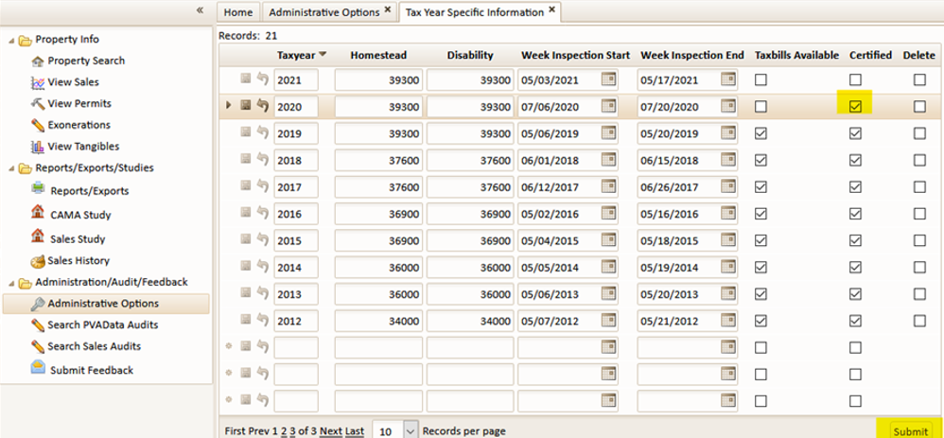
tax year specific information – ratio In Assess Right Pro the sales ratio calculation is based on the latest “certified” tax roll assessment per Revenue Cabinet requirements check your “Certified” box for the prior tax year in Administration/Settings/Tax Year Specific information This allows Assess Right Pro to calculate assessments for sales entered from the day you check the box - usually July 1st to use your prior year assessment

Slide 54
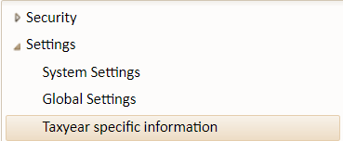
tax year specific information homestead/disability current yearly homestead and disability values are entered in the table the computer will then revalue all properties with these fields entered

Slide 55
tax year specific information week inspection start-week inspection end the inspection dates are entered in this table notices when printed will reflect these dates

Slide 56
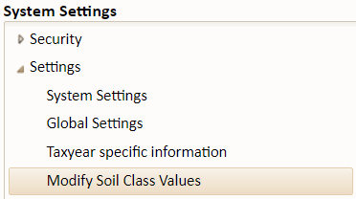
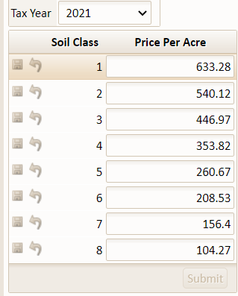
Modify soil class values this table is used to set the revenue recommended agricultural values for farmland

Slide 57
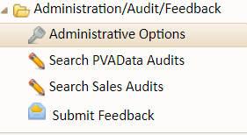
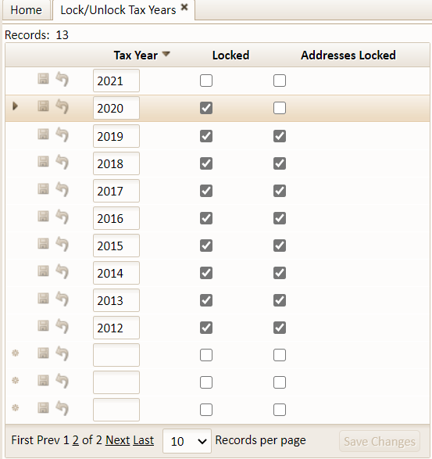
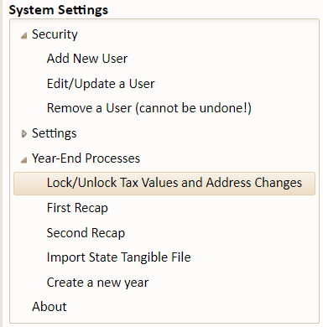
Lock/unlock tax values and address change in this example tax YEAR 2020 has the locked box checked indicating the county has TURNED IN THEIR SECOND RECAP the figures cannot be changed Addresses can be updated until the tax bills are printed Addresses CAN BE locked ONCE THE TAX BILL EXPORT IS COMPLETE

Slide 58
click MENU OPTION first recap you will see a BUTTON labeled create snapshot This will create a copy of THE data THE SYSTEM WILL CREATE A COMPLETE SNAPSHOT OF YOUR TAX DATA FOR THE SELECTED YEAR SO THAT ANY CHANGES CAN BE RECORDED Once you create a snapshot YOU’RE ready to run first recap Set the tax year /district and CLICK run first recap
FIRST RECAP

Slide 59
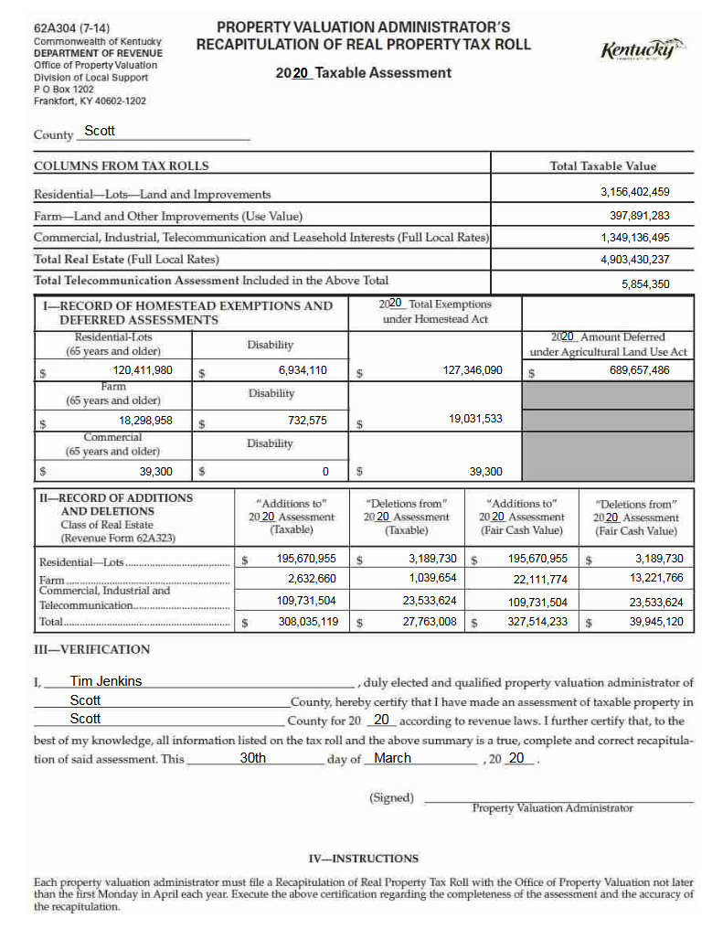
FIRST RECAP

Slide 60
click tab second recap you will see a tab labeled create snapshot This will create a copy of your data Once you create a snapshot you are ready to run the second recap Set tax year/district -CLICK run second recap Creating a snapshot will help FIND changes made From second recap to tax bill creation
SECOND RECAP

Slide 61
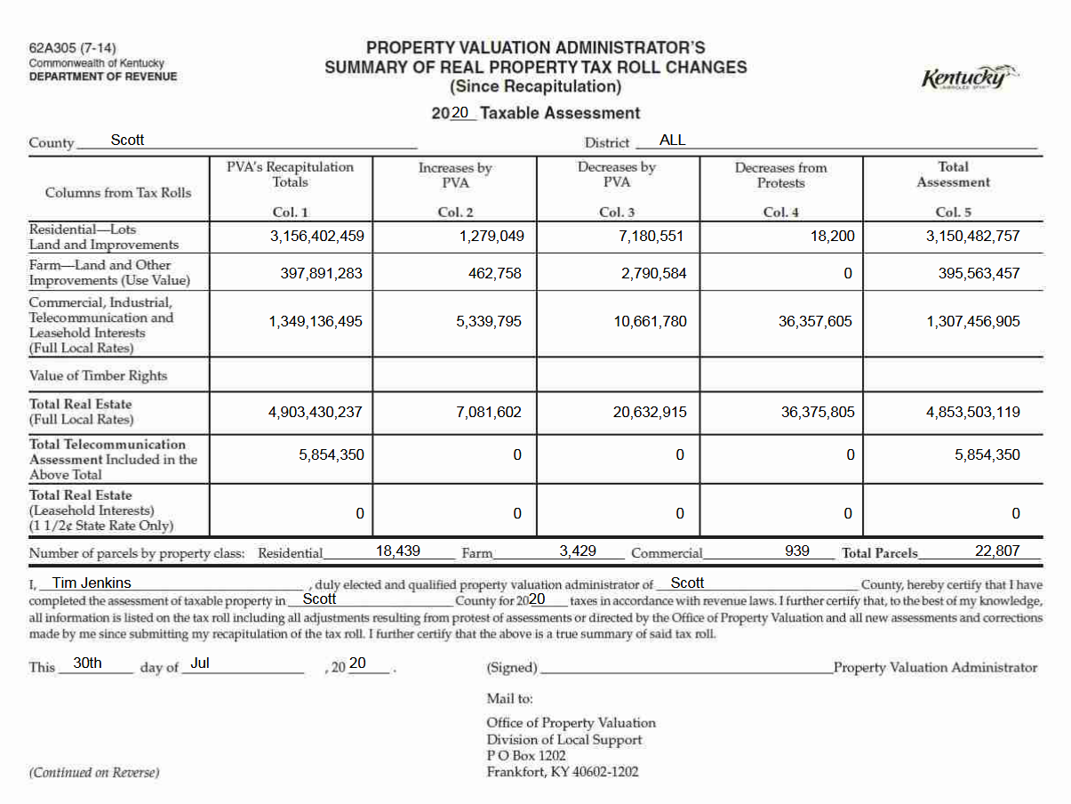
Second recap
THE SECOND RECAP AUTOMATICALLY GENERATES THE FORMS REQUIRED BY FRANKFORT INCLUDING ALL INCREASES AND DECREASES PLUS PROTEST AMOUNTS

Slide 62
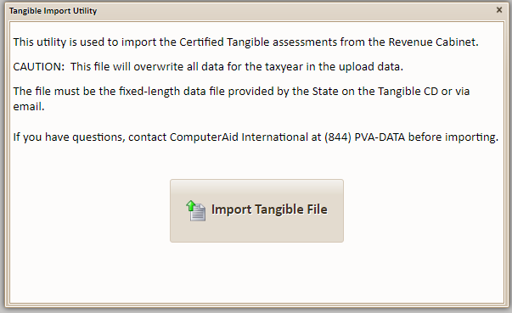
Import tangible file

Slide 63
Search pva data audits when you want to find data changes This search is for changes made by john in the 2019 tax year from 01/01/2019-03/01/2019 search returns 46,234 changes

Slide 64
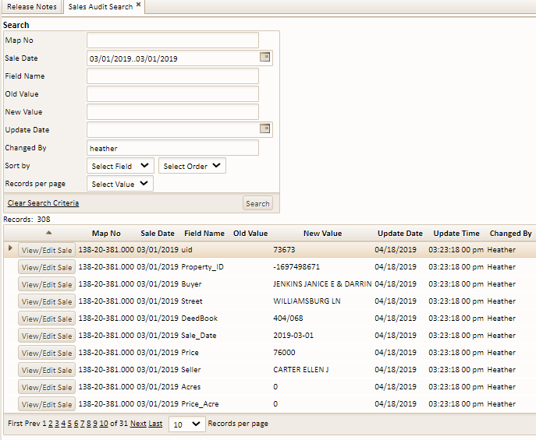
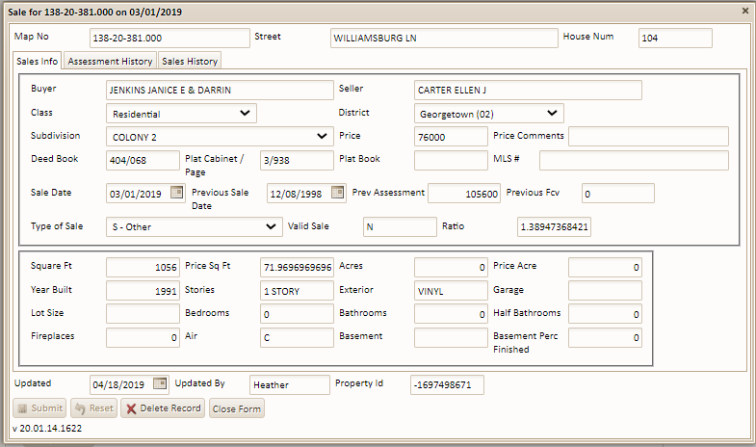
Search sales audits when you want to find sales data changes This search is for changes made by heather from 01/01/2019-03/01/2019 search returns 308 changes.

Slide 65
SUPPORT AND FEEDBACK
THE ASSESS RIGHT PRO USERS FORUM ALLOWS USERS TO EXCHANGE IDEAS, REQUEST ASSISTANCE, AND LOOKUP ANSWERS TO QUESTION ABOUT USING ASSESS RIGHT PRO

Slide 66
submit feedback/ suggestions
USERS CAN SUBMIT FEEDBACK OR REQUEST ASSISTANCE DIRECTLY FROM WITHIN ASSESS RIGHT PRO

Slide 67
Call my direct number 859-588-2947 for more information about assess right pro
LARRY HARNEY
Sales & Support Consultant
COMPUTERAID INTERNATIONAL
lharney@compuaid.com
Toll Free – (844)PVA-DATA(782-3282) ext. 102

