Slide 1
The Local Officials Compliance Branch
Education Essentials:
Your Primer for Education

Slide 2
Your Education Staff
Brian Stidham
Education Coordinator
Kim Holt

Slide 3
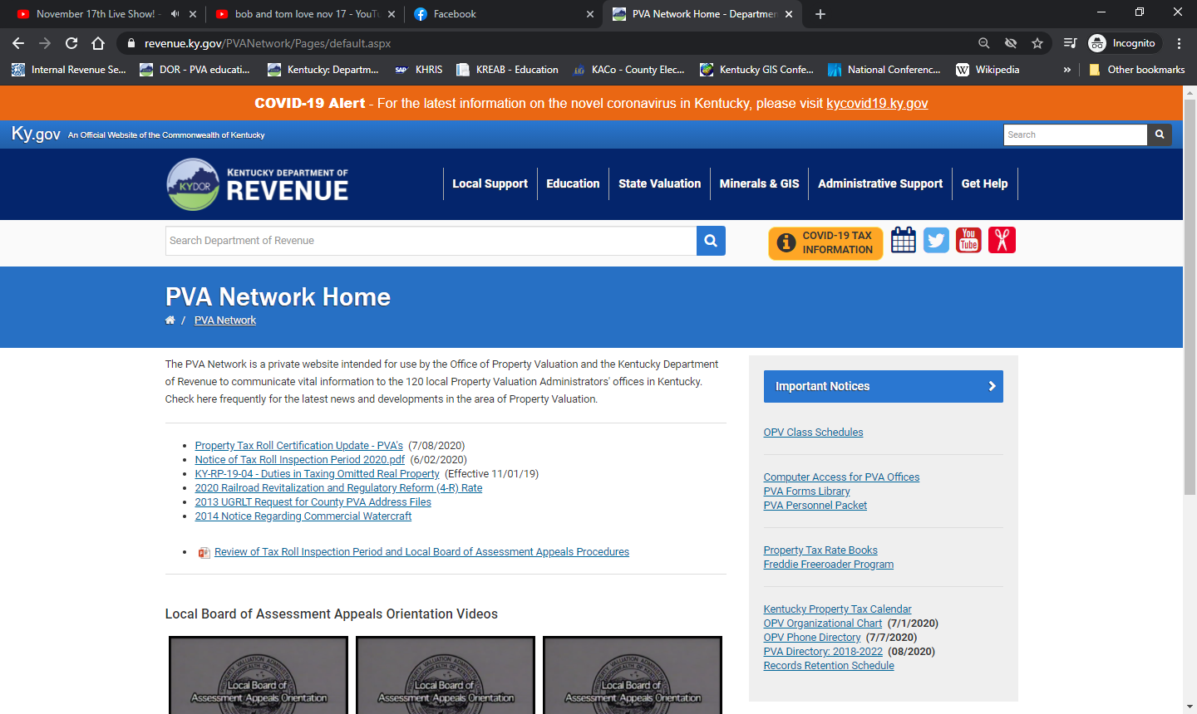
http://revenue.ky.gov/PVANetwork/

Slide 4
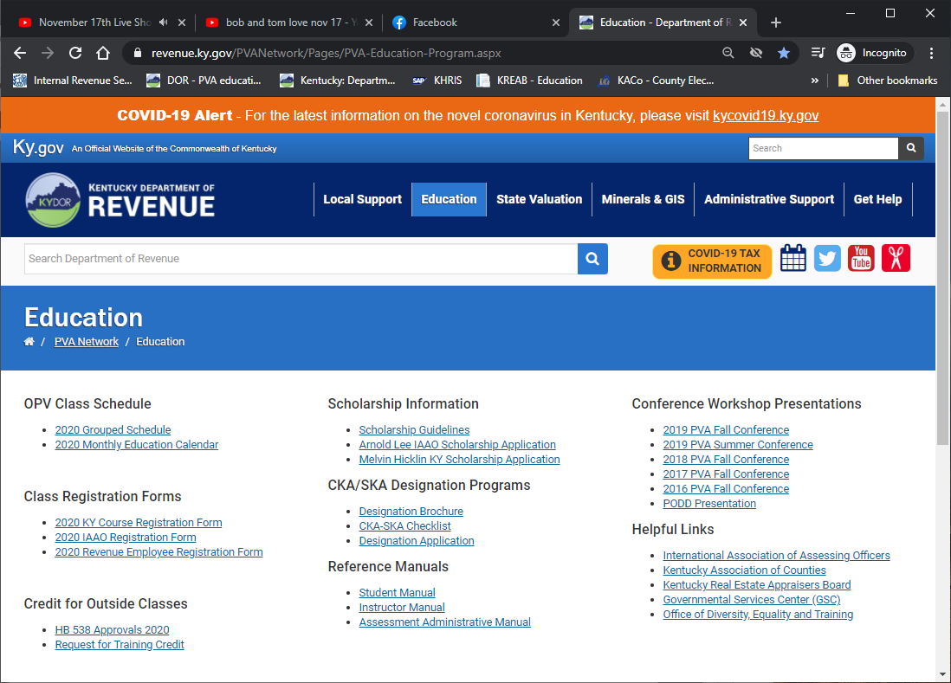
Education Page

Slide 5
Continuing Education Requirements
Two Statutory Education Requirements
KRS 132.597 – Expense Allowance Program
30 hours (15 with SKA) per calendar year
Hours in excess of 30 cannot be carried over to subsequent calendar years

Slide 6
Continuing Education Requirements
Two Statutory Education Requirements
House Bill 538 – Training Incentive Program
40 hours per calendar year
Lump Sum payment adjusted annually
Check is issued the month following completion of hours
Hours in excess of 40 can be carried over to subsequent years
A maximum of 40 hours can be carried over to subsequent years

Slide 7
Continuing Education Requirements
Two Statutory Education Requirements
Hours for both requirements can be earned concurrently

Slide 8
Breakdown of Hours

Slide 9
Example
Daisy Derby had 40 hours to carry over from 2019. This fulfills her HB 538 requirement for 2020. She would have received her check at the end of February 2020.
Daisy earned 56 hours during 2020. This fulfills her (15 hrs) 2020 expense allowance hours. since she has her SKA.
Daisy will be able to carry over 40 of her remaining 56 hrs to 2021.
Her remaining 16 hrs will roll off.

Slide 10
Example
She has already fulfilled her HB 538 requirement for 2021.
She will receive her HB 538 incentive check at the end of February 2021.
She will need 15 hrs to fulfill her Expense Allowance hrs. (SKA)
If no SKA, she’d need 30 hrs

Slide 11
How Do I Get My Hours
Approved Courses
KY Courses
Workshops/Conferences held by DOR
PVA Association Summer Conference
IAAO Courses
KY Office of Diversity, Equality, and Training (ODE&T)
KY Association of Counties (KACo) and Department of Local Government (DLG)
KY Real Estate Appraisal Board (KREAB) and KY Real Estate Commission (KREC)
Online classes from IAAO only
up to 10 hours per calendar year for all PVAs
up to 25 hours per calendar year with a SKA designation

Slide 12
How Do I Get My Hours
Other Education Options
Outside Training Opportunities
Submit Request for Training Credit Form
Two Weeks in Advance for Approval

Slide 13
How Do I Get My Hours
Outside Course Approval Criterion
Relevance to performed duties
Ability of sponsor to verify attendance
Reputation of organization/entity sponsoring the training
Extent of actual training
Availability to all PVAs
Note: If approval is granted for one PVA, it acts as blanket approval for all.

Slide 14
Kentucky Courses
Most KY courses are 15 hours
Begin Monday at 1:00
8:30 – 4:15 Tuesday
8:30 – 4:15 Wednesday
8:30 – 11:30 – Test
$40 cost for 15 hour class
3 hours for test
Passing grade is 70% or better
Must attend at least 12 hours of class to take exam

Slide 15
IAAO Courses
Cost
$435 for IAAO Members
$535 for Non-Members
Most IAAO Courses are 30 hours
15 hrs workshops
7.5 hrs workshops
8:30 – 5:00 Mon – Thurs
Test on Friday 8:30 (3 ½ hours)

Slide 16
Kentucky Professional Designation Program
Designations Offered
Certified Kentucky Assessor (CKA)
Senior Kentucky Assessor (SKA)

Slide 17
Kentucky Professional Designation Program
Certified Kentucky Assessor (CKA)
4 Tracks
Real Property Assessment Track
Personal Property Assessment Track
Administrative Track
Mapping Track
3 Years of Experience in Kentucky Property Tax Administration

Slide 18
Kentucky Professional Designation Program
Senior Kentucky Assessor (SKA)
Must have CKA
4 additional KY courses
1 additional IAAO 30 hr course or 2 IAAO 15 hour courses
Additional 2 years of experience in Kentucky property tax administration (total of 5 years)

Slide 19
Education Schedule
Cancellations
Must be received no less than 30 days prior to the course in order to receive credit/refund
Refunds
KY courses - receive class credit
IAAO course – can receive refund for cancellation
Send refund request to Kim Holt

Slide 20
Education Schedule
2021 Schedule will be emailed to everyone
Registrations can be mailed, faxed, or emailed to Brian Stidham (Brian.Stidham@ky.gov)
If emailed or faxed your spot will be held until payment is received

Slide 21
Scholarships
Scholarships are available for KY and IAAO courses
Scholarship Guidelines and Applications can be found on PVA Network
Reimbursement of meals and lodging
Does not include travel/mileage
Amounts can vary depending on type of class and location

Slide 22
Instructors
How to become an instructor:
KY Course Instructors – just have to be willing to volunteer their time
Received one class credit for your office for each class taught
PVA’s receive education hours for classes taught
IAAO Course Instructors – have to attend the Instructors Training Workshop and pass the test

Slide 23
Any Questions ??

