Slide 1
LOW-INCOME SUBSIDIZED HOUSING

Slide 2
Purpose for this workshop on
Subsidized Housing (Affordable Housing)
For the past 10-15 years valuation of subsidized housing has become an issue, not only in Kentucky but nationwide.
In Kentucky we have no statutory guidance on how to value this type of property other than fair cash value.
Several appeals have been brought before the old KBTA and KCC (now again KBTA) with different results.
No appeal has gone to Court of Appeals or higher court yet with state presence on this issue.

Slide 3
Most court cases nationwide say the income approach is the appropriate method to use on this type of property.
Most of you use the cost or sales approach because you do not have access to the income data until there is an appeal.
Reason for this workshop is to familiarize you with the different types of affordable housing and how they are set up so you can ask questions when approached by owners of such property if there is an appeal.
Future workshops will be held on valuation.

Slide 4
What is Subsidized Housing?
A financial assistance program whereby the government pays a portion of rent for low-income individuals or families to alleviate their housing costs.
Payment known as a subsidy.
Sometimes referred to as “affordable housing”.
In Kentucky there are three main types:
Public Housing
Co-operative Housing
Section 8 Vouchers

Slide 5
Different Forms or Types of Subsidies
Rent Subsidy (cash)
LIHTC (Low Income Housing Tax Credits)
Accelerated Depreciation on Improvements
Interest Credit Subsidy (Low Interest Mortgage 1%)
Home Funds

Slide 6
Different Types of Low Income
Subsidized Projects
Public Housing
Section “8” Projects
Housing Choice Vouchers (HCV)
Project-Based Vouchers (PBV)
Project-Based Rental Assistance (PBRA)
Rental Assistance Demonstration Program (RAD)
LIHTC Project (Section 42)
Section 236 Projects
Section 515 Projects
Section 202 Projects
Section 811 Projects

Slide 7
Public Housing
Projects are exempt from property taxation.
Publicly owned and operated by a governmental unit (PHA).
Managed for low and very low-income households by PHA.
Most units are reserved for seniors or for people with all kinds of disabilities.
Rent based on your income.
Most units rent is 30% of family’s adjusted gross income.

Slide 8
What is Section “8”
A federal government program that allows private landlords to rent apartments and houses to qualified low income families, the elderly, and the disabled.
A common name for the Housing Choice Voucher Program.
Rent vouchers are issued to qualifying families.
In 2018, upwards of 5 million people across the country used a voucher to pay their rent.
Upon acceptance of vouchers, private owners receive from the government the difference between contract rent and what the tenant can pay.
HAP contract
Tenant Rent to Owner
HAP Contract Rent
Contract Rent
to Owner
+
=

Slide 9
Two Types of Section “8”
Tenant Based Assistance Program (TBA)
Project Based Assistance Program (PBA)

Slide 10
Tenant Based Assistance Program (TBA)
HCV Program (Housing Choice Voucher)
HUD oversees the program
Federal assistance is tied to the renter
Voucher stays with the tenant, not the property
Tenant selects his own unit
PHA (Public Housing Authority) approves or disapproves the unit
Voucher is portable
Can use anywhere in the country where there is a HCV program
Housing subsidy is paid to landlord directly by PHA

Slide 11
Project-Based Assistance (PBA)
Rental subsidy stays with the unit or property, not the tenant.
Rental unit can be owned by private owner or by PHA.
Oversight by HUD
Owners enter into a HAP (Housing Assistance Payment) contract with HUD.
Contract provides a subsidy to cover the difference between contract rent and the amount the tenant is required to pay each month.
Tenant typically pays 30% of adjusted gross income.
Tenants who pay their own utilities receive an additional utility allowance - which is credited against their rent contribution.

Slide 12
Low-Income Housing Tax Credits (LIHTC)
Referred to as Section 42.
Created under the Tax Reform Act of 1986.
Largest federal program for providing low-income housing.
Created to give an incentive to private investors since affordable rental housing projects do not generate sufficient profit to warrant the investment.
In 2019 KHC awarded $13.7 million of LIHTC’s to 19 developments across the state.
Funding will help finance 855 housing units in 18 counties.
Two types of LIHTC
9% credit - generally for new construction or rehabilitation
4% generally for rehabilitation projects or new construction financed with tax exempt bonds

Slide 13
Example - Tax Credit Calculation -
100 Units in Development
Total Development Cost $1,000,000 $1,000,000
Less Land Value (100,000) (100,000)
Total Eligible Basis $900,000 $900,000
Unit Rent - income restrictions 100% 40%
Qualified Basis $900,000 $360,000
Credit % 9% 9%
Annual Tax Credit $81,000 $32,400
10 Year Tax Credit $810,000 $324,000

Slide 14
Low Income Housing Tax Credits (LIHTC)
(Continued)
Developers can use tax credits for themselves or trade or sell them to investors for equity into the project.
By selling the tax credits it forms a limited partnership with investors.
The equity that investors provide in exchange for the tax credits funds the majority of the construction costs.
The developer borrows the remaining construction costs from banks or other lending institutions.
In most cases the developer becomes a general partner and retains a small amount of ownership (usually 1%) in partnership with most ownership (99% balance) to limited partner who is the investor.

Slide 15
Low Income Housing Tax Credits
(Continued)
Under LIHTC program at least 20% of units in project must be for residents whose income does not exceed 50% of area median income (AMI) or 40% of units must be rent restricted whose income does not exceed 60% of AMI.
Tax credits are only good for 10 years from the time project is completed and occupied.
Types of projects eligible for LIHTC
Apartment buildings
Single family dwellings
Duplexes
Townhouses
HB 371 - State of Kentucky to allow State LIHTC’s - starting 1/1/21

Slide 16
Section 202
Supportive housing for very low-income elderly persons, including the frail.
Comprised of at least one person who is at least 62 years old.
A program administered by HUD.
Provides interest free capital advances to private, non-profit sponsors.
Does not have to be repaid as long as project serves low income elderly for 40 years.
No public body or agency of a public body can participate in program.
Program is similar to Supportive Housing for Persons with Disabilities (Section 811).

Slide 17
Section 811
Program known as Supportive Housing for Persons with Disabilities
Administered by HUD
Provides funding to develop and subsidize rental housing for very low and extremely low income adults who are disabled or have a chronic mental illness.
Authorized assistance to operate two ways:
Provide interest free capital advances to non profit developers.
Provide project rental assistance to state agencies through different sources such as FLT Housing Tax Credit, Federal Home Funds and others.

Slide 18
Section 236
HUD provides mortgage insurance and an interest subsidy to developers for private housing (low interest mortgage).
Developer provides affordable units to low income individuals by restricting rents and occupancy.
Tenant rent is based upon the operating costs of the property, (budget-based) unless they receive some rental assistance from government.
Assisted Units
Unassisted Units
Assisted Units - tenant receive additional subsidy based on their income (typically 30% of adjusted income).
Unassisted Units - pay budget based rent - receive no additional subsidy.

Slide 19
Section 515 Program
Administered by Rural Housing Services (RHS).
Addresses the need for affordable single-family or multi-family housing in rural areas.
Provides competitive mortgage loans for rental housing for very low, low, and moderate income families; the elderly and persons with disabilities.
Section 515 loans are up to thirty (30) years and an effective interest rate of 1 percent (1%) amortized over 50 years.
The 1% interest rate subsidy is one of the inducements used to encourage investors to provide Section 515 housing.

Slide 20
Section 515 Program (Continued)
Developer is required to make a 5% initial investment.
The for-profit investor can only receive 8% return on his investment.
Mortgage stays with property.
Should this interest credit subsidy be considered in valuation of market values?
According to the Federal Mortgage Housing Authority (1990) “Subsidies may provide additional value for the project, … To have an accurate appraisal, the value of subsidy must be measured and reflected in the appraisal.”

Slide 21
Home Investment Partnership Program
Federal block grant program that provides funding to states and localities that they can use exclusively for affordable housing to low income families.
Based upon a formula HUD annually distributes this funding to states and certain localities.
40% to states
60% to localities
State and localities must become participating jurisdictions and must put up 25% permanent contribution to affordable housing.
Four categories of home funds can be used for:
Rehabilitation of owner occupied housing
Assistance to homebuyers
Acquisition, rehabilitation, or construction of rental housing
Tenant based rental assistance

Slide 22
How Do I Find Types of Affordable Housing In My County?
Google Affordable Housing in _______ County Ky.

Slide 23
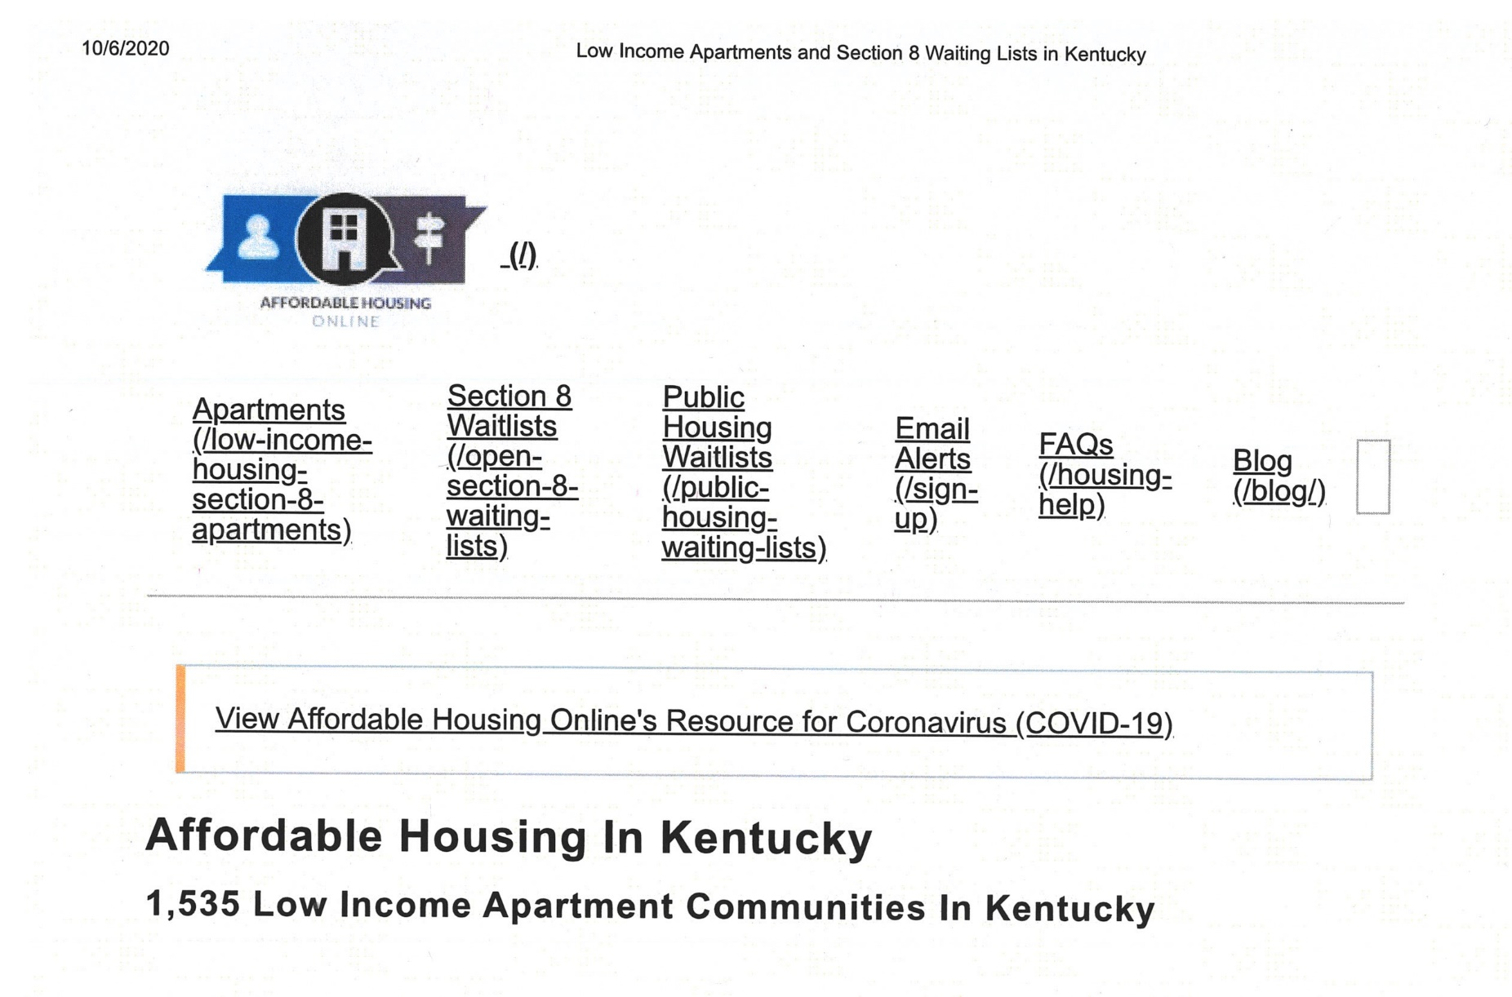

Slide 24
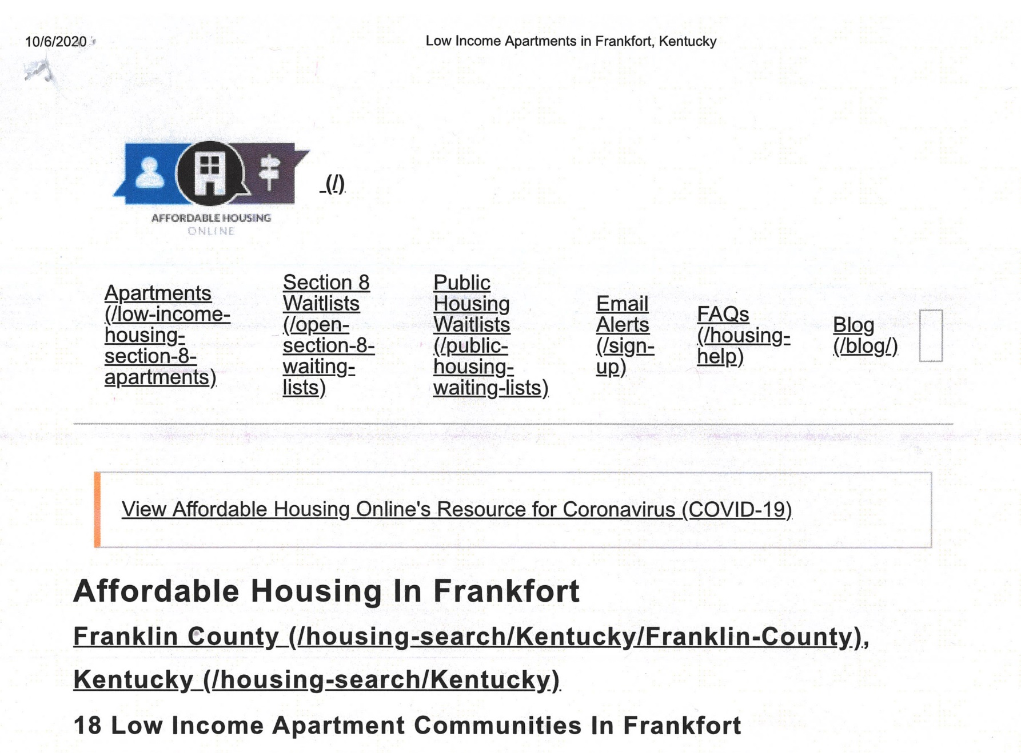

Slide 26
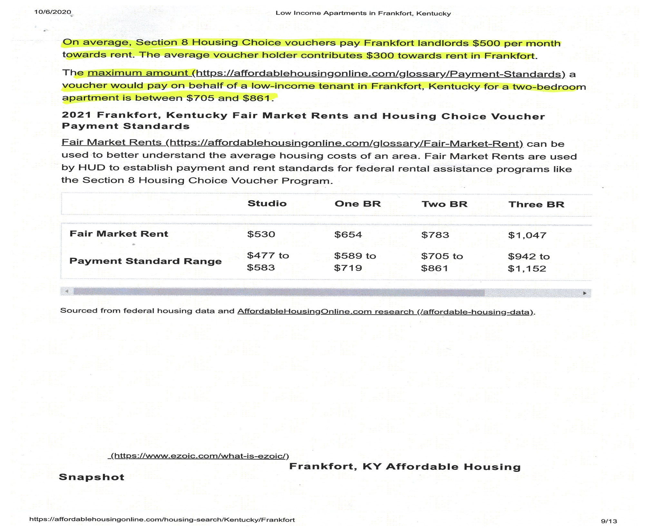

Slide 27
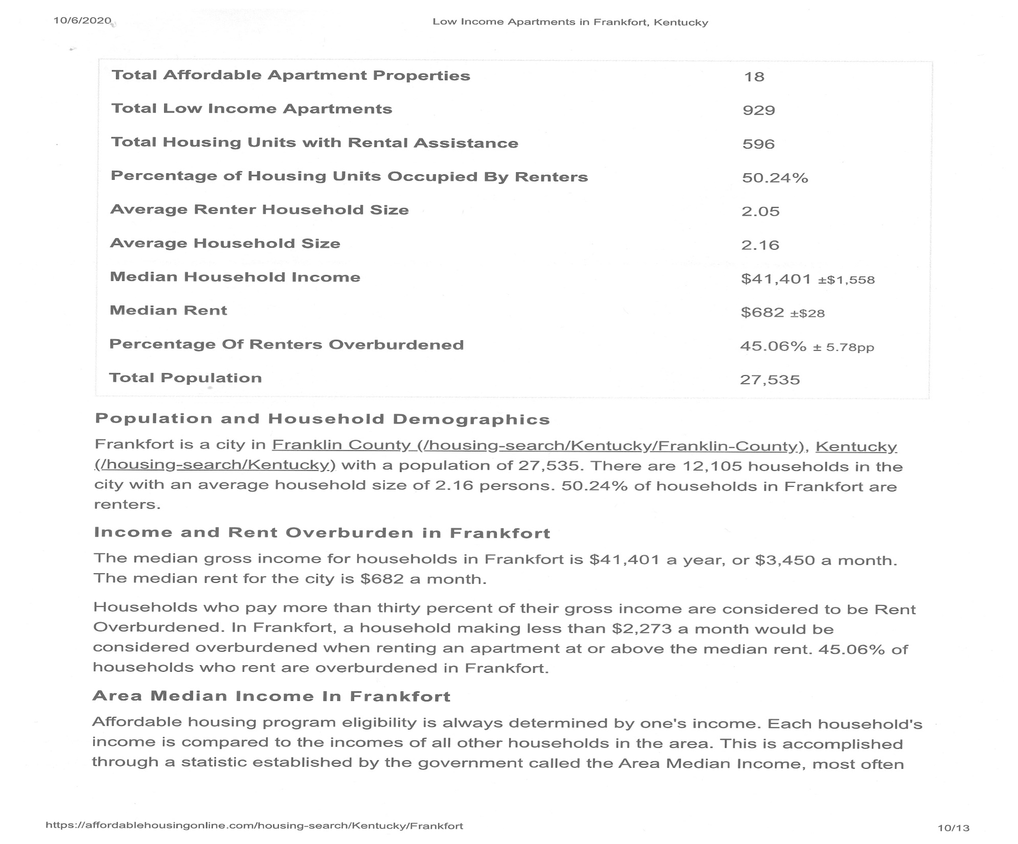

Slide 28
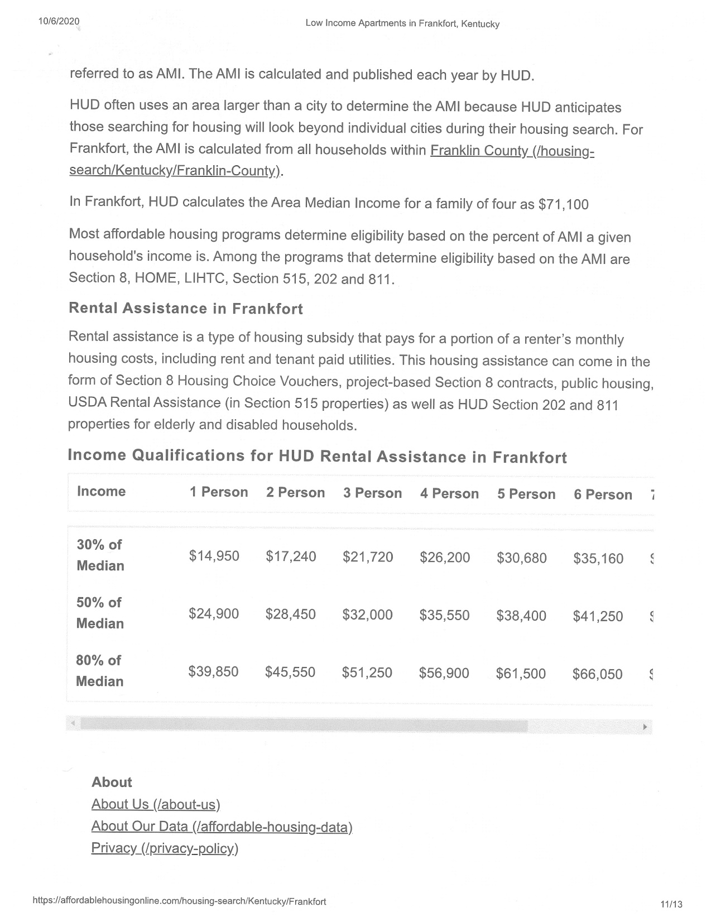

Slide 29
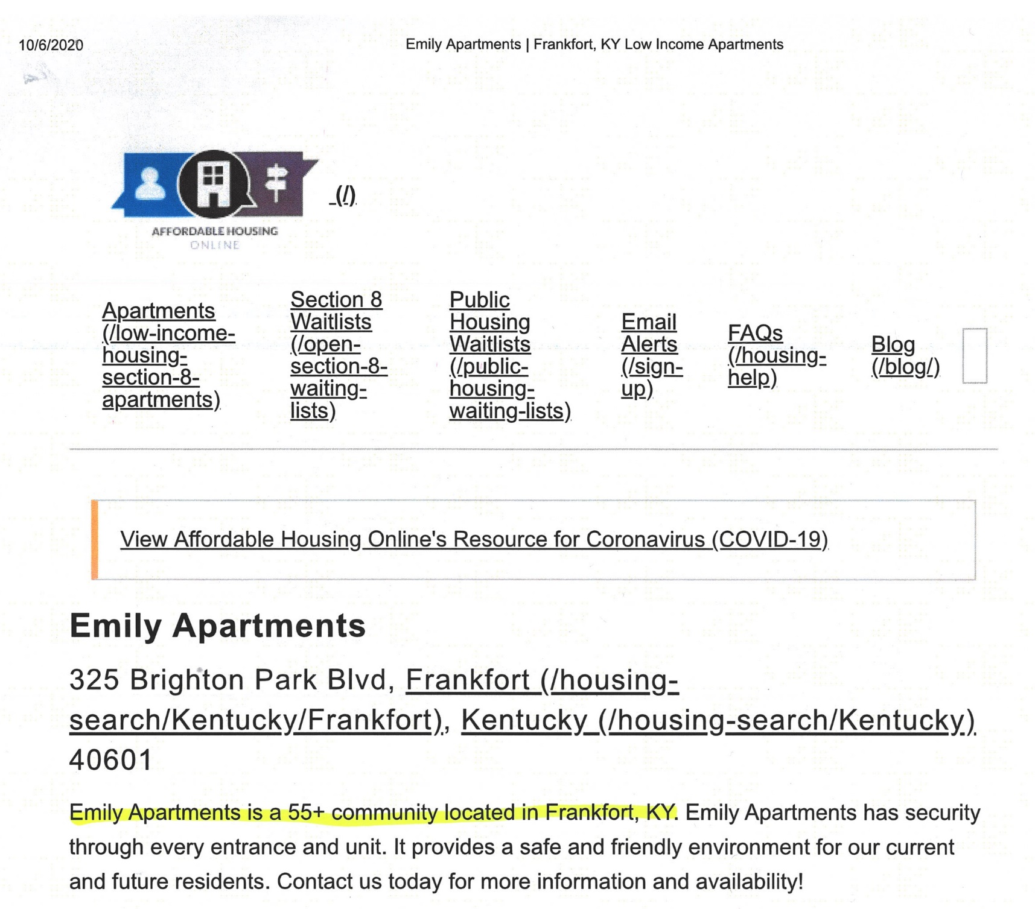

Slide 30
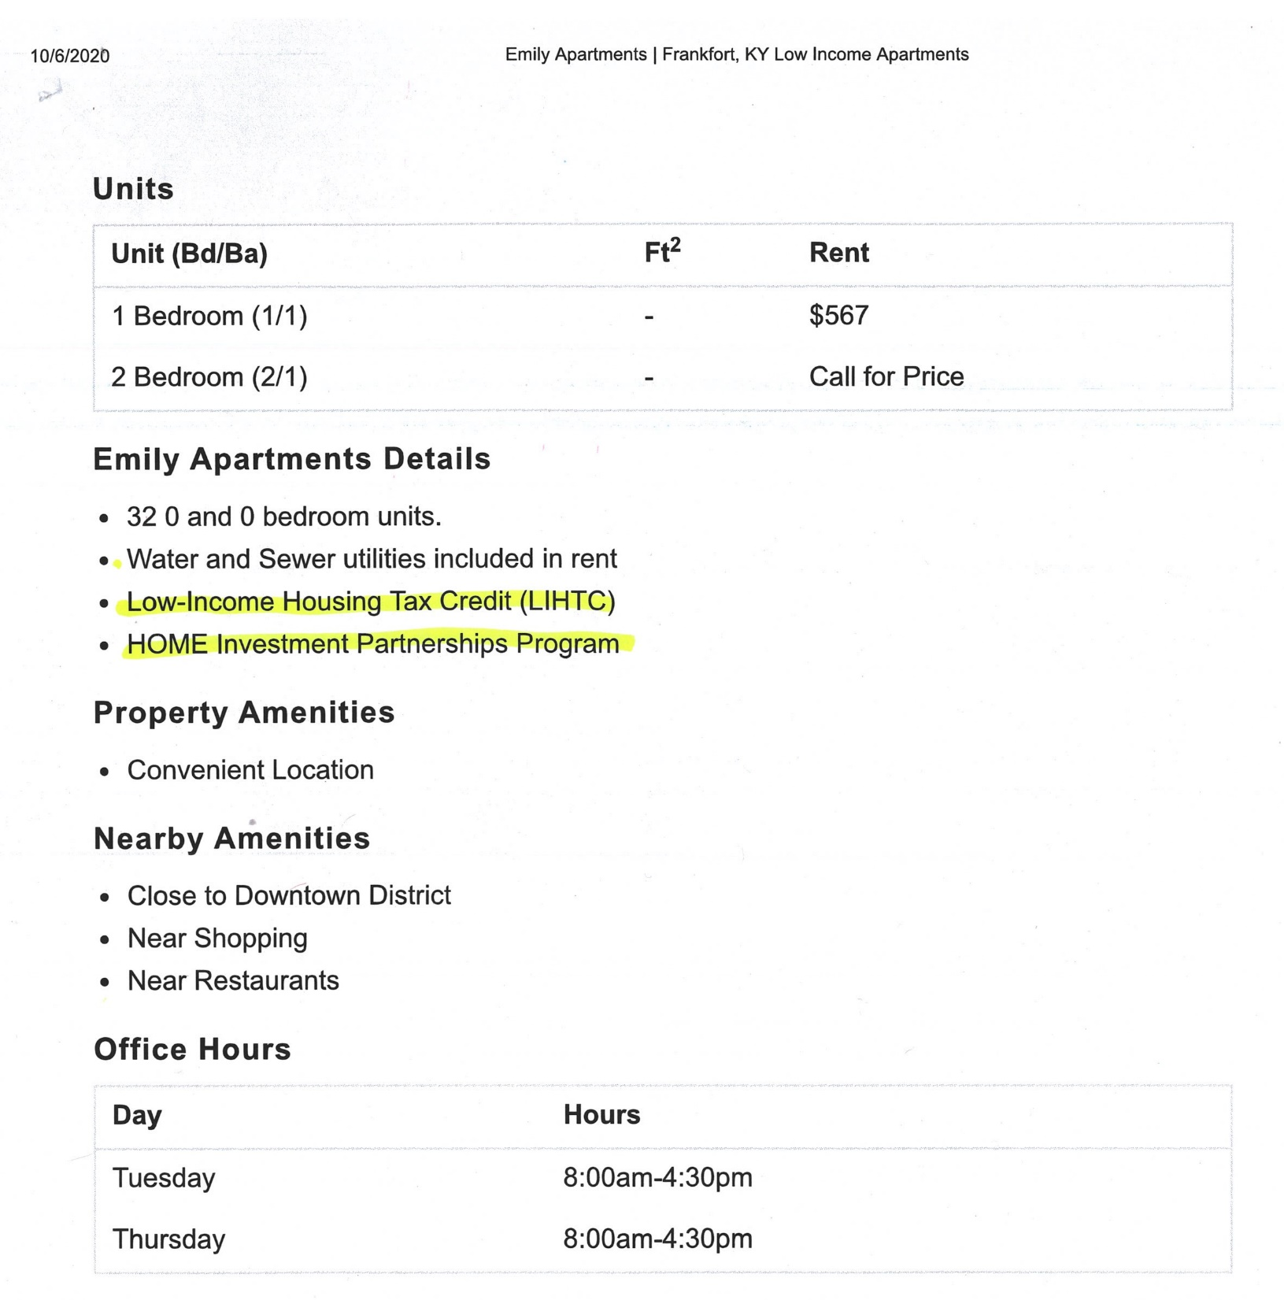

Slide 32
